Slide 2
INTERNET COMMUNICATION, MANAGEMENT AND CONTROL SYSTEM DESIGN
Instructor | Ph. D Dang Van My
Members | Tran Van Nguyen – 20181911
 | Nguyen Duc Minh – 20181905

Slide 3
Table of Contents
Chapter 1: Smart Home Overview
Chapter 2: General Architecture of Our Smart Home
Chapter 3: Detail Working Principle
Chapter 4: Communication
Chapter 5: Blynk Application
Chapter 6: Result and Conclusion

Slide 4
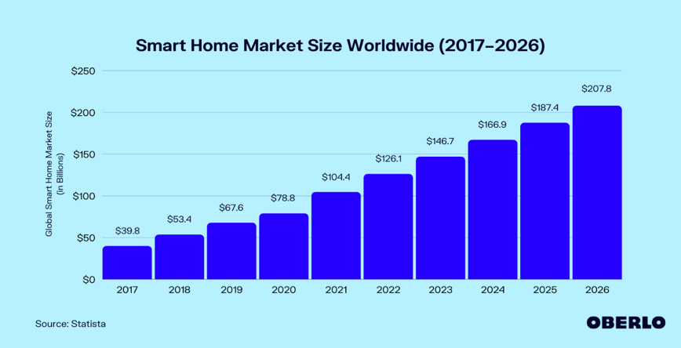
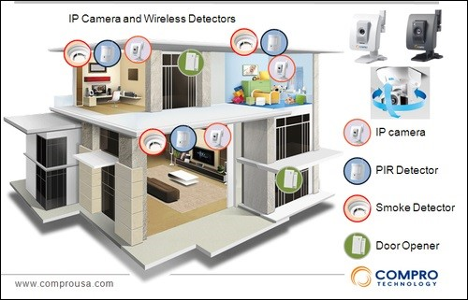
Chapter 1: Smart Home Overview
Currently, smart home has been a potential market, the largest market is in NA.
In Viet Nam, many manufactures enter this market : BKAV, Lumi Smart Home, …
The intelligence of a house: Automation, Security, Entertainment and Remote control.
A basic design with capabilities such as: Intrusion warning, gas warning, automatic door system, security camera system, entertainment system…

Slide 5
Chapter 2: General Architecture Of The Smart Home
Function
Monitor the temperature and humidity
Open main door using the password
Open/Close clothesline automatically according to weather
Turn on/off “Movie Mode” entertainment room
Open/Close curtains by remote control system
Control light, fan, air conditioning, door by remote control system
Alarm system

Slide 6
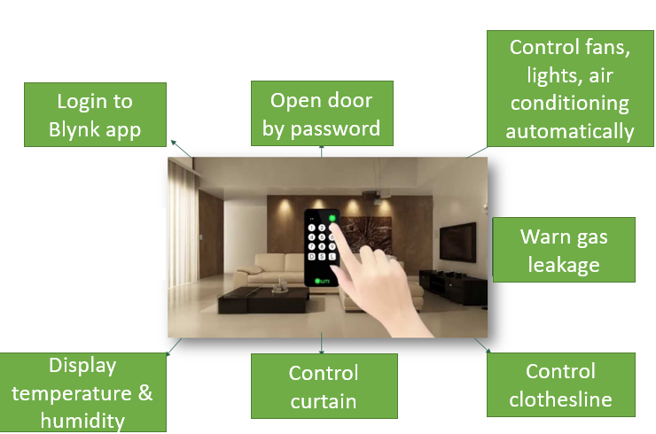
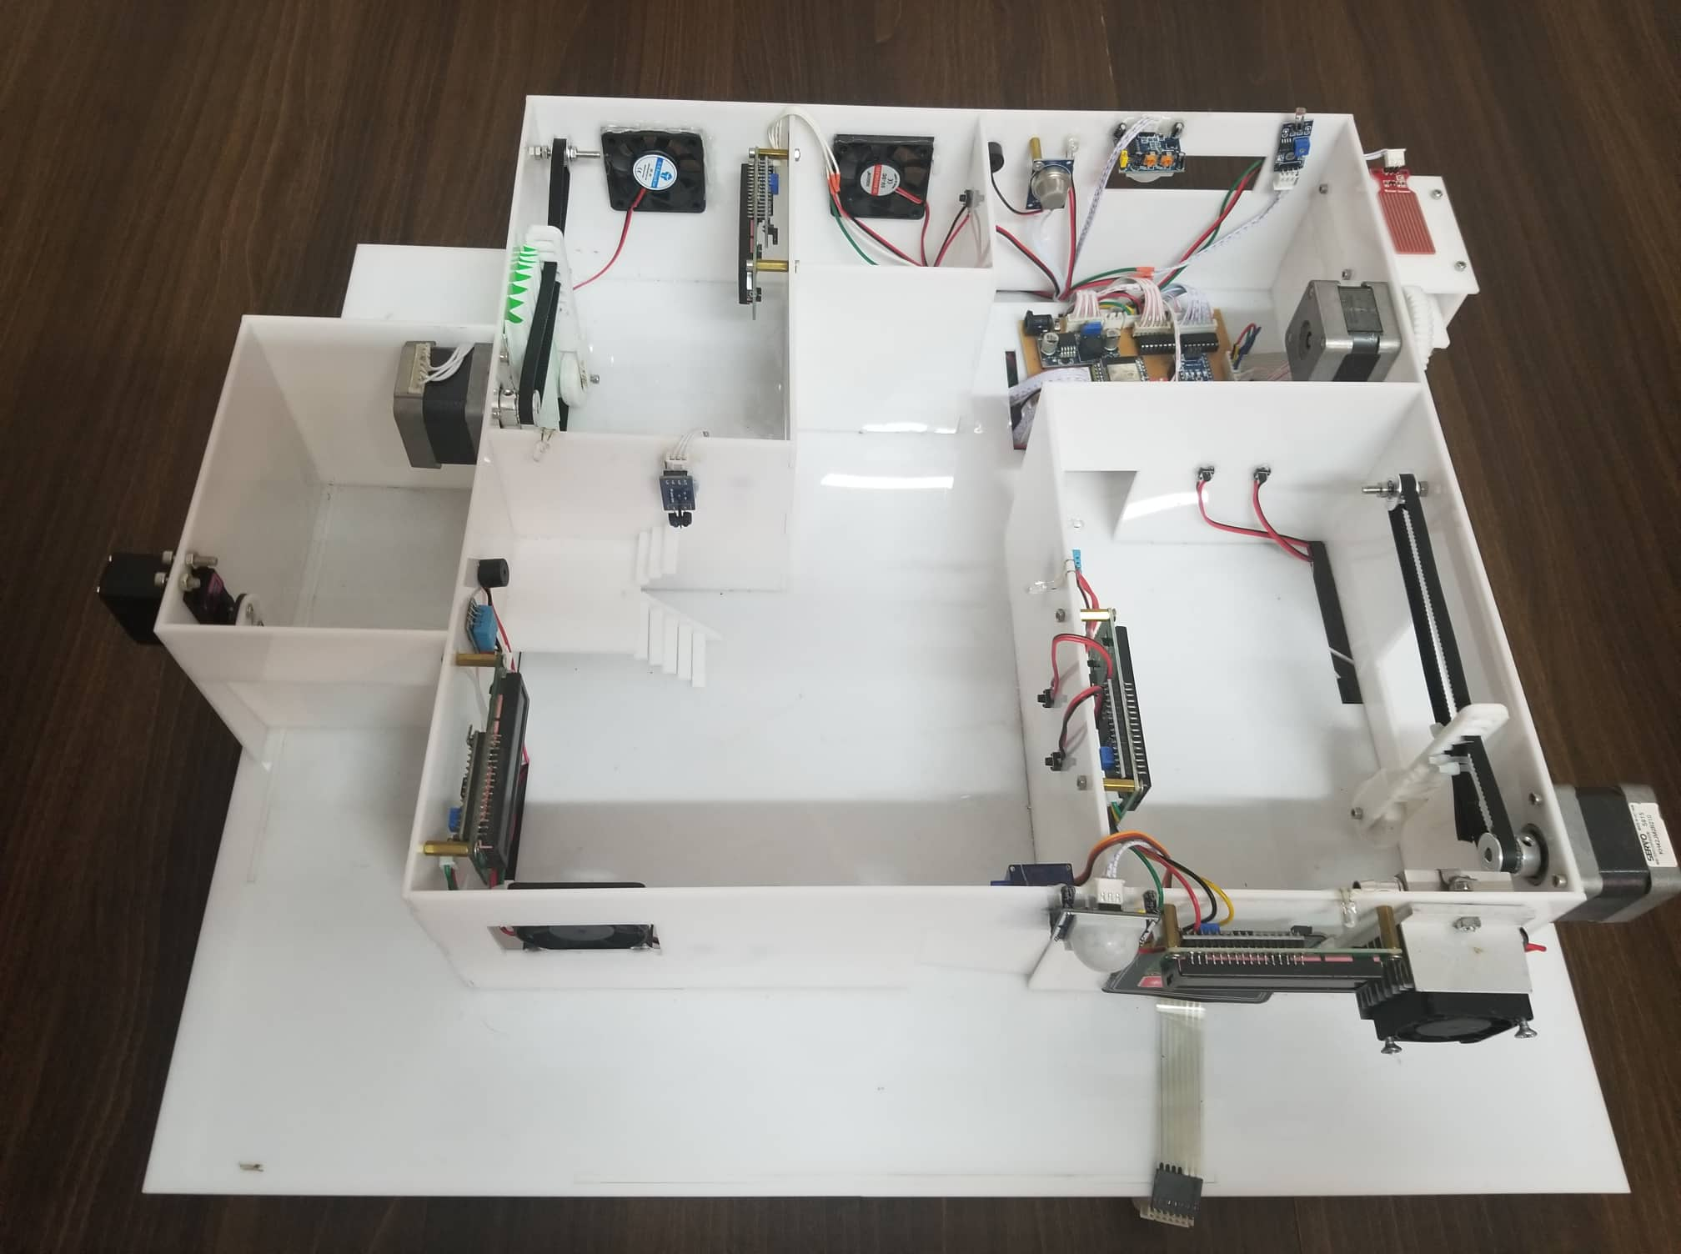
Chapter 2: General Architecture Of The Smart Home

Slide 7
Chapter 2: General Architecture Of The Smart Home
2. Components
Components | Specification | Application
1. DHT11 Sensor | Operating Voltage: 3.3 to 5.5V DC Humidity range: 20% - 90% Temperature range: 0 – 50 degree C | Living room Bedroom
2. Rain Sensor | Operating Voltage: 3.3 to 5V Analog output: 0 – 5V | Clothesline
3. Thermoelectric Peltier Module | Operating Voltage: 3 to 15V DC Cooling power: 50 W, 90 W, 120 W 2-sided temperature difference: up to 67 degree C | Bedroom
4. HC-SR501 Motion Sensor | Operating Voltage: 3.5 to 5.5V DC 2 operating modes: (L) no repeat activation,(H) repeat activation Scan angle < 100 degrees. | Outdoor Kitchen
5. Infrared Sensor | Operating Voltage: 3.3 to 5V DC Comparator IC: LM393 Analog output | Living room
6. Light Sensor | Operating Voltage: 3.3 to 5V DC Comparator IC: LM393 | Outdoor Bedroom

Slide 8
Chapter 2: General Architecture Of The Smart Home
2. Components
Components | Specification | Application
7. MQ2 Gas Sensor | Operating Voltage: 5V Sensing Resistance: 10 to 50 kΩ Concentration Scope: 200 to 10000 ppm | Kitchen
8. SG90 Servo Motor | Operating Voltage: 4.8 to 6 VDC Torque: 2.0kg/cm(4.8V) | Main door
9. MG996 RC Servo Motor | Operating Voltage: 4.8 to 6 VDC Torque: 9.4kg/cm (4.8V) | Garage
10. 17HS8401 Stepper Motor | Rated Current: 1.7A Step Angle : 1.8 degree Use with A4988 driver | Clothesline Curtain
11. Arduino Nano | 14 digital I/O pins 8 analog I/O pins Support many of communication protocol | Control block for sensors
12. ESP32 Development Board | 30 I/O pins Has Wi-Fi and Bluetooth built-in. Has wide variety of peripherals | Control block for actuators

Slide 9
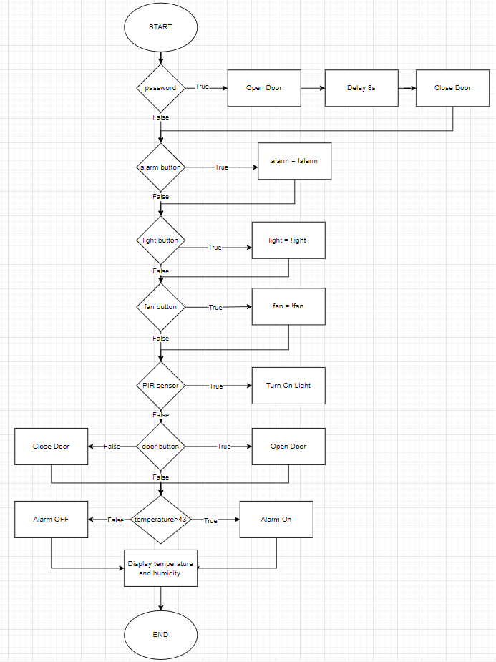
Chapter 3: Detail Working Principle
1. Living Room
Turn on/off the light, fan, door, alarm system by using button
Monitor the temperature and humidity
Display the temperature and humidity in the LCD
Turn on the light automatically when someone is in the stair

Slide 10
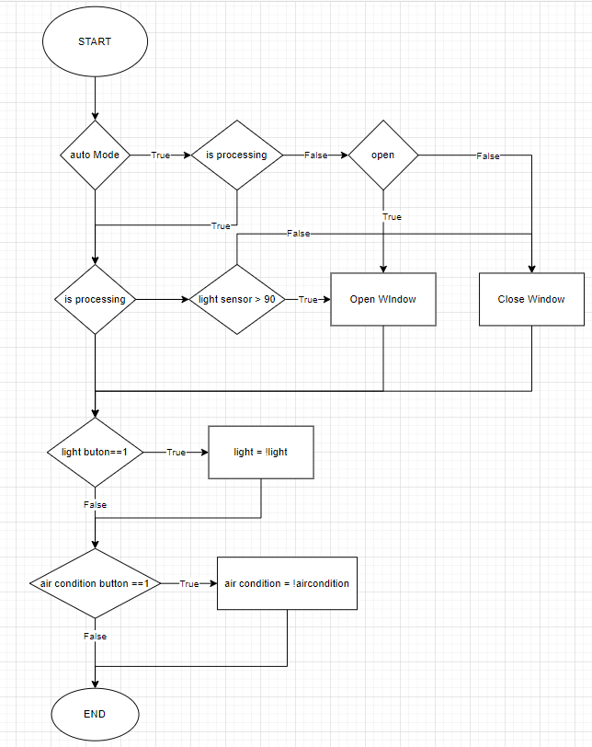
Chapter 3: Detail Working Principle
2. Bedroom
Turn on/off the light and air conditioning system by using button
Display the temperature and humidity in the LCD
Turn on/off the light by using Blynk application
Control the curtain automatically by the light sensor
Control the curtain system by using Blynk application

Slide 11
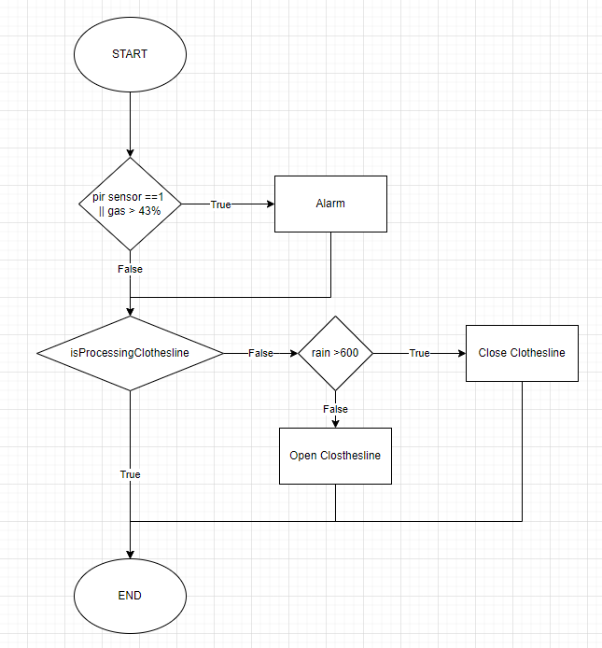
Chapter 3: Detail Working Principle
3. Kitchen
Turn on/off the fan by using button
Alarm system activates if the gas level over the set value
Alarm system activates if the motion sensor detects motion
Clothesline system is control automatically by the weather
Turn on/off the light and fan by using Blynk application

Slide 12
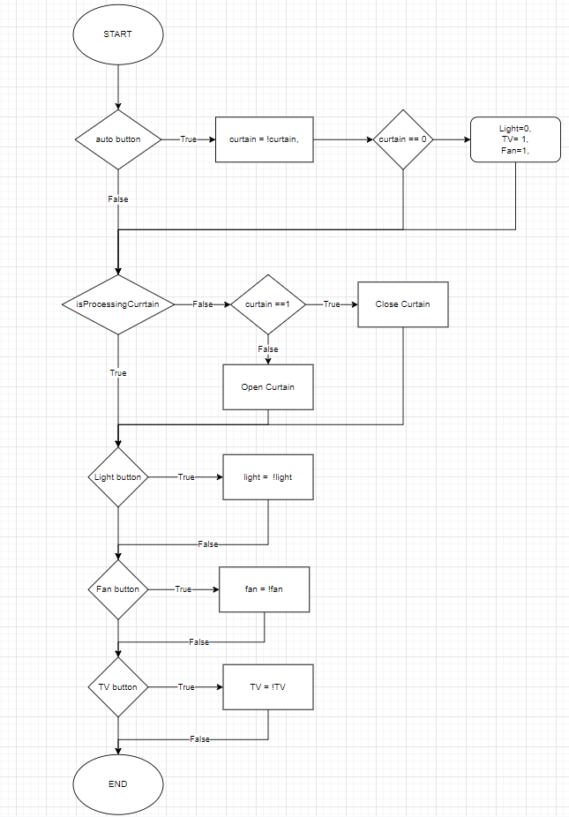
Chapter 3: Detail Working Principle
4. Entertainment room
Turn on/off the “movie mode” by using button
The curtain closes and the light, fan turns on when the “movie mode” is on
The curtain closes, TV is off when the “movie mode” is off
Turn on/off the light and fan by using Blynk application

Slide 13
Chapter 3: Detail Working Principle
5. Others
Open the door by password
The main door’ light turns on when the motion sensor detects the motion
The main door’ light adjusts light level according to the environment
Open/close the garage door by Blynk application

Slide 14
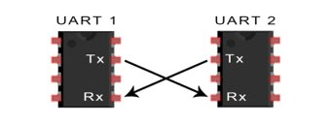
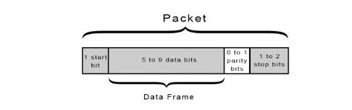
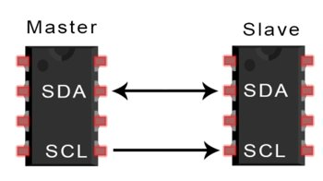
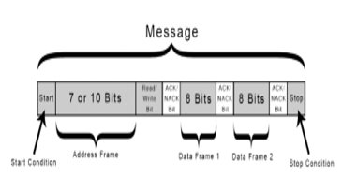
Chapter 4: Communication
UART Protocol
UART is an asynchronous communication protocol.
Both UARTs need to config at the same baud rate.
Data transmission is in the form of data package.
I2C Protocol
I2C is a synchronous protocol, multi master can connect to multi slaves.
Master select the slave by sending the address of the slave after it send the start condition
Master can send or receive one or more data frame before it send the stop condition.

Slide 15
Chapter 5: Blynk Application
1. Why use Blynk?
Blynk is an app on the phone, allowing users to create interfaces and control the device according to their personal preferences
Easy to use
Beautiful application with full function
Does need to build android and iOS application
Rapid testing, can be monitored anywhere with internet
2. How Blynk works with your system?
Node MCU ESP32 connects to Blynk application
Blynk Server – responsible for all communication between the smartphone and the hardware. You can use Blynk Cloud or run your own Blynk server locally
The Blynk library – for all popular hardware platforms – allows to communicate with the server and process all incoming and outgoing commands

Slide 16
Chapter 6: Result And Conclusion
1. Result
Design a Smart Home model, the model work as expected
Learn the basis and meaning of sensors and collecting data sensors
Learn the basis and meaning of controlling devices via the internet
Understand the working principle of the modules in the system
2. Conclusion and Future Work
Improve the accuracy of the value of sensors
Improve the accuracy of the actuators block
Adjust the power of the cooling system according to the temperature automatically
Improve the anti-theft system by image recognition
Control smart devices through voice
…

Slide 17
THANK YOU !

