Slide 1
CS202 – Observer pattern
APCS 2025
Nguyễn Đình Minh Huy - 25125083
Trần Gia Huy - 25125084

Slide 2
Agenda
Real-world problem
Naïve solution & Drawback
Observer pattern
Class diagram
Code implementation & Demo
Usage with Interpreter and Mediator design pattern
Pros & Cons
Quiz
Conclusion

Slide 3
Real-world problem
We are building a bank management system. We need to store users’ accounts and let them deposit their money into their accounts. However, when we call the deposit, aside from adding money, we are required to do other procedures such as logging, notifying, emailing,… These are from other services that we don’t have full control.

Slide 4
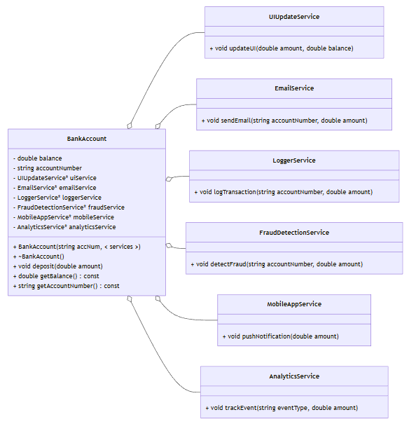
Naïve solution
When BankAccount::deposit is called, it invokes all the required services, which are saved as pointers.

Slide 5
Naïve solution - Drawback
However, there are some problems with this approach:
Tight coupling: The BankAccount must know the exact concrete types of services and their specific update methods.
Violates the Open-Closed Principle (OCP): If we want to change or add a service, we must modify the code in BankAccount.
Rigid and hard to scale: Changing and modifying either the service or the BankAccount are much more complex.

Slide 6
We notice that the services have similar parameters, but not exactly the same. If we have a general structure, we won’t need to know what each of them need.
Another thing is that the BankAccount don’t care what we need to call as they don’t need the result from invoking the services. => We only need a list of services to call when depositing.
=> Observer pattern

Slide 7
Observer Design Pattern - Intuition
Imagine a popular Youtube channel or a digital newsletter.
Subscribers should not have to constantly ask, "Is there a new video?" or "Is there a new edition?".
The Publisher maintains a list of Subscribers. When new content is published, the Publisher automatically pushes a notification to everyone on that list.
The pattern shifts the responsibility of tracking state changes from the data consumers to the data source, ensuring instant updates without wasteful continuous checks.
In Observer Design Pattern:
Subject = Publisher ; Observer = Subscriber

Slide 8
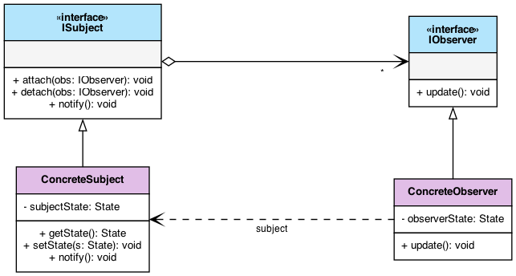
General Class Diagram
ISubject: Maintains a list of observers. Implements attach(), detach(), and broadcasts notify() when its state changes.
IObserver: Exposes an update() method that the subject calls during a notification.

Slide 9
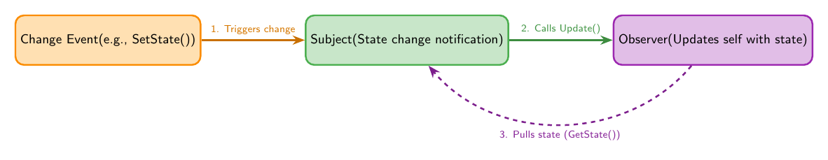
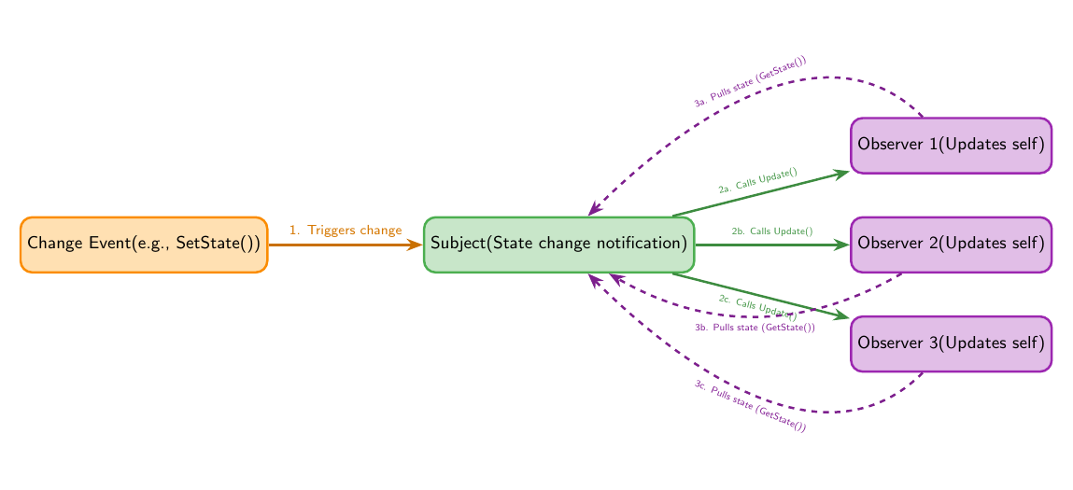
1 Subject – 1 Observer
1 Subject – many Observers
The Subject notifies that something changed, and the Observers retrieve the specific data they need (through a getter). (Pull Model)

Slide 10
1 Subject – 1 Observer
1 Subject – many Observers
The Subject notifies that something changed, and the Observers retrieve the specific data they need (through a getter). (Pull Model)
Alternative: The Subject sends the changed data directly.
(Push Model)

Slide 11
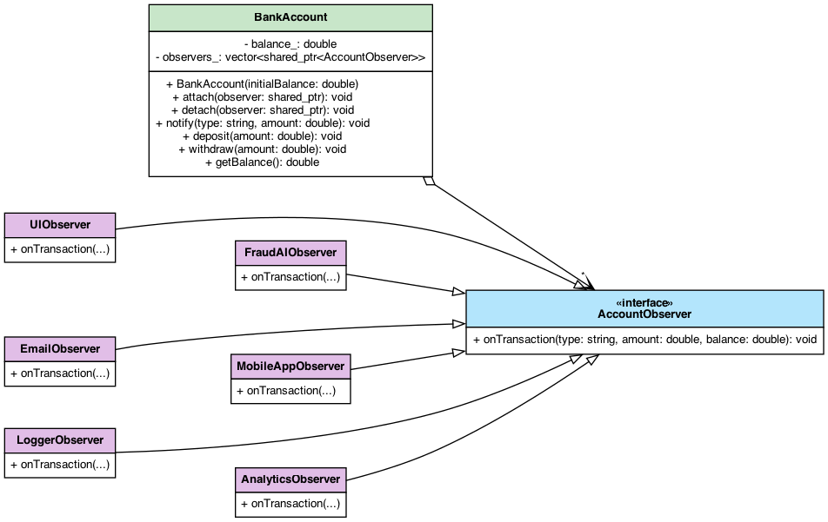
Bank Account Example
Bank Account UML Diagram

Slide 12
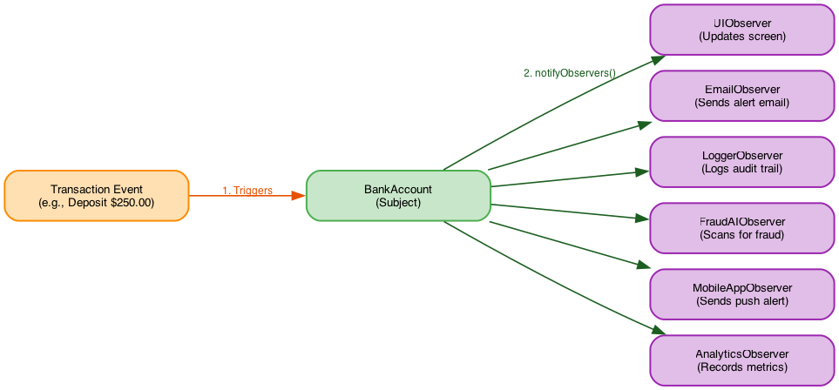
True Isolation: BankAccount is completely ignorant of the concrete services. It only knows they implement a generic observer interface.
Open/Closed Principle: New services can be added without modifying a BankAccount class.
Single Responsibility: Core financial logic remains clean. All secondary reactions (logging, fraud checks, UI) are delegated to dedicated components.
Runtime Flexibility: Observers can be dynamically attached or detached on the fly based on user settings or system state.

Slide 13
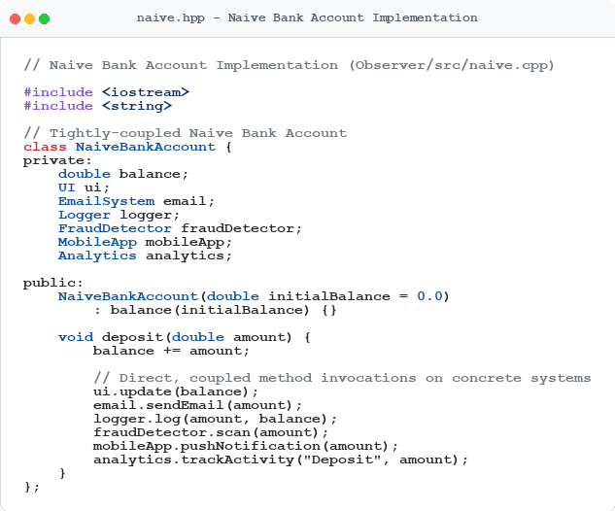
Implementation & Demo
Naïve Approach Implementation

Slide 14
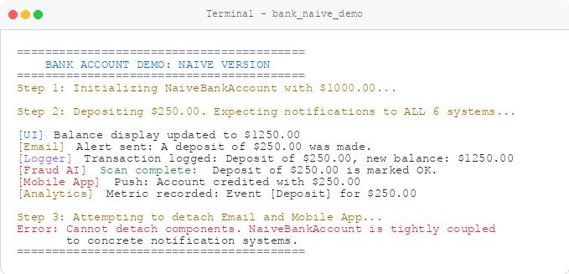
Naïve Approach Demo

Slide 15
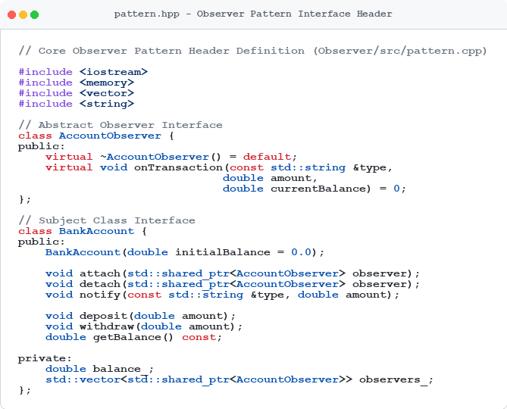
Observer Design Pattern Implementation

Slide 16
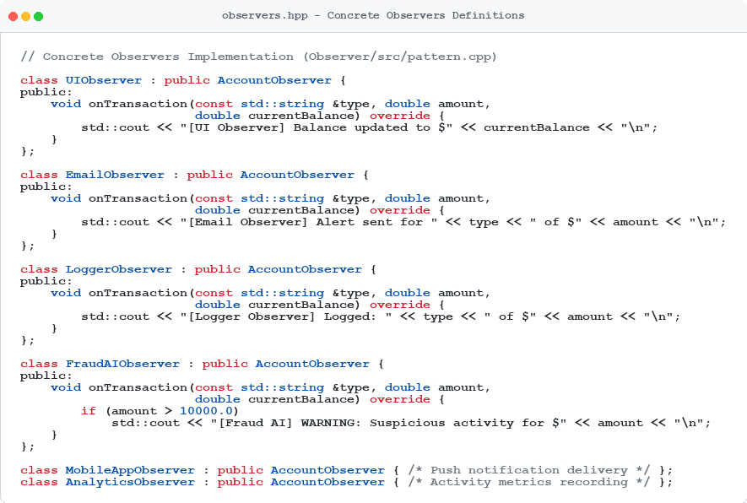
Observer Design Pattern Implementation

Slide 17
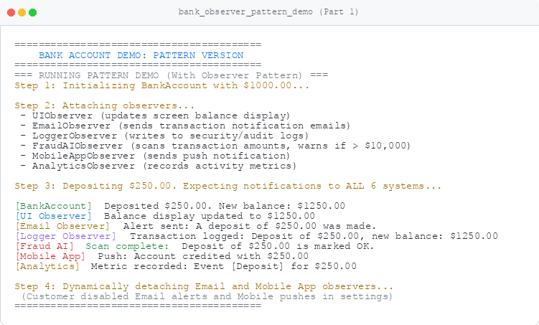
Observer Design Pattern Demo Part 1

Slide 18
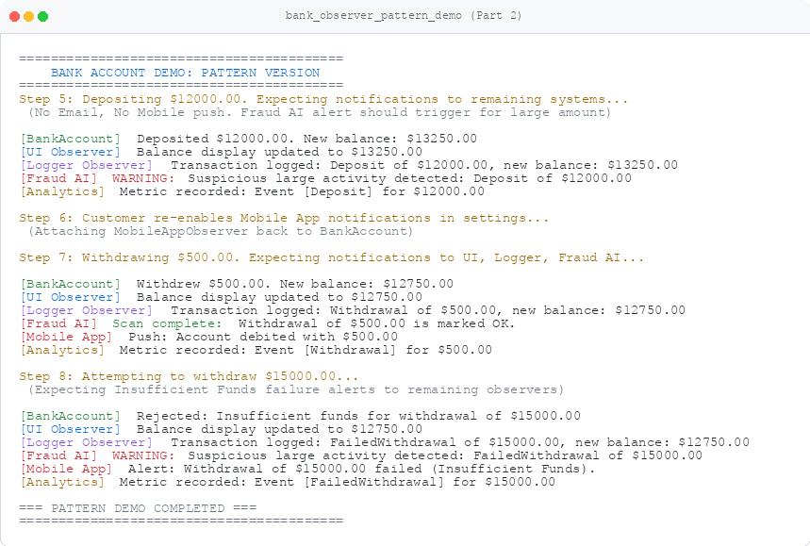
Observer Design Pattern Demo Part 2

Slide 19

Relationship with Mediator Pattern
What is the Mediator Pattern?
A behavioural design pattern that reduces chaotic dependencies between objects.
It restricts direct communications between objects (Colleagues) and forces them to collaborate exclusively via a centralized mediator object.
Airplanes communicate solely with the control tower (Mediator), which safely orchestrates the traffic.

Slide 20
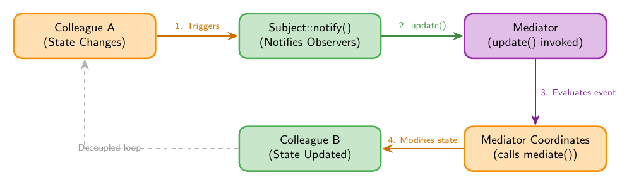
Observer-Mediator Fusion
The Colleagues act as Subjects,
The Mediator acts as the Observer.
When a Colleague's state changes, it triggers an event. The Mediator (who is subscribed to these events) catches the notification, evaluates the global context, and updates other relevant Colleagues accordingly.

Slide 21
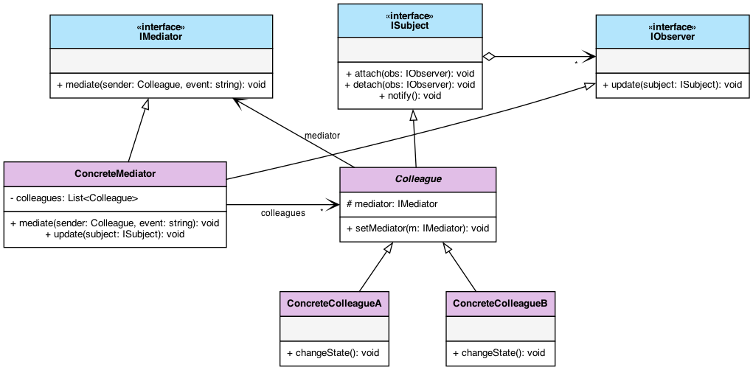
Observer-Mediator Fusion UML Diagram

Slide 22
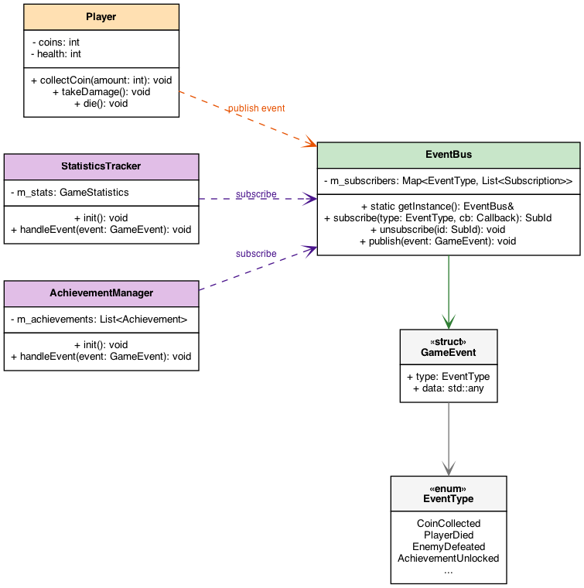
EventBus in Game Development
A Player character takes damage and dies (Event Publisher).
The Player does not call the AchievementManager or StatisticsTracker. It simply publishes a PlayerDied event to the central EventBus.
The systems that subscribed to that specific event type are immediately notified and execute their logic.

Slide 23
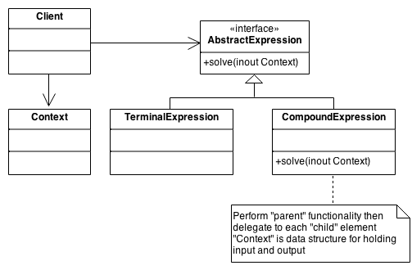
Relationship with Interpreter design pattern
Interpreter design pattern: Given a language, we need to defined a hierarchical representation for the language.
Example: Representing (5 + 1) x 10 + 41 - x as an operation tree.
Source: https://sourcemaking.com/

Slide 24
Usage with Interpreter
However, if the terminal expression is a variable, which can be changed by another process, services, … instead of being a constant, then we need to update the result of the operations according to the new value.
=> We use observer pattern to observe the changes in the variable and update the tree accordingly.

Slide 25
Usage with Interpreter
Example: We have a spreadsheet (like an Excel file). In cell A3, we have a formula “= A1 + A2”. The result of A3 depends on the result of A1 and A2, which can be changed by another formula(s) or by user.
=> We use the interpreter pattern to interpret the formula in A3, and the observer pattern to observe the changes in A1 and A2.

Slide 26
Pros & Cons
Pros:
Open/Closed Principle: New observer classes can be introduced without modifying the subject's code.
Loose Coupling: The subject only interacts with a generic interface, remaining completely ignorant of the concrete observer implementations.
Dynamic Relationships: Connections between publishers and subscribers can be established or terminated at runtime.

Slide 27
Pros & Cons
Cons:
The Lapsed Listener Problem: If an observer is not explicitly detached, the subject retains a reference to it. This leads to dangling pointers and fatal crashes when the subject notifies deleted memory.
Non-Deterministic Execution: The order in which subscribers are notified is usually arbitrary and cannot be relied upon for sequential logic.
Complex Debugging: Tracing the exact flow of execution through a massive chain of dynamic, event-driven updates can be difficult to step through in a debugger.

Slide 28
Quiz

Slide 29
Quiz
Q1: If the Observer pattern were a real-world subscription service, which of the following scenarios best describes it?
A. A client polling a server every 5 seconds to check if there are new emails.
B. A newspaper publisher automatically delivering the daily issue to all registered home addresses.
C. A customer walking into a physical store every day to check if a shoe is back in stock.
D. A mediator forwarding calls between two people who don't know each other.

Slide 30
Quiz
Q1: If the Observer pattern were a real-world subscription service, which of the following scenarios best describes it?
A. A client polling a server every 5 seconds to check if there are new emails.
B. A newspaper publisher automatically delivering the daily issue to all registered home addresses.
C. A customer walking into a physical store every day to check if a shoe is back in stock.
D. A mediator forwarding calls between two people who don't know each other.

Slide 31
Quiz
Q2: In our naive Bank Account implementation, why did we violate the Open-Closed Principle (OCP)?
A. Because the BankAccount class was too small to hold the logic.
B. Because adding a new service required modifying the existing code of BankAccount.
C. Because we used C++ smart pointers instead of raw pointers.
D. Because the deposit() function was private.

Slide 32
Quiz
Q2: In our naive Bank Account implementation, why did we violate the Open-Closed Principle (OCP)?
A. Because the BankAccount class was too small to hold the logic.
B. Because adding a new service required modifying the existing code of BankAccount.
C. Because we used C++ smart pointers instead of raw pointers.
D. Because the deposit() function was private.

Slide 33
Quiz
Q3: Imagine a temporary UI window (observer) is deleted in C++ but forgets to call detach() or unsubscribe() on the BankAccount. What is the likely runtime result of the next deposit?
A. The compiler will fail with a syntax error.
B. The program will run faster because there's one less service.
C. The program will crash or experience undefined behavior (dangling pointer).
D. The bank account will automatically recreate the UI window.

Slide 34
Quiz
Q3: Imagine a temporary UI window (observer) is deleted in C++ but forgets to call detach() or unsubscribe() on the BankAccount. What is the likely runtime result of the next deposit?
A. The compiler will fail with a syntax error.
B. The program will run faster because there's one less service.
C. The program will crash or experience undefined behavior (dangling pointer).
D. The bank account will automatically recreate the UI window.

Slide 35
Quiz
Q4: If you are building a system where observers must be notified in a strict, specific order (e.g., Security Logger must run before UI Updates), is the standard Observer Pattern a good choice?
A. Yes, because the standard Observer pattern guarantees alphabetical notification order.
B. Yes, because observers are always notified in the exact order they subscribed.
C. No, because the Observer pattern is only meant for web browsers.
D. No, because the standard Observer pattern makes no assumptions about notification order, and enforcing it violates loose coupling.

Slide 36
Quiz
Q4: If you are building a system where observers must be notified in a strict, specific order (e.g., Security Logger must run before UI Updates), is the standard Observer Pattern a good choice?
A. Yes, because the standard Observer pattern guarantees alphabetical notification order.
B. Yes, because observers are always notified in the exact order they subscribed.
C. No, because the Observer pattern is only meant for web browsers.
D. No, because the standard Observer pattern makes no assumptions about notification order, and enforcing it violates loose coupling.

Slide 37
Quiz
Q5: In modern C++, if a Subject holds strong std::shared_ptr<Observer> references to its observers, and observers hold std::shared_ptr<Subject> back to the subject, what issue arises?
A. The compiler throws a syntax error.
B. A circular reference occurs, preventing objects from ever being destroyed (memory leak).
C. The program automatically converts them into raw pointers.
D. Observers are executed in reverse order.

Slide 38
Quiz
Q5: In modern C++, if a Subject holds strong std::shared_ptr<Observer> references to its observers, and observers hold std::shared_ptr<Subject> back to the subject, what issue arises?
A. The compiler throws a syntax error.
B. A circular reference occurs, preventing objects from ever being destroyed (memory leak).
C. The program automatically converts them into raw pointers.
D. Observers are executed in reverse order.

Slide 39
Quiz
Q6: What dangerous side effect occurs if an Observer's update() method mutates the Subject's state and triggers another deposit() without guard conditions?
A. Infinite recursive notification loop leading to a stack overflow crash.
B. The operating system increases process priority.
C. The balance doubles on each iteration automatically.
D. The observer is automatically removed from the subscriber list.

Slide 40
Quiz
Q6: What dangerous side effect occurs if an Observer's update() method mutates the Subject's state and triggers another deposit() without guard conditions?
A. Infinite recursive notification loop leading to a stack overflow crash.
B. The operating system increases process priority.
C. The balance doubles on each iteration automatically.
D. The observer is automatically removed from the subscriber list.

Slide 41
Quiz
Q7: How can the Interpreter pattern and Observer pattern work together in an automated financial trading system?
A. The Interpreter parses custom user trading rules (e.g. price > 100 AND volume > 500), and the Observer pattern broadcasts stock price updates to trigger the rule evaluation.
B. They cannot be used in the same project.
C. Observer compiles C++ code, while Interpreter runs the executable.
D. Interpreter deletes the Observer's memory pointers.

Slide 42
Quiz
Q7: How can the Interpreter pattern and Observer pattern work together in an automated financial trading system?
A. The Interpreter parses custom user trading rules (e.g. price > 100 AND volume > 500), and the Observer pattern broadcasts stock price updates to trigger the rule evaluation.
B. They cannot be used in the same project.
C. Observer compiles C++ code, while Interpreter runs the executable.
D. Interpreter deletes the Observer's memory pointers.

Slide 43
Quiz
Q8: What happens if a concrete observer calls subject->detach(this) inside its own update() callback while notify() is running a simple range-for loop?
A. The loop safely skips the detached observer.
B. The C++ compiler creates a vector copy automatically.
C. The program prompts the user for manual confirmation.
D. Iterator invalidation / undefined behavior because modifying a std::vector during range-based iteration corrupts the loop.

Slide 44
Quiz
Q8: What happens if a concrete observer calls subject->detach(this) inside its own update() callback while notify() is running a simple range-for loop?
A. The loop safely skips the detached observer.
B. The C++ compiler creates a vector copy automatically.
C. The program prompts the user for manual confirmation.
D. Iterator invalidation / undefined behavior because modifying a std::vector during range-based iteration corrupts the loop.

Slide 45
Real world problem
Moodle notification system
The Learning management system (LMS) Moodle need a notification system to notify the announcements and updates to the student.
Your task is to design the notification system for Moodle, which support a wide variety of notification, such as announcements, new classes, new tasks and/or quiz.

Slide 46
References
E. Gamma, R. Helm, R. Johnson, and J. Vlissides, Design Patterns: Elements of Reusable Object-Oriented Software. Reading, MA, USA: Addison-Wesley, 1994.
A. Shvets, "Observer Design Pattern," Refactoring.Guru. [Online]. Available: https://refactoring.guru/design-patterns/observer.

Slide 47
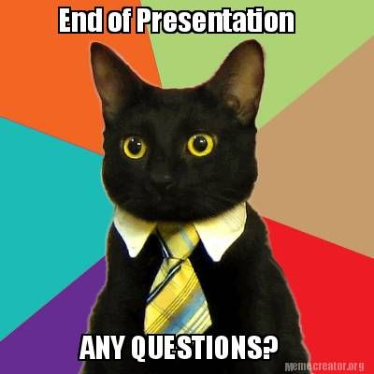
Thanks for watching

