Slide 1
CS202 · DESIGN PATTERNS
Observer
Design Pattern
Notify many objects — without letting the source know who they are.
Nguyễn Đình Minh Huy — 25125083
Trần Gia Huy — 25125084
APCS 2025 · Group 52
Copyright © University of Science, VNUHCM - APCS 2023

Slide 2
WHAT WE WILL COVER
Agenda
01
02
03
Real-world problem
Naïve solution & drawbacks
The Observer pattern
04
05
06
Class diagrams
Code implementation & demo
Pairing with Mediator & Interpreter
07
08
09
Pros & cons
Quiz
Conclusion
Group 52 · Observer Pattern
Copyright © University of Science, VNUHCM - APCS 2023

Slide 3
THE SETTING
Real-world problem
We are building a bank management system: it stores users’ accounts and lets them deposit money into those accounts.
BankAccount::deposit()
However, when deposit is called, aside from adding money we are required to run other procedures — logging, notifying, emailing, fraud checks. These belong to other services that we do not fully control.
Logging service
Notification service
Email service
Fraud detection
Analytics
Five extra services — five hard-wired calls.
Group 52 · Observer Pattern
Copyright © University of Science, VNUHCM - APCS 2023

Slide 4
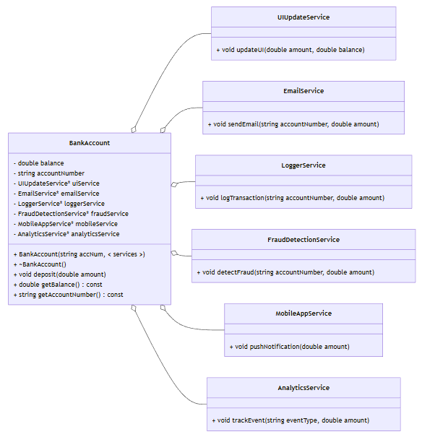
STEP 1 · THE OBVIOUS WAY
Naïve solution
When BankAccount::deposit is called, it invokes every required service directly — each one is stored as a pointer inside the account.
ui.update(balance);
email.sendEmail(amount);
logger.log(amount, balance);
fraudDetector.scan(amount);
mobileApp.pushNotification(amount);
analytics.trackActivity("Deposit", amount);
BankAccount must know all six concrete types and the exact name of every method it calls.
Naïve BankAccount UML
Group 52 · Observer Pattern
Copyright © University of Science, VNUHCM - APCS 2023

Slide 5
STEP 1 · WHAT BREAKS
Naïve solution — drawbacks
Tight coupling
✕
BankAccount must know the exact concrete types of the services and their specific update methods.
Violates the Open–Closed Principle
✕
Changing or adding a service forces us to reopen and modify BankAccount itself.
Rigid and hard to scale
✕
Every change to a service — or to the account — ripples through the other side.
Group 52 · Observer Pattern
Copyright © University of Science, VNUHCM - APCS 2023

Slide 6
THE INSIGHT
Two observations
01
02
The services take similar — but not identical — parameters. With one general structure, BankAccount no longer needs to know what each service requires.
BankAccount never uses the results of those calls. It does not care who runs; it only needs a list of things to call when depositing.
⇒ Observer pattern
One list of subscribers. One shared interface. One call to notify them all.
Group 52 · Observer Pattern
Copyright © University of Science, VNUHCM - APCS 2023

Slide 7
THE PATTERN
Observer — the intuition
Imagine a popular YouTube channel, or a digital newsletter.
Subscribers should not have to keep asking “is there a new video?” or “is there a new edition?”
The publisher maintains the list of subscribers. When new content appears, it pushes a notification to everyone on that list.
Tracking state changes moves from the consumers to the source — instant updates, no wasteful polling.
PUBLISHER
Subscriber 1
Subscriber 2
Subscriber 3
one notify() → every subscriber updated
In the Observer pattern:
Subject = Publisher · Observer = Subscriber
Group 52 · Observer Pattern
Copyright © University of Science, VNUHCM - APCS 2023

Slide 8
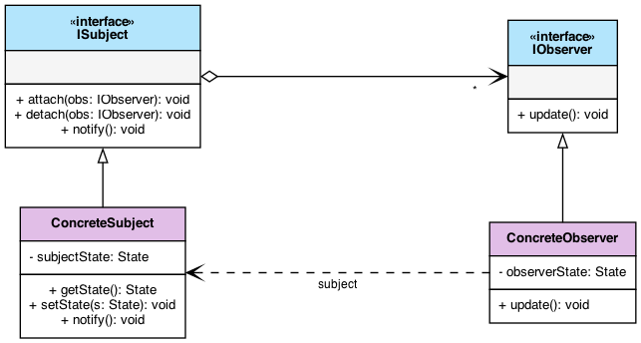
STRUCTURE
General class diagram
ISubject
Maintains the list of observers. Implements attach() and detach(), and broadcasts notify() whenever its state changes.
IObserver
Exposes a single update() method that the subject calls during a notification.
The Gang-of-Four structure: ISubject and IObserver
Group 52 · Observer Pattern
Copyright © University of Science, VNUHCM - APCS 2023

Slide 9
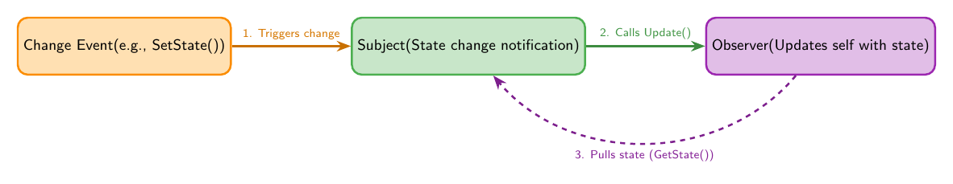
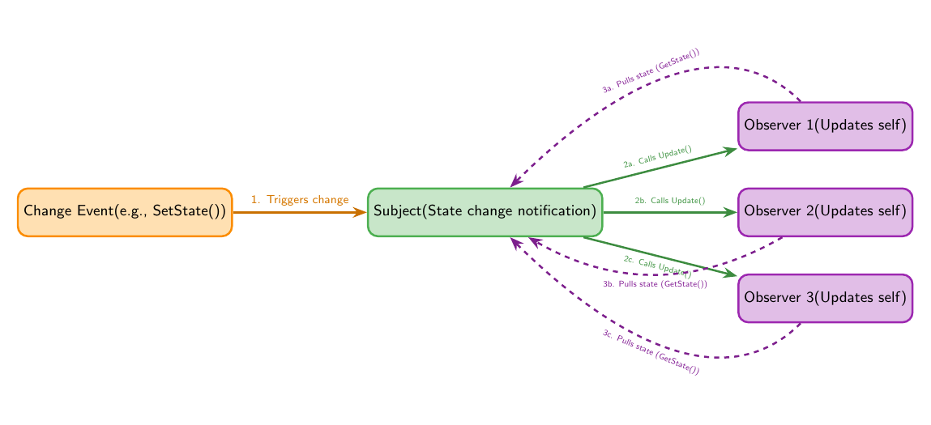
STRUCTURE
How a notification flows
1 SUBJECT · 1 OBSERVER
1 SUBJECT · MANY OBSERVERS
PULL MODEL
The subject only announces that something changed; each observer then retrieves the data it needs through a getter.
Group 52 · Observer Pattern
Copyright © University of Science, VNUHCM - APCS 2023

Slide 10
STRUCTURE
How a notification flows
1 SUBJECT · 1 OBSERVER
1 SUBJECT · MANY OBSERVERS
PULL MODEL
PUSH MODEL
The subject only announces that something changed; each observer then retrieves the data it needs through a getter.
The alternative: the subject sends the changed data directly along with the notification.
Group 52 · Observer Pattern
Copyright © University of Science, VNUHCM - APCS 2023

Slide 11
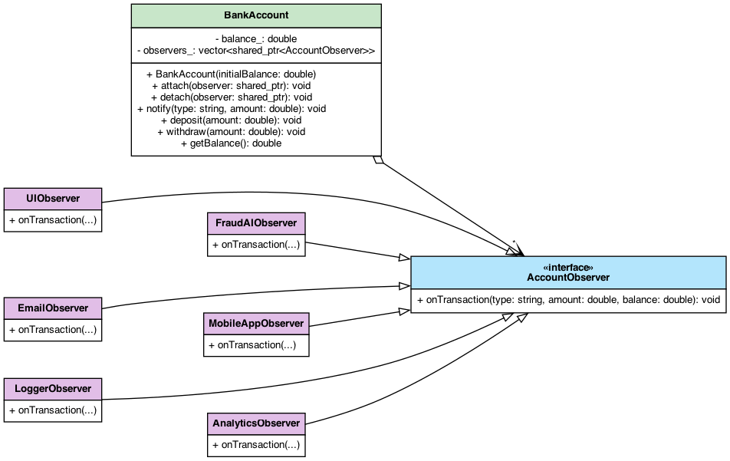
CASE STUDY
Bank account — class diagram
Concrete observers
UIObserver
EmailObserver
LoggerObserver
FraudAIObserver
MobileAppObserver
AnalyticsObserver
All six implement one interface: onTransaction(type, amount, balance).
BankAccount is the subject; every service becomes an AccountObserver
Group 52 · Observer Pattern
Copyright © University of Science, VNUHCM - APCS 2023

Slide 12
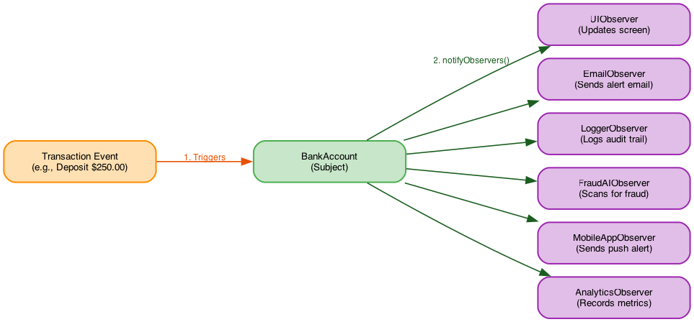
CASE STUDY
What the pattern buys us
True isolation
ONE CALL, SIX REACTIONS
✓
BankAccount is completely ignorant of the concrete services — it only knows the observer interface.
✓
Open/Closed Principle
New services can be added without modifying the BankAccount class.
✓
Single Responsibility
Core financial logic stays clean; logging, fraud checks and UI live in dedicated components.
A single transaction event travels through BankAccount::notify() and reaches every subscribed observer — the account never names one of them.
✓
Runtime flexibility
Observers can be attached or detached on the fly, based on user settings or system state.
Group 52 · Observer Pattern
Copyright © University of Science, VNUHCM - APCS 2023

Slide 13
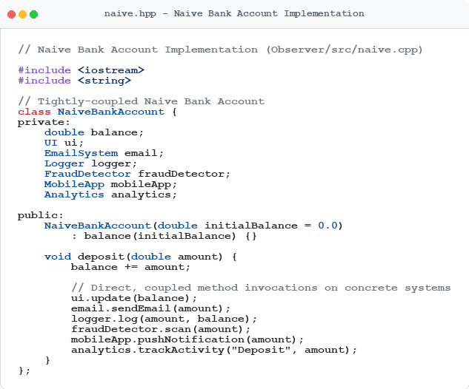
IMPLEMENTATION & DEMO
Naïve approach — implementation
HARD-WIRED
The account owns a member for every service: UI, EmailSystem, Logger, FraudDetector, MobileApp, Analytics — and deposit() calls each of them by name.
CONSEQUENCE
A service cannot be detached at runtime, and a new one cannot be added without editing this file.
Observer/src/naive.cpp
Group 52 · Observer Pattern
Copyright © University of Science, VNUHCM - APCS 2023

Slide 14
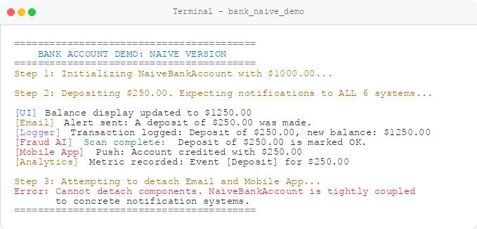
IMPLEMENTATION & DEMO
Naïve approach — demo
1
Initialise the account with $1000.00
2
Deposit $250.00 — all six systems fire
3
Try to detach Email and Mobile App
Error: cannot detach components. The naïve account is tightly coupled to concrete notification systems.
Terminal — bank_naive_demo
Group 52 · Observer Pattern
Copyright © University of Science, VNUHCM - APCS 2023

Slide 15
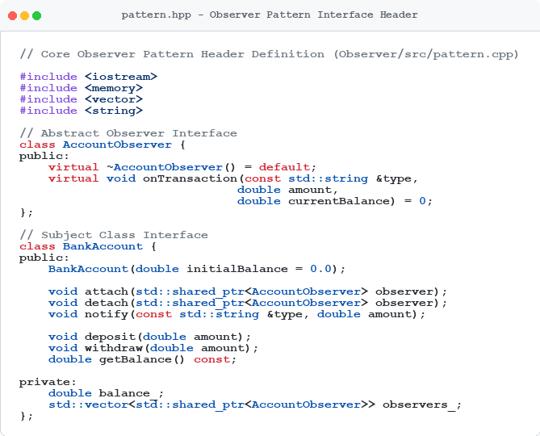
IMPLEMENTATION & DEMO
Observer pattern — interface header
AccountObserver
A pure-virtual onTransaction(type, amount, currentBalance) — the only thing the account knows about.
BankAccount
attach(), detach(), notify(), plus deposit() and withdraw() over a vector of shared_ptr observers.
Observer/src/pattern.cpp — pattern.hpp
Group 52 · Observer Pattern
Copyright © University of Science, VNUHCM - APCS 2023

Slide 16
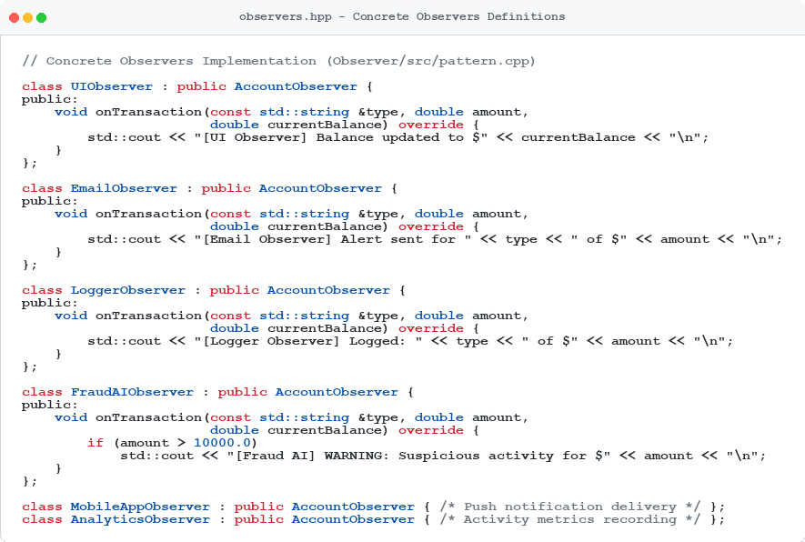
IMPLEMENTATION & DEMO
Observer pattern — concrete observers
Each observer overrides onTransaction() and reacts on its own terms — the account is never edited again.
Group 52 · Observer Pattern
Copyright © University of Science, VNUHCM - APCS 2023

Slide 17
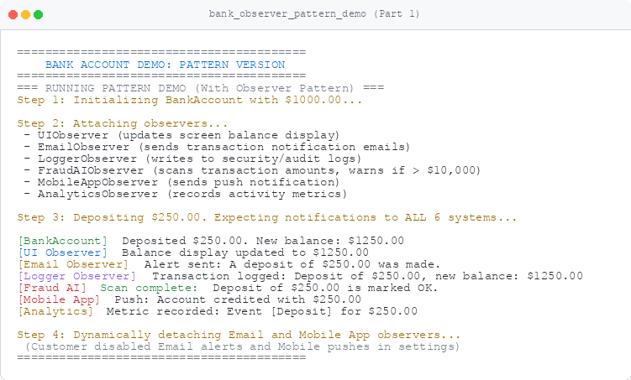
IMPLEMENTATION & DEMO
Observer pattern — demo, part 1
1
Initialise BankAccount with $1000.00
2
Attach all six observers
3
Deposit $250.00 — every observer reacts
4
Detach Email and Mobile App at runtime
Same deposit() body — the subscriber list changed, not the account.
Terminal — bank_observer_pattern_demo (part 1)
Group 52 · Observer Pattern
Copyright © University of Science, VNUHCM - APCS 2023

Slide 18
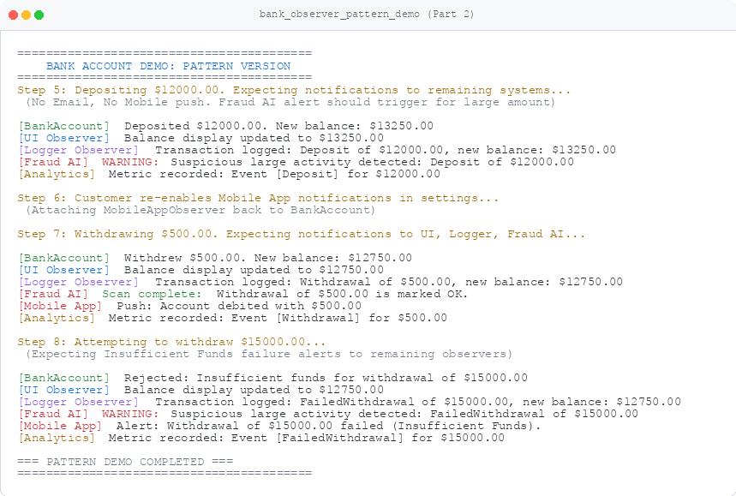
IMPLEMENTATION & DEMO
Observer pattern — demo, part 2
5
Deposit $12 000 — remaining observers only, Fraud AI warns
6
Customer re-enables Mobile App in settings
7
Withdraw $500 — UI, Logger and Fraud AI react
8
Withdraw $15 000 — rejected, failure broadcast
Observers come and go; BankAccount never notices.
Terminal — bank_observer_pattern_demo (part 2)
Group 52 · Observer Pattern
Copyright © University of Science, VNUHCM - APCS 2023

Slide 19

RELATED PATTERN
The Mediator pattern
A behavioural pattern that reduces chaotic dependencies between objects.
It restricts direct communication between objects — the colleagues — and forces them to collaborate exclusively through one centralised mediator object.
Airplanes communicate solely with the control tower — the mediator — which safely orchestrates all the traffic.
Group 52 · Observer Pattern
Copyright © University of Science, VNUHCM - APCS 2023

Slide 20
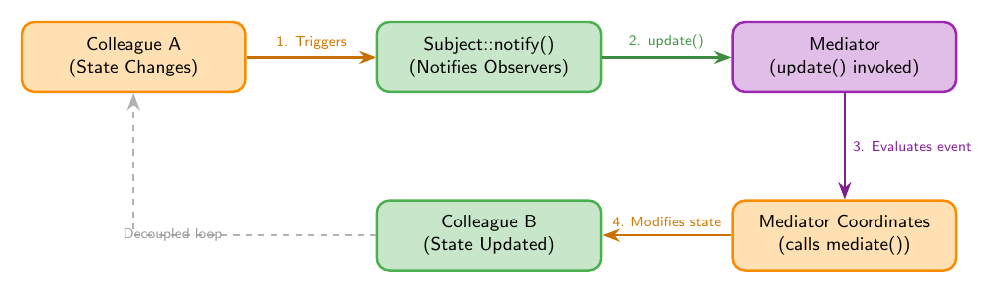
FUSION
Observer + Mediator, fused
Colleagues act as Subjects
The Mediator acts as the Observer
When a colleague’s state changes it raises an event. The mediator — subscribed to those events — catches the notification, evaluates the global context, and updates the other relevant colleagues.
Colleague A changes → Subject::notify() → Mediator evaluates → Colleague B updated
Group 52 · Observer Pattern
Copyright © University of Science, VNUHCM - APCS 2023

Slide 21
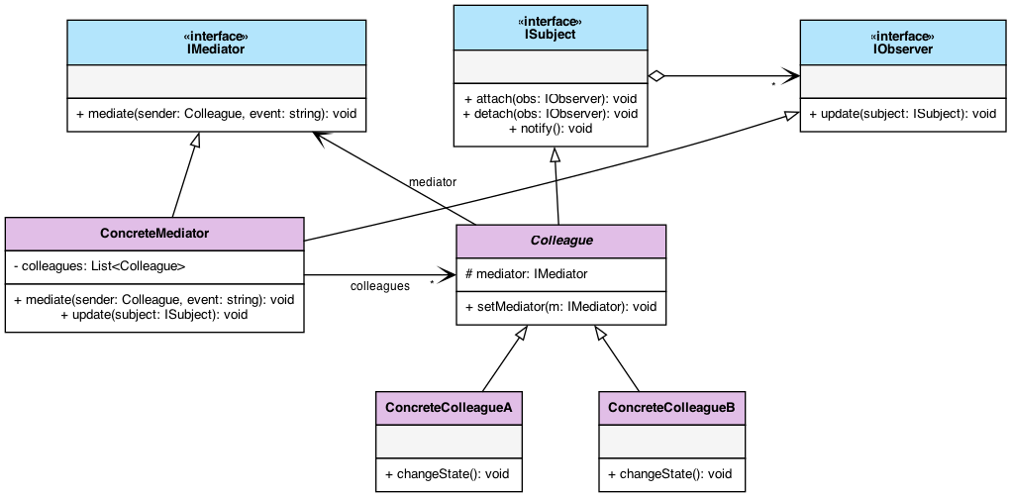
FUSION
Observer–Mediator class diagram
ConcreteMediator implements IObserver and is notified by every colleague it coordinates
Group 52 · Observer Pattern
Copyright © University of Science, VNUHCM - APCS 2023

Slide 22
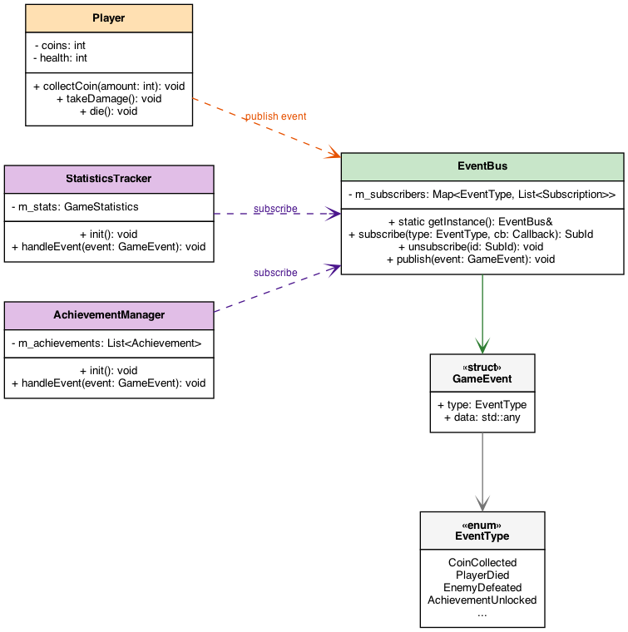
IN THE WILD
EventBus in game development
A player character takes damage and dies — it is the event publisher.
The player does not call AchievementManager or StatisticsTracker. It simply publishes a PlayerDied event to the central EventBus.
Every system that subscribed to that event type is notified immediately and runs its own logic.
Add a new system — quests, analytics, telemetry — by subscribing to PlayerDied. The player code never changes.
Group 52 · Observer Pattern
Copyright © University of Science, VNUHCM - APCS 2023

Slide 23
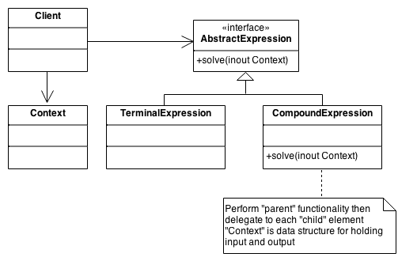
RELATED PATTERN
The Interpreter pattern
Given a language, we need a hierarchical representation for its expressions.
Each expression node knows how to solve itself and delegates to its children, so a sentence in the language becomes a tree of objects.
EXAMPLE
(5 + 1) × 10 + 41 − x as an operation tree
Source: sourcemaking.com
Group 52 · Observer Pattern
Copyright © University of Science, VNUHCM - APCS 2023

Slide 24
USAGE WITH INTERPRETER
When a leaf can change
If a terminal expression is a variable — something another process or service can change — instead of a constant, the results computed above it are no longer valid.
→
→
01
02
03
The variable changes
The observer is notified
The tree re-evaluates
Some other service writes a new value into the terminal node.
The expression node subscribed to that variable receives update().
Only the affected branch recomputes — the rest of the tree is untouched.
⇒ Observer watches the variable; the Interpreter tree keeps its results in sync.
Group 52 · Observer Pattern
Copyright © University of Science, VNUHCM - APCS 2023

Slide 25
USAGE WITH INTERPRETER
A spreadsheet, concretely
In a spreadsheet, cell A3 holds the formula “= A1 + A2”. Its result depends on A1 and A2, which can be rewritten by another formula or by the user at any moment.
A
1
1200.00
2
450.00
INTERPRETER
3
→ 1650.00
= A1 + A2
Parses the formula in A3 into an expression tree.
OBSERVER
A3 subscribes to A1 and A2. Change either one and A3 re-interprets its formula immediately — no polling, and no recalculation of the whole sheet.
Watches A1 and A2 and re-evaluates on change.
Group 52 · Observer Pattern
Copyright © University of Science, VNUHCM - APCS 2023

Slide 26
EVALUATION
Pros
✓
✓
✓
Open/Closed Principle
Loose coupling
Dynamic relationships
New observer classes can be introduced without modifying the subject’s code at all.
The subject interacts only with a generic interface, staying ignorant of every concrete observer implementation.
Connections between publishers and subscribers can be established or terminated at runtime.
The subject only ever talks to an interface — that single decision buys all three.
Group 52 · Observer Pattern
Copyright © University of Science, VNUHCM - APCS 2023

Slide 27
EVALUATION
Cons
!
!
!
The lapsed listener problem
Non-deterministic order
Harder debugging
If an observer is never detached, the subject keeps a reference to it — a dangling pointer and a fatal crash when it notifies deleted memory.
The order in which subscribers are notified is arbitrary and cannot be relied on for sequential logic.
Tracing execution through a long chain of dynamic, event-driven updates is difficult to step through in a debugger.
None of these are fatal — but they are the price of decoupling, and they must be designed for.
Group 52 · Observer Pattern
Copyright © University of Science, VNUHCM - APCS 2023

Slide 28
CHECK YOURSELF
Quiz
Eight questions on the Observer pattern
1
2
3
4
5
6
7
8
Group 52 · Observer Pattern
Copyright © University of Science, VNUHCM - APCS 2023

Slide 29
QUESTION 1 OF 8
If the Observer pattern were a real-world subscription service, which of the following scenarios best describes it?
A client polling a server every 5 seconds to check if there are new emails.
A
A newspaper publisher automatically delivering the daily issue to all registered home addresses.
B
A customer walking into a physical store every day to check if a shoe is back in stock.
C
A mediator forwarding calls between two people who don’t know each other.
D
Group 52 · Observer Pattern
Copyright © University of Science, VNUHCM - APCS 2023

Slide 30
ANSWER · QUESTION 1 OF 8
If the Observer pattern were a real-world subscription service, which of the following scenarios best describes it?
A client polling a server every 5 seconds to check if there are new emails.
A
A newspaper publisher automatically delivering the daily issue to all registered home addresses.
✓
B
A customer walking into a physical store every day to check if a shoe is back in stock.
C
A mediator forwarding calls between two people who don’t know each other.
D
Correct answer: B
Group 52 · Observer Pattern
Copyright © University of Science, VNUHCM - APCS 2023

Slide 31
QUESTION 2 OF 8
In our naïve Bank Account implementation, why did we violate the Open–Closed Principle (OCP)?
Because the BankAccount class was too small to hold the logic.
A
Because adding a new service required modifying the existing code of BankAccount.
B
Because we used C++ smart pointers instead of raw pointers.
C
Because the deposit() function was private.
D
Group 52 · Observer Pattern
Copyright © University of Science, VNUHCM - APCS 2023

Slide 32
ANSWER · QUESTION 2 OF 8
In our naïve Bank Account implementation, why did we violate the Open–Closed Principle (OCP)?
Because the BankAccount class was too small to hold the logic.
A
Because adding a new service required modifying the existing code of BankAccount.
✓
B
Because we used C++ smart pointers instead of raw pointers.
C
Because the deposit() function was private.
D
Correct answer: B
Group 52 · Observer Pattern
Copyright © University of Science, VNUHCM - APCS 2023

Slide 33
QUESTION 3 OF 8
A temporary UI window (observer) is deleted in C++ but forgets to call detach() on the BankAccount. What is the likely runtime result of the next deposit?
The compiler will fail with a syntax error.
A
The program will run faster because there’s one less service.
B
The program will crash or experience undefined behaviour (dangling pointer).
C
The bank account will automatically recreate the UI window.
D
Group 52 · Observer Pattern
Copyright © University of Science, VNUHCM - APCS 2023

Slide 34
ANSWER · QUESTION 3 OF 8
A temporary UI window (observer) is deleted in C++ but forgets to call detach() on the BankAccount. What is the likely runtime result of the next deposit?
The compiler will fail with a syntax error.
A
The program will run faster because there’s one less service.
B
The program will crash or experience undefined behaviour (dangling pointer).
✓
C
The bank account will automatically recreate the UI window.
D
Correct answer: C
Group 52 · Observer Pattern
Copyright © University of Science, VNUHCM - APCS 2023

Slide 35
QUESTION 4 OF 8
If observers must be notified in a strict order (e.g. Security Logger before UI updates), is the standard Observer pattern a good choice?
Yes, because the standard Observer pattern guarantees alphabetical notification order.
A
Yes, because observers are always notified in the exact order they subscribed.
B
No, because the Observer pattern is only meant for web browsers.
C
No, because the standard pattern makes no assumptions about notification order, and enforcing it violates loose coupling.
D
Group 52 · Observer Pattern
Copyright © University of Science, VNUHCM - APCS 2023

Slide 36
ANSWER · QUESTION 4 OF 8
If observers must be notified in a strict order (e.g. Security Logger before UI updates), is the standard Observer pattern a good choice?
Yes, because the standard Observer pattern guarantees alphabetical notification order.
A
Yes, because observers are always notified in the exact order they subscribed.
B
No, because the Observer pattern is only meant for web browsers.
C
No, because the standard pattern makes no assumptions about notification order, and enforcing it violates loose coupling.
✓
D
Correct answer: D
Group 52 · Observer Pattern
Copyright © University of Science, VNUHCM - APCS 2023

Slide 37
QUESTION 5 OF 8
In modern C++, if a Subject holds strong std::shared_ptr<Observer> references to its observers, and those observers hold std::shared_ptr<Subject> back, what issue arises?
The compiler throws a syntax error.
A
A circular reference occurs, preventing objects from ever being destroyed (memory leak).
B
The program automatically converts them into raw pointers.
C
Observers are executed in reverse order.
D
Group 52 · Observer Pattern
Copyright © University of Science, VNUHCM - APCS 2023

Slide 38
ANSWER · QUESTION 5 OF 8
In modern C++, if a Subject holds strong std::shared_ptr<Observer> references to its observers, and those observers hold std::shared_ptr<Subject> back, what issue arises?
The compiler throws a syntax error.
A
A circular reference occurs, preventing objects from ever being destroyed (memory leak).
✓
B
The program automatically converts them into raw pointers.
C
Observers are executed in reverse order.
D
Correct answer: B
Group 52 · Observer Pattern
Copyright © University of Science, VNUHCM - APCS 2023

Slide 39
QUESTION 6 OF 8
What dangerous side effect occurs if an observer’s update() mutates the subject’s state and triggers another deposit() without guard conditions?
Infinite recursive notification loop leading to a stack overflow crash.
A
The operating system increases process priority.
B
The balance doubles on each iteration automatically.
C
The observer is automatically removed from the subscriber list.
D
Group 52 · Observer Pattern
Copyright © University of Science, VNUHCM - APCS 2023

Slide 40
ANSWER · QUESTION 6 OF 8
What dangerous side effect occurs if an observer’s update() mutates the subject’s state and triggers another deposit() without guard conditions?
Infinite recursive notification loop leading to a stack overflow crash.
✓
A
The operating system increases process priority.
B
The balance doubles on each iteration automatically.
C
The observer is automatically removed from the subscriber list.
D
Correct answer: A
Group 52 · Observer Pattern
Copyright © University of Science, VNUHCM - APCS 2023

Slide 41
QUESTION 7 OF 8
How can the Interpreter pattern and the Observer pattern work together in an automated financial trading system?
Interpreter parses custom trading rules (e.g. price > 100 AND volume > 500), and Observer broadcasts price updates that trigger the rule evaluation.
A
They cannot be used in the same project.
B
Observer compiles C++ code, while Interpreter runs the executable.
C
Interpreter deletes the Observer’s memory pointers.
D
Group 52 · Observer Pattern
Copyright © University of Science, VNUHCM - APCS 2023

Slide 42
ANSWER · QUESTION 7 OF 8
How can the Interpreter pattern and the Observer pattern work together in an automated financial trading system?
Interpreter parses custom trading rules (e.g. price > 100 AND volume > 500), and Observer broadcasts price updates that trigger the rule evaluation.
✓
A
They cannot be used in the same project.
B
Observer compiles C++ code, while Interpreter runs the executable.
C
Interpreter deletes the Observer’s memory pointers.
D
Correct answer: A
Group 52 · Observer Pattern
Copyright © University of Science, VNUHCM - APCS 2023

Slide 43
QUESTION 8 OF 8
What happens if a concrete observer calls subject->detach(this) inside its own update() callback while notify() is running a simple range-for loop?
The loop safely skips the detached observer.
A
The C++ compiler creates a vector copy automatically.
B
The program prompts the user for manual confirmation.
C
Iterator invalidation / undefined behaviour — modifying a std::vector during range-based iteration corrupts the loop.
D
Group 52 · Observer Pattern
Copyright © University of Science, VNUHCM - APCS 2023

Slide 44
ANSWER · QUESTION 8 OF 8
What happens if a concrete observer calls subject->detach(this) inside its own update() callback while notify() is running a simple range-for loop?
The loop safely skips the detached observer.
A
The C++ compiler creates a vector copy automatically.
B
The program prompts the user for manual confirmation.
C
Iterator invalidation / undefined behaviour — modifying a std::vector during range-based iteration corrupts the loop.
✓
D
Correct answer: D
Group 52 · Observer Pattern
Copyright © University of Science, VNUHCM - APCS 2023

Slide 45
YOUR TURN
Real-world problem: Moodle notifications
The learning management system (LMS) Moodle needs a notification system to deliver announcements and updates to its students.
YOUR TASK
Design the notification system for Moodle so that it supports a wide variety of notifications — and so that adding the next kind costs nothing.
Thousands of students, dozens of courses, and a growing list of things worth telling them about.
1
2
3
4
Announcements
New classes
New tasks
Quizzes
Group 52 · Observer Pattern
Copyright © University of Science, VNUHCM - APCS 2023

Slide 46
SOURCES
References
E. Gamma, R. Helm, R. Johnson, and J. Vlissides, Design Patterns: Elements of Reusable Object-Oriented Software. Reading, MA, USA: Addison-Wesley, 1994.
1
A. Shvets, “Observer Design Pattern,” Refactoring.Guru. [Online]. Available: https://refactoring.guru/design-patterns/observer
2
Code, LaTeX report and this deck: DesignPatternsGroup52 · Observer
Group 52 · Observer Pattern
Copyright © University of Science, VNUHCM - APCS 2023

Slide 47

GROUP 52 · APCS 2025
Thanks for watching
Questions?
Nguyễn Đình Minh Huy — 25125083
Trần Gia Huy — 25125084
Group 52 · Observer Pattern
Copyright © University of Science, VNUHCM - APCS 2023

