Slide 1
CS202 – Observer design pattern
APCS 2025
Nguyễn Đình Minh Huy - 25125083
Trần Gia Huy - 25125084

Slide 2
Agenda
Real-world problem
Naïve solution & Drawback
Observer pattern
Class diagram
Code implementation & Demo
Pros & Cons
Relationship with Interpreter and Mediator design pattern
Quiz
Conclusion

Slide 3
Real-world problem
We are building a bank management system. We need to store users’ accounts and let them deposit their money into their accounts. However, when we call the deposit, aside from adding money, we are required to do other procedures such as logging, notifying, emailing,… These are from other services that we don’t have full control.

Slide 4
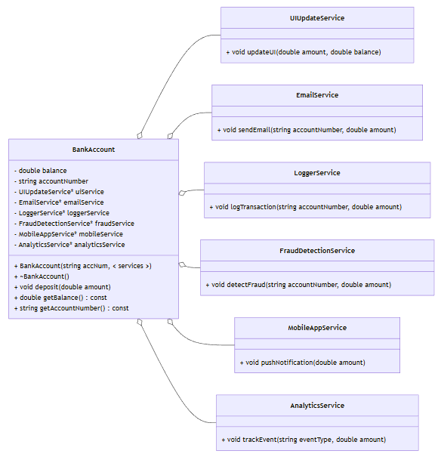
Naïve solution
When BankAccount::deposit is called, it invokes all the required services, which are saved as pointers.

Slide 5
Naïve solution - Drawback
However, there are some problems with this approach:
Tight coupling: The BankAccount must know the exact concrete types of services and their specific update methods.
Violates the Open-Closed Principle (OCP): If we want to change or add a service, we must modify the code in BankAccount.
Rigid and hard to scale: Changing and modifying either the service or the BankAccount are much more complex.

Slide 6
We notice that the services have similar parameters, but not exactly the same. If we have a general structure, we don’t need to know what each of them need.
Another thing is that the BankAccount don’t care what we need to call as they don’t need the result from invoking the services. Therefore, we only need a list of services to call when depositing.
=> Observer pattern

Slide 7
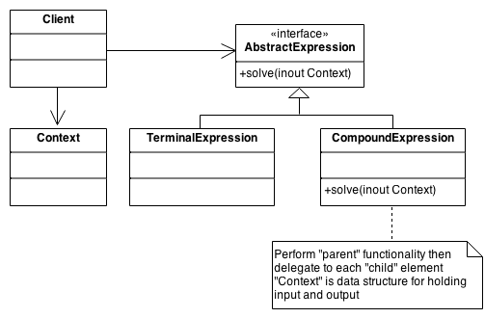
Relationship with Interpreter design pattern
Interpreter design pattern: Given a language, we need to defined a hierarchical representation for the language.
Example: Representing (5 + 1) x 10 + 41 - x as an operation tree.
Source: https://sourcemaking.com/

Slide 8
Relationship with Interpreter design pattern
However, if the terminal expression is a variable, which can be changed by another process, services, … instead of being a constant, then we need to update the result of the operations according to the new value.
=> We use observer pattern to observe the changes in the variable and update the tree accordingly.

Slide 9
Relationship with Interpreter design pattern
Example: We have a spreadsheet (like an Excel file). In cell A3, we have a formula “= A1 + A2”. The result of A3 depends on the result of A1 and A2, which can be changed by another formula(s) or by user.
=> We use the interpreter pattern to interpret the formula in A3, and the observer pattern to observe the changes in A1 and A2.

