Slide 1
CATCH: Case and Termination Checker for Haskell
Neil Mitchell
(Supervised by Colin Runciman)
http://www.cs.york.ac.uk/~ndm/

Slide 2
The Aim
Take a Haskell program
Analyse it
Prove statically that there are no “unsafe pattern matches”
No additional user work
Termination – not in 18 minutes!

Slide 3
Is this safe?
risers [] = []
risers [x] = [[x]]
risers (x:y:etc) =
if x <= y
then (x:s):ss
else [x]:(s:ss)
where (s:ss) = risers (y:etc)

Slide 4
Yes
risers [] = []
risers [x] = [[x]] -– ((x:[]):[])
risers (x:y:etc) =
if x <= y
then (x:s):ss
else [x]:(s:ss)
where (s:ss) = risers (y:etc)

Slide 5
How does Catch work?
Transform to reduced Haskell
Apply transformations on reduced Haskell
Generate a condition for case safety
Propagate this condition
Figure out if the precondition is True

Slide 6
Pattern Matches
let (a,b) = y
in (b,a)
if x then f else g
f x | null x = []
| otherwise = tail x
case x of
[] -> True
(a:b) -> a
[x | Just x <- xs]
f (x:xs) = x
f x = ys
where (y:ys)
do (x:xs) <- f y
return xs
\(a,b) -> a ++ b
f [x] = x

Slide 7
Reduced Haskell
Only simple case, functions, applications, constructors
data [] = [] | (:) hd tl
map f xs =
case xs of
[] -> []
(:) -> f xs.hd : map f xs.tl

Slide 8
Generating Reduced Haskell
Fully automatic
Uses Yhc’s Core language
  Yhc is a fork of nhc98
  Specify –core or –corep to see it
Some additional transformations
  Remove a few let’s
By the end, reduced Haskell

Slide 9
Transformations
About 8 are applied
Reachability
  Eliminate dead code
Arity raising
  Take out points free code
  odd = not . even
Defunctionalisation [Reynolds 72]
  Remove all higher order functions

Slide 10
The Checker itself
Operates on a simple first order language
Uses constraints of the form:
  <expression, path, constructors>
From the expression,
if I follow any valid path,
I get to one of the constructors

Slide 11
Constraints, intro by example
head (x:xs) = x
<head@1, λ, {:}>
fromJust (Just x) = x
<fromJust@1, λ, {Just}>
foldr1 f [x] = x
foldr1 f (x:xs) = f x (foldr1 f xs)
<foldr1@2, λ, {:}>

Slide 12
Constraints with paths
mapHead x = case x of
[] -> []
(:) -> head x.hd : mapHead x.tl
<mapHead@1, tl*.hd, {:}>
<mapHead@1, hd, {:}> ^
<mapHead@1, tl.hd, {:}> ^
<mapHead@1, tl.tl.hd, {:}> ^ …

Slide 13
Dealing with recursion
Just keep expanding it
  x ^ x.a ^ x.aa ^ x.aaa ^ x.aaaa
At a certain depth, give up
  x.aaaa -> x.aaa*
Simplify after
  x ^ x.a ^ x.aa ^ x.aaa ^ x.aaa* = x.a*

Slide 14
Going back to Risers
<risers (y:etc), λ, {:}>
<(y:etc), λ, {:}>
True
Risers is safe ☺

Slide 15
Other programs
Soda (Word search)
  One minor tweak required
  Was safe already
Adjoxo (XOX checker)
  One fix requried
  Was NOT safe before
  Improves code readability

Slide 16
State of play
Have a working prototype
  Full Haskell 98
  A number of Haskell 98 libraries
  Works on 1-2 page programs
Still lots to do
  A bit slow in some cases
  Some programs don’t work yet

Slide 17
Conclusion
CATCH is a practical tool for detecting pattern match errors
Uses a constraint language to prove safety
http://www.cs.york.ac.uk/~ndm/
A release is coming soon (2 months)

Slide 18
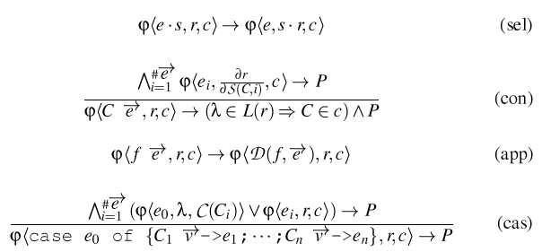
Transformation rules

Slide 19
Yhc vs GHC Core
GHC Core is:
  More complex (letrec’s, lambda’s)
  Lacks source position information
  Piles and piles of type information
  Slower to generate
  Harder to change GHC
  Less like the original code

