Slide 1
Hoogle
http://haskell.org/hoogle
Neil Mitchell

Slide 2
Haskell Types 101
isURI :: String -> Bool
(||) :: Bool -> Bool -> Bool
or :: [Bool] -> Bool
id :: a -> a
Just :: a -> Maybe a
map :: (a -> b) -> [a] -> [b]
(+) :: Num a => a -> a -> a

Slide 3
What does Hoogle do?
Search for Haskell functions
  By type
  By name
Demonstration…

Slide 4
What did Hoogle used to do?
Version 1
  Written in Javascript
  Only exact matches
Version 2
  Written in Haskell
  Partial matches
  Only the Haskell 98 libraries

Slide 5
The bits inside Hoogle
Generate a list of functions
Search
  By name
  By type
Decide on a ranking
Display documentation

Slide 6
A list of functions
Version 1 & 2
  Borrow them from Zvon
Version 3
  Take HTML documentation by Haddock
  Process it
  Try and figure out the original data
Dies on certain files…

Slide 7
Search by Type – v1
Rename all free variables to a canonical form
  [fred] -> bob → [a] -> b
Match by string comparison
No argument reordering
No “close” standards

Slide 8
Search by Type – v2
Use unification
  Have argument reordering on top
  Have missing arguments allowed
Example: search [c] -> [c]
map :: (a -> b) -> [a] -> [b]
  a = b = c
  (c -> c) is a missing argument

Slide 9
A problem…
Search for: k -> [(k,v)] -> v
lookup :: a -> [(a,b)] -> Maybe b
  a = k
  b = v = Maybe b [occurs check fails]
  = Maybe (Maybe b) = Maybe (Maybe…)
Also:
  Ranking is very hard

Slide 10
Searching by Type – v3
Convert type sig -> single steps
Apply each step
  Can fail => no match
  Can part fail => bad marks
map :: (a -> b) -> [a] -> [b]
  #1{->} {#1.1,#2.1}
  #2{[]} {#1.2,##.1}
  ##{[]}

Slide 11
Matching to filter
filter :: (a -> Bool) -> [a] -> [a]
#1{->} (a->Bool){->} Yes
#2{[]} [a]{[]} Yes
##{[]} [a]{[]} Yes
{#1.1,#2.1} {a, a} Yes
{#1.2,##.1} {Bool, a} Partial
a in two different sets Partial

Slide 12
Bad marks
Accumulate bad marks
  Argument missing
  Data too free/specific
  6 in total
Matches two ways, so a multiset of items from a 12 item set
Assign each item a score
Sum all the items

Slide 13
How to assign scores
Almost impossible to get right
Highly subjective
So don’t do it!
  Have an example set – when searching for a, I expect result b above result c
  Run a program, get a constraint program
  Solve constraint program, get answer
  Put back into Hoogle

Slide 14
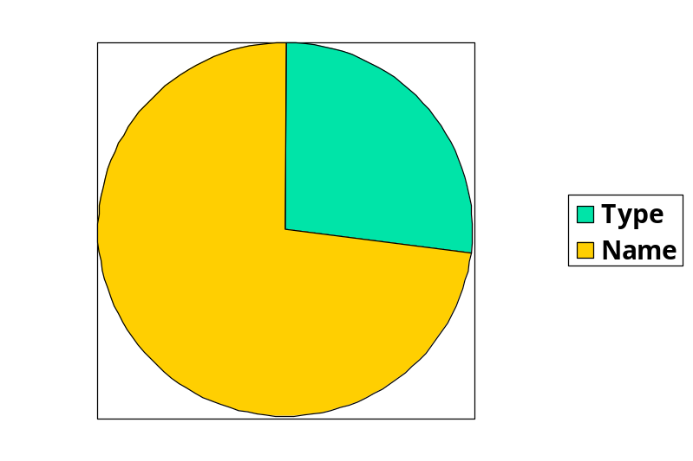
What do people search for?
3300 searches (about in a month)
600 used the prewritten searches
Lots of people search for “where”

Slide 15
What else do people search?
hotmail.com
google
eastenders
california public schools portable classes
Nintendo Revlution
Bondage

Slide 16
Conclusion
A useful practical tool for working with Haskell
Often just a fast way to lookup the documentation!
Online at http://haskell.org/hoogle
Open source, patches welcome!

