Slide 1
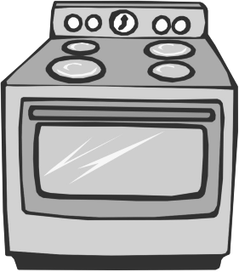
Shake ‘n’ Bake
Neil Mitchell
https://github.com/ndmitchell/{shake,bake}

Slide 2
Build ‘n’ Integrate
Ant
Travis
TeamCity
Make
SCons
Jenkins
In Haskell
Waf
shake
bake
Hudson
Ninja
CMake
Buildbot

Slide 3
Shake build system
Expressive, Robust, Fast
Haskell EDSL
Monadic
Polymorphic
Unchanging
1000’s of tests
100’s of users
Heavily used
Faster than
Ninja to
build Ninja

Slide 4
Simple example
out : in cp in out
(%>) :: FilePattern -> (FilePath -> Action ()) -> Rule ()
"out" %> \out -> do
need ["in"]
cmd "cp in out"
:: Rule ()
Monad Rule
:: Action ()
Monad Action

Slide 5


Longer example
import Development.Shake
import Development.Shake.FilePath
main = shakeArgs shakeOptions $ do
want ["result.tar"]
"*.tar" %> \out -> do
need [out -<.> "lst"]
contents <- readFileLines $ out -<.> "lst"
need contents
cmd "tar -cf" [out] contents
result.lst
notes.txt
talk.pdf
pic.jpg
result.tar
notes.txt
talk.pdf
pic.jpg

Slide 6
Generated files
MyGen.hs
MySource.xml
MySource.c
MySource.o
What does MySource.o depend on?

Slide 7
Generated approaches
Hardcode it?
Very fragile.
Hack an approximation of MyGen?
Slow, somewhat fragile, a lot of effort.
Run MyGen.hs and look at MySource.c
Easy, fast, precise.
Requires monadic dependencies

Slide 8
Monadic dependencies
Determine future dependencies
based on the results
of previous dependencies

Slide 9
Monadic dependencies in code
"MyHeader.h" %> \out -> do
need ["MyGen.hs","MyHeader.xml"]
cmd "runhaskell MyGen.hs"
"MySource.o" %> \out -> do
need =<< readFile’ "MySource.c.deps"
cmd "gcc -c MySource.c"
See user manual for .deps rule

Slide 10
Unchanging
Assume you change whitespace in MyHeader.xml and MySource.c doesn’t change
What rebuilds?
What do you want to rebuild?
(Very common for generated code)

Slide 11
Unchanging consequences
Assume you change whitespace in MyHeader.xml
Using file hashes: MyGen.hs runs and nothing
Using modtimes: Stops if MyGen.hs checks for Eq first
Always build children before their parents
What if a child fails, but the parent changed to no longer require that child?
Must rebuild the parent and fail on demand

Slide 12
Polymorphic dependencies
Can dependency track more than just files
"_build/run" <.> exe %> \out -> do
link <- fromMaybe "" <$> getEnv "C_LINK_FLAGS"
cs <- getDirectoryFiles "" ["//*.c"]
let os = ["_build" </> c -<.> "o" | c <- cs]
need os
cmd "gcc -o" [out] link os

Slide 13
Polymorphic dependencies
8 built in Rule instances
type ShakeValue a = (Show a, Typeable a, Eq a,
Hashable a, Binary a, NFData a)
class (ShakeValue k, ShakeValue v) => Rule k v where
storedValue :: k -> IO (Maybe v)

Slide 14
Using Shake for our build system has been a very good decision so far, we've been able to minimise the time spent with platform-dependent build systems and IDEs and get to write Haskell code instead ;)
Stefan Kersten, CTO Samplecount
Cross-platform music stuff in C/Haskell
Using Shake for > 2 years

Slide 15
Ready for primetime!
Standard Chartered have been using Shake since 2009, 1000’s of compiles per day.
factis research GmbH use Shake to compile their Checkpad MED application.
Samplecount have been using Shake since 2012, producing several open-source projects for working with Shake.
CovenantEyes use Shake to build their Windows client.
Keystone Tower Systems has a robotic welder with a Shake build system.
FP Complete use Shake to build Docker images.
Don’t write a build system unless you have to!

Slide 16
Stealing from Haskell
Syntax, reasonable DSLs
Some use of the type system (not heavy)
Abstraction, functions/modules/packages
Profiling the Haskell functions

Slide 17

Extra features
HTML profile reports
Very multithreaded
Progress reporting
Reports of live files
Lint reports
…

Slide 18
Why is Shake fast?
What does fast even mean?
Everything changed? Rebuild from scratch.
Nothing changed? Rebuild nothing.
In practice, a blend, but optimise both extremes and you win

Slide 19
Fast when everything changes
If everything changes, rule dominate (you hope)
One rule: Start things as soon as you can
Dependencies should be fine grained
Start spawning before checking everything
Make use of multiple cores
Randomise the order of dependencies (~15% faster)
Expressive dependencies, Continuation monad, cheap threads, immutable values (easy in Haskell)

Slide 20
Fast when nothing changes
Don’t run users rules if you can avoid it
Shake records a journal, [(k, v, …)]
Avoid lots of locking/parallelism
Take a lock, check storedValue a lot
Binary serialisation is a bottleneck
unchanged journal = flip allM journal $ \(k,v) ->
(== Just v) <$> storedValue k

Slide 21
Shake Questions?
Expressive, Robust, Fast
Haskell EDSL
Monadic
Polymorphic
Unchanging
1000’s of tests
100’s of users
Heavily used
Faster than
Ninja to
build Ninja

Slide 22
Bake Continuous Integration
A lot less applicable and mature than Shake
Not suitable for everyone
And those who it is suitable for might find it sucks
But already used in production at 3 or 4 places
DISCLAIMER

Slide 23

Bake for Managers
Continuous integration – Travis, Jenkins…
Designed for teams which are:
Large: ~5-50 people
Semi-trusted: Not always advance code review
Productive: Writing lots of code
Never break the build
https://github.com/ndmitchell/bake

Slide 24
Bake for Developers
Master branch always works perfectly
When code is ready, tell Bake
Bake compiles it, runs the tests, merges it
Bad code is rejected
master
neil

Slide 25
Not enough time in the day
50 patches are promoted per day
Compile & test = 10 hours (multithreaded)
20+ servers testing is infeasible
2 might be reasonable, Windows & Linux
Bake’s solution
Assume if p1+p2 pass the tests, that’s fine
If a test fails, then identify whether p1 or p2 fails

Slide 26
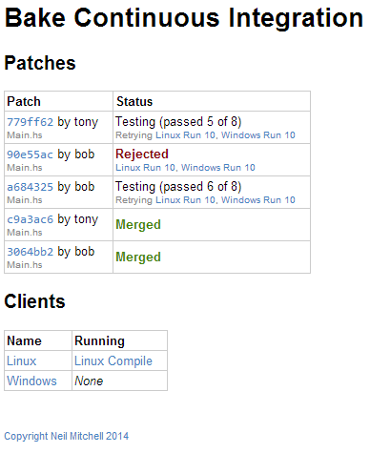

Slide 27
Configure in Haskell
data Action = Compile | Test
main = bake $
ovenGit repo "master" Nothing $
ovenTest (return [Compile,Test]) exec
defaultOven
exec Compile = run $ cmd "shake"
exec Test = after [Compile] $ run $ cmd "test"

Slide 28
Users
Dashboard
Query
Promote
Server *
Request
Merge
Client(s)
Reply
* Clever stuff
Prepare
Run
HTTP
Command line
90% string passing

Slide 29
String passing the Haskell way
data Stringy s = Stringy
{stringyTo :: s -> String
,stringyFrom :: String -> s
,stringyPretty :: s -> String
}
stringyTo . stringyFrom == id
stringyFrom . stringyTo == id
check :: Stringy s -> Stringy s

Slide 30
Stealing from Haskell
Parameterisable and configurable
Parameterised over version control
Parameterised over tests
Use types to safely pass different strings
A bit of pure “clever” stuff in the middle

Slide 31
Optimisation
First version was way too slow
Directory copy on Windows is very slow
Git checkout from scratch is very slow
Use a single directory for all building
Tarballs of each compiled state (distribution only)
Extract tarballs to do a bisection on test failure
Use exhaustive search near the leaves

Slide 32
Should you use Bake?
Are you in a large tech firm? Google/Facebook?
Probably have lots of CPU years dedicated to testing
Are you an individual or a small organisation?
Probably can use Travis just fine and fix your mistakes
Are you in the middle? With hours of tests?
Bake might be suitable here.

Slide 33

Questions?
Or beer?

