Slide 1

Playing with Haskell Data
Neil Mitchell

Slide 2
Overview
The “boilerplate” problem
Haskell’s weakness (really!)
Traversals and queries
Generic traversals and queries
Competitors (SYB and Compos)
Benchmarks

Slide 3
Data structures
A tree of typed nodes
Parent/child relationship is important

Slide 4
A concrete data structure
data Expr = Val Int
| Neg Expr
| Add Expr Expr
| Sub Expr Expr
Simple arithmetic expressions

Slide 5
Task: Add one to every Val
inc :: Expr -> Expr
inc (Val i) = Val (i+1)
inc (Neg x) = Neg (inc x)
inc (Add x y) = Add (inc x) (inc y)
inc (Sub x y) = Sub (inc x) (inc y)
What is the worst thing about this code?

Slide 6
Many things!
If we add Mul, we need to change
The action is one line, obscured
Tedious, repetitive, dull
May contain subtle bugs, easy to overlook
Way too long

Slide 7
The boilerplate problem
A lot of tasks:
  Navigate a data structure (boilerplate)
  Do something (action)
Typically boilerplate is:
  Repetitive
  Tied to the data structure
  Much bigger than the action

Slide 8
Compared to Pseudo-OO¹
class Expr
class Val : Expr {int i}
class Neg : Expr {Expr a}
class Add : Expr {Expr a, b}
class Sub : Expr {Expr a, b}
1) Java/C++ are way to verbose to fit on slides!

Slide 9
Inc, in Pseudo-OO
void inc(x){
if (x is Val) x.i += 1;
if (x is Neg) inc(x.a)
if (x is Add) inc(x.a); inc(x.b)
if (x is Mul) inc(x.a); inc(x.b)
}
Casts, type evaluation etc omitted

Slide 10
Haskell’s weakness
OO actually has a lower complexity
  Hidden very effectively by horrible syntax
In OO objects are deconstructed
In Haskell data is deconstructed and reconstructed
OO destroys original, Haskell keeps original

Slide 11
Comparing inc for Add
Haskell
inc (Add x y) = Add (inc x) (inc y)
OO
if (x is Add) inc(x.a); inc(x.b)
Both deconstruct Add (follow its fields)
Only Haskell rebuilds a new Add

Slide 12
Traversals and Queries
What are the common forms of “boilerplate”?
  Traversals
  Queries
Other forms do exist, but are far less common

Slide 13
Traversals
Move over the entire data structure
Do “action” to each node
Return a new data structure
The previous example (inc) was a traversal

Slide 14
Queries
Extract some information out of the data
Example, what values are in an expression?

Slide 15
A query
vals :: Expr -> [Int]
vals (Val i) = [i]
vals (Neg x) = vals x
vals (Add x y) = vals x ++ vals y
vals (Mul x y) = vals x ++ vals y
Same issues as traversals

Slide 16
Generic operations
Identify primitives
  Support lots of operations
  Neatly
  Minimal number of primitives
These goals are in opposition!
Here follow my basic operations…

Slide 17
Generic Queries
allOver :: a -> [a]
[ , , , , , ]

Slide 18
The vals query
vals x = [i | Val i <- allOver x]
Uses Haskell list comprehensions – very handy for queries
Can anyone see a way to improve on the above?
Short, sweet, beautiful ☺

Slide 19
More complex query
Find all negative literals that the user negates:
[i | Neg (Val i) <- allOver x
, i < 0]
Rarely gets more complex than that

Slide 20
Generic Traversals
Have some “mutator”
Apply to each item
traversal :: (a -> a) -> a -> a
Bottom up
Top down – automatic
Top down – manual

Slide 21
Bottom-up traversal
mapUnder :: (a -> a) -> a -> a

Slide 22
The inc traversal
inc x = mapUnder f x
where
f (Val x) = Val (x+1)
f x = x
Say the action (first line)
Boilerplate is all do nothing

Slide 23
Top-down queries
Bottom up is almost always best
Sometimes information is pushed down
Example: Remove negation of add
f (Neg (Add x y)) = Add (Neg x) (Neg y)
Does not work, x may be Add
f (Neg (Add x y)) =
Add (f (Neg x)) (f (Neg y))

Slide 24
Top-down traversal
mapOver :: (a -> a) -> a -> a
Produces one element per call

Slide 25
One element per call?
Sometimes a traversal does not produce one element
If zero made, need to explicitly continue
In two made, wasted work
Can write an explicit traversal

Slide 26
Top-down manual
compos :: (a -> a) -> a -> a

Slide 27
Compos
noneg (Neg (Add x y)) =
Add (noneg (Neg x)) (noneg (Neg y))
noneg x = compos noneg x
Compos does no recursion, leaves this to the user
The user explicitly controls the flow

Slide 28
Other types of traversal
Monadic variants of the above
allOverContext :: a -> [(a, a -> a)]
  Useful for doing something once
fold :: ([r] -> a) -> (x -> a -> r) -> x -> r
  mapUnder with a different return

Slide 29
The Challenge
Pick an operation
Will code it up “live”

Slide 30
Traversals for your data
Haskell has type classes
allOver :: Play a => a -> [a]
Each data structure has its own methods
allOver Expr /= allOver Program

Slide 31
Minimal interface
Writing 8+ traversals is annoying
Can define all traversals in terms of one:
replaceChildren :: x -> ([x], [x] -> x)
Get all children
Change all children

Slide 32
Properties
replaceChildren :: x -> ([x], [x] -> x)
(children, generate) = replaceChildren x
generate children == x
@pre generate y
length y == length children

Slide 33
Some examples
mapOver f x = gen (map (mapOver f) child)
where (child,gen) = replaceChildren (f x)
mapUnder f x = f (gen child2)
where (child,gen) = replaceChildren x
child2 = map (mapUnder f) child)
allOver x = x : concatMap allOver child
Where (child,gen) = replaceChildren x

Slide 34
Writing replaceChildren
A little bit of thought
Reasonably easy
Using GHC, these instances can be derived automatically

Slide 35
Competitors: SYB + Compos
Not Haskell 98, GHC only
Use scary types…
Compos
  Provides compos operator and fold
Scrap Your Boilerplate (SYB)
  Very generic traversals

Slide 36
Compos
Based on GADT’s
No support for bottom-up traversals
compos ::
(forall a. a -> m a) ->
(forall a b. m (a -> b) -> m a -> m b) ->
(forall a. t a -> m (t a)) ->
t c -> m (t c)

Slide 37
Scrap Your Boilerplate (SYB)
Full generic traversals
Based on similar idea of children
  But is actual children, of different types!
gfoldl ::
(forall a b. Term a => w (a -> b)
-> a -> w b)
-> (forall g. g -> w g)
-> a -> w a

Slide 38
SYB vs Play, children
SYB
Play

Slide 39
SYB continued
Traversals are based on types:
0 `mkQ` f
f :: Expr -> Int
mkQ converts a function on Expr, to a function on all types
Then apply mkQ everywhere

Slide 40
Paradise benchmark
salaryBill :: Company -> Float
salaryBill = everything (+) (0 `mkQ` billS)
billS :: Salary -> Float
billS (S f) = f
SYB
salaryBill c = case c of
S s -> s
_ -> composOpFold 0 (+) salaryBill c
Compos
salaryBill x = sum [x | S x <- allOverEx x]
Play

Slide 41
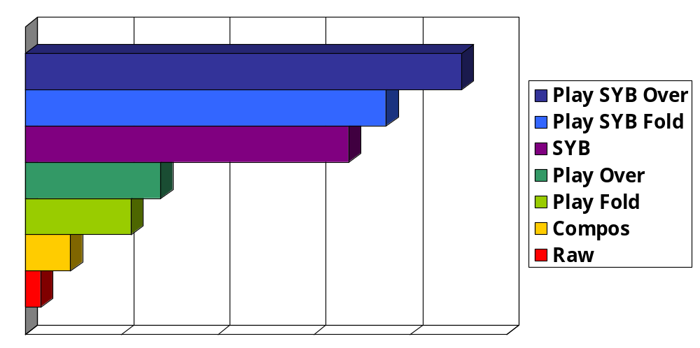
Runtime cost - queries

Slide 42
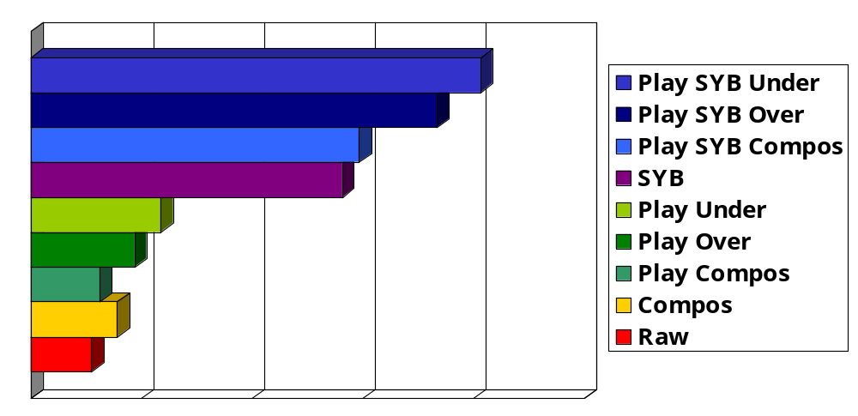
Runtime cost - traversals

Slide 43
In the real world?
Used in Catch about 100 times
Used in Yhc.Core library
Used by other people
  Yhc Javascript converter
  Settings file converter

Slide 44
Conclusions
Generic operations with simple types
Only 1 simple primitive
If you only remember two operations:
  allOver – queries
  mapUnder – traversals

