Slide 1

Agent-Based Model
Simulation outputs
Infected workers
Meat processing plant
Input data and assumptions
literature review
experiments
Module
Surfaces
transfer
Module
Food
Food contamination
projection
Perform simulations
Characteristics of SARS-CoV-2
sedimentation
projection
sedimentation
persistence, attack rates, variants of concerns…
Surfaces contamination
Module
Air
exhalation
Module
Workers
inhalation
Compare collected and simulated data
Scenario
Industrial investigations
Determine scenarios
to simulate
Extrinsic conditions
Behaviours
Epidemiological investigations
dimensions, ventilation, temperature, humidity…
mask wearing,…
Notes:
NDL – opérateurs
SD – aérosol

Slide 2
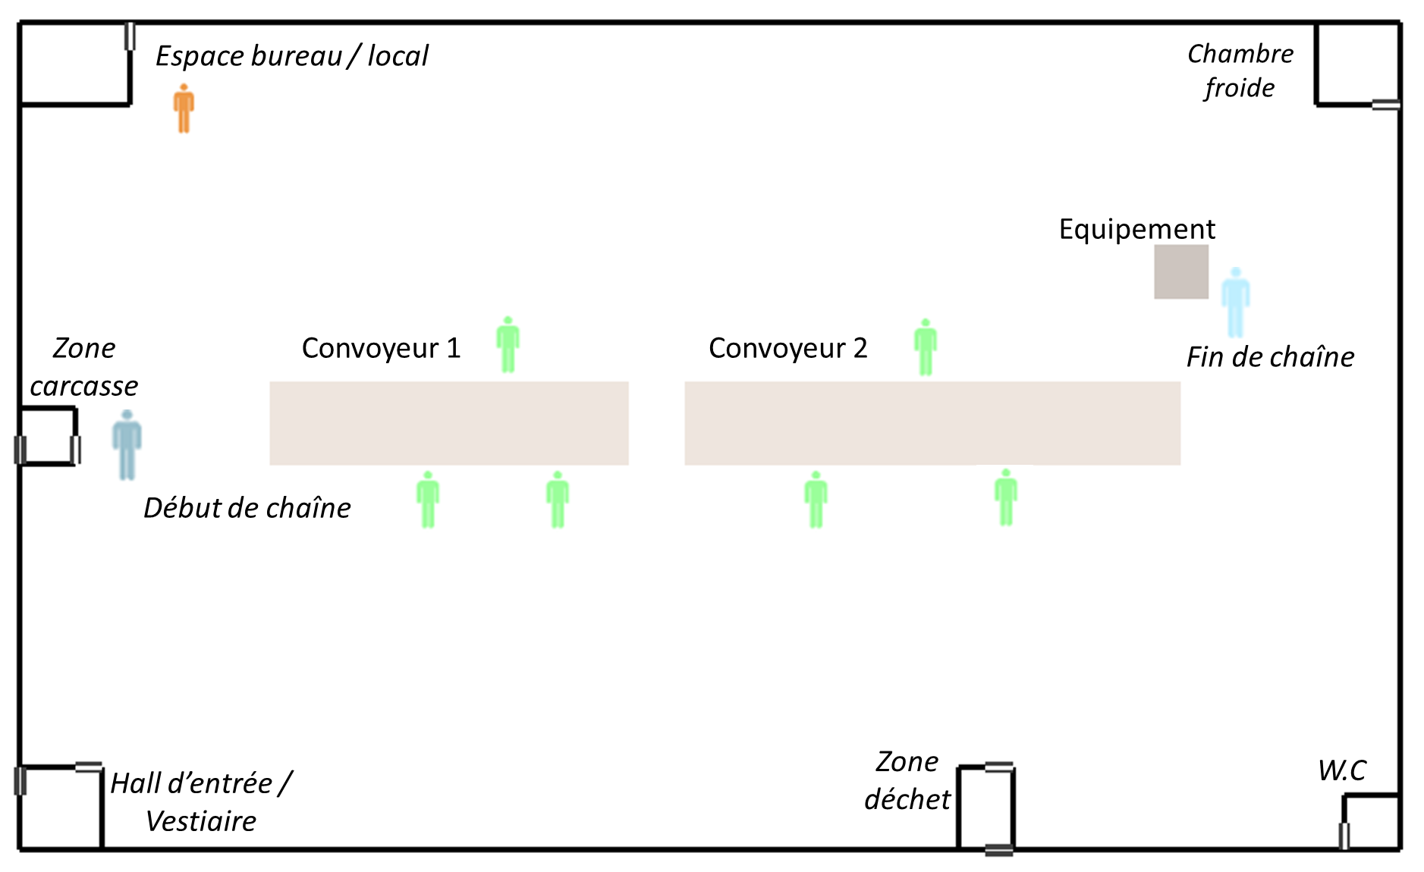
Module Opérateurs
Sources de contamination
Contamination en dehors de l’atelier
Transmission
au sein de l’atelier ?
situation épidémique régionale
Activités
en communauté

Slide 3
Air in the room
Air conditionner
aerosolized droplets
(with/without infectious virions)
Air flow rate
mask
% air renewal
different droplet size classes
mask
sedimentation
direct fall of
high-diameter droplets
Susceptible worker(s)
Infectious workers
Total number of droplets
inhaled by each worker
(end of the day)
Individual variability:
mask wearing, respiratory activities, symptoms development, …
Notes:
Port du masque (préférence / efficacité)
Paramètres associés à différentes actions des opérateurs : taux de respiration, concentration de gouttelettes émises en fonctions de l’activité → détail par SD

Slide 4
Air conditioning system
Air in the room
aerosolized droplets
(with/without infectious virions)
Batterie
froide
Air flow
droplets projections
coughing, sneezing, talking, etc.
mask
Air renewal
mask
sedimentation of droplets on inert surfaces and food
direct fall of
high-diameter droplets
Susceptible worker(s)
Infectious workers
Individual variability: mask wearing, respiratory activities, symptoms development, emitted viral quantity, etc.
Worker contamination
transfer from inert surfaces to food portions
Food contamination
Surfaces contamination
Notes:
Sédimentation sur surfaces/viandes
Transferts

