Slide 1

Simulation outputs
Model outline
Agent-Based Model
Infected workers
Meat processing plant
Input data and assumptions
literature review
experiments
Module
Workers
exhalation
Module
Air
Food contamination
inhalation
Characteristics of SARS-CoV-2
contamination
sedimentation
Simulations
variants of concerns,
attack rates…
Surfaces contamination
Module
Surfaces
transfers
Module
Food
Comparison for model validation perspectives
Scenario
Industrial & Epidemiological investigations
Extrinsic parameters
Behaviours
Epidemiological data
dimensions, ventilation, temperature, humidity…
mask wearing,
community activities…
Notes:
1 minutes

Slide 2
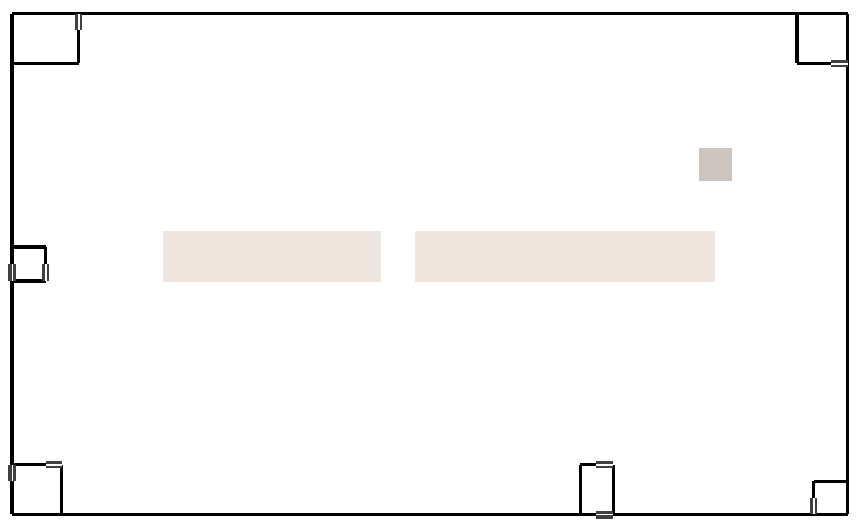


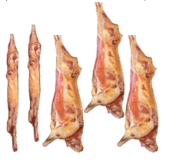



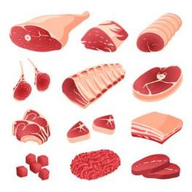

Modelling the meat processing plant
Office
Cutting room
Cooling area
Transverse
(manager, administrative…)
Equipment
(packaging)
Logistic
Arrival gate
Conveyor
Conveyor
Cutters
Cutters
Logistic
Entry hall
Transverse
(cleaning team)
W.C.
Waste area
Notes:
1min30

Slide 3
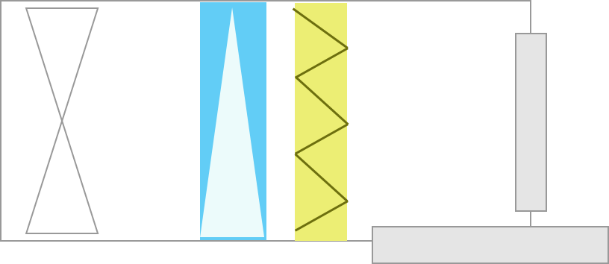

Transmission of SARS-CoV-2 between different agents
Air in the room
Ventilation system
aerosolized droplets
(with/without infectious virions –
Several size classes)
Air flow
Air renewal
droplets projections
coughing,
sneezing,
talking…
Workers contamination
epidemic situation prevalence
mask ?
inhaled doses ?
sedimentation of droplets on inert surfaces and food
other contamination
sources
(“outside”)
direct fall of
high-diameter droplets
contamination
inside the plant
air
Infectious workers
Duration (days)
between infection states
transfers between
inert surfaces and food portions
community activities
co-living, …
newly
infected
infectious
symptomatic
asymptomatic
non
infectious
recovered
Contamination of surfaces and meat cuts
Notes:
1min30

Slide 4
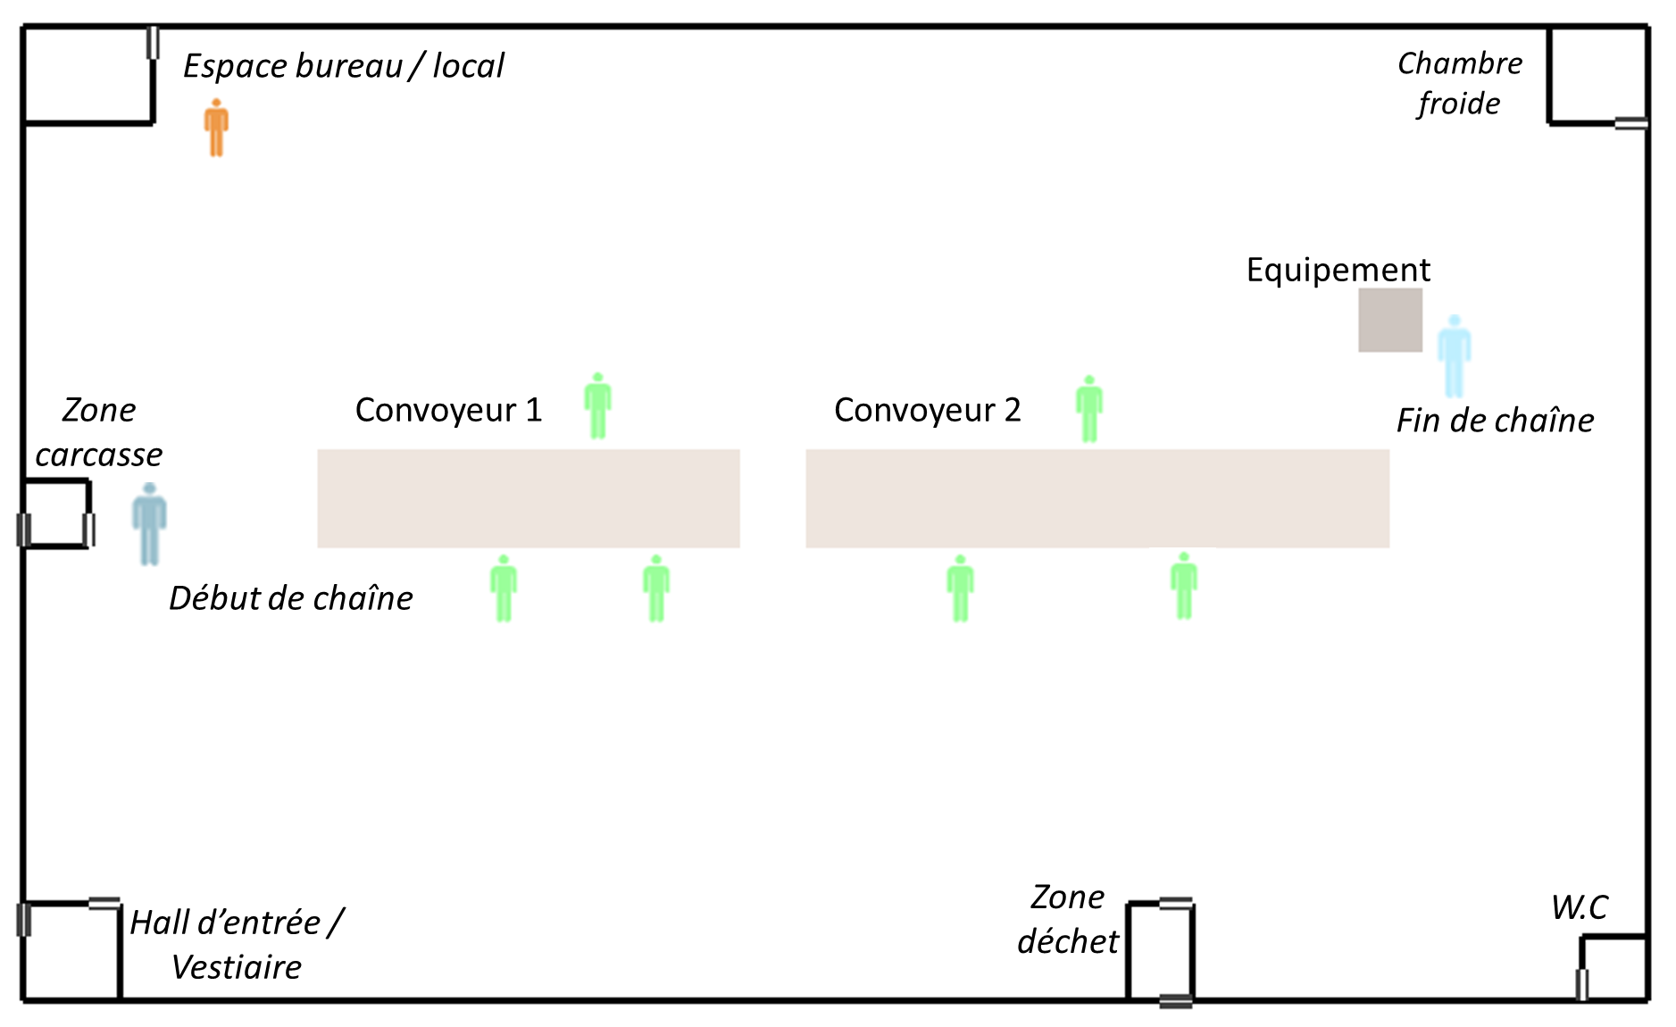
Module Opérateurs
Sources de contamination
Contamination en dehors de l’atelier
Transmission
au sein de l’atelier ?
situation épidémique régionale
Activités
en communauté

Slide 5
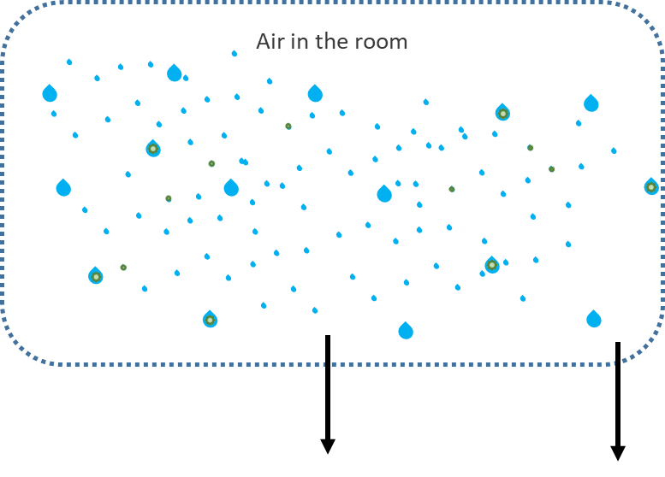
(i) aerosolization
and sedimentation
(iii) distribution of the droplets
falling directly onto
nearby environments
(ii) distribution of the droplets projected to nearby workers
0.015
0.015
cough
sneeze
0.015
0.015
0.045
0.045
0.045
0.015
0.015
0.03
0.03
0.03
0.05
0.045
0.11
0.045
0.03
0.05
0.05
0.03
0.11
0.11
0.03
0,05
0.05
0.03
0.015
0.015
0.045
0.11
1
0.01
0.045
0.015
0.015
0.2
0.11
0.11
0.045
0.03
0.05
0.05
0.05
0.03
0.045
0.11
0.015
0.015
0.045
0.045
0.015
0.03
0.03
0.03
0.015
0.045
0.015
0.015

Slide 6
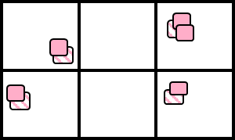

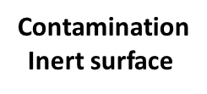

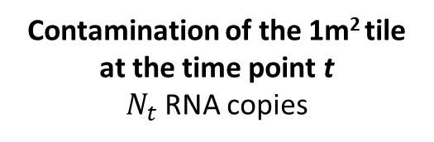


Contamination of the 1m² tile at the time point t
$N_{t}$RNA copies
Additional contamination of the 1m² tile
at the time point t + 1
Sedimentation
Projection
Sedimentation
Projection
Contamination
Inert surface
Balance of the contaminated
inert surfaces
$${prop}_{inert}∗N_{t}$$
Transfer
Surfaces → Food
t+2, t+3, …
Food portions
$${(1−prop}_{inert})∗N_{t}$$
Number of RNA copies :
exceeding a predefined threshold ?
Transfer
Food → Surfaces
equally distributed on
$N_{FP_{expo}}$ random portions
Time t
Time t+1
Transfer
Food → Other surfaces

Slide 7
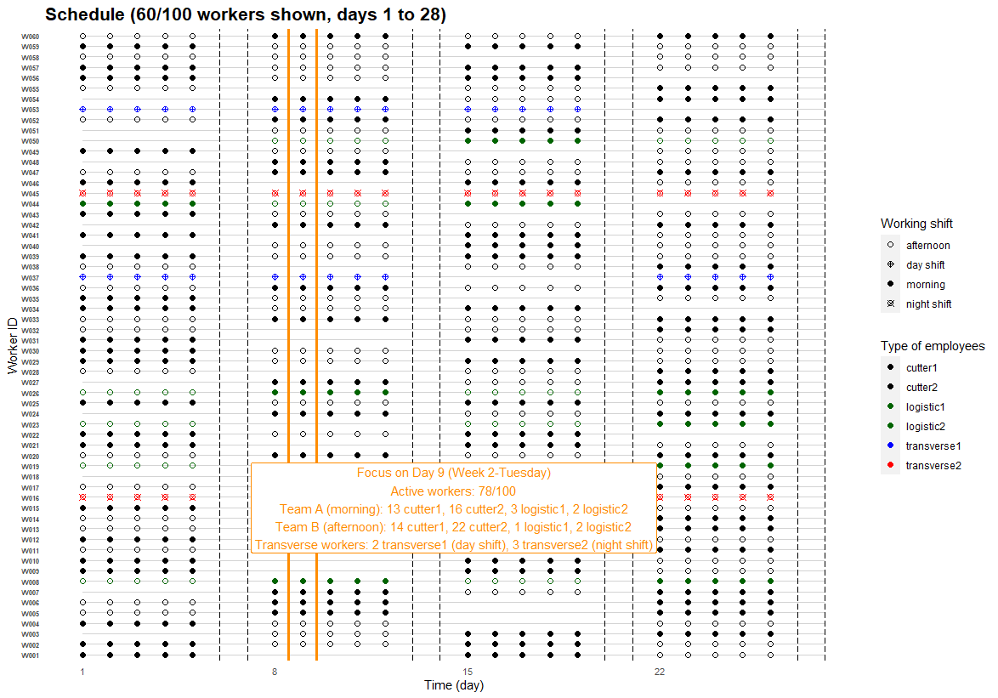

Slide 8
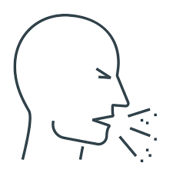

Symptomatic
Susceptible
Infected
Infectious
Pre-symptomatic
Time (day)
p(absent)
cutter→ logistic
Notes:
If an infectious worker develops symptoms :
→ probability to be absent at work;
pre-defined absence duration depending on the pandemic period
If there are missing for one or several types of workers (ex. logistic, …) at a given day:
Possible switches between from one team to another
To maintain activities of the plant (at least 1 worker for each type/team)

Slide 9


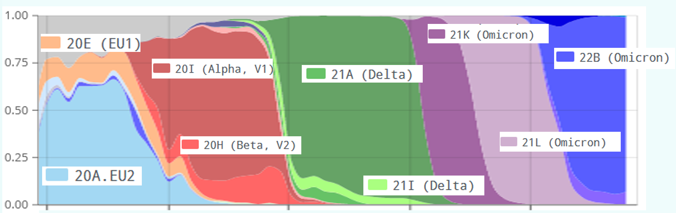


Sorties du modèles
Modèle Multi-agent
Entrées du modèle: données et hypothèses
Revue de la littérature
Expérimentations
Contamination des opérateurs
Ateliers
Module
Opérateurs
exhalation
Module
Air
Contamination des aliments
inhalation
Caractéristiques du SARS-CoV-2
contamination
sédimentation
Simulations
Variants, taux d’attaque, etc.
Contamination des surfaces
Module
Surfaces
transferts
Module
Aliments
Comparaison
Scénario
Facteurs de risques : aenquêtes épidémiologiques et enquêtes industrielles
Comportements et mesures
Paramètres
Données épidémiologiques
dimensions, ventilation, température, humidité…
Notes:
/!\ Dernière étape Comparaison , => challenge de méthode pour « valider » le modèle

