Slide 1
Big data challenges
Nguyen Dang Nhan

Slide 2
Introduction
PhD from Chalmers University of Technology, Sweden
Major: Computer Science
Specialties: Multicore programming, Concurrent Data Structures, Garbage collection, High Performance Computing, Big Data.

Slide 3







What do our customers like?

Slide 4
What do our customers like?
Personalized recommendations
Understand what a user wants: analyze their behaviors
Predict what they are going to watch/ buy/ go/ etc.
Our project: a system that can suggest TV programs suitable to each individual user

Slide 5

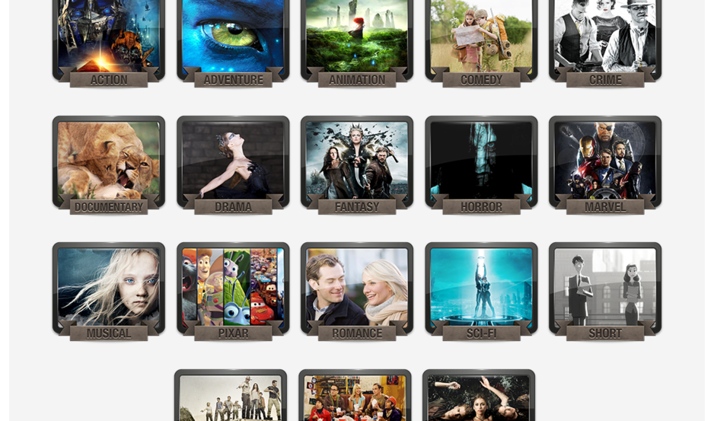

How much data do we analyze?
Large-scale Recommendation System
➔ Big data analytics and machine learning
22M
1M
100M new events/day
20B events

Slide 6
Big data analytics
Big data Infrastructures
Cloud computing (AWS, Cloudera)
Hadoop MapReduce Framework
HDFS, HBase
Big data analytics tools
R/RevoR for data analytics
Machine learning algorithms
Large-scale computing (Java MapReduce, Hadoop EcoSystems)
Two sub-projects
My role: research, data analytics, design solutions.

Slide 7
Problem #1: Too many users
Millions of users:
Not every of them are different
Many users share the same taste of TV viewing
Recommendation for individual vs for group of users
Group users with same taste together
Clustering algorithms
Recommending for a cluster, instead of recommending for every individual
Pros and Cons
Efficient recommendation, save resources
Tradeoff: efficiency vs accuracy

Slide 8
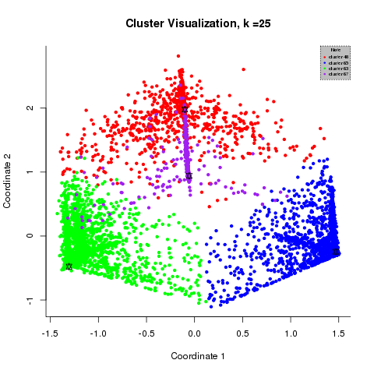
Clusters of users

Slide 9
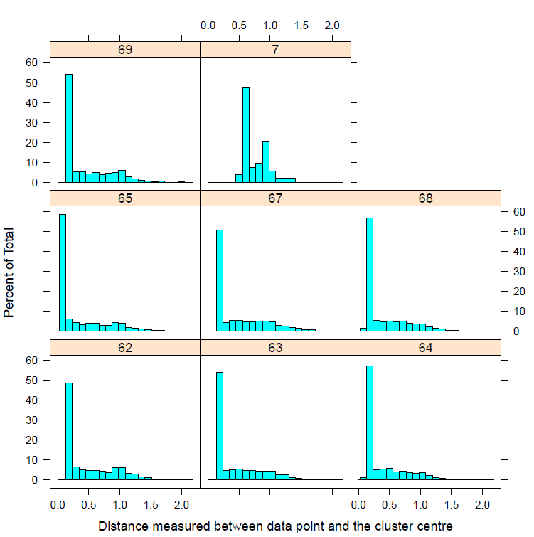
Distant to cluster centers

Slide 10
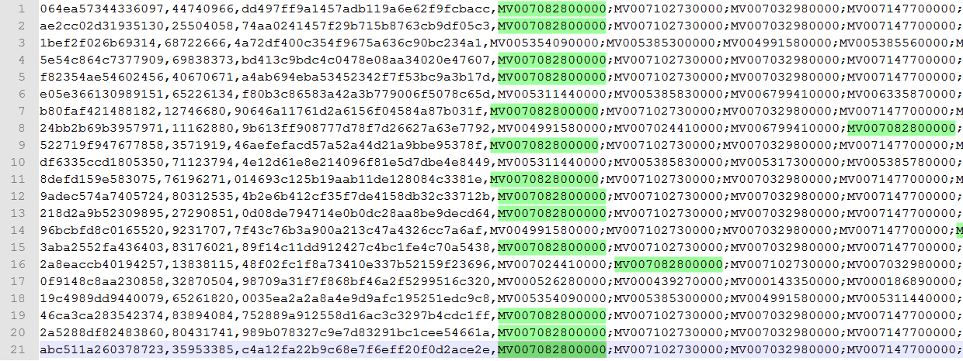
Recommendation quality
a cluster vs each user

Slide 11
Problem #2: Finding similar movies
Customers watch Titanic
➔ Recommend them similar movies
Content-based approach
Similar movies ⬄ similar contents
Content: Titles, directors, actors, genres, plot summary, etc.
Data: 1M programs
Algorithm challenges
Collaborative-based approach
Every user watches A also watches B ⬄ A similar to B
If another user watches A, he might also like B.
Data: 1M programs x 22M users
➔ Big data processing challenges!

Slide 12
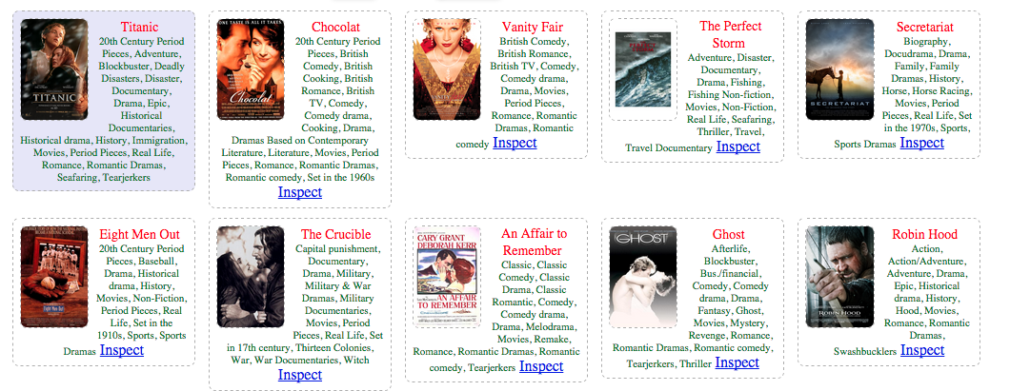
Content-based results

Slide 13
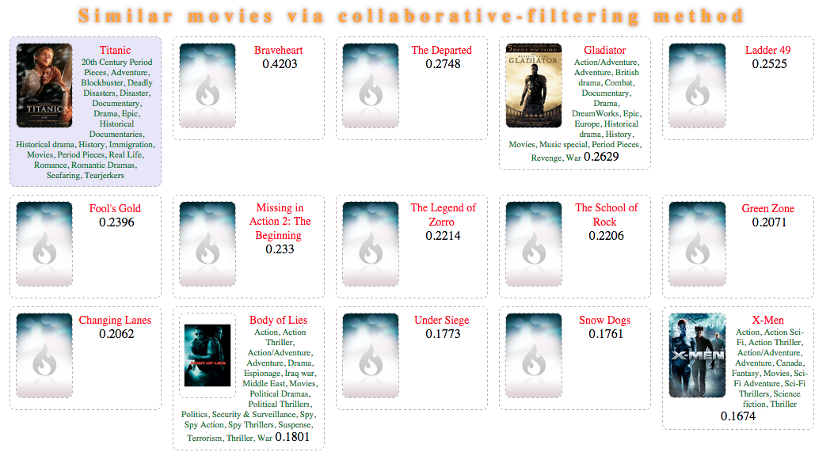








Collaborative-based results

Slide 14
Conclusions
Big data project
Big data technologies powered with machine learning algorithms to analyze user behaviors to personalize the recommendation of entertainment contents to customer.
Challenges:
Huge amount of data
Large-scale, distributed computing
Designing solutions, algorithms and analytics for 2 sub-projects
Clustering: computation efficiency
Movie similarity: recommendation quality
Questions?

Slide 15
Thank you!

