Slide 1
Basic java web application
Thanh cong tran
Kms technology
2015 Aug 11

Slide 2
Agenda
Architecture of Java Web Application
Java Servlet Technology

Slide 3
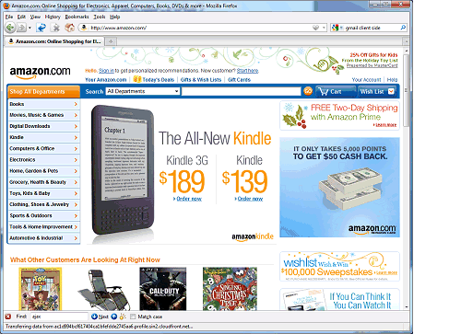



High-Level Architecture of a Web Application
Internet
Web server
Client (web browser)
User

Slide 4
Static Web Pages

Slide 5
HTTP Request and Response
A client sends an HTTP request to a server which contains the URL of a resource
A request also includes:
The type of user agent (the client browser and its version)
The types of resources that will be accepted (text, image, etc.)
The server responds with an HTTP response
Status line – HTTP version, status code and message
Header lines – information about the resource
Message body – contains the requested object

Slide 6
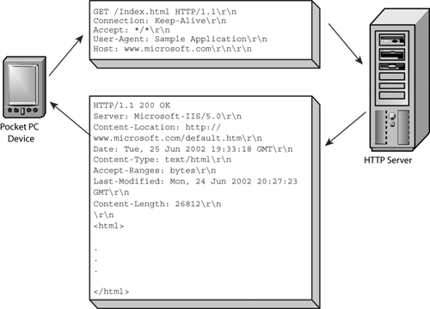
HTTP Request and Response

Slide 7
Dynamic Web Pages
The web application dynamically generates the HTML for a web page that contains elements based on the request parameters.

Slide 8
Architecture of a Java Web Application
Microsoft Explorer
Firefox
Google Chrome
Apple Safari
Where does the
web application live?
Tomcat
MySQL Relational
Database Manager

Slide 9
Technologies and Tools
JavaServer Pages (JSP)
Generate dynamic web pages
Java servlets and JavaBeans
Server-side web application logic
SQL and JDBC programming
Tomcat
Web server and JSP/servlet engine
Eclipse
Integrated development environment (IDE)

Slide 10
Java Servlet Technology
A servlet class extends the capabilities of servers that host the applications accessed by the way of request-response programming model.
JSP allows you to integrate the combined snippets of Java code with static markup in a text-based document.
JSTL provides a set of standard tags that can be used in a JSP page

Slide 11
A simple Servlet
package testPackage;
import java.io.*;
import javax.servlet.*;
import javax.servlet.annotation.*;
import javax.servlet.http.*;
@WebServlet("/hello")
public class HelloWorld extends HttpServlet {
@Override
public void doGet(HttpServletRequest request,
HttpServletResponse response)
throws ServletException, IOException {
response.setContentType("text/html");
PrintWriter out = response.getWriter();
out.println("<html><head><title>Hello</title></head>");
out.println("<body>Hello World</body></html>");
}
}

Slide 12
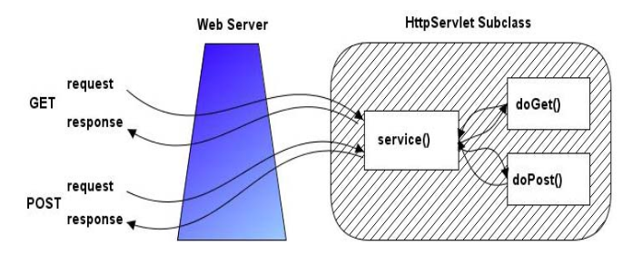
Servlet Methods

Slide 13
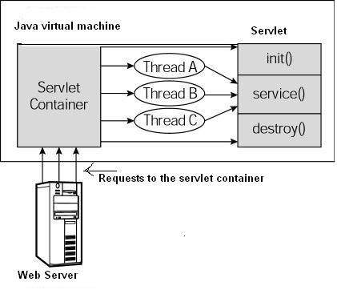
Servlet life cycle

Slide 14
Reading Form Data In Servlets
request.getParameter("name")
Returns URL-decoded value of first occurrence of name in query string
request.getParameterValues("name")
Returns an array of the URL-decoded values of all occurrences of name in query string
request.getParameterNames() or request.getParameterMap()
Returns Enumeration or Map of request params

Slide 15
filter
@WebFilter(urlPatterns = "/forbidden")
public class TestFilter implements Filter {
@Override
public void doFilter(ServletRequest req, ServletResponse res, FilterChain chain) throws IOException, ServletException {
boolean ok = false;
if (ok) {
chain.doFilter(req, res);
} else {
PrintWriter out = res.getWriter();
out.println(Constants.HTML_START + "<h2>Rejected !!!" + Constants.HTML_END);
}
}
}

Slide 16
listener
Servlet context listeners
These listeners are notified when the servlet context (i.e., the Web application) is initialized and destroyed.
Servlet context attribute listeners.
These listeners are notified when attributes are added to, removed from, or replaced in the servlet context.
Session listeners.
These listeners are notified when session objects are created, invalidated, or timed out.
Session attribute listeners.
These listeners are notified when attributes are added to These listeners are notified when attributes are added to, removed from, or replaced in any session.

Slide 17
listener
@WebListener
public class MyServletListener implements ServletContextListener {
@Override
public void contextDestroyed(ServletContextEvent evnt) {
// TODO Clean up/release any resource if needed.
}
@Override
public void contextInitialized(ServletContextEvent evnt) {
// TODO setup application-wide resource: database connection pool
// TODO Read the initial values of application-wide data that will be
// used by multiple servlets and JSP pages.
System.out.println(evnt.getServletContext().getInitParameter("jdbc.host"));
System.out.println(evnt.getServletContext().getInitParameter("jdbc.port"));
}
}

Slide 18
The Need for JSP
With servlets, it is easy to
Read form data
Read HTTP request headers
Set HTTP status codes and response headers
Use cookies and session tracking
Share data among servlets
Remember data between requests
But, it sure is a pain to
Use those println statements to generate HTML
Maintain that HTML

Slide 19
Benefits of JSP
Separate the (Java) code that creates the content from the (HTML) code that presents it
It is the servlets that run at request time
JSP technically can’t do anything servlets can’t do
You still need to understand servlets
Understanding how JSP really works
Servlet code called from JSP
Knowing when servlets are better than JSP
Mixing servlets and JSP

Slide 20
Basic Elements in a JSP File
HTML code: <html-tag>content</html-tag>
JSP Comments: <%-- comment --%>
Expressions: <%= expression %>
Scriptlets (statements): <% code %>
Declarations: <%! code %>
Directives: <%@ directive attribute="value" %>
Actions: <jsp:forward.../>, <jsp:include.../>
Expression-Language Expressions: ${expression}

Slide 21
JSP Expressions
A JSP expression is being used to insert Java values directly into the output
It has the form: <%= expression %> , where expression can be a Java object, a numerical expression, a method call that returns a value, etc...
For example:
<%= new java.util.Date() %>
<%= "Hello"+" World" %>
<%= (int)(100*Math.random()) %>

Slide 22
The JSTL Expression Language
Accessed via ${expression}
Looping Tags
Conditional Evaluation Tags
<c:forEach var="name" begin="x" end="y" step="z">
Blah, blah ${name}
</c:forEach>
<c:forEach var="name" items="array-or-collection">
Blah, blah ${name}
</c:forEach>
<c:choose>
<c:when test="test1">Content1</c:when>
...
<c:otherwise>Default Content</c:otherwise>
</c:choose>

Slide 23
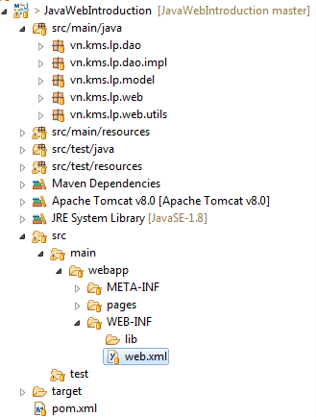
Java web project structure

Slide 24
What Are Beans?
Java classes that follow certain conventions
Must have a zero-argument (empty) constructor
Should have no public instance variables (fields)
Persistent values should be accessed through methods called getXxx and setXxx
public class StringBean {
private String message = "No message specified";
public String getMessage() {
return(message);
}
public void setMessage(String message) {
this.message = message;
}
}

Slide 25
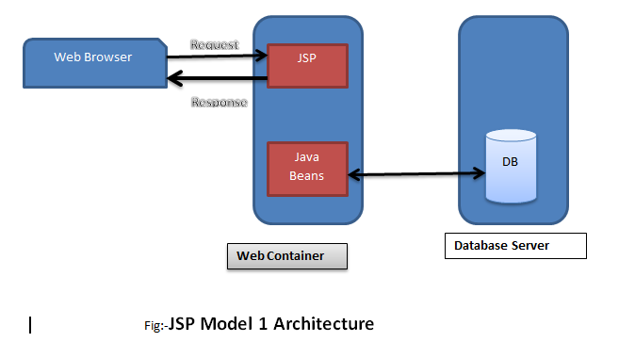
Jsp model 1 architecture

Slide 26
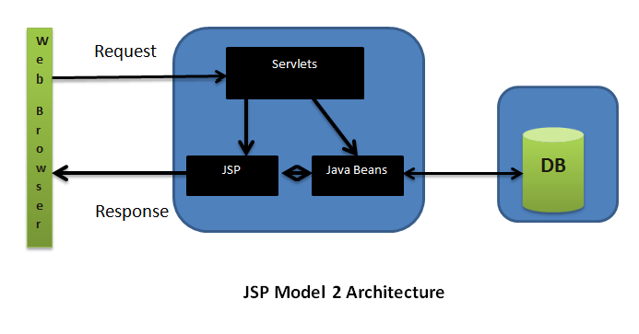
Jsp model 2 architecture

Slide 27
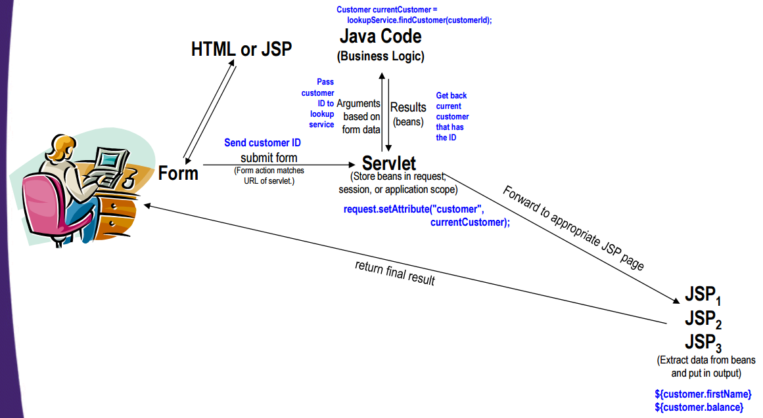
MVC Flow of Control

Slide 28
Implementing MVC
Define beans to represent result data
Use a servlet to handle requests
Obtain bean instances
Store the bean in the request, session, or servlet context
Forward the request to a JSP page
Extract the data from the beans

Slide 29
Request Forwarding Example
public void doGet(HttpServletRequest request,
HttpServletResponse response)
throws ServletException, IOException {
... // Do business logic and get data
String operation = request.getParameter("operation");
if (operation == null) {
operation = "unknown";
}
String address;
if (operation.equals("order")) {
address = "/WEB-INF/Order.jsp";
} else if (operation.equals("cancel")) {
address = "/WEB-INF/Cancel.jsp";
} else {
address = "/WEB-INF/UnknownOperation.jsp";
}
RequestDispatcher dispatcher = request.getRequestDispatcher(address);
dispatcher.forward(request, response);
}

Slide 30
Access to Databases
... web browsers ...
Internet
Web Application Sever
Database

Slide 31
JDBC Introduction
The Java DataBase Connectivity provides a standard library for accessing relational databases.
JDBC API can be used with
Enterprise java beans,
JSP,
Servlets, and
Java classes

Slide 32
Basic Steps in Using JDBC
Define the Connection URL
Establish the Connection
Create a Statement object
Execute a query
Process the results
Close the connection
String mySqlUrl = "jdbc:<vendorName>//<host>:<port>/<dbName>";
Properties userInfo = new Properties();
userInfo.put("user", "username");
userInfo.put("password", "secret");
Connection connection = DriverManager.getConnection(mySqlUrl, userInfo);
connection.close();

Slide 33
Make a Statement
A Statement is used to send queries or commands
Statement
PreparedStatement
CallableStatement
Statement statement = connection.createStatement();

Slide 34
Execute a Query
statement.executeQuery
This version returns a ResultSet
statement.executeUpdate
statement.execute
String query = "SELECT col1, col2, col3 FROM sometable";
ResultSet resultSet = statement.executeQuery(query);

Slide 35
Process the result
Important ResultSet methods
resultSet.next()
Goes to the next row. Returns false if no next row.
resultSet.getString("columnName")
Returns value of column with designated name in current row, as a String. Also getInt, getDouble, getBlob, etc.
resultSet.getString(columnIndex)
Returns value of designated column. First index is 1
while(resultSet.next()) {
System.out.println(resultSet.getString("address"));
}

Slide 36
Using Prepared Statements
Make a placeholder
Substitute in values
Execute command
String template = "INSERT INTO someTable VALUES(?, ?)";
PreparedStatement inserter = connection.prepareStatement(template);
inserter.setInt(1, someInt);
inserter.setString(2, someString);
inserter.executeUpdate();

Slide 37
Transactions
By default, after each SQL statement is executed the changes are automatically committed to the database
Turn auto-commit off to group two or more statements together into a transaction
Call commit to permanently record the changes to the database after executing a group of statements
Call rollback if an error occurs
connection.setAutoCommit(false);
connection.commit();
connection.rollback();

Slide 38
Transactions: Example
Connection connection = DriverManager.getConnection(url, userProperties);
connection.setAutoCommit(false);
try {
statement.executeUpdate(...);
statement.executeUpdate(...);
...
connection.commit();
} catch (Exception e) {
try {
connection.rollback();
} catch (SQLException sqle) {
// report problem
}
} finally {
try {
connection.close();
} catch (SQLException sqle) { }
}

Slide 39


Persistence framework - jpa

Slide 40



Web framework

Slide 41



Application framework

