Slide 1
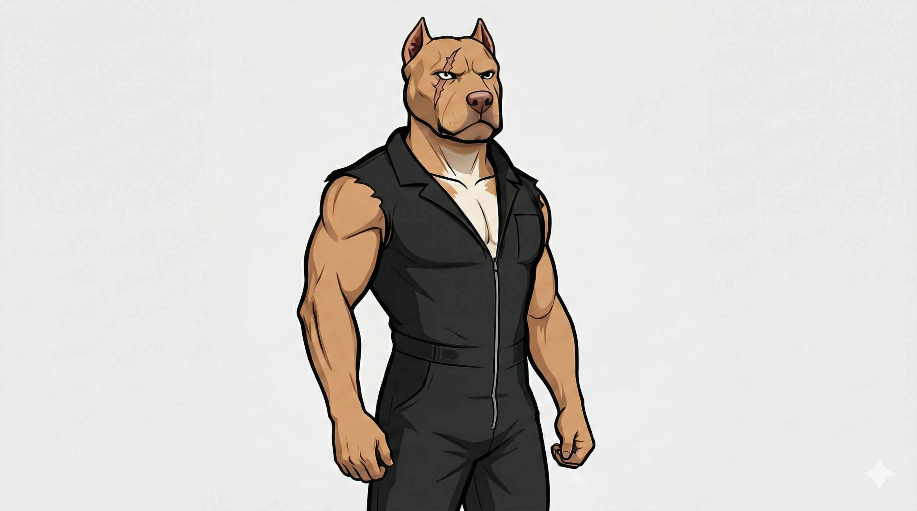
BOWTIE BULLIES
— THE AFTERMATH
We're already in the aftermath. Pay attention.

