Slide 1


LeafAI: a user-friendly, explainable query generation application for cohort discovery and biomedical reasoning using natural language
Nic Dobbins
UW Biomedical Natural Language Processing Group
UW Medicine Research IT Department of Biomedical Informatics & Medical Education
University of Washington, Seattle, WA
November 14th, 2022

Slide 2
Outline
Introduction
Related Works
Task Innovation
Specific Aims
Conclusion

Slide 3

Cohort Discovery
5.5m patients (EHR)
Process of finding (“discovering”) patients meeting certain criteria relevant to a potential study
Often used in prep-to-research, hypothesis generation, power calculations, and clinical trial recruitment
Can be done by manual chart review, electronic case report forms (eCRF), or queries of clinical databases
Over 65
Hypoglycemic
Left-handed
1,422 patients

Slide 4
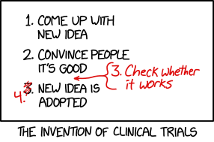
Randomized Controlled Trials
Prospective study designed to determine whether an intervention (drug, device, etc.) is safe and effective
“Randomized” if participants randomly assigned to different groups
“Controlled” if includes a control group which does not receive intervention in question
“Blinded” if participants do not know which group they are in (and “double-” if investigators do not either)
I will refer to interchangeably with “clinical trials”, though not technically synonymous
https://xkcd.com/2530

Slide 5
Clinical Trials
Conducted in “phases” which build upon one another.
Phase 0: Explore if new treatment will work. very small, not widely used; very small doses given.
Phase I: Is treatment safe? Find highest dose that can be given safely, look for side effects.
Phase II: Does treatment work? Participants typically receive same dose, no placebos used.
Phase III: Treatment better than alternatives? Larger number of patients, longer duration, often randomized & blinded, typically include controls.
Phase IV: What else need to know? Even longer duration (e.g., years), more participants, study long-term effects, cost effectiveness, etc.
Sources:
-Mahan, Vicki L. "Clinical trial phases." International Journal of Clinical Medicine 5.21 (2014): 1374.
-https://www.cancer.org/treatment/treatments-and-side-effects/clinical-trials/what-you-need-to-know/phases-of-clinical-trials.html

Slide 6
Clinical Trials - challenges
Tend to be expensive in the United States – between 2004 & 2016, the mean costs of a Phase I: $3.8m, Phase II: $13.3m, Phase III: $19.8m.
Finding and maintaining eligible, representative patients often time-consuming and costly.
Eligibility criteria – inclusion and exclusion requirements of eligible patients – often complex; some argue overly restrictive.
Patients recruited tend to be whiter and more affluent than populations at large.
Sources:
-Sertkaya, Aylin, et al. "Key cost drivers of pharmaceutical clinical trials in the United States." Clinical Trials 13.2 (2016): 117-126.
-G. Frank. Current challenges in clinical trial patient recruitment and enrollment. SoCRA Source, 2(February):30–38, 2004.
-C. Heller, J. E. Balls-Berry, J. D. Nery, P. J. Erwin, D. Littleton, M. Kim, and W. P. Kuo. Strategies addressing barriers to clinical trial enrollment of underrepresented populations: a systematic review. Contemporary clinical trials, 39(2):169–182, 2014.

Slide 7
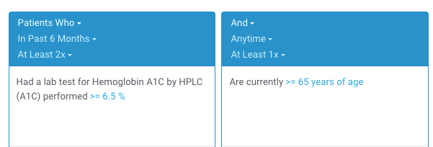
Clinical Trials Recruitment and (Cohort Discovery) Software
Computer software cannot solve all challenges related to clinical trials.
However, can (sometimes) significantly reduce manual workloads and save time and costs in study recruitment.
Existing tools can be used by manually translating free-text eligibility criteria into database queries.
“- At least 2 A1c tests > 6.5%
- 65+ y/o”
2,273 patients found
Example Leaf query.
Sources:
-Johnson, Emilie K., et al. "Use of the i2b2 research query tool to conduct a matched case–control clinical research study: advantages, disadvantages and methodological considerations." BMC medical research methodology 14.1 (2014): -L. Penberthy, R. Brown, F. Puma, and B. Dahman. Automated matching software for clinical trials eligibility: measuring efficiency and flexibility. Contemporary clinical trials, 31(3):207–217, 2010.
-S. R. Thadani, C. Weng, J. T. Bigger, J. F. Ennever, and D. Wajngurt. Electronic screening improves efficiency in clinical trial recruitment. Journal of the American Medical Informatics Association, 16(6):869–873, 2009.

Slide 8
Clinical Trials Recruitment and (Cohort Discovery) Software
Existing drag-and-drop cohort discovery tools are not a panacea:
Often have significant learning curves.
May visually represent biomedical data discordant with users “mental maps” of how data are collected or stored.
May be structurally unable to represent certain complex criteria or sequences of events.

Slide 9

Clinical Trials Recruitment and Natural Language Processing (NLP)
Alternatively, using NLP to automatically analyze free-text eligibility criteria and find patients has appeal.
Researchers are accustomed to writing criteria using natural language.
No (or less) need to learn special tools.
“- At least 2 A1c tests > 6.5%
- 65+ y/o”
2,273 patients found

Slide 10
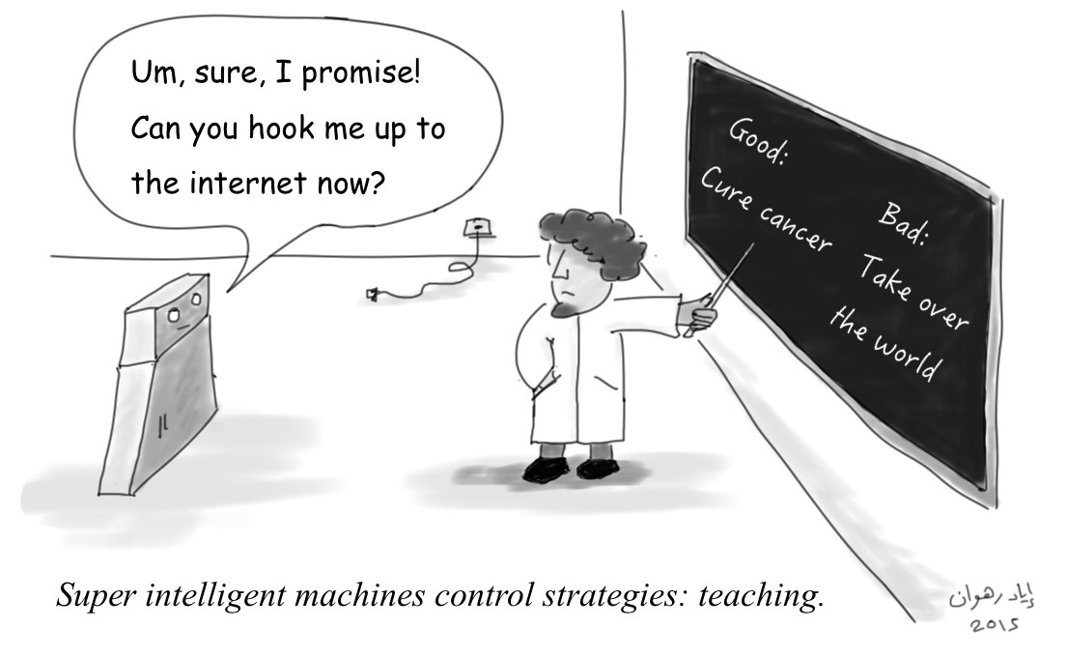
Project Goals
Create a human-annotated gold standard corpus of eligibility criteria.
Develop state-of-the-art NLP-based methods for generating SQL queries for cohort discovery from free-text.
Develop a web application for finding patients meeting user-provided free-text eligibility criteria.

Slide 11
Challenges
What kind of surgery?
How recent is “newly”?
1. Newly diagnosed with breast cancer and scheduled for surgery
2. 18 years or above
3. Those who experience high psychological stress will enter the RCT whereas those with low stress will be followed in an observational questionnaire study
4. No severe psychiatric disease requiring treatment, e.g., schizophrenia
What is 18 years or above?
Statement of fact, not a criterion
What could these be?
Many of these relate to reasoning. Also: acronyms, misspellings, etc.
Adapted from trial NCT03254875 at https://clinicaltrials.gov/ct2/show/NCT03254875

Slide 12
Broader Impact
Methods for finding cohorts may also be expanded to general purpose question-answering.
Cohort discovery using NLP may be useful for other kinds of biomedical research unrelated to clinical trials.
Evaluating system performance by comparing patients found to those actually enrolled in trials (Aim 2, discussed shortly) is a novel, high standard for this task

Slide 13
Related Work
Corpora of eligibility criteria
Methods for cohort discovery from free-text criteria
NLP-based software for cohort discovery

Slide 14
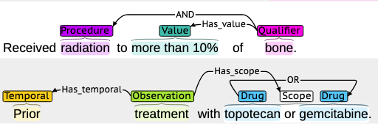
Corpora of Eligibility Criteria
EliXR by Weng et al. – 1,000 annotated eligibility criteria documents from various disease domains, custom schema. Not publicly available.
EliIE by Kang et al. – 230 annotated eligibility criteria related to Alzheimer's Disease, based on the OMOP (Observational Medical Outcomes Partnership) schema.
Chia by Kury et al. – 1,000 annotated eligibility criteria from various disease domains, based on OMOP schema.
Example Chia annotation.
Sources:
-C. Weng, X. Wu, Z. Luo, M. R. Boland, D. Theodoratos, and S. B. Johnson. EliXR: an approach to eligibility criteria extraction and representation. Journal of the American Medical Informatics Association, 18. Dec 2011. -T. Kang, S. Zhang, Y. Tang, G. W. Hruby, A. Rusanov, N. Elhadad, and C. Weng. EliIE: An open-source information extraction system for clinical trial eligibility criteria. JAMIA, 24(6):1062–1071, 2017. -F. Kury, A. Butler, C. Yuan, L.-h. Fu, Y. Sun, H. Liu, I. Sim, S. Carini, and C. Weng. Chia, a large annotated corpus of clinical trial eligibility criteria. Scientific data, 7(1):1–11, 2020.

Slide 15
Methods for generating SQL queries from free-text criteria
Database query generation
Document ranking and classification
Embeddings and similarity measurement
Logical representations and ontologies
A combination of the above

Slide 16
Database Query Generation
Extensive recent work on direct text-to-SQL generation using Encoder-Decoder Transformer architectures. This task is called a Sequence to Sequence or “Seq2Seq” problem.
Has been used in the biomedical domain for question-answering on electronic health record data most notably by Bae et al., Wang et al. and Pan et al.
Yu et al. used templated eligibility criteria to generate SQL queries for hypothetical database schema.
SELECT patient_id
FROM labs
WHERE lab_type = ‘a1c’ AND value > 6.5
“- A1c test > 6.5%”
Sources:
-S. Bae, D. Kim, J. Kim, and E. Choi. Question Answering for Complex Electronic Health Records Database using Unified Encoder-Decoder Architecture. In Machine Learning for Health, pages 13–25. PMLR, 2021.
-P. Wang, T. Shi, and C. K. Reddy. Text-to-SQL generation for question answering on electronic medical records. In Proceedings of The Web Conference 2020, pages 350–361, 2020. -Y. Pan, C. Wang, B. Hu, Y. Xiang, X. Wang, Q. Chen, J. Chen, J. Du, et al. A BERT-Based Generation Model to Transform Medical Texts to SQL Queries for Electronic Medical Records: Model Development and Validation. JMIR Medical Informatics, 9(12):e32698, 2021.
-Yu, Xiaojing, et al. "Dataset and enhanced model for eligibility criteria-to-SQL semantic parsing." 12th International Conference on Language Resources and Evaluation (LREC). 2020.

Slide 17
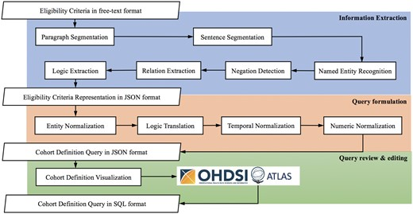
Database Query Generation (cont.)
Hybrid deep learning / rule-based systems also used. Criteria2Query (Yuan et al.) used BERT for negation detection and a Condition Random Field- (CRF) based classifier for Named Entity Recognition (NER).
Output values are analyzed by rules to create logical representations to generate queries for OMOP databases.
Sources:
-C. Yuan, P. B. Ryan, C. Ta, Y. Guo, Z. Li, J. Hardin, R. Makadia, P. Jin, N. Shang, T. Kang, and C. Weng. Criteria2Query: A natural language interface to clinical databases for cohort definition. Journal of the American Medical Informatics Association, 26(4):294–305, 2019.
-Fang, Yilu, et al. "Combining human and machine intelligence for clinical trial eligibility querying." Journal of the American Medical Informatics Association (2022).

Slide 18



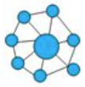
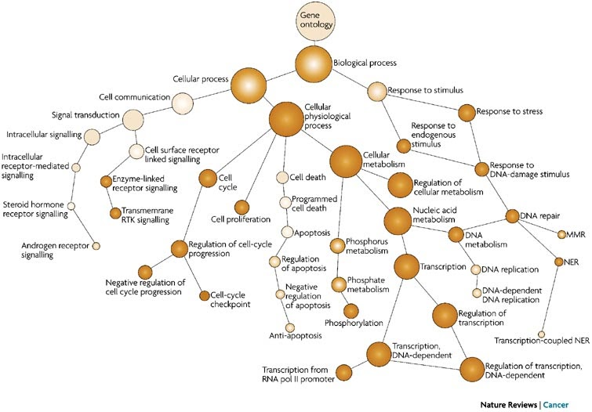
Other notable approaches
Document Ranking and Classification –Clinical notes sorted by most relevant using relatively small corpora of notes (low thousands) with different architectures (Chen et al.: biLSTM+CRF, Soni and Roberts: BERT).
Embeddings and similarity measurement – eligibility criteria and patient medical history represented as vectorized embeddings. Dhayne et al. used cosine similarity and heuristics to determine if patient met criteria; Zhang et al. treated as an entailment problem (ie, patient history entails criteria = { true, false, unknowable })
Logical representations and ontologies – Patrao et al. used pattern matching rules, RDF (Resource Description Framework) graphs and an OWL reasoner to predict eligibility. Others have proposed logical annotation representations for eligibility criteria.
Sources:
-L. Chen, Y. Gu, X. Ji, C. Lou, Z. Sun, H. Li, Y. Gao, and Y. Huang. Clinical trial cohort selection based on multi-level rule-based natural language processing system. JAMIA, 26(11):1218–1226, 2019.
-S. Soni and K. Roberts. Patient cohort retrieval using transformer language models. In AMIA annual symposium proceedings, volume 2020, page 1150. American Medical Informatics Association, 2020.
-H. Dhayne, R. Kilany, R. Haque, and Y. Taher. EMR2vec: Bridging the gap between patient data and clinical trial. Computers & Industrial Engineering, 156:107236, 2021.
-X. Zhang, C. Xiao, L. M. Glass, and J. Sun. DeepEnroll: patient-trial matching with deep embedding and entailment prediction. In Proceedings of The Web Conference 2020, pages 1029–1037, 2020.
-D. F. Patrão, M. Oleynik, F. Massicano, and A. Morassi Sasso. Recruit-An Ontology Based Information Retrieval System for Clinical Trials Recruitment. In MEDINFO 2015: eHealth-enabled Health, pages 534–538. IOS Press, 2015.

Slide 19
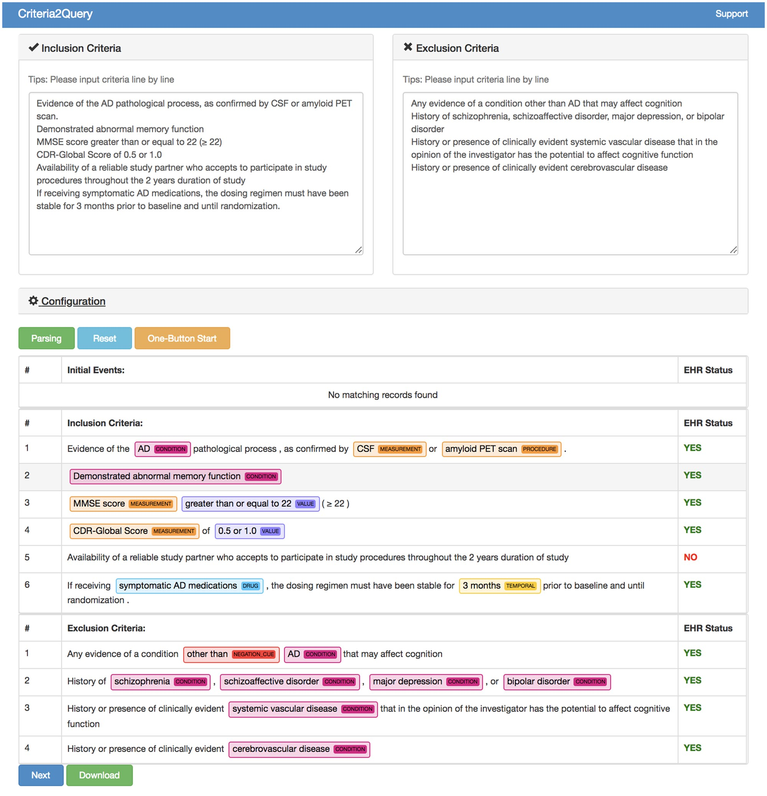
NLP-based software for cohort discovery
Criteria2Query by Yuan et al. most well known and recent.
Expanded by Fang et al. to allow users to edit predicted criteria, normalizations.
Outputs JSON-based logical representation of criteria to ”Atlas” tool, which in turn generates SQL from rules.
Returns a table of patients meeting criteria.
Sources:
-Yuan, Chi, et al. "Criteria2Query: a natural language interface to clinical databases for cohort definition." Journal of the American Medical Informatics Association 26.4 (2019): 294-305.
-Fang, Yilu, et al. "Combining human and machine intelligence for clinical trial eligibility querying." Journal of the American Medical Informatics Association (2022).

Slide 20
Task Innovation
Corpora of eligibility criteria Existing corpora narrowly focused, small in size, or lack sufficient annotation granularity. Our corpus is broad, large, and rich in granularity for generating accurate queries.
Methods for cohort discovery from free-text criteria Text2Sql-generated queries unrealistically simple, only work for single database schema. Performance of hybrid and rule-based systems can be improved upon. Our methods will generalize to virtually any clinical database schema while demonstrating at or near state-of-the art results in matching cohorts of patients from actual clinical trials.
NLP-based software for cohort discovery Existing software is limited and largely experimental, does not save user query history, is not always intuitive or explainable, and works only with a single database schema. Our system will be user-friendly, intuitive, explainable, and database schema-agnostic.

Slide 21
Specific Aims

Slide 22
Aim 1

Slide 23
Aim 2

Slide 24
Aim 2 – Process – Step 4
Predict structured logical form using fine-tuned T5 model, output as a string. Then, parse logical forms and instantiate as in-memory nested object structure.
intersect(
,
union(
,
),
.num_filter(
),
(
(
)
)
)
“-
cond(“Diabetic”)
“-
cond(“Diabetic”)
female()
and
female()
and
age()
male()
age()
eq(op(GT), val(“65”))
male()
eq(op(GT), val(“65”))
()
neg
()
with
neg
()
contraindication
with
()
contraindication
to
to
”
drug(“metformin”)
”
drug(“metformin”)
Logical Form Transformation
T5
Python

Slide 25
Aim 3

Slide 26
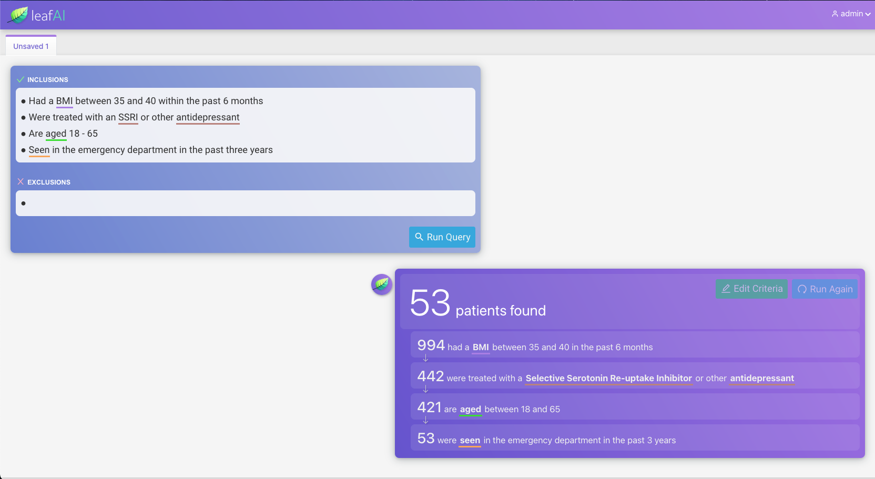

Slide 27
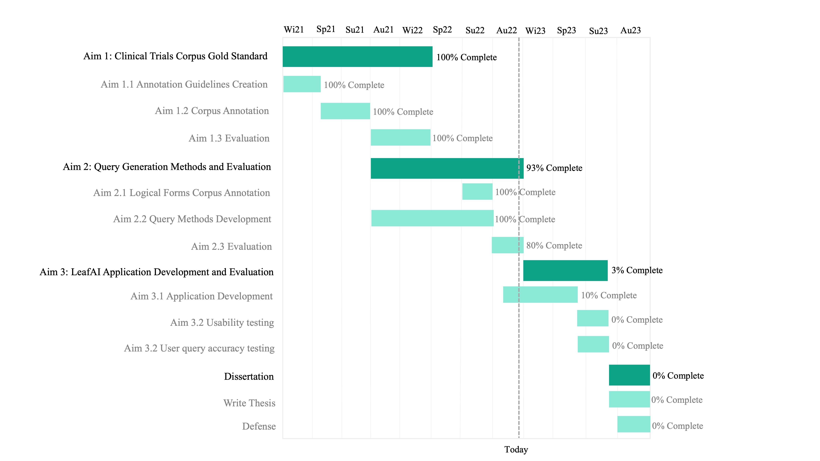
Timeline

Slide 28
Acknowledgements

Slide 29
Questions?

