Slide 1


Knowledge Base
LOINC2HPO
RDF + SPARQL
Disease Ontology
Symptom Ontology
Eligibility Criteria
- Women or men over age 65
UMLS
8
- Diagnosis of heart failure in past 6 months
Potential Drug-Drug Interactions (PDDI)
1
COVID-19 Ontology
Normalization
LeafAI API
MetaMapLite
BERT (Labs)
C#
6
Java
Python
Reasoner
Logical Form Interpreter
7
5
Logical Form Transformation
Clinical Database
SQL Compiler
Semantic Metadata Mapping
9
T5
4
Python
10
SELECT person_id
FROM person
WHERE ...
Named Entity Recognition
Relation Extraction
BERT
3
R-BERT
2
Python
Python

Slide 2
“Diabetics aged over 65 with no contraindications to metformin”
SELECT... FROM condition WHERE dx_code...
INTERSECT SELECT... FROM person WHERE age > 65
INTERSECT SELECT... FROM person WHERE NOT EXISTS
(SELECT... FROM condition WHERE dx_code...
SELECT... FROM medication WHERE med_code...)
Raw input
Link to Semantic Metadata Mapping and generate SQL queries
Numeric-Filter
Condition
Age
Eq-Comparison
Predict named entities and relations
Diabetics
aged
over 65
with
Operator: Greater Value: “65”
intersect(
cond(CUI: C0241863), age()
.num_filter(eq(op(GT), val(65))),
neg(
cond(CUI: C0035078), “Renal Insufficiency” drug(CUI: C3253985) “Dolutegravir”
)
)
Negates
Contraindicates
Negation
Contraindication
Drug
Use Knowledge Base to reason upon unspecified criteria
no
contraindications
to
metformin
Prepare logical form input
“cond(“Diabetics”) age() eq(op(GT), val(“65”)) with neg() contraindication() to drug(“metformin”)”
intersect(
cond(CUI: C0241863), age()
.num_filter(eq(op(GT), val(65))),
neg(
contraindication(
drug(CUI: C0025598).
)
)
)
intersect(
cond(“Diabetics”), age()
.num_filter(eq(op(GT), val(“65”))),
neg(
contraindication(
drug(“metformin”)
)
)
)
Normalize to UMLS concepts
Transform to logical form structure

Slide 3
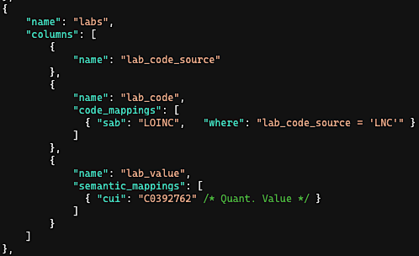
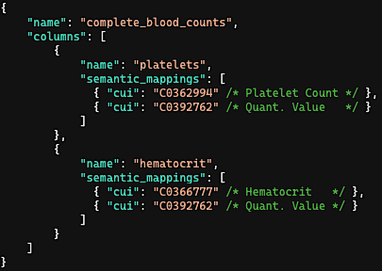
Eligibility Criteria
lab(CUI: C0362994, LOINC: 777-3, “Platelet count”)
.num_filter(eq(op(LT), val(“250”)))
(1) Tall Table Structure
(2) Pivoted Table Structure
Example SQL Record
patient_id | lab_code_source | lab_code | lab_value
ABC | LNC | 777-3 | 211
patient_id | platelets | hematocrit
ABC | 211 | 38.4
Semantic Metadata
Mapping
Generated Query
SELECT patient_id
FROM labs
WHERE lab_code_source = ‘LNC’ AND lab_code = ‘777-3’
AND lab_value < 250
SELECT patient_id
FROM complete_blood_counts
WHERE platelets < 250

Slide 4
2
Named Entity Recognition (NER) using BERT and Relation Extraction using R-BERT.
Or
Numeric-Filter
“- Diabetic women and men aged over 65 with no contraindications to metformin”
Condition
Female
Male
Age
Eq-Comparison
-
Diabetic
women
and
men
aged
over 65
Operator: Greater Value: “65”
Negates
Contraindicates
Negation
Contraindication
Drug
with
no
contraindications
to
metformin
Named Entity Recognition
Relation Extraction
BERT
R-BERT
Python
Python

Slide 5
3
Transform to logical form prediction input string, replacing raw text named entities values with named entities names and removing any hypothetical events.
Or
Numeric-Filter
“- cond(“Diabetic”) female() and male()
age() eq(op(GT), val(“65”))
with neg() contraindication() to
drug(“metformin”)”
Condition
Female
Male
Age
Eq-Comparison
-
Diabetic
women
and
men
aged
over 65
Operator: Greater Value: “65”
Negates
Contraindicates
Negation
Contraindication
Drug
with
no
contraindications
to
metformin

Slide 6
4
Predict structured logical form using fine-tuned T5 model, output as a string. Then, parse logical forms and instantiate as in-memory nested object structure.
intersect(
cond(“Diabetic”),
union(
female(),
male()
),
age()
.num_filter(
eq(op(GT), val(“65”))
),
neg(
contraindication(
drug(“metformin”)
)
)
)
“- cond(“Diabetic”) female() and
male() age() eq(op(GT), val(“65”))
with neg() contraindication() to
drug(“metformin”)”
Logical Form Transformation
T5
Python

Slide 7
5
Normalize to UMLS concepts using MetaMapLite and BERT (the latter only in the case of lab tests).
intersect(
cond(“Diabetic”),
...
neg(
contraindication(
drug(“metformin”)
)
)
)
intersect(
cond(CUI: C0241863 “diabetic”),
...
neg(
contraindication(
drug(CUI: C0025598 “metformin”)
)
)
)
Normalization
MetaMapLite
BERT (Labs)
Java
Python

Slide 8
6
Reason using Knowledge Base to determine: (1) Contraindications (2) Indications (3) Risk factors (4) Signs / symptoms
(5) Unspecified criteria (e.g., “conditions that affect respiratory function”).
intersect(
...
neg(
contraindication(
drug(CUI: C0025598 “metformin”)
)
)
)
intersect(
...
neg(
cond(CUI: C0035078 “Renal Insufficiency”),
cond(CUI: C0220981 “Metabolic acidosis”),
drug(CUI: C0025598 “Furosemide”),
drug(CUI: C3253985 “Dolutegravir”),
...
)
)
Knowledge Base
LOINC2HPO
RDF + SPARQL
Disease Ontology
Symptom Ontology
UMLS
ICD{9|10}, SNOMED Mappings
Potential Drug-Drug Interactions (PDDI)

Slide 9
Structured
Both
NLP
129,478 (87%)
11,314 (8%)
7,429 (5%)
Alcohol
23,909 (69%)
4,345 (12%)
6,617 (19%)
Tobacco
36,254 (86%)
1,972 (5%)
4,083 (10%)
Drug
1,772,595 (96%)
61,018 (3%)
8,295 (<1%)
Employment
7,359 (64%)
516 (4%)
3,692 (32%)
Living Status (homelessness)

Slide 10
Structured
Both
NLP
127,869 (87%)
11,542 (8%)
7,952 (5%)
Alcohol
22,959 (53%)
4,868 (11%)
15,223 (35%)
Tobacco
35,177 (71%)
2,690 (5%)
11,666 (24%)
Drug
290,280 (81%)
61,010 (17%)
8,303 (2%)
Employment
7,344 (62%)
525 (4%)
3,981 (34%)
Living Status (homelessness)

Slide 11
Structured
Both
NLP
87671 (82%)
11,558 (11%)
7,936 (7%)
Alcohol
14,185 (41%)
4,873 (14%)
15,228 (44%)
Tobacco
24,444 (63%)
2,695 (7%)
11,661 (30%)
Drug
131,490 (65%)
61,018 (30%)
8,295 (4%)
Employment
5,173 (53%)
525 (5%)
3,981 (41%)
Living Status (homelessness)

Slide 12
ALL PATIENTS
129,234 (87%)
11,558 (8%)
7,936 (5%)
Alcohol
23,381 (54%)
4,868 (11%)
15,228 (35%)
Tobacco
35,531 (71%)
2,695 (5%)
11,661 (24%)
Drug
1,772,595 (96%)
69,313 (4%)
Employment
7,350 (62%)
525 (4%)
3,981 (34%)
Living Status (homelessness)
PATIENTS /w NOTES
127,869 (87%)
11,542 (8%)
7,936 (5%)
Alcohol
22,959 (53%)
4,868 (11%)
15,228 (35%)
Tobacco
35,177 (71%)
2,690 (5%)
11,661 (24%)
Drug
290,280 (81%)
61,010 (17%)
8,295 (2%)
Employment
7,344 (62%)
525 (4%)
3,981 (34%)
Living Status (homelessness)
PATIENTS w/ SOCIAL HX SECTION IN NOTES
87,671 (82%)
11,558 (11%)
7,936 (7%)
Alcohol
14,185 (41%)
4,873 (14%)
15,228 (44%)
Tobacco
24,444 (63%)
2,695 (7%)
11,661 (30%)
Drug
131,490 (65%)
61,018 (30%)
8,295 (4%)
Employment
5,173 (53%)
525 (5%)
3,981 (41%)
Living Status (homelessness)

Slide 13
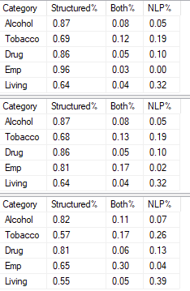
All patients
Only patients w/ notes
Only patients w/ social hx section in notes

Slide 14
Structured
Both
NLP
71.3%
20.3%
8%
Alcohol
42.4%
21.4%
36.2%
Tobacco
64.7%
19.7%
15.6%
Drug
90.2%
7.8%
1.9%
Employment
63.6%
4.4%
31.9%
Living Status

Slide 15
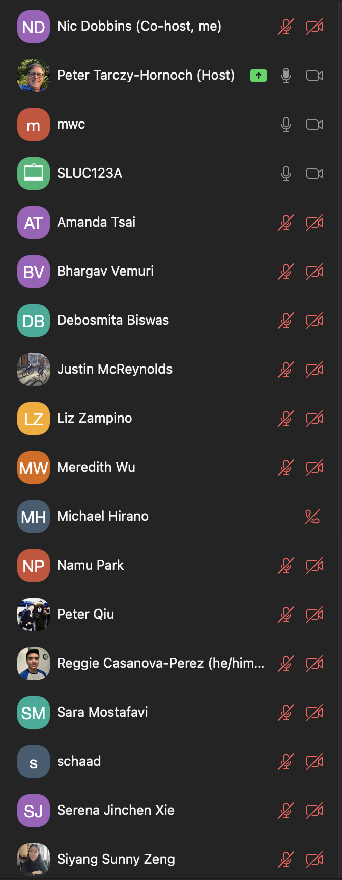

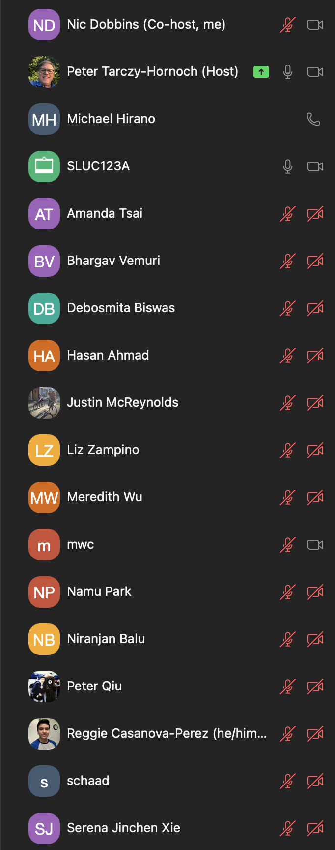

11:10
11:30

