Slide 1


1
User Question
How many patients had a BMI between 35 and 40 within the past 6 months, have been treated with an SSRI or other antidepressant, are aged 18 – 65 years, have no regular exercise, and visited the HMC adult medicine clinic in the past three years?
or

Slide 2
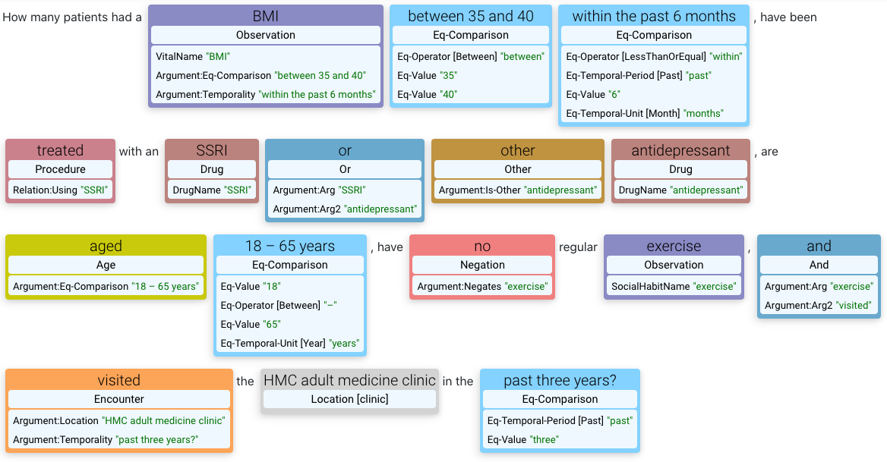
2
Named Entity and Criteria Recognition

Slide 3

3a
Disambiguation: UMLS Mapping
BMI
UMLS: C1305855 “Body Mass Index”
SSRI
UMLS Mapping NER
RxNorm: 107715 “Selective Serotonin Re-uptake inhibitor“
regularly exercise
UMLS: C0582191 “Regular exercise”
seen at
UMLS: C0545084 ”Visit, outpatient”

Slide 4

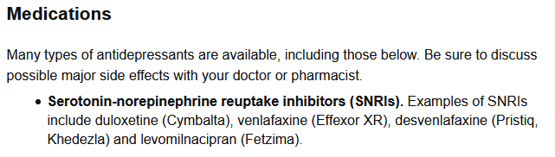



3b
Disambiguation: External Source Knowledgebase
External Datasource KB
antidepressant
- RxNorm: 596927’ (duloxetine)
- RxNorm: 844817’ (venlafaxine)
- RxNorm: 1433211’ (levomilnacipran)
- …
https://www.mayoclinic.org/diseases-conditions/depression/diagnosis-treatment/drc-20356013

Slide 5
3c
Disambiguation: Clinical Database Query Mapping
Clinical Database Query Map KB
HMC adult medicine clinic
ClinicID: 8512 “Harborview Adult Medicine Clinic”

Slide 6
4
Map concept form to Clinical Database/FHIR
Clinical Database Query Map KB
UMLS concept
UMLS: C1305855
TABLE: [MEAS_VITAL]
VAL_COL: [OBSERVATION_VALUE]
DATE_COL: [OBSERVATION_DTTM]
WHERE: ‘[VAL_TYPE] = ‘BMI’
RxNorm: 107715, 596927, 844817, 1433211, … TABLE: [MED_ORDER]
DATE_COL: [ORDER_DTTM]
WHERE: ‘[MED_CODE] IN ({107715, …})’
UMLS: C0001779
TABLE: [PERSON]
VAL_COL: DATEDIFF(DAY, [DOB], NOW()) / 365.25
???
UMLS: C0029921
TABLE: [ENCOUNTER]
DATE_COL: [ENC_START_DTTM]
WHERE: ‘[CLINIC_ID] = ‘{8512}’
C1305855 (BMI)
Num (>= 35, <= 40)
Date (>= Past 6 Months, < NOW())
107715, 596927, 844817, 1433211 (Anti-Depressants)
C0001779 (Age)
Num (>= 18, <= 65)
C0582191 (Regular exercise)
C0545084 (Outpatient visit)
Mod (ClinicID: 8512)

Slide 7
5
Query Compilation / Execution
Clinical Database Query Map KB
SELECT <inclusion_criteria_1>
∩
SELECT <inclusion_criteria_2>
∩
SELECT <inclusion_criteria_3>
(ignored)
∩
SELECT <inclusion_criteria_4>
FROM [MEAS_VITAL]
WHERE [OBSERVATION_VALUE] BETWEEN …
AND [OBSERVATION_DTTM] …
AND [VAL_TYPE] = ‘BMI’
FROM [MED_ORDER]
WHERE [ORDER_DTTM] …
AND [MED_CODE] IN (107715, …)
FROM [PERSON]
WHERE DATEDIFF(DAY, [DOB], NOW()) / 365.25 …
???
FROM [ENCOUNTER]
WHERE [ENC_START_DTTM]
AND [CLINIC_ID] = 8512

Slide 8

User free-text question
How many patients had a BMI between 35 and 40 within the past 6 months, have been treated with an SSRI or other antidepressant, are aged 18 – 65, don’t regularly exercise, and have been seen at the adult medicine clinic in the past three years?
Leaf AI’s response
I couldn’t identify patients who “don’t regularly exercise”, so you may need to refine your search, however:
223 patients were found with:
1) 1,046 had a body mass index (BMI) ≥ 35 and ≤ 40 (in the past 6 months)
2) 442 were treated with a Selective Serotonin Re-uptake Inhibitor (SSRI) or other antidepressant (anytime)
I identified “antidepressant” using:
https://www.mayoclinic.org/diseases-conditions/depression/diagnosis-treatment/drc-20356013
3) 421 are age ≥ 18 and ≤ 65
4) 223 had an outpatient visit at the Adult Medicine Clinic (in the past 3 years)
Try:
How many have been admitted to the ED?
When were they last seen?
Show me their BMI data

Slide 9
User free-text question
BMI between 35 and 40 within the past 6 months
Have been treated with an SSRI or other antidepressant
Are aged 18 – 65 and don’t regularly exercise
Seen in the emergency department in the past three years
Leaf AI’s response
I couldn’t identify patients who “don’t regularly exercise”, so you may need to refine your search, however:
53 patients were found:
1) 1,046 had a body mass index (BMI) between 35 and 40 (in the past 6 months)
2) 442 were treated with a Selective Serotonin Re-uptake Inhibitor (SSRI) or other antidepressant (anytime)
3) 421 are age ≥ 18 and ≤ 65
4) 53 visited the Emergency Department (in the past 3 years)

Slide 10

BMI between 35 and 40 within the past 6 months
Body Mass Index (UMLS: C1305855)
A general indicator of the body fat an individual is carrying based upon the ratio of weight to height.

Slide 11
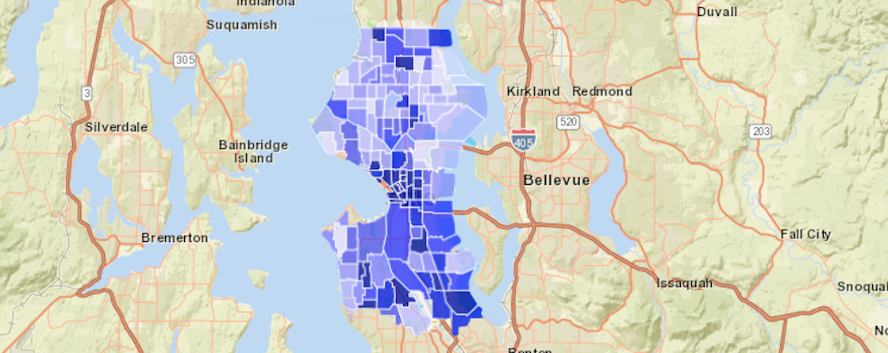
6
Report Results to User
Of those, who live in Seattle?
Of the 233, 139 (59%) live in Seattle:
Try:
How many live near Harborview?
Start a new query

Slide 12
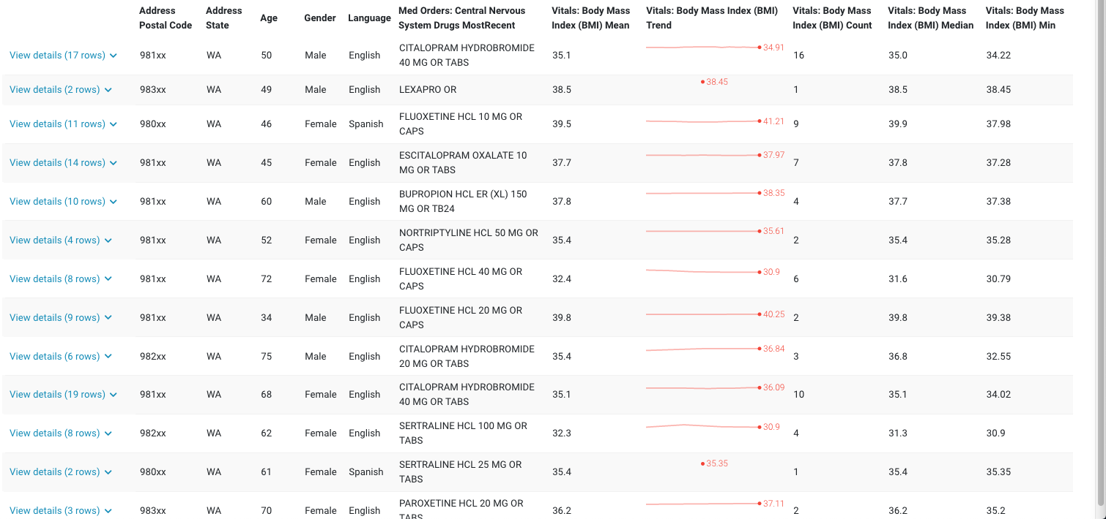
6
Report Results to User
Show me their med order and BMI data
Here’s what I found:
Try:
Of those, how many had an SSRI ordered at least twice?
Of those, how many have been in a clinical trial?

Slide 13
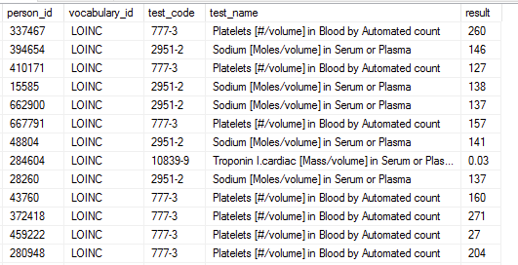
Mapping UMLS Concepts -> LOINC (or other) codes
Platelets Example
User input
“ - Females
- Platelets < 200 ml/uL in past 6 months
- Not taking anti-depressants ”
DB table of labs
NER output
“Platelets” – Observation [lab]
MetaMap output
“Platelets” – CUI [C0032181]
“Platelet Count Measurement”
lbpr (laboratory result)

Slide 14
Mapping UMLS Concepts -> LOINC (or other) codes
Platelets Example
What we need for query
MetaMap output
“Platelet # Bld Auto” C0362994 - clinical attribute codes –
LOINC – “777-3”
“Platelet Count Measurement”
C0032181 - laboratory result
has_component
measures
“Platelet”
C0005821 - cell

Slide 15
Mapping UMLS Concepts -> LOINC (or other) codes
Platelets Example

