Slide 1


Explainable query generation for cohort discovery and biomedical reasoning using natural language
Nic Dobbins
UW Biomedical Natural Language Processing Group
UW Medicine Research IT Department of Biomedical Informatics & Medical Education
University of Washington, Seattle, WA
November 14th, 2022

Slide 2
Outline
Introduction
Related Works
Task Innovation
Specific Aims
Conclusion

Slide 3

Introduction
Related Work
Task Innovation
Specific Aims
Conclusion
Cohort Discovery
5.5m patients (EHR)
Process of finding patients meeting certain criteria relevant to a potential study
Often used in prep-to-research, hypothesis generation, power calculations, clinical trial recruitment, etc.
Can be done by manual chart review, electronic case report forms (eCRF), or queries of clinical databases
Over 65
Hypoglycemic
Left-handed
1,422 patients

Slide 4
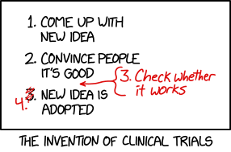
Introduction
Related Work
Task Innovation
Specific Aims
Conclusion
Clinical Trials
Prospective study designed to determine whether an intervention (drug, device, etc.) is safe and effective
“Randomized” if participants randomly assigned to different groups
“Controlled” if includes a control group which does not receive intervention in question
Recognized as gold standard method for determining safety and efficacy of new treatments
https://xkcd.com/2530

Slide 5
Introduction
Related Work
Task Innovation
Specific Aims
Conclusion
Clinical Trials - challenges
Expensive – between 2004 & 2016, mean costs:
Phase I: $3.8m
Phase II: $13.3m
Phase III: $19.8m
Finding eligible patients time-consuming and costly
Eligibility criteria often complex
Patients recruited tend to be whiter and more affluent than affected populations at large
Sources:
-Sertkaya, Aylin, et al. "Key cost drivers of pharmaceutical clinical trials in the United States." Clinical Trials 13.2 (2016): 117-126.
-G. Frank. Current challenges in clinical trial patient recruitment and enrollment. SoCRA Source, 2(February):30–38, 2004.
-C. Heller, J. E. Balls-Berry, J. D. Nery, P. J. Erwin, D. Littleton, M. Kim, and W. P. Kuo. Strategies addressing barriers to clinical trial enrollment of underrepresented populations: a systematic review. Contemporary clinical trials, 39(2):169–182, 2014.

Slide 6
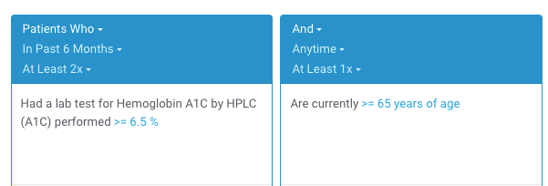
Introduction
Related Work
Task Innovation
Specific Aims
Conclusion
Clinical Trials Recruitment and (Cohort Discovery) Software
Computer software cannot solve all challenges
However, can sometimes reduce manual workloads and save time/costs related to recruitment
Existing cohort discovery tools can be used by manually translating free-text eligibility criteria into database queries
“- At least 2 A1c tests > 6.5%
- 65+ y/o”
2,273 patients found
Example Leaf query.
Sources:
-Johnson, Emilie K., et al. "Use of the i2b2 research query tool to conduct a matched case–control clinical research study: advantages, disadvantages and methodological considerations." BMC medical research methodology 14.1 (2014): -L. Penberthy, R. Brown, F. Puma, and B. Dahman. Automated matching software for clinical trials eligibility: measuring efficiency and flexibility. Contemporary clinical trials, 31(3):207–217, 2010.
-S. R. Thadani, C. Weng, J. T. Bigger, J. F. Ennever, and D. Wajngurt. Electronic screening improves efficiency in clinical trial recruitment. Journal of the American Medical Informatics Association, 16(6):869–873, 2009.

Slide 7
Introduction
Related Work
Task Innovation
Specific Aims
Conclusion
Clinical Trials Recruitment and (Cohort Discovery) Software
Existing drag-and-drop cohort discovery tools are not a panacea:
Significant learning curves
Visual representation of data discordant with “mental maps” of how data are collected or stored
May be structurally unable to represent certain complex criteria or sequences of events

Slide 8

Introduction
Related Work
Task Innovation
Specific Aims
Conclusion
Clinical Trials Recruitment and Natural Language Processing (NLP)
Alternatively, using NLP to automatically analyze free-text eligibility criteria and find patients has appeal
Researchers are accustomed to writing criteria using natural language
No (or less) need to learn special tools
“- At least 2 A1c tests > 6.5%
- 65+ y/o”
2,273 patients found

Slide 9
Introduction
Related Work
Task Innovation
Specific Aims
Conclusion
Challenges
What kind of surgery?
When is “newly”?
1. Newly diagnosed with breast cancer and scheduled for surgery
2. 18 years or above
3. Those who experience high psychological stress will enter the RCT whereas those with low stress will be followed in an observational questionnaire study
4. No severe psychiatric disease requiring treatment, e.g., schizophrenia
What is 18 years or above?
Statement of fact, not a criterion
What could these be?
Many of these relate to reasoning. Also: acronyms, misspellings, etc.
Adapted from trial NCT03254875 at https://clinicaltrials.gov/ct2/show/NCT03254875

Slide 10


Introduction
Related Work
Task Innovation
Specific Aims
Conclusion
Project Goals
Aim 1
Aim 2
Aim 3
Create a human-annotated gold standard corpus of eligibility criteria.
Develop state-of-the-art NLP-based methods for generating SQL queries for cohort discovery from free-text.
Develop web application for finding patients meeting user-provided free-text eligibility criteria.
“Patients with ...”
SELECT FROM...

Slide 11
Introduction
Related Work
Task Innovation
Specific Aims
Conclusion
Broader Impact
NLP for cohort discovery may be useful for other kinds of biomedical research, e.g.,
Question answering
Information extraction
May reduce cost + labor burden of finding patients for clinical trials
Evaluating system performance by comparing patients found to those actually enrolled in trials (Aim 2, discussed shortly)
Novel
Significantly raises standards for this task

Slide 12
Introduction
Related Work
Task Innovation
Specific Aims
Conclusion
Related Work
Corpora of eligibility criteria
Methods for query generation from free-text criteria
NLP-based software for cohort discovery

Slide 13
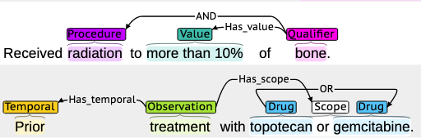
Introduction
Related Work
Task Innovation
Specific Aims
Conclusion
Corpora of Eligibility Criteria
EliXR by Weng et al. (2011)
1,000 eligibility criteria documents
Various disease domains, custom schema
Not publicly available.
EliIE by Kang et al. (2017)
230 eligibility criteria related to Alzheimer's Disease
Based on the OMOP database schema.
Chia by Kury et al. (2020)
1,000 eligibility criteria documents
Various disease domains
Based on OMOP database schema.
Example Chia annotation.
Sources:
-C. Weng, X. Wu, Z. Luo, M. R. Boland, D. Theodoratos, and S. B. Johnson. EliXR: an approach to eligibility criteria extraction and representation. Journal of the American Medical Informatics Association, 18. Dec 2011. -T. Kang, S. Zhang, Y. Tang, G. W. Hruby, A. Rusanov, N. Elhadad, and C. Weng. EliIE: An open-source information extraction system for clinical trial eligibility criteria. JAMIA, 24(6):1062–1071, 2017. -F. Kury, A. Butler, C. Yuan, L.-h. Fu, Y. Sun, H. Liu, I. Sim, S. Carini, and C. Weng. Chia, a large annotated corpus of clinical trial eligibility criteria. Scientific data, 7(1):1–11, 2020.

Slide 14
Introduction
Related Work
Task Innovation
Specific Aims
Conclusion
Methods for generating SQL queries from free-text criteria
Database query generation
Document ranking and classification
Embeddings and similarity measurement
Logical representations and ontologies
A combination of the above

Slide 15
Introduction
Related Work
Task Innovation
Specific Aims
Conclusion
Database Query Generation
Extensive recent Seq2Seq work using text-to-SQL generation with Encoder-Decoder Transformer architectures.
Tend to fall short by some combination of
Only generating queries for single data model
Assuming user utterances map directly to table/column names
Being dependent on specific data/codes in database (unknown to the model)
SELECT patient_id
FROM labs
WHERE lab_type = ‘a1c’ AND value > 6.5
“Hemoglobin A1c > 6.5%”
Sources:
-S. Bae, D. Kim, J. Kim, and E. Choi. Question Answering for Complex Electronic Health Records Database using Unified Encoder-Decoder Architecture. In Machine Learning for Health, pages 13–25. PMLR, 2021.
-P. Wang, T. Shi, and C. K. Reddy. Text-to-SQL generation for question answering on electronic medical records. In Proceedings of The Web Conference 2020, pages 350–361, 2020. -Y. Pan, C. Wang, B. Hu, Y. Xiang, X. Wang, Q. Chen, J. Chen, J. Du, et al. A BERT-Based Generation Model to Transform Medical Texts to SQL Queries for Electronic Medical Records: Model Development and Validation. JMIR Medical Informatics, 9(12):e32698, 2021.
-Yu, Xiaojing, et al. "Dataset and enhanced model for eligibility criteria-to-SQL semantic parsing." 12th International Conference on Language Resources and Evaluation (LREC). 2020.

Slide 16
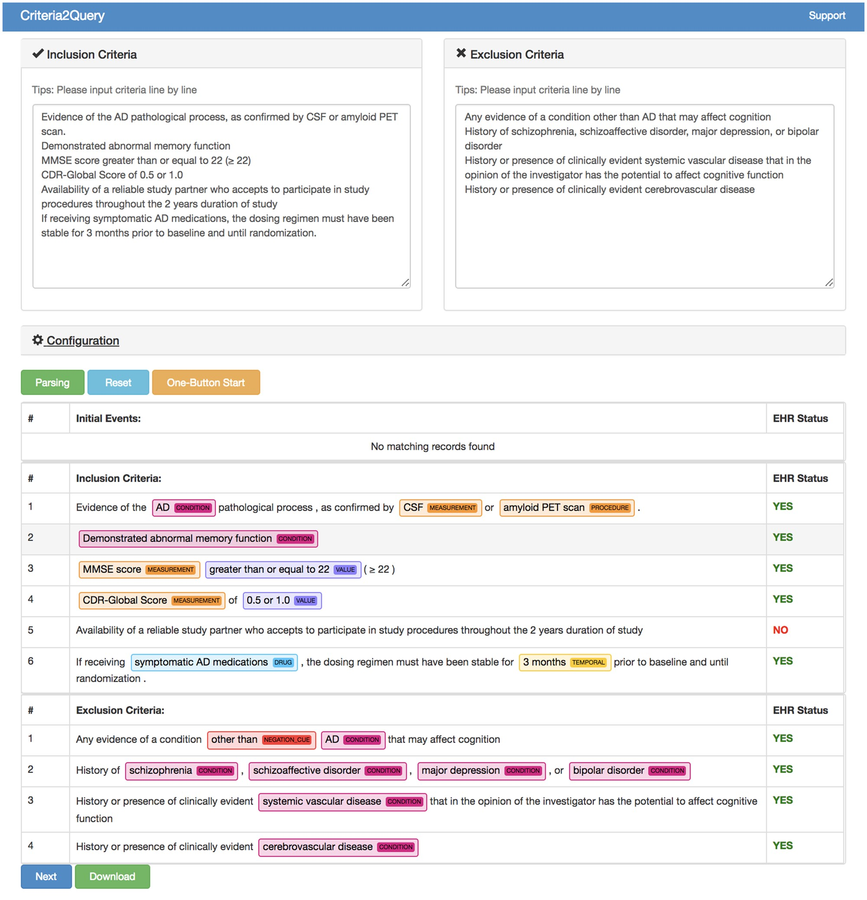
Introduction
Related Work
Task Innovation
Specific Aims
Conclusion
NLP-based software for cohort discovery
Criteria2Query by Yuan et al. most well known and recent.
Hybrid approach: BERT for negation detection and CRF-based classifier for NER, rules for logical composition.
Expanded by Fang et al. to allow users to edit predicted criteria.
Outputs JSON-based logical representation of criteria to ”Atlas” tool, generates SQL from rules.
Sources:
-Yuan, Chi, et al. "Criteria2Query: a natural language interface to clinical databases for cohort definition." Journal of the American Medical Informatics Association 26.4 (2019): 294-305.
-Fang, Yilu, et al. "Combining human and machine intelligence for clinical trial eligibility querying." Journal of the American Medical Informatics Association (2022).

Slide 17



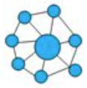
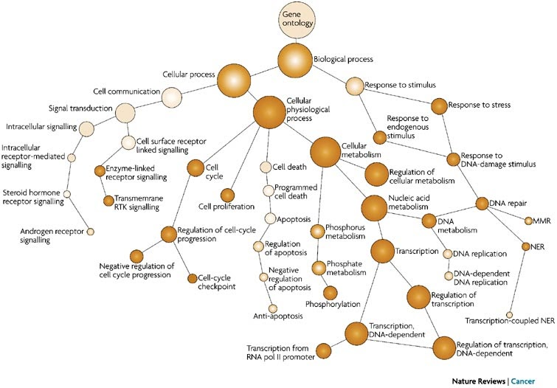
Introduction
Related Work
Task Innovation
Specific Aims
Conclusion
Other notable approaches
Document Ranking and Classification
Clinical notes sorted by those meeting criteria
Various architectures (Chen et al.: biLSTM+CRF, Soni and Roberts: BERT)
Embeddings and similarity measurement
Eligibility criteria and patient medical history represented as vectorized embeddings
Compare by cosine similarity or as entailment problem (ie, patient history entails criteria = { true, false, unknowable })
Logical representations and ontologies
Graphs, OWL reasoners to predict eligibility
Various logical annotation representations for eligibility criteria using First Order Logic, etc.
Sources:
-L. Chen, Y. Gu, X. Ji, C. Lou, Z. Sun, H. Li, Y. Gao, and Y. Huang. Clinical trial cohort selection based on multi-level rule-based natural language processing system. JAMIA, 26(11):1218–1226, 2019.
-S. Soni and K. Roberts. Patient cohort retrieval using transformer language models. In AMIA annual symposium proceedings, volume 2020, page 1150. American Medical Informatics Association, 2020.
-H. Dhayne, R. Kilany, R. Haque, and Y. Taher. EMR2vec: Bridging the gap between patient data and clinical trial. Computers & Industrial Engineering, 156:107236, 2021.
-X. Zhang, C. Xiao, L. M. Glass, and J. Sun. DeepEnroll: patient-trial matching with deep embedding and entailment prediction. In Proceedings of The Web Conference 2020, pages 1029–1037, 2020.
-D. F. Patrão, M. Oleynik, F. Massicano, and A. Morassi Sasso. Recruit-An Ontology Based Information Retrieval System for Clinical Trials Recruitment. In MEDINFO 2015: eHealth-enabled Health, pages 534–538. IOS Press, 2015.

Slide 18
Introduction
Related Work
Task Innovation
Specific Aims
Conclusion
Task Innovation
Corpora of eligibility criteria Our corpus is broad, large, and rich in granularity for generating accurate queries
Methods for cohort discovery from free-text criteria Our methods will generalize to virtually any clinical database schema, be capable of reasoning upon non-specific criteria and demonstrate near-human results in matching cohorts of patients from actual clinical trials
NLP-based software for cohort discovery Our system will be user-friendly, intuitive and explainable

Slide 19

Introduction
Related Work
Task Innovation
Specific Aims
Conclusion
Specific Aims
Aim 1
Aim 2
Aim 3
Create a human-annotated gold standard corpus of eligibility criteria.
Develop state-of-the-art NLP-based methods for generating SQL queries for cohort discovery from free-text.
Develop web application for finding patients meeting user-provided free-text eligibility criteria.
“Patients with ...”
SELECT FROM...

Slide 20
Introduction
Related Work
Task Innovation
Specific Aims
Conclusion
Aim
1
2
3
Aim 1 – Motivation
Create an annotated corpus of eligibility criteria which can be used to train prediction models to aid in SQL query generation.
Published in Nature Scientific Data in August 2022.
Sources:
-Dobbins, Nicholas J., et al. "The Leaf Clinical Trials Corpus: a new resource for query generation from clinical trial eligibility criteria." Nature Scientific Data 9.1 (2022): 1-15.

Slide 21
Introduction
Related Work
Task Innovation
Specific Aims
Conclusion
Aim
1
2
3
Aim 1 – Corpus Creation
Downloaded 1,020 randomly selected eligibility criteria documents from https://clinicaltrials.gov
Limited to studies
From Jan. 1 2018 onward
50 or more characters in length
20 documents for annotator training, remainder for main annotation task
Named “Leaf Clinical Trials” or “LCT” corpus
Sources:
-Dobbins, Nicholas J., et al. "The Leaf Clinical Trials Corpus: a new resource for query generation from clinical trial eligibility criteria." Nature Scientific Data 9.1 (2022): 1-15.

Slide 22
Introduction
Related Work
Task Innovation
Specific Aims
Conclusion
Aim
1
2
3
Aim 1 – Annotation Schema
Aimed to develop expressive, task-oriented annotation schema.
Analyzed previously published corpora.
Expanded named entities and relations. For example, added “Contraindication” entity.
50 total entity types
Categories: Clinical, Demographic, Logical, Qualifier, Temporal & Comparative, Other
51 total relation types
Categories: Alternative & Example, Clinical, Dependent, Logical, Qualifier, Temporal & Comparative, Other

Slide 23
Aim 1– Entity Examples (18 of 50 total)
Category | Entity | Values | Example Text
Clinical | Condition |  | “Diagnosed with hypertension in past year”
 | Contraindication |  | “Any contraindications to vaginal delivery”
Clinical | Drug |  | “on beta blockers”
 | Encounter | emergency, inpatient, outpatient | “recently admitted to hospital”
 | Observation | lab, vital, clinical-score, survey, social-habit | “Platelet count less than 500”
 | Procedure |  | “Undergoing or scheduled for a colonoscopy”
Demographic | Age |  | “65+ years old”
 | Birth |  | “Born within past 6 months”
Demographic | Family-Member | mother, father, sibling, etc. | “History of maternal breast cancer”
 | Language |  | “Speaks English or Spanish”
Logical | Negation |  | “with no systemic disease”
Qualifier | Assertion | intention, hypothetical, possible | “which may cause conditions”
Qualifier | Modifier |  | “alcohol or substance abuse”
 | Polarity | low, high, positive, negative | “showing elevated serum creatinine”
 | Stability | stable, change | “Conditions known to affect mood”
Temporal & Comparative | Eq-Comparison |  | “greater than 50 ml”, “within the past 3 years”
Temporal & | Eq-Temporal-Period | past, present, future, recent | “Active illness”, “in the next 10 days”,
Comparative | Eq-Temporal-Recency | first-time, most-recent | “Latest BMI > 35”, “First diagnosed in past 6 months”

Slide 24
Aim 1 – Relation Examples (18 of 51 total)
Category | Relation | Example Text
Alternative & Example | Abbrev-Of | “Post Concussion Syndrome ← ( PCS )”
Alternative & | Equivalent-To | “Thrombocytopenia : ← platelets < 100,000/mm3”
Example | Example-Of | “skin condition ← ( e.g., eczema ) “
Clinical | Contraindicates | “conditions contraindicating → MRI”
Dependent | Caused-By | “swellings → due to trauma”
 | Found-By | “lesion → seen on standard imaging”
Dependent | Treatment-For | “coronary bypass surgery → for atherosclerosis”
 | Using | “total knee arthroplasty → with spinal anesthesia”
Logical | If-Then | “BMI greater than 38 ← for women”
 | Negates | “No → previous history of depression”
 | Risk-For | “Risk → of death”
Qualifier | Severity | “mild → symptoms”
 | Stability | “hemodynamically → unstable”
Temporal & Comparative | After | “infected → following admission”
 | Before | “diagnosis of aortic stenosis → prior to visit”
 | Duration | “type 1 diabetes → for at least 1 year”
Temporal & | Numeric-Filter | “Body weight → less than 110 pounds”
Comparative | Temporality | “seen → within past 6 months”

Slide 25
Introduction
Related Work
Task Innovation
Specific Aims
Conclusion
Aim
1
2
3
Aim 1 – Entities
“Aged”
“18 and older”
(2) Fine-grained entities
Eq-Value
Eq-Operator [GT]
Value
Operator
(1) General entities
Age
Numeric-Filter
Eq-Comparison

Slide 26
Introduction
Related Work
Task Innovation
Specific Aims
Conclusion
Aim
1
2
3
Aim 1 – Named versus Non-specific Entities
Named entities refer to specific conditions, observations, treatments, etc.
“Diagnosis of Hepatitis C”
Condition-Name
Condition
Non-specific entities refer generally to unstated conditions, etc., which may need to be reasoned upon
“Conditions
which affect...”
Condition

Slide 27
Introduction
Related Work
Task Innovation
Specific Aims
Conclusion
Aim
1
2
3
Aim 1 – Annotation Process
2 annotators: 1 biomedical informatician, 1 computer science professor
Met bi-weekly for 3 months
887 single-annotated, 119 double-annotated documents
Inter-annotator agreement by F₁
78.1% for entities, 60.9% for relations by exact character and type matching

Slide 28
Introduction
Related Work
Task Innovation
Specific Aims
Conclusion
Aim
1
2
3
Aim 1 – Comparison to Chia corpus
Measure | EliIE | Chia | LCT Corpus
Disease domain | Alzheimer’s Disease | All | All
# Documents | 230 | 1,000 | 1,006
# Annotations | 15,596 | 68,174 | 105,816
# Entity types | 8 | 15 | 50
# Relation types | 3 | 12 | 51
Mean entities per doc. | - | 46 | 105
Mean relations per doc. | - | 19 | 49

Slide 29
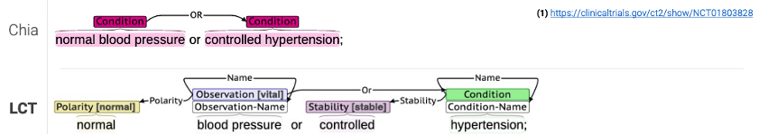
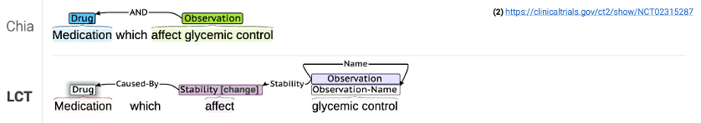
Introduction
Related Work
Task Innovation
Specific Aims
Conclusion
Aim
1
2
3
Aim 1 – Comparison to Chia corpus – Examples

Slide 30
Introduction
Related Work
Task Innovation
Specific Aims
Conclusion
Aim
1
2
3
Aim 1 – Comparison to Chia corpus – Examples

Slide 31
Introduction
Related Work
Task Innovation
Specific Aims
Conclusion
Aim
1
2
3
Aim 1 – Results - Entities
Trained 2 NER models, 1 each for general and fine-grained entities using various architectures
biLSTM+CRF
PubMedBERT (pretrained using PubMed abstracts)
SciBERT (pretrained using biomedical and computer science abstracts)
SciBERT achieved highest overall F₁ of 81%
Architecture | Precision | Recall | F1
biLSTM+CRF | 80% | 79% | 79%
PubMedBERT | 75% | 78% | 77%
SciBERT | 79% | 83% | 81%

Slide 32
Introduction
Related Work
Task Innovation
Specific Aims
Conclusion
Aim
1
2
3
Aim 1 – Results - Relations
Trained relation extraction models using
SciBERT
R-BERT + SciBERT (modification of BERT architecture by We & He)
R-BERT + SciBERT achieved highest overall F₁ of 85%
Architecture | Precision | Recall | F1
SciBERT | 80% | 88% | 84%
R-BERT + SciBERT | 82% | 88% | 85%
Sources:
-Wu, S. & He, Y. Enriching pre-trained language model with entity information for relation classification. In Proceedings of the 28th ACM International Conference on Information and Knowledge Management, 2361–2364 (2019).

Slide 33

Introduction
Related Work
Task Innovation
Specific Aims
Conclusion
Specific Aims
Aim 1
Aim 2
Aim 3
Create a human-annotated gold standard corpus of eligibility criteria.
Develop state-of-the-art NLP-based methods for generating SQL queries for cohort discovery from free-text.
Develop web application for finding patients meeting user-provided free-text eligibility criteria.
“Patients with ...”
SELECT FROM...

Slide 34
Introduction
Related Work
Task Innovation
Specific Aims
Conclusion
Aim
1
2
3
Aim 2
Sub-Aim 1
Create corpus of gold standard eligibility criteria logical forms
Sub-Aim 2
Develop methods for query generation

Slide 35
Introduction
Related Work
Task Innovation
Specific Aims
Conclusion
Aim
1
2
3
Sub-Aim 1
Query generation originally planned using rules, named entity and relation models from Aim 1
Predicted named entities with relations represented as graph
However, we learned that generating queries from graphs is difficult and error-prone
Many if-then, if-then, if-then rules.
Difficult to maintain and test.

Slide 36
Introduction
Related Work
Task Innovation
Specific Aims
Conclusion
Aim
1
2
3
Semantic Parsing
Instead: representing as a semantic parse disambiguates relations, nesting
Many rules become unnecessary or can be restructured as class/object-specific logic.
intersect(
cond(“Diabetic”),
union(
female(),
male()
),
age()
.num_filter(
eq(op(GT), val(“65”))
),
neg(
contraindication(
drug(“metformin”)
)
)
)
“Diabetic women and men aged over 65 with no contraindications to metformin”

Slide 37
Introduction
Related Work
Task Innovation
Specific Aims
Conclusion
Aim
1
2
3
Sub-Aim 1– Corpus Creation
Randomly selected 2,000 lines of eligibility criteria from the LCT corpus
~30% of lines (600) rare or complex entity/relation types (If-Then, Before/After, Contraindication, etc.)
Remaining ~70% random
20 lines for annotator training, remainder for main annotation task
Called “Leaf Logical Form” or “LLF” corpus

Slide 38
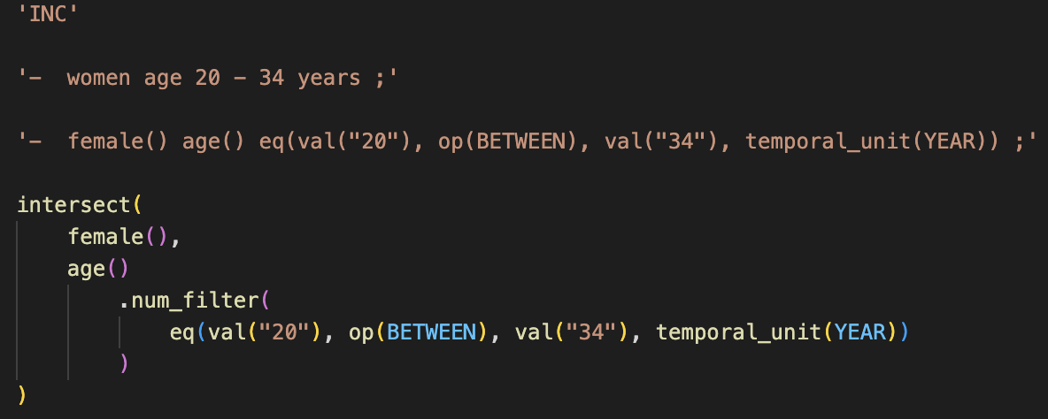
Introduction
Related Work
Task Innovation
Specific Aims
Conclusion
Aim
1
2
3
Sub-Aim 1– Corpus Creation (cont.)
Each eligibility criteria line saved as a JavaScript file of format:
Inclusion or Exclusion
Original text
Augmented text
Logical Form human annotation

Slide 39
Introduction
Related Work
Task Innovation
Specific Aims
Conclusion
Aim
1
2
3
Sub-Aim 1 – Annotation Process
3 annotators: all UW PhD students, 2 in BIME, 1 in Information School
Met weekly for 2 months
Resulting corpus 1,980 single-annotated, 20 triple files
Inter-annotator agreement by BLEU: 82.4%
Annotators | BLEU Score (%)
Annotator 1 / Annotator 2 | 86.6
Annotator 1 / Annotator 3 | 79.5
Annotator 2 / Annotator 3 | 81.0
Mean | 82.4

Slide 40
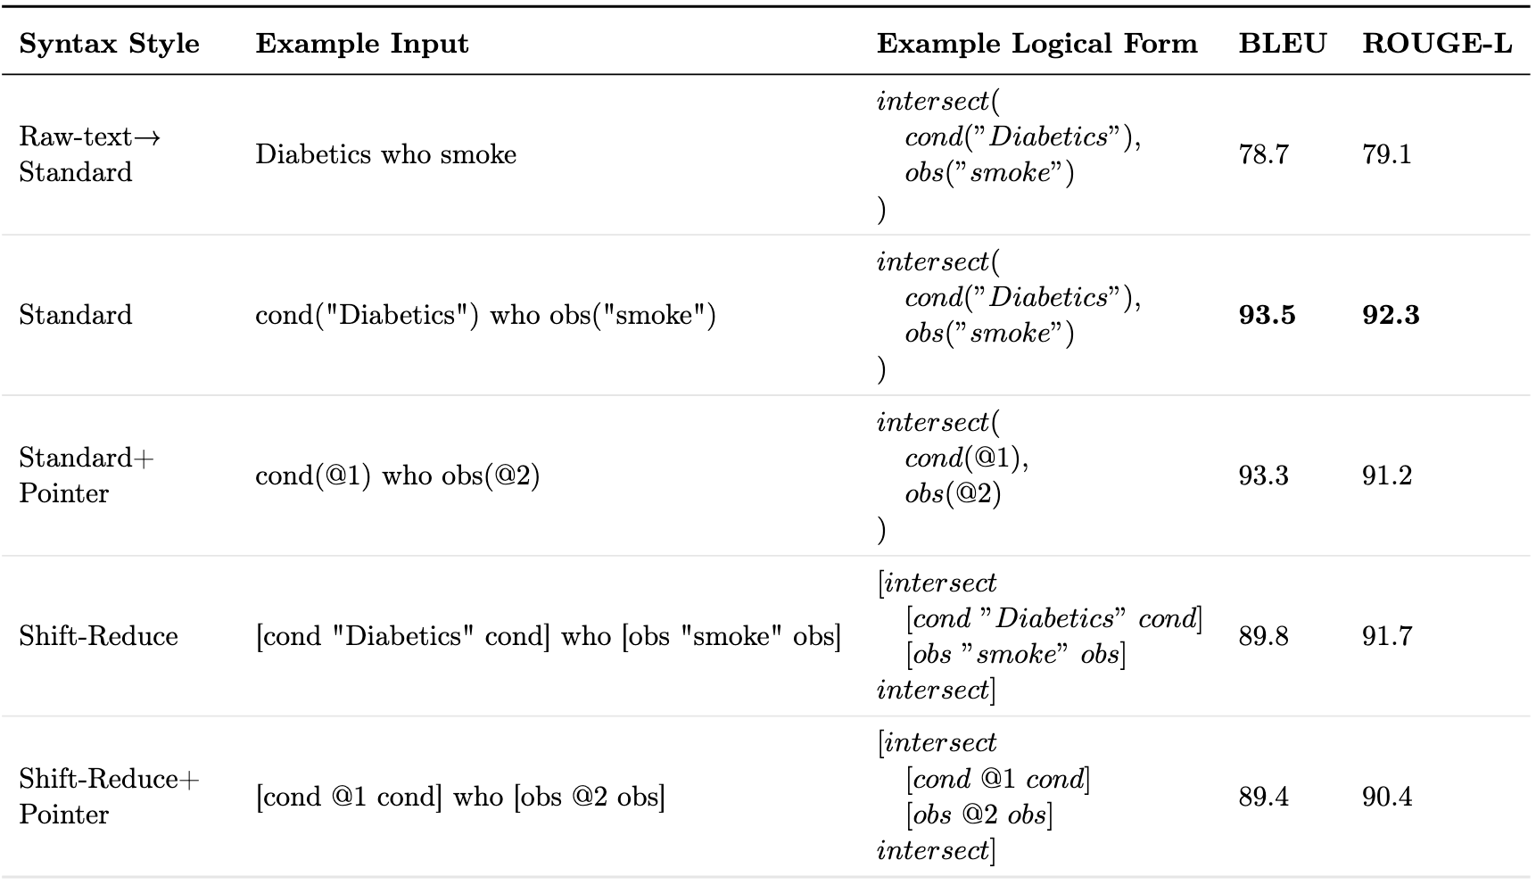
Introduction
Related Work
Task Innovation
Specific Aims
Conclusion
Aim
1
2
3
Sub-Aim 1 – Results
Random 70/20/10 train/test/dev split of corpus
Experimented with other syntax styles as well from literature
”Shift-Reduce”
“Pointer”
Conducted using ”T5” architecture and pretrained model for various Seq2Seq tasks
Replacing raw spans with named entity logical forms improved by +14.7%

Slide 41
Introduction
Related Work
Task Innovation
Specific Aims
Conclusion
Aim
1
2
3
Aim 2
Sub-Aim 1
Create corpus of gold standard eligibility criteria logical forms
Sub-Aim 2
Develop methods for query generation

Slide 42
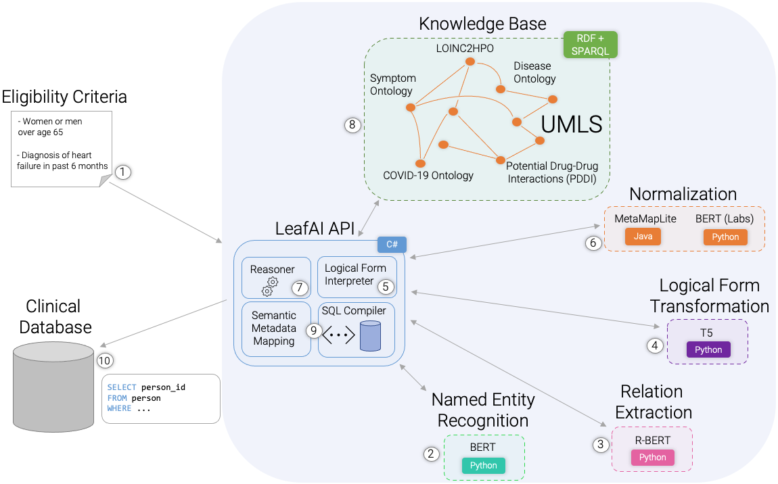
Introduction
Related Work
Task Innovation
Specific Aims
Conclusion
Aim
1
2
3
Sub-Aim 2 – System Overview

Slide 43
Introduction
Related Work
Task Innovation
Specific Aims
Conclusion
Aim
1
2
3
Sub-Aim 2 – Knowledge Base
Built using RDF, or Resource Description Framework graph database of triples query-able by SPARQL
Core is the UMLS
Also
LOINC2HPO (for Lab Result -> Condition reasoning)
Disease Ontology
Symptom Ontology
Potential Drug-Drug Interactions
COVID-19 Ontology
Knowledge Base
LOINC2HPO
RDF + SPARQL
Disease Ontology
Symptom Ontology
UMLS
COVID-19 Ontology
Potential Drug-Drug Interactions (PDDI)
Sources:
-L. M. Schriml, C. Arze, S. Nadendla, Y.-W. W. Chang, M. Mazaitis, V. Felix, G. Feng, and W. A. Kibbe. Disease Ontology: a backbone for disease semantic integration. Nucleic acids research, 40(D1):D940–D946, 2012.
-A. Sargsyan, A. T. Kodamullil, S. Baksi, J. Darms, S. Madan, S. Gebel, O. Keminer, G. M. Jose, H. Balabin, L. N. DeLong, et al. The COVID-19 ontology. Bioinformatics, 36(24):5703–5705, 2020.
-S. Ayvaz, J. Horn, O. Hassanzadeh, Q. Zhu, J. Stan, N. P. Tatonetti, S. Vilar, M. Brochhausen, M. Samwald, M. Rastegar-Mojarad, et al. Toward a complete dataset of drug–drug interaction information from publicly available sources. Journal of biomedical informatics, 55:206–217, 2015.
-X. A. Zhang, A. Yates, N. Vasilevsky, J. Gourdine, T. J. Callahan, L. C. Carmody, D. Danis, M. P. Joachimiak, V. Ravanmehr, E. R. Pfaff, et al. Semantic integration of clinical laboratory tests from electronic health records for deep phenotyping and biomarker discovery. NPJ digital medicine, 2(1):1–9, 2019.

Slide 44
Introduction
Related Work
Task Innovation
Specific Aims
Conclusion
Aim
1
2
3
Sub-Aim 2 – Semantic Metadata Mapping
Map logical forms to a ”Semantic Metadata Mapping”, or “SMM”:
Machine-readable “tagging” system for mapping database objects and records to their meaning and usage
Small pre-defined subset of UMLS concepts
C0421451 “Female”
If = “gender = ‘F’”
C0086582 “Male”
If = “gender = ‘M’”
C5236161 “Patient Identifier”
C0421451
“Date of Birth”
person_id | birthdate | gender
1 | 1-1-2000 | F
2 | 2-2-1980 | M
3 | 3-3-1970 | F

Slide 45
Introduction
Related Work
Task Innovation
Specific Aims
Conclusion
Aim
1
2
3
Aim 2 – Process – Steps 1,2
Named Entity Recognition (NER) using BERT and Relation Extraction using R-BERT.
Or
Numeric-Filter
“- Diabetic women and men aged over 65 with no contraindications to metformin”
Condition
Female
Male
Age
Eq-Comparison
-
Diabetic
women
and
men
aged
over 65
Operator: Greater Value: “65”
Negates
Contraindicates
Negation
Contraindication
Drug
with
no
contraindications
to
metformin
Named Entity Recognition
Relation Extraction
BERT
R-BERT
Python
Python

Slide 46
Introduction
Related Work
Task Innovation
Specific Aims
Conclusion
Aim
1
2
3
Aim 2 – Process – Steps 2,3
Transform to logical form prediction input string, replacing raw text named entities values with named entities names and removing any hypothetical events.
Or
Numeric-Filter
“- Diabetic women and men aged over 65 with no contraindications to metformin”
“- cond(“Diabetic”) female() and male()
age() eq(op(GT), val(“65”))
with neg() contraindication() to
drug(“metformin”)”
Condition
Female
Male
Age
Eq-Comparison
-
Diabetic
women
and
men
aged
over 65
Operator: Greater Value: “65”
Negates
Contraindicates
Negation
Contraindication
Drug
with
no
contraindications
to
metformin

Slide 47
Introduction
Related Work
Task Innovation
Specific Aims
Conclusion
Aim
1
2
3
Aim 2 – Process – Steps 4,5
Predict structured logical form using fine-tuned T5 model, output as a string. Then, parse logical forms and instantiate as in-memory nested object structure.
intersect(
,
union(
,
),
.num_filter(
),
(
(
)
)
)
“-
cond(“Diabetic”)
“-
cond(“Diabetic”)
female()
and
female()
and
age()
male()
age()
eq(op(GT), val(“65”))
male()
eq(op(GT), val(“65”))
()
neg
()
with
neg
()
contraindication
with
()
contraindication
to
to
”
drug(“metformin”)
”
drug(“metformin”)
Logical Form Transformation
T5
Python

Slide 48
Introduction
Related Work
Task Innovation
Specific Aims
Conclusion
Aim
1
2
3
Aim 2 – Process – Step 6
Normalize to UMLS concepts using MetaMapLite and BERT (the latter only in the case of lab tests).
intersect(
cond(“Diabetic”),
union(
female(),
male()
),
age()
.num_filter(
eq(op(GT), val(“65”))
),
neg(
contraindication(
drug(“metformin”)
)
)
)
intersect(
cond(C0241863 “Diabetic”),
union(
female(),
male()
),
age()
.num_filter(
eq(op(GT), val(“65”))
),
neg(
contraindication(
drug(C0025598 “metformin”)
)
)
)
Normalization
MetaMapLite
BERT (Labs)
Java
Python

Slide 49
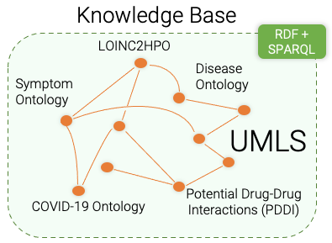
Introduction
Related Work
Task Innovation
Specific Aims
Conclusion
Aim
1
2
3
Aim 2 – Process – Steps 7,8
Reason using Knowledge Base to determine: contraindications, indications, risk factors, signs / symptoms, unspecified criteria.
intersect(
cond(C0241863 “Diabetic”),
union(
female(),
male()
),
age()
.num_filter(
eq(op(GT), val(“65”))
),
neg(
contraindication(
drug(C0025598 “metformin”)
)
)
)
intersect(
cond(CUI: C0241863 “Diabetic”),
union(
female(),
male()
),
age()
.num_filter(
eq(op(GT), val(“65”))
),
neg(
cond(C0220981 “Metabolic acidosis”),
drug(C3253985 “Dolutegravir”)
)
)

Slide 50
Introduction
Related Work
Task Innovation
Specific Aims
Conclusion
Aim
1
2
3
Aim 2 – Process – Step 9
Link to the Semantic Metadata Mapping to generate SQL statements.
Semantic Metadata Map
Logical forms
{
name: ”person”
columns:
{
name: “sex”
semantic_mappings:
C0086287 where sex = “F”
C0086582 where sex = “M”
}
{
name: “age”,
semantic_mappings: C0001779
}
{
name: “conditions”
columns:
{
name: “condition_code”
code_mappings:
ICD10 where code_source = “I10”
}
{
name: “code_source”
}
}
intersect(
C0241863, SAB: ICD10...
union(
C0086287,
C0086582,
),
C0001779
.num_filter(
eq(op(GT), val(“65”))
),
neg(
C0220981, SAB: ICD10...,
C3253985, SAB: RxNorm...
)
)
intersect(
cond(“Diabetic”),
union(
female(),
male()
),
age()
.num_filter(
eq(op(GT), val(“65”))
),
neg(
contraindication(
drug(“metformin”)
)
)
)
Semantic Metadata Mapping

Slide 51
Introduction
Related Work
Task Innovation
Specific Aims
Conclusion
Aim
1
2
3
Aim 2 – Process – Step 9
Use mapped database schema paired with logical forms to generate SQL statements using rules.
intersect(
C0241863 “condition_code”
union(
C0086287 “sex = ‘F’”,
C0086582 “sex = ‘M’”,
),
C0001779 “age”
.num_filter(
eq(op(GT), val(“65”))
),
neg(
C0220981 “condition_code”,
C3253985 “drug_code”
)
)
SELECT person_id FROM condition ...
INTERSECT
SELECT person_id FROM (
SELECT person_id FROM person
WHERE sex = ‘F’
UNION
SELECT person_id FROM person
WHERE sex = ‘M’
)
INTERSECT
SELECT person_id FROM person
WHERE age > 65
INTERSECT
SELECT person_id FROM person
WHERE NOT EXISTS...
SQL Generation

Slide 52
Introduction
Related Work
Task Innovation
Specific Aims
Conclusion
Aim
1
2
3
Aim 2 – Process – Step 10
Transform each eligibility criteria line into separate SQL statements, tracked using a SQL temporary table. Return incremental results after each line processed.
Execute criteria line 1
INSERT INTO #cohort
SELECT person_id, Step = 1 FROM ...
SELECT person_id, Step
FROM #cohort
WHERE Step = 1
Return line 1 incremental results
UPDATE #cohort
SET Step = 2
WHERE ...
Execute criteria line 2
SELECT person_id, Step
FROM #cohort
WHERE Step = 2
Return line 2 incremental results

Slide 53
Introduction
Related Work
Task Innovation
Specific Aims
Conclusion
Aim
1
2
3
Aim 2 – Multi-hop Reasoning
”Contraindications to drugs for conditions which affect respiration”
contraindication(
drug()
.for(
obs(“respiration”)
.change()
.caused_by(
cond()
)
)
)

Slide 54
Introduction
Related Work
Task Innovation
Specific Aims
Conclusion
Aim
1
2
3
Aim 2 – Multi-hop Reasoning
”Contraindications to drugs for conditions which affect respiration”
contraindication(
drug()
.for(
obs(“respiration”)
.change()
.caused_by(
cond()
)
)
)
1
Asthma causes changes to respiration

Slide 55
Introduction
Related Work
Task Innovation
Specific Aims
Conclusion
Aim
1
2
3
Aim 2 – Multi-hop Reasoning
”Contraindications to drugs for conditions which affect respiration”
contraindication(
drug()
.for(
obs(“respiration”)
.change()
.caused_by(
cond()
)
)
)
2
Methylprednisolone can be used to treat asthma
1
Asthma causes changes to respiration

Slide 56
Introduction
Related Work
Task Innovation
Specific Aims
Conclusion
Aim
1
2
3
Aim 2 – Multi-hop Reasoning
”Contraindications to drugs for conditions which affect respiration”
contraindication(
drug()
.for(
obs(“respiration”)
.change()
.caused_by(
cond()
)
)
)
Mycosis (fungal infection) is a contraindication to methylprednisolone
3
2
Methylprednisolone can be used to treat asthma
1
Asthma causes changes to respiration

Slide 57
Introduction
Related Work
Task Innovation
Specific Aims
Conclusion
Aim
1
2
3
Aim 2 – Evaluation
Extracted metadata on 165 clinical trials at UW between Jan. 2010 and Dec. 2021
At least 10 patients enrolled
Number of raw lines of eligibility criteria file <= 30
Grouped trials by “condition” field
Randomly chose 1 trial per condition (except cancer, where 2 chosen), 8 total
Generated SQL queries using LeafAI and human programmer
Data for each trial limited to data existing before end of trial.
Human instructed to
Skip criterion which cannot be known / computed or not in database
Reason about non-specific criteria where possible (e.g., symptoms, contraindications)

Slide 58
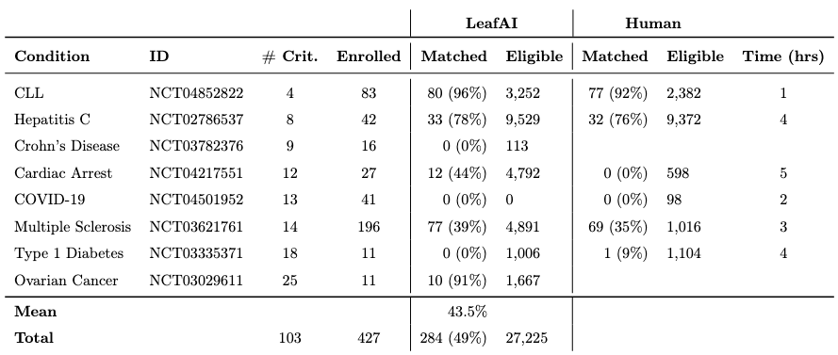
Introduction
Related Work
Task Innovation
Specific Aims
Conclusion
Aim
1
2
3
Aim 2 – Results
LeafAI found over 39% of matching patients in 5/8 trials
Zero patients matched in 3/8 trials
Human-generated query writing ongoing
~19 hours spent writing queries for 6 trials so far

Slide 59
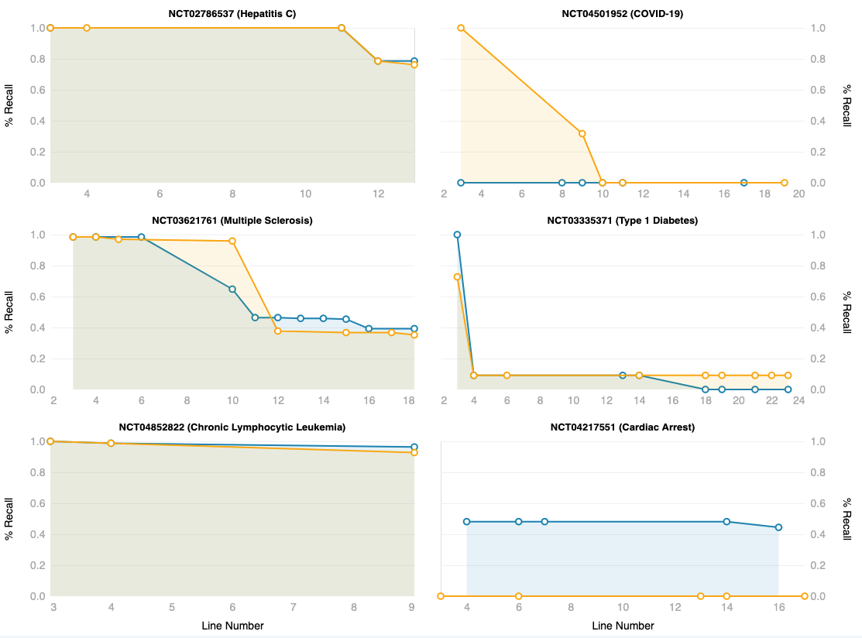
Introduction
Related Work
Task Innovation
Specific Aims
Conclusion
Aim
1
2
3
Aim 2 – Results
LeafAI
Human

Slide 60
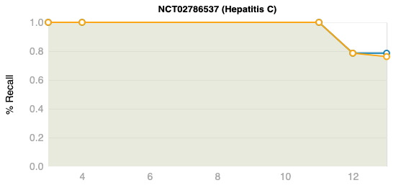
Introduction
Related Work
Task Innovation
Specific Aims
Conclusion
Aim
1
2
3
Aim 2 – Results
Exclusion: “Child Pugh (CTP) B or C Cirrhosis (documented CTP calculation is required)”
LeafAI
Human
Both LeafAI and human excluded 11 patients with diagnosis of Cirrhosis

Slide 61
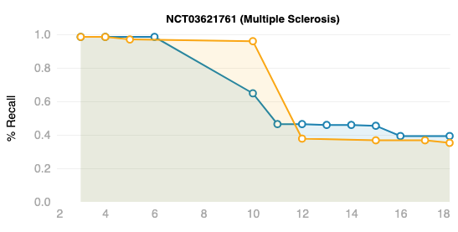
Introduction
Related Work
Task Innovation
Specific Aims
Conclusion
Aim
1
2
3
Aim 2 – Results
“Current shift work sleep disorder, or narcolepsy diagnosed with polysomnography and multiple sleep latency test”
LeafAI excluded patients with drowsiness, snoring, etc.
Exclusion: “Current stimulant or wake-promoting agent use (such as amantadine, modafinil, methylphenidate, or amphetamine) within 30 days of screening”
LeafAI
Human
Many patients had orders for stimulants.

Slide 62
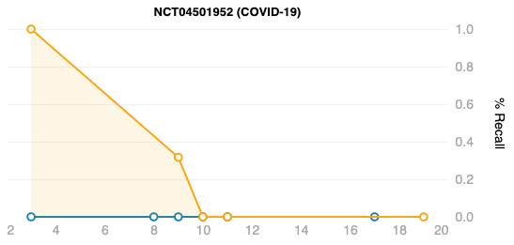
Introduction
Related Work
Task Innovation
Specific Aims
Conclusion
Aim
1
2
3
Aim 2 – Results
“Willing and able to provide written informed consent, (individuals ≥ 18 years of age) or assent (individuals ≥ 12 and < 18 years of age) prior to performing study procedures. Individuals age ≥ 18 years may be enrolled with the consent of a legal representative where permitted according to local law and approved nationally and by the relevant institutional review board (IRB) or independent ethics committee (IEC). For individuals ≥ 12 and < 18 years of age, a parent or legal guardian must be willing and able to provide written informed consent prior to performing study procedures”
LeafAI
Human
“Severe acute respiratory syndrome (SARS)-coronavirus (CoV)-2 infection confirmed by molecular diagnosis (nucleic acid (polymerase chain reaction (PCR) or antigen testing) ≤ 4 days prior to screening”
“Presence of ≥ 1 symptom(s) consistent with COVID-19 for ≤ 7 days prior to randomization”
Some patients had no PCR test. Others had no symptoms as diagnosis codes.

Slide 63
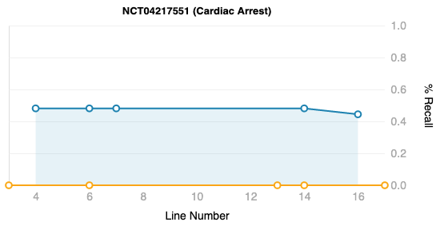
Introduction
Related Work
Task Innovation
Specific Aims
Conclusion
Aim
1
2
3
Aim 2 – Results
“Coma after resuscitation from out of hospital cardiac arrest”
Human queried for coma diagnosis, which no enrolled patients had. LeafAI failed to normalize “resuscitation”, so skipped.
LeafAI
Human
“Cooled to <34 deg C with 240 minutes of cardiac arrest”
LeafAI ignored the temperature, searched for diagnoses of cardiac arrest.

Slide 64
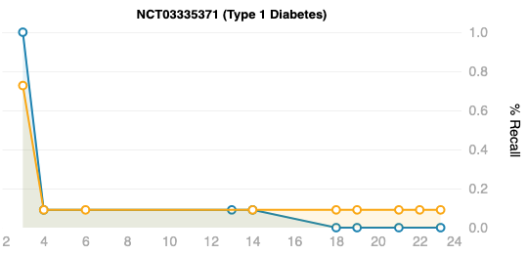
Introduction
Related Work
Task Innovation
Specific Aims
Conclusion
Aim
1
2
3
Aim 2 – Results
“People diagnosed with T1DM, confirmed diagnosis prior to 40 years of age and a diagnosed for minimum of 1 year.”
Human queried A1c > 6.5%, LeafAI used diagnosis codes.
LeafAI
“Type 1 diabetics using either continuous subcutaneous insulin infusion (with lispro or aspart) or multiple daily doses of insulin”
Human
Few patients had insulin orders.
Exclusion: “History or presence of symptomatic autonomic neuropathy or chronic gastrointestinal disease”
LeafAI excluded patients with diagnoses for abdominal pain, vomiting, constipation, etc.

Slide 65
Introduction
Related Work
Task Innovation
Specific Aims
Conclusion
Aim
1
2
3
Aim 2 – Summary
Created eligibility criteria text to Leaf Logical Form (LLF) corpus
Validation BLEU score 93.5%, inter-annotator agreement 82.4%
Created methods for query generation
Database schema agnostic
Capable of reasoning on non-specific criteria
Evaluated using 8 UW clinical trials
Matching patients in 5/8 trials
Mean 43% recall

Slide 66
Introduction
Related Work
Task Innovation
Specific Aims
Conclusion
Specific Aims
Aim 1
Aim 2
Aim 3
Create a human-annotated gold standard corpus of eligibility criteria.
Develop state-of-the-art NLP-based methods for generating SQL queries for cohort discovery from free-text.
Develop web application for finding patients meeting user-provided free-text eligibility criteria.
“Patients with ...”
SELECT FROM...

Slide 67
Introduction
Related Work
Task Innovation
Specific Aims
Conclusion
Aim
1
2
3
Aim 3 – Goals
Create an interactive self-service web application which generates and runs cohort discovery SQL queries on user-entered free-text criteria
User interface
Accessible user action history with chat-like interface
Previous actions and responses preserved above, new inputs inserted below
Rapid feedback, responsiveness from system
Explainability of system actions
Editable system responses enabling iteration, exploration

Slide 68

Introduction
Related Work
Task Innovation
Specific Aims
Conclusion
Aim
1
2
3
User-entered free-text eligibility criteria
Had a BMI between 35 and 40 within the past 6 months
Were treated with an SSRI or other antidepressant
Are aged 18 – 65 and don’t regularly exercise
Were seen in the emergency department in the past three years
Leaf AI’s response
I couldn’t identify patients who “don’t regularly exercise”, so you may need to refine your search, however:
53 patients were found:
1) 1,046 had a body mass index (BMI) between 35 and 40 (in the past 6 months)
2) 442 were treated with a Selective Serotonin Re-uptake Inhibitor (SSRI) or other antidepressant (anytime)
3) 421 are aged between 18 and 65
4) 53 were seen in the Emergency Department (in the past 3 years)

Slide 69
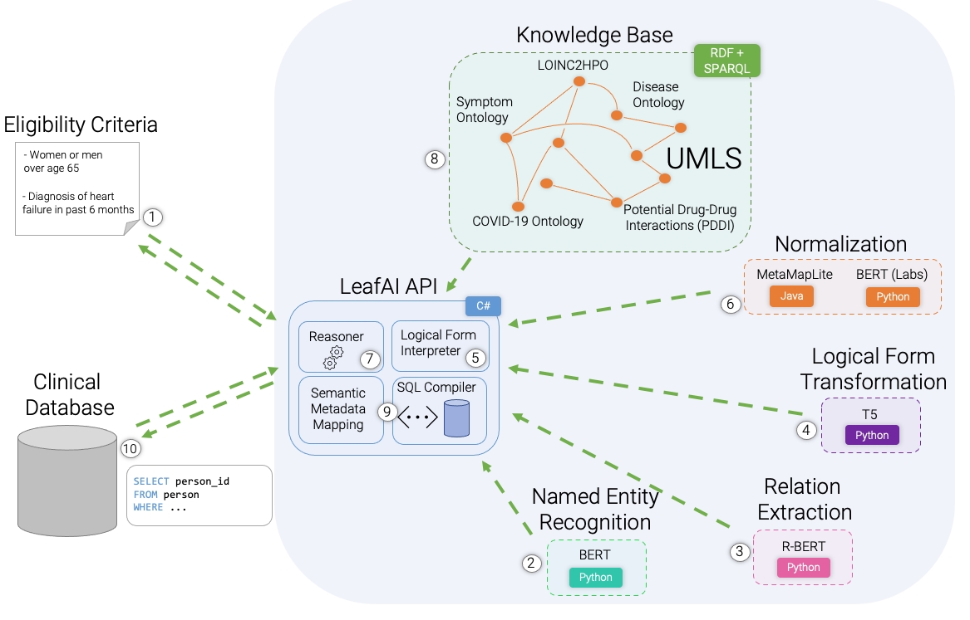
Introduction
Related Work
Task Innovation
Specific Aims
Conclusion
Aim
1
2
3
Aim 3 – Goals – Rapid feedback / Responsiveness
Bi-directional streaming interfaces between client and server.
Enables server to update client as to progress incrementally.

Slide 70
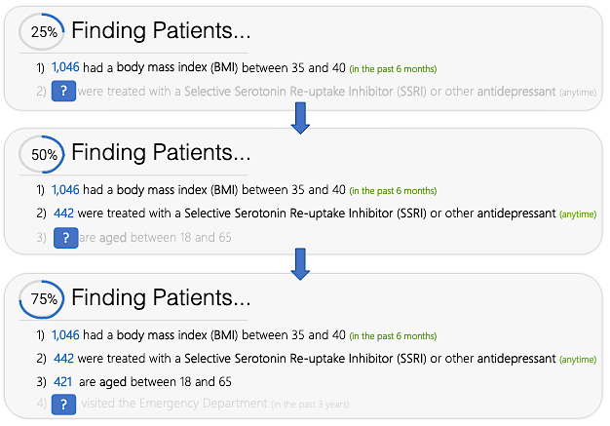
Introduction
Related Work
Task Innovation
Specific Aims
Conclusion
Aim
1
2
3
Aim 3 – Goals – Rapid feedback / Responsiveness
Each line of criteria executed as individual SQL statement
Streaming interfaces allow client to be updated incrementally as each line completed

Slide 71


Introduction
Related Work
Task Innovation
Specific Aims
Conclusion
Aim
1
2
3
Aim 3 – Goals – Explainability
If user writes eligibility criteria but does not know if system will understand until after queries executed:
Wasted time if query fails
Uncertainty, lack of trust in system
System will therefore perform NER and normalization as user types criteria
Allows user to better anticipate problems, understand system interpretation
BMI between 35 and 40 within the past 6 months
Body Mass Index (UMLS: C1305855)
A general indicator of the body fat an individual is carrying based upon the ratio of weight to height.
Previous diagnosis of Diabeets Mellitus
Unknown Condition (?)
LeafAI couldn’t figure out what this is. Check the spelling or try phrasing the name in another way.

Slide 72


Introduction
Related Work
Task Innovation
Specific Aims
Conclusion
Aim
1
2
3
Aim 3 – Goals – Explainability (cont.)
After query results returned, query inputs can be
Viewed and edited directly
Re-executed
Reasoned concepts can be enabled / disabled
1) 221 have contraindications to Metformin
Contraindications to Metformin
LeafAI found the following concepts which may be relevant. You can add or remove any of these and rerun your query.
Renal Insufficiency (UMLS: C0035078)
Dolutegravir (UMLS: C3253985)
+ Add Other Concepts

Slide 73
Introduction
Related Work
Task Innovation
Specific Aims
Conclusion
Aim
1
2
3
Aim 3 –Goals – Iterative exploration
User edits criteria based on results
Enabling user to directly edit previous query results
Saves time
Faster iteration, exploration
... have diagnosis of diabetes or A1c over 6.5%
... are over 18 30 years old
LeafAI responds with results
5,422 patients found
-6,149 have diagnosis of diabetes
-5,422 are over 18 years old
LeafAI responds with updated results
6,629 patients found
-7,587 have diagnosis of diabetes or A1c over 6.5%
-6,629 are over 30 years old
User provides initial criteria
-Have diagnosis of diabetes -Are over 18 years old

Slide 74
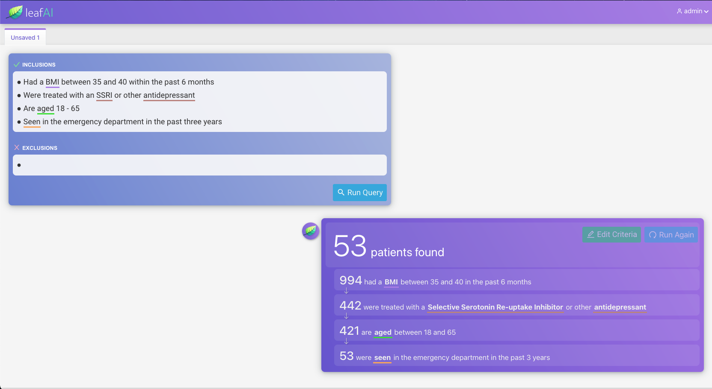

Slide 75
Introduction
Related Work
Task Innovation
Specific Aims
Conclusion
Aim
1
2
3
Aim 3 –Evaluation
2 methods
Usability / user satisfaction
Query accuracy matching patients real clinical trials’ eligibility criteria
Process
Recruit 10 researchers who have not used Leaf (or LeafAI)
Randomly assign
5 to Leaf group
5 to LeafAI group
Populate clinical database with patients from 5 clinical trials + other randomly selected patients not in trials
Train participants, assign each to find patients from 1 trial
Afterward, participants answer usability and user satisfaction questionnaire

Slide 76
Introduction
Related Work
Task Innovation
Specific Aims
Conclusion
Project Limitations
Both LCT and LLF corpora annotated by non-clinicians
Clinical trials evaluated only a small sample of all clinical trials, selected for only certain diseases and of shorter number of criteria
Queries generated use subsets of all data available within EHR
Certain queries and data likely cannot be handled by our system
As each criteria line processed individually, system fails in cases of multi-line coreferences. However,
Somewhat rare; only 78 coreference annotations in LCT corpus
Single-line processing arguably simplifies data entry process from user perspective in Aim 3

Slide 77
Introduction
Related Work
Task Innovation
Specific Aims
Conclusion
Future Work
Logical forms representations and methods can be adapted for general purpose question answering
Using predicates proposed by Roberts and Demner-Fuschman, such as latest(), λ(), or min() , our logical forms could be “wrapped”, e.g.
“Did the patient’s temperature exceed 38C in the last 48 hours?”
(1) Data retrieval
(2) Analysis
λ( measurement(”temperature”) .num_filter(eq(op(GT), val(”38”), unit(”C”))) .temporality(eq(op(LTEQ), val(”48”), unit(HOUR))) )
Sources:
-K. Roberts and D. Demner-Fushman. Annotating logical forms for EHR questions. In LREC... International Conference on Language Resources & Evaluation:[proceedings]. International Conference on Language Resources and Evaluation, volume 2016, page 3772. NIH Public Access, 2016.

Slide 78
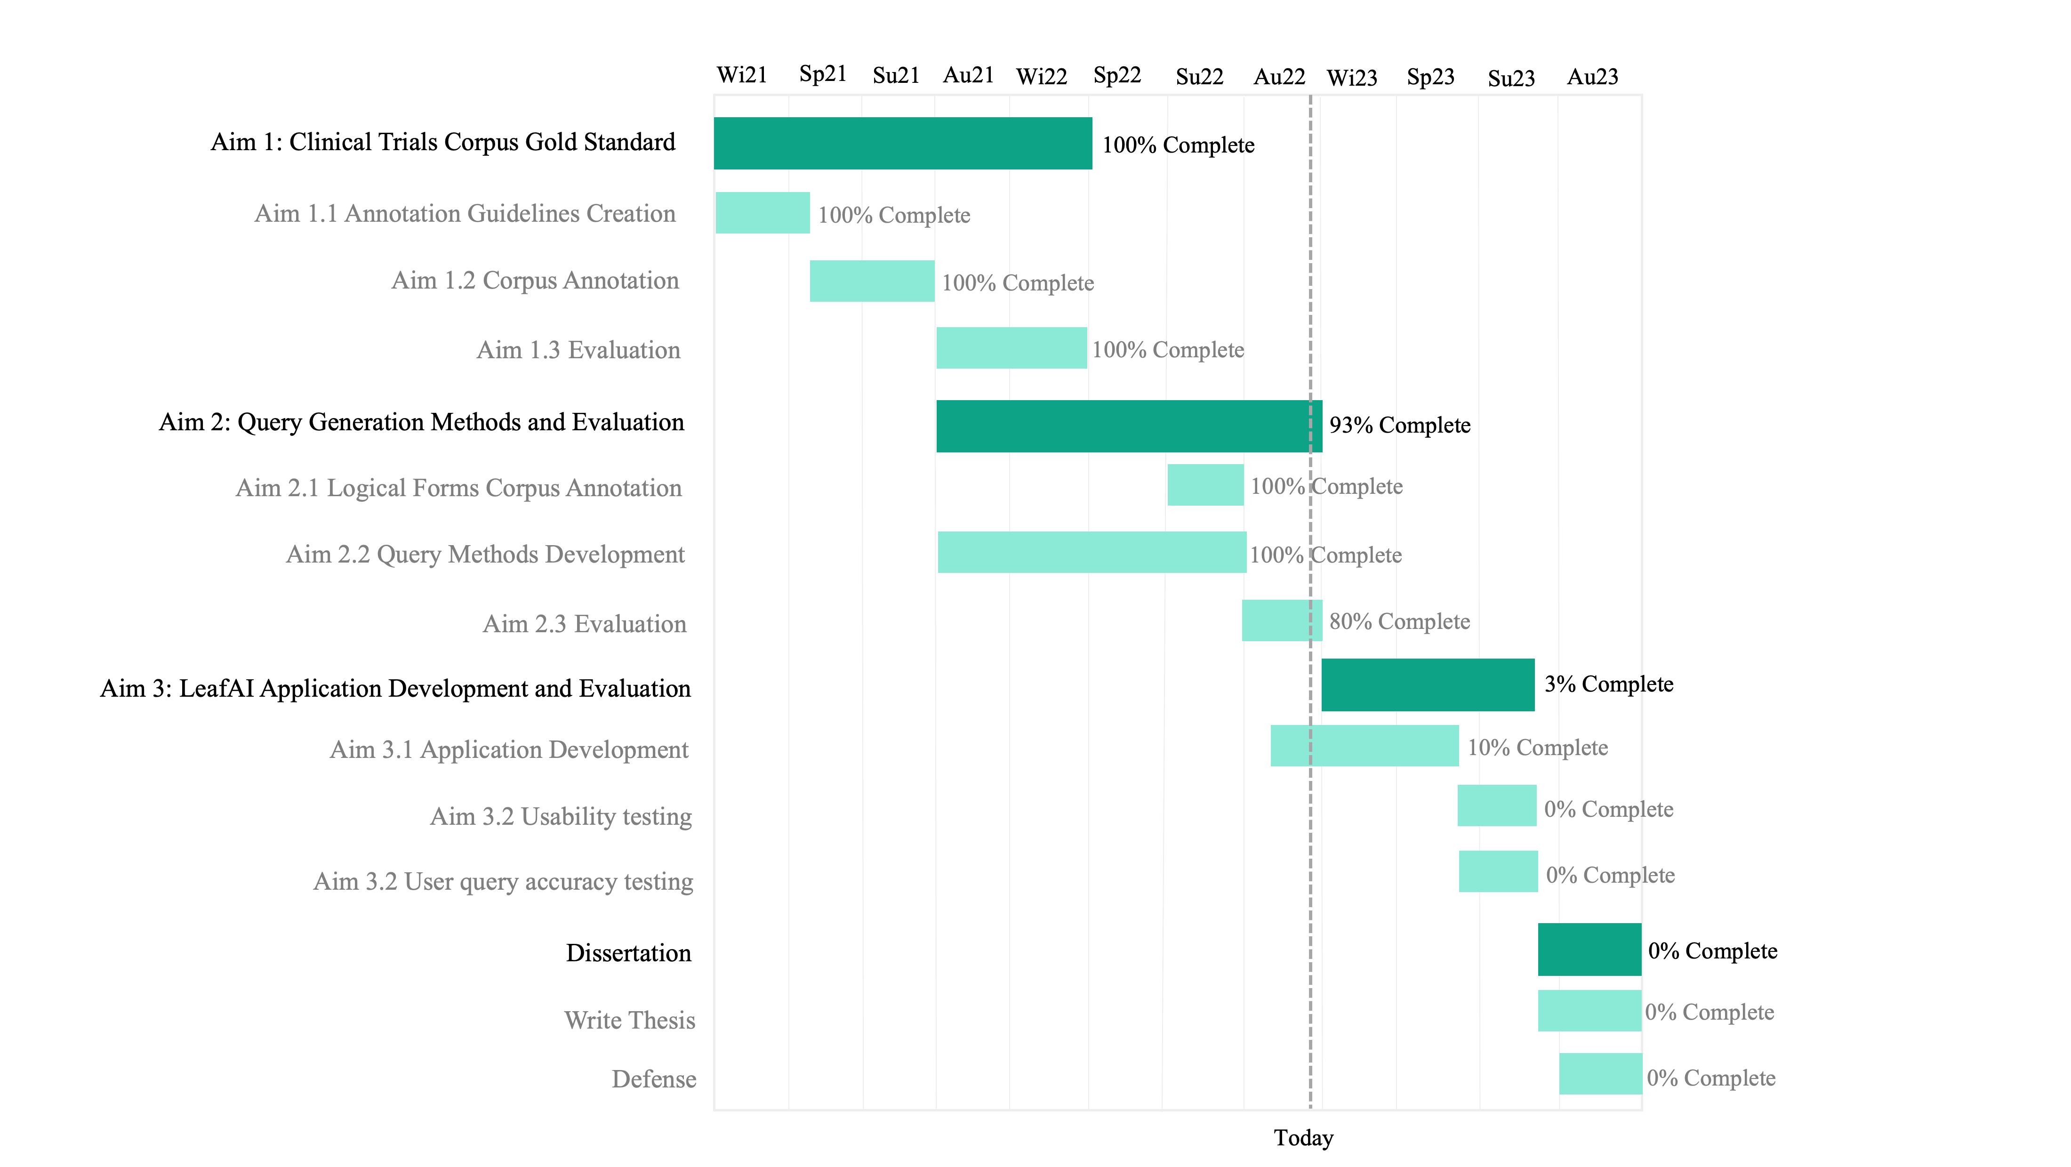
Introduction
Related Work
Task Innovation
Specific Aims
Conclusion
Timeline

Slide 79
Introduction
Related Work
Task Innovation
Specific Aims
Conclusion
Acknowledgements
My Committee Members
Meliha Yetisgen
Nina Kim
Trevor Cohen
Fei Xia
Annotators and Collaborators
Tony Mullen
Bin Han
Weipeng Zhou
Supporting Faculty
Sean Mooney
Peter Tarczy-Hornoch
Database Programmer
Kristine Lan
My family
Organizations
UWM Research IT
ITHS

Slide 80
Introduction
Related Work
Task Innovation
Specific Aims
Conclusion
Relevant First or Co-First Authored Work
Dobbins, N. J., Spital, C. H., Black, R. A., Morrison, J. M., De Veer, B., Zampino, E., ... & Mooney, S. D. (2020). Leaf: an open-source, model-agnostic, data-driven web application for cohort discovery and translational biomedical research. Journal of the American Medical Informatics Association, 27(1), 109-118.
Lee, K., Dobbins, N. J., McInnes, B., Yetisgen, M., & Uzuner, Ö. (2021). Transferability of neural network clinical deidentification systems. Journal of the American Medical Informatics Association, 28(12), 2661-2669.
Dobbins, N. J., Mullen, T., Uzuner, Ö., & Yetisgen, M. (2022). The Leaf Clinical Trials Corpus: a new resource for query generation from clinical trial eligibility criteria. Nature Scientific Data, 9(1), 1-15.
Lybarger, K., Dobbins, N.J., Long, R., Singh. A., Wedgeworth, P., Uzuner, O., Yetisgen, M. Leveraging natural language processing to augment structured social determinants of health data in the electronic health record. (submitting)

Slide 81
Introduction
Related Work
Task Innovation
Specific Aims
Conclusion
Questions?

