Slide 1


Knowledge Base
LOINC2HPO
RDF + SPARQL
Disease Ontology
Symptom Ontology
Eligibility Criteria
- Women or men over age 65
UMLS
8
- Diagnosis of heart failure in past 6 months
Potential Drug-Drug Interactions (PDDI)
1
COVID-19 Ontology
Normalization
LeafAI API
MetaMapLite
BERT (Labs)
C#
6
Java
Python
Reasoner
Logical Form Interpreter
7
5
Logical Form Transformation
Clinical Database
SQL Compiler
Semantic Metadata Mapping
9
T5
4
Python
10
SELECT person_id
FROM person
WHERE ...
Named Entity Recognition
Relation Extraction
BERT
3
R-BERT
2
Python
Python

Slide 2
Knowledge Base
LOINC2HPO
RDF + SPARQL
Disease Ontology
Symptom Ontology
Eligibility Criteria
UMLS
- Women or men over age 65
Potential Drug-Drug Interactions (PDDI)
COVID-19 Ontology
- Diagnosis of heart failure in past 6 months
Normalization
LeafAI API
MetaMapLite
BERT (Labs)
C#
Java
Python
Reasoner
Logical Form Interpreter
Clinical Database
Logical Form Transformation
Semantic Metadata Mapping
SQL Compiler
T5
SELECT person_id
FROM person
WHERE ...
Python
Named Entity Recognition
Relation Extraction
BERT
R-BERT
Python
Python

Slide 3
Normalization
Eligibility Criteria
Knowledge Base
MetaMapLite
BERT (Labs)
- Women or men over age 65
Java
Python
LOINC2HPO
RDF + SPARQL
- Diagnosis of heart failure in past 6 months
Disease Ontology
LeafAI API
Symptom Ontology
C#
Reasoner
Logical Form Interpreter
UMLS
Clinical Database
Semantic Metadata Mapping
SQL Compiler
Potential Drug-Drug Interactions (PDDI)
COVID-19 Ontology
SELECT person_id
FROM person
WHERE ...
Logical Form Transformation
Named Entity Recognition
Relation Extraction
T5
BERT
R-BERT
Python
Python
Python

Slide 4
Knowledge Base
LOINC2HPO
RDF + SPARQL
Disease Ontology
Symptom Ontology
Eligibility Criteria
- Women or men over age 65
UMLS
8
- Diagnosis of heart failure in past 6 months
Potential Drug-Drug Interactions (PDDI)
1
COVID-19 Ontology
Normalization
LeafAI API
MetaMapLite
BERT (Labs)
C#
6
Java
Python
Reasoner
Logical Form Interpreter
7
5
Logical Form Transformation
Clinical Database
SQL Compiler
Semantic Metadata Mapping
9
T5
4
Python
10
SELECT person_id
FROM person
WHERE ...
Named Entity Recognition
Relation Extraction
BERT
3
R-BERT
2
Python
Python

Slide 5
“Diabetics aged over 65 with no contraindications to metformin”
SELECT... FROM condition WHERE dx_code...
INTERSECT SELECT... FROM person WHERE age > 65
INTERSECT SELECT... FROM person WHERE NOT EXISTS
(SELECT... FROM condition WHERE dx_code...
SELECT... FROM medication WHERE med_code...)
Raw input
Link to Semantic Metadata Mapping and generate SQL queries
Numeric-Filter
Condition
Age
Eq-Comparison
Predict named entities and relations
Diabetics
aged
over 65
with
Operator: Greater Value: “65”
intersect(
cond(CUI: C0241863), age()
.num_filter(eq(op(GT), val(65))),
neg(
cond(CUI: C0035078), “Renal Insufficiency” drug(CUI: C3253985) “Dolutegravir”
)
)
Negates
Contraindicates
Negation
Contraindication
Drug
Use Knowledge Base to reason upon unspecified criteria
no
contraindications
to
metformin
Prepare logical form input
“cond(“Diabetics”) age() eq(op(GT), val(“65”)) with neg() contraindication() to drug(“metformin”)”
intersect(
cond(CUI: C0241863), age()
.num_filter(eq(op(GT), val(65))),
neg(
contraindication(
drug(CUI: C0025598).
)
)
)
intersect(
cond(“Diabetics”), age()
.num_filter(eq(op(GT), val(“65”))),
neg(
contraindication(
drug(“metformin”)
)
)
)
Normalize to UMLS concepts
Transform to logical form structure

Slide 6
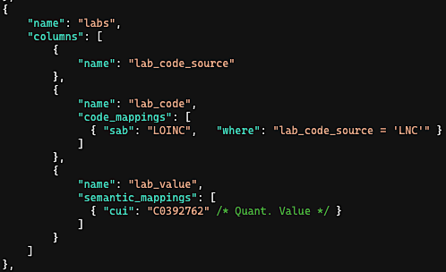
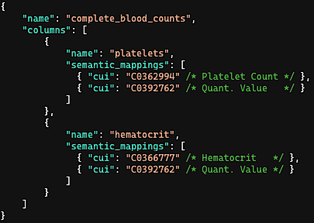
Eligibility Criteria
lab(CUI: C0362994, LOINC: 777-3, “Platelet count”)
.num_filter(eq(op(LT), val(“250”)))
(1) Tall Table Structure
(2) Pivoted Table Structure
Example SQL Record
patient_id | lab_code_source | lab_code | lab_value
ABC | LNC | 777-3 | 211
patient_id | platelets | hematocrit
ABC | 211 | 38.4
Semantic Metadata
Mapping
Generated Query
SELECT patient_id
FROM labs
WHERE lab_code_source = ‘LNC’ AND lab_code = ‘777-3’
AND lab_value < 250
SELECT patient_id
FROM complete_blood_counts
WHERE platelets < 250

Slide 7
2
Named Entity Recognition (NER) using BERT and Relation Extraction using R-BERT.
Or
Numeric-Filter
“- Diabetic women and men aged over 65 with no contraindications to metformin”
Condition
Female
Male
Age
Eq-Comparison
-
Diabetic
women
and
men
aged
over 65
Operator: Greater Value: “65”
Negates
Contraindicates
Negation
Contraindication
Drug
with
no
contraindications
to
metformin
Named Entity Recognition
Relation Extraction
BERT
R-BERT
Python
Python

Slide 8
3
Transform to logical form prediction input string, replacing raw text named entities values with named entities names and removing any hypothetical events.
Or
Numeric-Filter
“- cond(“Diabetic”) female() and male()
age() eq(op(GT), val(“65”))
with neg() contraindication() to
drug(“metformin”)”
Condition
Female
Male
Age
Eq-Comparison
-
Diabetic
women
and
men
aged
over 65
Operator: Greater Value: “65”
Negates
Contraindicates
Negation
Contraindication
Drug
with
no
contraindications
to
metformin

Slide 9
4
Predict structured logical form using fine-tuned T5 model, output as a string. Then, parse logical forms and instantiate as in-memory nested object structure.
intersect(
cond(“Diabetic”),
union(
female(),
male()
),
age()
.num_filter(
eq(op(GT), val(“65”))
),
neg(
contraindication(
drug(“metformin”)
)
)
)
“- cond(“Diabetic”) female() and
male() age() eq(op(GT), val(“65”))
with neg() contraindication() to
drug(“metformin”)”
Logical Form Transformation
T5
Python

Slide 10
5
Normalize to UMLS concepts using MetaMapLite and BERT (the latter only in the case of lab tests).
intersect(
cond(“Diabetic”),
...
neg(
contraindication(
drug(“metformin”)
)
)
)
intersect(
cond(CUI: C0241863 “diabetic”),
...
neg(
contraindication(
drug(CUI: C0025598 “metformin”)
)
)
)
Normalization
MetaMapLite
BERT (Labs)
Java
Python

Slide 11
6
Reason using Knowledge Base to determine: (1) Contraindications (2) Indications (3) Risk factors (4) Signs / symptoms
(5) Unspecified criteria (e.g., “conditions that affect respiratory function”).
intersect(
...
neg(
contraindication(
drug(CUI: C0025598 “metformin”)
)
)
)
intersect(
...
neg(
cond(CUI: C0035078 “Renal Insufficiency”),
cond(CUI: C0220981 “Metabolic acidosis”),
drug(CUI: C0025598 “Furosemide”),
drug(CUI: C3253985 “Dolutegravir”),
...
)
)
Knowledge Base
LOINC2HPO
RDF + SPARQL
Disease Ontology
Symptom Ontology
UMLS
ICD{9|10}, SNOMED Mappings
Potential Drug-Drug Interactions (PDDI)

Slide 12

User-entered free-text eligibility criteria
Had a BMI between 35 and 40 within the past 6 months
Were treated with an SSRI or other antidepressant
Are aged 18 – 65 and don’t regularly exercise
Were seen in the emergency department in the past three years
Leaf AI’s response
I couldn’t identify patients who “don’t regularly exercise”, so you may need to refine your search, however:
53 patients were found:
1) 1,046 had a body mass index (BMI) between 35 and 40 (in the past 6 months)
2) 442 were treated with a Selective Serotonin Re-uptake Inhibitor (SSRI) or other antidepressant (anytime)
3) 421 are aged between 18 and 65
4) 53 were seen in the Emergency Department (in the past 3 years)

Slide 13
25%
Finding Patients...
1) 1,046 had a body mass index (BMI) between 35 and 40 (in the past 6 months)
2) 442 were treated with a Selective Serotonin Re-uptake Inhibitor (SSRI) or other antidepressant (anytime)
?
50%
Finding Patients...
1) 1,046 had a body mass index (BMI) between 35 and 40 (in the past 6 months)
2) 442 were treated with a Selective Serotonin Re-uptake Inhibitor (SSRI) or other antidepressant (anytime)
3) 421 are aged between 18 and 65
?
75%
Finding Patients...
1) 1,046 had a body mass index (BMI) between 35 and 40 (in the past 6 months)
2) 442 were treated with a Selective Serotonin Re-uptake Inhibitor (SSRI) or other antidepressant (anytime)
3) 421 are aged between 18 and 65
4) 53 visited the Emergency Department (in the past 3 years)
?

Slide 14


1) 221 have contraindications to Metformin
Contraindications to Metformin
LeafAI found the following concepts which may be relevant. You can add or remove any of these and rerun your query.
Renal Insufficiency (UMLS: C0035078)
Dolutegravir (UMLS: C3253985)
+ Add Other Concepts

Slide 15


BMI between 35 and 40 within the past 6 months
Previous diagnosis of Diabeets Mellitus
Body Mass Index (UMLS: C1305855)
A general indicator of the body fat an individual is carrying based upon the ratio of weight to height.
Unknown Condition (?)
LeafAI couldn’t figure out what this is. Check the spelling or try phrasing the name in another way.

Slide 16
User edits criteria based on results
... have diagnosis of diabetes or A1c over 6.5%
... are over 18 30 years old
LeafAI responds with results
5,422 patients found
-6,149 have diagnosis of diabetes
-5,422 are over 18 years old
LeafAI responds with updated results
6,629 patients found
-7,587 have diagnosis of diabetes or A1c over 6.5%
-6,629 are over 30 years old
User provides initial criteria
-Have diagnosis of diabetes -Are over 18 years old

Slide 17
Wi21
Sp21
Su21
Au21
Wi22
Sp22
Su22
Au22
Wi23
Sp23
Su23
Au23
Aim 1: Clinical Trials Corpus Gold Standard
100% Complete
Aim 1.1 Annotation Guidelines Creation
100% Complete
Aim 1.2 Corpus Annotation
100% Complete
Aim 1.3 Evaluation
100% Complete
Aim 2: Query Generation Methods and Evaluation
93% Complete
Aim 2.1 Logical Forms Corpus Annotation
100% Complete
Aim 2.2 Query Methods Development
100% Complete
Aim 2.3 Evaluation
80% Complete
Aim 3: LeafAI Application Development and Evaluation
3% Complete
Aim 3.1 Application Development
10% Complete
Aim 3.2 Usability testing
0% Complete
Aim 3.2 User query accuracy testing
0% Complete
Dissertation
0% Complete
Write Thesis
0% Complete
Defense
0% Complete
Today

Slide 18
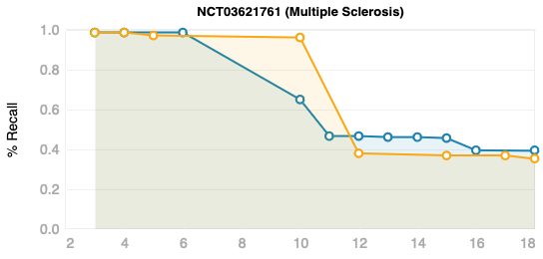
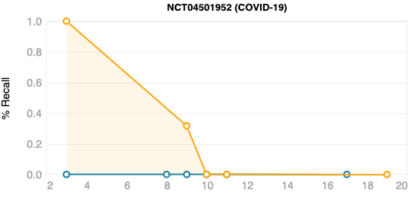
LeafAI
Human
Exclusion: “Current shift work sleep disorder, or narcolepsy diagnosed with polysomnography and multiple sleep latency test”
LeafAI excluded patients with diagnoses of drowsiness, snoring, etc.
Exclusion: “Current stimulant or wake-promoting agent use (such as amantadine, modafinil, methylphenidate, or amphetamine) within 30 days of screening”
Many patients appeared to have orders for stimulants over the course of the trial.
“Severe acute respiratory syndrome (SARS)-coronavirus (CoV)-2 infection confirmed by molecular diagnosis (nucleic acid (polymerase chain reaction (PCR) or antigen testing) ≤ 4 days prior to screening”
Some patients had no PCR or antigen results in our system during this time and are presumed to been tested elsewhere.
“Willing and able to provide written informed consent, (individuals ≥ 18 years of age) or assent (individuals ≥ 12 and < 18 years of age) prior to performing study procedures. Individuals age ≥ 18 years may be enrolled ... For individuals ≥ 12 and < 18 years of age ....”
LeafAI queried for patients older than 18 and younger than 18 and older than 12, which is not possible, and found zero.

Slide 19
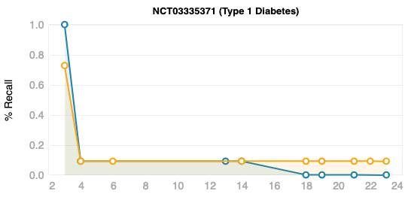
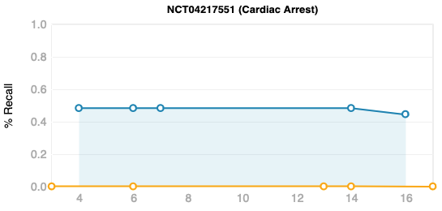
LeafAI
Human
“People diagnosed with T1DM, confirmed diagnosis prior to 40 years of age and a diagnosed for minimum of 1 year.”
Human queried using A1c > 6.5%, while LeafAI use diagnosis codes.
“Type 1 diabetics using either continuous subcutaneous insulin infusion (with lispro or aspart) or multiple daily doses of insulin”
Few patients appeared to have insulin orders within our system.
“Cooled to <34 deg C within 240 minutes of cardiac arrest”
LeafAI failed to normalize “deg”, so ignored the temperature, but searched for diagnoses of cardiac arrest.
“Coma after resuscitation from out of hospital cardiac arrest”
Human queried for coma diagnosis, which no enrolled patients had. LeafAI failed to normalize “resuscitation” and skipped this criterion.

Slide 20
LeafAI
Human
(A)
Exclusion: “Current shift work sleep disorder, or narcolepsy diagnosed with polysomnography and multiple sleep latency test”
LeafAI excluded patients with diagnoses of drowsiness, snoring, etc.
Exclusion: “Current stimulant or wake-promoting agent use (such as amantadine, modafinil, methylphenidate, or amphetamine) within 30 days of screening”
Many patients appeared to have orders for stimulants over the course of the trial, though those orders may not have occurred within 30 days of screening, the dates of which were unknown to the human programmer and LeafAI.
(B)
“Severe acute respiratory syndrome (SARS)-coronavirus (CoV)-2 infection confirmed by molecular diagnosis (nucleic acid (polymerase chain reaction (PCR) or antigen testing) ≤ 4 days prior to screening”
Some patients had no PCR or antigen results in our system during this time and are presumed to been tested elsewhere.
“Willing and able to provide written informed consent, (individuals ≥ 18 years of age) or assent (individuals ≥ 12 and < 18 years of age) prior to performing study procedures. Individuals age ≥ 18 years may be enrolled ... For individuals ≥ 12 and < 18 years of age ....”
LeafAI queried for patients older than 18 and younger than 18 and older than 12, which is not possible, and found zero.
(C)
“People diagnosed with T1DM, confirmed diagnosis prior to 40 years of age and a diagnosed for minimum of 1 year.”
Human queried using A1c > 6.5%, while LeafAI use diagnosis codes.
“Type 1 diabetics using either continuous subcutaneous insulin infusion (with lispro or aspart) or multiple daily doses of insulin”
Few patients appeared to have insulin orders within our system. We hypothesize that most of the enrolled instead receive insulin from pharmacies outside of our hospital system.
(D)
“Cooled to <34 deg C within 240 minutes of cardiac arrest”
LeafAI failed to normalize “deg”, so ignored the temperature, but searched for diagnoses of cardiac arrest.
“Coma after resuscitation from out of hospital cardiac arrest”
Human queried for coma diagnosis, which no enrolled patients had. LeafAI failed to normalize “resuscitation” and skipped this criterion.
Criteria Line #

