Slide 1


CONFIDENTIAL — RISK DIVISION
FEBRUARY 2026
Cyber Risk Sectorial Assessment: Automotive Sector 2026
A comprehensive threat intelligence briefing for Risk Executives on the evolving cybersecurity landscape across the global automotive and smart mobility ecosystem — informed by 494 publicly reported incidents in 2025 and the landmark Jaguar Land Rover systemic event.

Slide 2
CHAPTER 1
THREAT LANDSCAPE
Key Threats & Top 5 Cyber Attacks
The automotive cybersecurity landscape underwent a fundamental transformation in 2025. The convergence of software-defined vehicles, AI integration, and API-driven connectivity has created an attack surface extending far beyond traditional vehicle boundaries into manufacturing ecosystems, supply chains, and critical infrastructure.
Ransomware Dominance
API-Centric Attacks
Supply Chain Compromise
44% of all incidents in 2025 — more than doubling from 2024. 108 ransom attacks accompanied by 214 data breaches. Average demand: $5.08M. Vehicle-level ransomware demonstrated mid-2025.
67% of incidents involved telematics and cloud systems. CDK Global attack hit 15,000 dealerships with $1.02B losses. LLM prompt injection emerging as new vector.
Third-party involvement nearly doubled to 30% of incidents. Vehicles contain 30,000–50,000 components from thousands of suppliers. Tier 2–3 suppliers remain structurally vulnerable.
Data Exfiltration
EV Charging Infrastructure
68% of incidents involved data theft. 530 vulnerabilities identified in 2024, including 174 zero-days from Pwn2Own Automotive. Location, ADAS, and firmware data at critical risk.
Cross-sector threat combining energy and vehicle systems. Demonstrated attacks via V2G Evil tool. Botnet-driven grid destabilization carries national security implications.
Ransomware Escalation: 2024 → 2025
Metric | 2024 Baseline | 2025 Actual | Change
Share of automotive incidents | ~20% | 44% | +120%
Reported ransom attacks | ~50 | 108 | +116%
Associated data breaches | ~90 | 214 | +138%
Average ransom demand | $5.08M | $5.08M | Flat
OT/manufacturing targeting | Limited | Widespread | Critical shift
Direct vehicle compromise | None reported | Documented cases | New vector
Automotive-Specific Vulnerabilities
Beyond threat categories, the sector exhibits structural vulnerabilities that amplify risk and complicate mitigation.
1
2
SDV Architecture Risks
IT/OT Convergence Gaps
OTA update mechanisms create persistent attack vectors. Inverse relationship between innovation velocity and security maturity at higher abstraction layers.
IT security incidents automatically become OT incidents. JLR's IT shutdown halted manufacturing — reflecting insufficient segmentation across the industry.
3
4
Third-Party & Open-Source Risk
AI/ML System Vulnerabilities
Modern vehicles incorporate 100M+ lines of code, mostly from third parties. SBOM adoption remains inconsistent; transitive dependencies create hidden exposure.
Adversarial examples, prompt injection, data poisoning, and model extraction introduce novel failure modes in safety-critical autonomous driving systems.

Slide 3
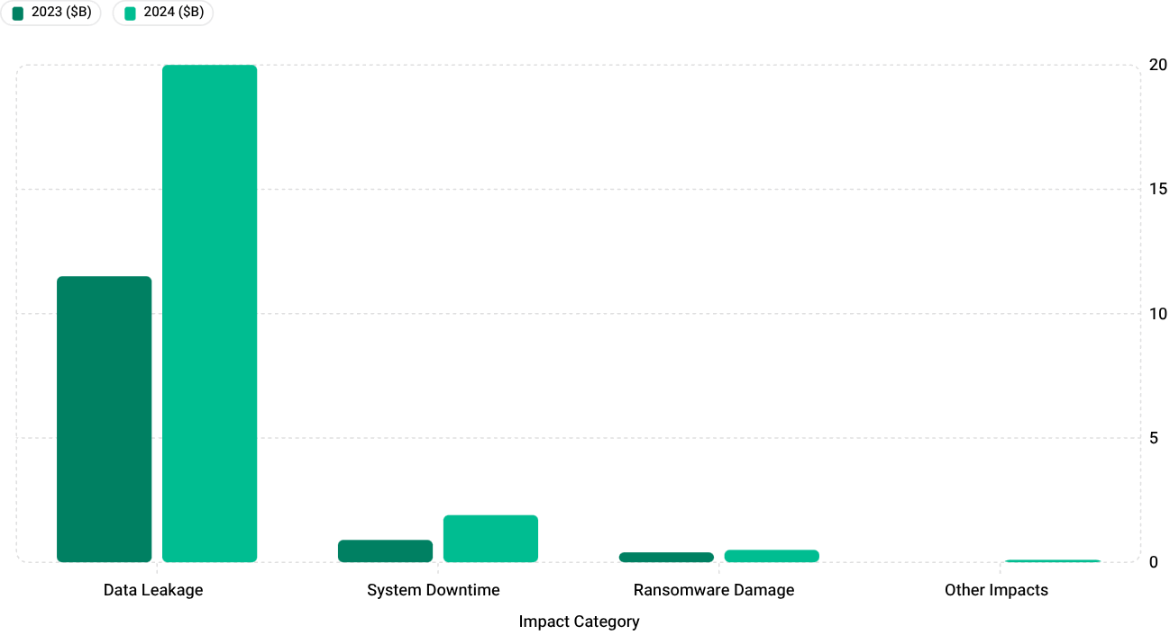
CHAPTER 2
FINANCIAL IMPACT
Financial Impact of Cyber Incidents
The automotive ecosystem experienced a dramatic cost escalation in 2024, with total estimated impact reaching $22.5 billion — a 76% year-over-year increase. This growth substantially exceeds general cyber risk trends, driven by connected vehicle proliferation, manufacturing digitization, and supply chain complexity.
Industry-Wide Impact Breakdown (2024)
$22.5B
Total 2024 Impact
+76% year-over-year
89%
Data Leakage Share
Dominant cost driver
+111%
Downtime Cost Growth
Operational targeting surge
Cost Breakdown by Category
Direct Costs
Indirect Costs
Automotive-Specific Drivers
Business disruption: $3.26M (59%). Detection & response: $1.44M (28%). Regulatory fines: ~$0.53M. Ransom payments: $5.08M avg when paid.
Supply chain penalties: £127M (JLR). Supplier financing: £156M + £1.5B guarantee. Customer compensation, insurance premium increases, long-term market share loss.
Production shutdown: ~£50M/week. Vehicle recall: $500M–$1B per campaign. Engineering security overhead: 10–15%. No substitution for fixed-cost manufacturing.
Average Breach Cost: Automotive vs. All Industries (2025)
Sector / Region | Average Cost | vs. Global Average | Source
Global Average | $4.44M | Baseline (−9% YoY) | IBM 2025
Manufacturing / Automotive | ~$5.00M | +12.6% | Industry est.
United States | $10.22M | +130% | IBM 2025
Healthcare | $7.42M | +67% | IBM 2025
Financial Services | $6.08M | +37% | IBM 2025
Germany | $4.03M | −9% | IBM 2025
United Kingdom | $4.14M | −7% | IBM 2025
The automotive sector's 12.6% premium reflects structural factors unlikely to diminish: OT integration, IP value, and supply chain complexity. JLR's £882M ($1.17B) in company-specific losses demonstrates that tail risk can be extreme — far exceeding any average. Composite automotive premium estimated at +75–120% vs. pure IT.

Slide 4

CHAPTER 3
WORST-CASE SCENARIOS
Financial Impact: Worst-Case Scenarios
While historical data provides essential baselines, evolving threats and increasing connectivity create potential for incidents that substantially exceed historical experience. Scenario analysis enables risk executives to evaluate tail risk exposure.
CMC Severity Classification Framework
Category | Impact Range | Characteristics | Automotive Relevance
1 | <£10M | Limited organizational impact | Routine incidents
2 | £10M–£1B | Significant organizational impact | Major OEM, limited cascade
3 | £1B–£5B | Severe, lasting economic effects | JLR demonstrated
4 | £5B–£25B | National economic impact | Plausible near-term; multi-OEM
5 | >£25B | International systemic impact | National transportation paralysis
Catastrophic Scenario Modelling
1
2
3
Mass Fleet Immobilization
Critical Infrastructure Integration Failure
Autonomous Vehicle Safety Compromise
100,000+ connected vehicles compromised simultaneously. Estimated impact: $40–115 billion. 61% of 2025 incidents had potential to impact thousands to millions of assets. Vehicle-level ransomware demonstrated mid-2025.
Coordinated EV charging attack exploiting grid integration. Estimated impact: $5–15 billion. Tens of millions of V2G-capable vehicles by 2030 create sufficient aggregate power for grid destabilization.
Adversarial manipulation of AV perception and decision systems. Estimated impact: $60–210 billion. Potential for permanent AV deployment halt. Adversarial examples demonstrated across all major perception modalities.
Long-Term Financial Consequences
Organizational Impact (JLR Evidence)
Systemic & Macroeconomic Effects
Q2 FY26: £485M pre-tax loss vs. £398M profit prior year
Q3 FY26: 43.3% wholesale volume decline
YTD FY26: £444M cumulative loss vs. £1.6B profit prior year
Full financial recovery extends well beyond operational recovery
GDP impact: −0.17 percentage points (Bank of England)
104,000+ supply chain jobs at risk
Government intervention: £1.5B loan guarantee
Insurance market: JLR reportedly underinsured; capacity contraction sector-wide
Regulatory & Legal Exposure: Product liability for cyber-physical incidents is expanding. Class action litigation increasing in volume and settlement size. SEC/FCA disclosure requirements intensifying. Criminal executive liability emerging as a possibility for severe future incidents.

Slide 5
CHAPTER 4
CASE STUDY
Case Study: Jaguar Land Rover Cyberattack
August – November 2025 · The most financially damaging cyber event in UK history
Attack Profile
Detection | Late August 2025
Disclosure | September 2, 2025
Vector | Social engineering → IT network intrusion
Threat Actor | "Scattered Lapsus$ Hunters"
Response | Proactive global IT shutdown (Sep 1)
Shutdown | 6 weeks complete production halt
Full Recovery | Mid-November 2025
CMC Rating | Category 3 — highest ever assigned
Global scope: UK (Solihull, Halewood, Wolverhampton), Slovakia, China, India, Brazil all simultaneously affected. Forensic investigation revealed extensive system contamination with multiple restart setbacks in October.
Financial Impact
£882M
£1.9B
27%
£1.5B
Total Company Impact
UK Economic Impact
UK Car Production Decline
Government Loan Guarantee
$1.17B — excludes long-term effects
$2.5B — CMC estimate; 5,000+ businesses affected
September 2025 — worst since 1952
UK Export Finance — supply chain stabilization
"With a cost of nearly £2 billion, this incident looks to have been by some distance, the single most financially damaging cyber event ever to hit the UK." — Ciaran Martin, former CEO, National Cyber Security Centre
Operational Impact Timeline
Late Aug 2025
Intrusion detected. Anomalous activity and reconnaissance observed.
Sep 1, 2025
Global IT shutdown. All production halted. ~5,000 vehicles/week lost.
Sep 28, 2025
Government announces £1.5B loan guarantee and supplier financing.
Oct 1–14, 2025
Phased restart attempts. Multiple setbacks from system contamination.
Mid-Nov 2025
Normal production restored. Total duration: ~11 weeks detection to full restoration.
Key Lessons Learned
IT/OT Convergence
Supply Chain Cascade
Manufacturing dependent on IT for core functions — single point of failure with no graceful degradation. Binary shutdown decision required.
5,000+ organizations affected. £156M supplier support + £1.5B government guarantee required to prevent broader economic contagion.
Resilience Absence
Strategic Imperatives
No manual fallback or parallel production capacity. Extended recovery with no operational alternatives. Insurance coverage gap at time of attack.
Board-level cyber governance. Zero-trust OT segmentation. Pre-negotiated government intervention frameworks. Structured supplier notification protocols.

Slide 6
CHAPTER 5
MITIGATION & RECOMMENDATIONS
Mitigation Strategies
Evidence-based cybersecurity approaches for the automotive sector, with implementation metrics benchmarked against demonstrated incident costs — including the JLR reference case of £50M/week production downtime.
Implementation Metrics Summary
Strategy | Effectiveness | Implementation Cost | ROI Timeline | ROI | Priority
Zero Trust IT/OT | 60% risk reduction | $2–5M (mid-size OEM) | 24 months | 3:1 | Critical
AI Threat Detection | 25% incident reduction | $1–3M + $500K/yr | 18 months | 4:1 | High
Supply Chain Security | 40% supply chain risk reduction | $500K–1.5M | 12 months | 5:1 | Critical
SSDLC / ISO 21434 | 50% vulnerability reduction | 10–15% dev overhead | 24 months | 6:1 | High
OT Resilience | 70% downtime reduction | $5–15M (major facilities) | 12 months | 2:1 | Critical
Organizations with extensive AI-driven security achieved 80-day reduction in breach lifecycle and $1.9M average cost savings per incident (34% reduction) compared to organizations without automation.
Automotive-Specific Security Framework
Regulatory Foundation
Organizational Structure
UN R155/R156 mandatory for new vehicles. ISO/SAE 21434 becoming procurement prerequisite. EU Cyber Resilience Act phased 2024–2027.
CISO reporting to CEO. Vehicle Cybersecurity Director under CTO. Manufacturing Security Manager. Supply Chain Security Coordinator.
Technical Controls
Operational Processes
Vehicle: secure boot, HSMs, signed firmware, IDS. Manufacturing: IT/OT micro-segmentation, air-gapped backups. Enterprise: zero trust, EDR/XDR, SOAR.
OT-specific incident playbooks. Annual business continuity testing. Continuous pen testing & bug bounty. Auto-ISAC membership & threat intelligence.
Bank-Specific Risk Mitigation Recommendations
Client Due Diligence
Loan & Credit Risk
Investment & Portfolio
Evaluate ISO/SAE 21434 compliance, IT/OT segmentation maturity, cyber insurance adequacy, and supply chain risk management. Critical finding from JLR: no active cyber insurance policy at time of attack.
Cyber risk covenants with incident reporting requirements. Supply chain financing concentration limits. Stress testing for Category 3+ scenarios with cascade multiplier effects and extended recovery timelines.
Cybersecurity as ESG governance factor. Valuation adjustments for cyber risk in DCF models. Active engagement on board-level cyber accountability. Supply chain tier diversification in portfolio construction.

Slide 7
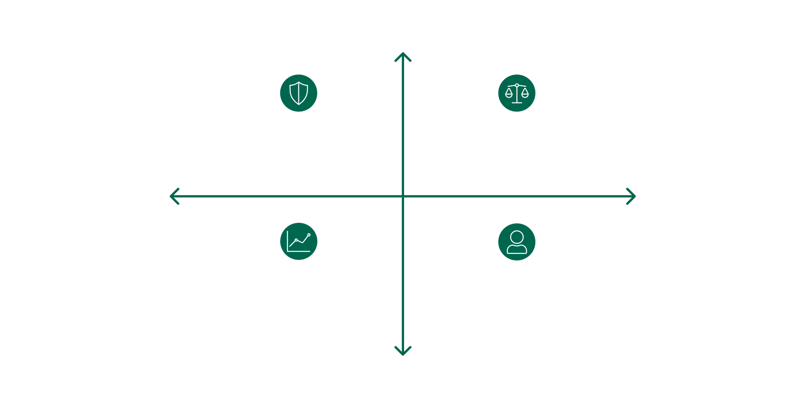
EXECUTIVE SUMMARY
Key Takeaways for Risk Executives
The automotive sector's cybersecurity risk profile has fundamentally transformed in 2025–2026, with four critical developments demanding immediate attention from EU-based financial institutions.
1
Ransomware with OT Targeting
2
API-Centric Attack Surface Explosion
44% of incidents. Direct vehicle compromise now demonstrated. Attackers optimized for disruption leverage — JLR lost £50M/week in production.
67% of incidents involve telematics/cloud. AI integration expands vulnerability exponentially. Backend infrastructure now the "primary weak points."
3
Supply Chain as Systemic Risk Vector
4
Cyber Insurance Market Failure
JLR's £1.9B national economic impact from a single-company incident. Cascade through 5,000+ organizations. Government intervention now precedent.
JLR's coverage gap illustrates sector-specific capacity constraints. Risk transfer increasingly inadequate for operational technology exposure.
High Risk Exposure
Mandatory cybersecurity due diligence (IT/OT segmentation, insurance, supply chain)
Sectoral concentration limits to curb systemic risk
Low Regulatory Scrutiny
High Regulatory Scrutiny
Stress testing Category 3+ scenarios with supply chain multipliers
Board-level cyber accountability as an ESG governance priority
Low Risk Exposure
Investment priority: Zero-trust IT/OT segmentation and supply chain security programs demonstrate 3–5:1 ROI with payback periods under 24 months when benchmarked against demonstrated incident costs.

