Slide 1
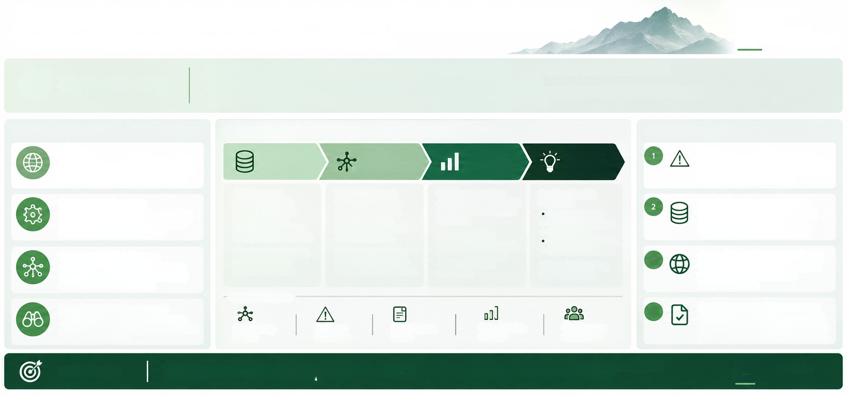
From Attack Surface to Value Chain Exposure
Turning external insights into actionable risk intelligence
CONNECTING
THREATS
DEPENDENCIES
AND OPPORTUNITIES
Ⓒ My Positioning
I bring a cybersecurity lens combined with a different approach to External Attack Surface Management (EASM),
focused on understanding real-world dependencies and ecosystem relationships.
This aligns directly with the Value Chain initiative and can help turn dispersed data into meaningful exposure intelligence
for risk management, business analysis, compliance and strategic decision-making.
1. Unique Perspective & Capabilities
Modern EASM approach
2. From Data to Decisions -
How I Can Contribute
3. Key Use Cases
1. INGEST
& MAP
2. ENRICH
3. ANALYSE
4. ENABLE
Event-driven exposure
When a major vulnerability or outage occurs,
identify which clients, suppliers or sectors are
exposed and the potential impact.
Using Al (e.g. Gemini) to go beyond domain
inventory and map real digital relationships
across clients, suppliers and third parties.
& CONTEXTUALISE
& PRIORITISE
RISK ACTION
Collect external
attack surface data
(domains, CNAMES,
certificates, open
technologies, trackers,
third-party services, etc.).
Enrich with internal
data (e.g. client lists,
supplier information,
sector, geography,
criticality) and external
threat intelligence.
Validate and challenge
declared dependencies
with observable evidence.
Identify concentration
risks, critical dependencies
and potential blast radius
scenarios.
Provide actionable
insights for:
Incident response
⚫ Strategic risk analysis
• Stress testing
Compliance validation.
Dependency discovery
Identify technologies, SaaS, cloud, trackers,
identity providers and infrastructure links
from externally observable signals.
Third/Nth-party concentration
Reveal hidden common dependencies
(e.g. cloud, SaaS, payment providers)
across apparently diversified clients.
Assess materiality
based on BNPP exposure,
dependency criticality
and current threat
landscape.
Contextual risk intelligence
Combine external telemetry with internal
knowledge (e.g. procurement, credit, CTI)
to highlight what really matters.
Map digital relationships
and build an initial
dependency graph.
• Business discussions
Geopolitical and supply chain risk
Understand which value chains depend
on providers or infrastructure in
higher-risk regions.
Deliver clear reporting
and visualisations.
3
Example Outputs
Practical and action-oriented
Translate complex data into clear insights
and visualisations that support Risk, Business
and Compliance teams.
4
Regulatory and resilience support
Provide evidence and insights to support
digital operational resilience requirements
Dependency
graphs
Exposure
Event impact
briefs
Concentration
analysis
Client/sector
heat maps
risk insights
(e.g. DORA) and internal risk assessments.
Conclusion
By combining an innovative EASM approach with value chain thinking, I can help turn external data into exposure intelligence
that supports better risk management, stronger client discussions and a more resilient and informed organisation.
INSIGHTS TODAY
A MORE RESILIENT
TOMORROW

