Slide 1
Blockchain, Digital Assets & Risk Management
A comprehensive course for finance, risk, technology, and cybersecurity professionals seeking practical digital asset risk knowledge.

Slide 2
Course Overview
3 Strategic Modules
Applied Learning
Risk-Focused
From blockchain foundations to regulatory compliance
Concept → Demonstration → Case → Risk Analysis
Every topic viewed through a risk management lens
Designed specifically for professionals who need to understand, evaluate, and manage blockchain and digital asset risks in their organisations.

Slide 3



Learning Journey
Foundations
Blockchain mechanics and cryptographic principles
Applications
Digital assets and real-world use cases
Risk Management
Controls, compliance, and governance frameworks

Slide 4
Module 1
Blockchain Foundations & Cryptography
How does blockchain ensure trust without intermediaries?

Slide 5
Module 1: Learning Objectives
01
02
Blockchain Mechanics
Core Principles
Explain what blockchain is and how it functions in practice
Describe consensus, immutability, and decentralisation concepts
03
04
Cryptographic Foundations
Risk Identification
Understand hashing, keys, and digital signatures
Interpret transactions and identify potential risk points

Slide 6

Section A: Blockchain Evolution
Timeline & Development
Bitcoin's breakthrough (2009)
Ethereum's smart contracts (2015)
Enterprise blockchain emergence
Modern institutional adoption
Risk Focus: What are the underlying trust assumptions in each evolutionary phase?

Slide 7



Blockchain Types & Risk Profiles
Public Blockchains
Private Networks
Consortium Models
Bitcoin, Ethereum
Hyperledger, R3 Corda
Industry partnerships
Open access, maximum decentralisation, regulatory uncertainty
Controlled access, higher performance, centralised risks
Shared governance, balanced control, coordination challenges

Slide 8






Consensus Mechanisms
Proof of Stake
Energy-efficient with different security assumptions
Proof of Work
Energy-intensive but battle-tested security model
Alternative Models
Delegated systems and hybrid approaches

Slide 9
Consensus Risk Analysis
Mechanism
Security Risk
Operational Risk
Governance Risk
Proof of Work
51% attack potential
Energy dependency
Miner centralisation
Proof of Stake
Nothing-at-stake problem
Validator availability
Wealth concentration
Delegated Systems
Validator collusion
Reduced decentralisation
Political capture

Slide 10



Cryptographic Foundations
Hashing Functions
Public-Private Keys
Digital Signatures
SHA-256 creates unique digital fingerprints for data integrity
Asymmetric cryptography enables secure transactions without shared secrets
Mathematical proof of message authenticity and non-repudiation

Slide 11
Cryptographic Risk Factors
Key Management Risks
Implementation Risks
Private key theft: Unauthorised access to wallets
Replay attacks: Transaction duplication
Side-channel attacks: Information leakage
Key loss: Permanent asset inaccessibility
Quantum computing: Future cryptographic threats
Weak entropy: Predictable key generation

Slide 12

Module 1: Practical Exercise
Risk Assessment
Transaction Analysis
Map potential vulnerabilities in the transaction flow
Blockchain Explorer
Identify block details, confirmations, and fee structures
Use Blockchain.com or Etherscan to examine real transactions
Optional: Demonstrate hash generation and public-private key pair creation using online tools

Slide 13
Module 2
Digital Assets & Real-World Applications
How are tokens, NFTs, and stablecoins used and managed securely?

Slide 14
Module 2: Learning Objectives
1
Asset Classification
2
Use Case Analysis
Distinguish between cryptocurrencies, stablecoins, CBDCs, NFTs, and security tokens
Analyse applications across payments, DeFi, and tokenisation
3
Asset Lifecycle
4
Security & Custody
Understand issuance, trading, and storage mechanisms
Identify key risks in digital asset management

Slide 15










Section A: Digital Asset Taxonomy
Stablecoins
Cryptocurrencies
USDT, USDC - price-stable digital currencies
BTC, ETH - native blockchain tokens
CBDCs
Central bank digital currencies
Utility Tokens
Platform access and governance rights
NFTs
Non-fungible tokens for unique assets

Slide 16
Asset Risk Profiles
Asset Type
Volatility Risk
Liquidity Risk
Regulatory Risk
Bitcoin/Ethereum
High
Low
Moderate
Stablecoins
Low-Moderate
Low
High
NFTs
Very High
Very High
High
CBDCs
Low
Low
Low

Slide 17
Section B: Real-World Use Cases
Tokenised Real Estate
Cross-Border Payments
Digital Art & Collectibles
Fractional property ownership through blockchain tokens, enabling smaller investments and improved liquidity in traditionally illiquid markets.
Stablecoins facilitate faster, cheaper international transfers, reducing settlement times from days to minutes.
NFTs provide provenance and ownership verification for digital creative works and collectible items.

Slide 18
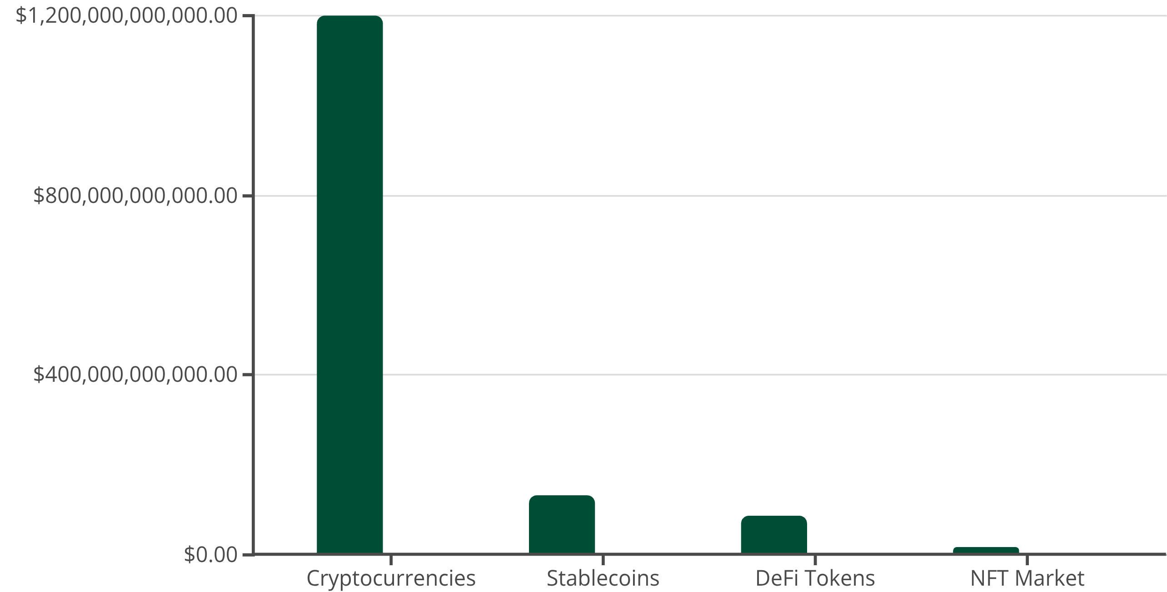
Market Landscape Analysis
Market Cap
Growth Rate
Market capitalisation and annual growth rates demonstrate the rapid expansion of digital asset categories, with particular growth in DeFi and NFT sectors.

Slide 19
Use Case Risk Assessment
Consumer Protection Risks
AML/KYC Compliance
Market Manipulation
Transaction anonymity challenges
Pump and dump schemes
Misleading marketing and fraud
Wash trading in NFT markets
Cross-border regulatory differences
Insider trading on token launches
Lack of dispute resolution mechanisms
Monitoring complex DeFi interactions
Educational gaps among users

Slide 20
Section C: Wallets & Custody
1
Hot Wallets
Internet-connected for frequent transactions, higher convenience but increased security risks
2
Cold Storage
Offline storage for long-term holdings, maximum security but reduced accessibility
3
Multi-Signature
Require multiple key approvals for transactions, enhanced security through distributed control

Slide 21
Wallet Security Risks
Technical Vulnerabilities
Operational Risks
Private key exposure: Software vulnerabilities
Phishing attacks: Fraudulent websites
Malware attacks: Keyloggers and trojans
Social engineering: Human manipulation
Seed phrase theft: Backup compromise
Physical theft: Hardware wallet loss
Risk Mitigation: Implement multi-signature schemes, hardware security modules, and regular security audits

Slide 22
Section D: Exchange & Custodian Security
Centralised Exchanges (CEX)
Traditional order book model with custody services - convenient but introduces counterparty risk
Decentralised Exchanges (DEX)
Peer-to-peer trading with user-controlled keys - eliminates custody risk but requires technical knowledge
Institutional Custodians
Professional-grade storage with insurance and compliance - suitable for large holdings with regulatory oversight

Slide 23
Exchange Breach Analysis
Exchange
Year
Loss Amount
Root Cause
Mt. Gox
2014
$450 million
Hot wallet compromise
Coincheck
2018
$530 million
Insufficient cold storage
FTX
2022
$8 billion
Misuse of customer funds

Slide 24
Module 2: Practical Exercise
01
02
Wallet Creation
Test Transaction
Set up MetaMask or Trust Wallet on testnet environment
Execute a sample transaction using test tokens
03
04
Ecosystem Mapping
Risk Documentation
Identify key actors: issuers, custodians, regulators, consumers
Document observed security features and potential vulnerabilities

Slide 25
Module 3
Risk Management & Regulatory Compliance
What can go wrong — and how do we detect, control, and govern it?

Slide 26




Module 3: Learning Objectives
Control Frameworks
Risk Taxonomy
Understand cyber, operational, financial, and compliance controls
Identify main risk categories affecting blockchain and digital assets
Risk Governance
Regulatory Landscape
Build risk-aware digital asset governance structures
Recognise key global regulations: MiCA, FATF, FCA, Basel

Slide 27

Section A: Digital Asset Risk Taxonomy
Financial Risks
Cyber + Financial
Operational + Financial
Cyber + Operational + Financial
Cyber + Operational
Cyber Risks
Operational Risks

Slide 28
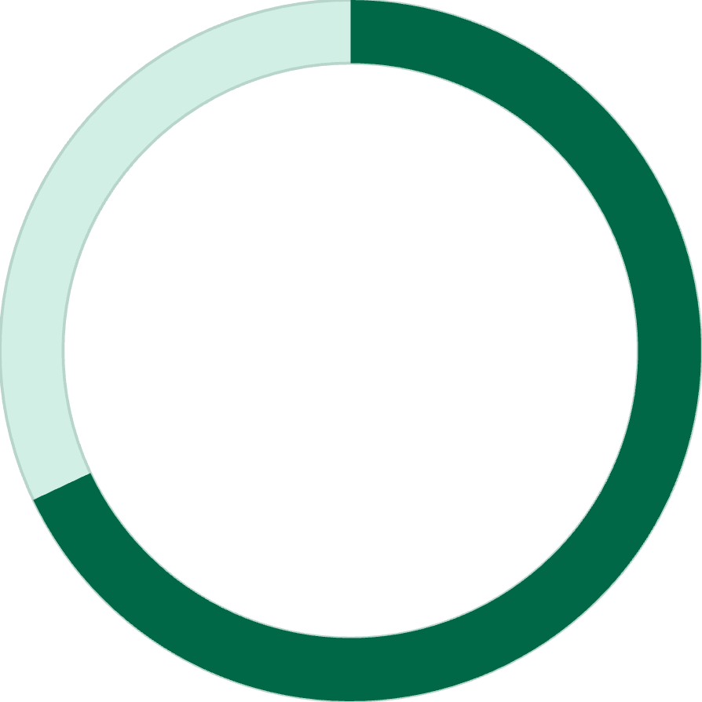
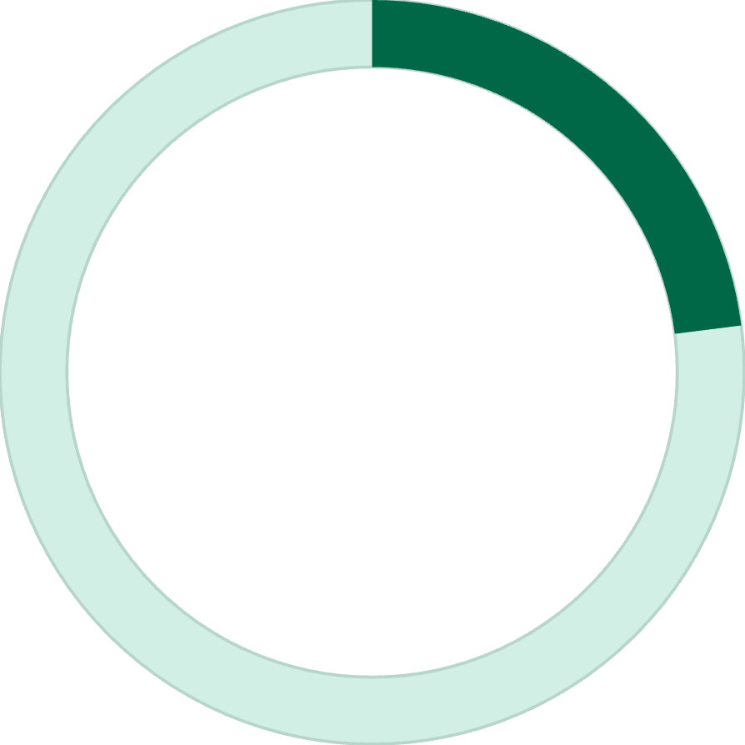
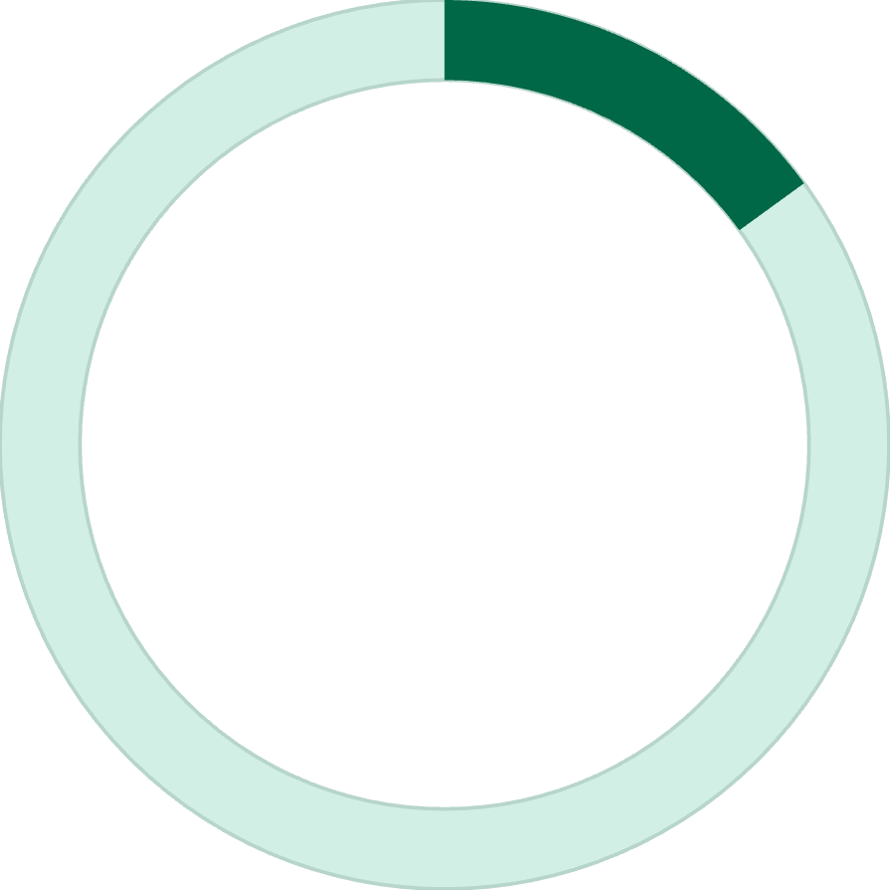
Risk Category Deep Dive
68%
23%
15%
Cyber Risk Impact
Operational Failures
Market Risk
Proportion of digital asset losses attributed to cyber attacks and security breaches
Losses from system outages, human error, and process breakdowns
Financial losses from price volatility and liquidity constraints

Slide 29





Section B: Cyber & Operational Risk Controls
1
Strategic Controls
2
Governance & Policy
3
Process & Procedures
4
Technical Safeguards
5
Monitoring & Detection
Layered defence approach ensures comprehensive protection across all operational levels, from strategic oversight to technical implementation.

Slide 30
Custody Control Framework
Segregation Controls
Recovery Procedures
Separate customer and proprietary assets
Business continuity planning
Multi-signature wallet architectures
Disaster recovery protocols
Audit trail maintenance
Key recovery mechanisms
Case Study Reference: Analyse the Mt. Gox and FTX collapses to understand control failures and their consequences

Slide 31
Section C: Global Regulatory Framework
EU: Markets in Crypto-Assets (MiCA)
1
Comprehensive licensing regime for crypto service providers, stablecoin issuance rules
2
UK: FCA Cryptoasset Regulation
AML requirements, marketing restrictions, and proposed stablecoin framework
US: Multi-Agency Approach
3
SEC securities law, CFTC derivatives oversight, Treasury sanctions compliance
4
FATF: Travel Rule
International standards for virtual asset service provider information sharing

Slide 32
Regulatory Compliance Matrix
Jurisdiction
Licensing
AML/KYC
Consumer Protection
Market Conduct
EU (MiCA)
Required
Comprehensive
Strong
Market abuse rules
UK
Limited scope
Required
Marketing rules
Under development
US
State-by-state
FinCEN rules
SEC oversight
Enforcement focus
Singapore
Payment services
Required
Investor protection
Comprehensive

Slide 33


Compliance Obligations
Reporting Requirements
Customer Due Diligence
Transaction monitoring, suspicious activity reports, regulatory filings
KYC procedures, enhanced due diligence for high-risk customers
Record Keeping
Staff Training
Transaction records, customer information, compliance documentation
Regular compliance training, awareness programmes, certification requirements

Slide 34



Section D: Three Lines of Defence Model
First Line: Business Management
Day-to-day risk management, operational controls, front-line compliance
Second Line: Risk & Compliance
Independent risk oversight, policy development, compliance monitoring
Third Line: Internal Audit
Independent assurance, control effectiveness testing, board reporting

Slide 35




Digital Asset Governance Structure
Board Oversight
Sets governance and risk appetite.
Chief Executive
Executes strategy and reporting.
Risk, Compliance, Tech
Parallel functions overseeing controls.
Operations & Audit
Teams: wallets, trading, onboarding.

Slide 36


Control Certification Standards
SOC 2 Type II
ISO 27001
Service organisation controls for security, availability, and confidentiality
International information security management system standard
Third-party validation
Risk-based approach
Continuous monitoring
Continuous improvement
Customer assurance
Global recognition

Slide 37
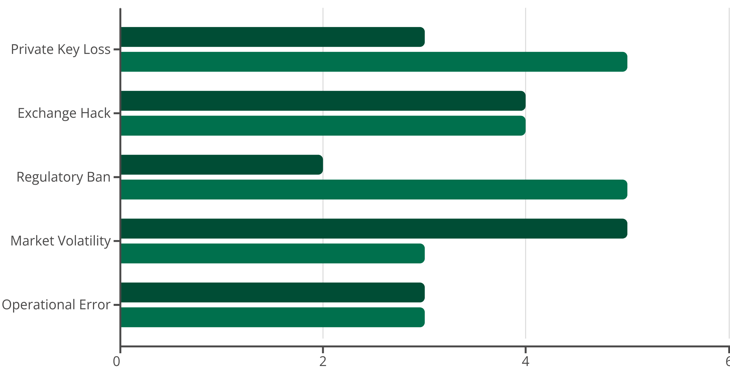
Module 3: Risk Matrix Exercise
Likelihood Score
Impact Score
Risk assessment using likelihood × impact scoring (1-5 scale) helps prioritise control investments and mitigation strategies.

Slide 38
Scenario Planning Exercise
"A custodian loses access to private keys controlling 15% of customer assets due to a ransomware attack. Recovery attempts fail, and regulatory investigation begins."
01
02
Immediate Response
Impact Assessment
Customer notification, regulatory reporting, crisis communication plan
Financial exposure, reputational damage, operational continuity
03
04
Recovery Options
Control Enhancement
Insurance claims, legal remedies, customer compensation
Lessons learned, process improvements, preventive measures

Slide 39


Key Takeaways & Reflection
Technology Understanding
Risk Awareness
"Digital assets introduce new risk categories requiring updated control frameworks and governance structures."
"I now understand how blockchain creates trust through cryptographic proof and consensus mechanisms."
Regulatory Preparedness
"Global regulatory evolution demands proactive compliance strategies and continuous monitoring."
Reflection Question: "What new risk or opportunity does this technology create for my organisation?"

Slide 40

Next Steps & Implementation
Immediate Actions
Conduct organisational risk assessment
Review existing policies and procedures
Identify regulatory requirements
Plan staff training programmes
Medium-Term Goals
Develop digital asset strategy
Implement control frameworks
Establish governance structures
Monitor regulatory developments
Continue your learning journey with industry forums, regulatory updates, and advanced certification programmes in blockchain and digital asset risk management.

