Slide 1
Introduction to Blockchain Technology
Welcome to the revolutionary world of blockchain technology – a groundbreaking innovation that's transforming how we think about data, trust, and digital transactions. This comprehensive introduction will guide you through the fundamentals of blockchain, exploring its mechanics, applications, and transformative potential across industries worldwide.

Slide 2
What is Blockchain?
Shared Digital Ledger
Linked Block Structure
Decentralised Database
A blockchain is fundamentally a shared, immutable digital ledger that records transactions securely across multiple computers. Unlike traditional databases controlled by a single entity, blockchain operates on a distributed network where every participant maintains an identical copy of the entire transaction history.
Data is meticulously stored in cryptographically linked blocks, forming an unbreakable chain that is inherently tamper-resistant. Each block contains a unique fingerprint (hash) that connects it to the previous block, creating a chronological sequence that cannot be altered without detection.
Rather than relying on a central authority, blockchain operates as a decentralised, distributed database spread across numerous computers worldwide. This architecture eliminates single points of failure and ensures no single entity can control or manipulate the data unilaterally.
The genius of blockchain lies in its ability to create trust without requiring a trusted intermediary. By distributing identical copies of the ledger across multiple nodes and using cryptographic verification, blockchain ensures that all participants can verify the authenticity of transactions independently.

Slide 3





How Does Blockchain Work?
Transaction Initiation
Network Validation
Block Creation
When a user initiates a transaction, it is digitally signed using cryptographic keys and broadcast to the network. This transaction contains all necessary information including sender, receiver, amount, and timestamp.
Network participants (nodes) receive the transaction and validate it using predetermined rules. They verify digital signatures, check account balances, and ensure the transaction adheres to the network's protocol standards.
Validated transactions are grouped together into a block by miners or validators. Each block contains a cryptographic hash of the previous block, creating an unbreakable link in the chain's chronological sequence.
Consensus Achievement
Chain Integration
The network reaches consensus on the new block through mechanisms like Proof of Work or Proof of Stake. This ensures all participants agree on the block's validity before it's permanently added to the blockchain.
Once consensus is reached, the new block is cryptographically linked to the previous block and distributed across all nodes. This creates an immutable record that becomes part of the permanent blockchain history.
Cryptographic Hashing
Consensus Mechanisms
Each block contains a unique hash – a digital fingerprint created by processing all the block's data through a complex mathematical algorithm. Even the smallest change to the block's content produces a completely different hash, making tampering immediately detectable.
Different blockchain networks employ various consensus mechanisms to validate transactions. These protocols ensure network agreement without requiring a central authority, maintaining security and preventing double-spending or fraudulent activities.

Slide 4



Visualising the Blockchain
This illustration demonstrates how blocks are connected in a chronological chain, with each block containing a cryptographic hash that links it to the previous block. The visual representation shows how altering any single block would break the chain's integrity, making tampering immediately apparent to all network participants.
Genesis Block
Transaction Blocks
Latest Block
The first block in the chain, containing initial network parameters
Subsequent blocks containing validated transactions and hash references
The most recently added block, linked to the entire chain history
The interconnected nature of blockchain blocks creates an immutable historical record. Each block's hash is calculated based on its contents plus the hash of the previous block, creating a cascading effect where any alteration would require changing every subsequent block – a computationally impossible task on a well-established network.

Slide 5
Key Features of Blockchain
Decentralisation
Immutability
Traditional systems rely on central authorities like banks or governments to validate transactions and maintain records. Blockchain eliminates this dependency by distributing control across multiple nodes in the network. No single entity can unilaterally alter records or shut down the system, creating unprecedented resilience and democratic governance.
Once data is recorded in a blockchain block and confirmed by the network, it becomes extraordinarily difficult to alter. The cryptographic linking of blocks means that changing historical data would require recalculating all subsequent blocks – a task requiring more computational power than the entire network possesses.
Multiple nodes hold identical copies of the ledger
Historical records cannot be changed without detection
No single point of failure or control
Provides audit trail and accountability
Resistant to censorship and manipulation
Prevents retroactive fraud and manipulation
Transparency
Security
All network participants have access to the same transaction history, creating unprecedented transparency in record-keeping. While personal identities may be pseudonymous, all transactions are visible and verifiable by anyone, building trust through openness rather than authority.
Blockchain employs advanced cryptography and consensus mechanisms to create a highly secure environment. Digital signatures ensure transaction authenticity, whilst consensus protocols prevent fraudulent activities. The distributed nature makes the system resilient against cyber attacks targeting centralised infrastructure.
Complete transaction history visible to all participants
Real-time verification of network state
Cryptographic protection of all transactions
Builds trust through openness and verifiability
Consensus mechanisms prevent fraud
Distributed architecture resists cyber attacks

Slide 6








Types of Blockchains
Public Blockchains
Private Blockchains
Fully decentralised and transparent
Controlled access for internal use
Open to anyone worldwide, requiring no permissions to join or participate. Examples like Bitcoin and Ethereum demonstrate how public blockchains create trustless environments where strangers can transact safely without intermediaries.
Restricted to specific organisations or groups, offering greater control over participation and data access. Companies use private blockchains for internal processes whilst maintaining some blockchain benefits like immutability and traceability.
Complete decentralisation and openness
Single organisation control
Global accessibility without restrictions
Restricted access and participation
Highest level of transparency and trust
Enhanced privacy for sensitive operations
Consortium Blockchains
Hybrid Blockchains
Shared governance model
Best of both worlds
Controlled by a pre-selected group of organisations that collaborate whilst maintaining some decentralisation. Industries like banking and supply chain management use consortium blockchains to share information securely amongst trusted partners.
Combines public and private features, allowing organisations to control access whilst maintaining selective transparency. This approach enables businesses to share specific information publicly whilst keeping sensitive data private.
Controlled by group of organisations
Selective transparency and access control
Semi-decentralised governance
Balances privacy with openness
Enhanced collaboration between partners
Customisable governance structures
Choosing the Right Type
The choice of blockchain type depends on specific use cases, privacy requirements, and governance needs. Public blockchains excel for global, trustless applications, whilst private and consortium blockchains serve enterprise needs requiring controlled access and enhanced privacy.

Slide 7
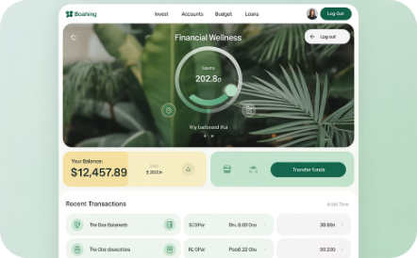



Real-World Applications
Financial Services
Energy Trading
Media and Entertainment
Supply Chain Management
Blockchain is revolutionising finance through faster, more secure interbank payments and cross-border transactions. The Singapore Exchange uses blockchain for trade settlements, reducing processing time from days to minutes whilst eliminating intermediary fees and counterparty risks.
Peer-to-peer solar energy trading platforms enable homeowners with solar panels to sell excess energy directly to neighbours without utility company intermediaries. This creates more efficient energy markets and promotes renewable energy adoption through direct economic incentives.
Sony Music Japan leverages blockchain for copyright management and royalty tracking, ensuring artists receive fair compensation for their work. The technology creates transparent, immutable records of creative works and automates royalty distribution based on actual usage and streaming data.
Transparent tracking of goods from origin to consumer enables unprecedented visibility into product journeys. Companies can verify authenticity, ensure ethical sourcing, and provide consumers with complete product histories, from raw materials through manufacturing to final delivery.
Instant cross-border payments
Direct peer-to-peer energy trading
Transparent copyright protection
End-to-end product traceability
Reduced transaction costs and fees
Automated smart contract settlements
Automated royalty distribution
Authenticity verification and anti-counterfeiting
Enhanced security and fraud prevention
Transparent pricing and consumption tracking
Reduced piracy through verification
24/7 settlement without banking hours
Fair compensation for creators
Ethical sourcing compliance
Promotes renewable energy adoption
Enhanced consumer trust and transparency
These applications represent just the beginning of blockchain's transformative potential. As the technology matures, we're seeing innovative implementations across healthcare, voting systems, identity management, and intellectual property protection, each leveraging blockchain's core strengths of transparency, security, and decentralisation.

Slide 8




Why Blockchain Matters
Eliminates Intermediaries
Enhances Trust Through Transparency
Traditional transactions require trusted third parties like banks, payment processors, or escrow services, each adding costs, delays, and potential points of failure. Blockchain enables direct peer-to-peer transactions, dramatically reducing costs whilst increasing transaction speed and accessibility.
Rather than trusting institutions or authorities, blockchain creates trust through mathematical proof and transparency. All participants can independently verify transactions and network state, creating unprecedented levels of trust without requiring faith in centralised entities.
Trust built on cryptographic proof, not reputation
Cost savings of up to 80% in cross-border payments
Protects Against Fraud
Enables New Business Models
The immutable nature of blockchain records makes fraud and data manipulation extremely difficult. Cryptographic signatures ensure transaction authenticity, whilst consensus mechanisms prevent double-spending and other fraudulent activities that plague traditional systems.
Blockchain has spawned entirely new categories of digital assets and business models. Cryptocurrencies, NFTs, decentralised finance (DeFi), and smart contracts create unprecedented opportunities for innovation, entrepreneurship, and economic participation.
Fraud reduction of over 90% in tested implementations
DeFi market value exceeding $200 billion globally
Economic Impact
Democratic Access
Blockchain technology is projected to add $1.76 trillion to the global economy by 2030. This growth stems from increased efficiency, reduced costs, and new business opportunities across multiple industries. Early adopters are already experiencing significant competitive advantages.
Perhaps most importantly, blockchain democratises access to financial services and digital participation. Individuals in developing countries can access banking services, participate in global markets, and build wealth without traditional banking infrastructure.

Slide 9
Challenges and Future Outlook
Current Challenges
1
Blockchain technology faces several critical hurdles that must be addressed for widespread adoption. Scalability remains the primary concern, with popular networks like Bitcoin processing only 7 transactions per second compared to Visa's 65,000. Energy consumption, particularly in Proof of Work systems, raises environmental concerns that demand innovative solutions.
2
Technological Solutions
Layer 2 scaling solutions, sharding, and new consensus mechanisms are dramatically improving blockchain performance. Ethereum's transition to Proof of Stake reduced energy consumption by 99.95%, whilst Lightning Network enables Bitcoin microtransactions. These innovations are making blockchain more practical for everyday use.
Cross-Industry Adoption
3
Beyond finance, blockchain adoption is accelerating across healthcare, logistics, gaming, and governance. Major corporations like Walmart, Maersk, and Microsoft are implementing blockchain solutions for supply chain transparency, whilst governments explore blockchain voting and digital identity systems.
4
Emerging Technology Integration
The convergence of blockchain with AI, IoT, and metaverse technologies is creating unprecedented opportunities. Smart contracts powered by AI can make autonomous decisions, IoT devices can participate in blockchain networks, and virtual worlds are building entire economies on blockchain foundations.
Global Transformation
5
Blockchain's potential to revolutionise transparency and efficiency extends to combating corruption, ensuring fair elections, and creating more equitable economic systems. As regulatory frameworks mature and technology improves, we're approaching a tipping point for mass adoption.
Market Growth Projections
Regulatory Evolution
The global blockchain market is expected to grow from $11.14 billion in 2022 to $162.84 billion by 2027, representing a compound annual growth rate of 68.4%. This explosive growth reflects increasing enterprise adoption, regulatory clarity, and technological maturation across multiple sectors.
Governments worldwide are developing comprehensive blockchain regulations that balance innovation with consumer protection. Clear regulatory frameworks are accelerating institutional adoption and creating stability for long-term blockchain investments and development.
Enterprise blockchain adoption up 67% year-over-year
Over $25 billion invested in blockchain startups in 2023
More than 80% of executives planning blockchain initiatives

Slide 10
The Blockchain Revolution is Here
Reshaping Data Trust
Innovation Gateway
Decentralised Future
Blockchain fundamentally transforms how we record, share, and establish trust in data. Traditional systems built on institutional authority are giving way to mathematical proof and cryptographic verification, creating unprecedented transparency and reliability in our digital interactions.
Understanding blockchain's transformative power is essential for unlocking future innovation opportunities. Whether you're an entrepreneur, developer, investor, or business leader, blockchain literacy is becoming as fundamental as internet literacy was two decades ago.
We're transitioning from centralised, intermediary-dependent systems to peer-to-peer, trustless networks that empower individuals and democratise access to financial services, digital assets, and global markets. This shift represents one of the most significant technological transformations in human history.
Ready for the Revolution?
The blockchain revolution isn't coming – it's already here, transforming industries and creating new possibilities daily. Early adopters are gaining competitive advantages, whilst those who wait risk being left behind in an increasingly decentralised world.
The question isn't whether blockchain will transform our digital future, but whether you'll be an active participant in shaping that transformation. The tools, knowledge, and opportunities are available now – the choice is yours.
"The blockchain revolution represents the greatest shift in how we organise society since the invention of the internet itself. Those who understand and embrace this technology today will be the architects of tomorrow's decentralised world."
Start Learning
Stay Informed
Take Action
Begin your blockchain journey today by exploring cryptocurrency wallets, understanding smart contracts, and experimenting with decentralised applications.
Follow blockchain developments, regulatory changes, and technological innovations that are shaping the future of digital interaction and commerce.
Whether through investment, development, or implementation in your business, active participation in the blockchain ecosystem positions you for the decentralised future.

Slide 11
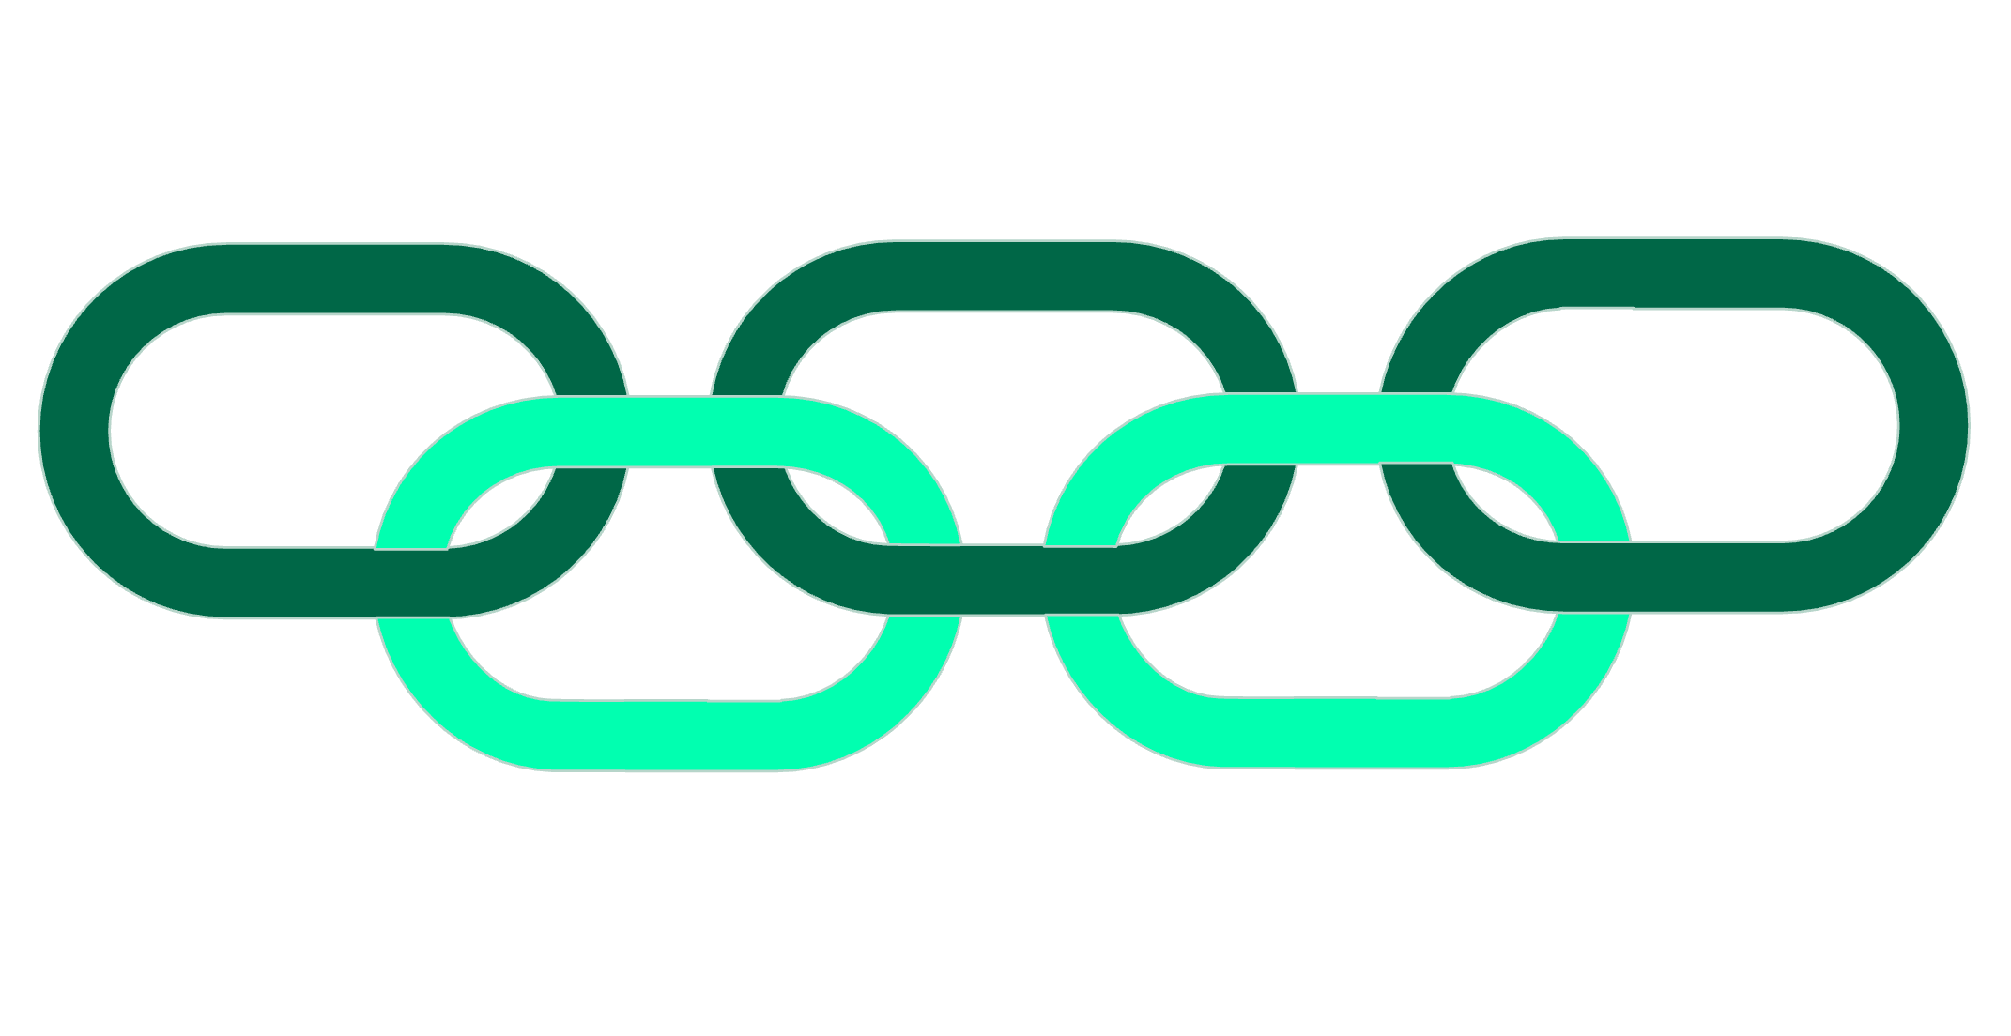
How Does Blockchain Work?
Validate Transaction
Hash & Link
Replicate Across Nodes
Bundle into Block
Append to Chain
At its heart, blockchain technology operates on a simple yet powerful principle: a decentralised, distributed ledger. This ledger is made up of 'blocks' of information, chronologically chained together using cryptography. Each new block contains a cryptographic hash of the previous block, creating an unbreakable link and making the data immutable.
When a transaction occurs, it's broadcast to the network. Participants (nodes) verify the transaction's legitimacy. Once verified, it's grouped with other transactions into a new 'block'. This block is then given a unique cryptographic 'hash' and added to the end of the existing chain, creating a permanent, transparent record.

