Slide 1
Some terminology (for an example gene on the forward strand):
Non-template strand
Relative to the gene: Sense/Coding strand
Relative to the genome: Positive/(+)/Forward strand*
5’
3’
3’
5’
Template strand (template that gets transcribed)
Relative to the gene: Antisense/Non-coding strand
Relative to the genome: Negative/(-)/Reverse strand*
transcription
5’
3’
mRNA (copy of the non-template strand)
Reverse transcription
3’
5’
First-strand cDNA
Second-strand synthesis
5’
3’
Second-strand cDNA
*For a gene on the reverse strand these swap:
Its coding strand is on the negative/reverse strand

Slide 2
More terminology (that helps us to choose the right parameters for Trinity):
5’
3’
Transcript
R1
R2
fr-secondstrand*, FR,
direct stranded
← Read 1 runs in the same direction as the transcript (sense), that’s why we call it "direct"
R2
R1
fr-firststrand*, RF,
reverse stranded
← Read 1 runs opposite to the transcript (antisense), that’s why we call it "reverse"
R1
R2
← We don’t know from what strand a read came from
unstranded
R2
R1
*first-/second-strand = the cDNA strand whose sequence Read 1 matches.
Colours: sequence of first- (green) or second-strand (blue) cDNA, as on the previous slide.

Slide 3
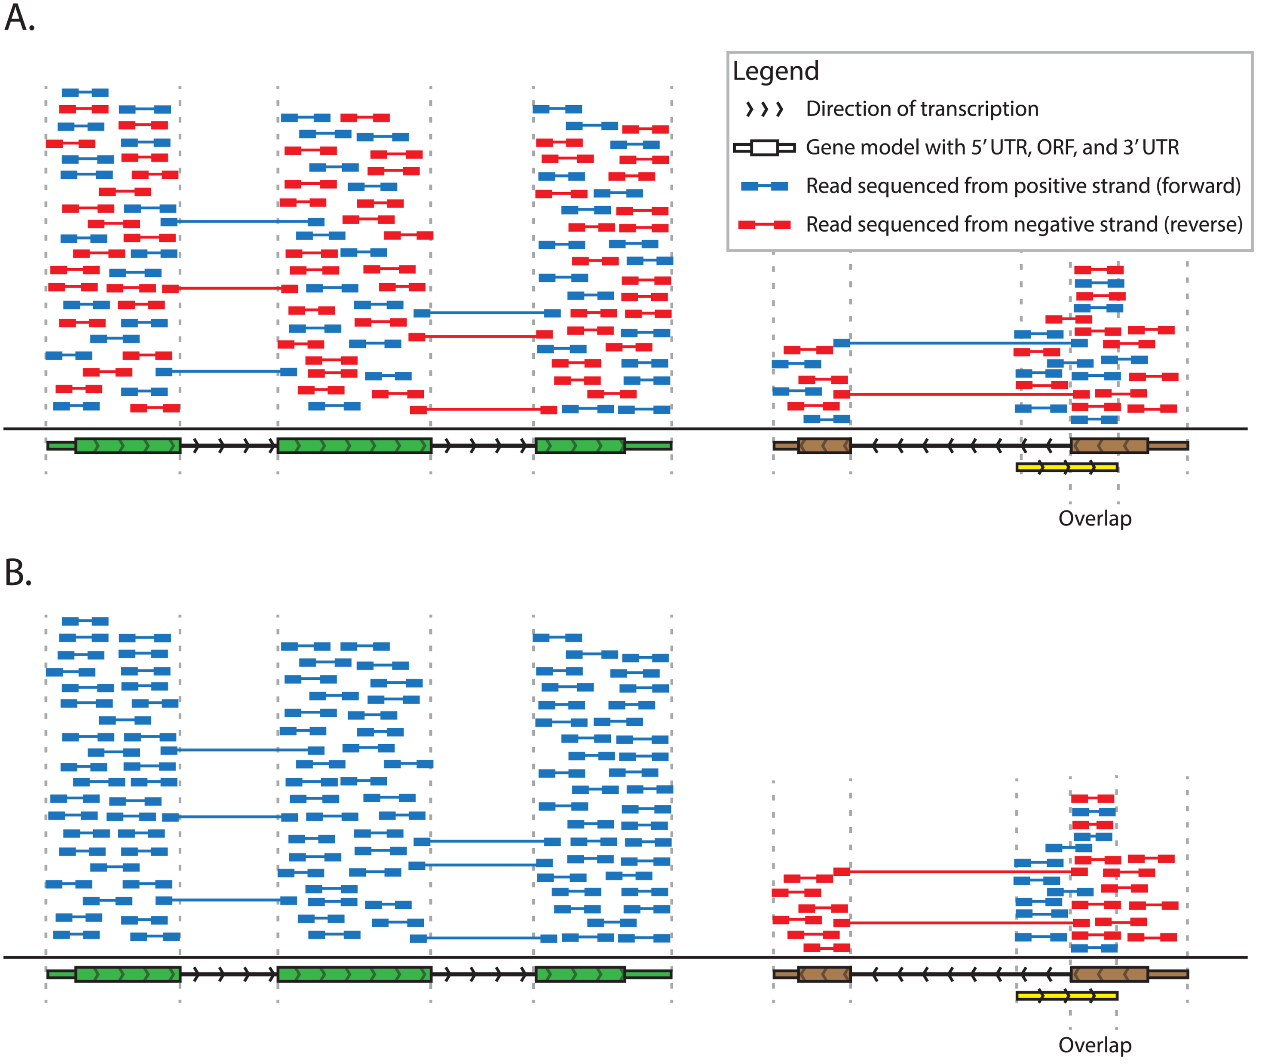
Why we care:
Unstranded sequencing protocol
Colours = genome strand (+/-) a pair appears to come from
    not cDNA strand as on the previous slide
    → Blue = forward (+) strand
    → Red = reverse (–) strand
https://images.marinespecies.org/thumbs/48541_cymodocea-nodosa.jpg
Green (+) gene:
~50% of read pairs appear to come from +, ~50% from –
→ This tells us nothing about the gene’s strand
Griffith et al., 2015; doi:10.1371/journal.pcbi.1004393
Notes:
Brown = Sits on the reverse strand. Its coding strand is the reverse strand on the reference, and its template strand is the forward strand

Slide 4
Why we care:
Unstranded sequencing protocol
Colours = genome strand (+/-) a pair appears to come from
    not cDNA strand as on the previous slide
    → Blue = forward (+) strand
    → Red = reverse (–) strand
https://images.marinespecies.org/thumbs/48541_cymodocea-nodosa.jpg
Green (+) gene:
~50% of read pairs appear to come from +, ~50% from –
→ This tells us nothing about the gene’s strand
Stranded sequencing protocol
In a stranded library, R1 always has the same orientation relative to the transcript . Combined with where the pair maps, this tells us the transcript's strand relative to the genome.
Green (+) gene:
All read pairs appear to come from +, the gene's own strand
→ The reads tell us the strand of the transcript
Griffith et al., 2015; doi:10.1371/journal.pcbi.1004393
Notes:
Brown = Sits on the reverse strand. Its coding strand is the reverse strand on the reference, and its template strand is the forward strand

Slide 5
Why we care:
Unstranded sequencing protocol
Colours = genome strand (+/-) a pair appears to come from
    not cDNA strand as on the previous slide
    → Blue = forward (+) strand
    → Red = reverse (–) strand
https://images.marinespecies.org/thumbs/48541_cymodocea-nodosa.jpg
Stranded sequencing protocol
Yellow (+) and brown (-) overlap:
A: We can’t tell whether a read belongs to yellow or brown
B: Only blue reads go to yellow
Only red reads go to brown
Griffith et al., 2015; doi:10.1371/journal.pcbi.1004393
Notes:
Brown = Sits on the reverse strand. Its coding strand is the reverse strand on the reference, and its template strand is the forward strand

