Slide 2
Objectives
Create an array
Work with array properties and methods
Create a program loop
Work with the for loop
Write comparison and logical operators
Create a conditional statement
Use the if statement

Slide 3
Introducing the Monthly Calendar
Calendar should appear in the form of a web table with links to specific events placed within the table cells
Appearance and placement of the calendar will be set using a CSS style sheet
The program created should be easily adaptable so that it can be used to create other monthly calendars

Slide 4
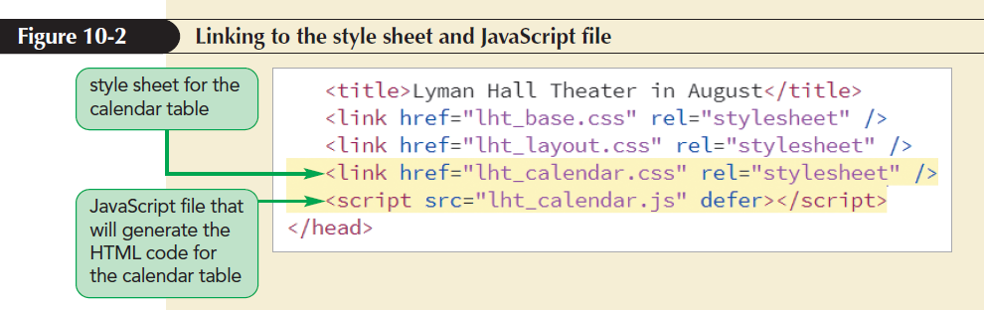
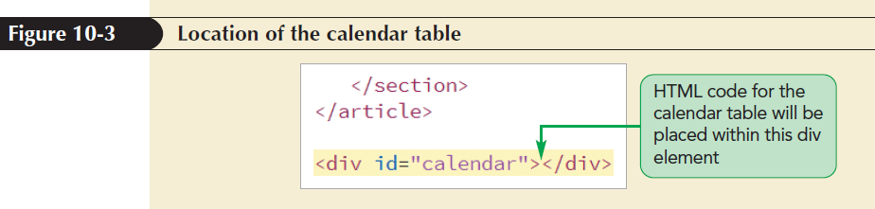
Introducing the Monthly Calendar (continued)

Slide 5
Reviewing the Calendar Structure
Names and IDs assigned to the different parts of the table
Entire calendar is set in a web table with the ID calendar_table
Cell containing the calendar title has the ID calendar_head
Seven cells containing the days of the week abbreviations all belong to the class calendar_weekdays

Slide 6
Reviewing the Calendar Structure (continued)
All cells containing the dates of the month belong to the class calendar_dates
The cell containing the current date has the ID calendar_today
Class and ID designations make it easier for page developers to assign different styles to the different parts of the calendar

Slide 7
Adding the calendar() Function
Place the commands that generate the calendar within a single function named createCalendar()
Initial code to generate the calendar
var thisDay = new Date(“August 24, 2018”);
document.getElementById(“calendar”).innerHTML = createCalendar(thisDay);

Slide 8
Adding the calendar() Function (continued)
function createCalendar(calDate) {
var calendarHTML = “<table id='calendar_table'>”;
calendarHTML += “</table>”;
return calendarHTML;
}
thisDay variable: Stores the current date

Slide 9
Introducing Arrays
getMonth() method: Extracts a month number
getFullYear() method: Extracts the four-digit year value
The Date method does not return the name of the month
One way to associate each month number with a month name is by using an array

Slide 10
Introducing Arrays (continued 1)
Array: Collection of values organized under a single name
Index: The number that each individual value is associated with and that distinguishes it from other values in the array
Array values are referenced using the expression array[i]
where array is the name of the array and i is the index of a specific value in the array

Slide 11
Introducing Arrays (continued 2)
Index values start with 0 so that the initial item in an array has an index value of 0
Second item in the array will have an index value of 1, and so on
Example
The expression monthName[4] references the fifth (not the fourth) item in the monthName array

Slide 12
Creating and Populating an Array
To create an array, apply the object constructor
var array = new Array(length);
where array is the name of the array and length is the number of items in the array
The length value is optional; if the length parameter is omitted then the array expands automatically as more items are added to it

Slide 13
Creating and Populating an Array (continued 1)
An array can be populated with values by specifying both the array name and the index number of the array item
Command to set the value of a specific item in an array
array[i] = value;
where value is the value assigned to the array item with the index value i

Slide 14
Creating and Populating an Array (continued 2)
Populate the entire array in a single statement using the following command:
var array = new Array(values);
where values is a comma-separated list of the values in the array
Example
var monthName = new Array(“January”, “February”, “March”, “April”, “May”, “June”, “July”, “August”, “September”, “October”, “November”, “December”);

Slide 15
Creating and Populating an Array (continued 3)
Array literal: Creates an array in which the array values are a comma-separated list within a set of square brackets
var array = [values];
where values are the values of the array
Example
var monthName = [“January”, February”, “March”, “April”, “May”, “June”, “July”, “August”, “September”, “October”, “November”, “December”];

Slide 16
Creating and Populating an Array (continued 4)
Array values need not be of the same data type
Mix of numeric values, text strings, and other data types within a single array is allowed
Example
var x = [“April”, 3.14, true, null];

Slide 17
Working with Array Length
JavaScript array automatically expands in length as more items are added
Apply the following length property to determine the array’s current size:
array.length
where array is the name of the array
Value returned by the length property is equal to one more than the highest index number in the array

Slide 18
Working with Array Length (continued)
Sparse arrays: Created in JavaScript in which some of the array values are undefined
The length value is not always the same as the number of array values
Occurs frequently in database applications
Value of the length property cannot be reduced without removing items from the end of the array

Slide 19
Reversing an Array
Items are placed in an array either in the order in which they are defined or explicitly by index number, by default
JavaScript supports two methods for changing the order of the array items
reverse()
sort()
reverse(): Reverses the order of items in an array, making the last items first and the first items last

Slide 20
Sorting an Array
sort(): Rearranges array items in alphabetical order
The sort() method when applied to numeric values will sort the values in order by their leading digits, rather than by their numerical values

Slide 21
Sorting an Array (continued 1)
Compare function: Compares values of two adjacent array items
General form of a compare function is
function fname(a, b) {
return a negative, positive, or 0 value
}
where fname is the name of the compare function and a and b are parameters that represent a pair of array values

Slide 22
Sorting an Array (continued 2)
Based on comparison of two adjacent array item values, the function returns a negative, positive, or zero value
If a negative value is returned, then a is placed before b in the array
If a positive value is returned, then b is placed before a
If a zero value is returned, a and b retain their original positions

Slide 23
Sorting an Array (continued 3)
Function to sort numeric values in ascending order
function ascending(a, b) {
return a - b;
}
Function to sort numbers in descending order
function descending(a, b) {
return b - a;
}

Slide 24
Sorting an Array (continued 4)
The compare function is applied to the sort() method as follows
array.sort(fname)
where fname is the name of the compare function
Example
x.sort(ascending)

Slide 25
Extracting and Inserting Array Items
Subarray: Section of an array
To create a subarray use slice() method
array.slice(start, stop)
where start is the index value of the array item at which the slicing starts and stop is the index value at which the slicing ends
The stop value is optional; if it is omitted, the array is sliced to its end

Slide 26
Extracting and Inserting Array Items (continued)
splice(): Removes and inserts array items
array.splice(start, size, values)
start is the starting index in the array, size is the number of array items to remove after the start index, and values is an optional comma-separated list of values to insert into the array
If no values are specified, the splice method simply removes items from the array
Always alters the original array

Slide 27
Using Arrays as Data Stacks
Stack: Arrays can be used to store information in a data structure
New items are added to the top of the stack or to the end of the array
A stack data structure employs the last-in first-out (LIFO) principle
In the LIFO principle the last items added to the stack are the first ones removed

Slide 28
Using Arrays as Data Stacks (continued 1)
push() method: Appends new items to the end of an array
array.push(values)
where values is a comma-separated list of values to be appended to the end of the array
pop() method: Removes or unstacks the last item
array.pop()

Slide 29
Using Arrays as Data Stacks (continued 2)
Queue: Employs the first-in-first-out (FIFO) principle in which the first item added to the data list is the first removed
Similar to a stack
shift() method: Removes the first array item
unshift() method: Inserts new items at the front of the array

Slide 30
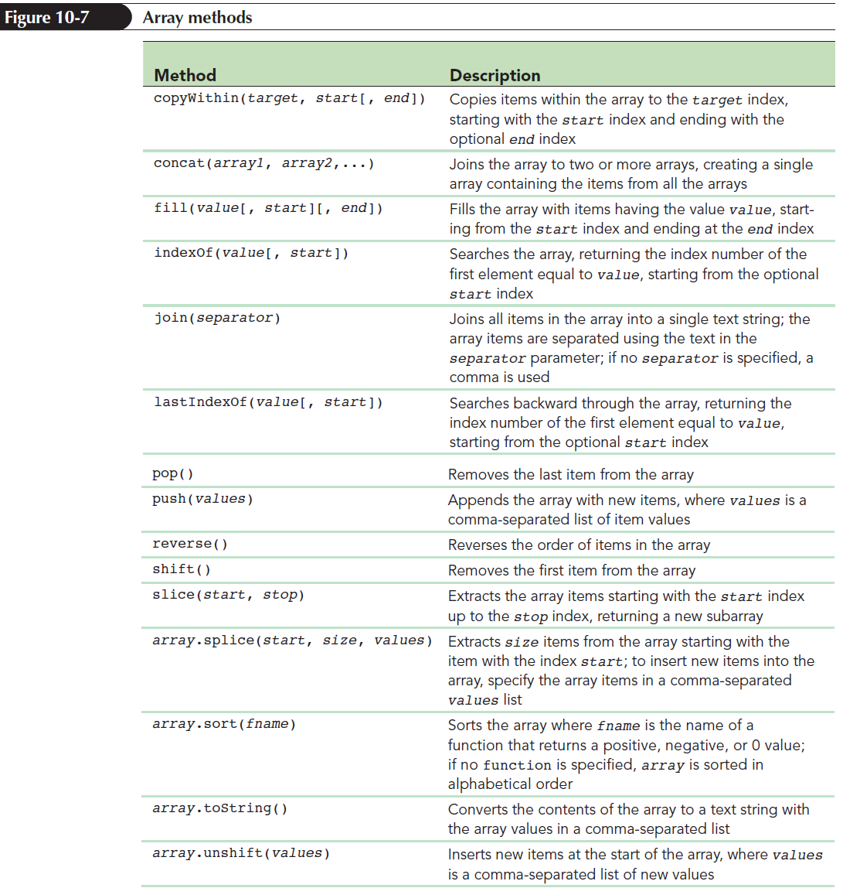
Using Arrays as Data Stacks (continued 3)

Slide 31
Working with Program Loops
Program loop: Set of commands executed repeatedly until a stopping condition is met
Two commonly used program loops in JavaScript are
for loops
while loops

Slide 32
Exploring the for Loop
In a for loop, a variable known as a counter variable is used to track the number of times a block of commands is run
When the counter variable reaches or exceeds a specified value, the for loop stops
General structure of a for loop
for (start; continue; update) {
commands
}

Slide 33
Exploring the for Loop (continued 1)
where start is an expression that sets the initial value of a counter variable
continue is a Boolean expression that must be true for the loop to continue
update is an expression that indicates how the value of the counter variable should change each time through the loop
commands are the JavaScript statements that are run for each loop

Slide 34
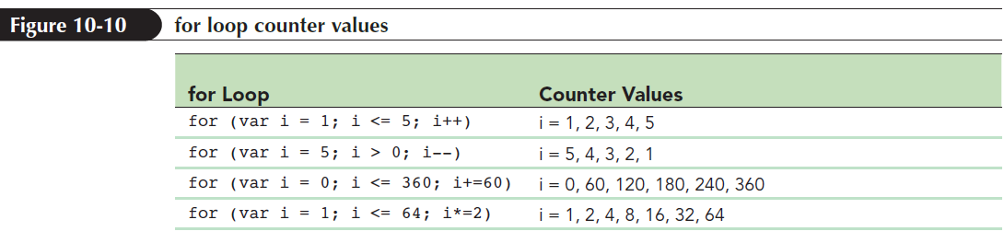
Exploring the for Loop (continued 2)
Command block: Collection of commands that is run each time through a loop
Indicated by its opening and closing curly braces { }
One for loop can be nested within another

Slide 35
Exploring the while Loop
while loop: Command block that is run as long as a specific condition is met
Condition in a while loop does not depend on the value of a counter variable
General syntax for the while loop
while (continue) {
commands
}
where continue is a Boolean expression

Slide 36
Exploring the do/while Loop
do/while loop: Generally used when the program loop should run at least once before testing stopping condition
Tests the condition to continue the loop right after the latest command block is run
Structure of the do/while loop
do {
commands
}
while (continue);

Slide 37
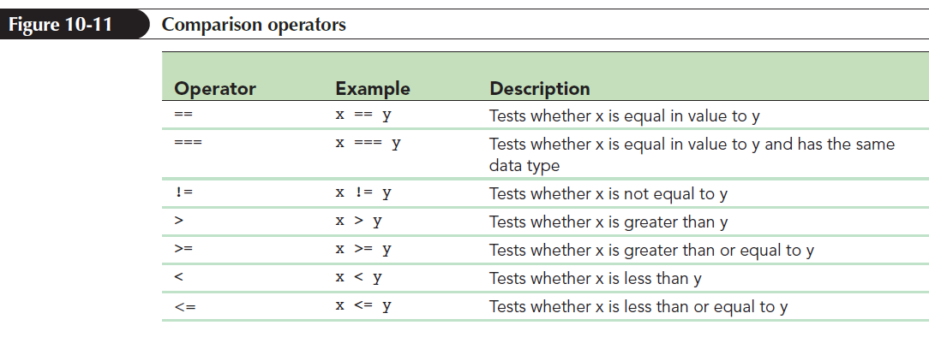
Comparison and Logical Operators
Comparison operator: Compares the value of one expression to another returning a Boolean value indicating whether the comparison is true or false

Slide 38
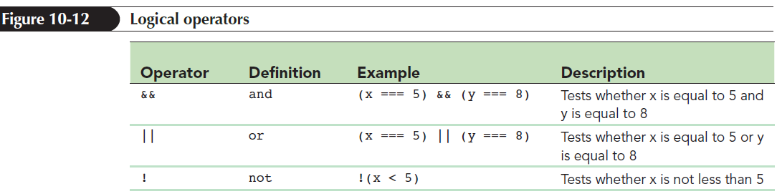
Comparison and Logical Operators (continued)
Logical operators allow several expressions to be connected
Example: The logical operator && returns a value of true only if both of the expressions are true

Slide 39
Program Loops and Arrays
Program loops: Cycle through different values contained within an array
General structure to access each value from an array using a for loop
for (var i = 0; i < array.length; i++) {commands involving array[i]
}
where array contains the values to be looped through and i is the counter variable used in the loop

Slide 40
Array Methods to Loop Through Arrays
JavaScript supports several methods to loop through the contents of an array without having to create a program loop structure
Each of these methods is based on calling a function that will be applied to each item in the array

Slide 41
Array Methods to Loop Through Arrays (continued 1)
The general syntax
array.method(callback [, thisArg])
where array is the array, method is the array method, and callback is the name of the function that will be applied to each array item
thisArg: A callback optional argument that can be included to pass a value to the function

Slide 42
Array Methods to Loop Through Arrays (continued 2)
General syntax of the callback function
function callback(value [, index, array]) {
commands }
where value is the value of the array item during each pass through the array, index is the numeric index of the current array item, and array is the name of the array
Only the value parameter is required; the other are optional

Slide 43
Running a Function for Each Array Item
forEach() method: Runs a function for each item in the array
General syntax
array.forEach(callback [, thisArg])
where callback is the function that is applied to each item in the array

Slide 44
Mapping an Array
map() method: The function it calls returns a value that can be used to map the contents of an existing array into a new array
Example
var x = [3, 8, 12];
var y = x.map(DoubleIt);
function DoubleIt(value) {
return 2*value;
}

Slide 45
Filtering an Array
filter() method: Extracts array items that match some specified condition
array.filter(callback [, thisArg])
where callback is a function that returns a Boolean value of true or false for each item in the array
Array items that return a value of true are copied into the new array

Slide 46
Filtering an Array (continued 1)
every() method: Returns the value true if every item in the array matches the condition specified by the callback function; if otherwise, returns false
array.every(callback [, thisArg])
some() method: Returns a value of true if some array items match a condition specified in the function, but otherwise returns false if none of the array items match the condition specified in the function

Slide 47
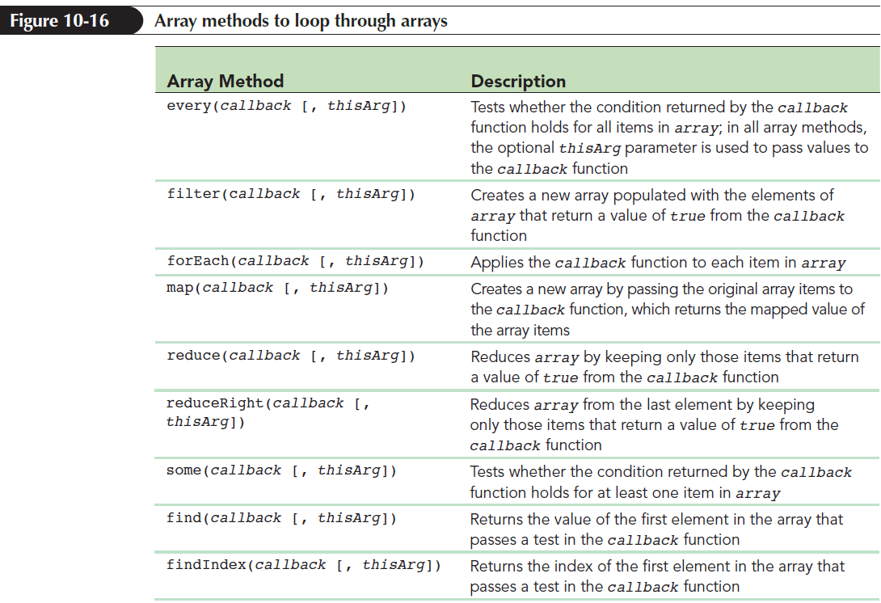
Filtering an Array (continued 2)

Slide 48
Introducing Conditional Statements
Parallel array: Each entry in the array matches or is parallel to an entry in the other array
Conditional statement: Runs a command or command block only when certain circumstances are met

Slide 49
Exploring the if Statement
The most common conditional statement is the if statement
General structure of the if statement
if (condition) {
commands
}
where condition is a Boolean expression that is either true or false and commands is the command block that is run if condition is true

Slide 50
Exploring the if Statement (continued)
Conditional statement uses the same comparison and logical operators that are used with program loops
Modulus operator: Returns the integer remainder after dividing one integer by another

Slide 51
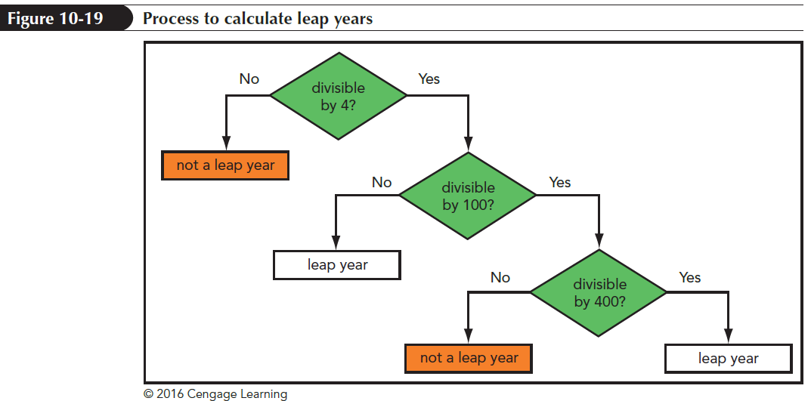
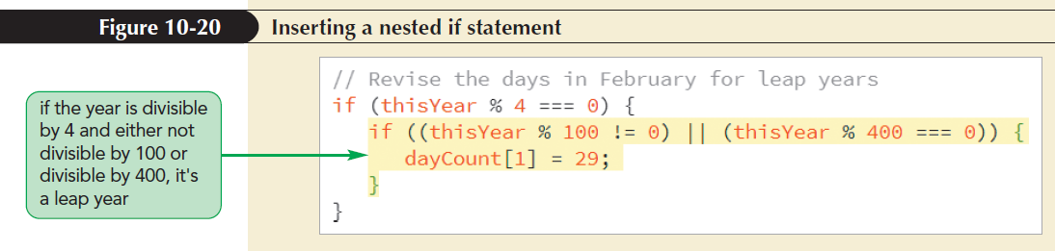
Nesting if Statements
One if statement is nested inside another

Slide 52
Exploring the if else Statement
if else statement: Chooses between alternate command blocks
It runs one command block if the conditional expression is true and a different command block if the expression is false
General structure
if (condition) {
commands if condition is true }
else {
commands if condition is false }

Slide 53
Using Multiple else if Statements
Structure of an if else statement is:
if (condition1) {
commands1
} else if (condition2) {
commands2
}...
else {
default commands}
where condition 1, condition 2,… are the different conditions to be tested

Slide 54
Completing the Calendar App
The completed calendar app must do the following:
Calculate the day of the week in which the month starts
Write blank table cells for the days before the first day of the month
Loop through the days of the current month, writing each date in a different table cell and starting a new table row on each Sunday

Slide 55
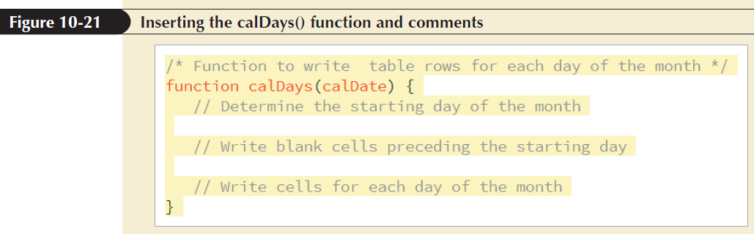
Completing the Calendar App (continued)

Slide 56
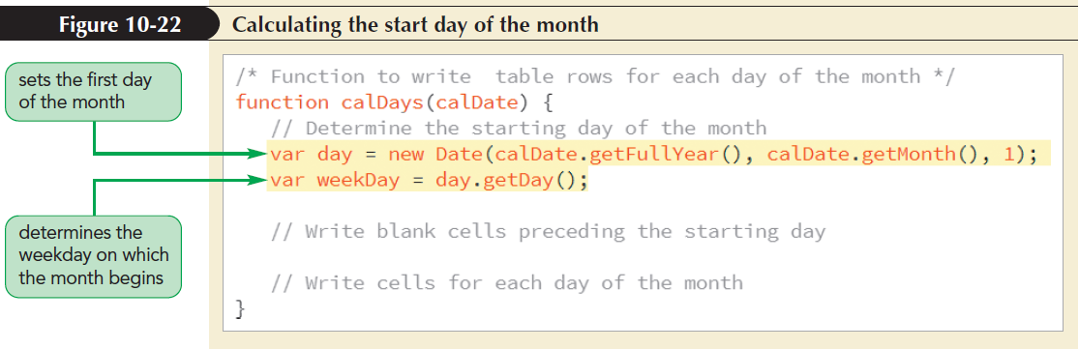
Setting the First Day of the Month

Slide 57
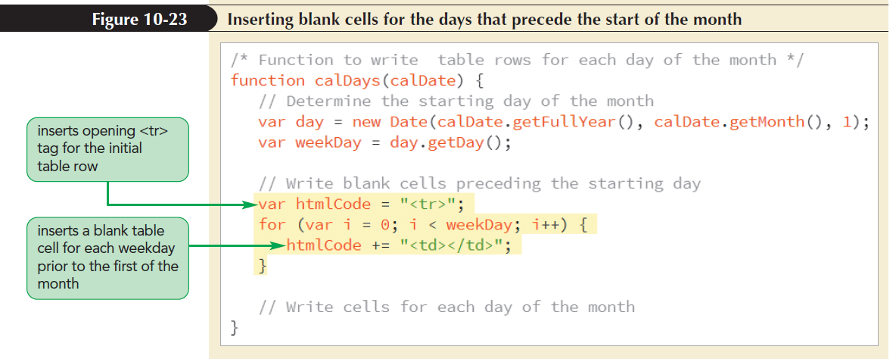
Placing the First Day of the Month

Slide 58
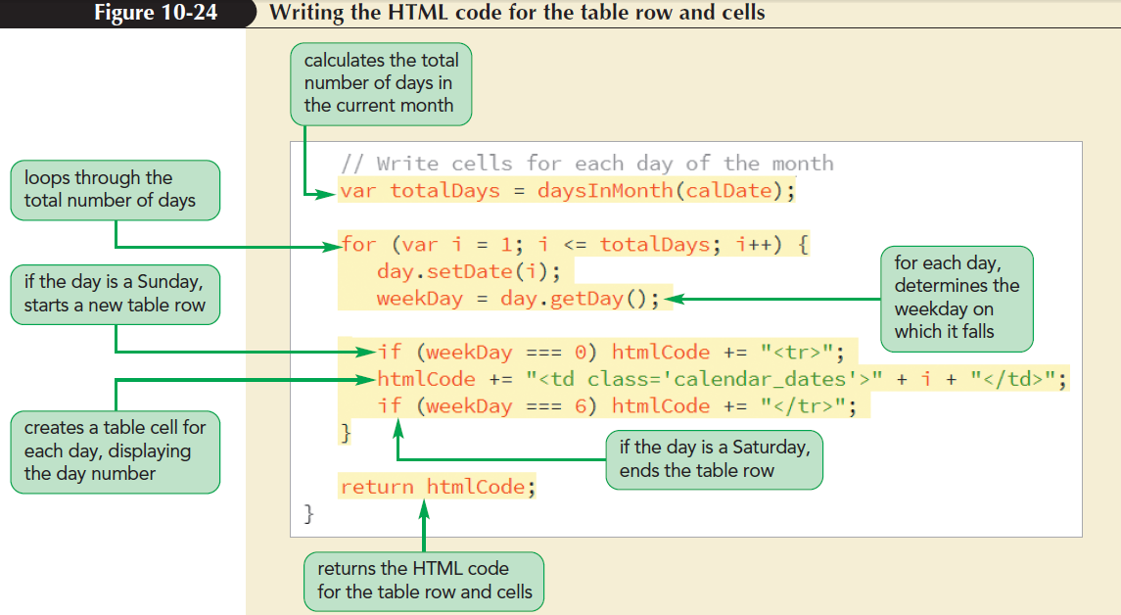
Writing the Calendar Days

Slide 59
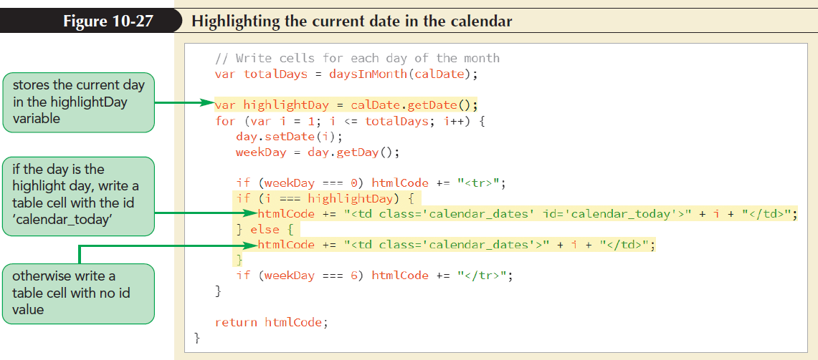
Highlighting the Current Date

Slide 60
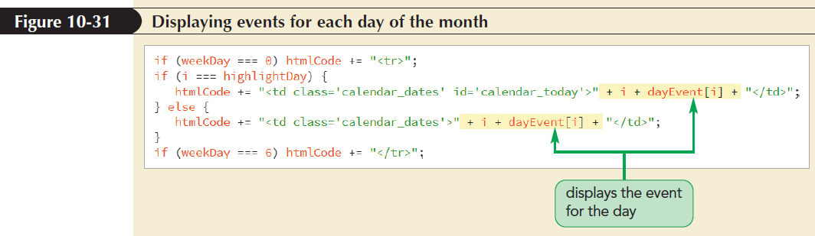
Displaying Daily Events

Slide 61
Exploring the break Command
break statement: Terminates any program loop or conditional statement
Used anywhere within the program code
When a break statement is encountered, control is passed to the statement immediately following it
It is most often used to exit a program loop before the stopping condition is met

Slide 62
Exploring the continue Command
continue statement: Stops processing the commands in the current iteration of the loop and continues on to the next iteration
It is used to jump out of the current iteration if a missing or null value is encountered

Slide 63
Exploring Statement Labels
Statement labels: Identifies statements in JavaScript code
Can be referenced elsewhere in a program
Syntax of the statement label
label: statements
where label is the text of the label and statements are the statements identified by the label

