Slide 2
Objectives
Reference forms and form fields
Create calculated fields
Retrieve field values from selection lists and radio buttons
Format numeric and currency data
Append field names and data to URLs

Slide 3
Objectives (continued)
Explore the syntax of regular expressions
Use a regular expression to extract data from the URL query string
Work with the validityState object
Create custom validation messages
Validate credit card numbers

Slide 4
Exploring the Forms Object
The knowledge of properties and methods of the form object and the elements it contains is essential to program the behavior and contents of a web form
Web forms and their elements are part of the hierarchy of objects within the web document

Slide 5
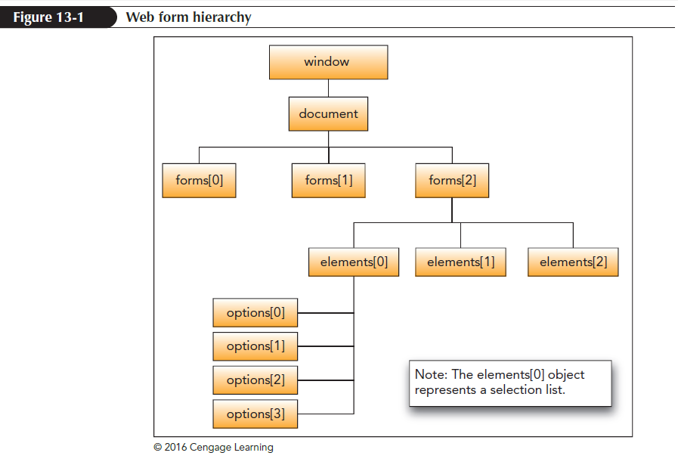
Exploring the Forms Object (continued 1)

Slide 6
Exploring the Forms Object (continued 2)
JavaScript organizes the forms into the following object collection:
document.forms[idref]
where idref is the index number or ID of the form
The form can be referenced using either the id or name attribute as follows:
document.forms.fname
where fname is either the form’s ID or name

Slide 7
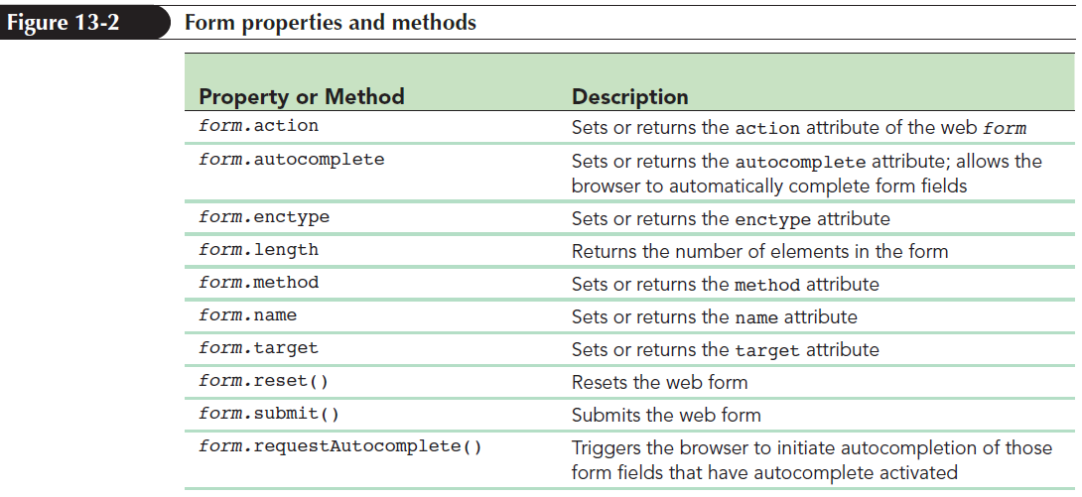
Exploring the Forms Object (continued 3)

Slide 8
Working with Form Elements
A form’s input controls, selection lists, text area boxes, and field sets are organized into the following elements collection:
form.elements[idref]
where
form is the reference to the web form
idref is the index number or ID of the element

Slide 9
Working with Form Elements (continued 1)
Element can also be referenced using its name or id attribute using the following expression:
form.elements.ename;
where ename is either the element’s ID or name
Example: Refer the orderDate field from the orderForm using the following object reference:
document.orderForm.elements.orderDate

Slide 10
Working with Form Elements (continued 2)
Reference a field using the value of the field name attribute using the following expression:
form.field
where field is the value of the field name

Slide 11
Setting the Field Value
To set the value of an input control, use the following expression:
element.value = value;
where
element is a reference to a form element
value is the value to be stored in the element
Example: Store the text string “2018-03-10” in the orderDate field as follows:
document.orderForm.orderData.value = “2018-03-01”;

Slide 12
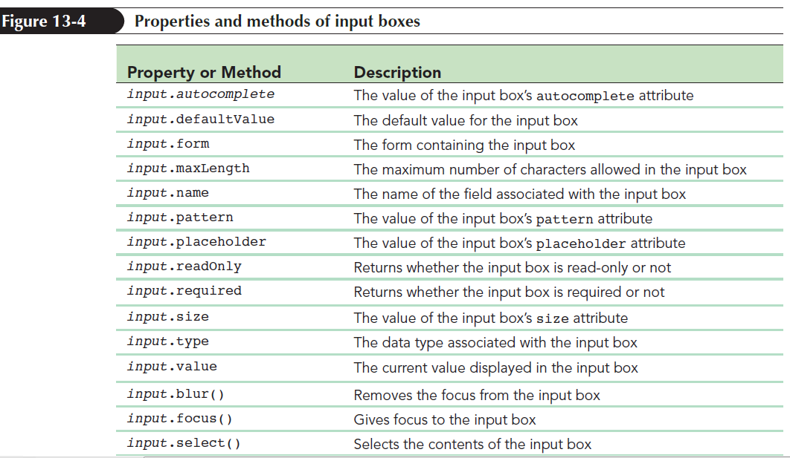
Setting the Field Value (continued 1)

Slide 13
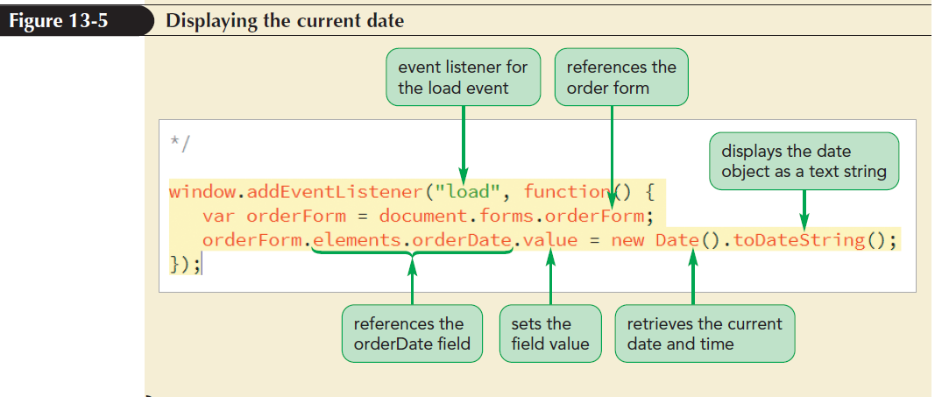
Setting the Field Value (continued 2)

Slide 14
Navigating between Fields
A field can be selected automatically when the form opens so that it is ready for data entry
When a form field is selected either by clicking it or by moving it using keyboard buttons or arrows, it receives the focus of the browser
To program this action, you use the following focus() method:
element.focus();

Slide 15
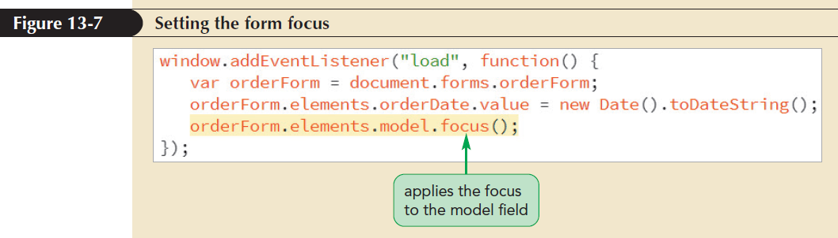
Navigating between Fields (continued 1)

Slide 16
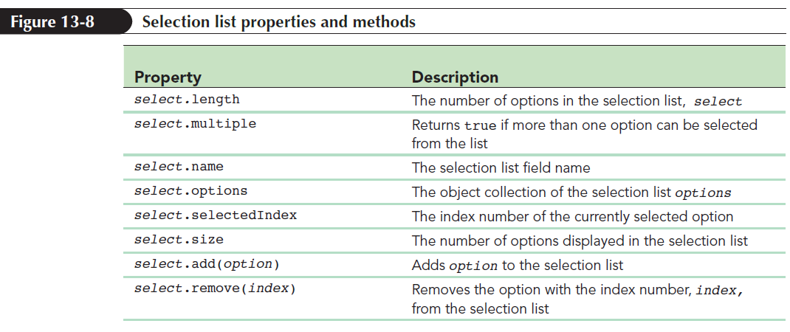
Working with Selection Lists
Various properties and methods are associated with the selection list object

Slide 17
Working with Selection Lists (continued 1)
The value of a selection list is determined by the option that is selected by the user
The selection list options are organized into the following options object collection:
select.options[idref]
where select is the reference to the selection list object and idref is the index number or ID of the option

Slide 18
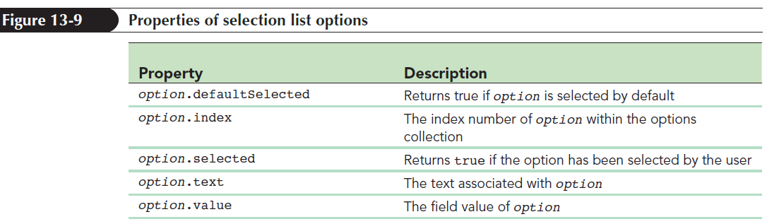
Working with Selection Lists (continued 2)

Slide 19
Working with Selection Lists (continued 3)
selectedIndex property returns the value of the selected option from a selection list
Example:
var orderForm = document.forms.orderForm;
var model = orderForm.elements.model;
var modelIndex = model.selectedIndex;
var modelValue = model.options[modelIndex].value;

Slide 20
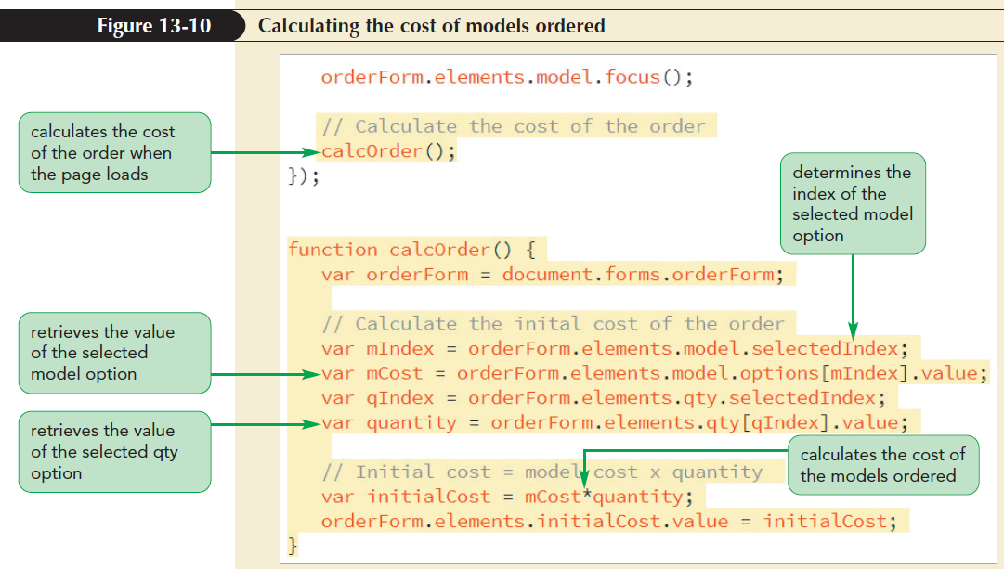
Working with Selection Lists (continued 4)

Slide 21
Working with Options Buttons and Check Boxes
Option or radio buttons are grouped by a common field name placed within the following array:
options[idref]
where
options is the common field name used by all the option buttons
idref is either the index number or ID of the option button

Slide 22
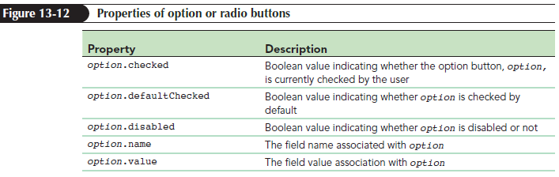
Working with Options Buttons and Check Boxes (continued 1)

Slide 23
Working with Options Buttons and Check Boxes (continued 2)
To retrieve the value of the checked option button without using a for loop, use the following CSS selector:
input[name=”protection”]:checked
Example: Determine the option button that has been checked by the user as follows:
var orderForm = document.forms.orderForm;
var protection = orderForm.elements.protection;

Slide 24
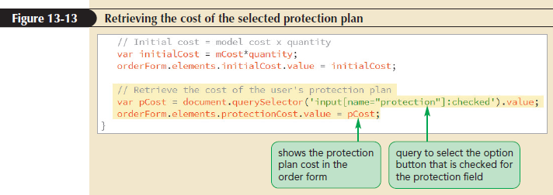
Working with Options Buttons and Check Boxes (continued 3)
for (var i = 0; i < protection.length; i++) {
if (protection[i].checked === true){
var pCost = protection[i].value;
break;}}

Slide 25
Working with Check Boxes
Check box controls work the same way as option buttons in which the checked property indicates whether the box is checked
The value associated with a checked box is stored in the value property of the check box object

Slide 26
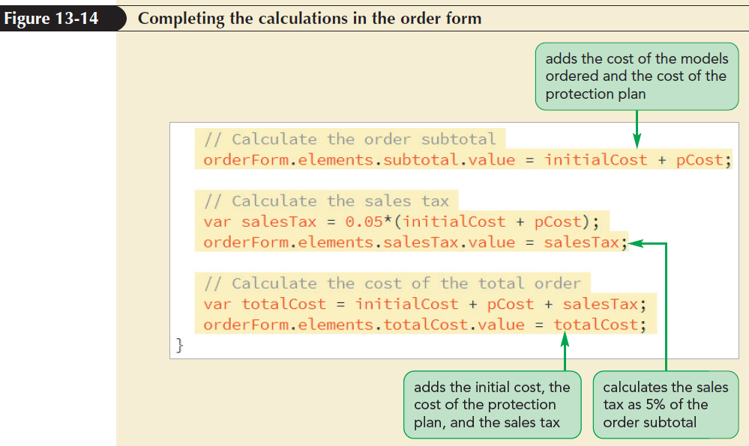
Working with Check Boxes (continued 1)

Slide 27
Formatting Numeric Values
Numeric values are displayed by JavaScript to 16 decimal place accuracy
To control the number of digits displayed by the browser, use toFixed()method
The toFixed()method is limited to only defining the decimal place accuracy and it does not format numbers as currency or separate thousands with the comma symbol

Slide 28
Formatting Numeric Values (continued 1)
To have more control over the numeric format, use the following method:
value.toLocaleString(locale, {options})
where locale is a comma-separated list of location and language codes and options is a comma-separated list of formatting options for numeric values

Slide 29
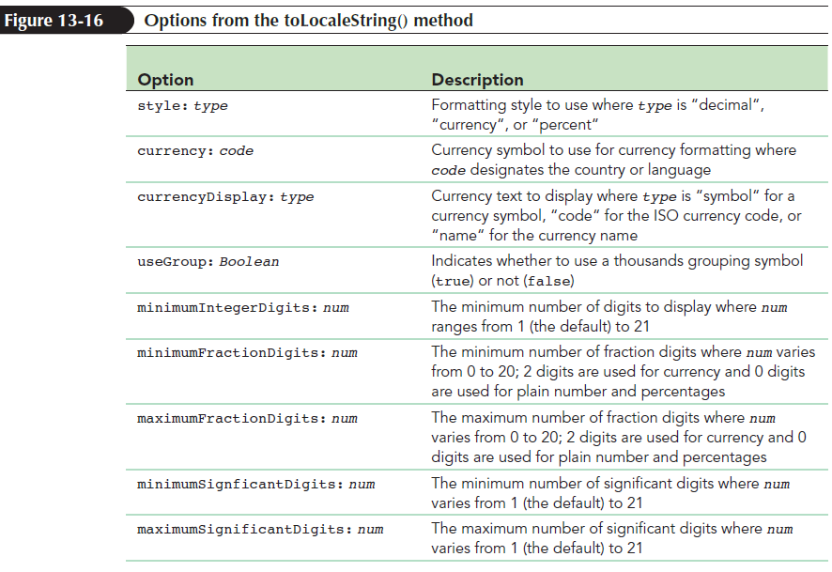
Formatting Numeric Values (continued 2)

Slide 30
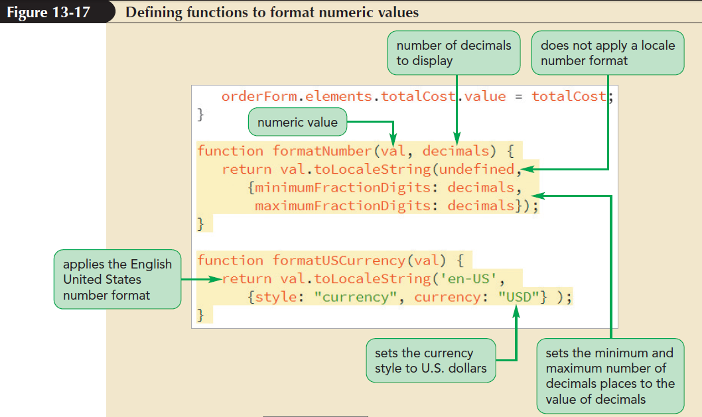
Formatting Numeric Values (continued 3)

Slide 31
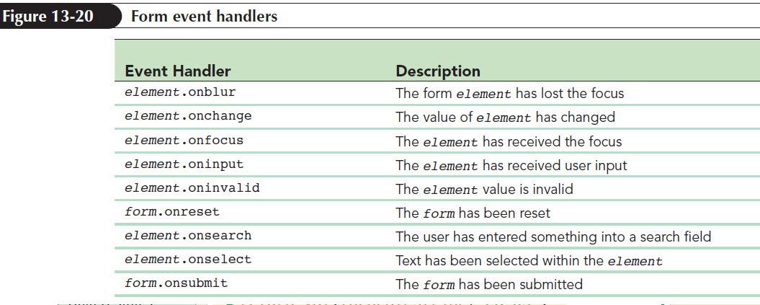
Applying Form Events
JavaScript supports event handlers to respond to user actions within a form

Slide 32
Applying Form Events (continued 1)
Example: To rerun the calcOrder() function when the user changes the quantity of items to order, use the following event handler:
orderForm.elements.qty.onchange = calcOrder;
Use the onclick event handler for options buttons and check boxes

Slide 33
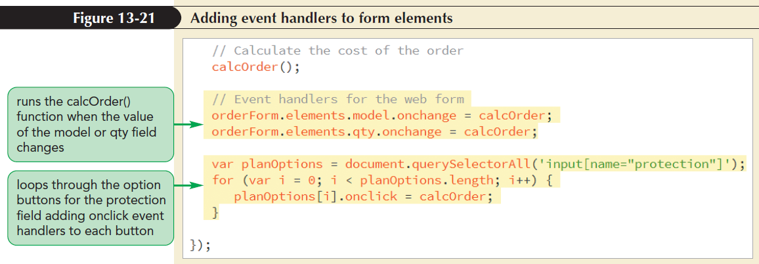
Applying Form Events (continued 2)

Slide 34
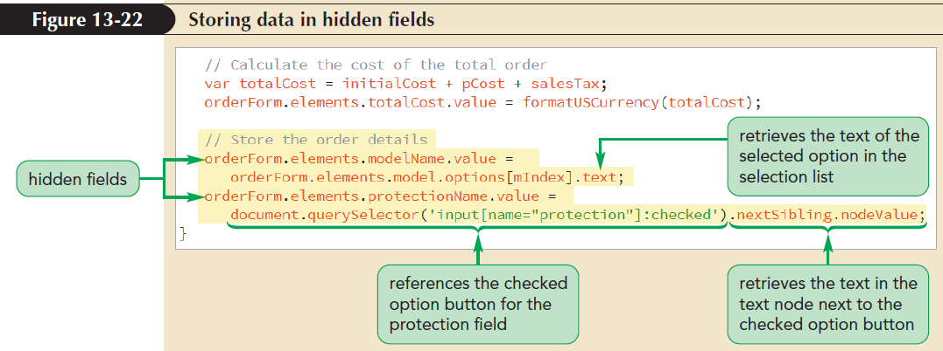
Working with Hidden Fields
Hidden fields are used to store important data
The data stored in hidden fields is available only to programmers and removed from the user’s control

Slide 35
Appending Form Data
To append form data to the URL, add method and action attributes to the form element as follows:
<form method="get" action="url">
where url is the URL of the page to which the form data has to be appended

Slide 36
Appending Form Data (continued 1)
General format of the URL
http://server/path/file?field1=value 1&field2=value2&field3=value3...
where
server and path are the server and path names for the web page
file is the filename of the web page
? character followed by query string contains field names and data values appended to the URL

Slide 37
Examining the location Object
Location object stores the current location of the web document
Location object is referenced using the following expressions:
window.location
document.location
location
To load a new page in the current window, use
window.location = url
where url is the URL of the new page

Slide 38
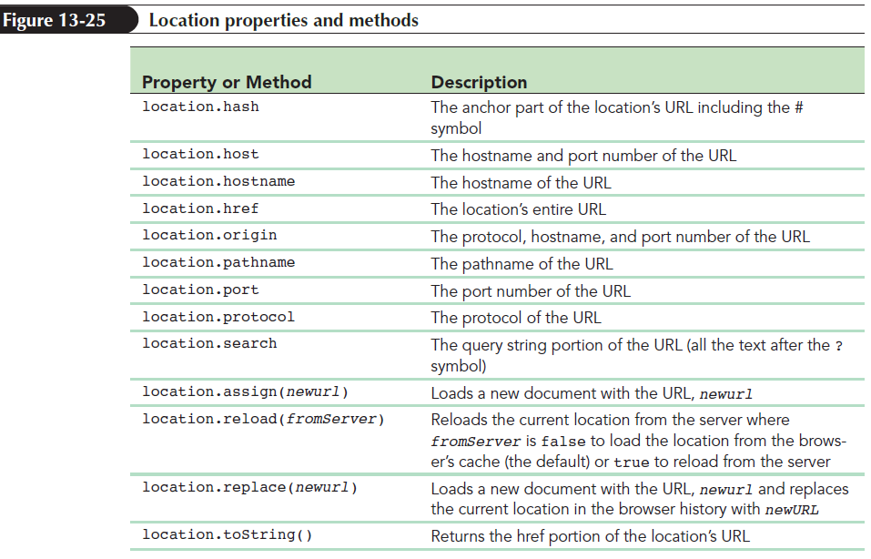
Examining the location Object (continued 1)

Slide 39
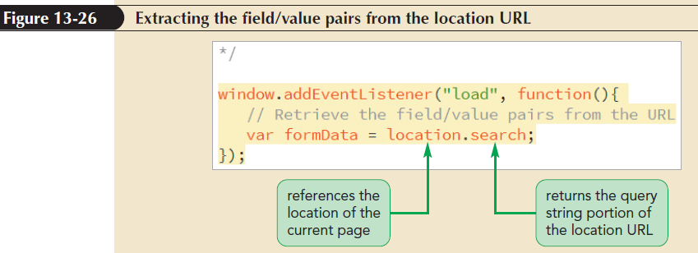
Examining the location Object (continued 2)

Slide 40
Working with Text Strings
Text string objects are created implicitly
when storing any text string value within a variable or
by extracting a text string from a web form field or a location URL
Text string objects can be explicitly created using the following object constructor:
var stringVar = new String(text);
where stringVar is a variable that stores the text string and text is the text of the string

Slide 41
Extracting Substrings from a Text String
To extract a character in a text string, use
string.charAt(i)
where string is the string object and i is the index value of the character
The charAt() method extracts only a single character

Slide 42
Extracting Substrings from a Text String (continued)
To extract substrings, use string.slice(start [,end])
where start is the starting index value and end is the index value at which the slicing stops
To create an array of substrings, use strArray = string.split(str)
where strArray is the array to store the substrings and str is a delimiter that determines the break between substrings

Slide 43
Searching within a Text String
To search for the occurrence of substrings within larger text strings, use
string.indexOf(str [,start])
where start indicates the index value where the search starts
The indexOf() method returns the index value of the first occurrence of the substring str

Slide 44
Introducing Regular Expressions
Regular expression: Text string that defines a character pattern
General form:
/pattern/
where pattern is the regular expression code that defines a character pattern

Slide 45
Matching a Substring
The most basic regular expression is /chars/
where chars is the substring text
To specify the beginning or end of the regular expressions, mark the beginning and end of a text string with the ^ and $ characters, respectively

Slide 46
Setting Regular Expression Flags
By default, pattern matching stops after the first match is discovered and flag is added to the end of a regular expression to override the default
To perform a global search and match all occurrences of a character pattern within the text string, use /pattern/g method
To make a regular expression insensitive to case, use /pattern/I method

Slide 47
Defining Character Types and Character Classes
Regular expression can match substrings based on the general type of character
The four general types of characters
Alphabetical characters
Digits (numbers 0 to 9)
Word characters: Alphabetical characters, digits, or the underscore character ( _ )
White space characters (blank spaces, tabs, and new lines)

Slide 48
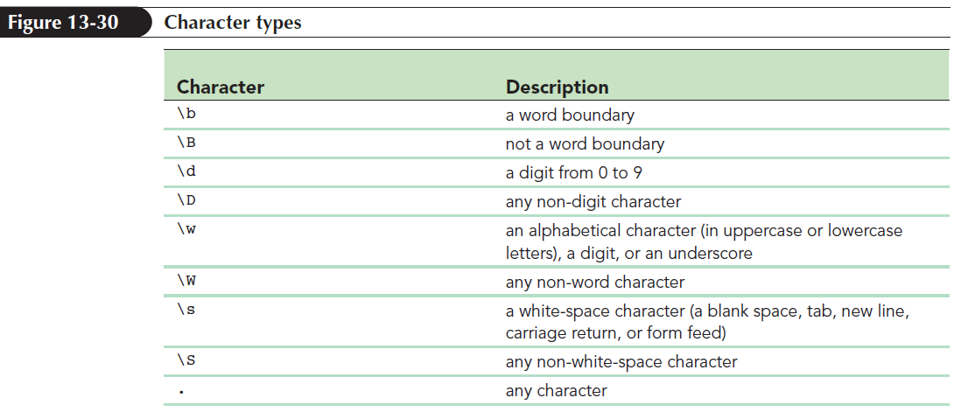
Defining Character Types and Character Classes (continued 1)

Slide 49
Defining Character Types and Character Classes (continued 2)
In regular expression language, word refers to any string of symbols consisting solely of word characters
Example: The string “R2D2” is considered a single word but “R2D2&C3PO” is considered two words with the & symbol marking the boundary between the words

Slide 50
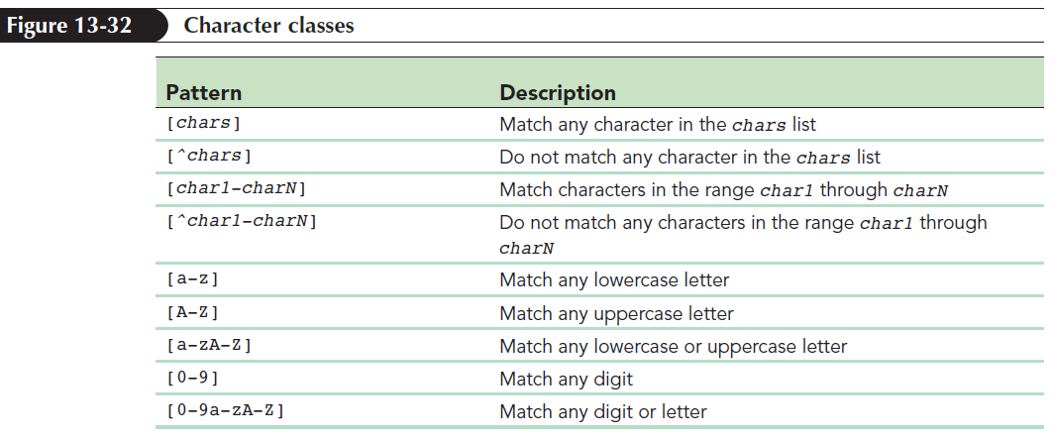
Defining Character Types and Character Classes (continued 3)
Character class is used to limit the regular expression to a select group of characters

Slide 51
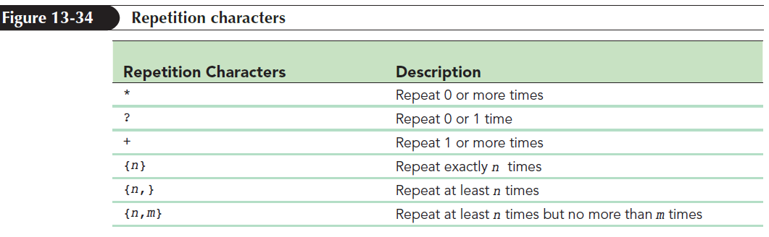
Specifying Repeating Characters
To specify the exact number of times to repeat a character, append the character with {n} symbol
where n is the number of times to repeat the character

Slide 52
Using Escape Sequences
Escape sequence is used by prefacing the character with the backslash character (\)
The backslash character indicates that the character that follows should be interpreted as a character and not a command

Slide 53
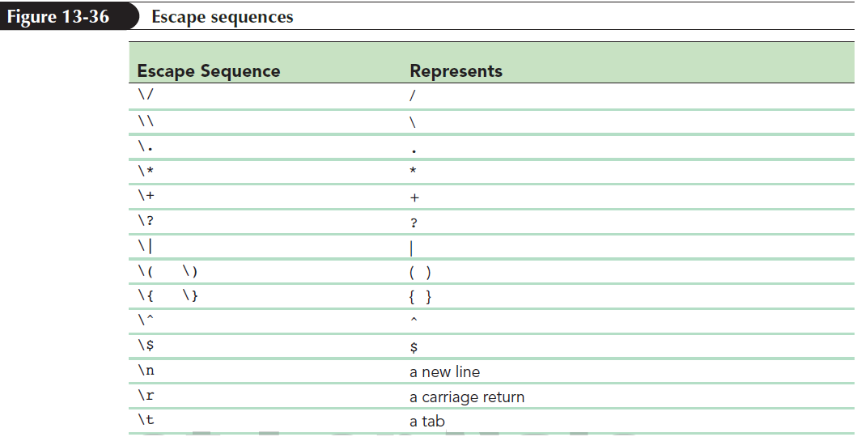
Using Escape Sequences (continued 1)

Slide 54
Specifying Alternate Patterns and Grouping
To define two patterns for the same text string, use the “|” character as follows:
pattern1|pattern2
where pattern1 and pattern2 are two distinct patterns
To group character symbols as a single unit, use the following syntax:
(pattern)
where pattern is a regular expression pattern

Slide 55
Programming with Regular Expressions
Regular expression literal is used to directly enter the code of a regular expression in JavaScript
For example, the following command stores a regular expression in the regx variable:
var regx = /\d{5}-\d{4}/g;

Slide 56
Programming with Regular Expressions (continued)
A regular expression can be defined using new RegExp() object constructor as follows:
new RegExp(pattern, flags);
where pattern is the regular expression pattern and flags are any modifiers added to the pattern
One of the advantages of using an object constructor is the ability of storing regular expressions as variables

Slide 57
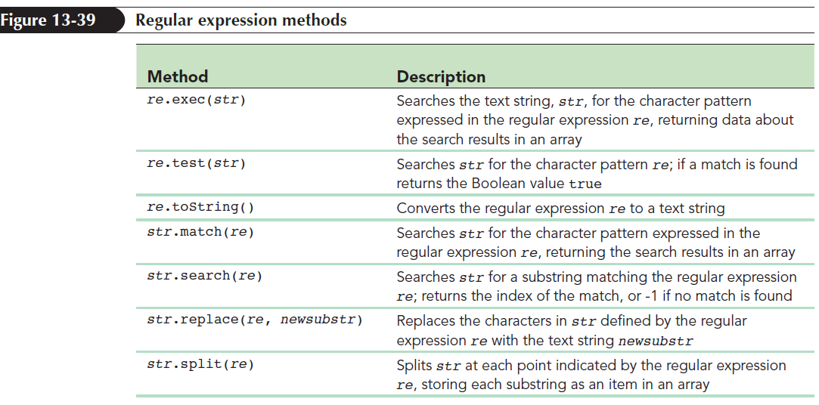
Regular Expression Methods
Regular expressions have their own methods as they are another type of JavaScript object

Slide 58
Replacing URI Encoded Characters
When the browser finds a character in a field name or value that is reserved for other purposes, it replaces the character with a character code known as URI encoded character
To decode the field value back into its original values, use
decodeURIComponent(string)
where string is a text string containing URI─ encoded characters

Slide 59
Writing URL Data to a Web Form
To split the query string at each occurrence of the & or = character in the form data, use the split() method as follows:
var formFields formData.split(/&=/g);
where /&=/g is a regular expression that matches every “&” and “=“ character in the formData text string

Slide 60
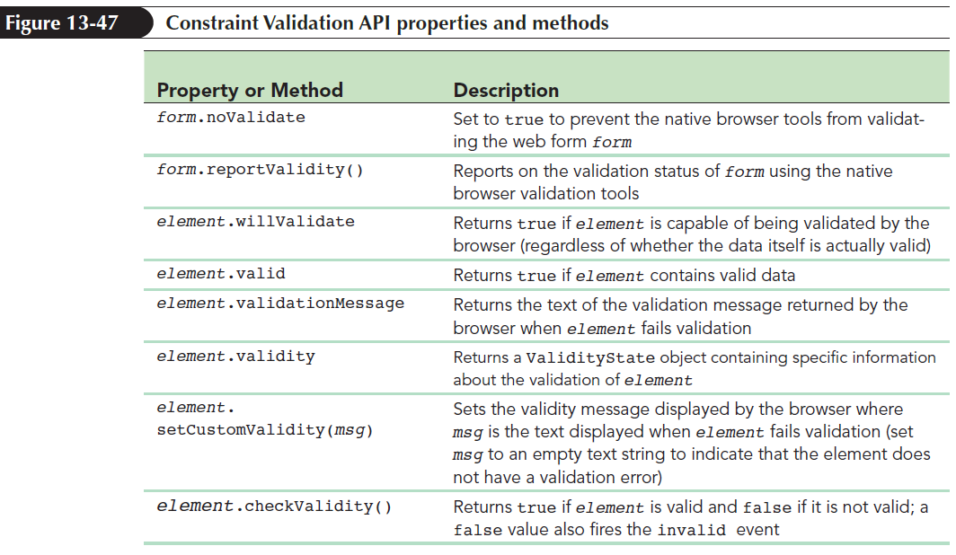
Validating Data with JavaScript
Constraint Validation API: Form validation properties and methods built into JavaScript

Slide 61
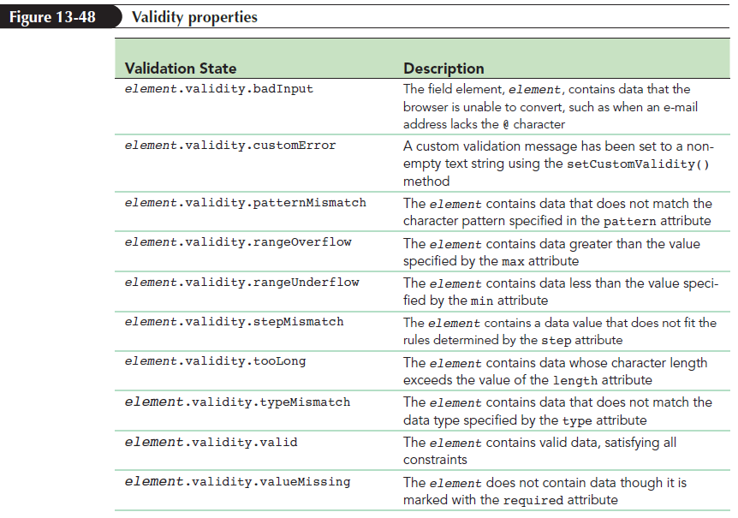
Exploring the ValidityState Object
ValidityState object: Stores the reason for validation fail of a data field

Slide 62
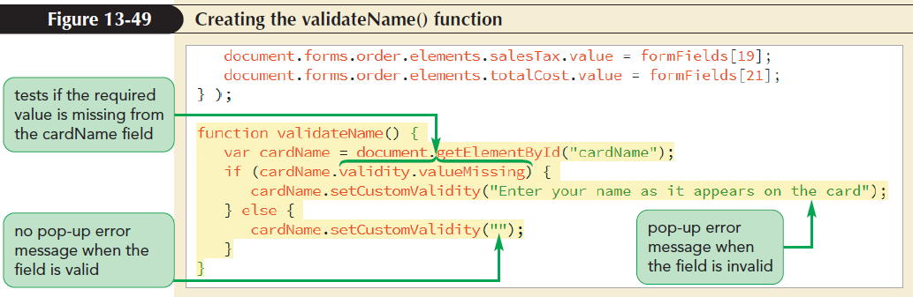
Creating a Custom Validation Message
To display the same error message across all browsers, use the following method:
element.setCustomValidity(msg)
where msg is the custom message displayed by the browser when an element is invalid

Slide 63
Responding to Invalid Data
To check the validity of form data as it’s being inserted, use an event handler or event listener for the input event
To catch invalid data before the form is submitted, add an event handler or event listener for the click event of the form’s submit button

Slide 64
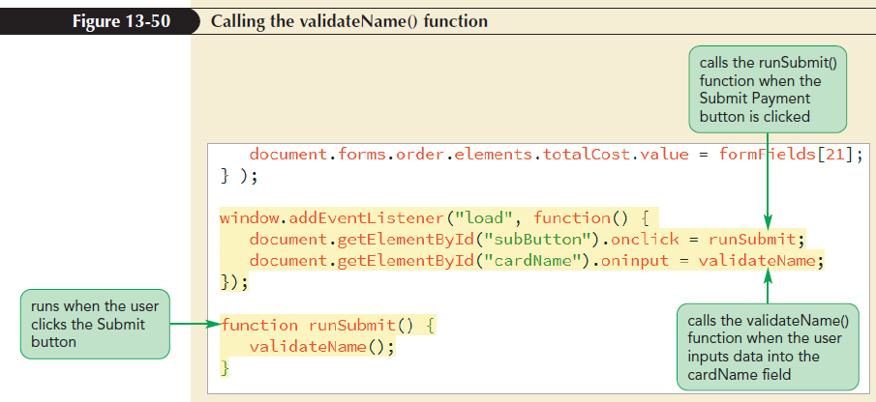
Responding to Invalid Data (continued)

Slide 65
Validating Data with Pattern Matching
Text strings can be matched against a regular expression pattern by adding the following pattern attribute to the input element:
pattern = “regex”
where regex is the regular expression
Use the valueMissing property to test if the field has been left blank and patternMismatch property to test for the correct pattern

Slide 66
Validating a Selection List
Use the selectedIndex property to determine the value of the index that is selected
If the index is 0, the browser will declare the field value as invalid

Slide 67
Testing a Form Field Against a Regular Expression
Credit card CVC numbers are either 3-digit numbers or 4-digit numbers
The regular expressions for 4-digit CVC numbers and 3-digit CVC numbers are /^\d{4}$/ and /^\d{3}$/ respectively
Regular expression patterns can be tested using the test() method

Slide 68
Testing for Legitimate Card Numbers
Luhn Algorithm/Mod10 Algorithm: Provides a quick validation check on unique identification numbers
Luhn Algorithm ensures that the sum of the digits in the number meet certain mathematical criteria

Slide 69
Testing for Legitimate Card Numbers (continued 1)
The steps involved in Luhn Algorithm are as follows:
Start from the last digit and move to the left. Divide the alternating digits of the ID number into two groups
Add the digits in the first group
Double the digits in the second group and then add the sum of the doubled digits

Slide 70
Testing for Legitimate Card Numbers (continued 2)
Calculate the total sum from the two groups
If the total sum is evenly divisible by 10, the ID number is considered legitimate, otherwise the ID number is illegitimate

Slide 71
Testing for Legitimate Card Numbers (continued 3)
To sum the digits found within a text string, use
function sumDigits(numStr) {
var digitTotal = 0;
for (var i = 0; i < numStr.length; i++){digitTotal += parseInt(numStr.charAt(i));
}
return digitTotal;
}

Slide 72
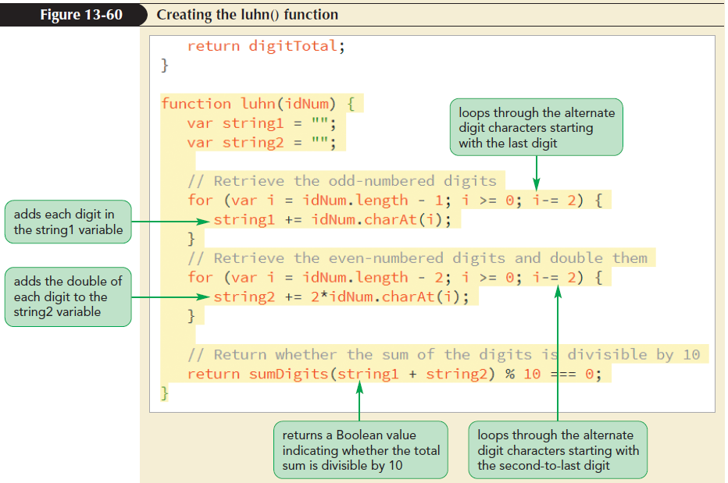
Testing for Legitimate Card Numbers (continued 4)

Slide 73
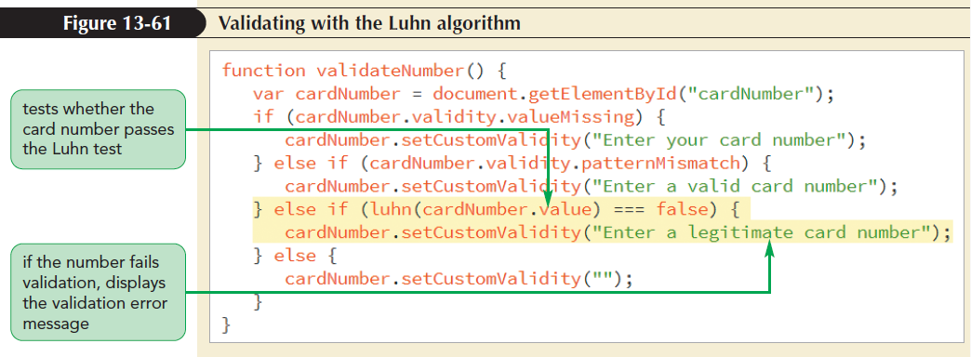
Testing for Legitimate Card Numbers (continued 5)

