Slide 2
Objectives
Explore the history of CSS
Study different types of style sheets
Explore style precedence and inheritance
Apply color in CSS
Use contextual selectors
Work with attribute selectors

Slide 3
Objectives (continued)
Apply text and font styles
Use a web font
Define list styles
Work with margins and padding space
Use pseudo-classes and pseudo-elements
Insert page content with CSS

Slide 4
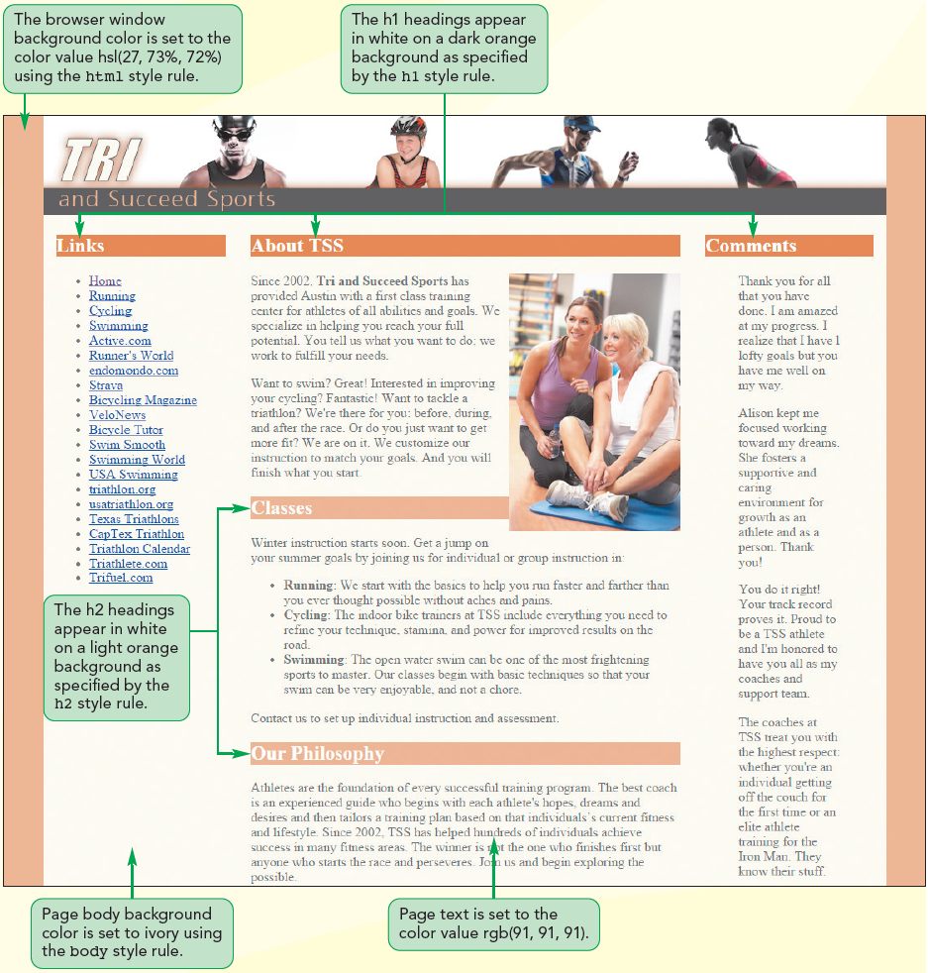
CSS Styles and Colors

Slide 5
Introducing CSS
The appearance of the page is determined by one or more style sheets written in the Cascading Style Sheets (CSS) language
The latest version of the CSS language is CSS3
CSS3 is built upon several modules, where each module is focused on a separate design topic

Slide 6
Types of Style Sheets
Browser styles or user agent styles – Styles built into the browser
User-defined styles – Styles defined by a user based on the configuration setting of the user’s browser
External styles – Styles created by a website author, placed within a CSS file, and linked to the page

Slide 7
Types of Style Sheets (continued)
Embedded styles – Styles added to the head of an HTML document
Inline styles – Styles added as element attributes within an HTML document and applied to only that particular element

Slide 8
Exploring Style Rules
The general syntax of a CSS style rule is
selector{
property1: value1;
property2: value2;
...
}

Slide 9
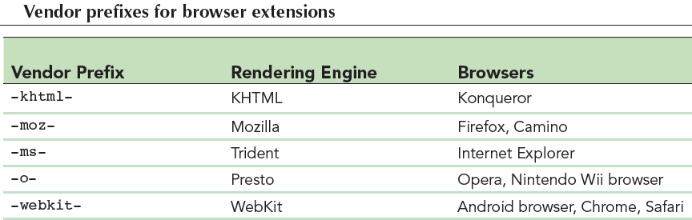
Exploring Style Rules (continued)
Browser extensions are an extended library of style properties in the browser
Vendor prefix – Indicates the browser vendor that created and supports the style property

Slide 10
Embedded Style Sheets
They are inserted directly into the HTML file as metadata by adding the following element to the document head
<style>
style rules
</style>
where style rules are the different rules embedded in the HTML page

Slide 11
Inline Styles
They are styles applied directly to specific elements using the following style attribute
<element style=“property1: value1;
property2: value2; …”>
content
</element>
where the property: value pairs define the styles applied directly to that element

Slide 12
Style Specificity and Precedence
The more specific style rule has precedence over the more general style rule
Specificity is an issue when two or more styles conflict
If two rules have equal specificity and equal importance, then the one that is defined last has precedence

Slide 13
Style Inheritance
Style inheritance – Process in which properties are passed from a parent element to its children
For example, the following style rule sets the color of article text to blue and the rule is passed to any paragraph or other elements nested within that article
article {color: blue;}
p {text-align: center;}

Slide 14
Browser Developer Tools
They allow designers to view HTML code and CSS styles
They make it easier to locate the source of a style that has been applied to a specific page element
They are different in each browser and are updated and improved constantly

Slide 15
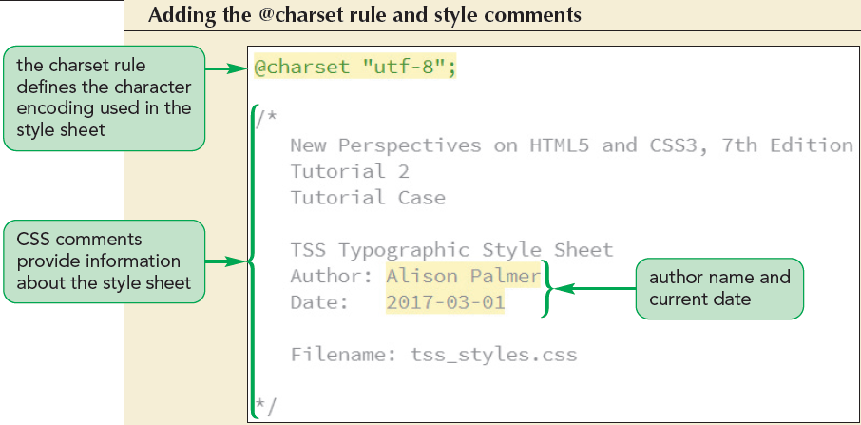
Writing Style Comments

Slide 16
Importing Style Sheets
@import is a CSS at-rule used to import the content of a style sheet file
@import url(url);
where url is the URL of an external stylesheet file
It is similar to adding link elements to an HTML file

Slide 17
Working with Color in CSS
Color values – Values in which the color is given by an exact numeric representation
RGB triplet – The intensity of primary colors expressed as a set of numbers in CSS
rgb(red, green, blue)
Hexadecimal numbers – A number expressed in the base 16 numbering system

Slide 18
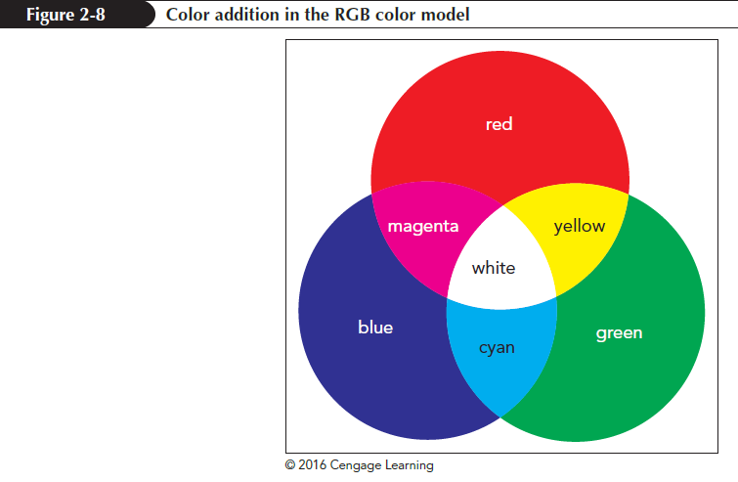
RGB Color Values

Slide 19
HSL Color Values
Hue – Tint of a color, represented by a direction on a color wheel
Saturation – Measures the intensity of a color and ranges from 0% (no color) up to 100% (full color)
Lightness – Measures the brightness of a color and ranges from 0% (black) up to 100% (white)

Slide 20
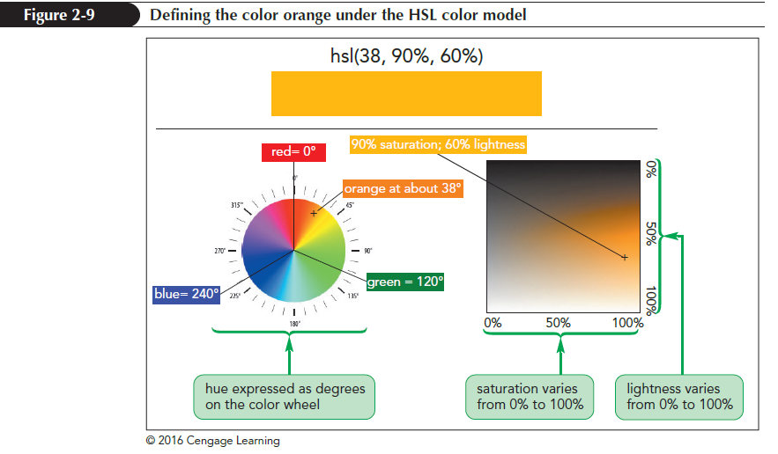
HSL Color Values (continued)

Slide 21
Defining Semi-Opaque Colors
Opacity – Defines how solid a color appears
A color’s opacity is specified using the following properties:
rgba(red, green, blue, opacity)
hsla(hue, saturation, lightness, opacity)
where opacity sets the opacity of the color ranging from 0 (completely transparent) up to 1.0 (completely opaque)

Slide 22
Setting Text and Background Color
CSS defines the text and background color for each element on a webpage
color: color;
background-color: color;
where color is a color name or a color value

Slide 23
Employing Progressive Enhancement
Progressive enhancement – A technique of placing the code conforming to elder standards before newer properties
It provides support for older browsers and allows newer standards to be used by the browsers that support them

Slide 24
Contextual Selectors
Contextual selector – Specifies the context under which a particular page element is matched
Context is based on the hierarchical structure of a document, whichs involves the relationships between a parent element containing one or more child elements and within those child elements several levels of descendant elements

Slide 25
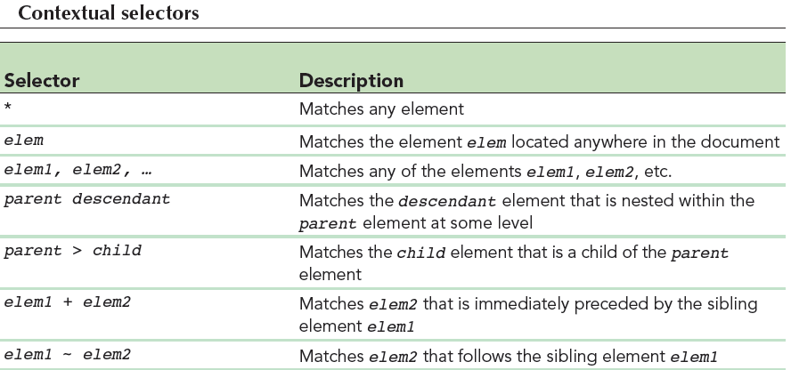
Contextual Selectors (continued 1)

Slide 26
Contextual Selectors (continued 2)
To match any element, a wildcard selector with the * character is used
Sibling selectors are used to select elements based on elements that are adjacent to them in the document hierarchy

Slide 27
Attribute Selectors
Selectors also can be defined based on attributes and attribute values within elements
id – Identifies specific elements within the document
class– Identifies a group of elements that share a similar characteristic or property

Slide 28
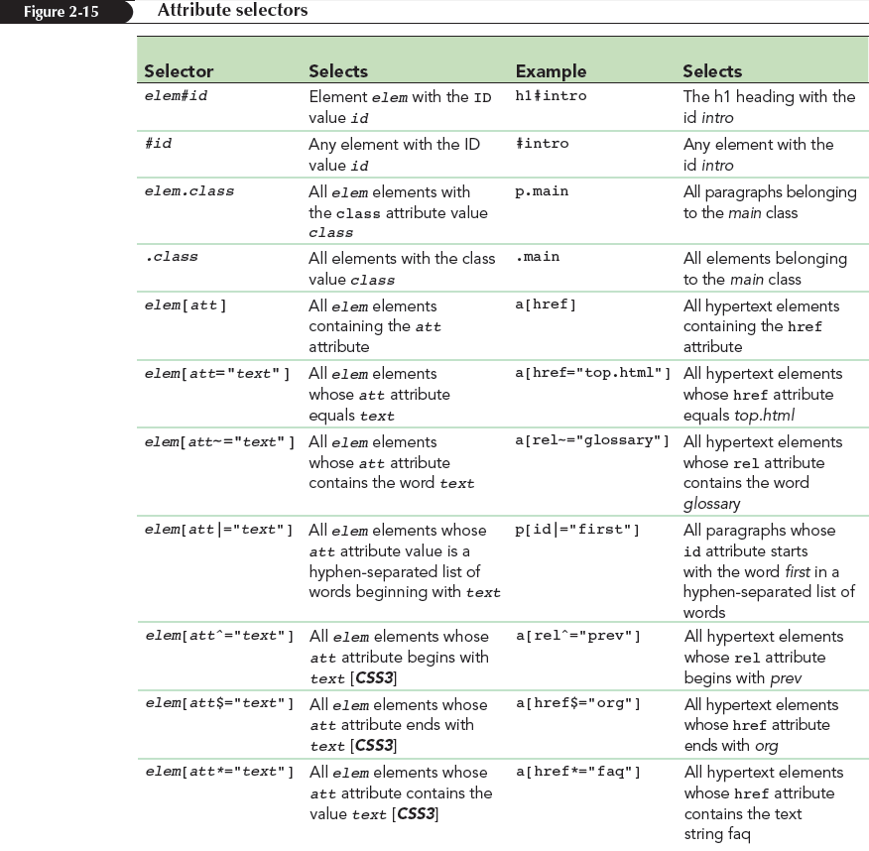
Attribute Selectors (continued)

Slide 29
Working with Fonts
Typography is the art of designing the appearance of characters and letters on a page
Color and font are one of few properties in the CSS family of typographical styles

Slide 30
Choosing a Font
Text characters are based on fonts that define the style and appearance of each character in the alphabet
The general structure of defining font for any page element is
font-family: fonts;
where fonts is a comma-separated list,
also known as a font stack

Slide 31
Choosing a Font (continued)
Specific font – Identified by name and based on a font definition file stored in a user’s computer or accessible on the web
Generic font – Describes the general appearance of the characters in the text but does not specify any particular font definition file
Supports the font groups serif, sans-serif, monospace, cursive, and fantasy

Slide 32
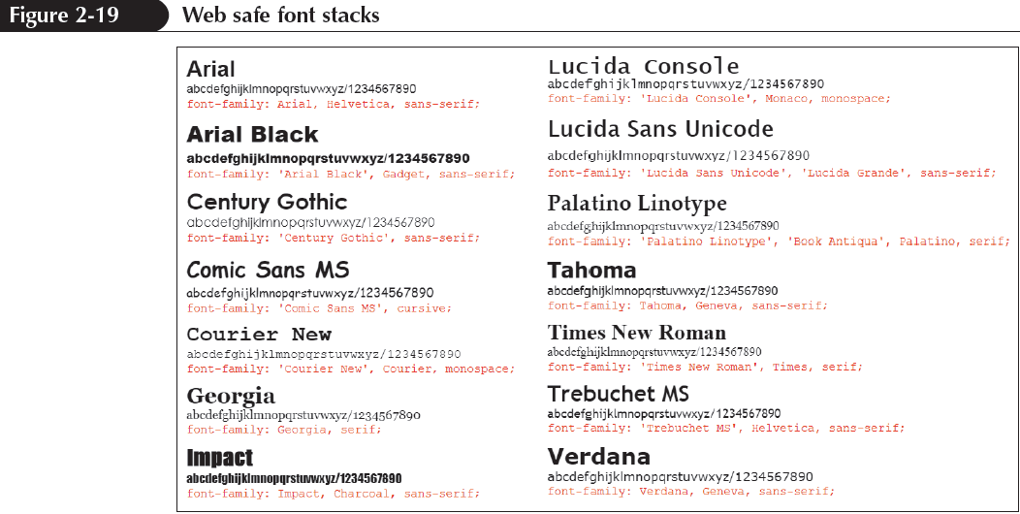
Styling Web Page Text

Slide 33
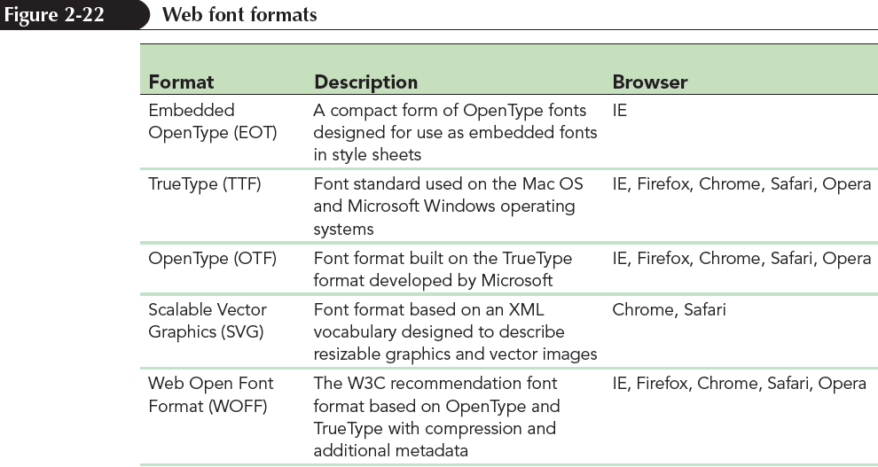
Exploring Web Fonts
Web font – Definition font is supplied to the browser in an external file because web safe fonts limit the number of fonts choices

Slide 34
The @font-face Rule
To access and load a web font, add the @font-face rule to the style sheet
Once a web font is defined using the @font-face rule, it is included in the font stack

Slide 35
The @font-face Rule (continued 1)
The general syntax to include @font-face is
@font-face {
font-family: name;
src: url (‘url1’) format (‘text1’),
url (‘url2’) format (‘text2’),
…;
descriptor1: value1;
descriptor2: value2;
…
}

Slide 36
The @font-face Rule (continued 2)
where name is the name of the font, url is the location of the font definition file, text is an optional text description of the font format, and the descriptor1: value1; pairs are optional style properties of the font

Slide 37
Setting the Font Size
To set a font size, use the style property
font-size: size;
where size is a CSS unit of length in either relative or absolute units.
Absolute units – Fixed in size regardless of the output device and are used only with printed media
Relative units – Expressed relative to the size of other objects within the web page or to the display properties of the device itself

Slide 38
Scaling Fonts with ems and rems
Text is made scalable with all font sizes expressed relative to default font sizes
The three relative measurements used to provide scalability are
percentage
em unit
rem or root em unit

Slide 39
Using Viewport Units
Viewport unit – A relative unit used to express length as a percentage if the width and height if the browser window
CSS3 introduced four viewport units
1 vw = 1% of the browser window width
1 vh = 1% of the browser window height
1 vmin = 1 vw or 1 vh (whichever is smaller)
1 vmax = 1 vw or 1 vh (whichever is larger)

Slide 40
Sizing Keywords
Font sizes are expressed using the following keywords
xx-small
x-small
small
medium
large
x-large
xx-large
larger
smaller

Slide 41
Controlling Spacing and Indentation
Kerning measures the amount of space between characters, while tracking measures the amount of space between words
The properties to control an element’s kerning and tracking are:
letter-spacing: value;
word-spacing: value;

Slide 42
Controlling Spacing and Indentation (continued 1)
Leading – Measures the amount of space between lines of text and is set using the following line-height property:
line-height: size;
Text spacing can be controlled by setting the indentation for the first line of text block by using the text-indent property
text-indent: size;

Slide 43
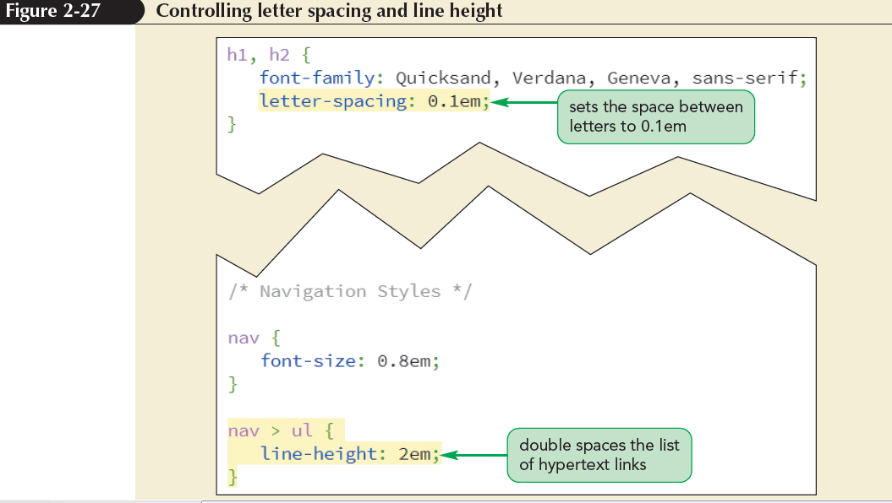
Controlling Spacing and Indentation (continued 2)

Slide 44
Working with Font Styles
To specify the font style, use
font-style: type;
where type is normal, italic, or oblique
To change the weight of the font, use
font-weight: weight;
where weight is the level of bold formatting applied to the text

Slide 45
Working with Font Styles (continued 1)
To specify a text decoration, use
text-decoration: type;
where type is none, underline, overline, or line-through
To transform text, use
text-transform: type;
where type is capitalize, uppercase, lowercase, or none

Slide 46
Working with Font Styles (continued 2)
To display a font variant of text, use
font-variant: type;
where type is normal or small-caps

Slide 47
Aligning Text Horizontally and Vertically
To horizontally align the text , use
text-align: alignment;
where alignment is left, right, center, or justify
To vertically align the text within each line, use
vertical-align: alignment;
where alignment is baseline, bottom, middle, sub, super, text-bottom, text-top, or top

Slide 48
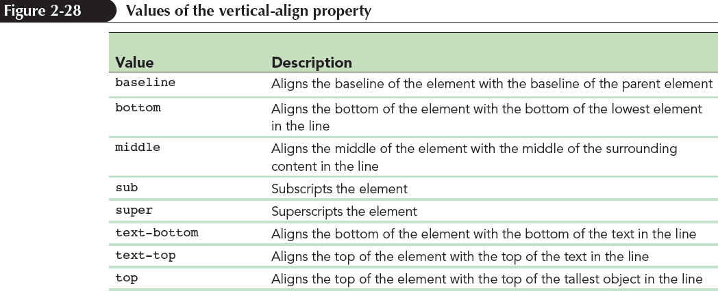
Aligning Text Horizontally and Vertically (continued)

Slide 49
Combining All Text Formatting in a Single Style
The text and font styles can be combined using the following shorthand font property:
font: style variant weight size/height family;
where style is the font’s style, variant is the font variant, weight is the font weight, size is the font size, height is the height of each line, and family is the font stack

Slide 50
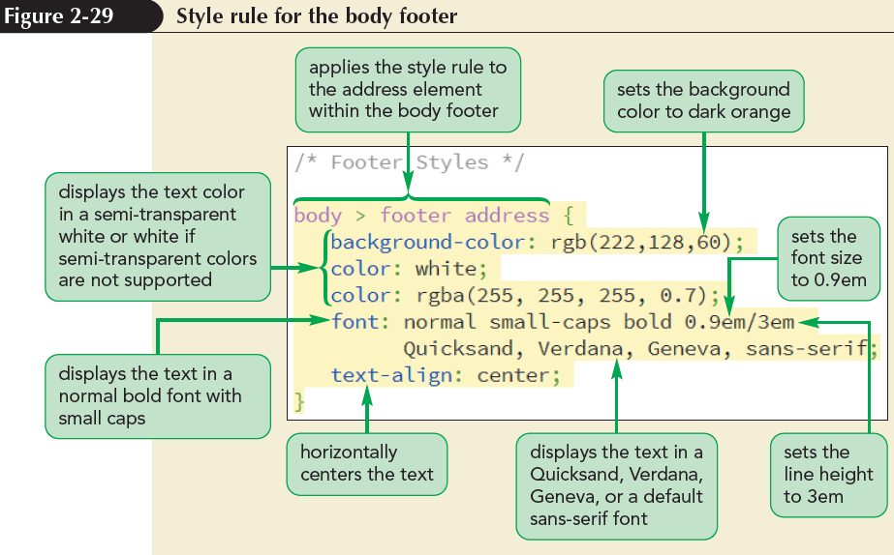
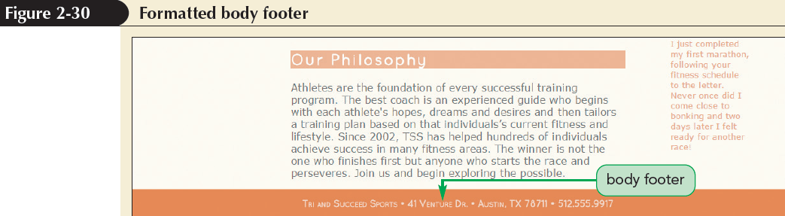
Combining All Text Formatting in a Single Style (continued)

Slide 51
Formatting Lists
List marker – It is the default browser style symbol displayed before each list item for unordered and ordered lists
To change the type of list marker or to prevent any display of a list marker, use
list-style-type: type;
where type is the various types of markers

Slide 52
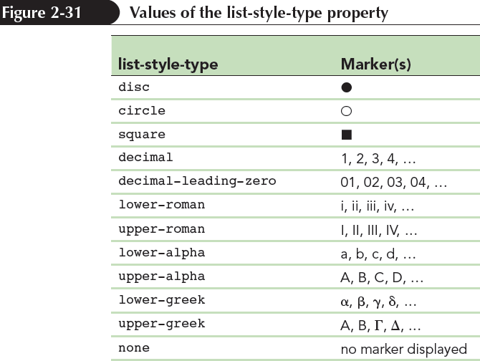
Formatting Lists (continued)

Slide 53
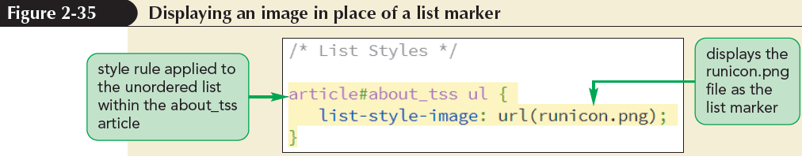
Using Images for List Markers
A customized graphic image for the list marker can be supplied by the user
list-style-image: url (url);
where url is the URL of a graphic file containing the marker image

Slide 54
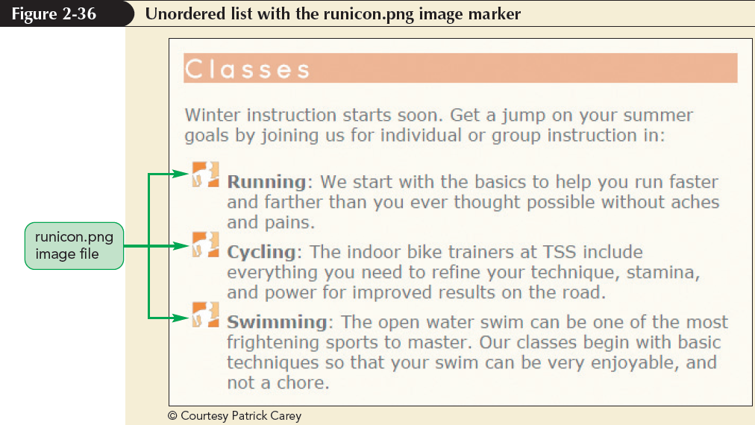
Using Images for List Markers (continued)

Slide 55
Setting the List Marker Position
CSS treats each list item as a block-level element, placed within a virtual box in which the list marker is placed outside of the list text
To change the default behaviour, use
list-style-position: position;
where position is either outside or inside

Slide 56
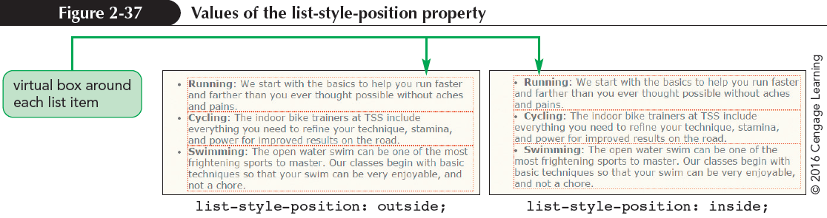
Setting the List Marker Position (continued)

Slide 57
Working with Margins and Padding
Block-level elements follow the structure of the box model
Contents in a box model are enclosed within the following series of concentric boxes:
The content of the element itself
The padding space, which extends from the element’s content to a border

Slide 58
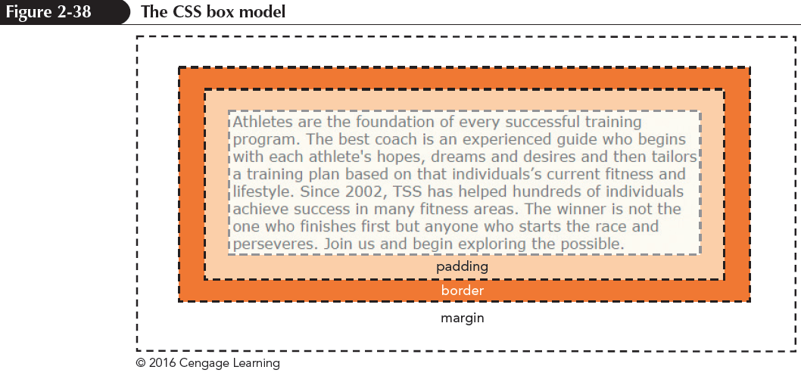
Working with Margins and Padding (continued)
The border surrounding the padding space
The margin space comprised of the space beyond the border up to the next page element

Slide 59
Setting the Padding Space
To set the width of the padding space, use the following padding property
padding: size;
where size is expressed in one of the CSS units of length or the keyword auto to let the browser automatically choose the padding

Slide 60
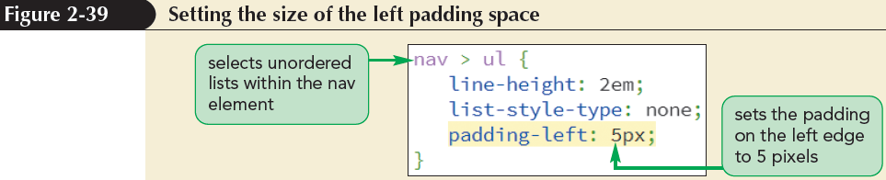
Setting the Padding Space (continued)

Slide 61
Setting the Margin and Border Spaces
To set the size of the margin around block-level elements, use
margin: size;
margin: top right bottom left;
To set the size of the border space, use
border-width: size;
border-width: top right bottom left;

Slide 62
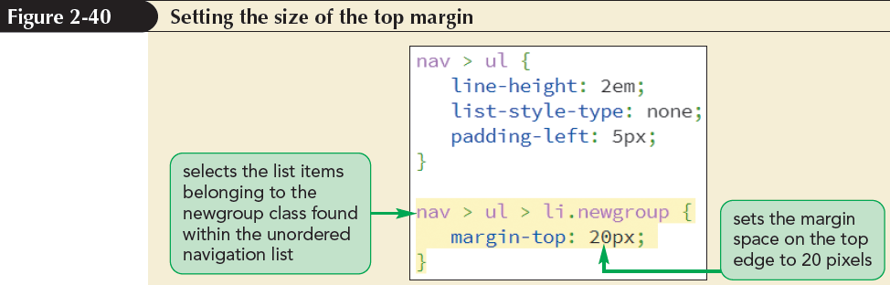
Setting the Margin and Border Spaces (continued)

Slide 63
Using Pseudo-Classes and Pseudo-Elements
Pseudo-class – classifies an element based on its current status, position, or use in the document
element: pseudo-class
where element is an element from the document and pseudo-class is the name of a css pseudo-class
Structural pseudo-class – classifies an element based on its location within the structure of the HTML document

Slide 64
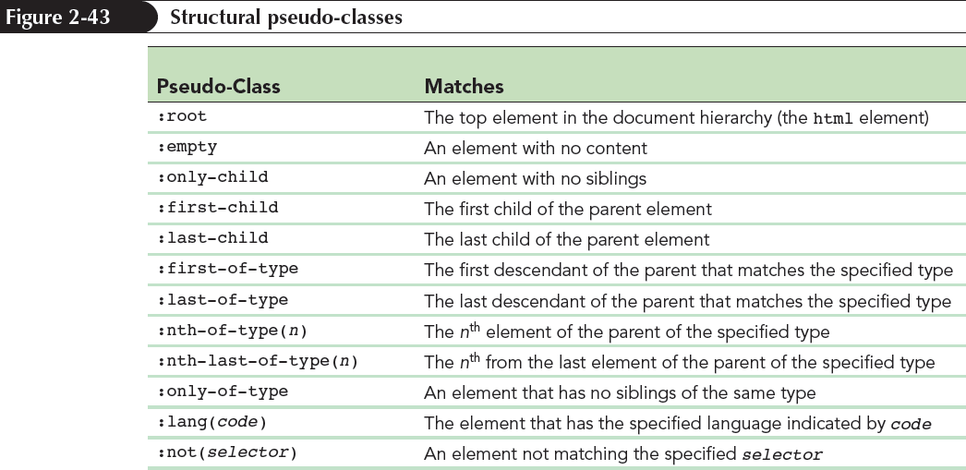
Using Pseudo-Classes and Pseudo-Elements (continued 1)

Slide 65
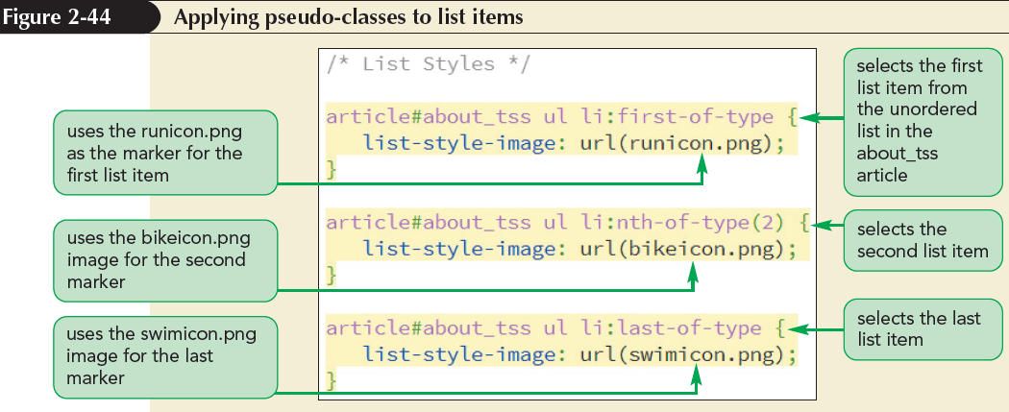
Using Pseudo-Classes and Pseudo-Elements (continued 2)

Slide 66
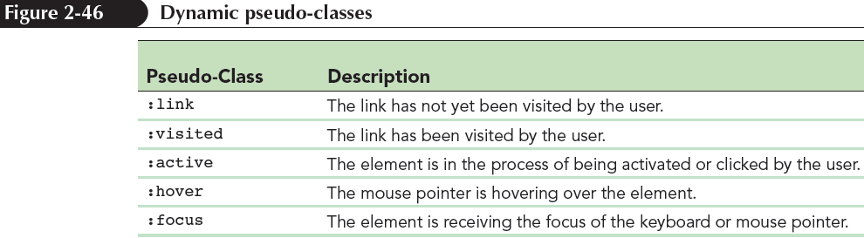
Pseudo-classes for Hypertext
Dynamic pseudo-class – A type of pseudo-class in which the class can change state based on the actions of the user

Slide 67
Pseudo-Elements
Pseudo-element – An object that exists only in the rendered page
Pseudo-elements can be selected using the following CSS selector:
element::pseudo-element
where element is an element from the HTML file and pseudo-element is the name of a CSS pseudo-element

Slide 68
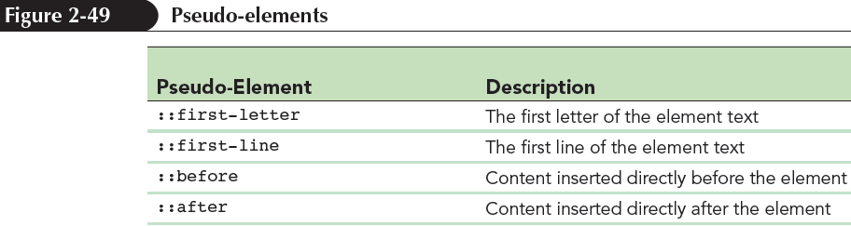
Pseudo-Elements (continued)

Slide 69
Generating Content with CSS
New content can be added either before or after an element using the following before and after pseudo-elements:
element::before {content: text;}
element::after {content: text;}
where text is the content to be inserted into the rendered web page

Slide 70
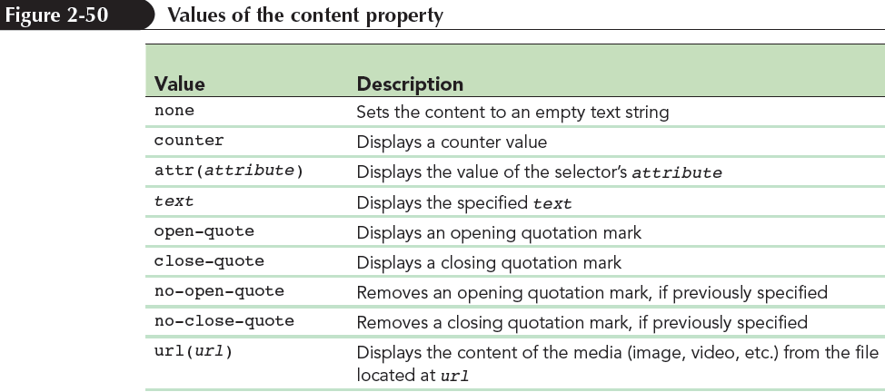
Generating Content with CSS (continued)

Slide 71
Displaying Attribute Values
The content property can be used to insert an attribute value into the rendered web page using the attr( ) function
content: attr(attribute);
where attribute is an attribute of the selected element

Slide 72
Inserting Quotation Marks
The blockquote and q elements are used for quoted material
Decorative opening and closing quotation marks can be inserted using the content property as follows:
content: open-quote;
content: close-quote;

Slide 73
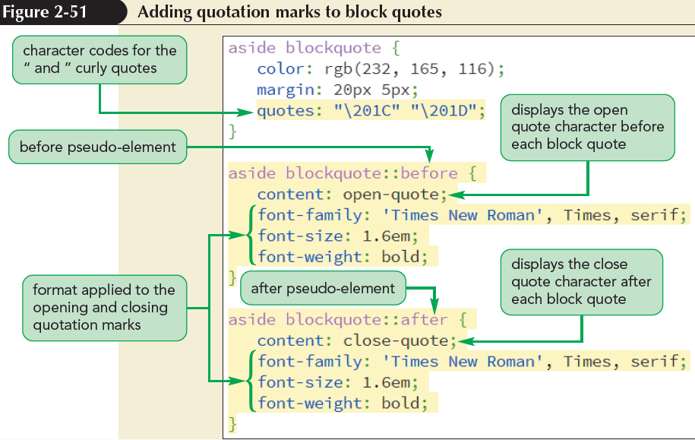
Inserting Quotation Marks (continued)

