Slide 2
Objectives
Create a media query
Work with the browser viewport
Apply a responsive design
Create a pulldown menu with CSS
Create a flexbox

Slide 3
Objectives (continued)
Work with flex sizes
Explore flexbox layouts
Create a print style sheet
Work with page sizes
Add and remove page breaks

Slide 4
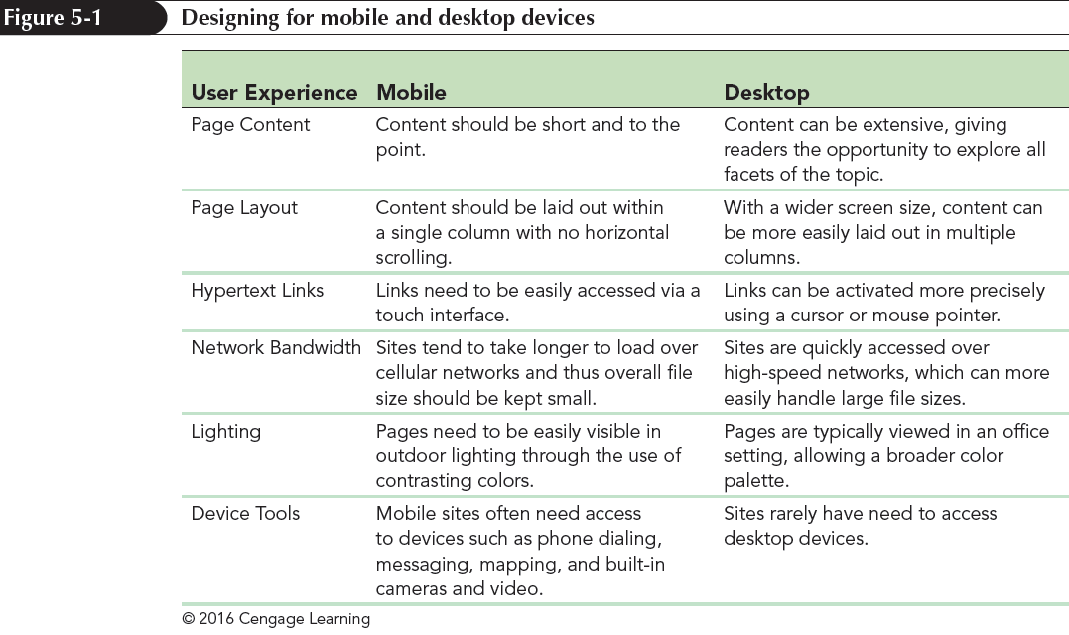
Introducing Responsive Design

Slide 5
Introducing Responsive Design (continued 1)
The three primary components of responsive design theory identified by Ethan Marcotte are:
flexible layout so that the page layout automatically adjusts to screens of different widths
responsive images that rescale based on the size of the viewing device
media queries that determine the properties of the device rendering the page so that appropriate designs can be delivered to specific devices

Slide 6
Introducing Media Queries
Media queries are used to associate a style sheet or style rule with a specific device or list of device features
To create a media query within an HTML file, add the following media attribute to either the link or style element in the document head:
media=“devices”
where devices is a comma-separated list of supported media types associated with a specified style sheet

Slide 7
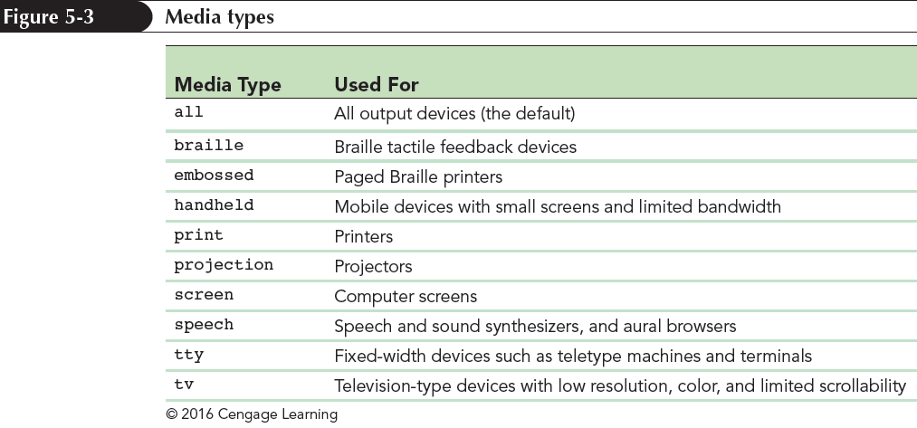
Introducing Media Queries (continued)

Slide 8
The @media Rule
Media queries can be used to associate specific style rules with specific devices using the following:
@media devices {
style rules
}
where devices are supported media types and style rules are the style rules associated with those devices

Slide 9
Media Queries and Device Features
To target a device based on its features, add the feature and its value to the media attribute using the syntax:
media=“devices and|or (feature:value)”
where feature is the name of a media feature and value is the feature’s value
The and and or keywords are used to create media queries that involve different devices or features, or combinations of both

Slide 10
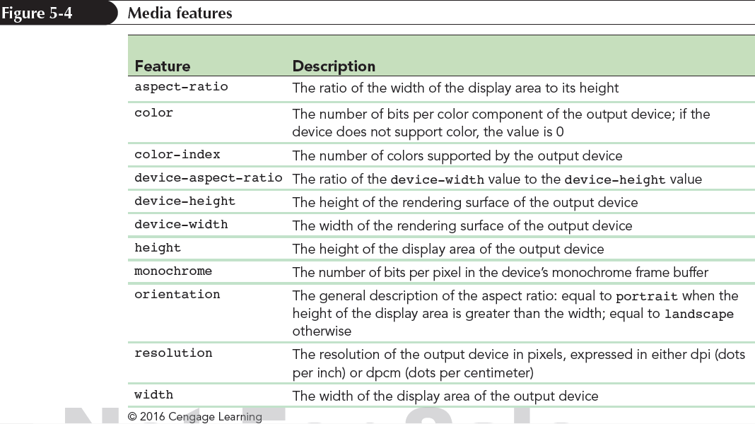
Media Queries and Device Features (continued)

Slide 11
Applying Media Queries to a Style Sheet
The mobile first principle is one in which the overall page design starts with base styles that apply to all devices followed by style rules specific to mobile devices
Tablet styles are applied when the screen width is 481 pixels or greater
Desktop styles build upon the tablet styles when the screen width exceeds 768 pixels
As the screen width increases, more features found in smaller devices are added or replaced

Slide 12
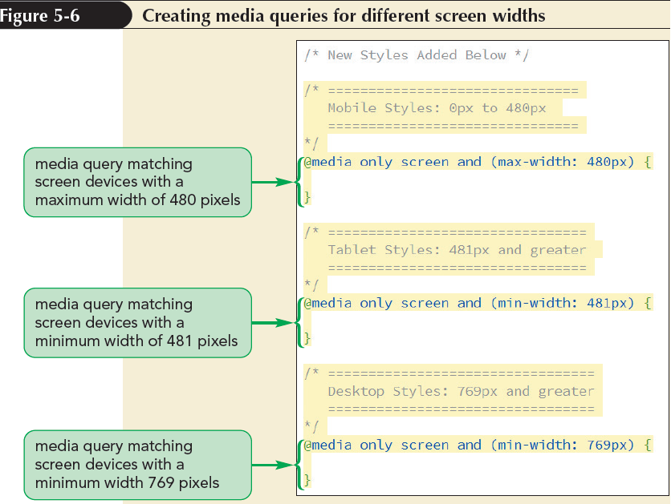
Applying Media Queries to a Style Sheet (continued)

Slide 13
Exploring Viewports and Device Width
Web pages are viewed within a window called the viewport
Mobile devices have two types of viewports:
Visual viewport – displays the web page content that fits within a mobile screen
Layout viewport – contains the entire content of the page, some of which may be hidden from the user

Slide 14
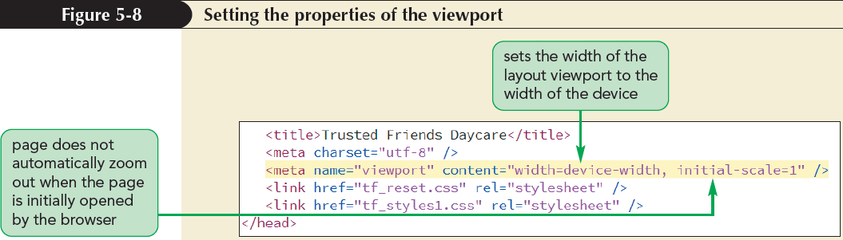
Exploring Viewports and Device Width (continued)

Slide 15
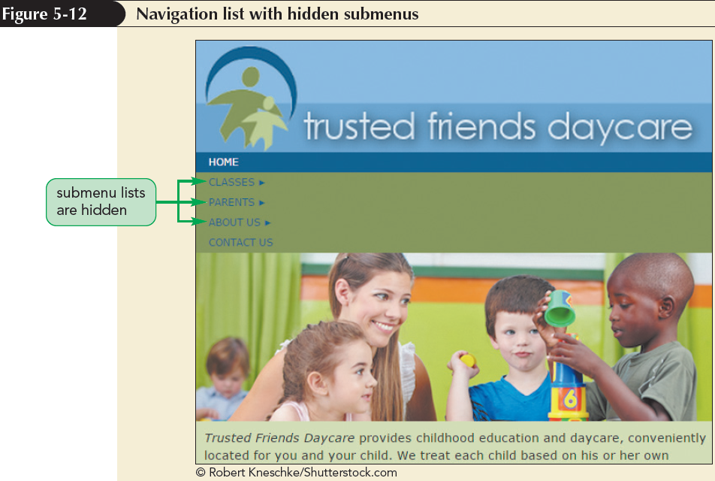
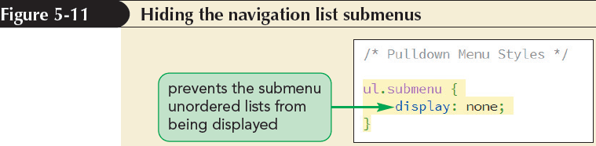
Creating a Pulldown Menu with CSS

Slide 16
Creating a Pulldown Menu with CSS (continued 1)
The following selector can be used to select the submenu that is immediately preceded by a hovered submenu title:
a.submenuTitle:hover+ul.submenu
In order to keep the submenu visible as the pointer moves away from the title and hovers over the now-visible submenu, use the following:
a.submenuTitle:hover+ul.submenu, ul.submenu:hover

Slide 17
Creating a Pulldown Menu with CSS (continued 2)
To make a submenu visible, change its display property back to block, using the following style rule:
a.submenuTitle:hover+ul.submenu, ul.submenu:hover {
display: block;
}

Slide 18
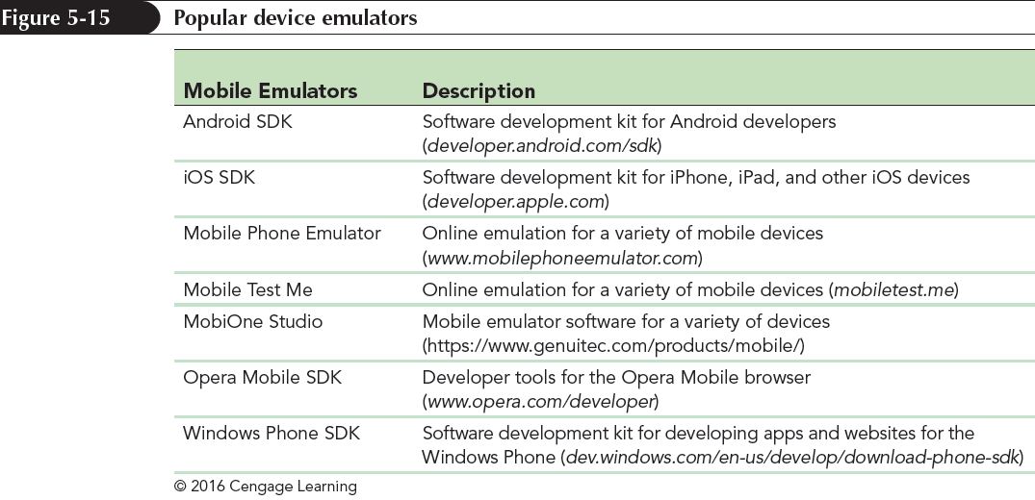
Testing your Mobile Website

Slide 19
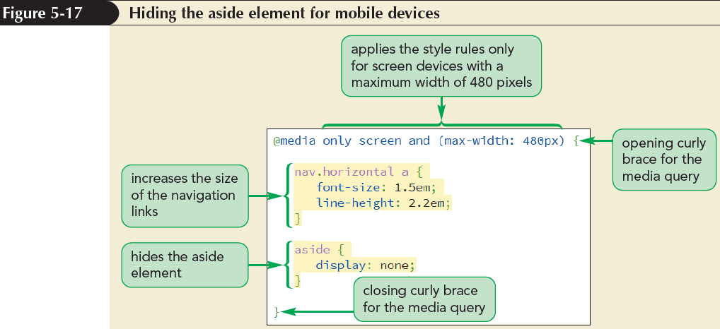
Testing your Mobile Website (continued)

Slide 20
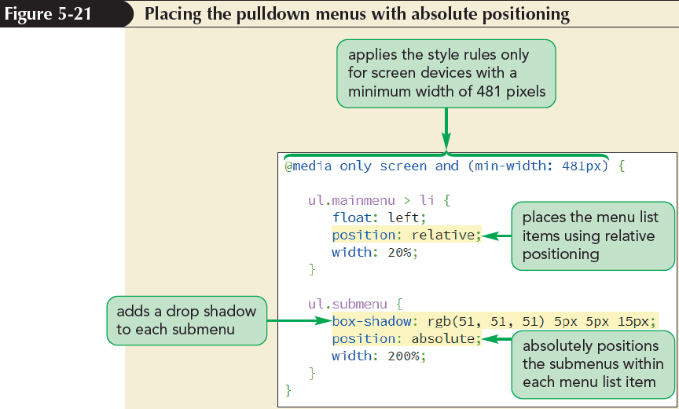
Creating a Tablet Design

Slide 21
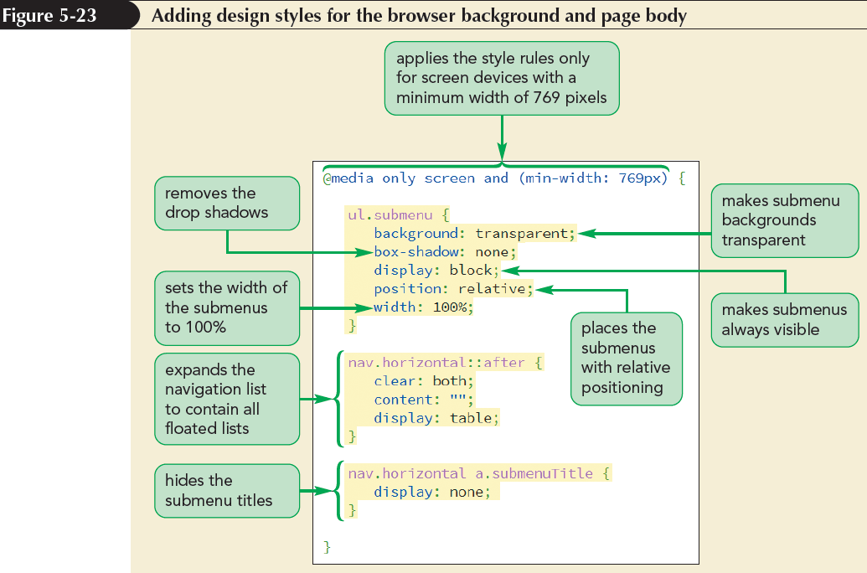
Creating a Desktop Design

Slide 22
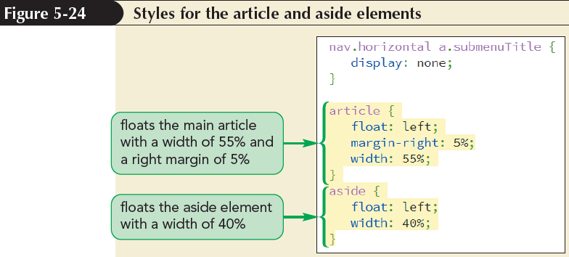
Creating a Desktop Design (continued)

Slide 23
Defining a Flexible Box
A flexible box or flexbox is a box containing items whose sizes can shrink or grow to match the boundaries of the box
Items within a flexbox are laid out along a main axis
The main axis can point in either the horizontal or vertical direction
Cross axis is perpendicular to the main axis and is used to define the height or width of each item

Slide 24
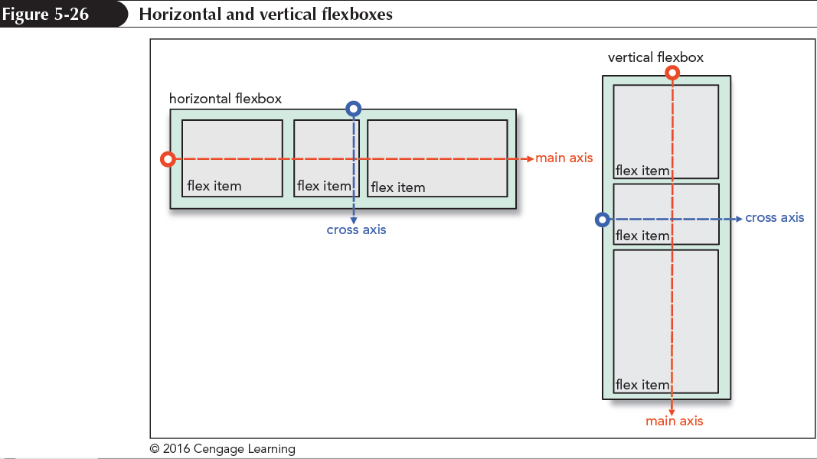
Defining a Flexible Box (continued 1)

Slide 25
Defining a Flexible Box (continued 2)
To define an element as a flexbox, apply either of the following display styles:
display: flex;
or
display: inline-flex;
where a value of flex starts the flexbox on a new line and a value of inline-flex keeps the flexbox in-line with its surrounding content

Slide 26
Cross-Browser Flexboxes
The complete list of browser extensions that define a flexbox is entered as:
display: -webkit-box;
display: -moz-box;
display: -ms-flexbox;
display: -webkit-flex:
display: flex;

Slide 27
Setting the Flexbox Flow
By default, flexbox items are arranged horizontally starting from the left and moving to the right
The orientation of a flexbox can be changed using,
flex-direction: direction;
where direction is row (the default), column, row-reverse, or column-reverse

Slide 28
Setting the Flexbox Flow (continued 1)
The row option in a flex-direction lays out the flex items from left to right
The column option in a flex-direction creates a vertical layout starting from the top and moving downward
The row-reverse and column-reverse options in a flex-direction lay out the items bottom-to-top and right-to-left respectively

Slide 29
Setting the Flexbox Flow (continued 2)
Flex items try to fit within a single line, either horizontally or vertically
Flex items can wrap to a new line using the following property:
flex-wrap: type;
where type is either:
nowrap (the default)
wrap to wrap the flex items to a new line

Slide 30
Setting the Flexbox Flow (continued 3)
wrap-reverse to wrap flex items to a new line starting in the opposite direction from the current line

Slide 31
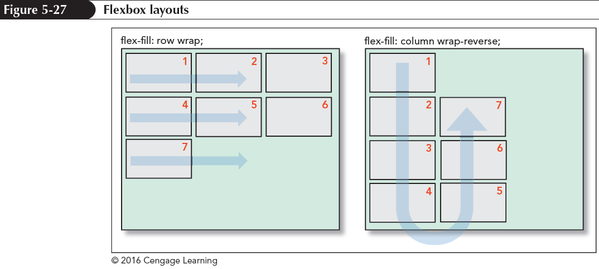
Setting the Flexbox Flow (continued 4)

Slide 32
Setting the Flex Basis
The flex items are determined by three properties:
the base size
the growth value
the shrink value
The basis size defines the initial size of the item before the browser attempts to fit it to the flexbox

Slide 33
Setting the Flex Basis (continued)
The basis size is set using the following:
flex-basis: size;
where size is one of the CSS units of measurement, which sets the initial size of the flex item based on its content or the value of its width or height property
For example,
aside {
flex-basis: 200px;
}

Slide 34
Defining the Flex Growth
The rate at which a flex item grows from its basis size is determined by the flex-grow property
flex-grow: value;
where value is a non-negative value that expresses the growth of the flex item relative to the growth of the other items in the flexbox
The default flex-grow value is 0, which is equivalent to the flex item remaining at its basis size

Slide 35
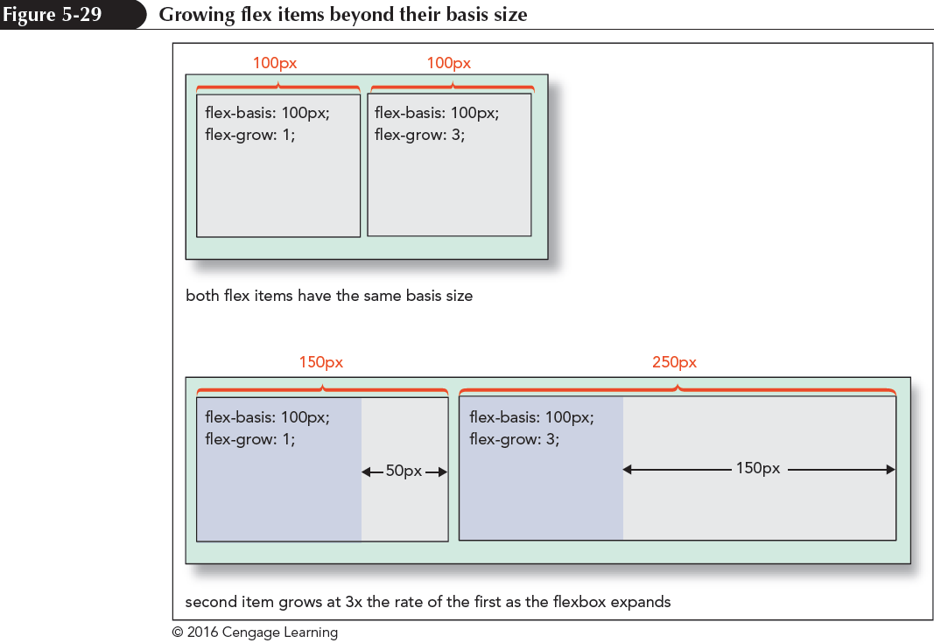
Defining the Flex Growth (continued 1)

Slide 36
Defining the Flex Growth (continued 2)
The following style rule creates a layout for navigation list in which each list item is assigned an equal size and grows at the same rate
nav ul {
display: flex;
}
nav ul li {
flex-basis: 0px;
flex-grow: 1;
}

Slide 37
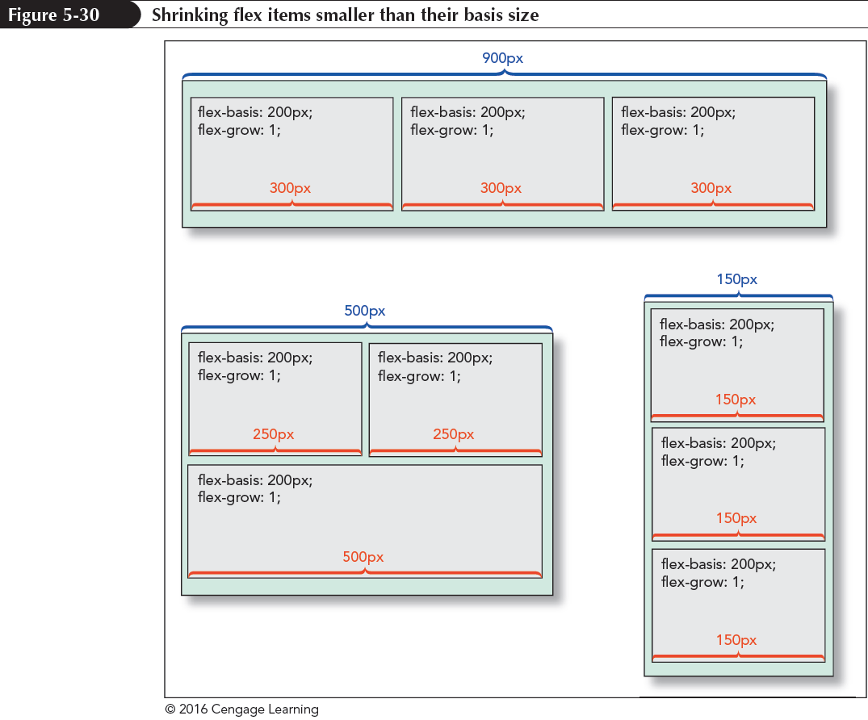
Defining the Shrink Rate

Slide 38
Defining the Shrink Rate (continued)
The rate at which flexboxes shrink below their basis size is given by the following property:
flex-shrink: value;
where value is a non-negative value that expresses the shrink rate of the flex item relative to the shrinkage of the other items in the flexbox
The default flex-shrink value is 1
If the flex-shrink value is set to 0, then the flex item will not shrink below its basis value

Slide 39
The Flex Property
The syntax for the flex property is
flex: grow shrink basis;
where grow defines the growth of the flex item, shrink provides its shrink rate, and basis sets the item’s initial size
The default flex value is
flex: 0 1 auto;
which automatically sets the size of the flex item to match its content or the value of its width and height property

Slide 40
The Flex Property (continued)
The flex property supports the following keywords:
auto – Use to automatically resize the item from its default size (equivalent to flex: 1 1 auto;)
initial – The default value (equivalent to flex: 0 1 auto;)
none – Use to create an inflexible item that will not grow or shrink (equivalent to flex: 0 0 auto;)
inherit – Use to inherit the flex values of its parent element

Slide 41
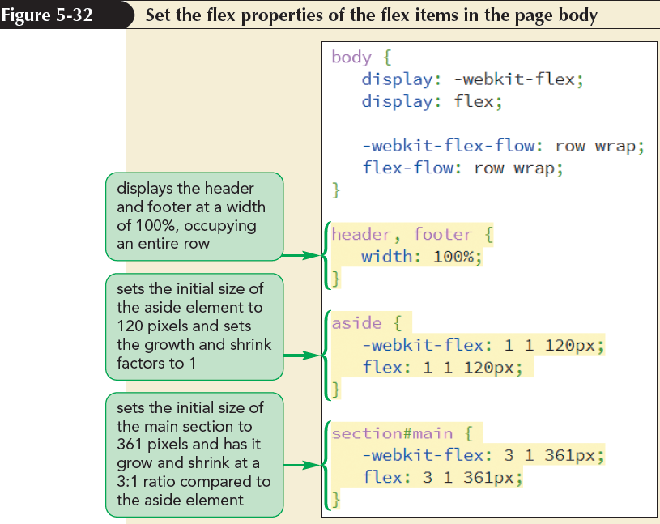
Applying a Flexbox Layout

Slide 42
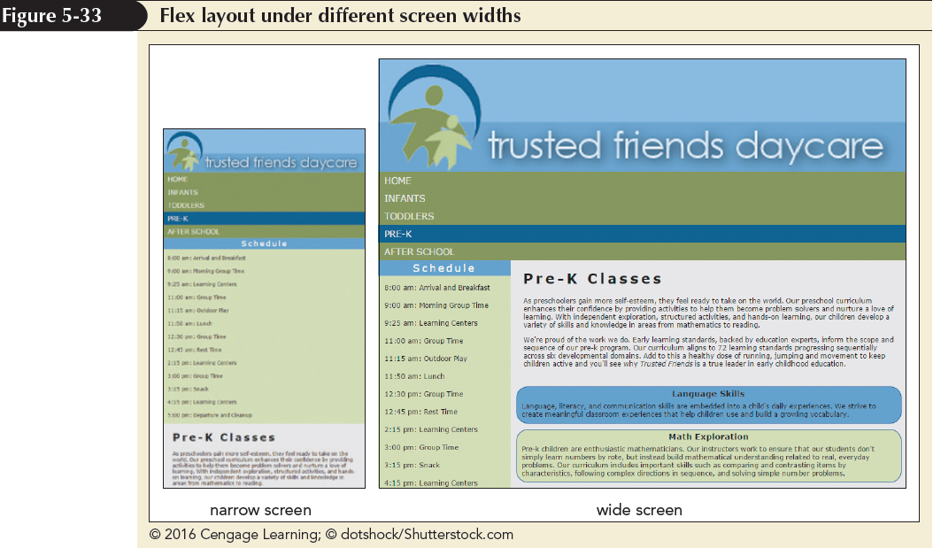
Applying a Flexbox Layout (continued)

Slide 43
Reordering Page Content with Flexboxes
The flexbox model allows to place the flex items in any order using the following order property:
order: value;
where value is an integer where items with smaller order values are placed before items with larger order values

Slide 44
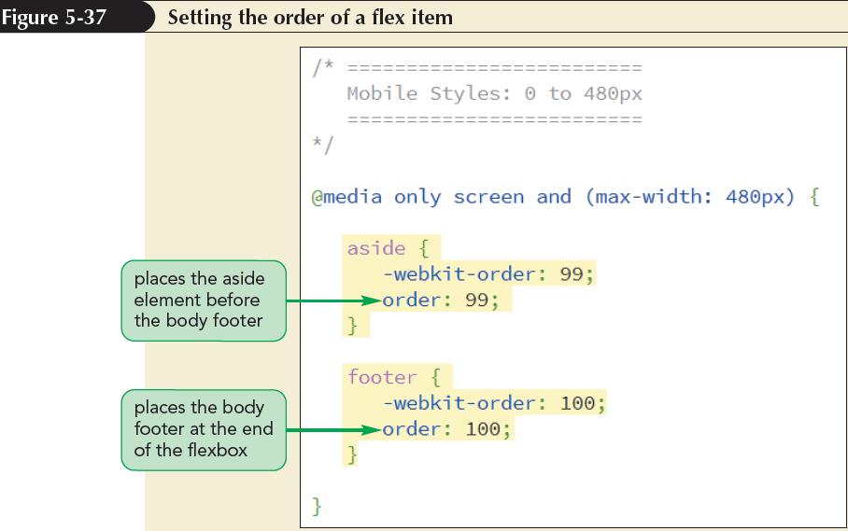
Reordering Page Content with Flexboxes (continued)

Slide 45
Aligning Items along the Main Axis
By default, flex items are laid down at the start of the main axis
To specify a different placement, apply the following justify-content property
justify-content: placement;
where placement is one of the following keywords:
flex-start – Items are positioned at the start of the main axis (the default)

Slide 46
Aligning Items along the Main Axis (continued)
flex-end – Items are positioned at the end of the main axis
center – Items are centered along the main axis
space-between – Items are distributed evenly with the first and last items aligned with the start and end of the main axis
space-around – Items are distributed evenly along the main axis with equal space between them and the ends of the flexbox

Slide 47
Aligning Flex Lines
The align-content property is similar to the justify-content property except that it arranges multiple lines of content along the flexbox’s cross axis
The syntax of the align-content property is:
align-content: value;
where value is one of the following keywords:
flex-start – Lines are positioned at the start of the cross axis

Slide 48
Aligning Flex Lines (continued)
flex-end – Lines are positioned at the end of the cross axis
stretch – Lines are stretched to fill up the cross axis (the default)
center – Lines are centered along the cross axis
space-between – Lines are distributed evenly with the first and last lines aligned with the start and end of the cross axis
space-around – Lines are distributed along the cross axis with equal space between them and the ends of the cross axis

Slide 49
Aligning Items along the Cross Axis
The align-items property aligns each flex item about the cross axis
The syntax is
align-items: value;
where value is one of the following keywords:
flex-start – Items are positioned at the start of the cross axis
flex-end – Items are positioned at the end of the cross axis

Slide 50
Aligning Items along the Cross Axis (continued 1)
center – Items are centered along the cross axis
stretch – Items are stretched to fill up the cross axis (the default)
baseline – Items are positioned so that the baselines of their content align
The align-items property is only impactful when there is a single line of flex items
The align-content property is used to layout the flexbox content for multiple lines of flex items

Slide 51
Aligning Items along the Cross Axis (continued 2)
To align a single item out of a line of flex items, use the following align-self property:
align-self: value;
where value is one of the alignment choices supported by the align-self property

Slide 52
Creating a Navicon Menu
Navicon – It is used to indicate the presence of hidden navigation menus in mobile websites
The navicon is a symbol represented as three horizontal lines
When a user hovers or touches the navicon, the navigation menu is revealed

Slide 53
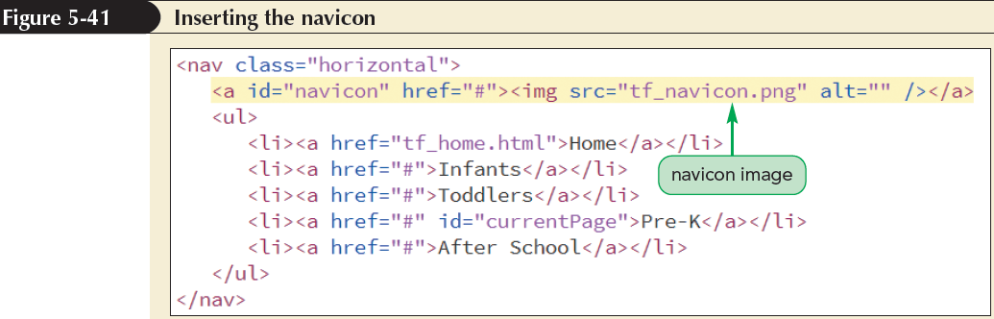
Creating a Navicon Menu (continued 1)

Slide 54
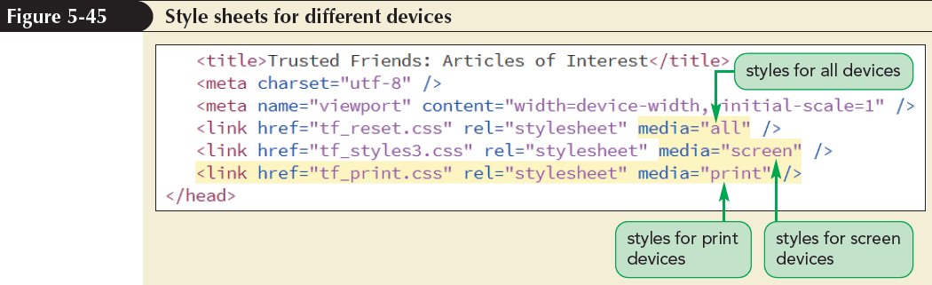
Designing for Printed Media
To apply a print style sheet, the media attribute is used in the link elements to target style sheets to either screen devices or print devices

Slide 55
Working with the @page Rule
Every printed page in CSS is defined as a page box
Page box is composed of two areas:
page area – Contains the content of the document
margin area – Contains the space between the printed content and the edges of the page
Styles are applied to the page box using,
@page {
style rules
}

Slide 56
Setting the Page Size
The following size property allows web authors to define the dimensions of a printed page:
size: width height;
where width and height are the width and height of the page
The keyword auto lets browsers determine the page dimensions
The keyword inherit inherits the page size from the parent element

Slide 57
Using the Page Pseudo-Classes
Different styles can be defined for different pages by adding the following:
@page:pseudo-class {
style rules
}
where pseudo-class is first for the first page of the printout, left for the pages that appear on the left in the double-sided printouts, or right for pages that appear on the right in double-sided printouts

Slide 58
Page Names and the Page Property
To define styles for pages other than the first, left, or right, create a page name as follows:
@page name {
style rules
}
where name is the label given to the page

Slide 59
Page Names and the Page Property (continued)
To assign a page name to an element, use
selector {
page: name;
}
where selector identifies the element that will be displayed on its own page, and name is the name of a previously defined page style

Slide 60
Formatting Hypertext Links for Printing
To append the text of a link’s URL to the linked text, apply the following style rule:
a::after {
content: “ (“ attr(href) “) “;
}
This style rule uses the after pseudo-element along with the content property and the attr() function to retrieve the text of the href attribute and add it to the contents of the a element

Slide 61
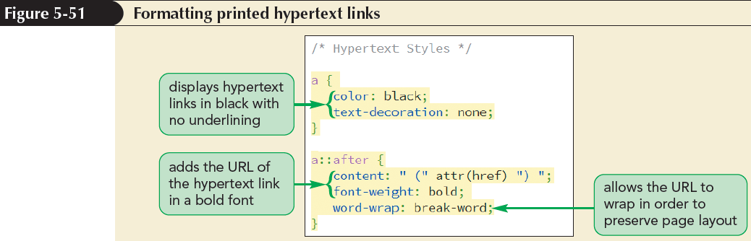
Formatting Hypertext Links for Printing (continued)
The word-wrap property is used to break long text strings at arbitrary points if it extends beyond the boundaries of its container

Slide 62
Working with Page Breaks
Page breaks can be inserted either directly before or after an element, using the following properties:
page-break-before: type;
page-break-after: type;
where type has the following possible values:
always – Use to always place a page break before or after the element
avoid – Use to never place a page break

Slide 63
Working with Page Breaks (continued)
left – Use to place a page break where the next page will be a left page
right – Use to place a page break where the next page will be a right page
auto – Use to allow the printer to determine whether or not to insert a page break
inherit – Use to insert the page break style from the parent element

Slide 64
Preventing Page Breaks
Page breaks can be prevented by using the keyword avoid in the page-break-after or page-break-before properties
For example, the following style rule prevents page breaks from being added after any heading
h1, h2, h3, h4, h5, h6 {
page-break-after: avoid;
}

Slide 65
Working with Widows and Orphans
Page breaks within block elements, such as paragraphs, often leave behind widows and orphans
A widow is a fragment of text left dangling at the top of a page
An orphan is a text fragment left at the bottom of a page

Slide 66
Working with Widows and Orphans (continued)
To control the size of widows and orphans, CSS supports the following properties:
widows: value;
orphans: value;
where value is the number of lines that must appear within the element before a page break can be inserted by printer

