Slide 2
Objectives
Explore web forms
Work with form servers
Create forms and field sets
Create labels and input boxes
Explore form layout
Work with date and time fields
Create a selection list

Slide 3
Objectives (continued)
Create option buttons
Create check boxes and text area boxes
Create spinners and range sliders
Use data lists
Create form buttons
Validate a form
Apply validation styles

Slide 4
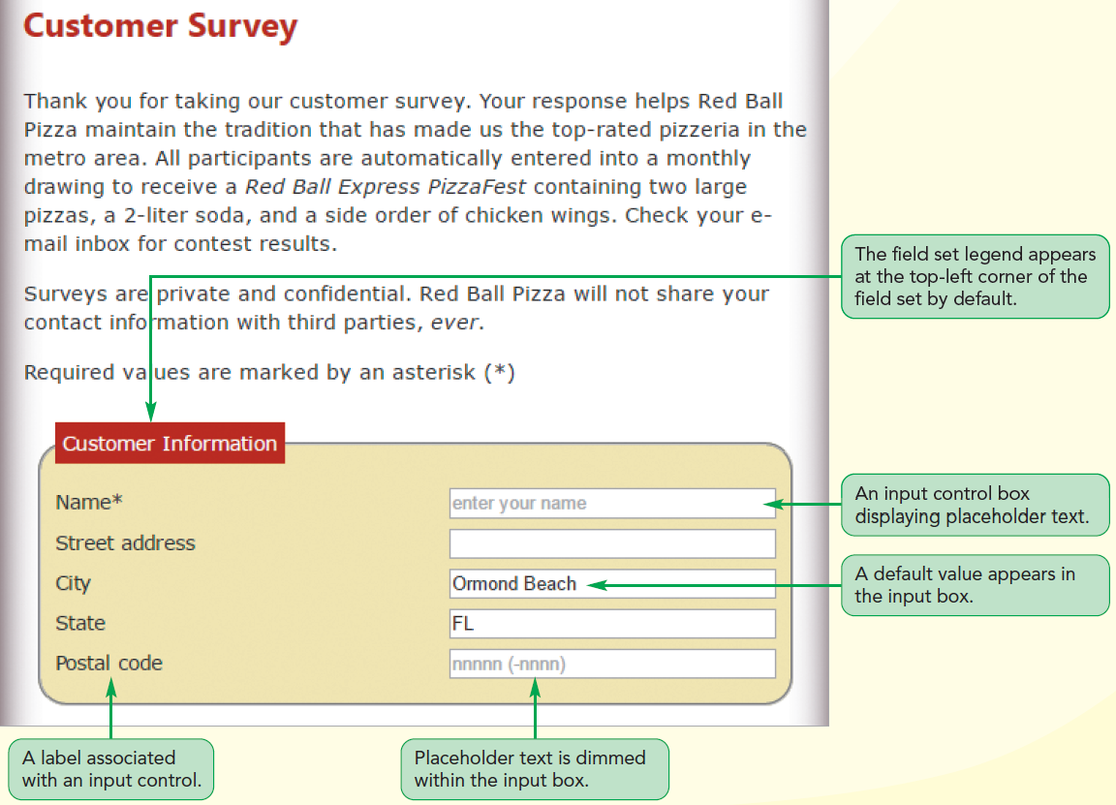
Structure of a Web Form

Slide 5
Introducing Web Forms
Web form
Allows users to enter data that can be saved and processed
Common way to accept user input
Allows the creation of interactive websites for user feedback

Slide 6
Parts of a Web Form
Controls, also known as widgets, are the objects that allow a user to interact with a form
Each data entry control is associated with a data field
Data field: Stores the data values supplied by a user

Slide 7
Parts of a Web Form (continued 1)
Types of controls
Input boxes to insert text and numeric values
Option/radio buttons to select data values from a predefined set of options
Selection lists to select data values from an extensive list of options
Check boxes to select data values limited to two possibilities, such as “yes” or “no”
Text area boxes to enter text strings that may include several lines of content

Slide 8
Parts of a Web Form (continued 2)
Types of widgets
Spin boxes to enter integer values confined to a specified range
Slider controls to enter numeric values confined to a specified range
Calendar controls to select date and time values
Color pickers to choose color values

Slide 9
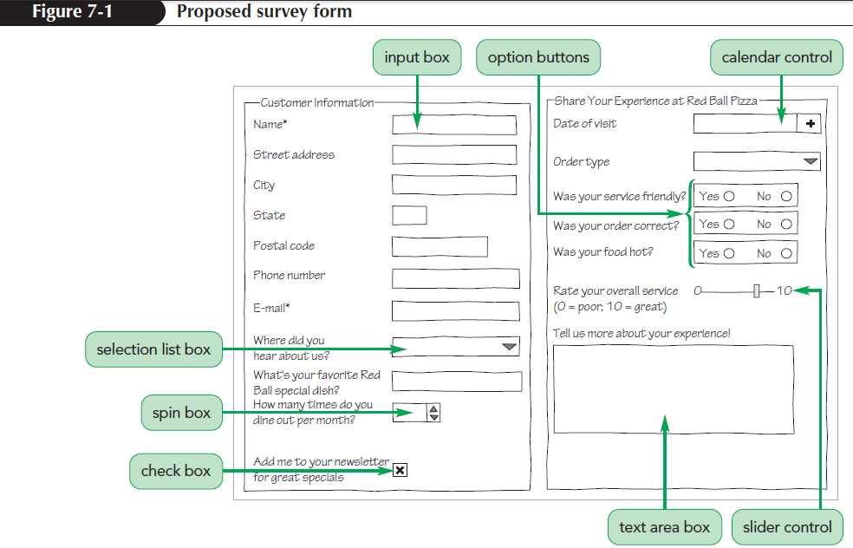
Parts of a Web Form (continued 3)

Slide 10
Forms and Server-Based Programs
Field values entered by a user are processed by a program running on the user’s computer or on a web server in a secure location
Example: A web form is used to collect data from a customer for an order and the server program processes the data and handles the billing and delivery

Slide 11
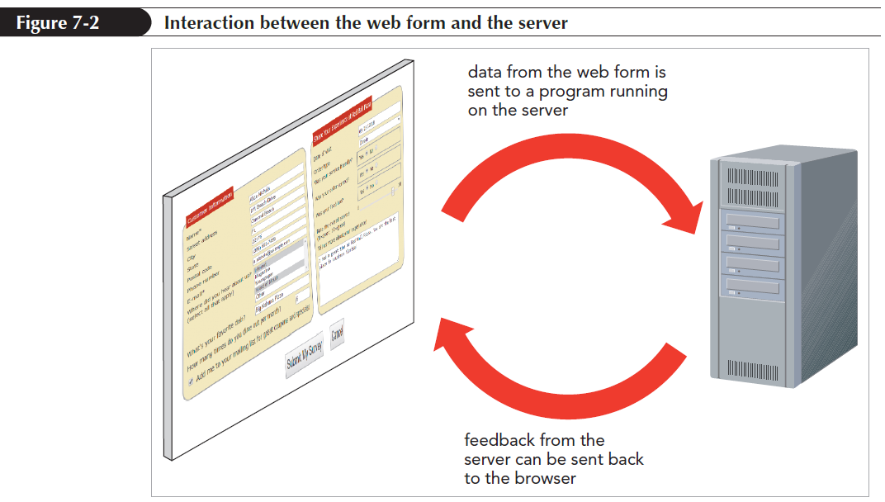
Forms and Server-Based Programs (continued)

Slide 12
Starting a Web Form
Web forms are marked using the form element
<form id=“text” attributes>
content
</form>
id identifies the form
attributes specify how the form should be processed by the browser
content is the form’s content

Slide 13
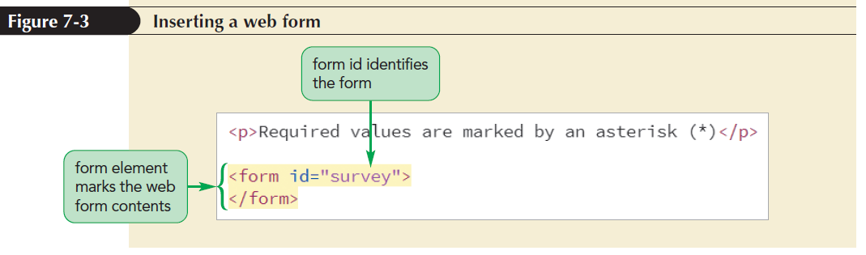
Starting a Web Form (continued)
A form element can be placed anywhere within the body of a page
Forms also can contain page elements such as tables, paragraphs, inline images, and headings

Slide 14
Interacting with the Web Server
The action, method, and enctype attributes have to be included in a form to specify where and how to send the form data
<form action=“url” method=“type” enctype=“type”>
content
</form>

Slide 15
Interacting with the Web Server (continued 1)
action attribute provides the location of the web server program that processes the form
method attribute specifies how the browser should send form data to the server
enctype attribute specifies how the form data should be encoded as it is sent to the server

Slide 16
Interacting with the Web Server (continued 2)
Two possible values for method attribute
Get method: Tells the browser to append the form data to the end of the URL specified in the action attribute
The get method is the default method
Post method: Sends the form data in its own separate data stream
The post method is considered to be a more secure form of data transfer

Slide 17
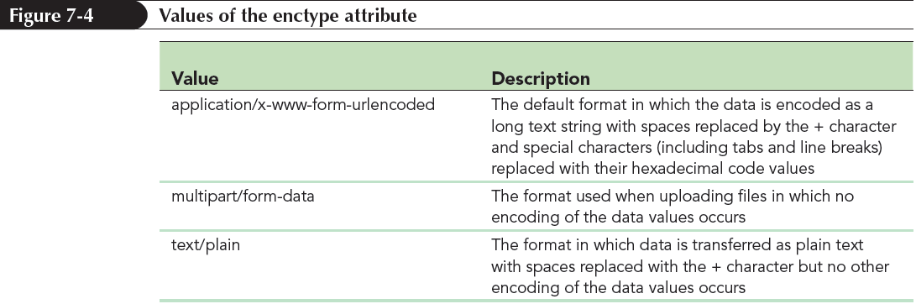
Interacting with the Web Server (continued 3)
The enctype attribute has three possible values

Slide 18
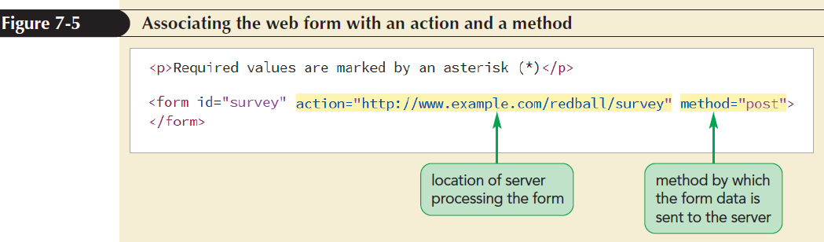
Interacting with the Web Server (continued 4)

Slide 19
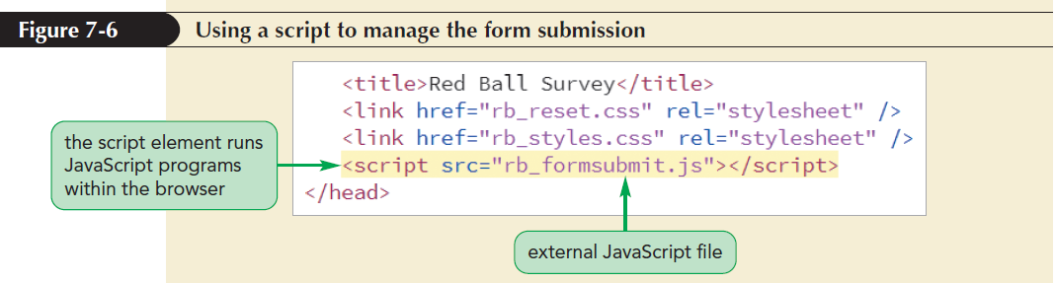
Interacting with the Web Server (continued 5)
A script element is an HTML element used to access and run JavaScript programs that will run within the user’s browser

Slide 20
Creating a Field Set
Field set: Groups fields that share a common purpose
Field sets are created using the fieldset element
<fieldset id=“id”>
content
</fieldset>
id identifies the field set
content is the form content within the field set

Slide 21
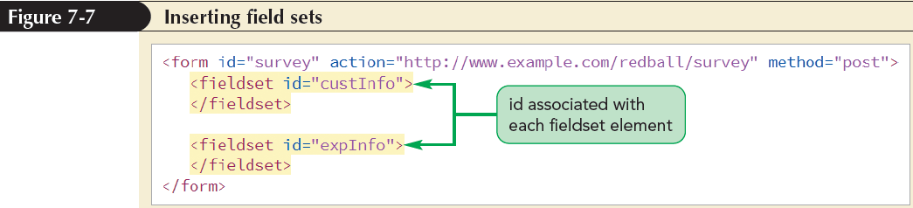
Marking a Field Set

Slide 22
Adding a Field Set Legend
Legend describes the content of a field set using the legend element
<legend>text</legend>
where text is the text of the legend
The legend element contains only text and no nested elements
By default, legends are placed in the top-left corner of the field set box and can be moved to a different location using the CSS positioning styles

Slide 23
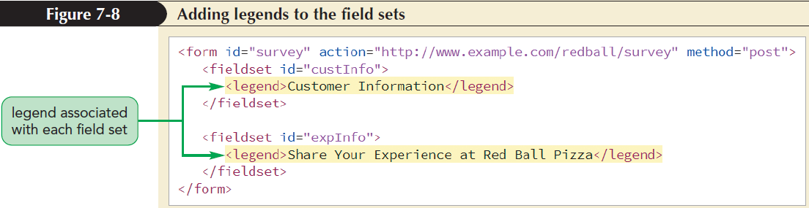
Adding a Field Set Legend (continued)

Slide 24
Creating Input Boxes
Syntax for the input element
<input name=“name” id=“id” type=“type” />
The name attribute provides the name of the data field associated with the control
The id attribute identifies the control in which the user enters the field value
The type attribute indicates the data type of the field

Slide 25
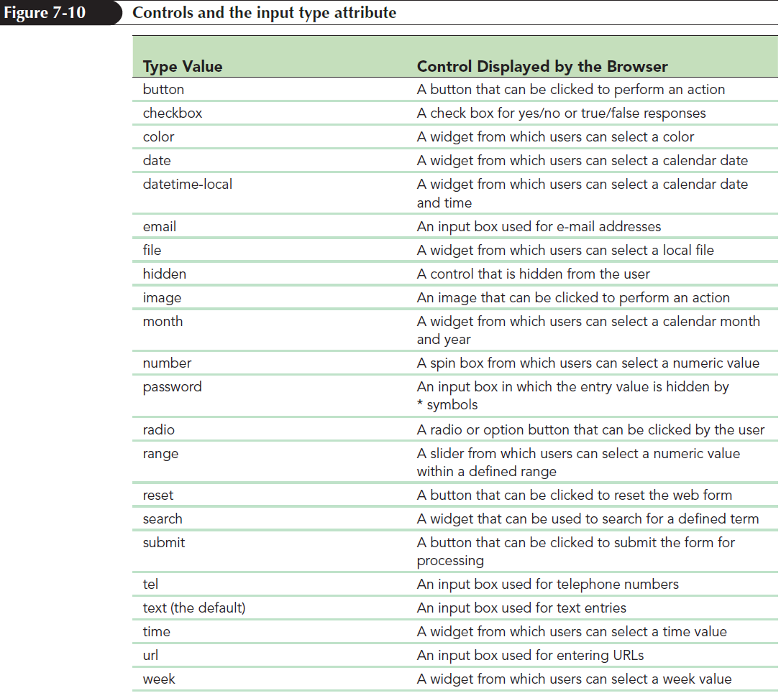
Creating Input Boxes (continued 1)

Slide 26
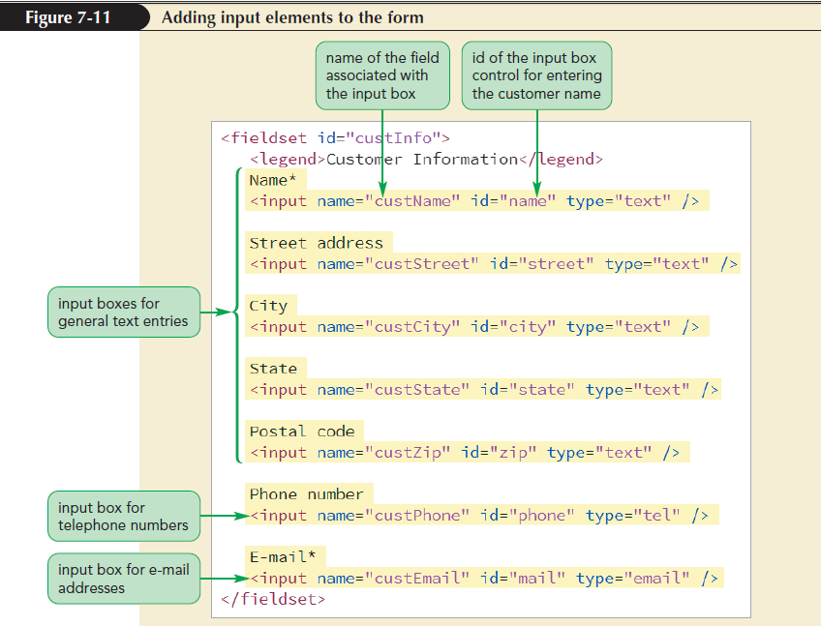
Creating Input Boxes (continued 2)

Slide 27
Input Types and Virtual Keyboards
Virtual keyboards are software representations of a physical device
Web forms can be made responsive by displaying different virtual keyboards for each input type
Example: An input box for telephone number is more convenient to read with digits displayed prominently on the keyboard

Slide 28
Adding Field Labels
To associate a text string with a control, the text string has to be enclosed within the label element
<label for=“id”>label text</label>
id is the id of the control that is associated with the label
label text is the text of the label

Slide 29
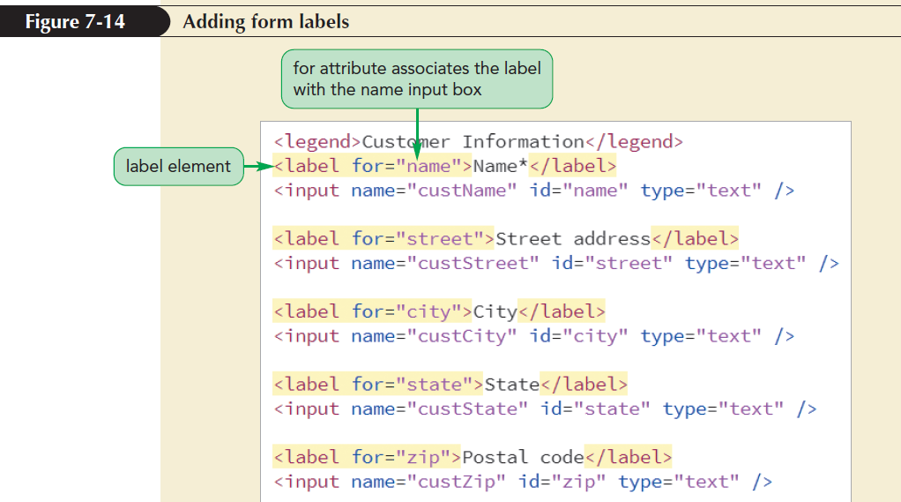
Adding Field Labels (continued)

Slide 30
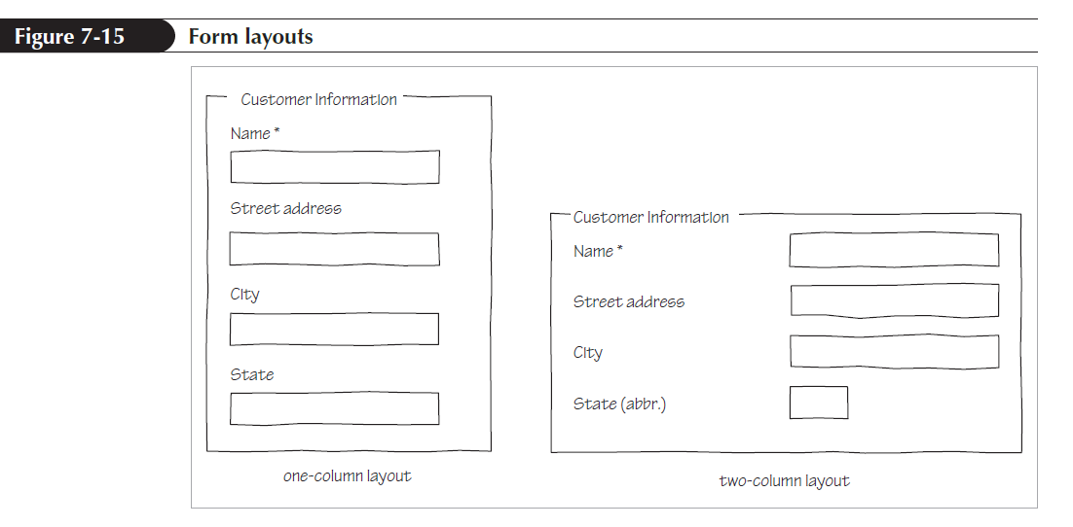
Designing a Form Layout
There are two general layouts
Labels are placed directly above the input controls
Labels and controls are placed side-by-side

Slide 31
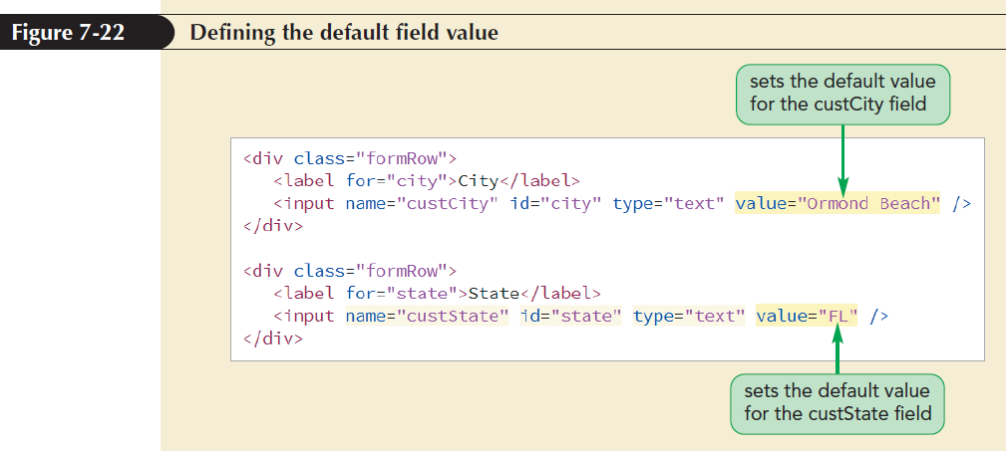
Defining Default Values and Placeholders
The value attribute is used to specify a default field value

Slide 32
Defining Default Values and Placeholders (continued 1)
Placeholders: Text strings that appear within a form control, providing a hint about the kind of data that should be entered into a field
They are defined using the placeholder attribute
placeholder=“text”
where text is the text of the placeholder

Slide 33
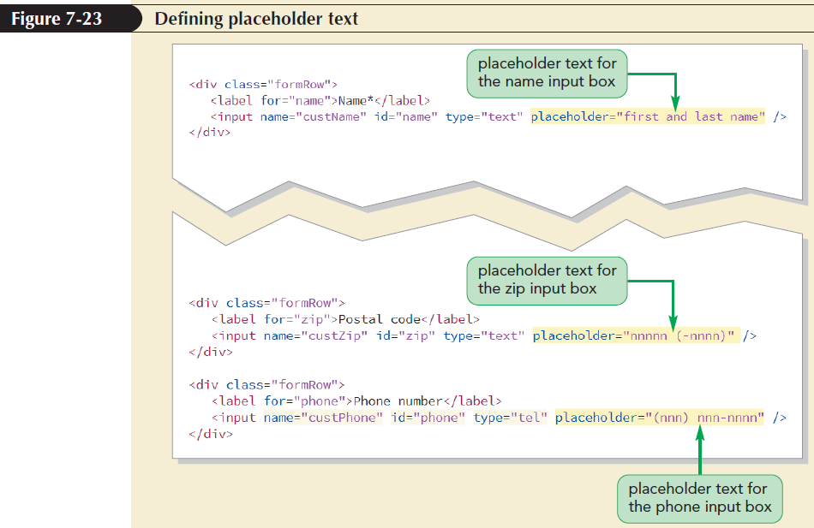
Defining Default Values and Placeholders (continued 2)

Slide 34
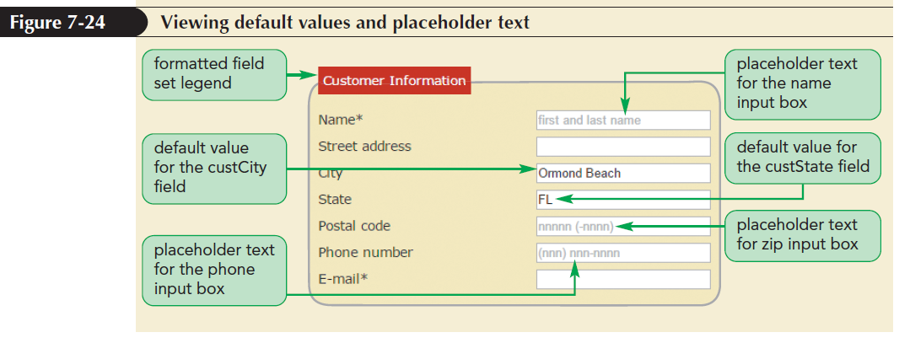
Defining Default Values and Placeholders (continued 3)

Slide 35
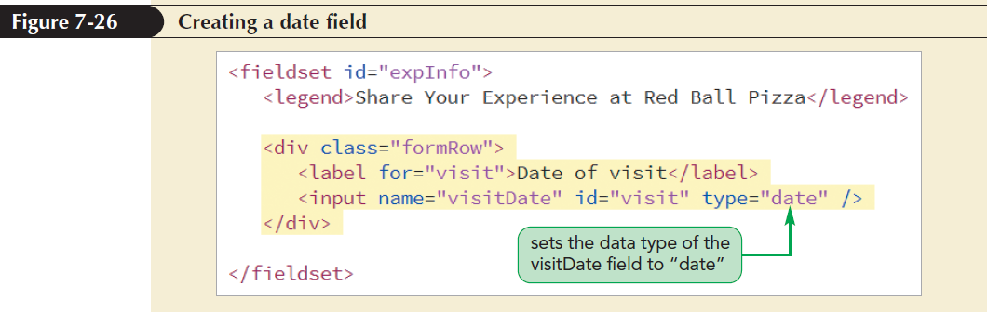
Entering Date and Time Values
Date and time fields ensure that users enter data in the correct format
Indicated using type attributes: date, time, datetime-local, month, and week

Slide 36
Creating a Selection List
A selection list is a list box that presents users with a group of possible values for the data field
The list is created using the select and option elements
<select name=”name”>
<option value=”value1”>text1</option>
<option value=”value2”>text2</option>
...
</select>

Slide 37
Creating a Selection List (continued 1)
name is the name of the data field
value1, value2,… are the possible field values
text1, text2,… are the text of the entries in the selection list that users see on the web form

Slide 38
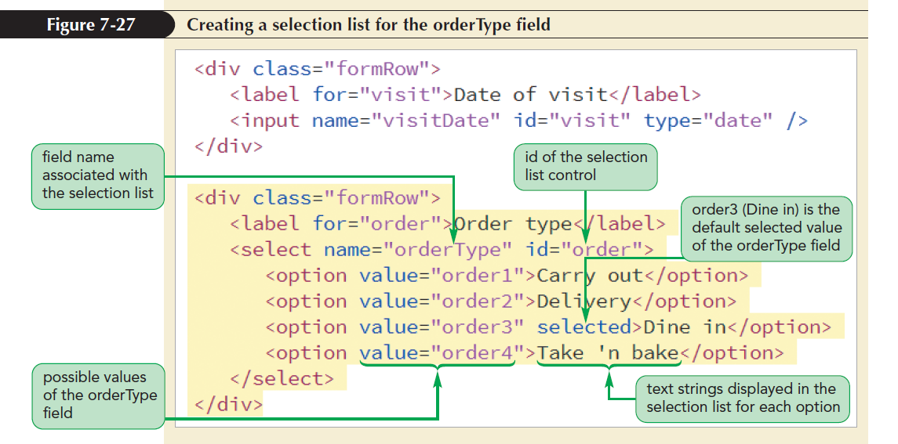
Creating a Selection List (continued 2)

Slide 39
Working with Select Attributes
By default, a selection list appears as a drop-down list box
To display a selection list as a scroll box, use the size attribute to the select element
<select size=“value”> ... </select>
where value is the number of options that the selection list displays at one time

Slide 40
Working with Select Attributes (continued 1)
By default, selection lists allow only one selection from the list of options
To allow more than one item to be selected, add multiple attribute
<select multiple> ... </select>

Slide 41
Working with Select Attributes (continued 2)
Two ways for users to select multiple items from a selection list
For non-contiguous selection, press and hold the Ctrl key while making the selections
For contiguous selection, select the first item, press and hold the Shift key, and then select the last item in the range

Slide 42
Grouping Selection Options
Organize selection list options by placing them in option groups using the optgroup element
<select>
<optgroup label=”label1”>
<option>text1</option>
<option>text2</option>
</optgroup>
</select>
where label1 is the label for the different groups of options

Slide 43
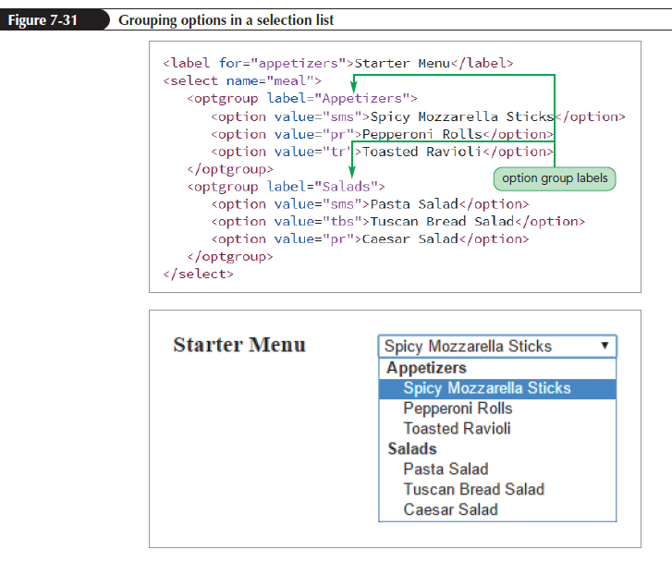
Grouping Selection Options (continued)

Slide 44
Creating Option Buttons
Option buttons are also called radio buttons
Unlike selection lists, the options appear as separate controls in the web form
They are created with a group of input elements with a type attribute value of “radio”
<input name=“name” value=“value1” type=“radio” />

Slide 45
Creating Option Buttons (continued 1)
<input name=“name” value=“value2” type=“radio” />
…
where name is the name of the data field and value1, value2, value3,… are the field values associated with each option
Set an option button to be selected as the default by adding the checked attribute to the input element
<input name=”name” type=”radio” checked />

Slide 46
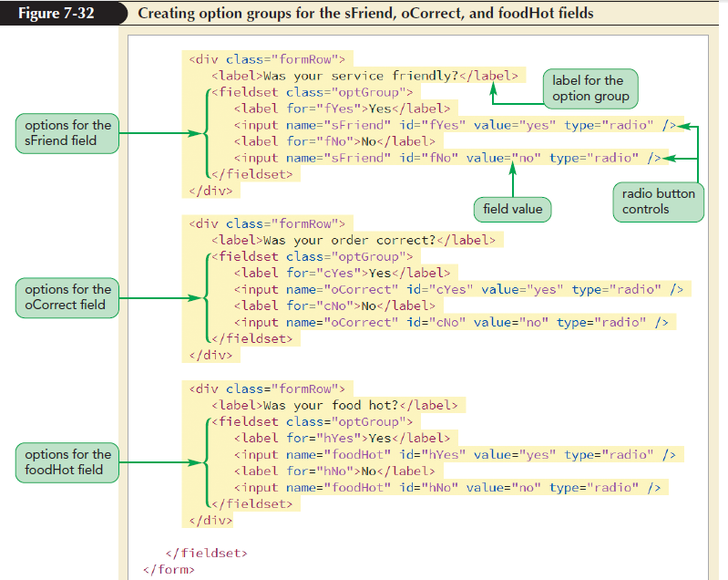
Creating Option Buttons (continued 2)

Slide 47
Creating Check Boxes
Check boxes are designed for fields that record the presence or absence of an object or event
They are created using the input element with the type attribute set to “checkbox”
<input name=“name” value=“value” type=“checkbox” />
value attribute contains the value of the field when the check box is checked
type attribute indicates that the input box is a check box

Slide 48
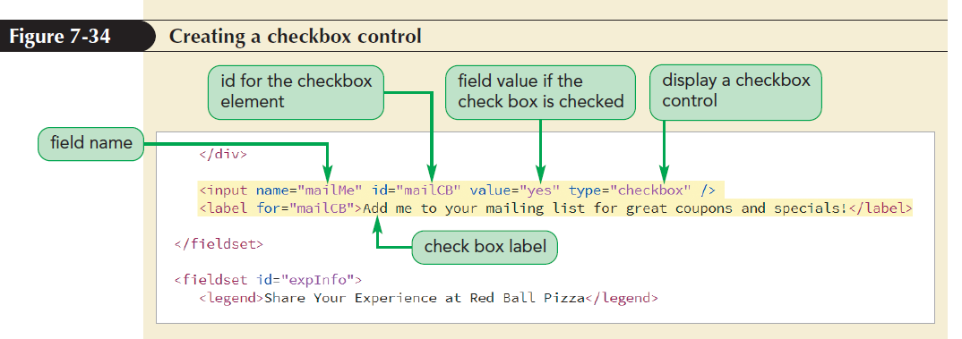
Creating Check Boxes (continued)
By default, a check box is not checked

Slide 49
Creating a Text Area Box
Text area is created using the textarea element
<textarea name=“name”>
text
</textarea>
where text is the default value of the data field

Slide 50
Creating a Text Area Box (continued 1)
HTML supports the rows and cols attributes to set the text area size
<textarea rows=”value” cols=”value”>
...
</textarea>
rows attribute specifies the number of lines in the text area box
cols attribute specifies the number of characters per line

Slide 51
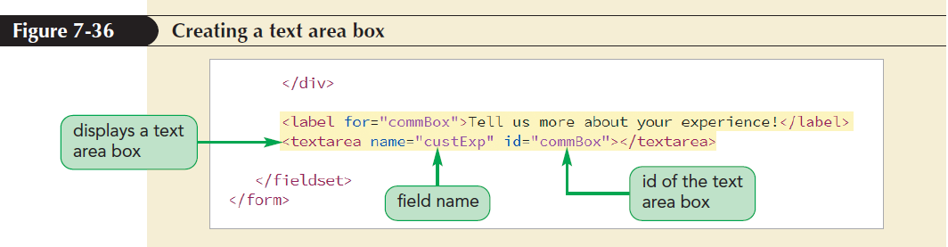
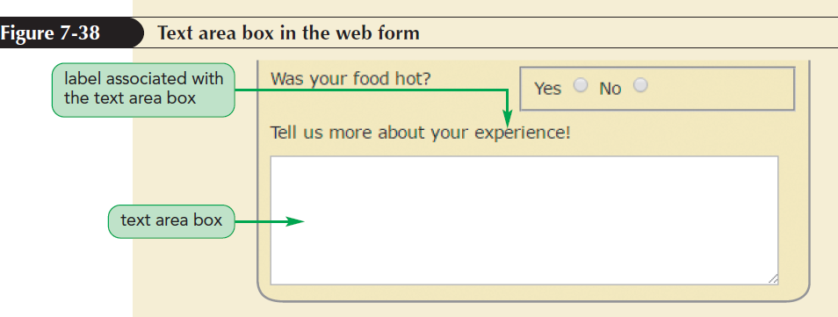
Creating a Text Area Box (continued 2)

Slide 52
Entering Numeric Data
Creating a Spinner Control
Spinner control: Displays an up or down arrow to increase or decrease the field value by a set amount
To create a spinner control, apply the input element using the number data type

Slide 53
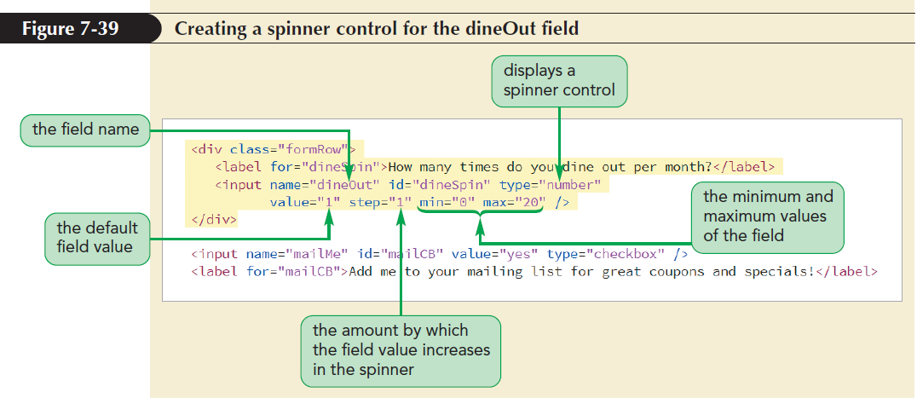
Entering Numeric Data (continued 1)

Slide 54
Entering Numeric Data (continued 2)
Creating a Range Slider
Slider control: Limits a numeric field to a range of possible values
To create a slider control, apply the range data type in the input element

Slide 55
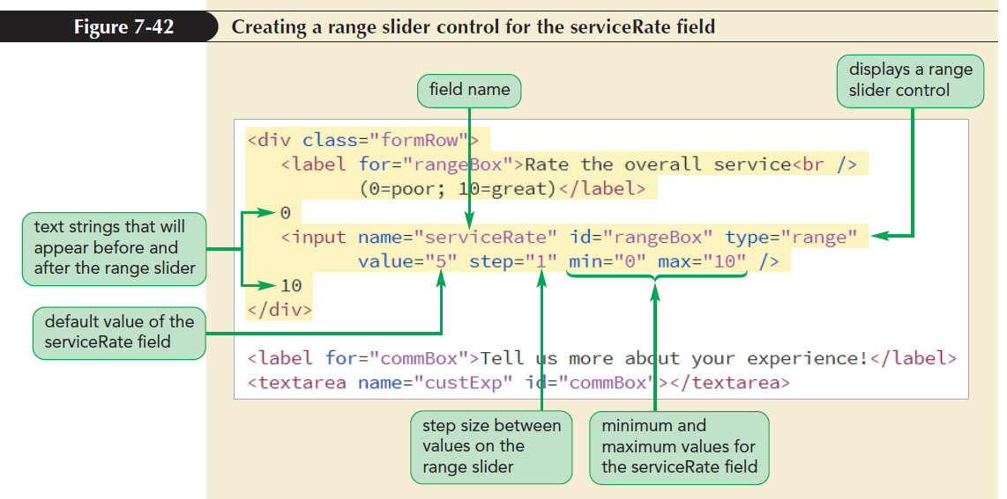
Entering Numeric Data (continued 3)

Slide 56
Suggesting Options with Data Lists
Data list: A list of possible data values that a form field can have
Data lists are defined using the datalist element
<datalist id=”id”>
<option value=”value” />
<option value=”value” />
…
</datalist>

Slide 57
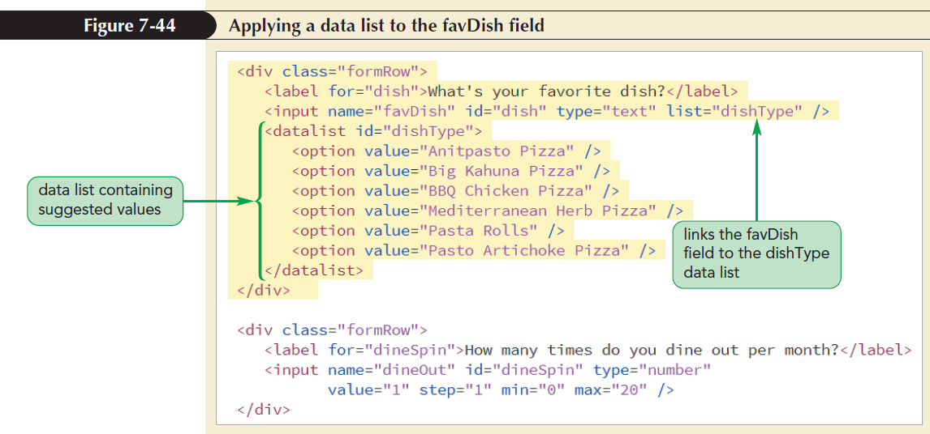
Suggesting Options with Data Lists (continued)

Slide 58
Working with Form Buttons
Form buttons: A type of form control that performs an action
Actions performed
Run a command from a program linked to the web form
Submit the form to a program running on the web server
Reset the form fields to their default values

Slide 59
Creating a Command Button
Command button: Runs a program that affects the content of a page or the actions of a browser
Created using the input element with the type attribute set to button
<input value=“text” onclick=“script” type=“button” />
text is the text that appears on the button
script is the name of the program code that is run when the button is clicked by the user

Slide 60
Creating Submit and Reset Buttons
Submit button: Submits a form to the server for processing when clicked
Submit button is created using input elements with the type attribute set to “submit” and “reset” respectively
<input value=“text” type=“submit” />
where text is the text string that appears on the button

Slide 61
Creating Submit and Reset Buttons (continued 1)
Reset button: Resets a form, changing all fields to their default values and deleting any field values that a user has entered
Reset button is created using input elements with the type attribute set to “reset”
<input value=“text” type=“reset” />
where text is the text string that appears on the button

Slide 62
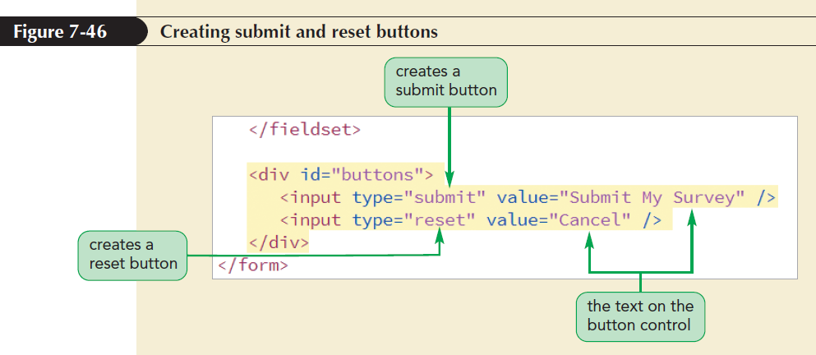
Creating Submit and Reset Buttons (continued 2)

Slide 63
Designing a Custom Button
The appearance of a command, submit, and reset button is determined by the browser
For more control over a button’s appearance use the button element
<button type=“text”>
content
</button>
type attribute specifies the button type
content are HTML elements placed within the button

Slide 64
Validating a Web Form
Validation: Process of ensuring that a user has supplied valid data
Types of validation
Server-side validation – validation occurs on the web server
Client-side validation – validation occurs in the user’s browser

Slide 65
Identifying Required Values
The first validation test is to verify if data is supplied for all the required data fields
Add the required attribute to the control to identify the required data fields
If a required field is left blank, the browser will not submit the form returning an error message to indicate the unavailability of data

Slide 66
Validating Based on Data Type
A form fails the validation test if the data values entered into a field do not match the field type
Example:
A data field with the number type will be rejected if nonnumeric data is entered
Fields with email and url types will be rejected if a user provides an invalid e-mail address or text that does not match the format of a URL

Slide 67
Testing for a Valid Pattern
To test whether a field value follows a valid pattern of characters, test the character string against a regular expression
Regular expression or regex is a concise description of a character pattern
To validate a text value against a regular expression, add the pattern attribute to the input element

Slide 68
Testing for a Valid Pattern (continued)
Example: The value of the custZip field against the regular expression pattern ^\d{5}$
<input name=“custZip” pattern=“^\d{5}$” />
where regular expression ^\d{5}$ represents any string of five numeric characters

Slide 69
Defining the Length of the Field Value
The syntax to define the maxlength attribute is <input maxlength=“value” />
where value is the maximum number of characters in the field value
Example:
<input name=”custZip” maxlength=“5” />
The maxlength attribute does not distinguish between characters and digits

Slide 70
Applying Inline Validation
Inline validation: The technique of immediate data validation and reporting of errors
The focus pseudo-class is used to change the display style of fields that currently contain invalid data
Focus: The state in which an element has been clicked by the user, making it the active control on the form

Slide 71
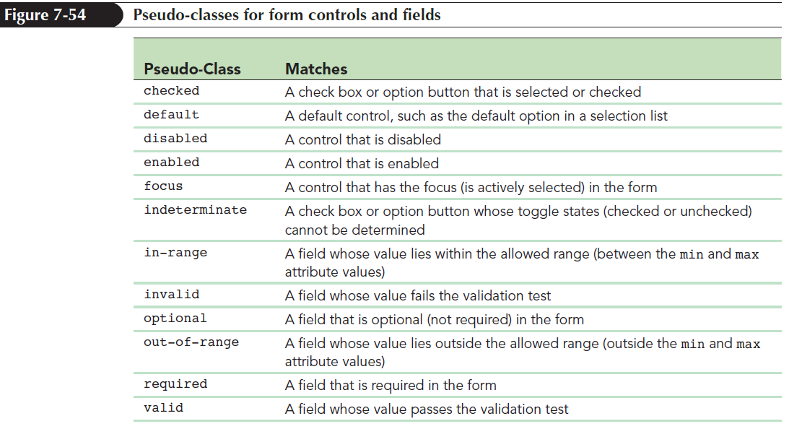
Applying Inline Validation (continued 1)

Slide 72
Applying Inline Validation (continued 2)
Example: To create styles for all of the checked option buttons in the form, apply the checked pseudo-class
input[type=”radio”]:checked {
styles
}
styles are the CSS styles applied to checked option buttons

Slide 73
Pseudo-Classes for Valid and Invalid Data
The valid and invalid pseudo-classes are used to format controls based on whether their field values pass/fail a validation test
Example: To display input elements containing valid data with a light green background, use the following style rule:
input:valid {
background-color: rgb(220, 255, 220);
}

Slide 74
Pseudo-Classes for Valid and Invalid Data (continued 1)
Example: To display input elements containing invalid data with a light red background with focus, use the following style rule:
input:focus:invalid {
background-color: rgb(255, 232, 233);
}

Slide 75
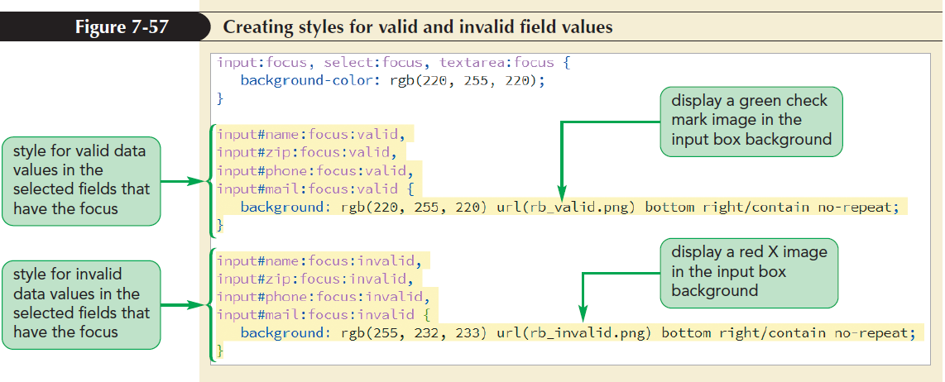
Pseudo-Classes for Valid and Invalid Data (continued 2)

