Slide 2
Objectives
Understand audio and video formats
Insert an HTML audio clip
Support multiple audio formats
Insert an HTML video clip
Write a video caption track

Slide 3
Objectives (continued)
Format video captions
Create a CSS transition
Explore transition attributes
Create a CSS key frame animation
Apply a CSS animation

Slide 4
Introducing Multimedia on the Web
HTML is the perfect tool to share text and data
The next major phase in HTML language was the introduction of multimedia support
Streaming audio, video, and interactive games, made the web a dominant entertainment platform
One of the biggest challenges
Delivering multimedia content in a form that can be retrieved quickly and easily without loss of quality

Slide 5
Understanding Codecs and Containers
Codec: Computer program that encodes and decodes streams of data
Codecs compress data to transmit it in fast and efficient manner
Codecs decompress data when it is to be read or played back

Slide 6
Understanding Codecs and Containers (continued 1)
The compression method can be either lossy or lossless
Lossy compression: Nonessential data is removed in order to achieve a smaller file size
Example:
An audio file might be compressed by removing sounds that the human ear can barely hear

Slide 7
Understanding Codecs and Containers (continued 2)
The more the file is compressed, the more the content is lost
Data removed during compression cannot be recovered
Lossless compression: Data is compressed by removing redundant information
Example:
AAAABBBBBCCCCCC requires 15 characters of information, which can be rewritten using 6 characters as 4A5B6C

Slide 8
Understanding Codecs and Containers (continued 3)
Lossless compression cannot achieve the same level of compression as with lossy compression
Codecs are placed within a container that handles the packaging, transportation and presentation of data
Container is the file format identified by a file extension

Slide 9
Understanding Codecs and Containers (continued 4)
The web supports a multitude of container and codec combinations
Not all containers and codecs are equally supported
For example, the combination of WebM container and VP8 codec is supported by Google Chrome but not Internet Explorer or any Apple device

Slide 10
Understanding Plug-Ins
Media player: Decodes and plays multimedia content stored within a container file
Plug-in: Software program accessed by a browser to provide a feature or capability not native to the browser
A plug-in either opens in its own external window or runs within the web page as an embedded object

Slide 11
Understanding Plug-Ins (continued 1)
Problems with the plug-in approach for delivery of multimedia content
Plugs-ins require users to install a separate application in addition to their web browsers
A common plug-in is not available across all browsers, operating systems, and devices
HTML documents that support multiple plug-ins are difficult to create and maintain

Slide 12
Understanding Plug-Ins (continued 2)
Plug-ins consume valuable system resources, resulting in slow and unreliable performance
Plug-ins are a security risk with some of the most prominent Internet attacks working their way into browsers via a plug-in

Slide 13
Working with the audio Element
Audio clips are embedded within a web page using audio element
<audio src=“url” attributes />
where url specifies the source of the audio file and attributes define how the audio clip should be handled by the browser

Slide 14
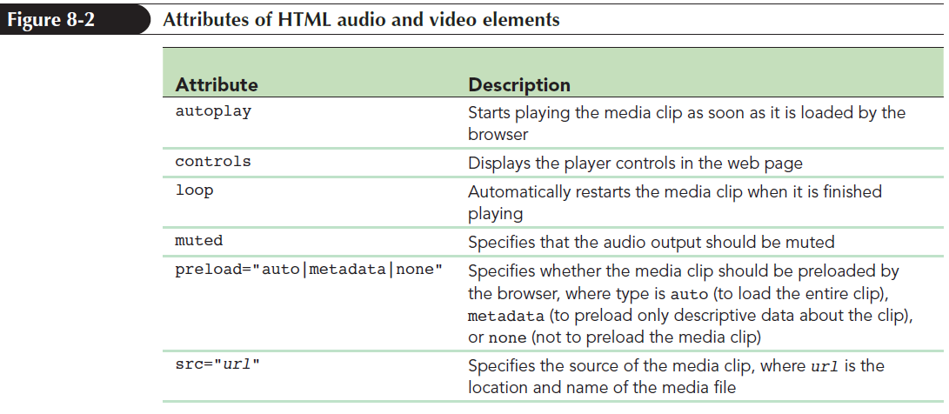
Working with the audio Element (continued)

Slide 15
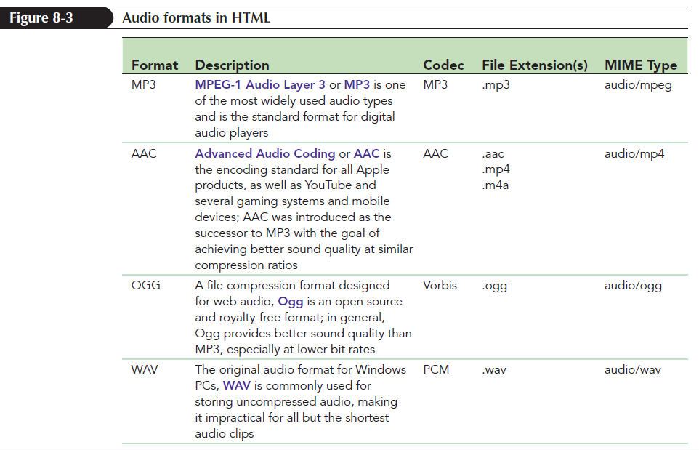
Browsers and Audio Formats
HTML does not specify any particular audio format

Slide 16
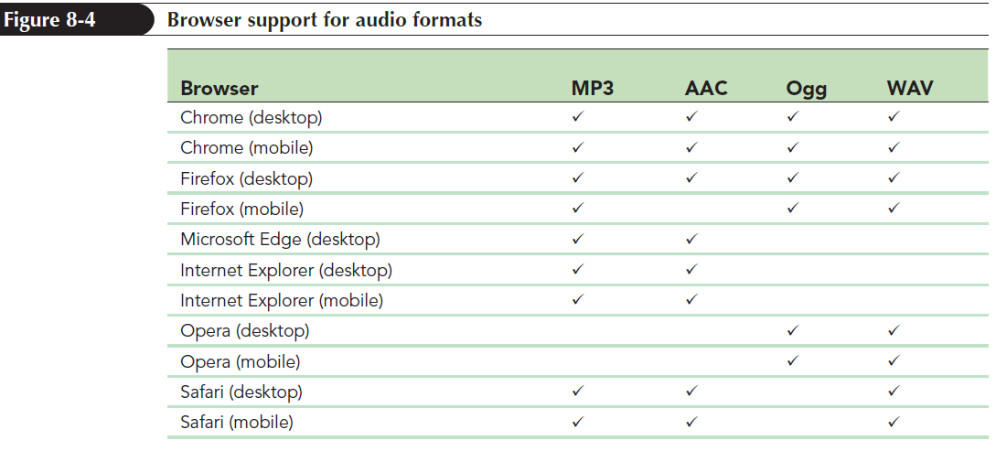
Browsers and Audio Formats (continued 1)

Slide 17
Browsers and Audio Formats (continued 2)
Nest several source elements within a single audio element to provide several versions of the same media file
<audio>
<source src=“url1” type=“mime-type” />
<source src=“url2” type=“mime-type” />
… </audio>
where, url1, url2,… are the URLs for each audio file and mime-type specifies the audio format associated with each file

Slide 18
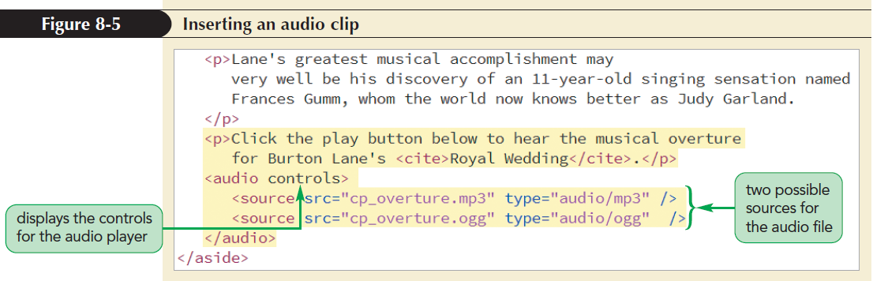
Browsers and Audio Formats (continued 3)

Slide 19
Applying Styles to the Media Player
The appearance of a media player is determined by the browser itself
CSS can be applied to set the width of the media player, add borders and drop shadows, and apply filters and transformations to the player’s appearance

Slide 20
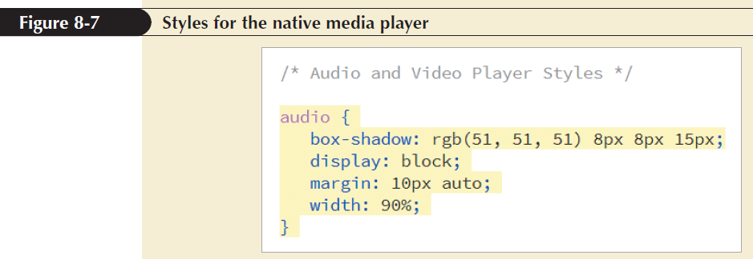
Applying Styles to the Media Player (continued)

Slide 21
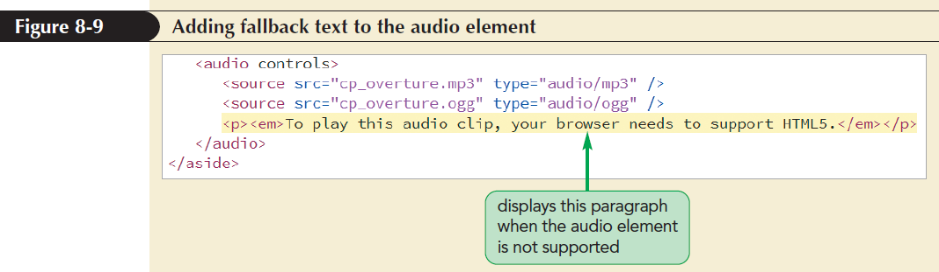
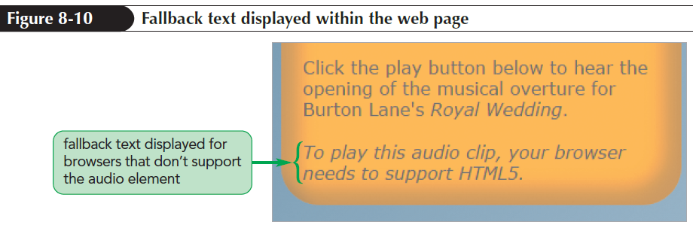
Providing a Fallback to an Audio Clip

Slide 22
Exploring Embedded Objects
Plug-ins in older browsers are marked using the embed element
<embed src=“url” type=“mime-type”
width=“value” height=“value” />
where url is the location of the media file, type attribute provides the mime-type, and width and height attributes set the width and height of the media player

Slide 23
Plug-In Attributes
src, type, height, and width attributes are generic attributes applied to embed element for any plug-in
For example, the following embed element adds attributes to display the media player controls and prevent the playback from starting automatically:
<embed src=“cp_overture.mp3” width=“250” height=“50” controller=“yes” autoplay=”no” />

Slide 24
Plug-Ins as Fallback Options
Add embed element to the end of the audio element as the last option for a browser that does not support HTML5 multimedia elements
Use of plug-ins has steadily declined since the widespread adoption of HTML5 standard

Slide 25
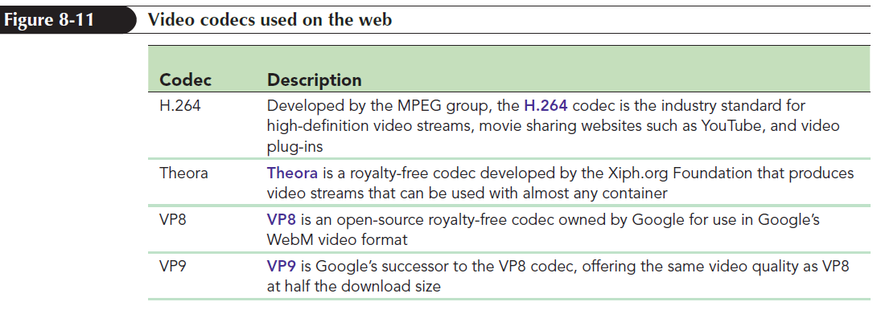
Video Formats and Codecs
A video file contains codecs for the following:
audio
video images

Slide 26
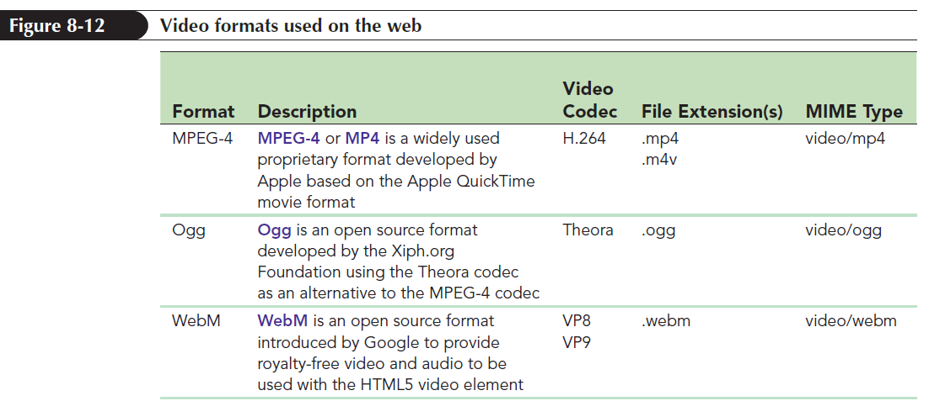
Video Formats and Codecs (continued 1)

Slide 27

Video Formats and Codecs (continued 2)

Slide 28
Using the HTML5 video Element
Videos are embedded into a web page using video element
<video attributes>
<source src=“url1” type=“mime-type” />
<source src=“url2” type=“mime-type” />
… </video>
where attributes are HTML attributes that control the behaviour and appearance of the video playback, url1, url2,… are the possible sources of the video

Slide 29
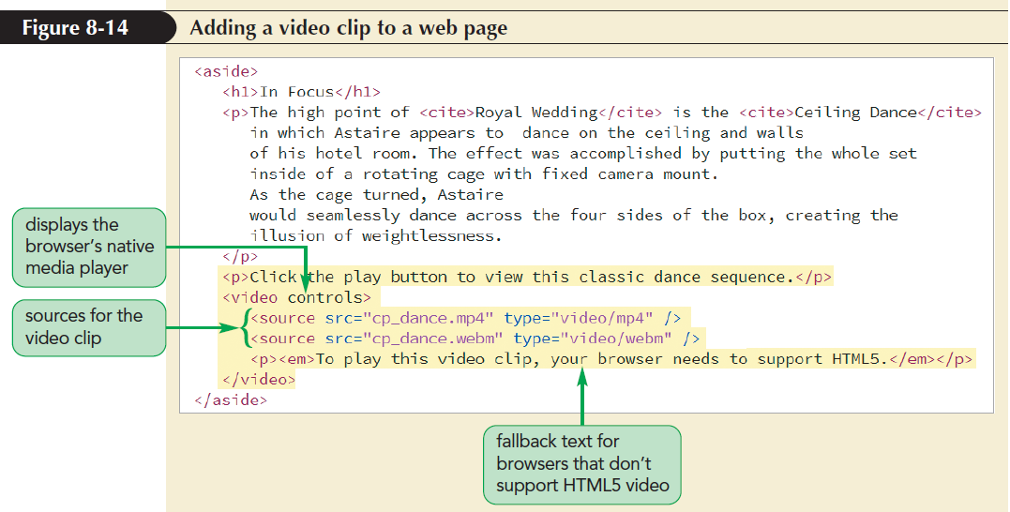
Using the HTML5 video Element (continued 1)
mime-type specifies the format associated with each video file

Slide 30
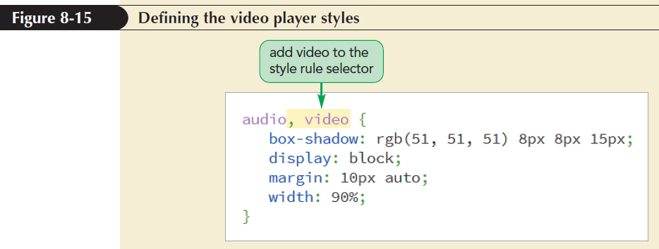
Using the HTML5 video Element (continued 2)

Slide 31
Using the HTML5 video Element (continued 3)
poster attribute defines a video’s preview image
<video poster=”url”>
…
</video>
where url points to an image file containing the preview image
poster attribute is used as a placeholder image that is displayed when a video is being downloaded

Slide 32
Adding a Text Track to Video
Text track that needs to be read or recited to visually impaired users can be added to a media clip
Audio and video content accessible to all users
Text tracks are added to an audio or video clip using track element

Slide 33
Adding a Text Track to Video (continued 1)
<track kind=“type” src=“url” label=“text” srclang=“lang” />
where,
kind attribute defines the track type
src attribute references a file containing the track text
label attribute gives the track name
srclang attribute indicates the language of the track

Slide 34
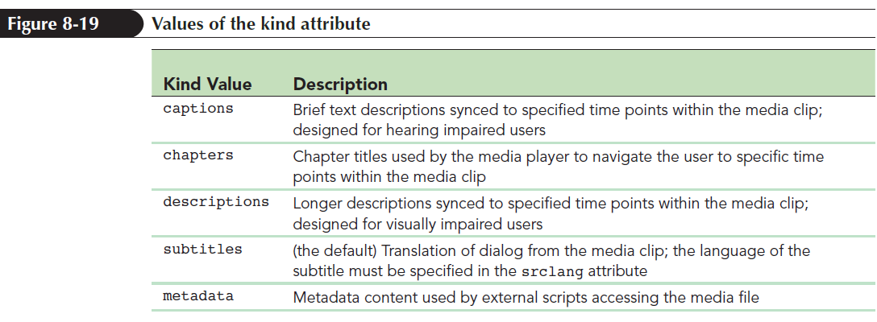
Adding a Text Track to Video (continued 2)

Slide 35
Making Tracks with WebVTT
Tracks are stored as simple text files written in Web Video Text Tracks or WebVTT language
Format of a WebVTT file
WEBVTT
cue1
cue2
…
where cue1, cue2,… are cues matched with specific time intervals within a media clip

Slide 36
Making Tracks with WebVTT (continued 1)
List of cues is separated by a single blank line after a cue text
White space is not ignored in WebVTT files
General form of a cue
label
start --> stop
cue text
where label is the name assigned to the cue, start and stop define the time interval, and cue text is the text of the cue

Slide 37
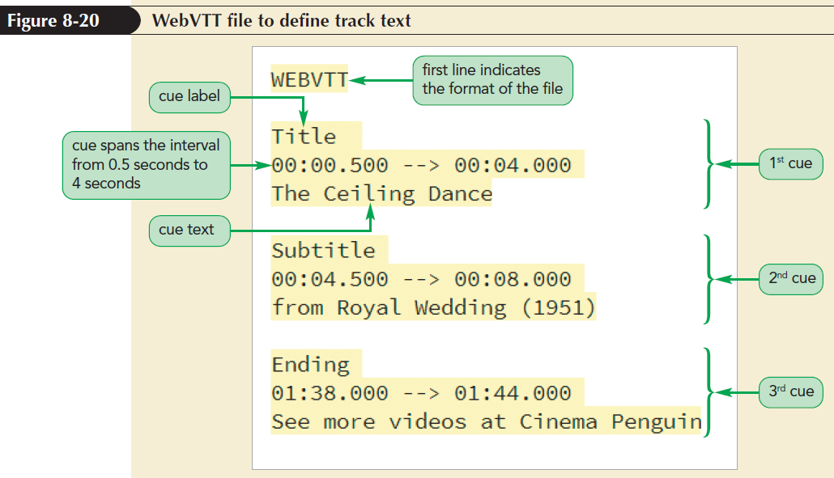
Making Tracks with WebVTT (continued 2)

Slide 38
Placing the Cue Text
Size and position of a cue text can be set using cue settings directly after the cue’s time interval
setting1:value1 setting2:value2 …
where setting1, setting2,… define the size and position of the cue text and value1, value2,… are the setting values
There is no space between the setting name and value

Slide 39
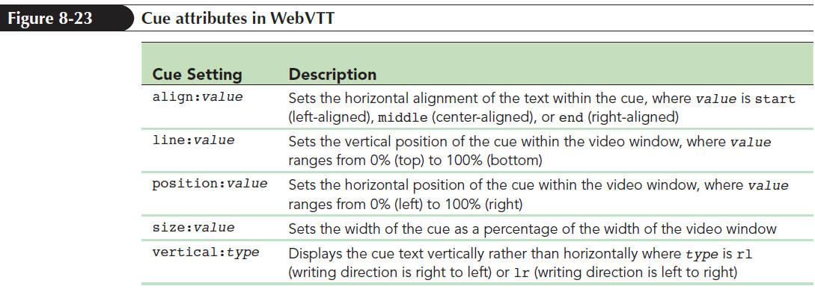
Placing the Cue Text (continued 1)

Slide 40
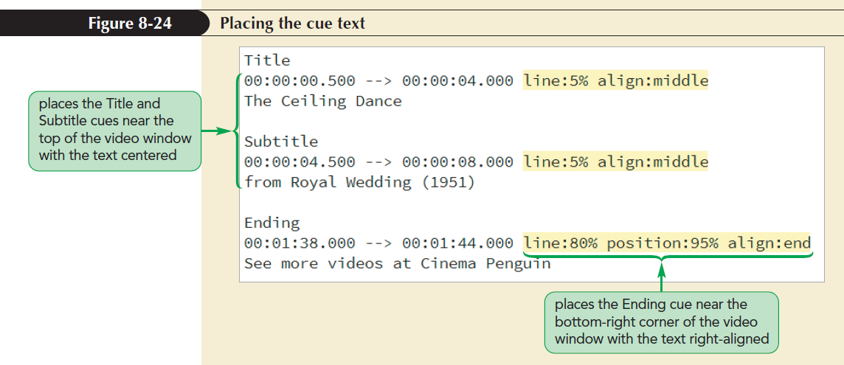
Placing the Cue Text (continued 2)

Slide 41
Applying Styles to Track Cues
cue pseudo-element to format the appearance of the cues appearing within a media clip
::cue {
styles
}
Styles for the cue pseudo-element are limited to background, color, font, opacity, outline, text-decoration, text-shadow, visibility, and white-space properties

Slide 42
Applying Styles to Track Cues (continued 1)
Format specific cues or text strings within a cue using the following markup tags:
<i></i> for italicized text
<b></b> for bold-faced text
<u></u> for underlined text
<span></span> to mark spans of text
<ruby></ruby> to mark ruby text
<rt></rt> to mark ruby text

Slide 43
Applying Styles to Track Cues (continued 2)
WebVTT supports tags that are not part of the HTML library
<c></c> tag is used to mark text strings belonging to a particular class
<c.classname></c>
<v></v> tag is used for captions that distinguish between one voice and another
<v name></v>

Slide 44
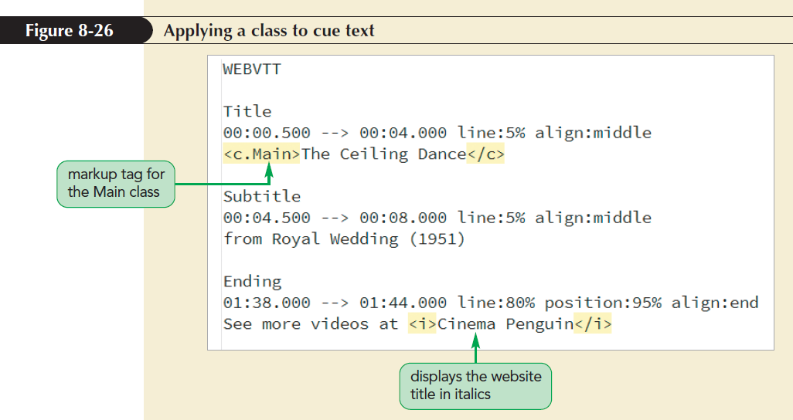
Applying Styles to Track Cues (continued 3)

Slide 45
Using Third-Party Video Players
object element is used to define browsers with plug-ins
<object attributes>
parameters
</object>
where attributes define the object and parameters are values passed to the object controlling the object’s appearance and actions

Slide 46
Using Third-Party Video Players (continued)
Parameters of the object are defined using param element
<param name=“name” value=“value” />
where name is the name of the parameter and value is the parameter’s value

Slide 47
Exploring the Flash Player
The most-used plug-in for video playback is Adobe Flash player embedded using the following object element:
<object data=“url”
type=“application/x-shockwave-flash”
width=“value” height=“value”>
<param name=“movie” value=“url” />
parameters
</object>

Slide 48
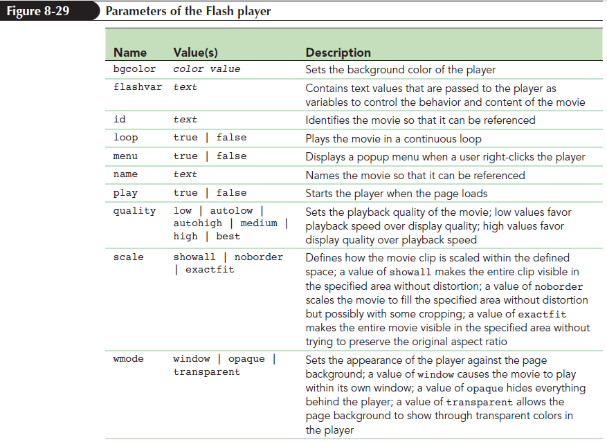
Exploring the Flash Player (continued)

Slide 49
Embedding Videos from YouTube
YouTube videos are easy to embed in a web page using YouTube’s HTML5 video player
Click the Share button below the YouTube video player to share it
YouTube provides options to post a hypertext link to the video to a multitude of social media sites or to share the link via e-mail

Slide 50
Embedding Videos from YouTube (continued 1)
To embed a video within a website, click Embed, which brings up a preview of the embedded player and the HTML code that needs to be added to the web page
The general code for the embedded player is
<iframe width=“value” height=“value” src=“url”
frameborder=“0” allowfullscreen>
</iframe>
where, the url provides the link to the

Slide 51
Embedding Videos from YouTube (continued 2)
YouTube video
width and height attributes define the dimensions of the player embedded on a web page
frameborder attribute sets the width of the border around the player in pixels
allowfullscreen attribute allows the user to play the video in full screen mode

Slide 52
Embedding Videos from YouTube (continued 3)
iframe element: Used to mark inline frames
Inline frames: Windows embedded within a web page that display the content of another page or Internet resource

Slide 53
HTML5 Video Players
HTML5 video player works within a browser with CSS and JavaScript files
It presents a customizable player that can be adapted to the needs of business or organization
For example, YouTube player that provides both the player and a hosting service for the video content

Slide 54
HTML5 Video Players (continued)
HTML5 includes the following video players:
JWPlayer (www.jwplayer.com)
Video.js (www.videojs.com)
MediaElement.js (mediaelementjs.com)
Projekktor (www.projekktor.com)
Flowplayer/Flash player (flowplayer.org)

Slide 55
Introducing Transitions
Transition: Change in an object’s style from the initial state to the ending state, usually in response to an event initiated by the user or the browser
It slows down the change from one color to another and provides intermediate styles

Slide 56
Introducing Transitions (continued)
To create transition, employ the following transition style:
transition: property duration;
where,
property is a property of the object that changes between the initial and end states
duration is the transition time in seconds or milliseconds

Slide 57
Setting the Transition Timing
Varying speed of transition is defined using
transition: property duration timing-function;
where timing-function is one of the following keywords:
ease: (the default) Transition occurs more rapidly at the beginning and slows down near the end

Slide 58
Setting the Transition Timing (continued 1)
ease-in: Transition starts slowly and maintains a constant rate until the finish
ease-out: Transition starts at a constant rate and then slows down toward the finish
ease-in-out: Transition starts slowly, reaches a constant rate, and then slows down toward the finish
linear: Transition is applied at a constant rate throughout the duration

Slide 59
Setting the Transition Timing (continued 2)
Timing function can be visualized as a graph
It shows the progress of transition vs. duration
The graphical representation of the timing function is the basis of another measure of transition timing using
cubic-bezier(n, n, n, n)
where n parameter values define the shape of the timing curve

Slide 60
Delaying a Transition
Transition does not need to start immediately after the event that triggers it
Start of the transition can be delayed by adding delay value to the following:
transition: property duration timing-function delay;
where delay is measured in seconds or milliseconds

Slide 61
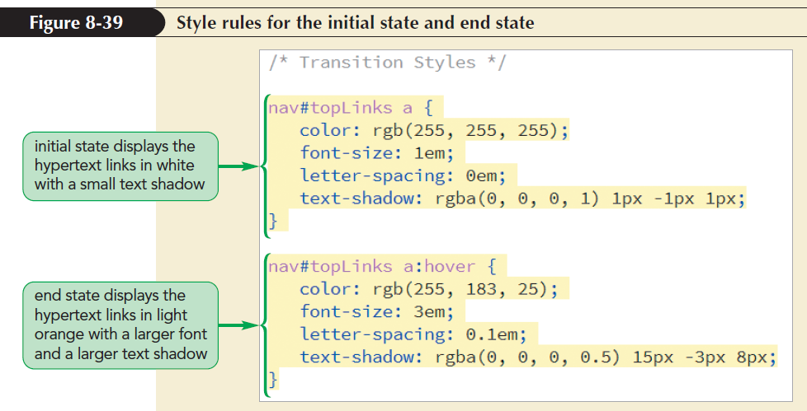
Creating a Hover Transition
Transition property can be added to slow down the transition from initial to end state

Slide 62
Creating a Hover Transition (continued)
Limitations of transition
It can only be run when a CSS property is being changed, such as during the hover event
It is run once and cannot be looped for repetition
Initial and end states of the transition can be defined but not the styles of intermediate states
Animation is created to overcome the limitations

Slide 63
Animating Objects with CSS
Key frame: Sequence of changing images to create illusive movement for animation
CSS replaces the concept of key frame images with key frame styles that are applied in rapid succession to a page object
@keyframes Rule
@keyframes name {
keyframe1 {styles;}
keyframe2 {styles;}
…}

Slide 64
Animating Objects with CSS (continued)
name provides the name or title of the animated sequence
keyframe1,keyframe2,… defines the progress of individual key frames that are expressed as percentages or with keywords from and to
styles are styles applied within each key frame

Slide 65
Applying an Animation
Key frames animation is applied to an object using animation-name and animation-duration properties
animation-name: keyframes;
animation-duration: times;
where keyframes is a comma-separated list of animations applied to the object using the names from the @keyframes rule and times are the lengths of each animation expressed in seconds or milliseconds

Slide 66
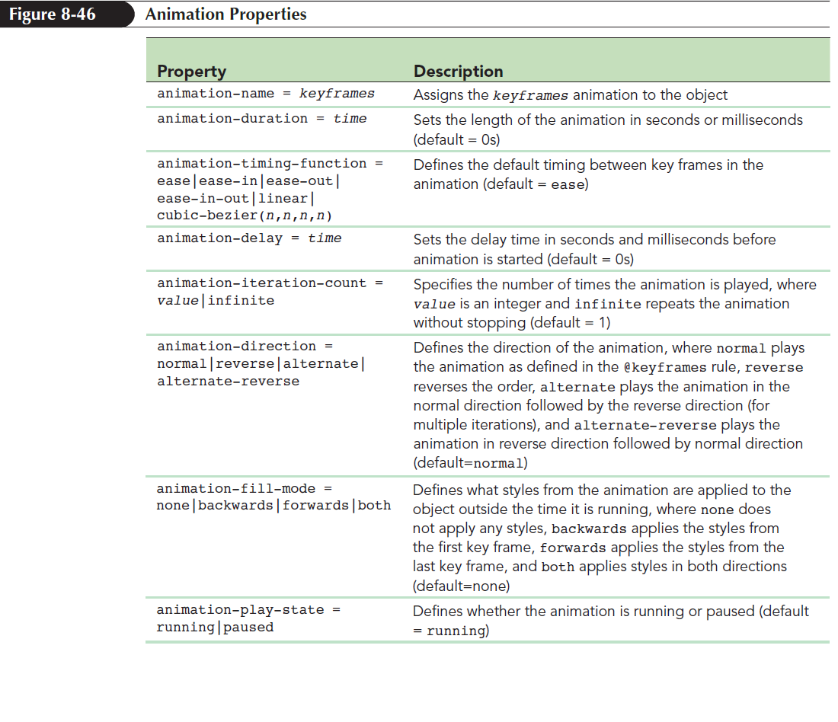
Applying an Animation (continued)

Slide 67
Controlling an Animation
Animation can have two states of operation — play or pause
Check box can be used to control animation
Selecting the check box will play the animation
Unselecting the check box will pause the animation

Slide 68
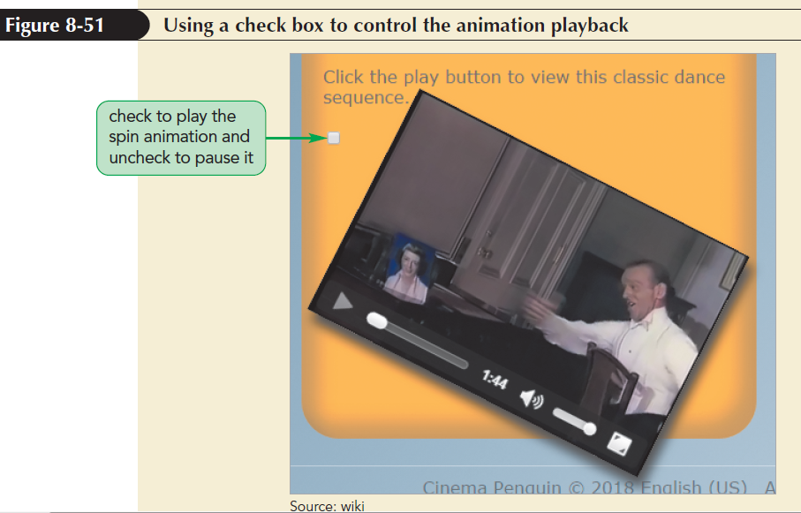
Controlling an Animation (continued 1)

Slide 69
Controlling an Animation (continued 2)
Check box can be replaced with more attractive icons
Display symbol to run the animation
Display symbol to pause the animation
The two symbols have the Unicode values \21bb and \270b, respectively

Slide 70
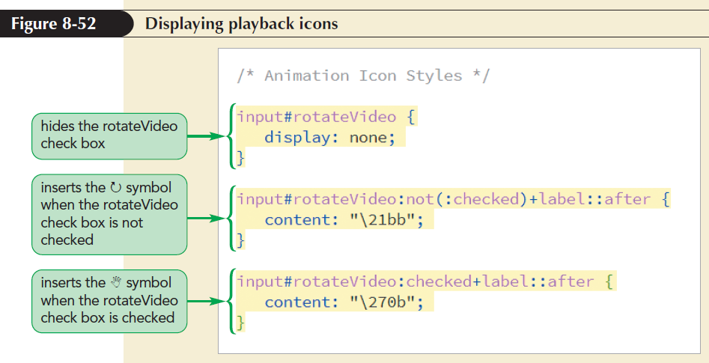
Controlling an Animation (continued 3)

