Slide 2
Objectives
Insert a script element
Write JavaScript comments
Display an alert dialog box
Use browser debugging tools
Reference browser and page objects
Use JavaScript properties and methods

Slide 3
Objectives (continued)
Write HTML code and text content into a page
Work with a Date object
Use JavaScript operators
Create a JavaScript function
Create timed commands

Slide 4
Server-Side and Client-Side Programming
Server-side programming: Program code runs from the server hosting the website
Advantage
Connects a server to an online database containing information not directly accessible to end users
Disadvantages
Use server resources and requires Internet access
Long delays in cases of system over-load

Slide 5
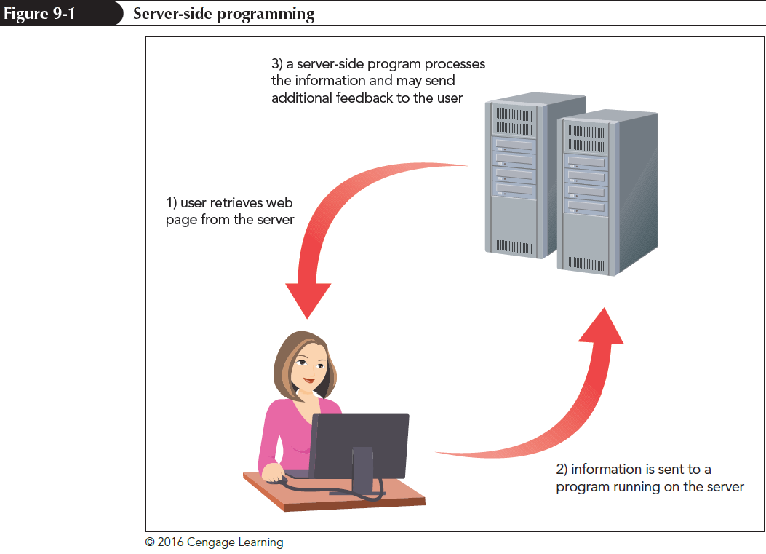
Server-Side and Client-Side Programming (continued 1)

Slide 6
Server-Side and Client-Side Programming (continued 2)
Client-side programming: Programs run on the user’s computer using downloaded scripts with HTML and CSS files
Distributes load to avoid overloading of program-related requests
Client-side programs can never replace server-side programming

Slide 7
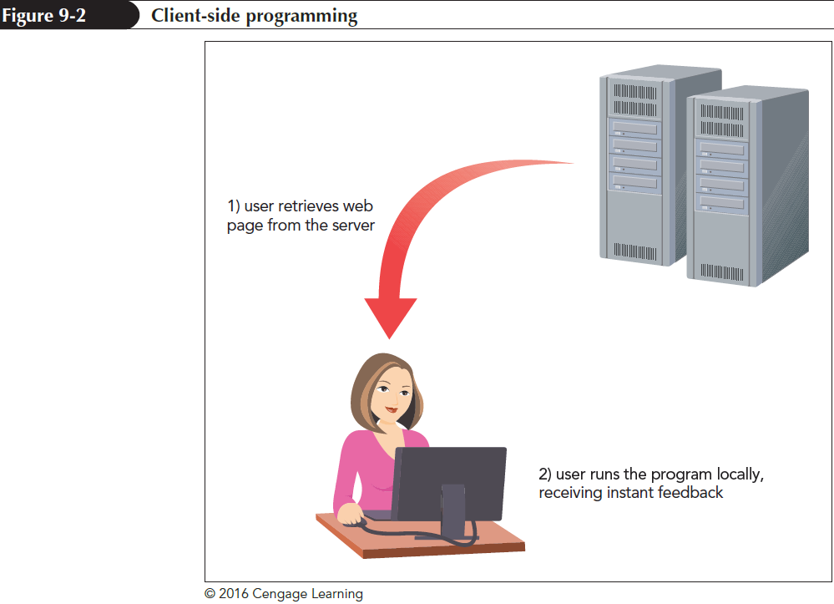
Server-Side and Client-Side Programming (continued 3)

Slide 8
The Development of JavaScript
JavaScript is a programming language for client-side programs
It is an interpreted language that executes a program code without using an application
Compiler is an application that translates a program code into machine language
JavaScript code can be directly inserted into or linked to an HTML file

Slide 9
Working with the script Element
JavaScript code is attached to an HTML file using the script element
<script src=”url”></script>
where url is the URL of the external file containing the JavaScript code
An embedded script can be used instead of an external file by omitting the src attribute
<script>
code
</script>

Slide 10
Loading the script Element
script element can be placed anywhere within an HTML document
When a browser encounters a script, it immediately stops loading the page and begins loading and then processing the script commands
async and defer attributes can be added to script element to modify its sequence of processing

Slide 11
Loading the script Element (continued)
async attribute tells a browser to parse the HTML and JavaScript code together
defer attribute defers script processing until after the page has been completely parsed and loaded
async and defer attributes are ignored for embedded scripts

Slide 12
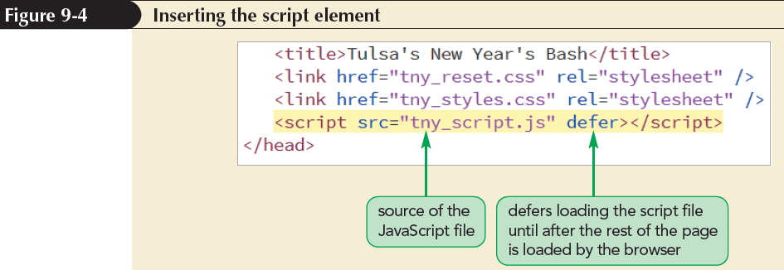
Inserting the script Element

Slide 13
Creating a JavaScript Program
JavaScript programs are created using a standard text editor
Adding Comments to your JavaScript Code
Comments help understand the design and purpose of programs
JavaScript comments can be entered on single or multiple lines

Slide 14
Creating a JavaScript Program (continued 1)
Syntax of a single-line comment is as follows:
// comment text
Syntax of multiple-line comments is as follows:
/*
comment text spanning
several lines
*/

Slide 15
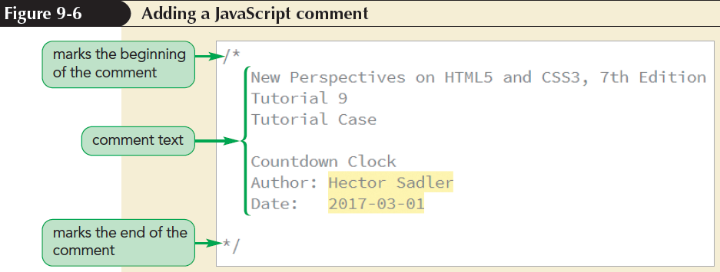
Creating a JavaScript Program (continued 2)

Slide 16
Creating a JavaScript Program (continued 3)
Writing a JavaScript Command
A command indicates an action for a browser to take
A command should end in a semicolon
JavaScript command;

Slide 17
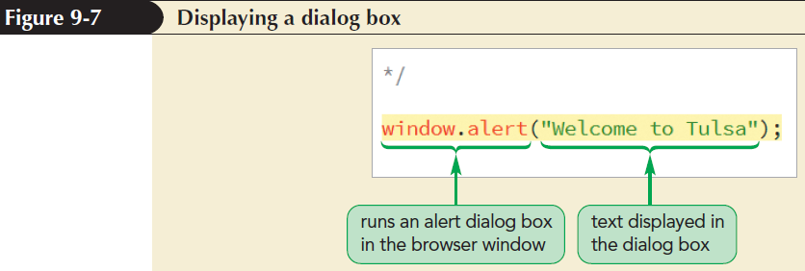
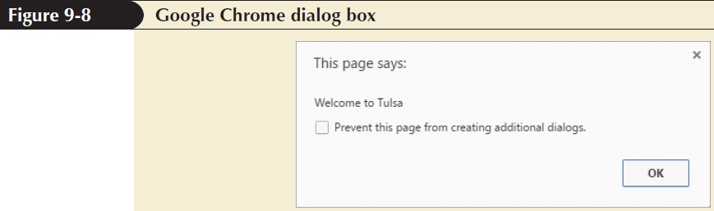
Creating a JavaScript Program (continued 4)

Slide 18
Creating a JavaScript Program (continued 5)
Understanding JavaScript Syntax
JavaScript is case sensitive
Extra white space between commands is ignored
Line breaks placed within the name of a JavaScript command or a quoted text string cause an error

Slide 19
Debugging your Code
Debugging: Process of locating and fixing a programming error
Types of errors
Load-time errors – occur when a script is first loaded by a browser
Run-time errors – occur during execution of a script without syntax errors
Logical errors – are free from syntax and executable mistakes but result in an incorrect output

Slide 20
Opening a Debugger
Debugging tools locate and fix errors in JavaScript codes
Shortcut to open a debugging tool is F12 key
The tools can also be opened by selecting Developer Tools from the browser menu

Slide 21
Inserting a Breakpoint
A useful technique to locate the source of an error is to set up breakpoints
Breakpoints are locations where a browser pauses a program to determine whether an error has occurred at that point during execution

Slide 22
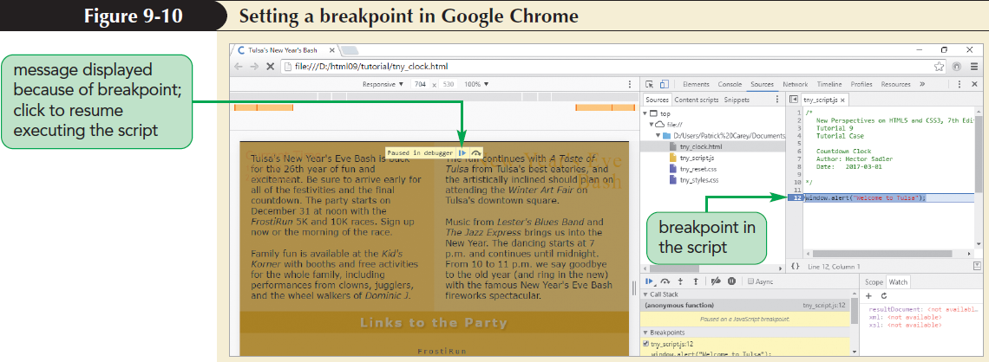
Inserting a Breakpoint (continued)

Slide 23
Applying Strict Usage of JavaScript
Strict mode enables all lapses in syntax to result in load-time or run-time errors
To run a script in strict mode, add the following statement to the first line of the file:
“use strict”;

Slide 24
Introducing Objects
Object: Entity within a browser or web page that has properties and methods
Properties: Define objects
Methods: Act upon objects
JavaScript is an object-based language that manipulates an object by changing one or more of its properties

Slide 25
Introducing Objects (continued 1)
Types of JavaScript objects
Built-in objects – intrinsic to JavaScript language
Browser objects – part of browser
Document objects – part of web document
Customized objects – created by a programmer to use in an application
Browser object model (BOM) and document object model (DOM) organize browser and document objects in hierarchical structures, respectively

Slide 26
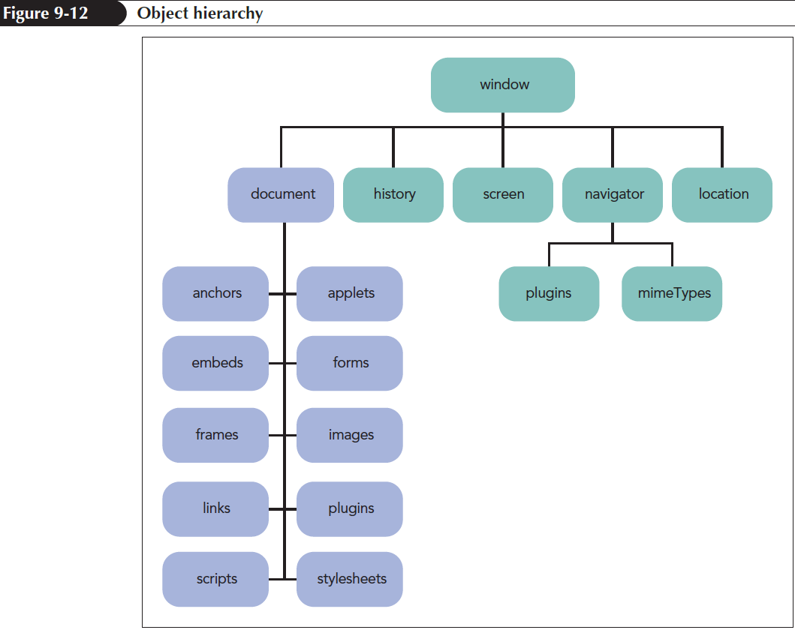
Introducing Objects (continued 2)

Slide 27
Object References
Objects within the object hierarchy are referenced by their object names such as window, document, or navigator
Objects can be referenced using the notation
object1.object2.object3 ...
where object1 is at the top of the hierarchy, object2 is a child of object1, and so on

Slide 28
Referencing Object Collections
Object collections: Objects organized into groups
To reference a specific member of an object collection, use
collection[idref]
or collection.idref
where collection is a reference to the object collection and idref is either an index number or the value of id attribute

Slide 29
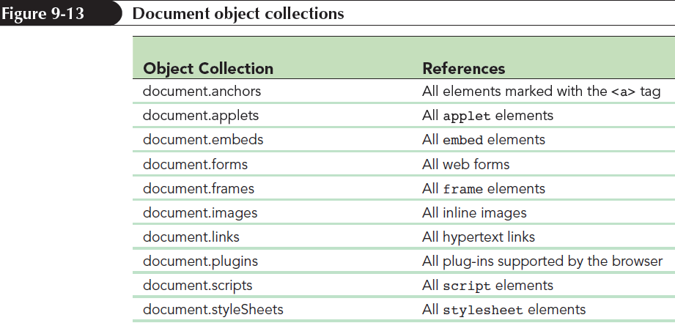
Referencing Object Collections (continued)

Slide 30
Referencing an Object by ID and Name
An efficient approach to reference an element is to use its id attribute using the expression
document.getElementById(id)
where id is the value of id attribute

Slide 31
Changing Properties and Applying Methods
Object Properties
Object property is accessed using
object.property
where object is a reference to an object and property is a property associated with that object
Read-only properties cannot be modified

Slide 32
Changing Properties and Applying Methods (continued)
Applying a Method
Objects can be modified using methods
Methods are applied using the expression
object.method(values)
where object is a reference to an object, method is the name of the method applied to the object, and values is a comma-separated list of values associated with the method

Slide 33
Writing HTML Code
HTML code stored within a page element is referenced using
element.innerHTML
where element is an object reference to an element within a web document

Slide 34
Writing HTML Code (continued 1)
HTML code stored within a page element is referenced using
element.innerHTML
where element is an object reference to an element within a web document
For example,
/* Display the current date and time */
document.getElementById(“dateNow”).innerHTML = “m/d/y<br />h:m:s”;

Slide 35
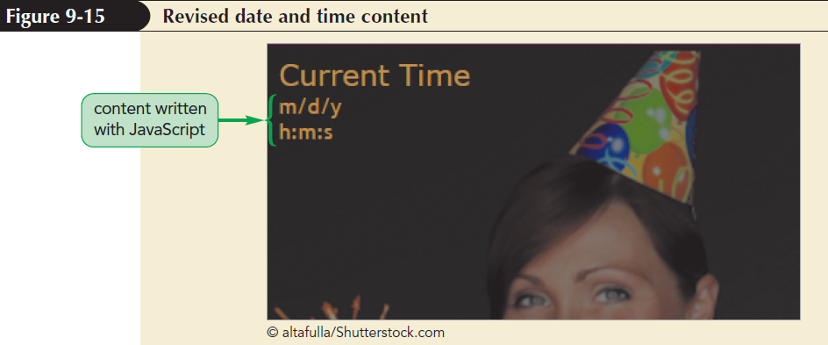
Writing HTML Code (continued 2)

Slide 36
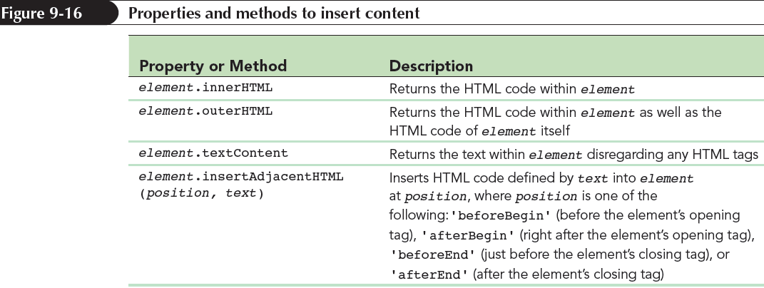
Writing HTML Code (continued 3)

Slide 37
Working with Variables
Variable: Named item in a program that stores a data value
Declaring a Variable
Introduced into a script by declaring the variable using the var keyword
var variable = value;
where variable is the name assigned to the variable and value is the variable’s initial value

Slide 38
Working with Variables (continued)
Conditions to assign variable names in JavaScript
First character must be either a letter or an underscore character ( _ )
The characters after the first character can be letters, numbers, or underscore characters
No spaces
No using names that are part of JavaScript language

Slide 39
Variables and Data Types
Data type: Type of information stored in a variable
Supported data types
Numeric value
Text string
Boolean value
Object
null value

Slide 40
Variables and Data Types (continued)
Numeric value: Any number
Text string: Group of characters enclosed within either double or single quotation marks
Boolean value: Indicates the truth or falsity of a statement

Slide 41
Variables and Data Types (continued 1)
Object – Simplifies code by removing the need to rewrite complicated object references
null value – Indicates that no value has yet been assigned to a variable

Slide 42
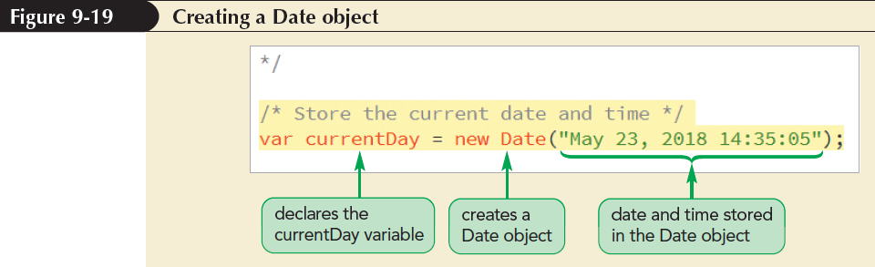
Working with Date Objects
Date object: Built-in JavaScript object used to store information about dates and times

Slide 43
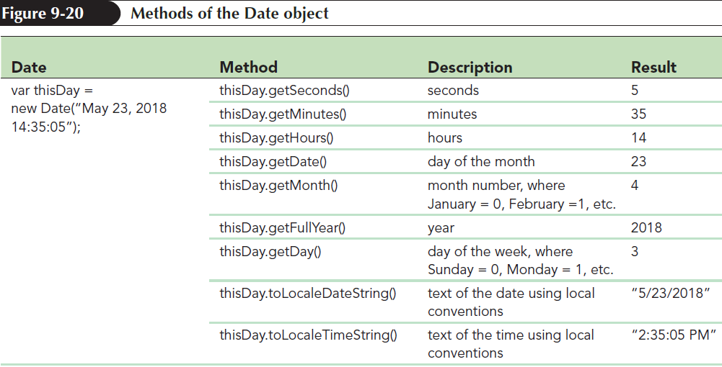
Working with Date Objects (continued 1)

Slide 44
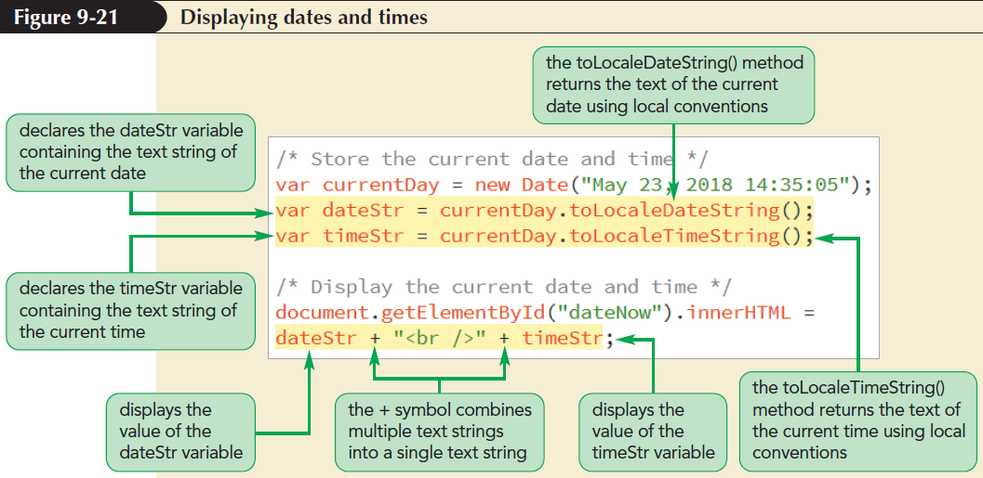
Working with Date Objects (continued 2)

Slide 45
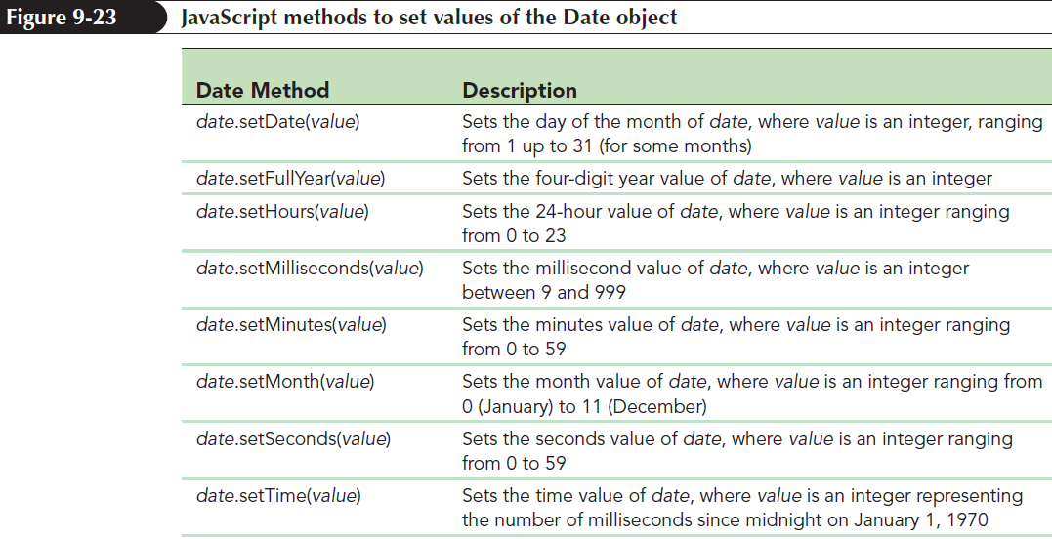
Setting Date and Time Values

Slide 46
Working with Operators and Operands
Operator: Symbol used to act upon an item or a variable within an expression
Operands: Variables or expressions that operators act upon
Types of operators
Binary operators – require two operands in an expression

Slide 47
Working with Operators and Operands (continued)
Unary operators – require only one operand
Increment operator (++) – increases the value of an operand by 1
Decrement operator (--) – decreases the value of an operand by 1

Slide 48
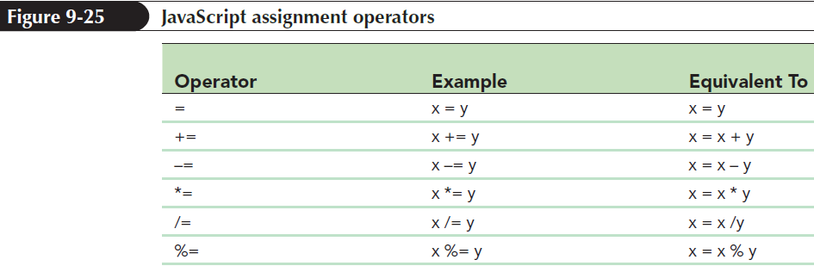
Using Assignment Operators
Assignment operator: Assigns a value to an item

Slide 49
Working with the Math Object
Math object: Built-in object used to perform mathematical tasks and store mathematical values
Syntax to apply a Math method is
Math.method(expression)
where method is the method applied to a mathematical expression

Slide 50
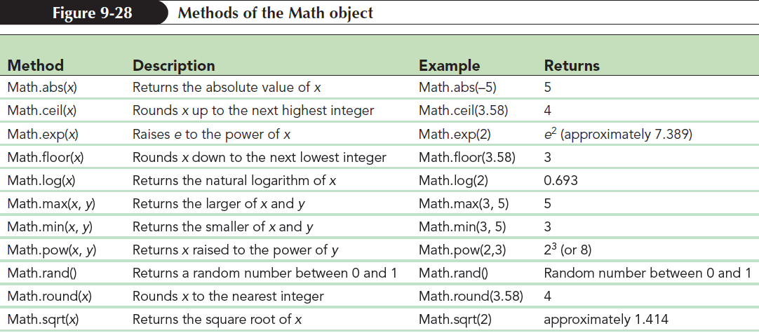
Working with the Math Object (continued 1)

Slide 51
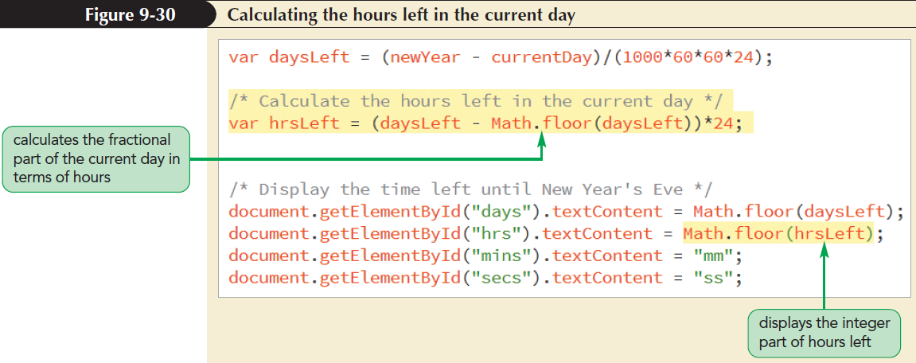
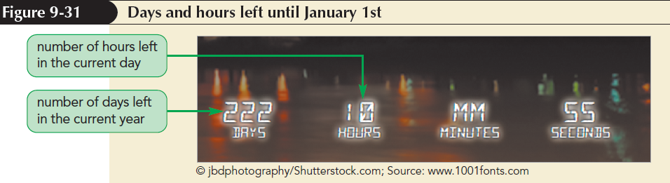
Working with the Math Object (continued 2)

Slide 52
Using Math Constants
Math functions refer to built-in constants stored in JavaScript Math object
Syntax to access mathematical constants is
Math.CONSTANT
where CONSTANT is the name of one of the mathematical constants supported by Math object

Slide 53
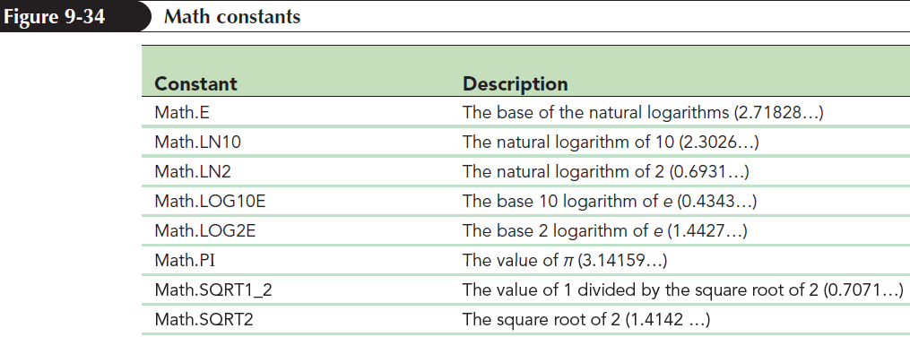
Using Math Constants (continued)

Slide 54
Working with JavaScript Functions
Function: Collection of commands that performs an action or returns a value
A function name identifies a function and a set of commands that are run when the function is called
Parameters: Variables associated with the function

Slide 55
Working with JavaScript Functions (continued)
General syntax of a JavaScript function is
function function_name(parameters){
commands
}
where,
function_name is the name of the function
parameters is a comma-separated list of variables used in the function
commands is the set of statements run by the function

Slide 56
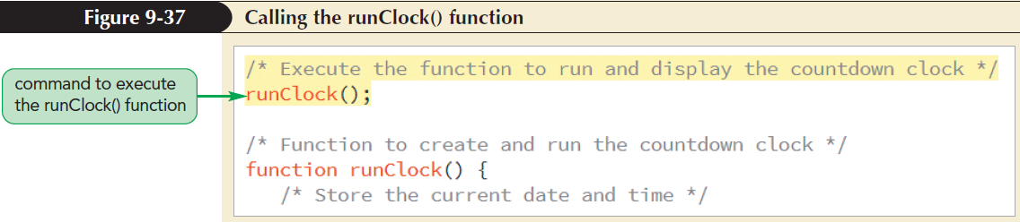
Calling a Function

Slide 57
Creating a Function to Return a Value
Functions return values using return statement
function function_name(parameters){
commands
return value;
}
where value is the calculated value that is returned by the function

Slide 58
Running Timed Commands
Methods to update the current and the remaining time constantly
Time-delayed commands
Timed-interval commands
Working with Time-Delayed Commands
Time-delayed commands: JavaScript commands run after a specified amount of time has passed

Slide 59
Running Timed Commands (continued 1)
Time delay is defined using
setTimeout(“command”, delay);
where command is a JavaScript command and delay is the delay time in milliseconds before a browser runs the command
Running Commands at Specified Intervals
The timed-interval command instructs browsers to run a command repeatedly at a specified interval

Slide 60
Running Timed Commands (continued 2)
Timed-interval commands are applied using setInterval() method
setInterval(“command”, interval);
where interval is the interval in milliseconds before the command is run again

Slide 61
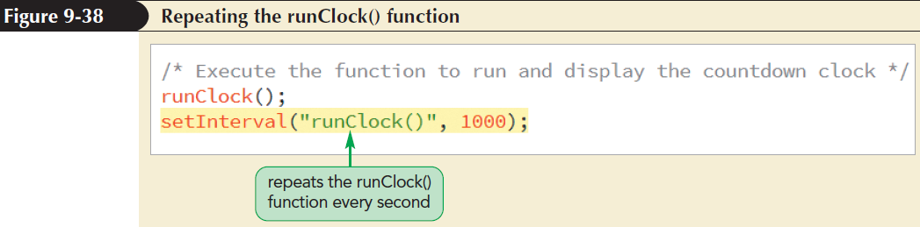
Running Timed Commands (continued 3)

Slide 62
Controlling How JavaScript Works with Numeric Values
Handling Illegal Operations
Mathematical operations can return results that are not numeric values
JavaScript returns NaN if an operation does not involve only numeric values

Slide 63
Controlling How JavaScript Works with Numeric Values (continued)
isNaN() function returns a Boolean value of true if the value is not numeric and false if otherwise
Infinity value is generated for an operation whose result is less than the smallest numeric value and greater than the largest numeric value supported by JavaScript

Slide 64
Defining a Number Format
JavaScript stores a numeric value to 16 decimal places of accuracy
The number of digits displayed by browsers is controlled using toFixed() method
value.toFixed(n)
where value is the value or variable and n is the number of decimal places displayed in the output

Slide 65
Defining a Number Format (continued)
toFixed() limits the number of decimals displayed by a value and converts the value into a text string
toFixed() rounds the last digit in an expression rather than truncating it

Slide 66
Converting Between Numbers and Text
+ operator adds a text string to a number
For example,
testNumber = 123; // numeric value
testString = testNumber + “”; // text string
where + operator concatenates a numeric value with an empty text string resulting in a text string

Slide 67
Converting Between Numbers and Text (continued 1)
parseInt() function extracts the leading integer value from a text string
It returns the integer value from the text string by discarding any non-integer characters
Example,
parseInt(“120.88 lbs”); // returns 120
parseInt(“weight equals 120 lbs”); // returns NaN

Slide 68
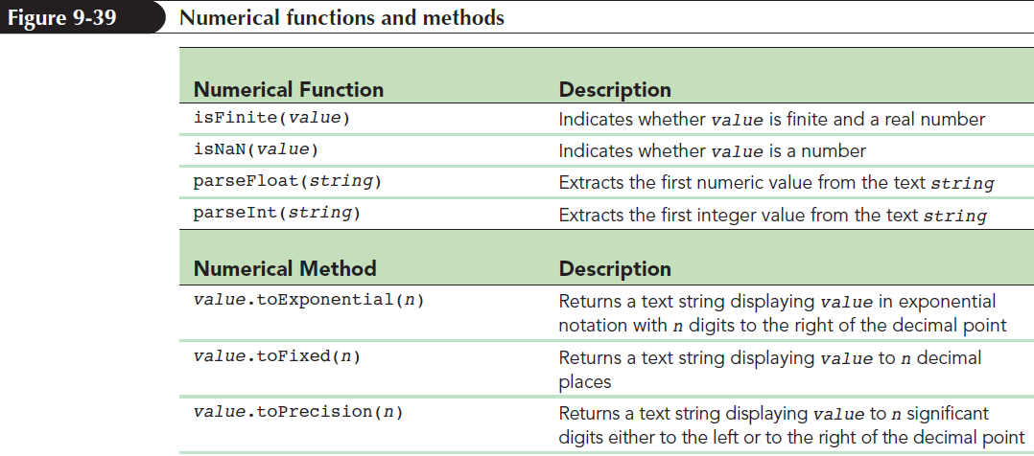
Converting Between Numbers and Text (continued 2)

