Slide 1
Room Reservation System
By Nikita Dongare
Akshay Sigar

Slide 2
Introduction
The Users of this system are the customers and the administrator.
All rates and availability are automatically updated by the system.
The room reservation system also reduces the risk of overbooking and increases the overall smoothness of the reservation process.
Collection of data is an important factor in the hospitality sector where customers are demanding a more personalized experience.

Slide 3
The Business Rules

Slide 4
The customer must be a registered user on the system.
The user must have a valid id proof for reservations.
The property can be an apartment,villa,cottage or bungalow.
A user can make one or more reservations.
The user must cancel a reservation 24 hours prior to check-in.
The user must complete the payment process in order to make a reservation.
Guests can be an individual person or a group of people.
The ratings in customer feedback must be given on a scale of 0 to 5.

Slide 5
Tools used for Implementation
Microsoft Sql Server
Microsoft Access 2016
Microsoft Visio 2016

Slide 6
Entities
Customer
Property
Property Type
Reservation
Available Services
Reservation Services
Payment Method
Customer Feedback

Slide 7
Major Data Questions

Slide 8
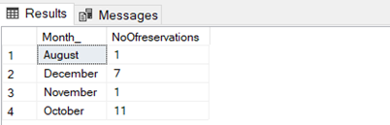

Which month had the maximum number of reservations?

Slide 9


Which month had the greatest number of service requests in 2019?

Slide 10
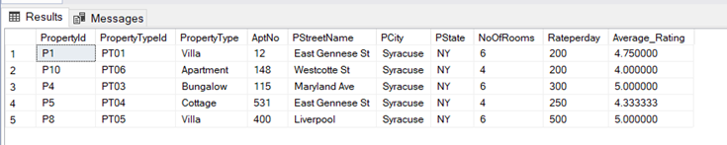
Which properties have received an average rating of more than 3?

Slide 11
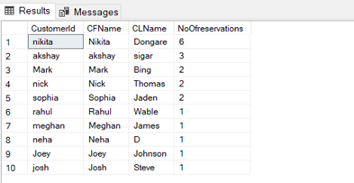
Which customer has made the maximum reservations between 2015 and 2019?

Slide 12

Which type of property was booked maximum number of times
e.g. villa, cottage, apartment or bungalows?

Slide 13
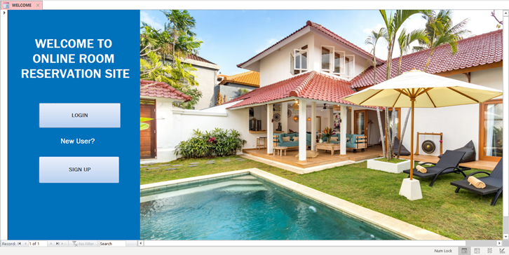
Interfaces:

Slide 14
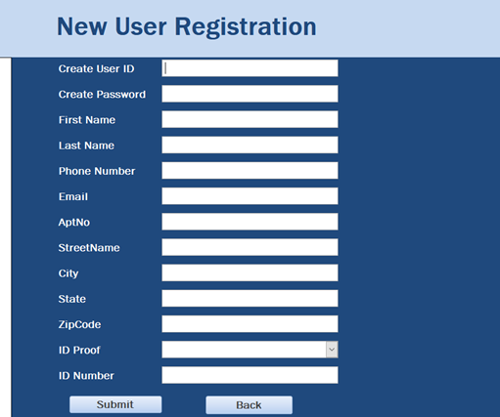
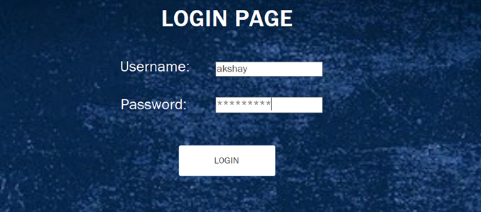
User Interface:

Slide 15
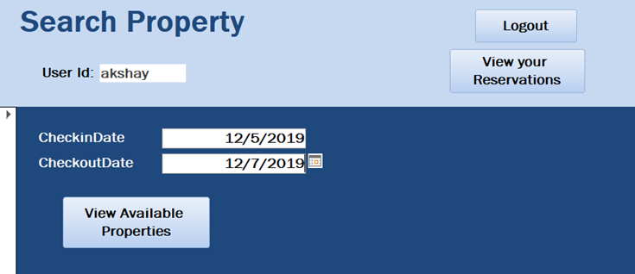
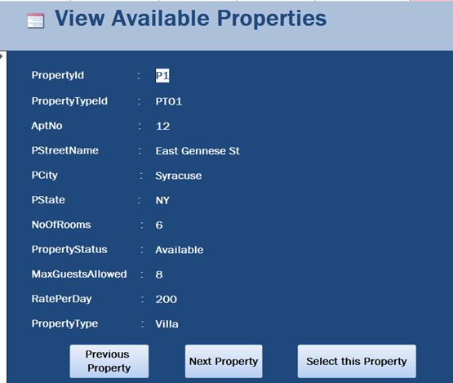

Slide 16
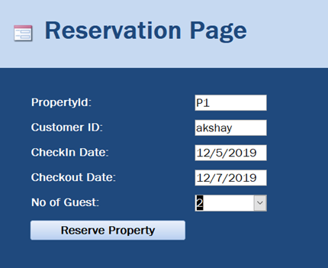
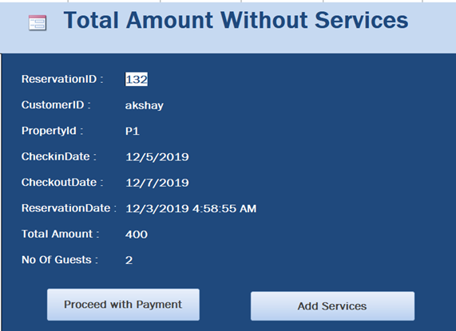

Slide 17
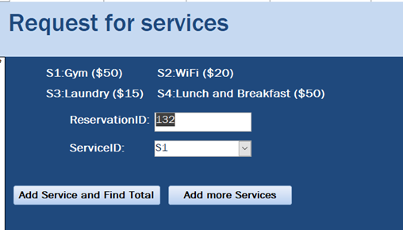
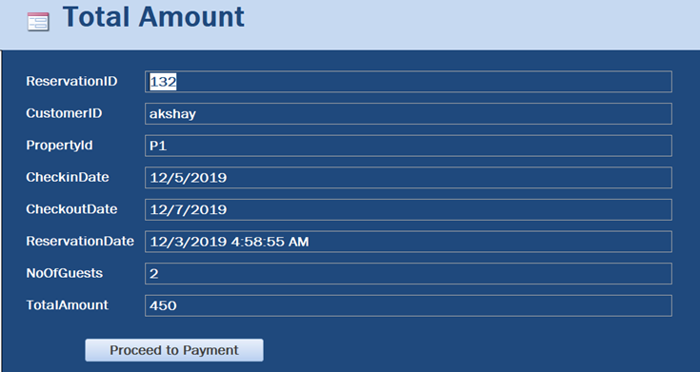

Slide 18
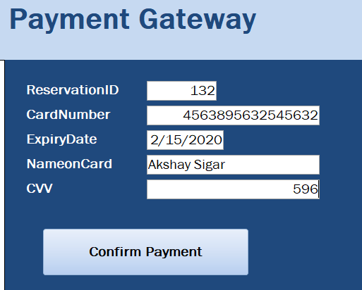
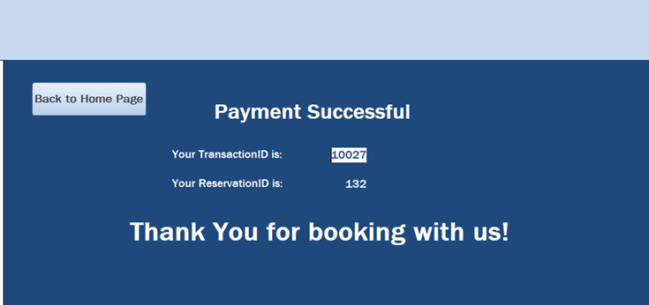

Slide 19
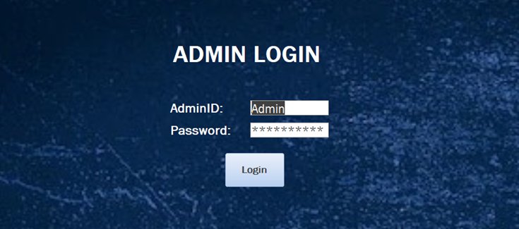
Admin Interface:

Slide 20
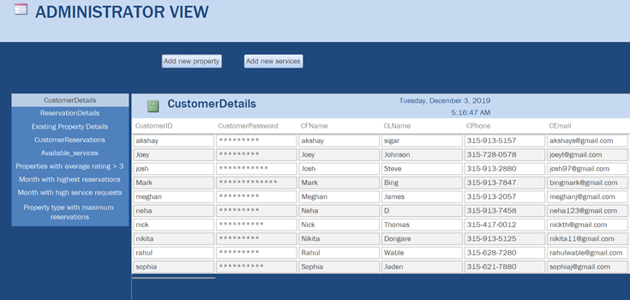
Different Reports in Administrator View:

Slide 21
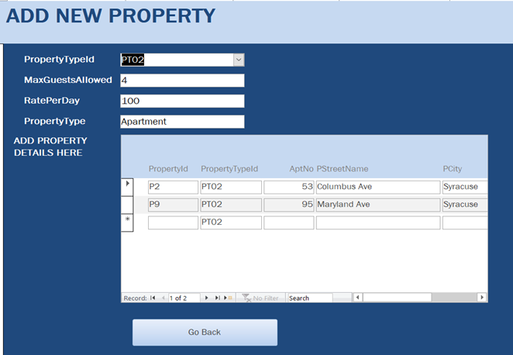
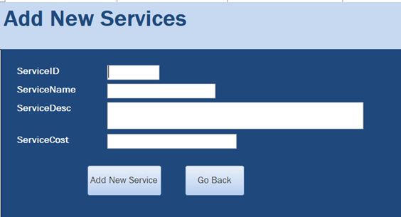

Slide 22
THANK YOU

