Slide 1
A General method of inferring species interactions using random matrix theory
Naika Dorilas

Slide 2
Goal:
The goal of my work this summer was to infer parameters of an interaction matrix between different species, given a set of data and a model of population growth using maximum likelihood. This means that we were trying to predict how species interact with one another and coexist in a specified ecosystem.
Notes:
Clarify why and how this is different from what people have previously done, time series ->matrix

Slide 3
Contents
Background
Methods
Results
Discussion
Notes:
First I will start off with some background about random matrix theory and the methods used in this paper: what it is, why it is useful in an ecological context, what is maximum likelihood and how all of these come together to achieve my goal
Then I will get into the methods where we will see how RMT played a large role in my idea: Some relevant results from random matrix theory that apply to my project, I will get a little bit into the calculations for maximum likelihood/ P(x|,mu,sigma,d) to solve for mu, sigma, d given my data set, the simulation of data to see how my likelihood equation behaves on a data set with no noise, the work done to extract parameter values from an arbitrary time series data set
And then get into my results: the values I obtained for my parameters as compared to their actual values and the behavior of my simulation output, more specifically the maximum likelihood given different parameter values
In the discussion I will address where I still want to go with this project

Slide 4

Background

Slide 5
What IS Random Matrix Theory?
Statistics + Matrix Theory
Allows us to generalize
Applications
Notes:
Random Matrix Theory is a combination of statistics and traditional matrix theory. In this field, many tools from statistics are used to describe matrices with random elements instead of relying on those individual elements. It allows us to generalize about certain characteristics of matrices with similar statistical properties. Many problems in physical systems modeling and biological systems modeling involve matrices with random entries

Slide 6
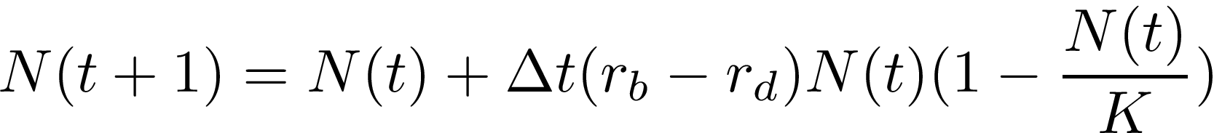
Why Is It Useful In An Ecological Context?
One dimensional population model
Interacting Species
Notes:
Traditionally in one-dimensional models of population growth, there are birth rates $r_b$, death rates $r_d$, and a carrying capacity, K. *Model*. Although, if we want to include the effects of other species on a single species, in ecological models of population growth across species we often include something called an interaction matrix. It describes the way that different species interact with each other and effect each others survival whether it be positively, negatively or with no effect at all. The simplest (Stochastic) model of populations size of the ith species in an ecosystem is given by
$y_i(t+1)=y(t) + \Delta t(A_ij * y_i +\xi_i)$
where $y_i(t)$ is the population of species i at time t, $\xi_i$ is random noise that might affect a species growth, and $A_ij$ is the matrix that describes the interactions between the species.
For my project I used this version of the equation and used small dt, which is similar to using the deterministic model

Slide 7
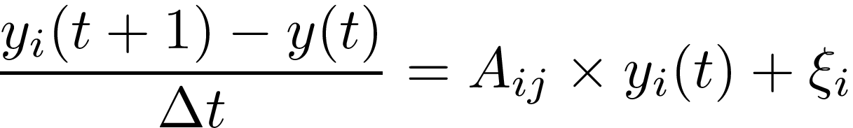
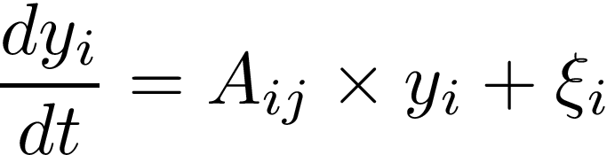


Slide 8

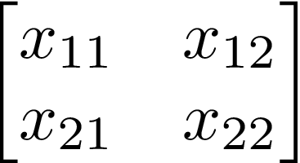
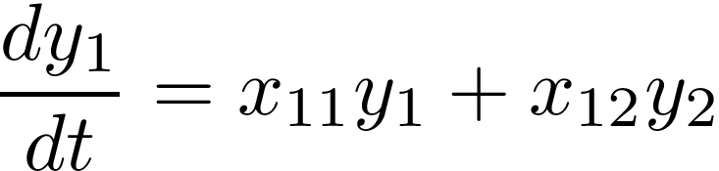
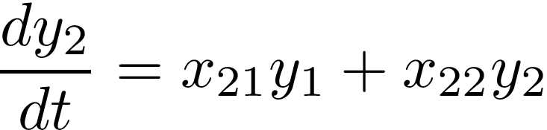
Two-Dimensional Interaction Case
Notes:
For a two species interaction case with interaction matrix on the left, the model can b expanded to the equations on the right

Slide 9
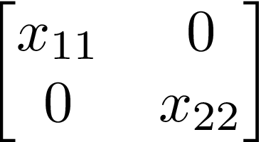
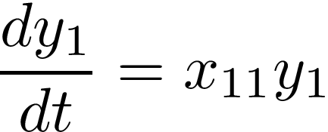
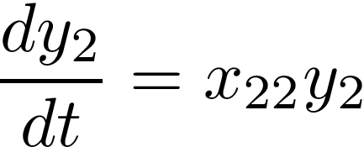
Example 1:
Notes:
In this case, for interaction matrix like the one on the left, the model expands to the equations on the right.
In both cases the species are only affecting themselves, and positively (the y2 term gets dropped from the first equation the y1 term get dropped form the2nd) so we would say that the species are not interacting

Slide 10
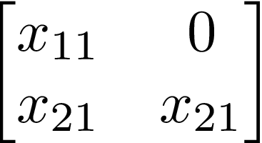

Example 2:
Notes:
In this case, for interaction matrix like the one on the left, the model expands to the equations on the right.
This is modeling commensalism between the two species. Species 1 is not being affected by the actions of species 2 but species 2 is positively benefiting from the actions of species 1

Slide 11
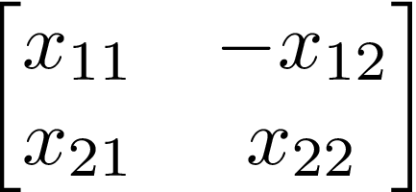
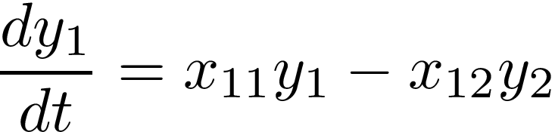
Example 3:
Notes:
In this case, for interaction matrix like the one on the left, the model expands to the equations on the right.
This is modeling parasitism between the two species. Species 1 is being negatively affected by the actions of species 2 but species 2 is positively benefiting from the actions of species 1

Slide 12
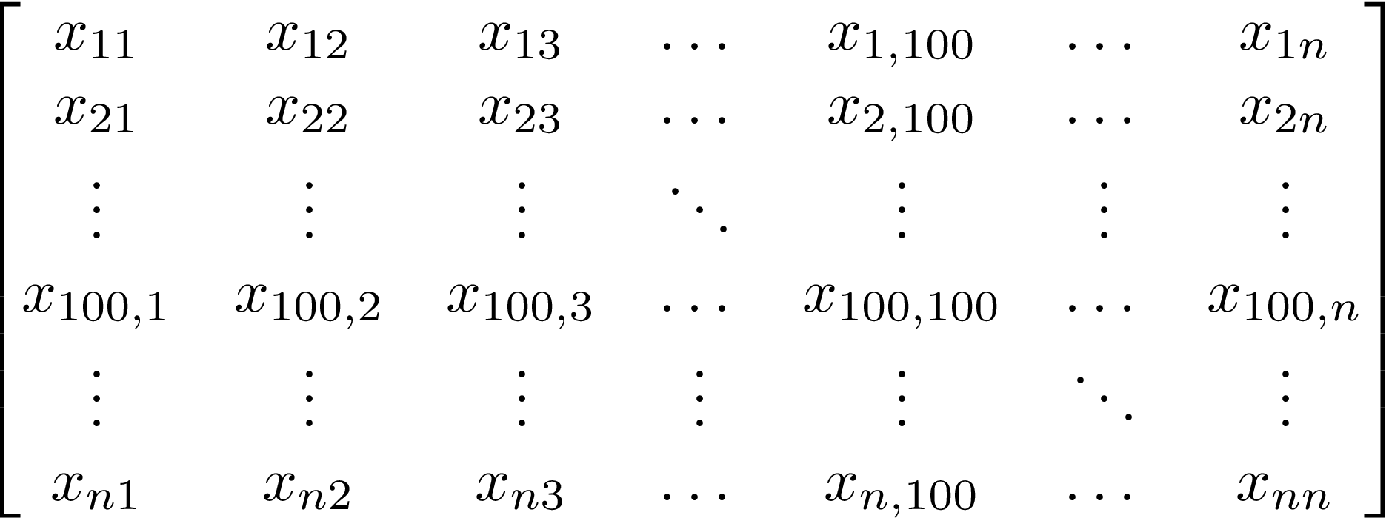
Imagine If We Had Larger Matrices
Random processes
Stability
RMT
Notes:
In biological systems many aspects of the environment and growth process are random, large and can vary over space and time. On top of that, the stability of a biological system is very pertinent, in an ecological context it determines the survival of species. Generally we look at the "community matrix", which for a population of S species is influenced by S equations for population growth. The community matrix looks at equilibrium solutions for these equations in small perturbations around the equilibria. We say a system is stable if when starting close to an equilibrium we stay close to that equilibria. Local stability can be determined by the eigenvalues of M. For higher dimensions, the exact entries of the matrix matter less than certain aspects about the distribution of their entries such as the mean, variance and diagonal elements. Different results from RMT allow us to say something about the distribution of eigenvalues given mu,sigma,d and therefore stability of an ecosystem

Slide 13


What Is Maximum Likelihood Estimation?
Parameter Estimation
Notes:
Model-f(x)
Parameters-p
Get likelihood of observing the model input x given the parameters p1:pn and maximize this likelihood. This gives us back the parameter values that make the data the most probable

Slide 14
Statistical Properties
Mu
Sigma
d

Slide 15

How Does All of This Tie In With My Goal?
Stable, symmetric matrix A
Generate time series data
Find maximum P(x|mu, sigma,d)
Notes:
We start with a stable symmetric matrix A which allows us to do a lot in terms of our computations, then generate time series data and I find the maximum likelihood of x given mu, sigma, d,
Clarify why and how this is different from what people have previously done, time series ->matrix

Slide 16
Methods

Slide 17
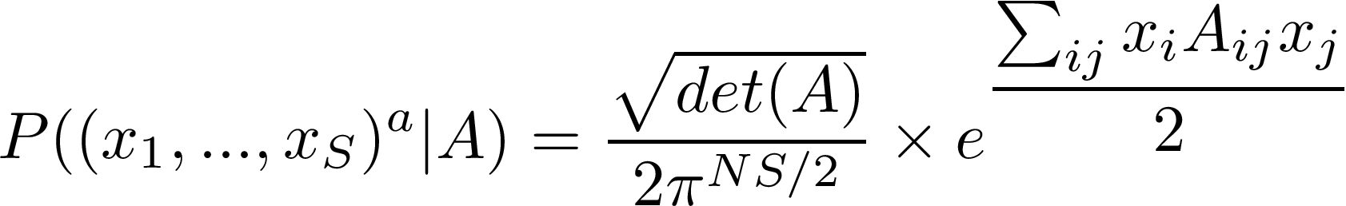
How did we generate the data?
“Snapshots” of time series data
Notes:
We took Data from discrete time steps. Generated X from a multivariate normal distribution of means mu* and covariance matrix C. We did this because our assumption of X in our calculations is that it comes from P(x|A) and to make sure this method for inferring parameters is valid, we want to make sure it works when our data perfectly fits our assumption

Slide 18


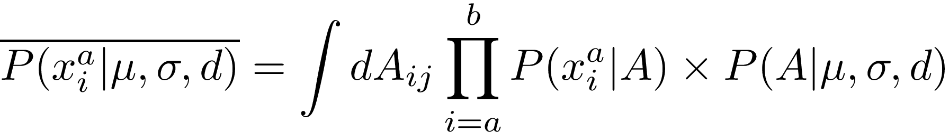
How Did I Derive The Maximum Likelihood Equation?
Goal: maximize
independent
Notes:
Our goal is to maximize **, Since x_i^a are independent, the average probability of observing them given, mu,sigma, d is given here
##columns not correlated rows are get rid of I

Slide 19
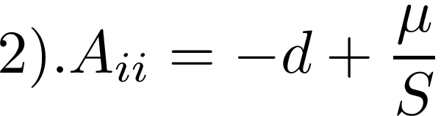
Assumptions:
Notes:
To simplify our calculations we assume A is an SxS symmetric matrix and so that the variables, mu, sigma, d appear in the likelihood so that we can maximize likelihood with respect to them 1) Aij=M/S +Bij where Bij~N(0, sigma^s/S) which is equivalent to saying Aij~N(m/S,sigma^2/S). 2) The diagonals Aii=-d+mu/S, and 3) . that the detA for large A are very close to each other. The determinant of a matrix A is given by the multiplication of its eigenvalues so we use the semicircular law from RMT to compute the average log determinant, log for simplicity reasons.

Slide 20
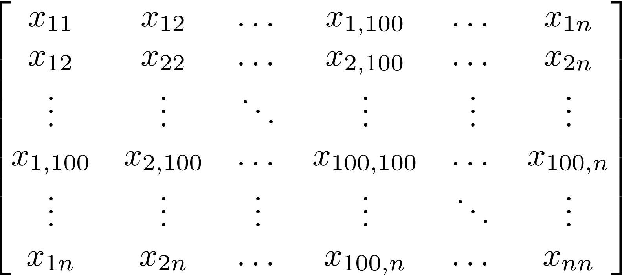
What Results From RMT Are Relevant to My Project?
Semicircular law-Wigner (1955)
Notes:
Wigner theorized that the distribution of eigenvalues for a symmetric matrix A whose entries were randomly generated independentely by a given distribution with mean: mu, variance :sigma and average diagonal elements d lie on a semicircular centered at d with diameter 2sigma

Slide 21
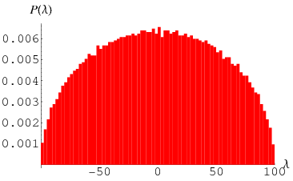
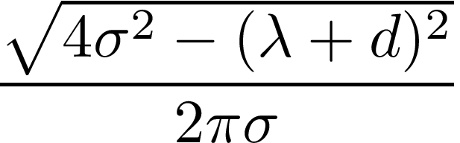
Notes:
The distribution of eiqenvalues is given by the equation sqrt(4sigma^2-(lambda+d)^2)/2pi sigma, and if we plot the eigen values of a symmetric matrix with entries from a standard normal distribution, we get this figure on the right

Slide 22


Slide 23
Notes:
Since we are taking the average determinant of A we replace that term with D. The P(x|mu,sigma,d) becomes the equation above and when we take log and multiply by 2/N we get the equation below which is a more or less simplified version of the log likelihood.

Slide 24
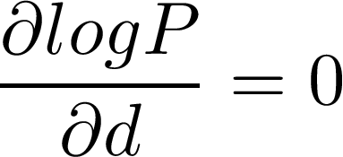
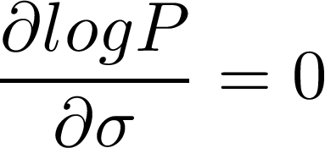
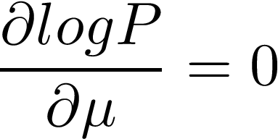
Maximization:
Notes:
So then we take the partial derivate of log P wrt mu,sigma and d, set them equal to 0 and solve them for mu sigma and d
##rhs vs lhs

Slide 25
Results

Slide 26

How did we know this method was valid?
simulated vs analytical log determinant
Notes:
We graphed the expected value of mu vs the actual value and the simulated log determinants vs the actual log determinants

Slide 27
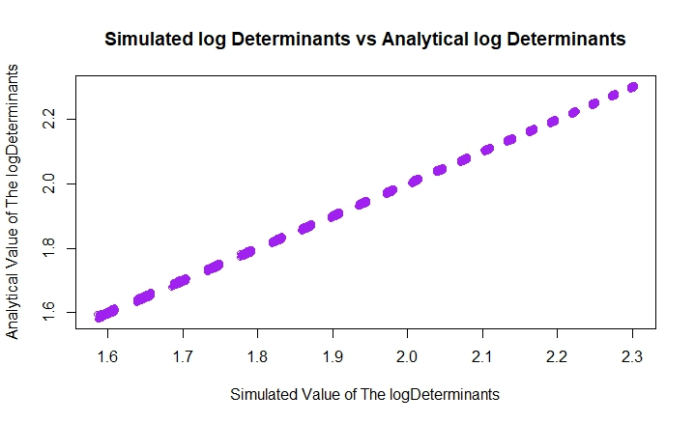
The average log determinant estimation is accurate
Notes:
We computed the average log determinants computed by generating matrices with different mu,sigma and d and then computing their determinants vs. the value of the log determinant of A based on Wigner’s formula using the same mu, sigma and d. We computed them separately for mu->-3:3, sigma->):1.5, d->4:10 then plotted them against eachother to make sure the values correspond

Slide 28
What Did My Maximum Likelihood Equations Predict?
expected value of mu, sigma, d vs. actual value
Notes:
My simulation predicted that the optimal mu,sigma and d, given my assumptions would be as follows

Slide 29
Discussion

Slide 30
Summary

Slide 31
Future Directions
Using real data
Multiple data sets
Sensitivity Analysis
Notes:
In the future I would like to use real world data sets of different species, and maybe even try multiple data sets and see how different types of data fare under this method. It would also be cool to do some sensitivity analysis to see how much error exists for different data sets

