Slide 1
A General method of inferring species interactions using random matrix theory
Naika Dorilas
Mentors: Jacopo Grilli & Andy Rominger

Slide 2
Goal:
My goal was to infer parameters of a matrix that describes how species interact, given a set of data. So based on a specified ecosystem I’m trying to find a method of inferring the statistical properties of the interaction of different species based on a simple model of population fluctuation.
Notes:
So basically, The objective was to infer parameters of a matrix that describes how species interact, given a set of data. So based on a specified ecosystem I’m trying to find a method of inferring the statistical properties of the interaction of different species based on a simple model of population fluctuation.

Slide 3
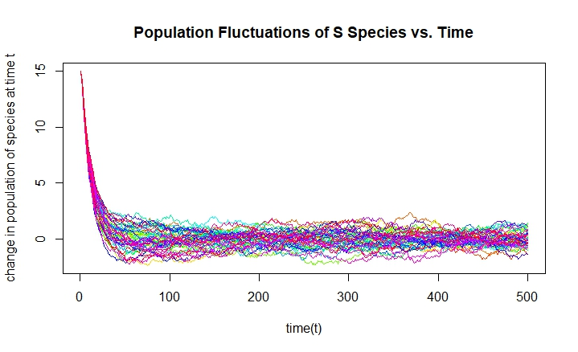
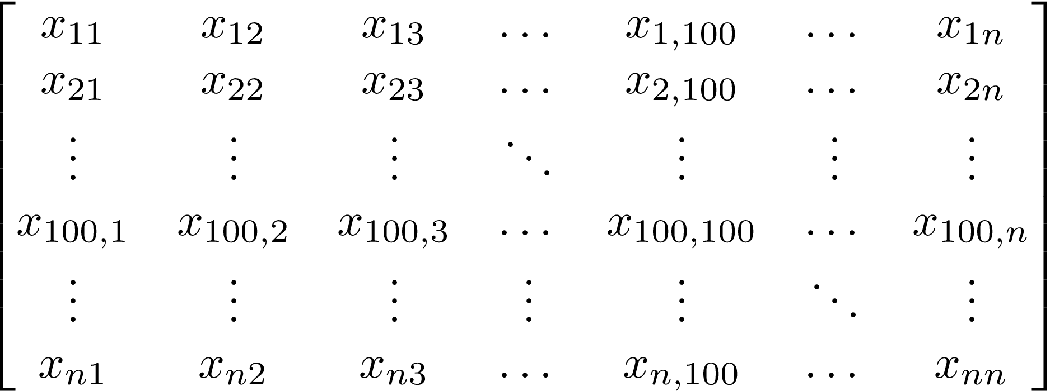

Notes:
Generally many people try to infer the exact matrix A that describes how a given set of species interact, but what I’m doing is inferring 3 statistical properties about a randomly created symmetric and stable interaction matrix from a set of data. So not trying to find the exact entries of the matrix, but the parameters that can generate a random interaction matrix that fits the species data.

Slide 4
Contents
Background
Methods
Results
Discussion
Notes:
First I will start off with some background about random matrix theory and the methods used in this paper: what it is, why it is useful in an ecological context, what is maximum likelihood and how all of these come together to achieve my goal
Then I will get into the methods where we will see how RMT played a large role in my idea: Some relevant results from random matrix theory that apply to my project, I will get a little bit into the calculations for maximum likelihood/ P(x|,mu,sigma,d) to solve for mu, sigma, d given my data set, the simulation of data to see how my likelihood equation behaves on a data set with no noise, the work done to extract parameter values from an arbitrary time series data set
And then get into my results: the values I obtained for my parameters as compared to their actual values and the behavior of my simulation output, more specifically the maximum likelihood given different parameter values
In the discussion I will address where I still want to go with this project

Slide 5

Background

Slide 6
What IS Random Matrix Theory?
Statistics + Matrix Theory
Allows us to generalize
Applications
Notes:
Random Matrix Theory is a combination of statistics and traditional matrix theory. In this field, many tools from statistics are used to describe matrices with random elements instead of relying on those individual elements. It allows us to generalize about certain characteristics of matrices with similar statistical properties. Many problems in physical systems modeling and biological systems modeling involve matrices with random entries

Slide 7
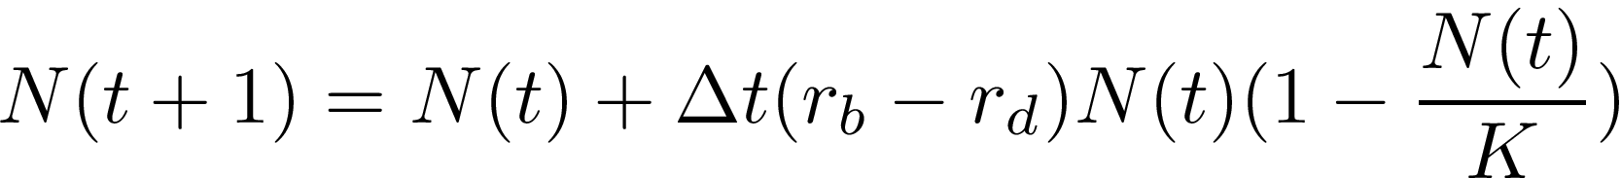
Why Is It Useful In An Ecological Context?
One dimensional population model
Interacting Species
Notes:
Traditionally in one-dimensional models of population growth population at the next time step depends on birth rates $r_b$, death rates $r_d$, and a carrying capacity, K. *Model*. Although, if we want to include the effects of other species on a single species, in ecological models of population growth across species we often include something called an interaction matrix. It describes the way that different species interact with each other and effect each others survival whether it be positively, negatively or with no effect at all. The simplest “linearized”(Stochastic) model of populations size of the ith species in an ecosystem is given by
$y_i(t+1)=y(t) + \Delta t(A_ij * y_i +\xi_i)$
where $y_i(t)$ is the population of species i at time t, $\xi_i$ is random noise that might affect a species growth, and $A_ij$ is the matrix that describes the interactions between the species.

Slide 8
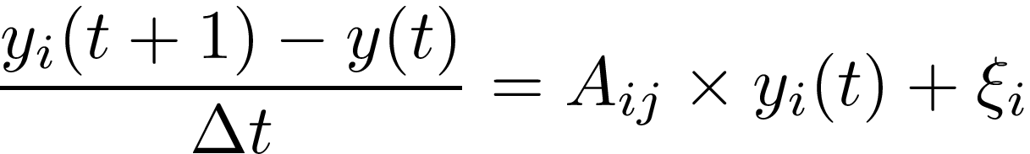
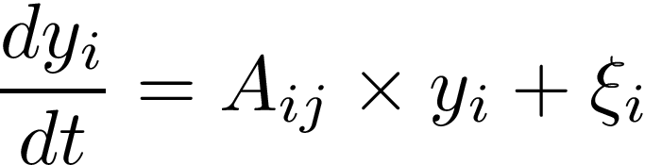

Notes:
If we rearrange the terms and allow dt to go to 0 then we get this differential equation model which I will use to explain how to interpret an interaction matrix in terms of a simple model

Slide 9

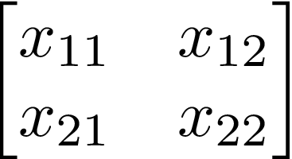
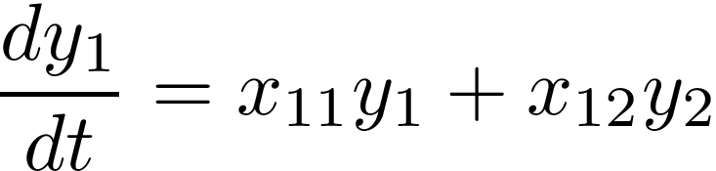
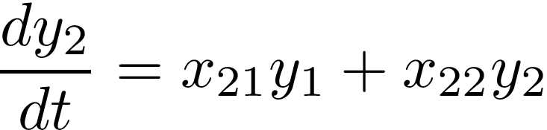
Two-Dimensional Interaction Case
Notes:
For a two species interaction case with interaction matrix on the left, the model can b expanded to the equations on the right

Slide 10
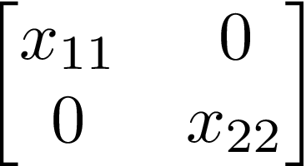
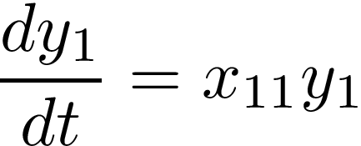
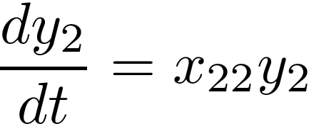
Example 1:
Notes:
In this case, for interaction matrix like the one on the left, the model expands to the equations on the right.
In both cases the species are only affecting themselves, and positively (the y2 term gets dropped from the first equation the y1 term get dropped form the2nd) so we would say that the species are not interacting

Slide 11
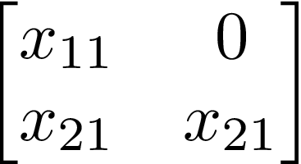

Example 2:
Notes:
In this case, for interaction matrix like the one on the left, the model expands to the equations on the right.
This is modeling commensalism between the two species. Species 1 is not being affected by the actions of species 2 but species 2 is positively benefiting from the actions of species 1

Slide 12
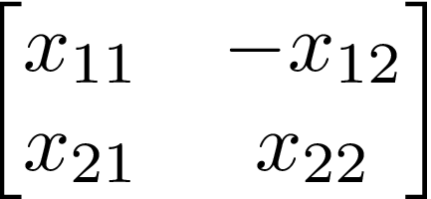
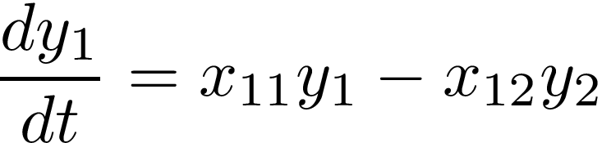
Example 3:
Notes:
In this case, for interaction matrix like the one on the left, the model expands to the equations on the right.
This is modeling parasitism between the two species. Species 1 is being negatively affected by the actions of species 2 but species 2 is positively benefiting from the actions of species 1

Slide 13
Imagine If We Had Larger Matrices
Random processes
Stability
RMT
Notes:
In biological systems many aspects of the environment and growth process are random, large and can vary over space and time. On top of that, the stability of a biological system is very pertinent, in an ecological context it determines the survival of species. Generally we look at the "community matrix", which for a population of S species is influenced by S equations for population growth. The community matrix looks at equilibrium solutions for these equations in small perturbations around the equilibria. We say a system is stable if when starting close to an equilibrium we stay close to that equilibria. Local stability can be determined by the eigenvalues of M. For higher dimensions, we can look directly at A and the exact entries of the matrix matter less than certain aspects about the distribution of their entries such as the mean, variance and diagonal elements. Different results from RMT allow us to say something about the distribution of eigenvalues given mu,sigma,d and therefore stability of an ecosystem

Slide 14


What Is Maximum Likelihood Estimation?
Parameter Estimation
Notes:
Model-f(x)
Parameters-p
Get likelihood of observing the model input x given the parameters p1:pn and maximize this likelihood. This gives us back the parameter values that make the data the most probable

Slide 15

How Does All of This Tie In With My Goal?
Stable, symmetric matrix A
Generate time series data
Find maximum P(x|mu, sigma,d)
Notes:
We start with a stable symmetric matrix A which allows us to do a lot in terms of our computations, then generate time series data and I find the maximum likelihood of x given mu, sigma, d,
And again, instead of going from time series data to a specific matrix I’m going from time series data to matrix’s statistical properties, meaning any matrix that follows these properties can be used to infer species interaction for that data set.

Slide 16
Methods

Slide 17
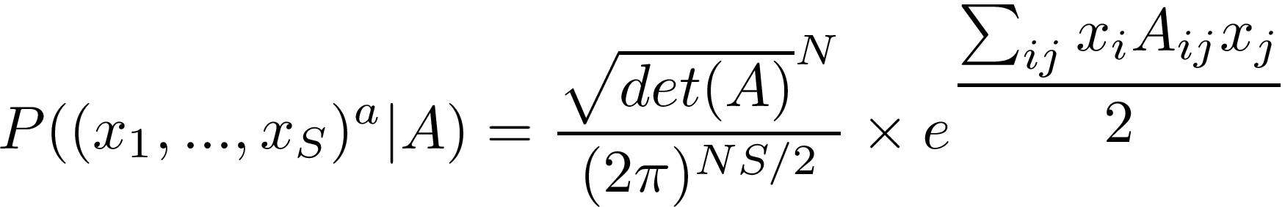
How did we generate the data?
“Snapshots” of time series data
Notes:
Generated X from a multivariate normal distribution. We did this because our assumption of X in our calculations is that it comes from P(x|A) and to make sure this method for inferring parameters is valid, we want to make sure it works when our data perfectly fits our assumption

Slide 18
Notes:
We took Data from discrete time steps.

Slide 19


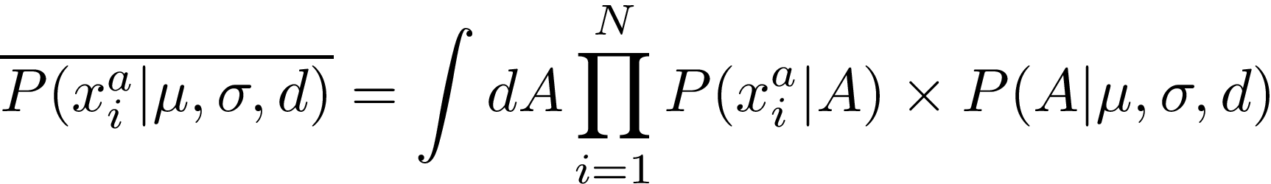
How Did I Derive The Maximum Likelihood Equation?
Goal: maximize
independent
Notes:
Our goal is to maximize **, Since x^a are independent, the average probability of observing them given, mu,sigma, d is given here

Slide 20
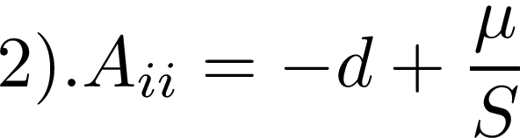
Assumptions:
Notes:
To simplify our calculations we assume A is an SxS symmetric matrix and so that the variables, mu, sigma, d appear in the likelihood so that we can maximize likelihood with respect to them 1) Aij=M/S +Bij where Bij~N(0, sigma^s/S) which is equivalent to saying Aij~N(m/S,sigma^2/S). 2) The diagonals Aii=-d+mu/S, and 3) . that the detA for large A are very close to each other. The determinant of a matrix A is given by the multiplication of its eigenvalues so we use the semicircular law from RMT to compute the average log determinant, log for simplicity reasons.

Slide 21
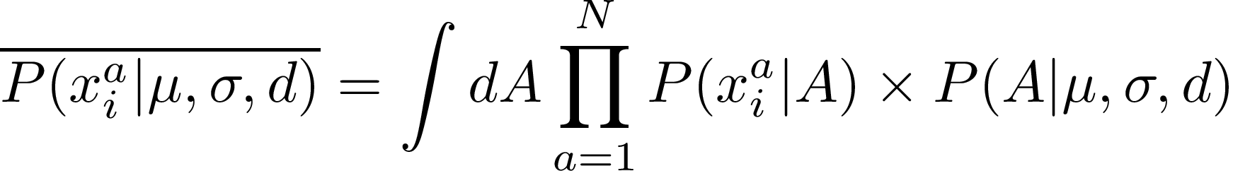
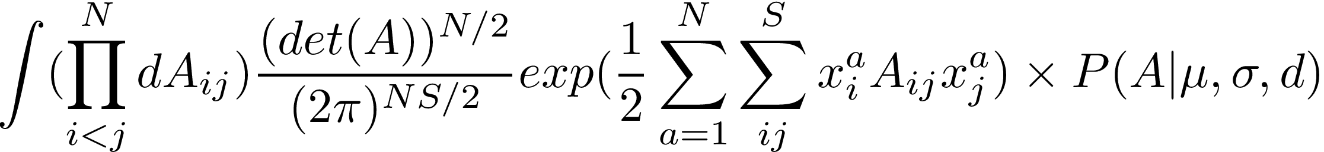
Notes:
Just to clarify, N is the number of data point taken for each species and S is the number of species. The first part of the integral simplifies to this:, we only need to integrate over the top half of A because A is symmetric and we can separate the term for the detA if we make an assumption.

Slide 22
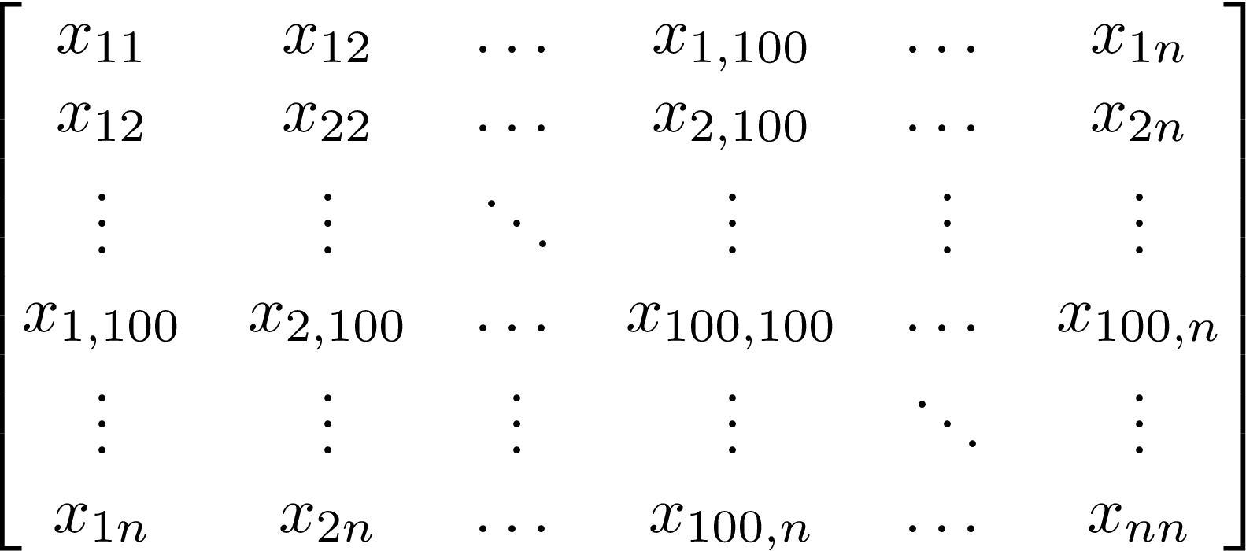
Relevant Results from RMT?
Semicircular law-Wigner (1955)
Notes:
So my assumption is based on a law from RMT. Physicist Eugene Wigner theorized that the distribution of eigenvalues for a symmetric matrix A whose entries were generated randomly and independently by a given distribution with mean: mu, variance :sigma and average diagonal elements d lie on a semicircular centered at d with diameter 2sigma

Slide 23
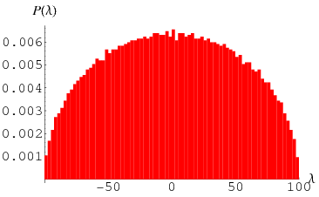
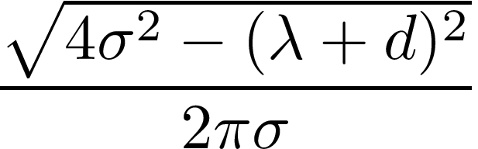
Notes:
The distribution of eiqenvalues is given by the equation sqrt(4sigma^2-(lambda+d)^2)/2pi sigma, and if we plot the eigen values of a symmetric matrix with entries from a standard normal distribution, we get this figure on the right

Slide 24
Assumptions:
Notes:
So this brings me to our third assumption which is that the average determinants for large matrices are very similar, so in our equation we replace the detA with the formula for the average log Determinant of A given by the semicircular law

Slide 25
Notes:
Since we are taking the average determinant of A we replace that term with D. The P(x|mu,sigma,d) becomes this equation and when we take log and multiply by 2/N we get the equation below which is a more or less simplified version of the log likelihood.

Slide 26
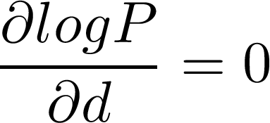
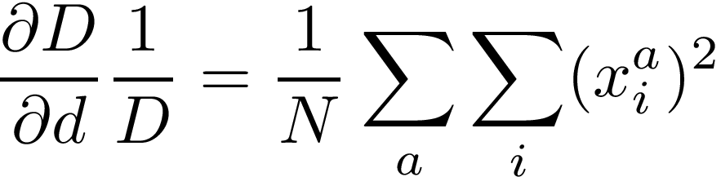
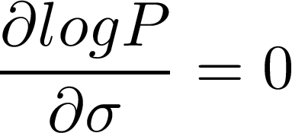
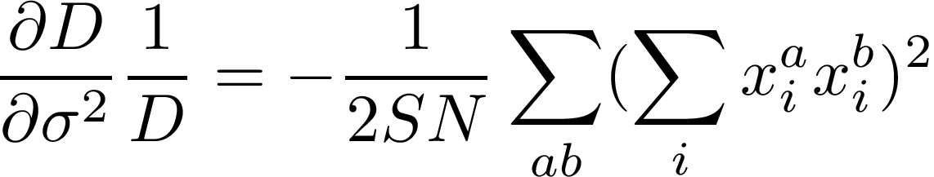
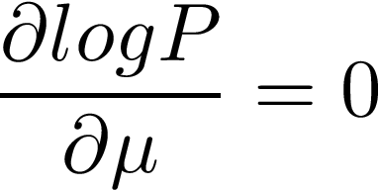
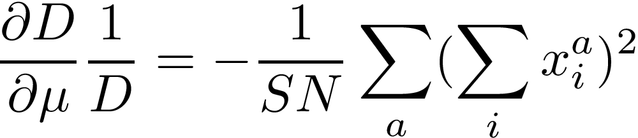
Maximization:
Notes:
So then we take the partial derivate of log P wrt mu,sigma and d, set them equal to 0 and solve them for mu sigma and d
Those partial derivatives become the equations on the right. The partial of the log determinant wrt d, sigma, mu set equal these sums

Slide 27
Results

Slide 28

How did we know this method was valid?
simulated vs analytical log determinant
Rhs vs Lhs of maximization equations
Optimization functions vs parameters
Notes:
We graphed the simulated log determinants vs the analytical log determinants , the Rhs vs Lhs of the maximization equations, the output our optimization function for different mu,sigma,d

Slide 29
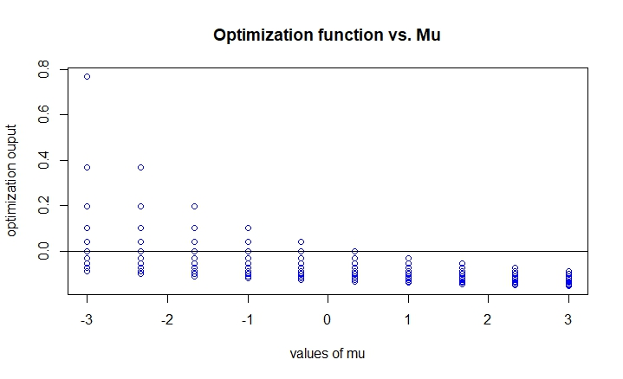
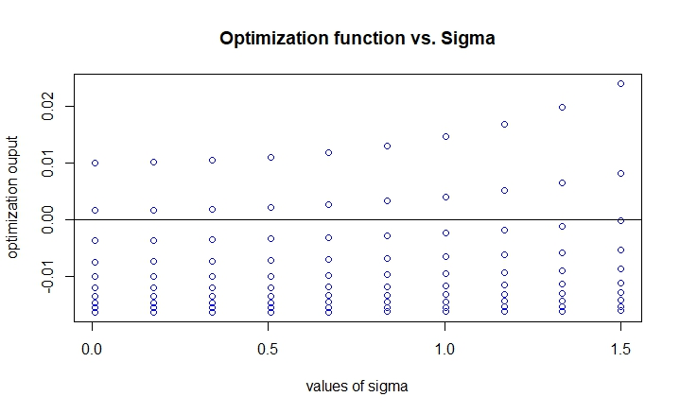
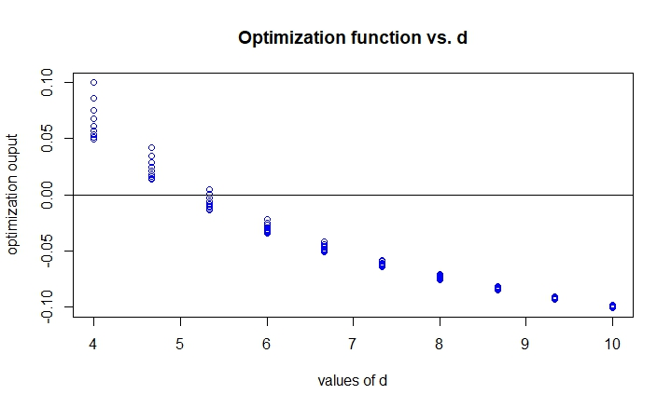
There should be at least one root
Notes:
We computed the partial derivatives of the log likelihood wrt mu,sigma, d and plotted them against mu,sigma and d respectively. What we are looking for is where this is equal to 0. As you can see, the horizontal line at y=0 shows for what values it is equal to 0 and just by looking at the graphs, intuitively, we should be able to find the roots for these equations.

Slide 30
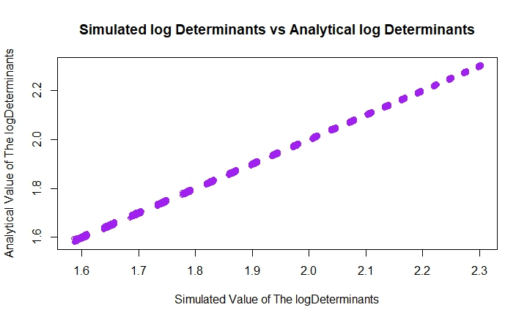
The average log determinant estimation is accurate
Notes:
We computed the average log determinants computed by generating matrices with different mu,sigma and d and then computing their determinants vs. the value of the log determinant of A based on Wigner’s formula using the same mu, sigma and d. We computed them separately for mu->-3:3, sigma->):1.5, d->4:10 then plotted them against eachother to make sure the values correspond

Slide 31
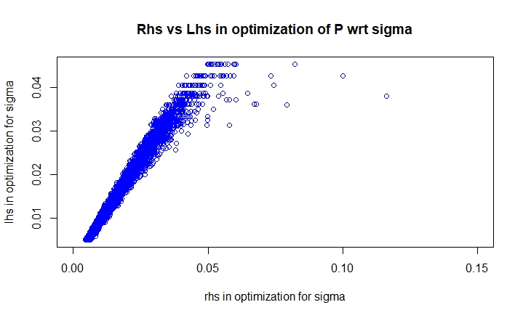
The maximization equations are also valid

Slide 32
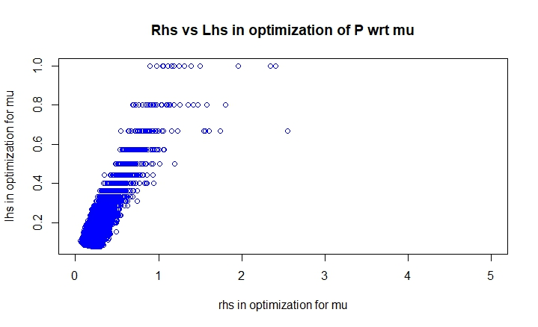

Slide 33
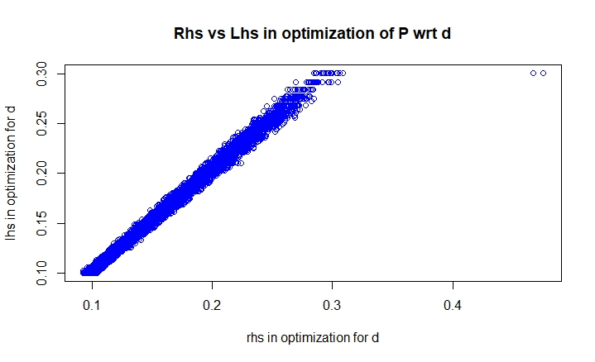

Slide 34
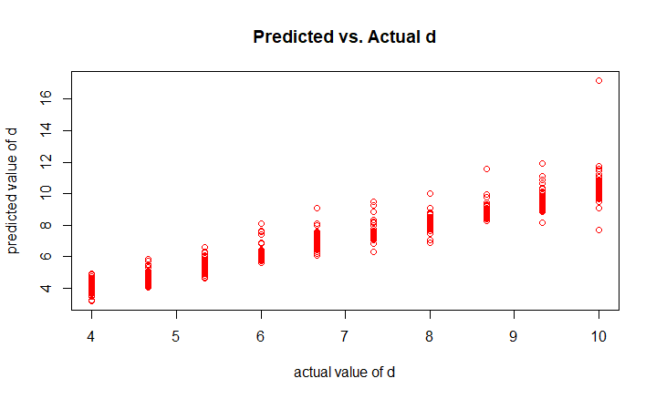
What Did My Maximum Likelihood Equations Predict?
Notes:
We know that this method is actually valid, and now actually solving for mu, sigma,d we ran into technical issues with different rootsolvers in R for mu and sigma, but for d, we got a more or less accurate solution. In this graph we are varying mu sigma and d, but only plotting d, against the predicted values of d, these values are pretty close to the actual values of d.

Slide 35
Discussion

Slide 36
Impact
Key aspects of A
Notes:
The impact of doing this method successfully is that hopefully we will be able to determine the key aspects of interaction given a specific data set and not have to infer an exact matrix. So we would be able to say that any random interaction matrix with those parameters mu, sigma and d would be able to describe how the species in that given data set interact.

Slide 37
Future Directions
Using real data
Multiple data sets
Sensitivity Analysis
Change other parameters
Notes:
In the future I would like to use real world data sets of different species, and maybe even try multiple data sets and see how different types of data fare under this method. It would also be cool to do some sensitivity analysis to see how much error exists for different data sets, we can also see what happens if we include another parameter, which is the correlation rho.

Slide 38
Thank You!

