Slide 1

IMDb Movie Chatbot
A Naive RAG Application by Nitin Pawar
NSS DS-08 Capstone Project 2025

Slide 2
Motivation for the Project
End-to-End Learning Opportunity : Combine data engineering, AI, and app development in one project.
Hands-On with RAG Architecture : Build a real-world semantic search + RAG pipeline, a fast-growing AI use case
Modern AI Relevance : Semantic search and RAG are central to intelligent assistants and contextual query engines.
Skill Enhancement : Strengthens expertise in embedding generation, vector search, and retrieval workflows

Slide 3
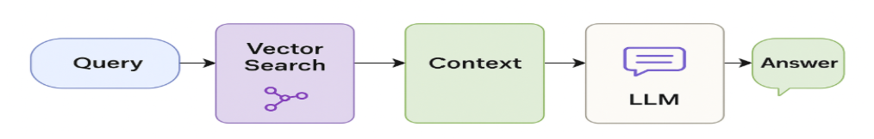
IMDb Project & RAG Components
This project demonstrates an end-to-end Naive RAG system using :
IMDb movie metadata, ratings, crew, principals (Data Source)
PostgreSQL + pg vector for vector search (Retrieval)
Sentence Transformers for embedding generation (Embedding Model)
LLM (Open AI Free version) (Generator)
Answer Format - Natural language responses contextualized to retrieved movies
Streamlit frontend for user interaction
This chatbot enables semantic search over movies + people data, providing natural language answers to the movie-related queries.

Slide 4
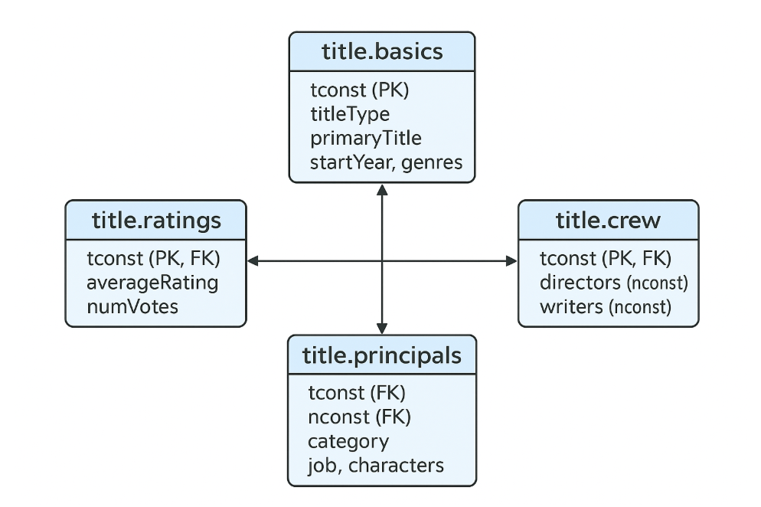
Understanding Data Source
IMDb’s datasets at https://datasets.imdbws.com/ comprise seven tab-separated, gzipped files. They are interrelated by the identifiers to form relations.

Slide 5
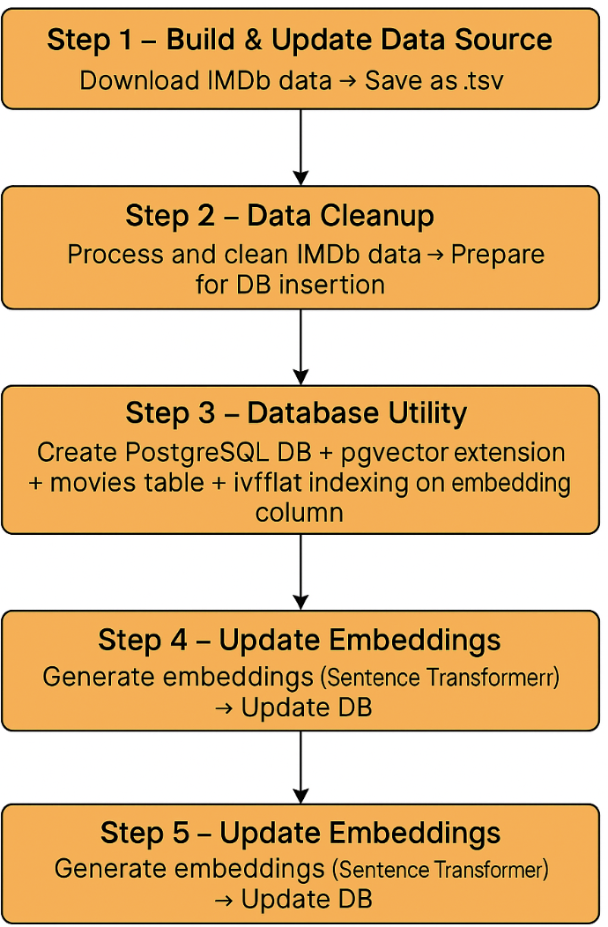
High Level Flow

Slide 6
Installing pgVector Extension
Install PostGreSQL
Version 16 and above
Enable C++ support into VS
Click here for details
Build pgVector extension
Run nmake commands
Create extension in DB
Run below command-
Go to - C:\Program Files\Microsoft Visual Studio\2022\Community\VC\Auxiliary\Build
call "C:\Program Files\Microsoft Visual Studio\2022\Community\VC\Auxiliary\Build\vcvars64.bat"
set "PGROOT=C:\Program Files\PostgreSQL\16"
cd C:\Users\nitin\Documents\NSS\NSS_Projects\pgvector
nmake /F Makefile.win
nmake /F Makefile.win install
The installation details are available here - https://github.com/pgvector/pgvector

Slide 7


Step 1. IMDb Data Download Script
Downloads and decompresses selected IMDb datasets from https://datasets.imdbws.com
Key Operations Defines 5 core IMDb .tsv.gz files to download. Downloads each file via urllib.request.urlopen(). Decompresses the .gz files in memory using Python gzip module. Saves the extracted .tsv files to a local download/ directory
Output A local copy of each IMDb TSV file in uncompressed format for further processing.

Slide 8
Step 2. Data Cleanup
Prepare IMDb principal and metadata files for clean ingestion into PostgreSQL and embedding.
Merge IMDb datasets Merge title.principals.tsv with cleaned title.basics.tsv and name.basics.tsv. Joins enrich principal data with movie metadata (e.g., title, genres, year) and person info (e.g., name, birthYear). Ensures consistent tconst and nconst references across datasets.
Filter Principal -title Entries Pick movies (titles) with votes 10K or more. Filter Principal dataset with valid movies from titles.. Remove special characters from characters (Principal) and only select 10 characters or roles per title.
Clean characters Column Drop rows where character info is missing. Remove special characters like brackets, quotes; retain plain names (e.g., ["ABC"] → "ABC").
Output Build final summary string. These summaries become the foundation for semantic embedding and retrieval. The data is stored in movies.csv for further processing.

Slide 9
Step 2. Output..
String that is captured in table for embedding
Movie "The Shawshank Redemption" released in year 1994, is a Drama film, directed by "Frank Darabont", written by "Stephen King, Frank Darabont", with a runtime of 142 minutes, rated 9.3/10 on IMDb, based on 3038716 votes., The top casting is as follow : Character "Andy Dufresne" played by actor "Tim Robbins", Character "Ellis Boyd Red Redding" played by actor "Morgan Freeman", Character "Warden Norton" played by actor "Bob Gunton", Character "Heywood" played by actor "William Sadler", Character "Captain Hadley" played by actor "Clancy Brown", Character "Tommy" played by actor "Gil Bellows", Character "Bogs Diamond" played by actor "Mark Rolston", Character "Brooks Hatlen" played by actor "James Whitmore", Character "1946 DA" played by actor "Jeffrey DeMunn", Character "Skeet" played by actor "Larry Brandenburg"

Slide 10
Step 3. Database Utility
Create and configure the PostgreSQL database, enable vector support, and initialize the movies table.
Key Actions
Database Setup : Connects to PostgreSQL and checks if the imdb database exists; creates it if not
Enable pgvector Extension : Ensures the vector extension is enabled to support embedding storage and similarity search
Create movies Table : Defines schema with mov_id (primary key), mov_details (text), and embedding (vector of 384 dimensions). If the table exists, deletes all existing records to refresh with new data.
Insertion : Final database set up to support full vector search.
Output
Table structure along with vector supported column ready for insertion and embedding.

Slide 11
Step 4. Populate Movie Records
Insert movie metadata into the PostgreSQL database with placeholder embeddings..
Key Actions
Read Data : Loads a CSV file (movies.csv) containing movie IDs and textual descriptions.
Database Connection : Establishes a connection to the imdb PostgreSQL database using psycopg2.
Insert Records : Iterates over each movie row in the DataFrame. Executes an INSERT SQL statement for each row with: mov_id, mov_details, and embedding set as NULL..
Insertion : Final database set up to support full vector search.
Output
The movies table is populated with metadata, ready for embedding in the next step.

Slide 12
Step 5. Update Embeddings in Database
Generate and store sentence embeddings for each movie's textual metadata using Hugging Face transformer.
Key Actions
Connect to PostgreSQL : Establishes connection to the imdb database.
Select Records Needing Embeddings : Queries all rows from the movies table where the embedding column is NULL.
Generate Embeddings : Uses Sentence Transformer model all-MiniLM-L6-v2 to embed mov_details
Update Database: Stores each generated embedding vector back into the movies table against its mov_id.
Output
Movies now have semantic embeddings, enabling similarity-based retrieval and RAG functionality in the next steps.

Slide 13
Step 6. Interactive Movie Chatbot
Build a conversational chatbot that answers movie-related questions using semantic search and LLM-generated responses.
Query Flow : 1.User question is embedded 2. Vector search on `movies` table retrieves top matches 3. Context is constructed from movie details 4. LLM prompt is dynamically generated 5. LLM responds with a natural language answer
Output
A user-friendly, movie-aware chatbot that demonstrates real-world Retrieval-Augmented Generation (RAG).
Sample Questions and Answers - chat
Check the screen recording to see sample chat

Slide 14
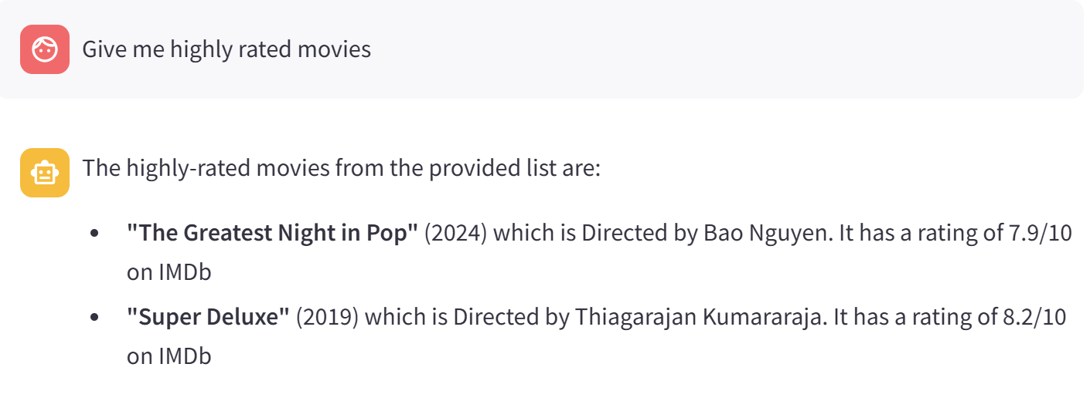
Let’s chat!
Tip
Ask questions like -
Suggest movies like “Jurassic Park”
Ask about specific actor or actress
Movies about foreign languages
Note : The semantic search doesn't work on numbers like ratings because Semantic search ranks results based on vector similarity, not business logic (like rating or vote count). See example below -

Slide 15
Questions?

