Slide 2
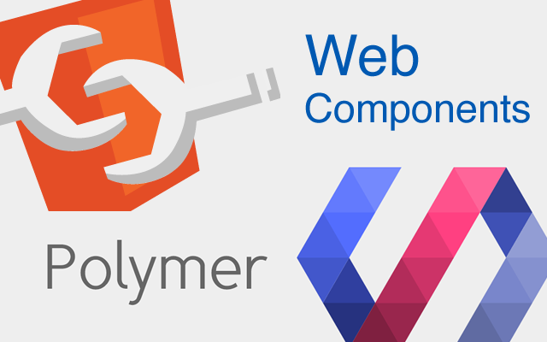
Web Components and Polymer

Slide 3
Agenda
What are Web Components?
What is Polymer?
Q & A
How to use Polymer?
Notes:
+ Show todo-apps

Slide 4
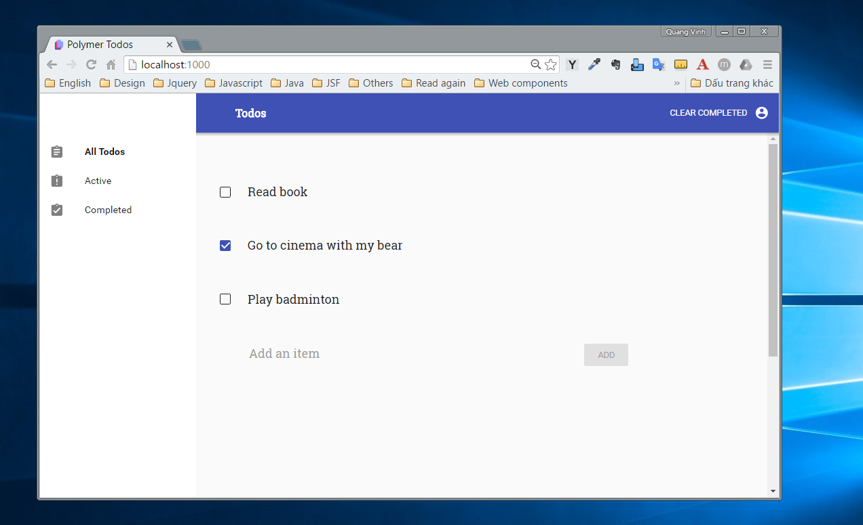

Slide 6
TODO-LIST

Slide 7
TODO-ITEM
Notes:
+ item sua mot lan anh huong tat ca cac trang trong web site va tham chi dua cai item nay len mang, app khac van su dung dc.
+ item going nhau ve style, behavior.

Slide 8

What are Web Components

Slide 9
What are Web Components?
You can think of Web Components as reusable user interface widgets that are created using open Web technology.
Notes:
An existing Web Component can be used without writing code, simply by adding an import statement to an HTML page.

Slide 10
What are Web Components?
Shadow DOM
Custom Elements
Templates
HTML Imports

Slide 11
Shadow DOM

Slide 12
Shadow DOM
Shadow DOM is a new part of the HTML spec which allows developers to encapsulate their HTML markup, CSS styles and JavaScript.

Slide 13


Shadow DOM
Notes:
There's a play button, a scrubber, timecodes and a volume slider.
Lots of stuff that you didn't have to write any markup for, it just appeared when you asked for <audio>.
The browser makers needed a way to guarantee that the tags they implemented would always render the same, regardless of any wacky HTML, CSS or JavaScript we might already have on the page.
To do this, they created a secret passageway where they could hide their code and keep it out of our hot little hands. They called this secret place: the Shadow DOM.
Ever wonder how the player controls are built and styled?

Slide 14
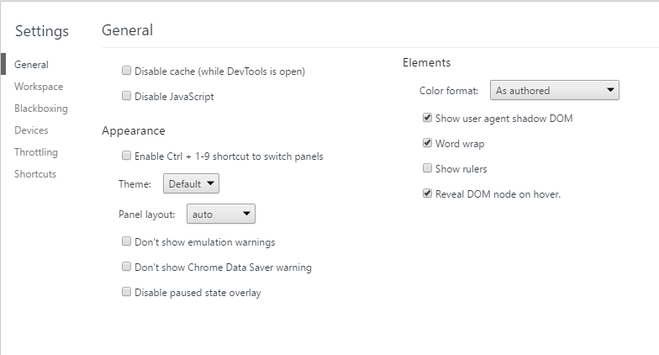
Shadow DOM

Slide 15
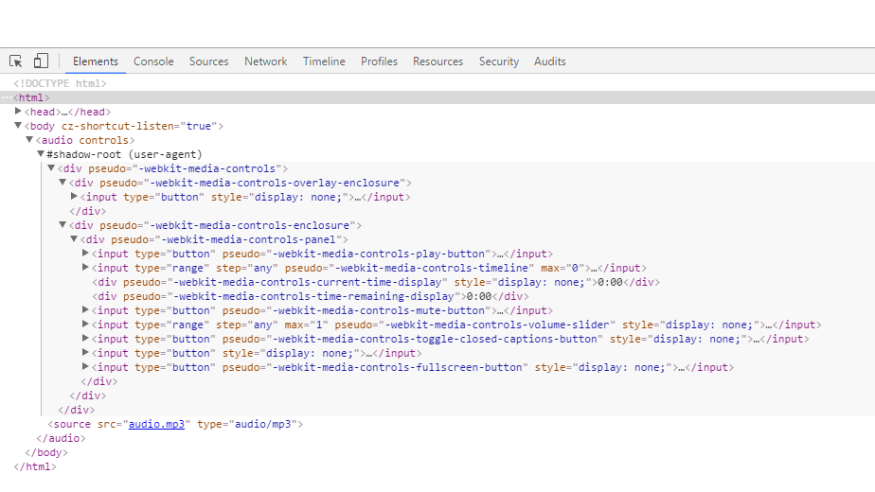
Shadow DOM
Notes:
Shadow DOM gives us the best features of iframes, style and markup encapsulation, without nearly as much bloat.
Shadow DOM is a new part of the HTML spec which allows developers to encapsulate their HTML markup, CSS styles and JavaScript.
Shadow DOM, along with a few other technologies which we'll cover later, gives developers the ability to build their own 1st class tags and APIs just like the <audio> tag.

Slide 16
Custom Elements
Notes:
Custom Elements, which let authors define their own elements, including new presentation and API, that can be used in HTML documents
Input element is a native element now you can define their own elements

Slide 17
Custom Elements
Custom Elements, which let authors define their own elements, including new presentation and API, that can be used in HTML documents
Notes:
Custom Elements, which let authors define their own elements, including new presentation and API, that can be used in HTML documents
Input element is a native element now you can define their own elements

Slide 18
<todo-list> </todo-list>

Slide 19
Templates
Notes:
Combining templates with Shadow DOM and Custom Elements gives us the future component model for the web

Slide 20
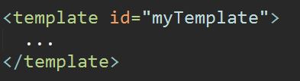
Templates
Templates are where we define reusable HTML code that can be cloned and inserted in the page by Javascript
Notes:
Templates, Shadow DOM, Custom Elements.
Templates define reusable parts of DOM.
The template element is used to declare fragments of HTML that can be cloned and inserted in the document by script.
Don't know about you, but I love avoiding extra work.
Templates giup chung ta dinh nghia hay them nhung the html ma co the su dung lại sau do.
Vi du nhu don xin viec.

Slide 21
HTML Imports

Slide 22
HTML Import
HTML Imports provide a way to include and reuse HTML documents in other HTML documents.
<link rel=“import” href=“myElement.html”>
Notes:
Lưu ý: We can import also for html file, khác với các kiểu import khác css, javascript
HTML Imports allow bundling HTML/CSS/JS as a single resource. While useful by themselves, this idea becomes extremely powerful in the world of Web Components.
Developers can create reusable components for others to consume and bring in to their own app, all delivered through <link rel="import">.

Slide 23
Why Web Components?

Slide 24
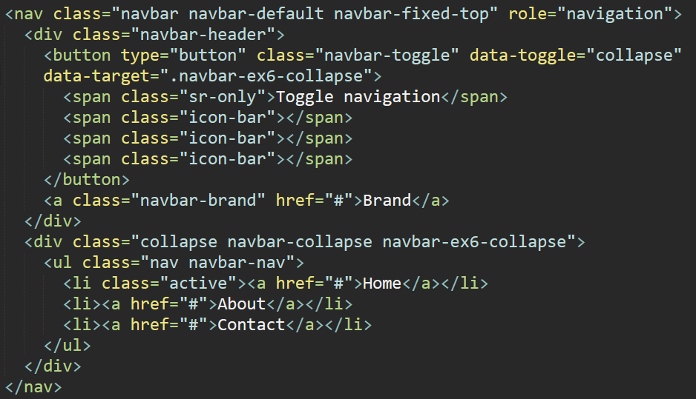
Notes:
+ Because there is no way to package Bootstrap components you must write out the HTML exactly as it is documented.
+ A real-world example is Bootstrap. Bootstrap is comprised of individual files (bootstrap.css, bootstrap.js, fonts), requires JQuery for its plugins, and provides markup examples
+ And the root problem is that CSS really has no opinion about scoping. Everything’s everywhere. Everything’s global. Classes everybody can have a class.
+ The only thing stopping is that you should name things really well.
+ The way I like to think about the Shadow DOM. It is actually a tiny little castle.
+ You put your markup. You put your styles. And you close it down with walls around it.
+ And that castle is basically your web component
+ Everything that is does and all its styles just live inside. And they do not leak out and nothing gets in.
+ Because in Sass and Less, styles and variables are still global

Slide 25
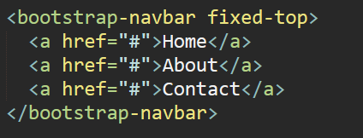
Why Web Components?
Notes:
Bootstrap comes with a lot of CSS which means, right out of the gate, there are a ton of class names which you probably shouldn't use for your own elements.
Want to define a class of .container? Too bad, Bootstrap already uses that name. Want to upgrade Bootstrap in a few months? OK, but you need to double check that none of their new classes conflict with any of yours.
Wouldn't it be awesome if you could use all of the little widgets from Bootstrap and not worry at all about possible collisions?
Well, that's what Web Components are trying to solve and so today I want to look at one part of the Web Components standards

Slide 26
Web Components
Encapsulate markup and styles
Package HTML/CSS/JS as single resource
Reusable components
Notes:
Nói về tương lai khi sử dụng web components

Slide 27

What is Polymer?
Notes:
Material design xu hướng hiện tại, google mail

Slide 28

What is Polymer?
It’s a core library makes it easier than ever, to make fast, beautiful, and interoperable Web Components.

Slide 29
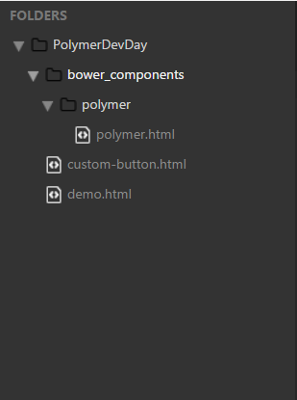
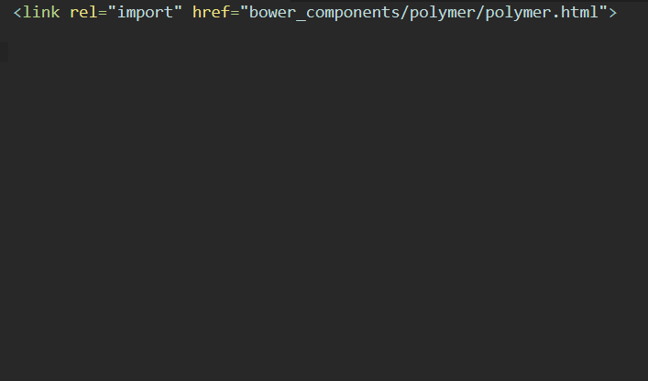
How to create custom elements?
Notes:
Giới thiệu them một số từ khóa để sinh viên có thể tìm hiểu them

Slide 30
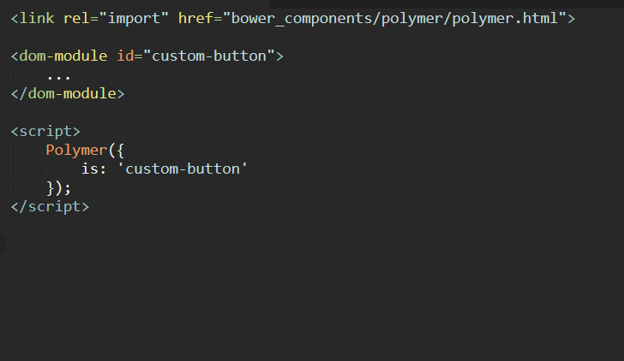
How to create custom elements?
Notes:
Ví dụ button cho dễ hiểu
To specify DOM to use for an element’s local DOM, use the <dom-module> element. Give the <dom-module>an id attribute that matches its element’s is property and put a <template> inside the <dom-module>. Polymer will automatically clone this template’s contents into the element’s local DOM.

Slide 31
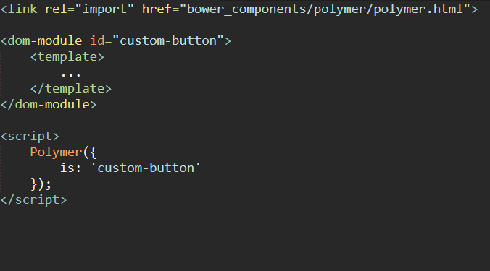
How to create custom elements?
Notes:
Import html

Slide 32
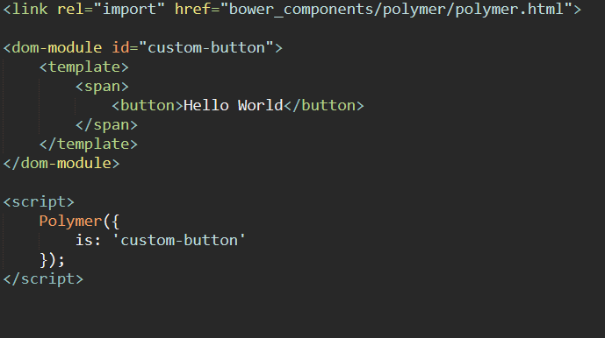
How to create custom elements?
Notes:
Import html

Slide 33
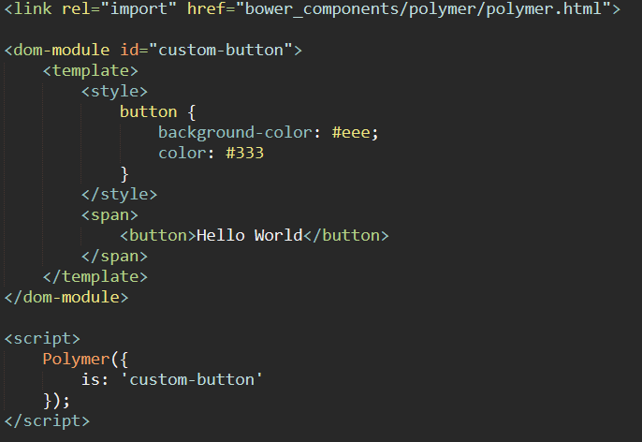
How to create custom elements?
Notes:
Import html
Custom elements let you define new HTMLElements, i.e. creating new tags. Custom elements leverage templates and shadow DOM to encapsulate their markup and styles, and often are loaded into an application via HTML imports.

Slide 34
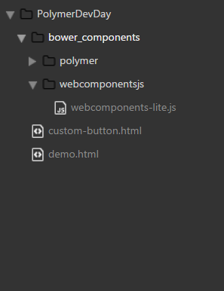
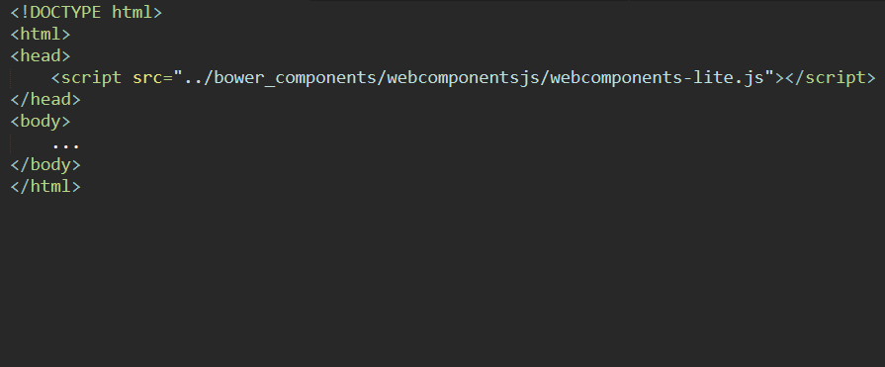
How to reuse component?
Notes:
Import html

Slide 35
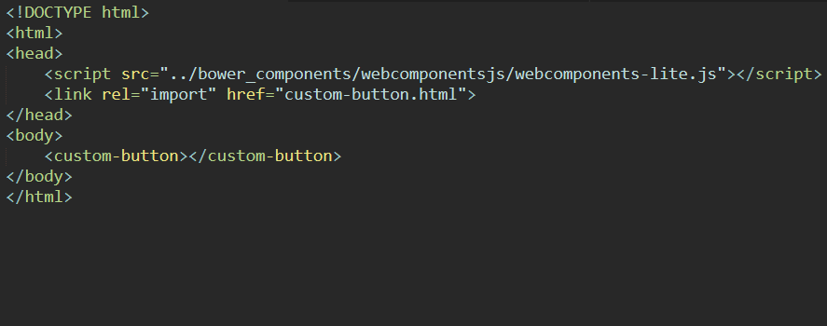

How to reuse component?
Notes:
Import html

Slide 36
Github
https://github.com/ndqvinh2109/Polymer.git

Slide 37
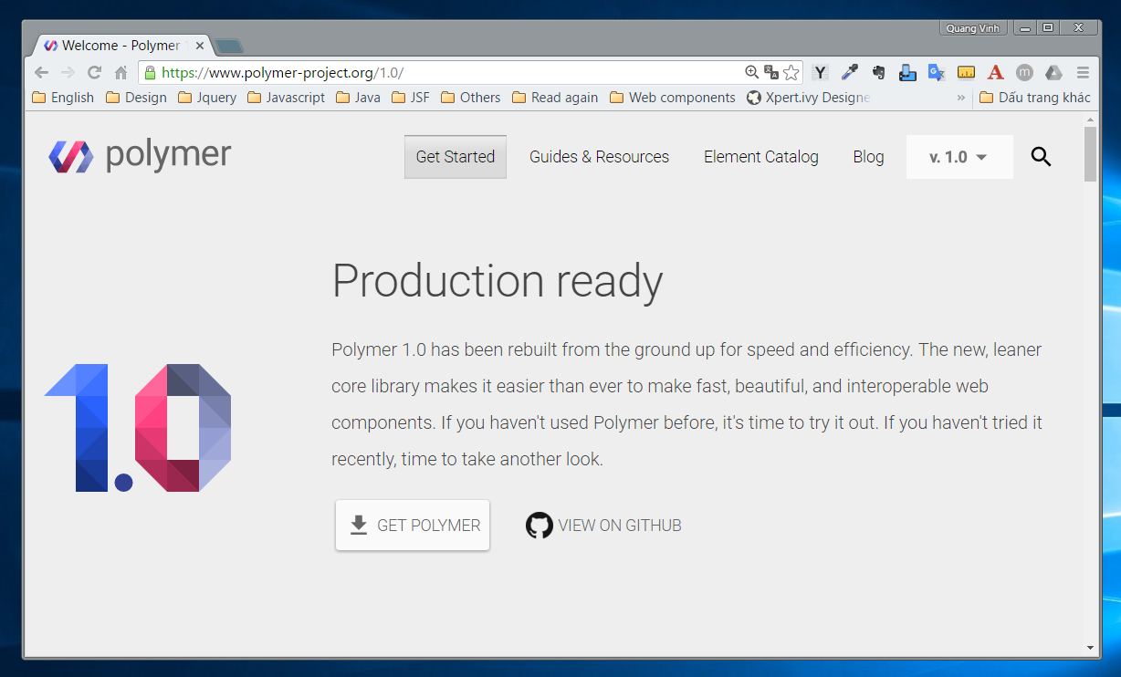

Slide 38
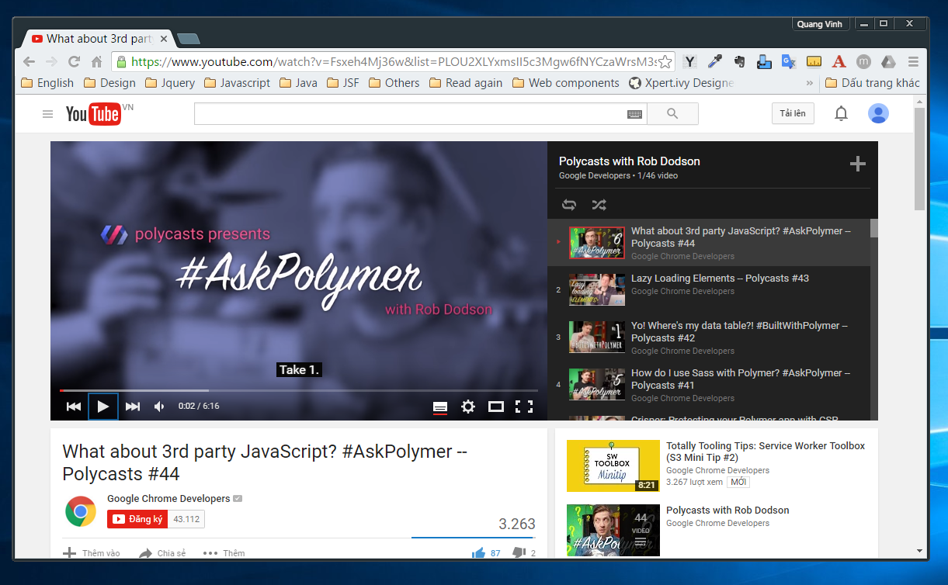

Slide 39
Practice
https://codelabs.developers.google.com/polymer-summit

Slide 40
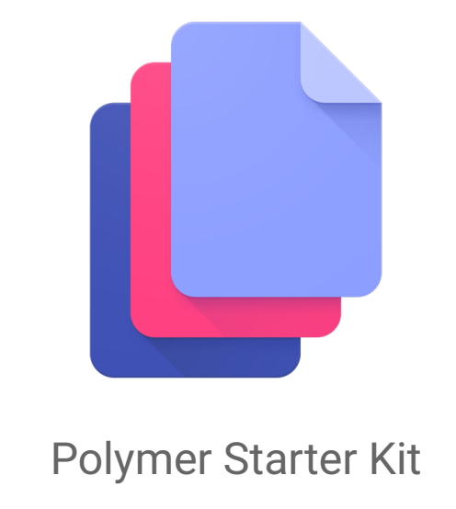
Polymer Starter Kit

Slide 41
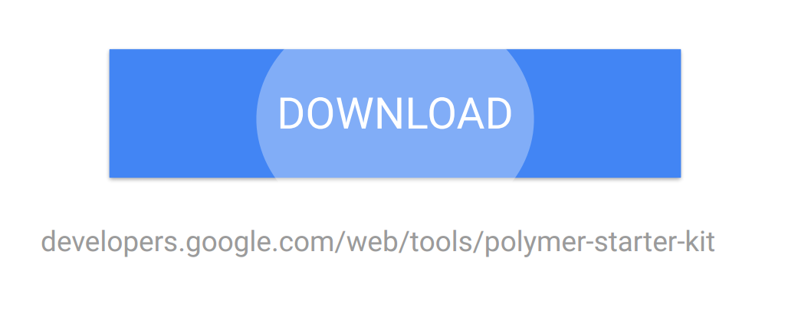
How to use Polymer
Notes:
Responsive app layout boilerplate
Components for nearly any app, out of the box
Material design ready

Slide 42
Q & A

