Slide 2
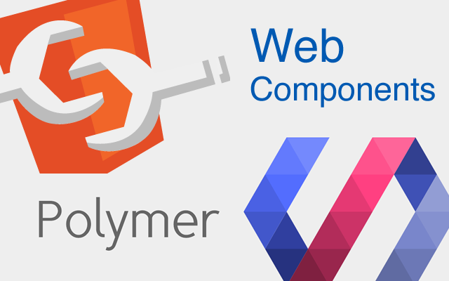
Web Components and Polymer

Slide 3
Agenda
What are Web Components?
What is Polymer?
Q & A
How to use Polymer?
Notes:
+ Show todo-apps

Slide 4
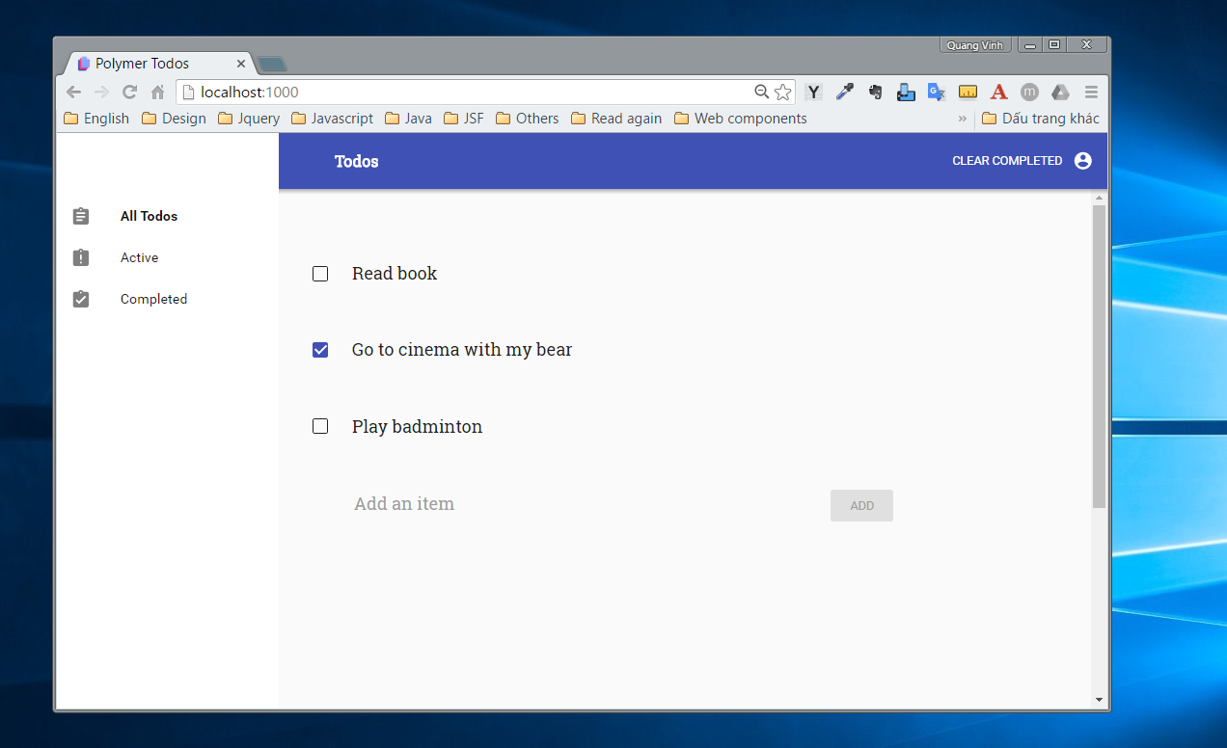
TODO-NAV-BAR

Slide 5
TODO-SIDE-BAR

Slide 6
TODO-CONTENT

Slide 7
TODO-LIST

Slide 8

What are Web Components

Slide 9
What are Web Components?
You can think of Web Components as reusable user interface widgets that are created using open Web technology.
Notes:
An existing Web Component can be used without writing code, simply by adding an import statement to an HTML page.

Slide 10
What are Web Components?
Shadow DOM
Custom Elements
Templates
HTML Imports

Slide 11
Shadow DOM

Slide 12
Shadow DOM
Shadow DOM is a new part of the HTML spec which allows developers to encapsulate their HTML markup, CSS styles and JavaScript.

Slide 13


Shadow DOM
Notes:
Ever wonder how the player controls are built and styled?

Slide 14
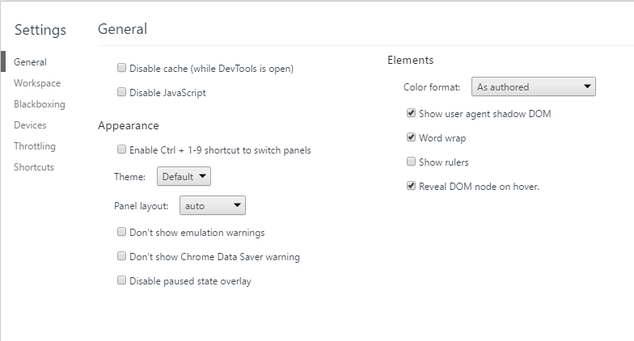
Shadow DOM

Slide 15
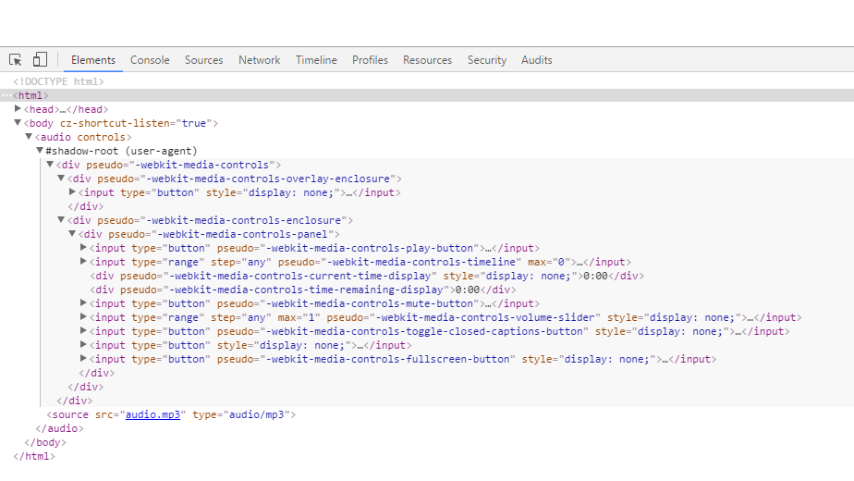
Shadow DOM

Slide 16
Custom Elements

Slide 17
Custom Elements
Custom Elements, which let authors define their own elements, including new presentation and API, that can be used in HTML documents

Slide 18
<todo-list> </todo-list>

Slide 19
Templates

Slide 20
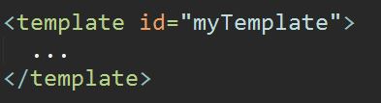
Templates
Templates are where we define reusable HTML code that can be cloned and inserted in the page by Javascript

Slide 21
HTML Imports

Slide 22
HTML Import
HTML Imports provide a way to include and reuse HTML documents in other HTML documents.
<link rel=“import” href=“my-element.html”>

Slide 23
Why Web Components?

Slide 24
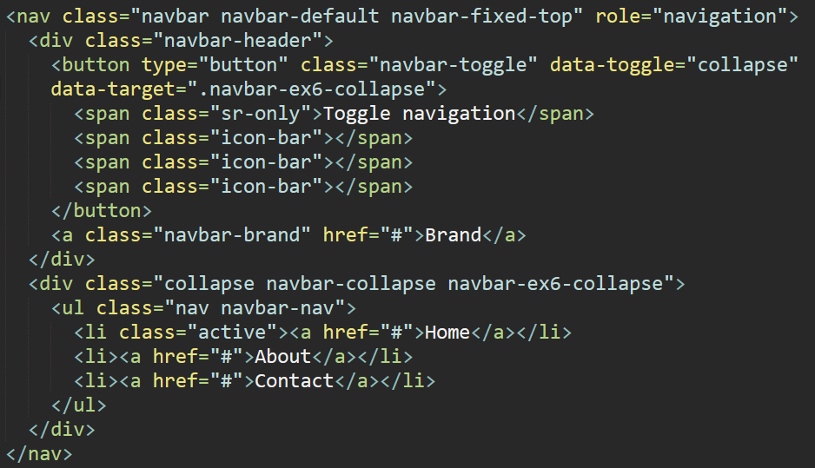

Slide 25
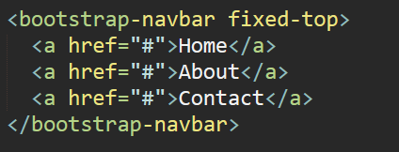
Why Web Components?

Slide 26
Web Components
Encapsulate markup and styles
Package HTML/CSS/JS as single resource
Reusable components

Slide 27

What is Polymer?

Slide 28

What is Polymer?
The Polymer library is designed to make it easier and faster for developers to create great, reusable components for the modern web.

Slide 29
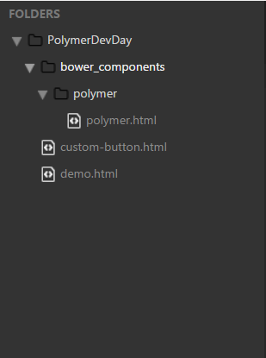
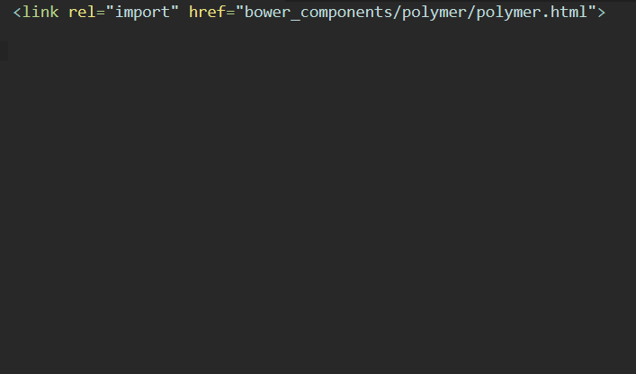
How to create custom elements?

Slide 30
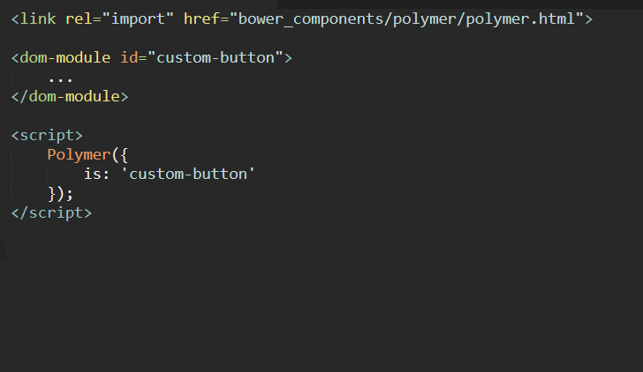
How to create custom elements?

Slide 31
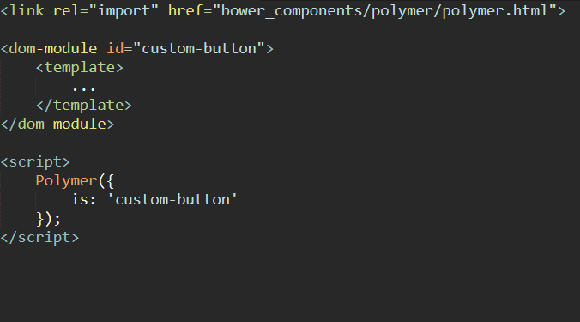
How to create custom elements?
Notes:
Import html

Slide 32
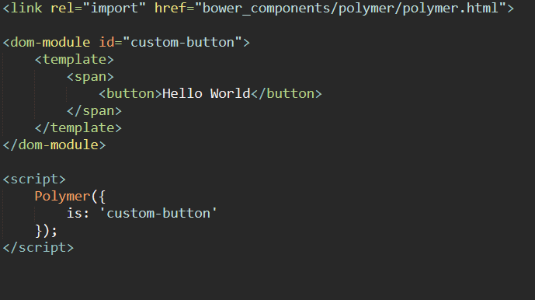
How to create custom elements?
Notes:
Import html

Slide 33
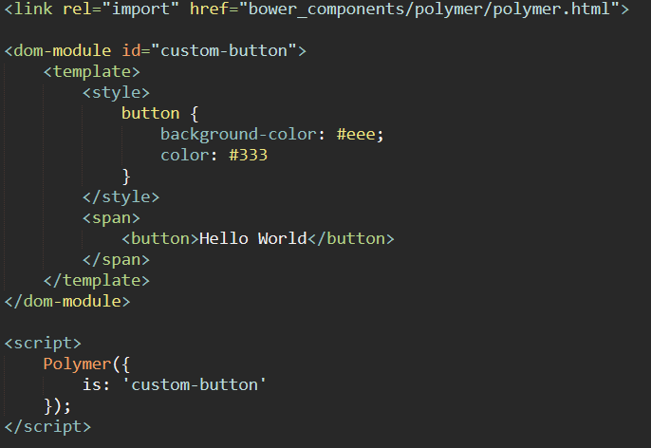
How to create custom elements?

Slide 34
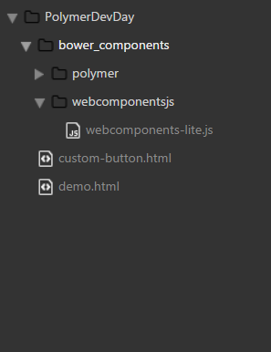
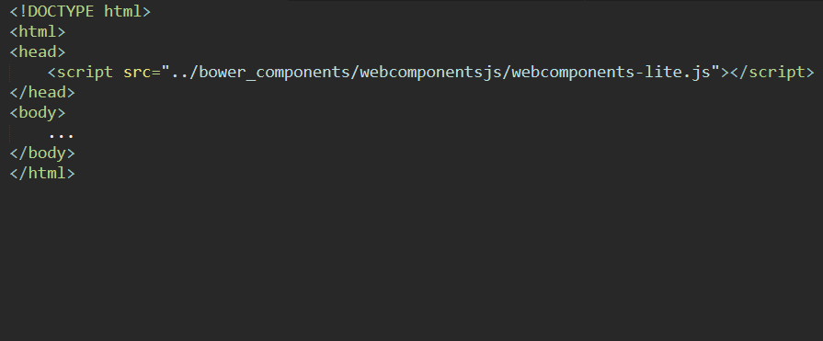
How to reuse component?
Notes:
Import html

Slide 35
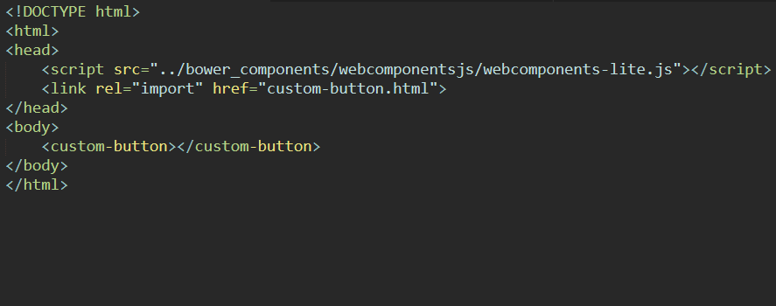

How to reuse component?
Notes:
Import html
A polyfill is a browser fallback, made in javascript, that allows functionality you expect to work in modern browsers to work in older browsers. Ie to support canvas (an html5 feature) in older browsers.

Slide 36
Github
https://github.com/ndqvinh2109/Polymer.git

Slide 37
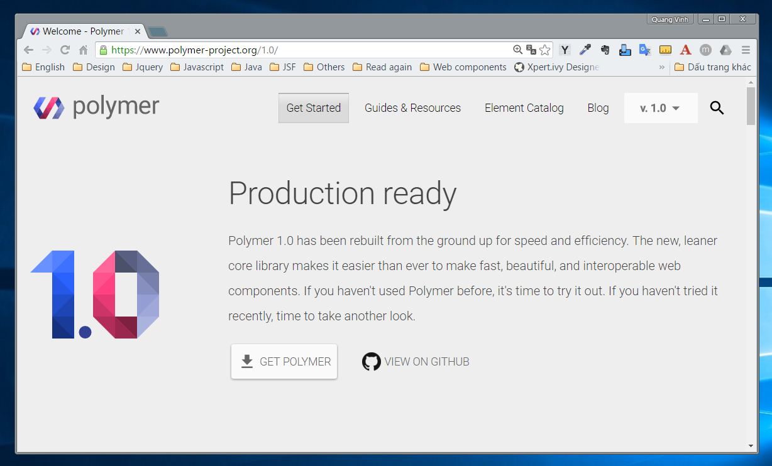

Slide 38
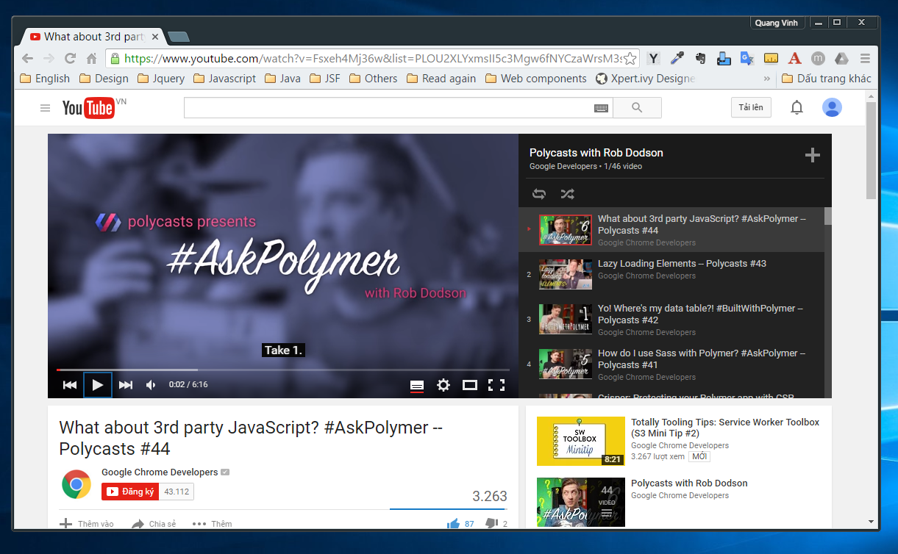

Slide 39
Practice
https://codelabs.developers.google.com/polymer-summit

Slide 40
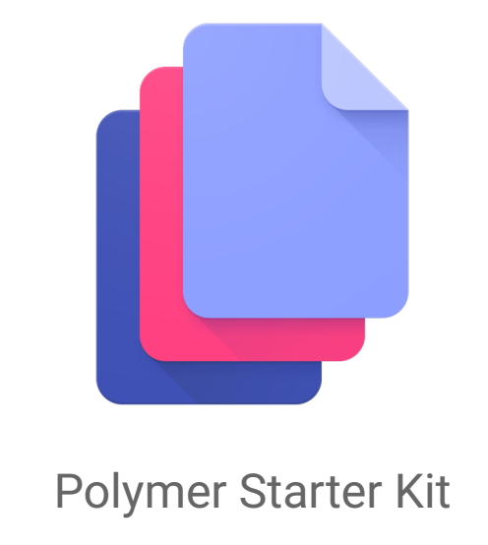
Polymer Starter Kit

Slide 41
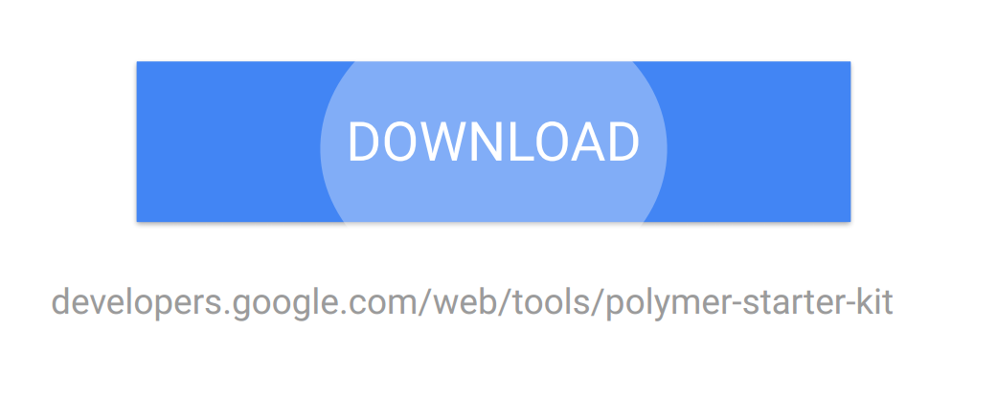
How to use Polymer

Slide 42
Q & A

