Slide 1

seminar
BI503G, Seminar
André Bourbonnais, Luan Gardenalli
12-15-2022

Slide 2


Project LuAndre !
B
I
O
I
N
F
O
R
M
A
T
I
C
S
Contributors:
Luan Gardenalli
André Bourbonnais

Slide 3
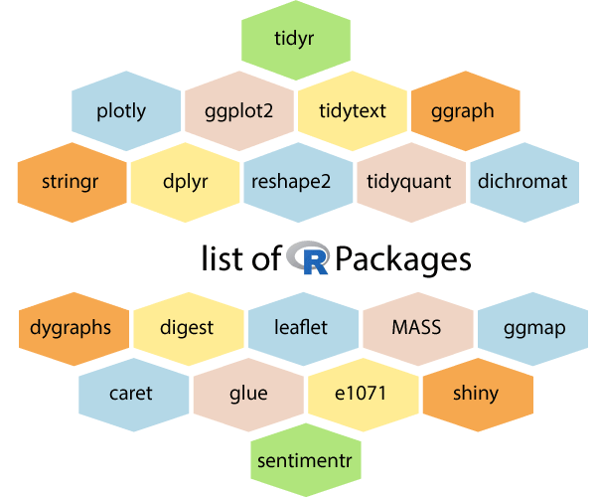
LuAndre – A brand new R package!
B
I
O
I
N
F
O
R
M
A
T
I
C
S
Function:
Enrichment Analysis of RNA-seq dataset for dummies.
Luandre
List-of-R-packages (modified), creative common license: https://creativecommons.org/licenses/by-sa/4.0/deed.en

Slide 4
LuAndre:
fetch_data_from_file()
Filter()
digital_gene_expression()
Dependencies:
edgeR,
limma,
clusterProfiler,
org.Hs.eg.db,
ggplot2,
enrichplot,
GOSemSim,
ggupset,
openxlsx
B
I
O
I
N
F
O
R
M
A
T
I
C
S
fit_test_model()
get_deg()
get_Hs_entrez()
Enrich_Hs_genes()
enrich_plots()
save_deg_excel()
Enrich_analysis

Slide 5
Returns list with data frames
Filters count data by mean-log2-cpm
Returns DGE list and a design matrix
LuAndre:
fetch_data_from_file()
Filter()
digital_gene_expression()
<Count data file + sample table file>
B
I
O
I
N
F
O
R
M
A
T
I
C
S
Fetches entrezid from the DEG list and adds it as a column
Filters DEG list
Return list with DEGs
fit_test_model()
get_deg()
get_Hs_entrez()
Performs enrichment using either GO or KEGG and returns the results
Enrich_Hs_genes()
enrich_plots()
save_deg_excel()
Plots the enrichment results and saves it to working directory
saves DEG list to working directory

Slide 6
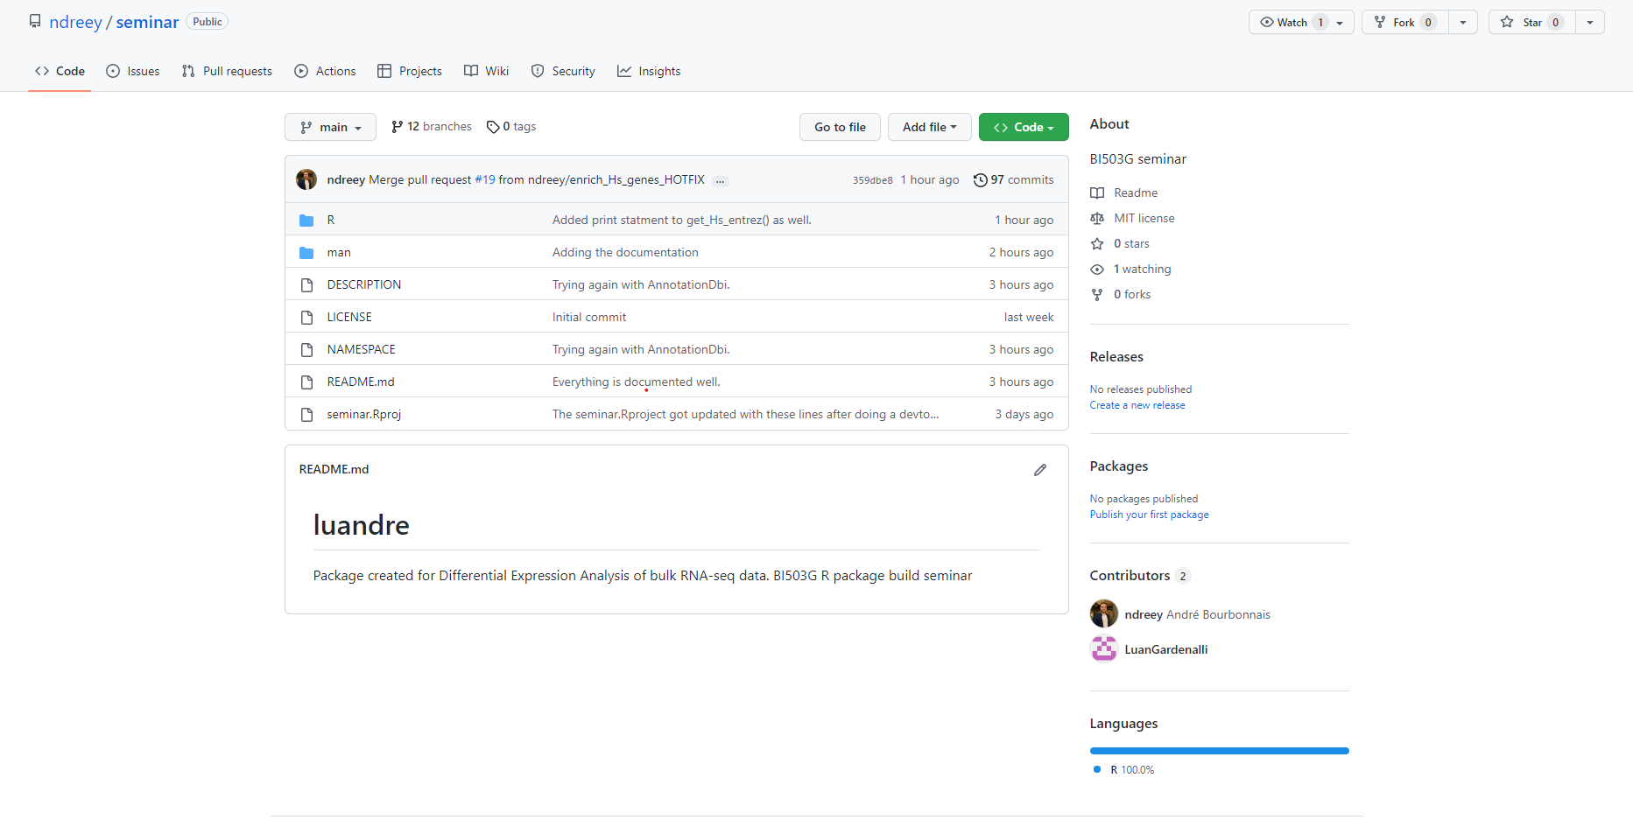
Repository sneak-peak
B
I
O
I
N
F
O
R
M
A
T
I
C
S
https://github.com/ndreey/seminar

Slide 7
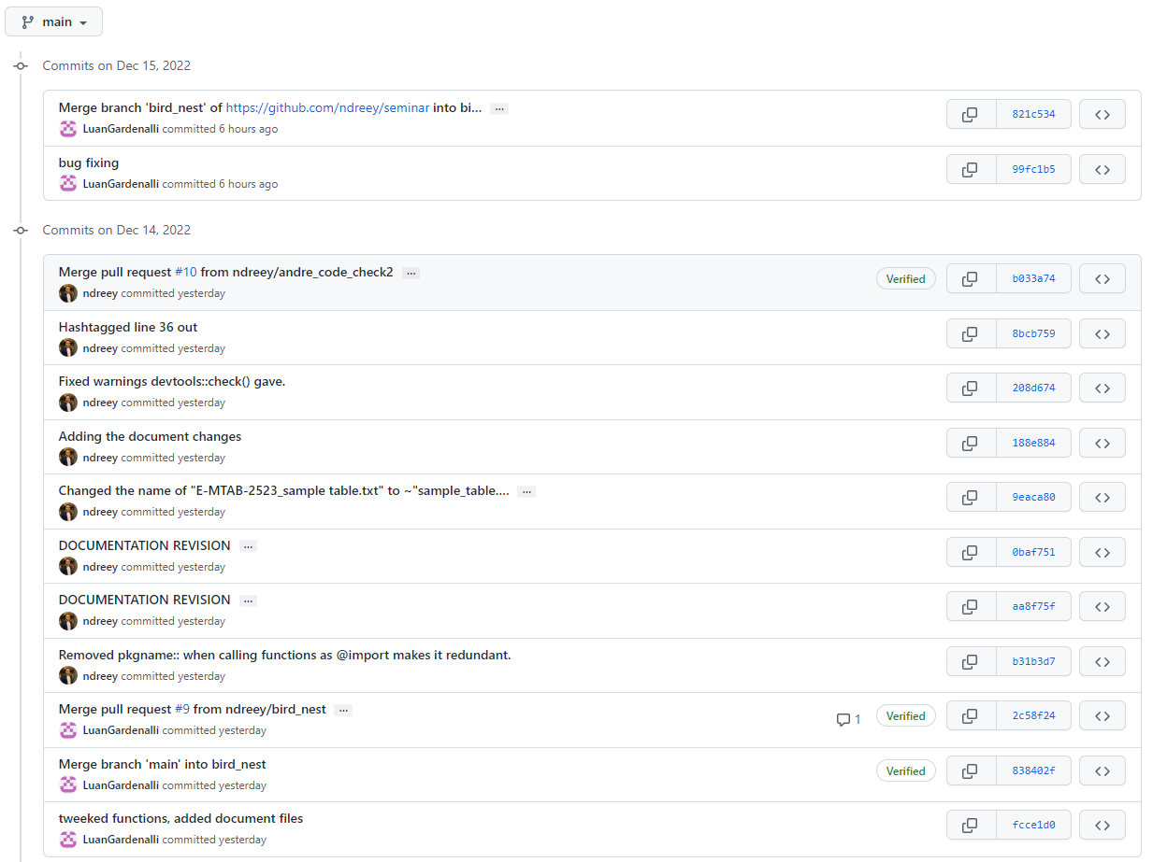
Branching and committing
B
I
O
I
N
F
O
R
M
A
T
I
C
S

Slide 8
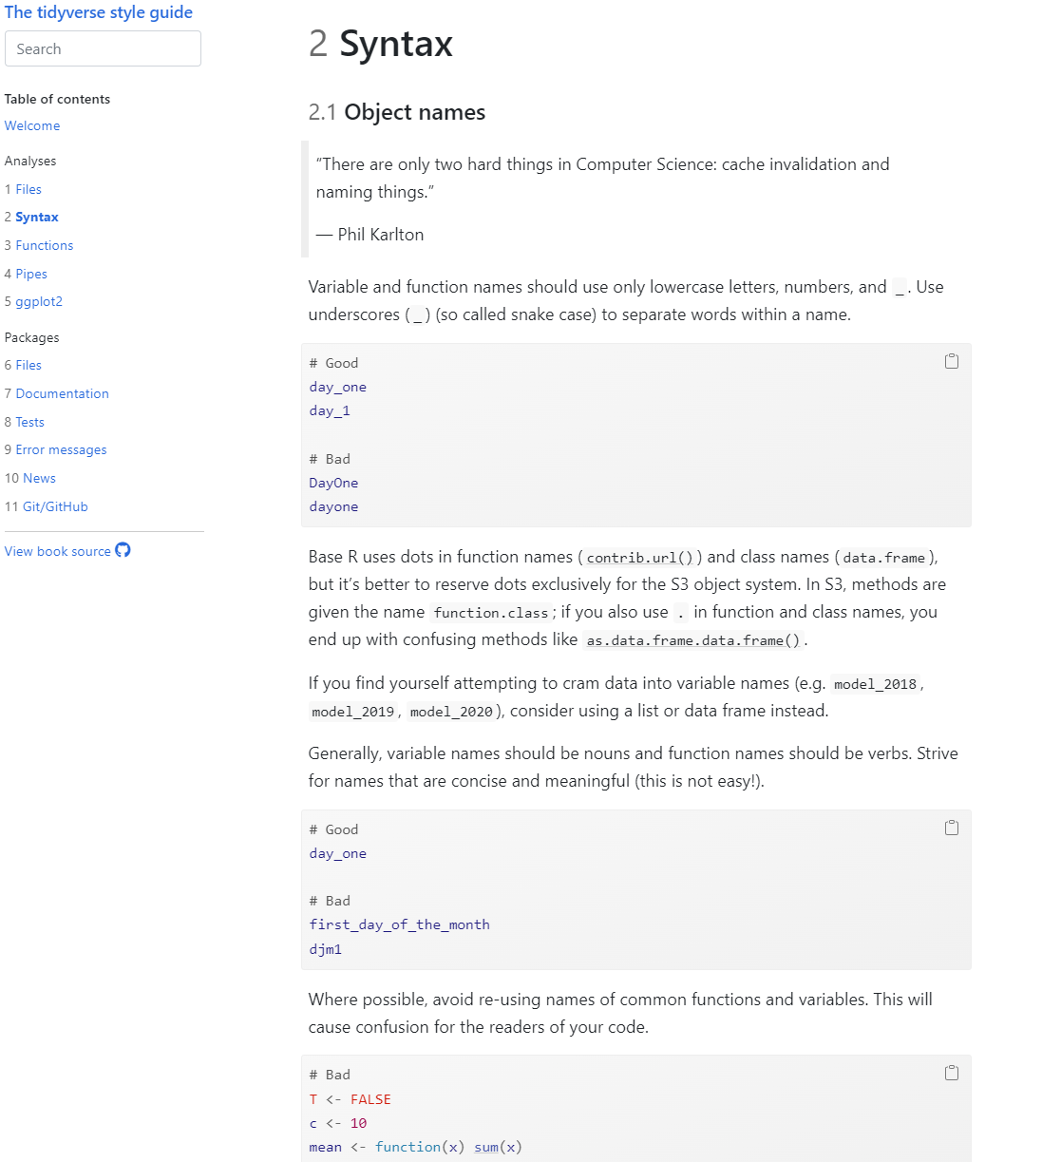
The Tidyverse style guide
B
I
O
I
N
F
O
R
M
A
T
I
C
S
Gives the code a uniform appearance
Majorly improves code readability
Coding as a team is much easier
Debugging is more efficient
Makes the code very... tidy.

Slide 9
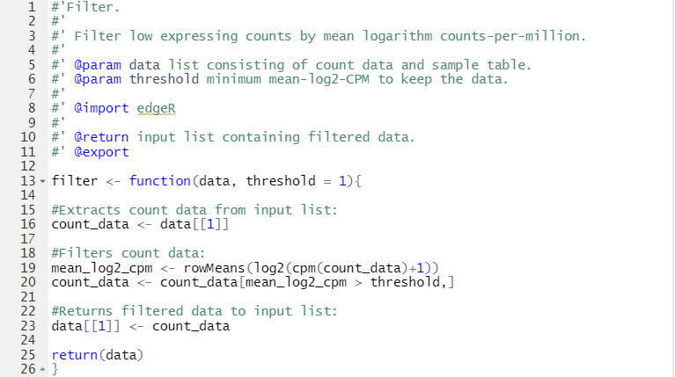
Always put a space after commas
B
I
O
I
N
F
O
R
M
A
T
I
C
S
Concise and meaningful variables names, separated by underlines
Operators surrounded by spaces
Curly braces only as first or last character on the line

Slide 10
B
I
O
I
N
F
O
R
M
A
T
I
C
S
Thank You!
Chen, S., Gao, Y., Fan, Y., Guo, S., Zhou, J., Liu, T., & Xu, W. (2022). The Dynamic Change of Immune Responses Between Acute and Recurrence Stages of Rodent Malaria Infection. Frontiers in Microbiology, 13, 844975. DOI: 10.3389/fmicb.2022.844975

