Slide 1
Teaching activity process
The goal of this project is to define a normative process model for the activity of teaching in a course and then check for discrepancies between the expected behaviours and simulated behaviours. In particular, we posed our attention on the point of view of the professor

Slide 2
Business process model
Main components
Preparation of documents and contents
Do lectures
Conclusion of the course

Slide 3
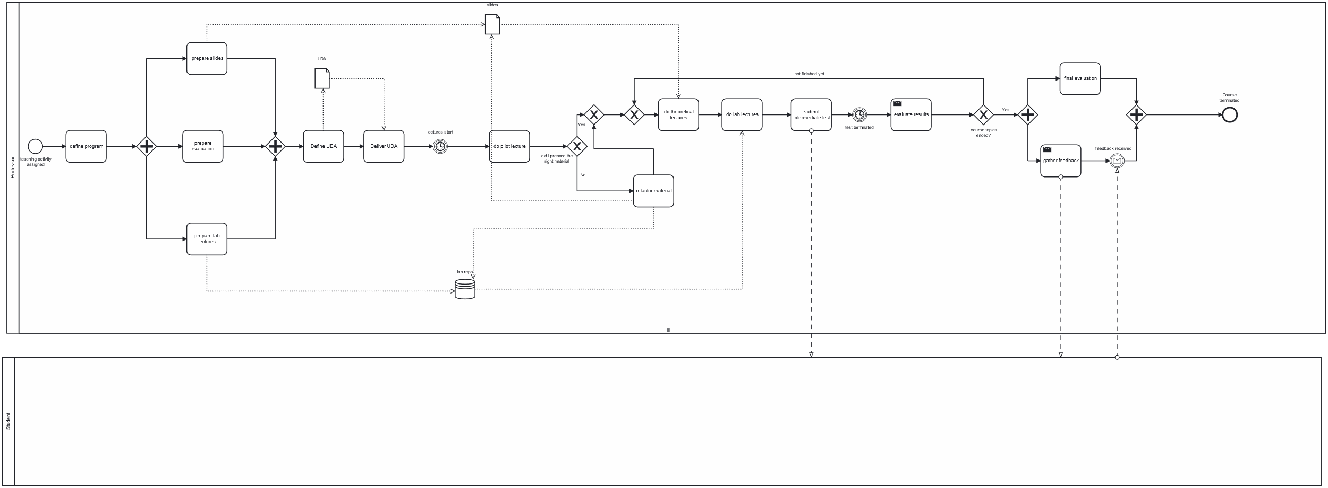
Business process model

Slide 4
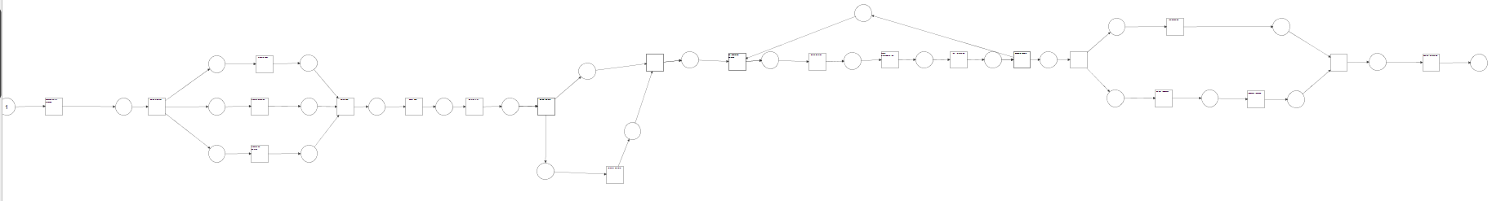
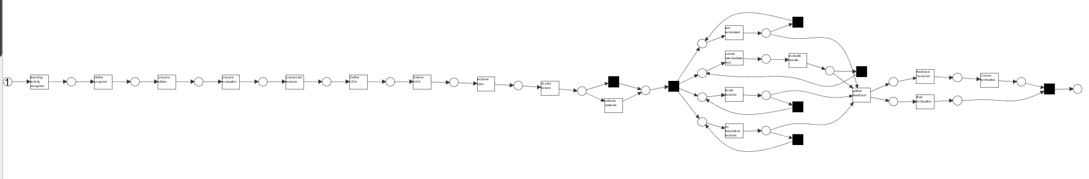
Normative vs Descriptive PN

Slide 5
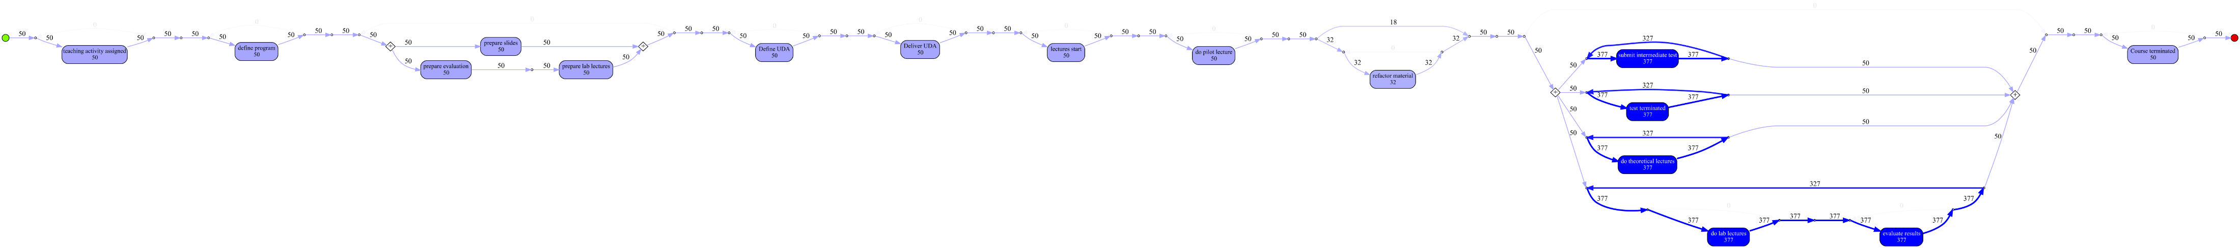
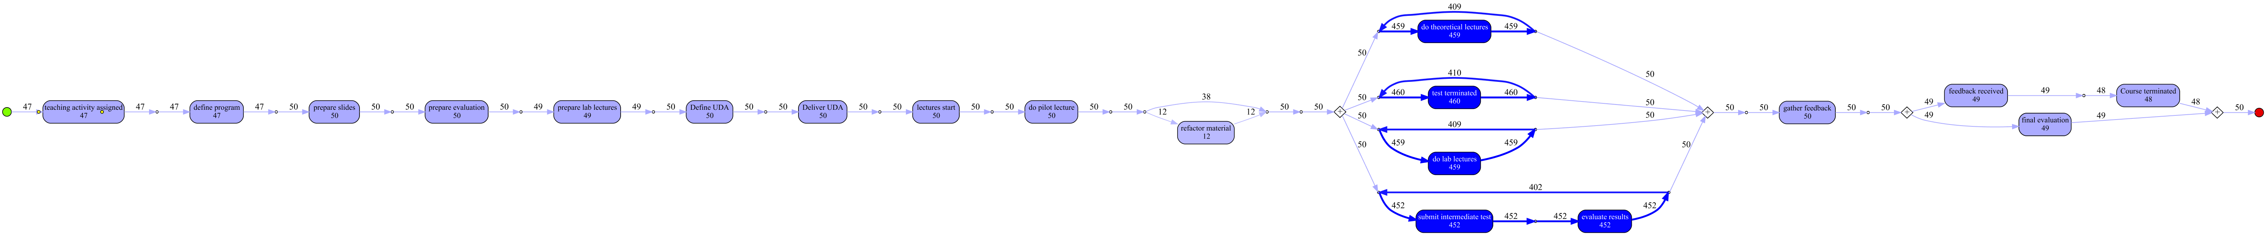
Mined process model VIM-A & VIM-B (1 activities 0.80 paths )

Slide 6
Mined process model VIM-A & VIM-B (1 activities 0.95 paths )

Slide 7
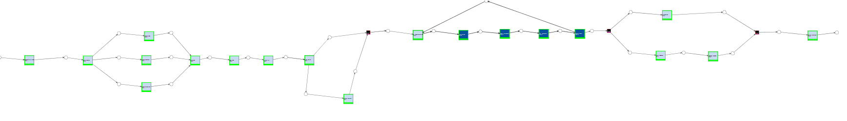
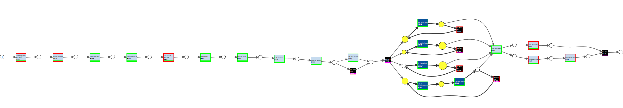
Conformance checking <PN-A, F-XES-A>, <PN-B, XES-B>

Slide 8
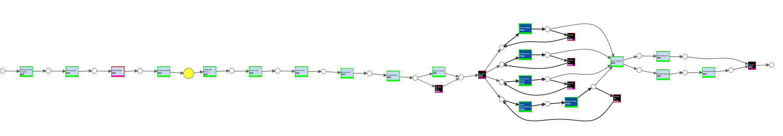
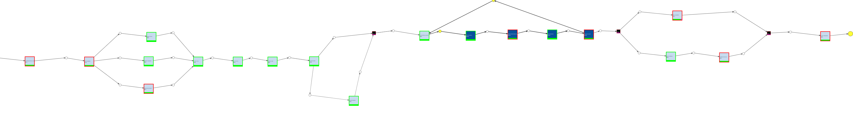
Conformance checking <PN-B, F-XES-A>, <PN-A, XES-B>

Slide 9
Conformance checking
fitness | F-XES-A | XES-B
PN-A | 1.00 | 0.99
PN-B | 0.96 | 0.99

