Slide 1
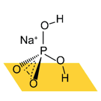
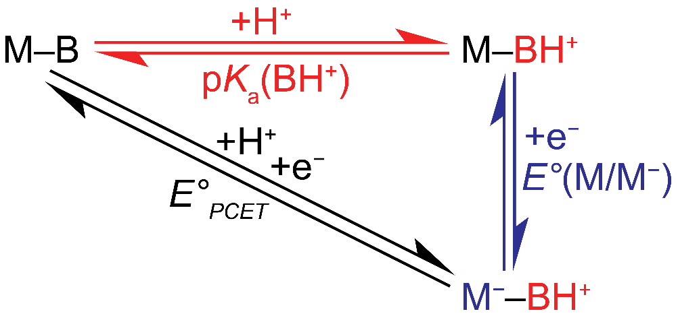
Molecular control of interfacial proton-coupled electron transfer
Megan Jackson, Onyu Jung
Surendranath Group, MIT
ONR In-person Meeting
Feb 22, 2018
Notes:
Introduce
5 months

Slide 2



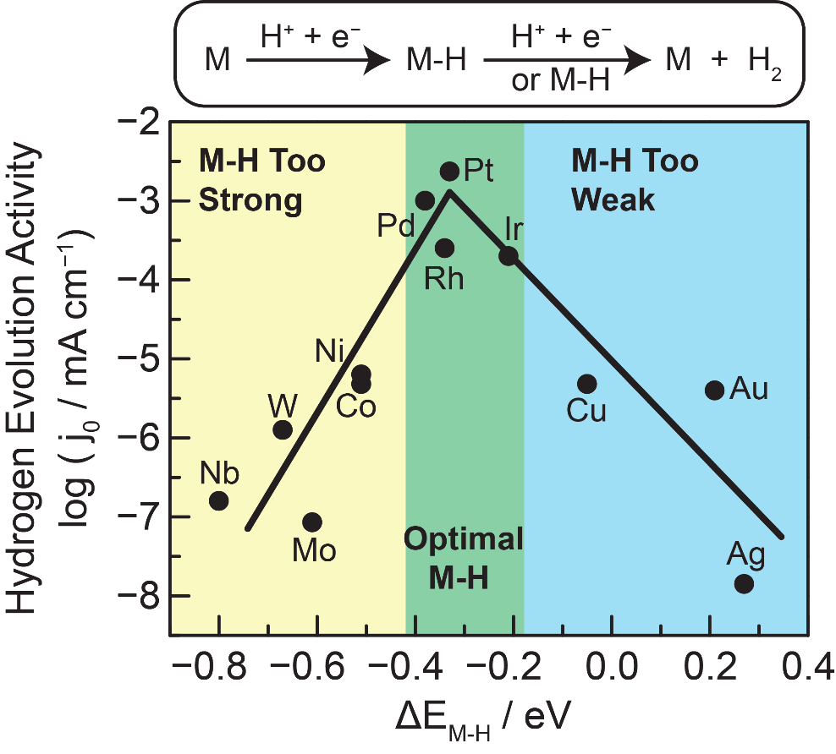
HER on Au proceeds through rate-limiting CPET
Rate-limiting electron transfer
First order in H₃O⁺
Rate of HER on Au is rate of CPET
Norskov, J; et al. J. Electrochem. Soc. 2005, 152, J23.
Notes:
point to low adsorption energy of H on Au (computation Norskov JES – schmickler).
J is related to rate (have on slide and state)
Show data w/o slope and say j is related to rate
Why is it log/linear? Arrhenius eqn=> changing delta G double dagger gives change in rate
Have slopes appear and say it’s informative
Then equations
Either don’t use marcus curves or label products and reactants on the wells

Slide 3
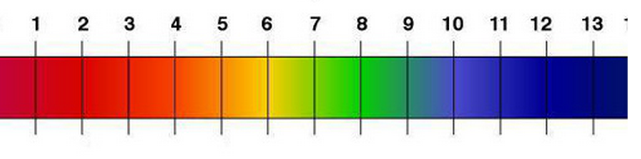
pH-dependence of HER in aqueous media
pH scale
H₃O⁺ donor?
H₂O donor?
Inverse order in pH?
No pH-dependence?

Slide 4
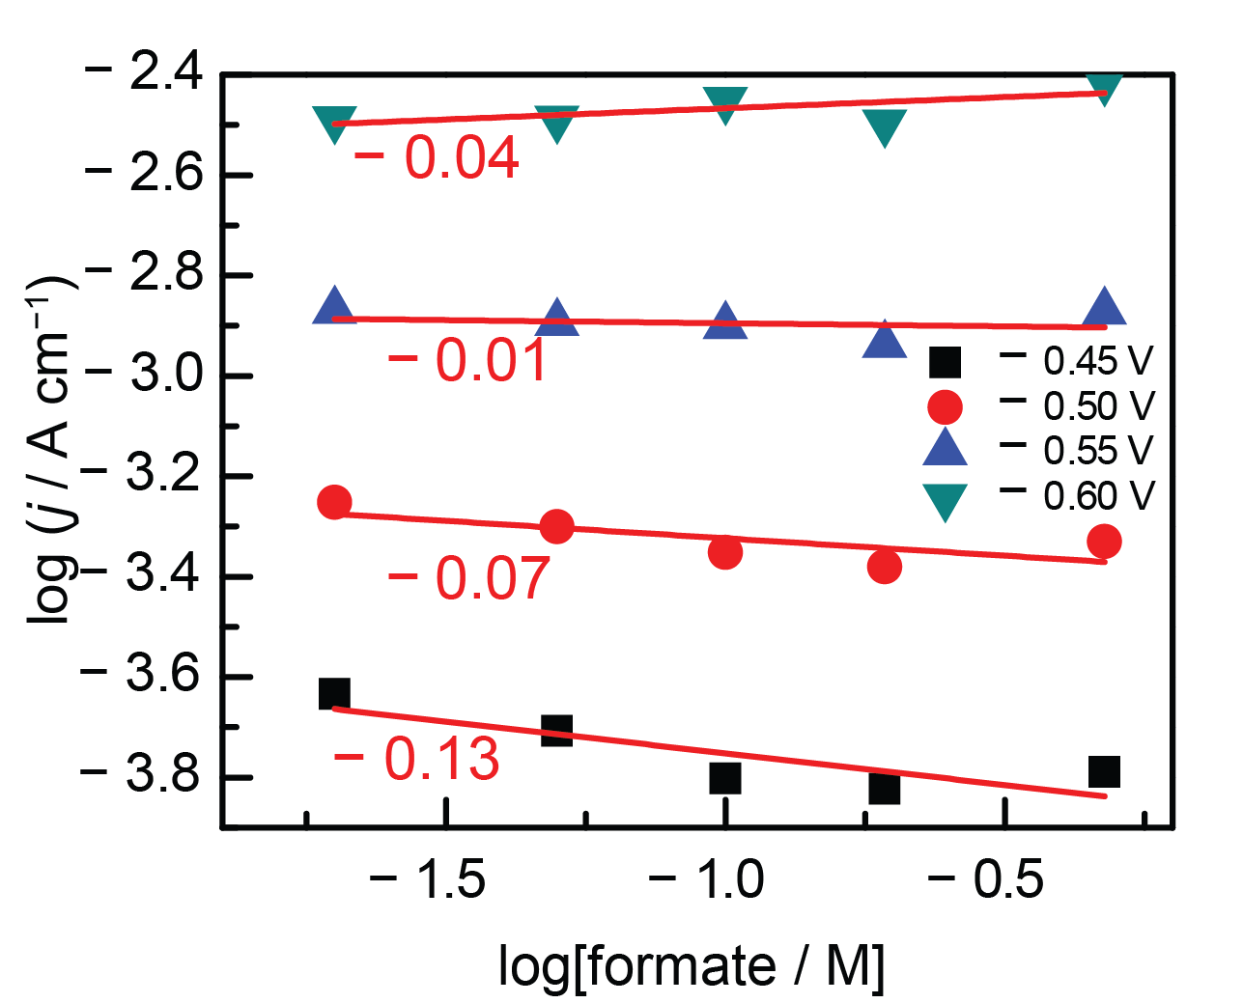
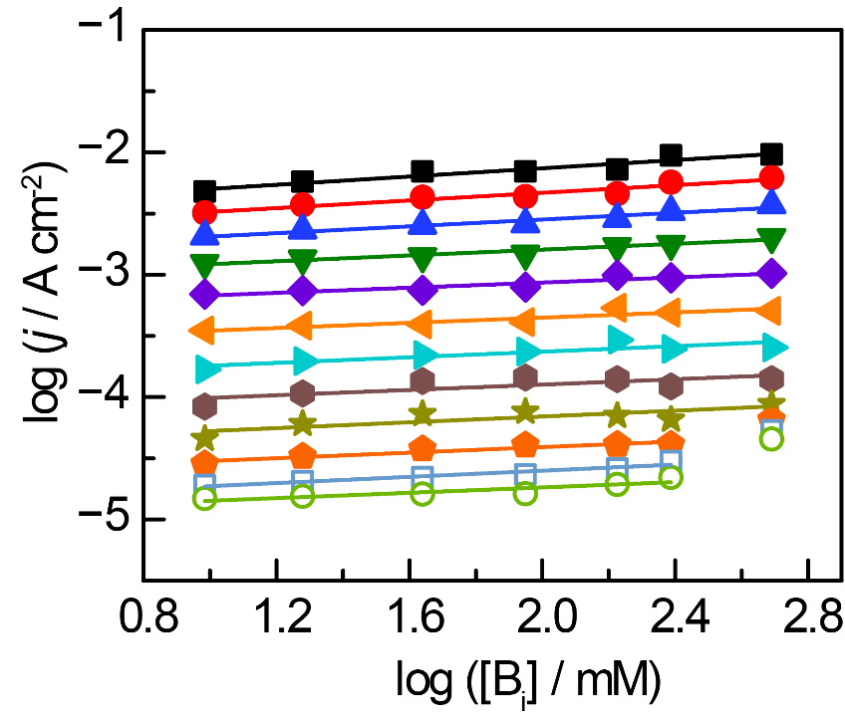
Choice of electrolyte
Formate and borate buffers do not seem to contribute of the kinetics of HER.
Formate (pK_{a} = 3.75)
Borate (pK_{a} = 9.1)
~ 0.1
They allow direct measurement of pH-dependence of HER across the pH range

Slide 5
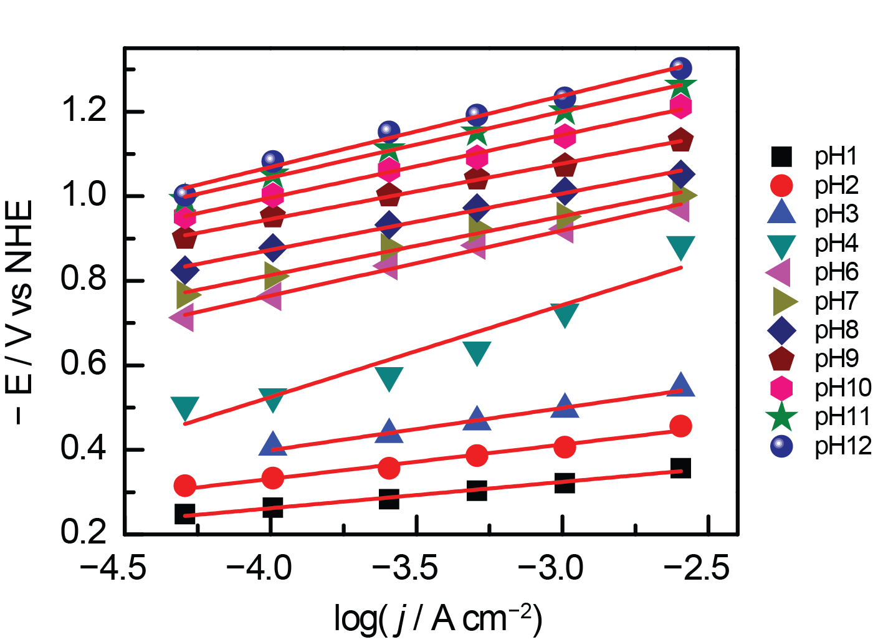
pH-dependent Tafel slope
~120 mV dec⁻¹
60-90 mV dec⁻¹
The Tafel slope of HER is 60 to 90 mV/dec at very low pH,
and increases to 120 mV/dec at intermediate to high pH.

Slide 6
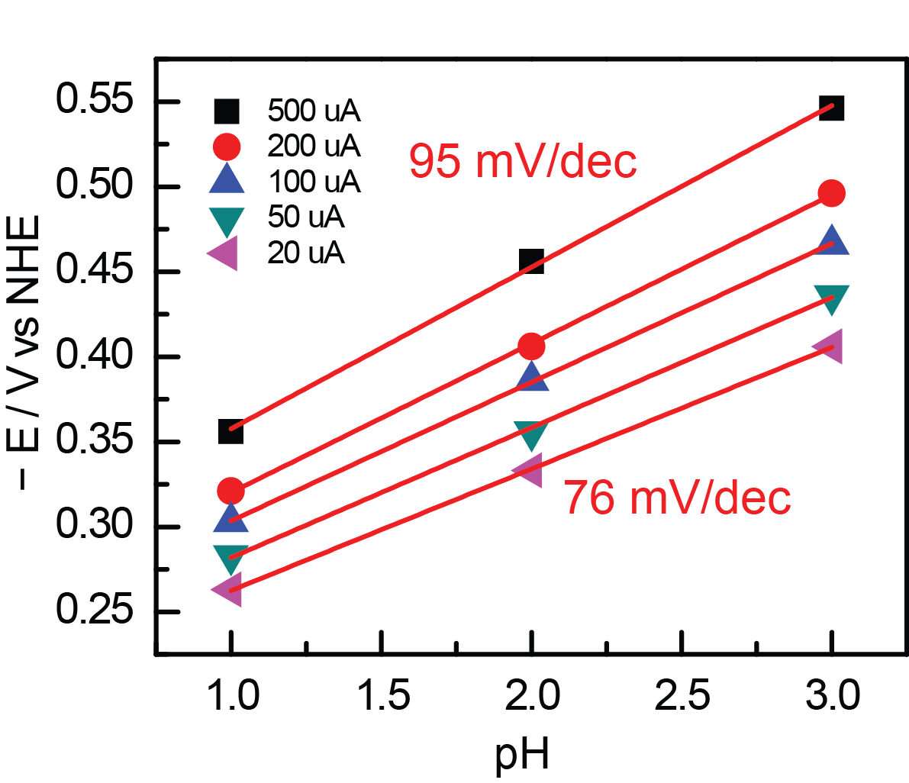
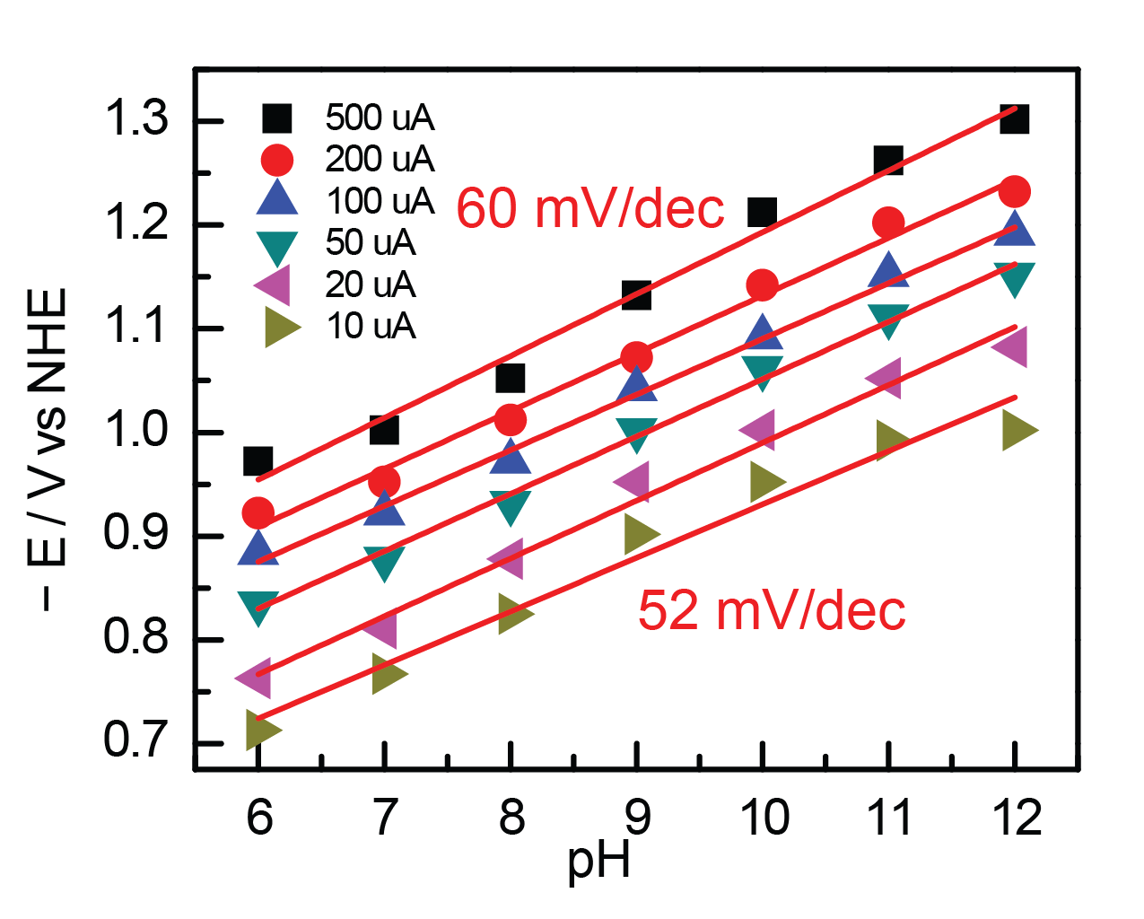
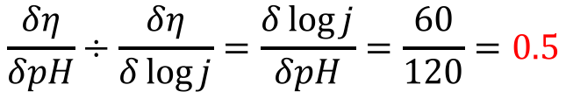
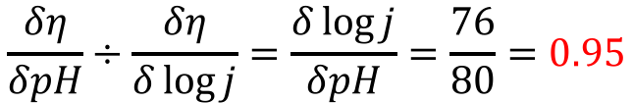
HER is first-order at low pH and half-order at high pH
Low pH
High pH
Order in [H⁺]:
$$\frac{δη}{δpH}÷\frac{δη}{δ\log{j}}=\frac{δ\log{j}}{δpH}=\frac{76}{80}=0.95$$
$$\frac{δη}{δpH}÷\frac{δη}{δ\log{j}}=\frac{δ\log{j}}{δpH}=\frac{60}{120}=0.5$$

Slide 7
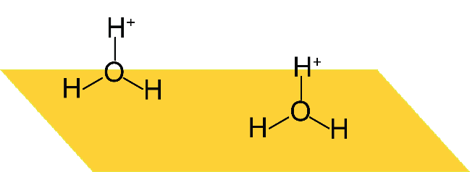
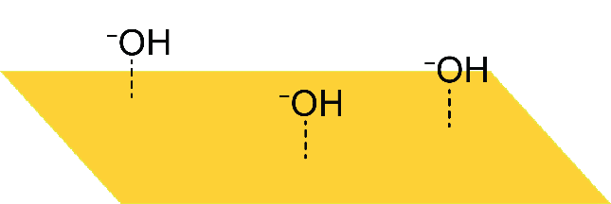
What is the origin of the half order?
Is the PZC changing with pH?
~120 mV dec⁻¹
Fractional order suggests adsorption.
Is there pH-dependent surface adsorption at intermediate and high pH?
60-90 mV dec⁻¹
or
?

Slide 8
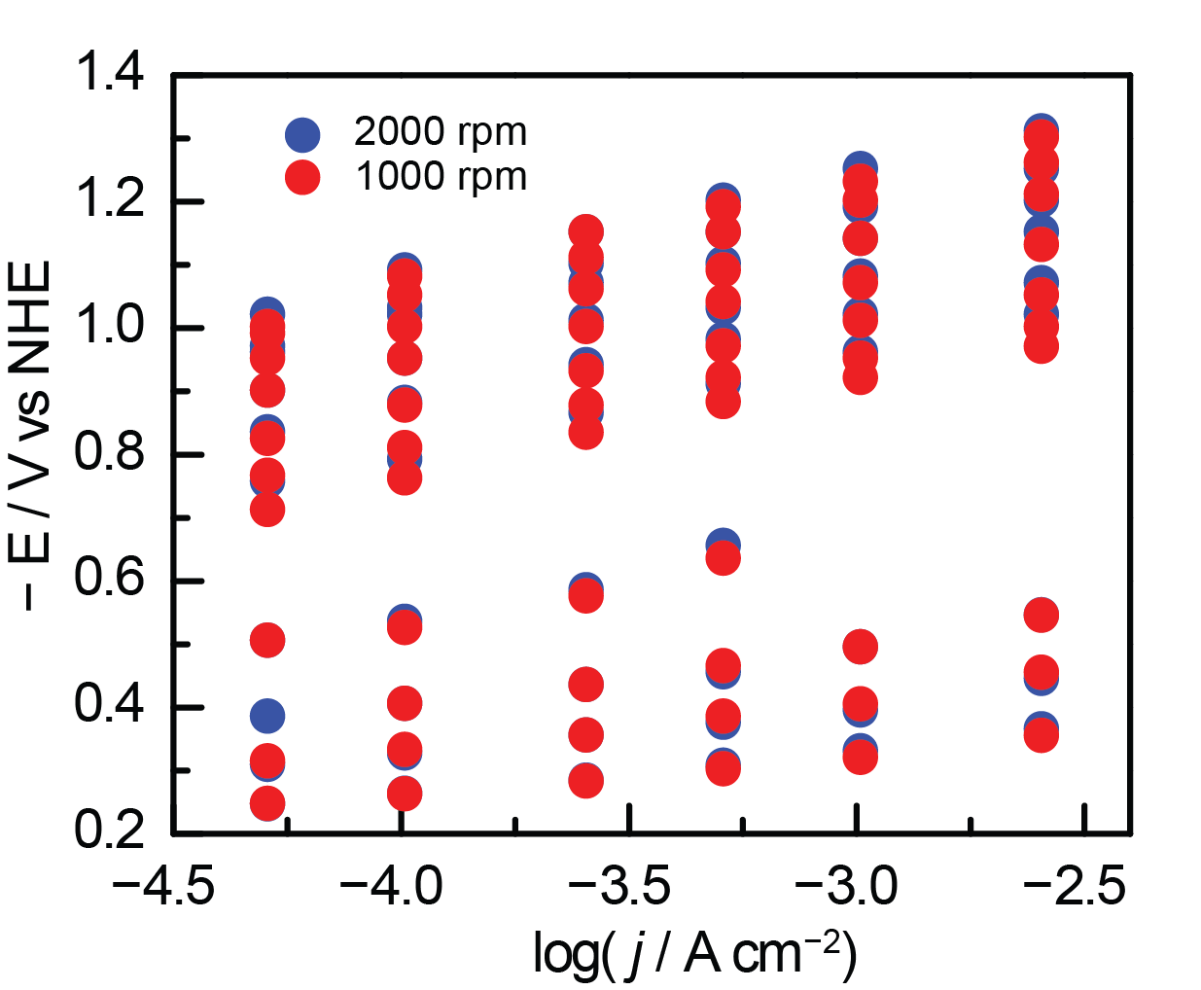
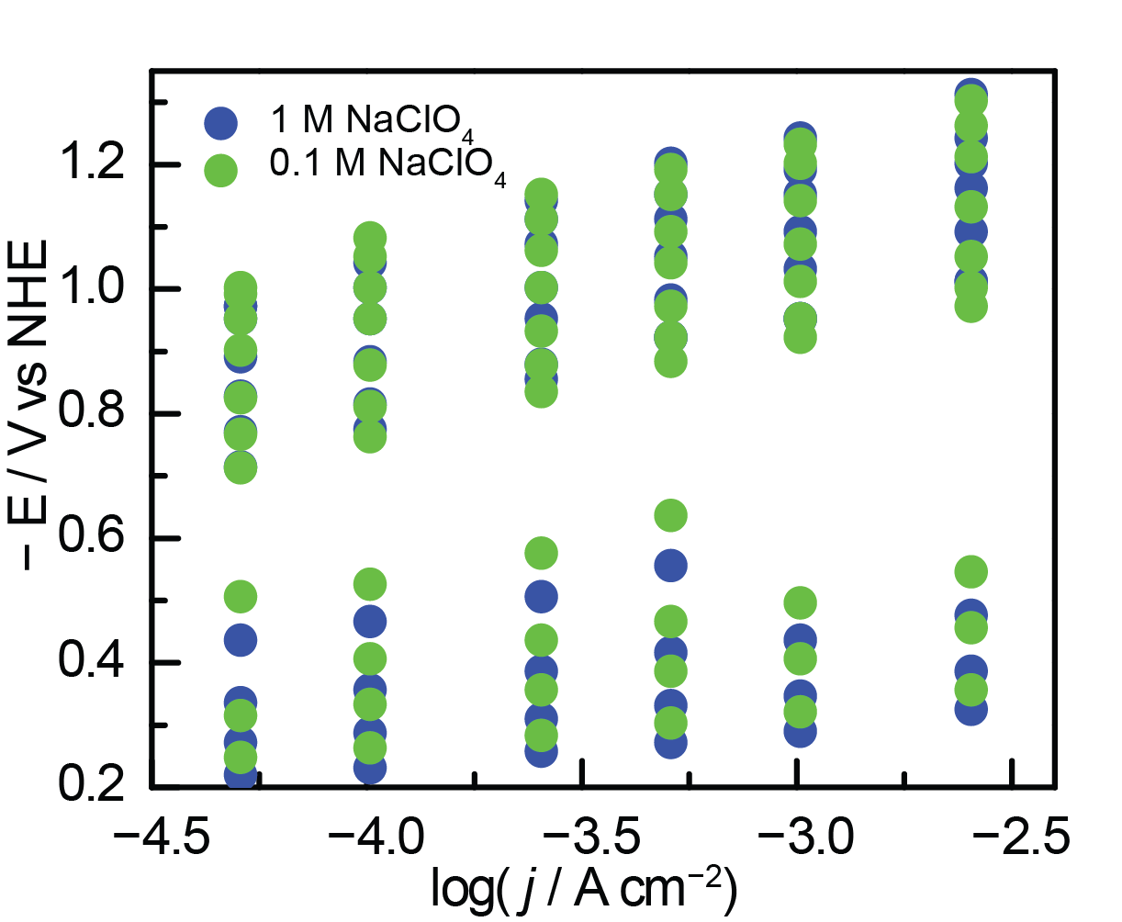
No diffusion or migration effects observed
Similar activity observed at different rotation rates
Similar activity observed with different concentrations of supporting electrolyte

