Slide 1


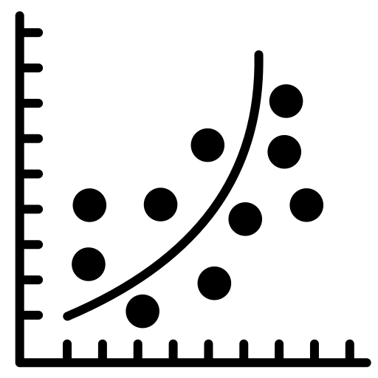



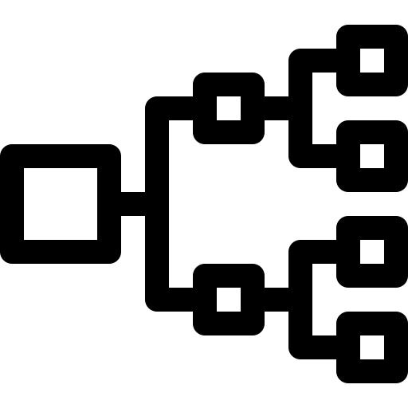


Unconstrained ML model training
Feature importance extraction
ML model partitioning
1
2
W
3
Database
Monolithic ML model
Importance matrix
...
...
...
1
5
...
...
6
4
n
User plane
Ordered ML sub-models
ML sub-models
ML sub-model P4 build
ML sub-model sequencing
Hardware-compliant
ML sub-models training

Slide 2
