Slide 1

stGradient
Distance-based analysis of tumor boundaries
in single-cell spatial transcriptomics
R package demo for collaborators • Xenium breast cancer example
Noah D. Simons
Contributors: Anton Kravchenko, Alexa Dowdell
github.com/ndsimons/stGradient
Notes:
Welcome. Today I'll walk through stGradient, an R package for quantifying how cells, cell-cell organization and gene expression change as a function of distance from tumor boundaries. Everything shown was run on a public 10x Xenium breast cancer section that was annotated and decontaminated with the SPLIT workflow.

Slide 2
Why stGradient: interactive tumor analysis in R
MOTIVATION
Single-cell spatial platforms like Xenium measure where every cell is and what it expresses, but turning that into answers about tumor biology usually takes custom code. stGradient makes those analyses routine.
Built for how researchers already work
Questions it is built to answer
• Stays in R and Seurat: works directly on Xenium Seurat objects; results come back as metadata columns, sf polygons and data frames
• Interactive where it helps: draw tumor regions in a Shiny app and pull them straight into your session
• Reproducible where it matters: data-driven region calls and parameters you can re-run on every sample
• Publication-ready output: every plot is a ggplot you can restyle or combine
How far does the tumor’s influence extend into the stroma?
Are T cells infiltrating tumor nests, or held back in the stroma?
Which immune and stromal cells sit together around the tumor?
Which genes and programs change across the tumor margin?
Are there tertiary lymphoid structures, and how mature are they?
Xenium output
Seurat object
stGradient
Figures & tables
stGradient | spatial analysis of tumor boundaries
2
Notes:
The pitch in one slide. Viewers such as Xenium Explorer are great for looking at the tissue, but quantitative questions about tumor boundaries (how far, which cells, which genes) usually need bespoke scripts. stGradient packages those analyses as R functions that work on a standard Seurat object, so anyone comfortable with Seurat can go from a Xenium run to these answers interactively in their own R session. Each question on the right maps to one module we'll walk through.

Slide 3
Roadmap
01
Why tumor boundaries?
05
Spatial co-occurrence (PCF)
Biological motivation and the analytical gap
Which cell types organize together in the stroma?
02
Demo data
06
Gene–distance analysis
Xenium breast cancer, RCTD + SPLIT
Which genes rise or fall with distance?
03
Defining tumor regions
07
Tertiary lymphoid structures
Interactive drawing or DBSCAN + concave hulls
Call TLS from labels, validate with a signature
04
Distance profiles
08
Takeaways and discussion
How far does the tumor’s influence reach?
Summary, code, limitations, next steps
stGradient | spatial analysis of tumor boundaries
3
Notes:
For each analysis I'll cover: the motivating biological question, the method in enough detail to judge assumptions, the result on the demo data, and caveats.

Slide 4
Why tumor boundaries matter
WHY
• The invasive margin is a distinct ecosystem. Tumor, stroma, myeloid and lymphoid cells meet; gradients of chemokines, hypoxia and ECM remodeling shape who gets in.
• Immune spatial phenotypes predict outcome. Inflamed vs. immune-excluded vs. desert tumors respond differently to checkpoint blockade; T-cell density at the core and margin (e.g. Immunoscore) is prognostic.
• Excluded T cells are often trapped in stroma, e.g. by macrophages or fibroblast barriers, which is invisible if we only count cell types per sample.
• Tertiary lymphoid structures (TLS) near tumors associate with checkpoint response and survival.
• Single-cell spatial platforms (Xenium, CosMx, ATERA) give per-cell coordinates and transcriptomes, so we can measure these gradients directly instead of inferring them.
The analytical gap
• Most spatial tools summarize clusters / niches, not continuous change relative to a structure
• “Margin” widths are usually chosen arbitrarily (e.g. 100 µm)
• Boundary calls are often manual and irreproducible
What stGradient adds
• Reproducible tumor-region polygons from cell labels
• Signed per-cell distance to boundary as a common coordinate
• Separation, co-occurrence, gene-trend and TLS analyses on that coordinate
stGradient | spatial analysis of tumor boundaries
4
Notes:
Key idea: distance to the tumor boundary is a biologically meaningful axis. Immune exclusion, stromal barriers, and TLS formation are all spatial phenomena defined relative to tumor nests. Context references: Chen & Mellman 2017 (immune phenotypes), Galon et al. (Immunoscore), Peranzoni et al. 2018 PNAS (macrophages retain CD8 T cells in stroma), Cabrita/Helmink/Petitprez 2020 Nature (TLS and checkpoint response).

Slide 5
Questions stGradient answers
OVERVIEW
Biological question | Module | Key functions
Where exactly are the tumor nests? | Region selection | launch_stGradient(), optimize_dbscan_params(), add_dbscan_polygons()
How far does the tumor's influence extend, and which cells change? | Distance profiles | calculate_boundary_distances(), calculate_distance_profile(), find_critical_distance()
Which cell types co-localize in the peritumoral stroma? | Pair correlation (PCF) | calculate_pcf_outside_summary(), plot_pcf_outside_pair_envelopes()
Which genes change along the tumor→stroma axis? | Gene–distance | compute_distance_from_boundary(), find_distance_associated_genes()
Are there organized lymphoid aggregates (TLS)? | TLS analysis | call_tls(), add_tls_score(), summarize_tls_score()
stGradient | spatial analysis of tumor boundaries
5
Notes:
Each module maps to a concrete biological question. All functions take a Seurat object with a spatial FOV and a cell-type column, so the package drops into existing Seurat workflows.

Slide 6
Workflow at a glance
OVERVIEW
Load
Define ROIs
Distance
load_xenium_seurat()
stable IDs + is_cancer flag
Shiny drawing or
DBSCAN + concave hull
signed distance of every
cell to nearest boundary
Distance profiles
PCF
Gene–distance
TLS
transcriptomic distance
composition difference
DE strength
critical distance
cross-type pair correlation
outside tumor
Monte Carlo envelopes
per-gene linear model +
Spearman vs distance
BH-adjusted
DBSCAN on B+T cells
maturity flag (LAMP3+ DC)
signature-score validation
Every module returns ggplot objects / data frames; TLS calling needs only cell labels + coordinates (no tumor polygons).
stGradient | spatial analysis of tumor boundaries
6
Notes:
The organizing principle is a single per-cell coordinate: signed distance to the nearest tumor boundary, negative inside, positive outside. Downstream modules all consume that coordinate or the polygons. TLS calling is independent of the tumor polygons.

Slide 7
PART 1
Demo data
Public 10x Xenium FFPE breast cancer section, annotated with RCTD and decontaminated with SPLIT

Slide 8
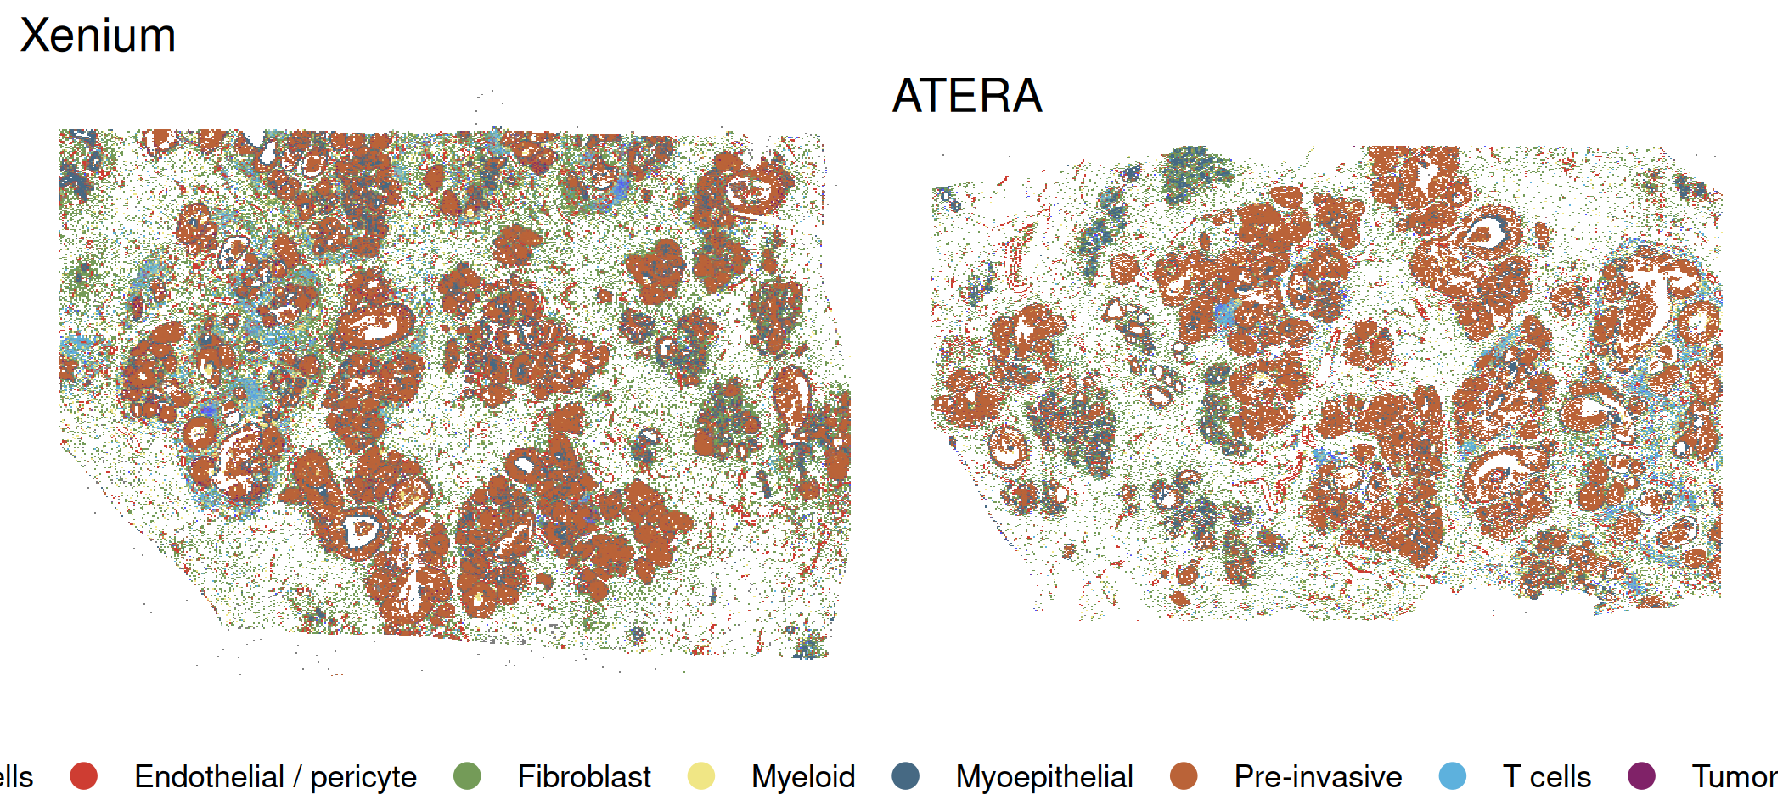
Demo data: Xenium FFPE human breast cancer
DATA
• Sample: 10x Genomics public dataset “Xenium FFPE Human Breast with biomarkers” (sample S1, bottom section)
• Platform: Xenium in situ, targeted panel (269 genes in the object)
• Field: ≈ 7.5 × 5.5 mm, >100k segmented cells
• Histology: ductal carcinoma in situ (DCIS) and invasive carcinoma nests in a stroma rich in T, B and myeloid cells
• Processed in the SPLIT vignette “ATERA vs Xenium comparison plus SPLIT”, which compares Xenium to a matched full-transcriptome ATERA section from the same donor
Xenium (used here) and matched ATERA section. Source: SPLIT vignette
Why this dataset for a demo
Public and well annotated; contains both pre-invasive (DCIS) and invasive tumor nests, an immune-rich stroma, and lymphoid aggregates, so every stGradient module has signal to find.
stGradient | spatial analysis of tumor boundaries
8
Notes:
Data sources listed in the SPLIT vignette: Xenium https://www.10xgenomics.com/datasets/xenium-ffpe-human-breast-biomarkers (S1 bottom); ATERA WTA FFPE human breast cancer; Chromium Flex reference from Janesick et al. 2023. We use only the Xenium object downstream. Cell counts / field size are approximate from the coordinate range.

Slide 9
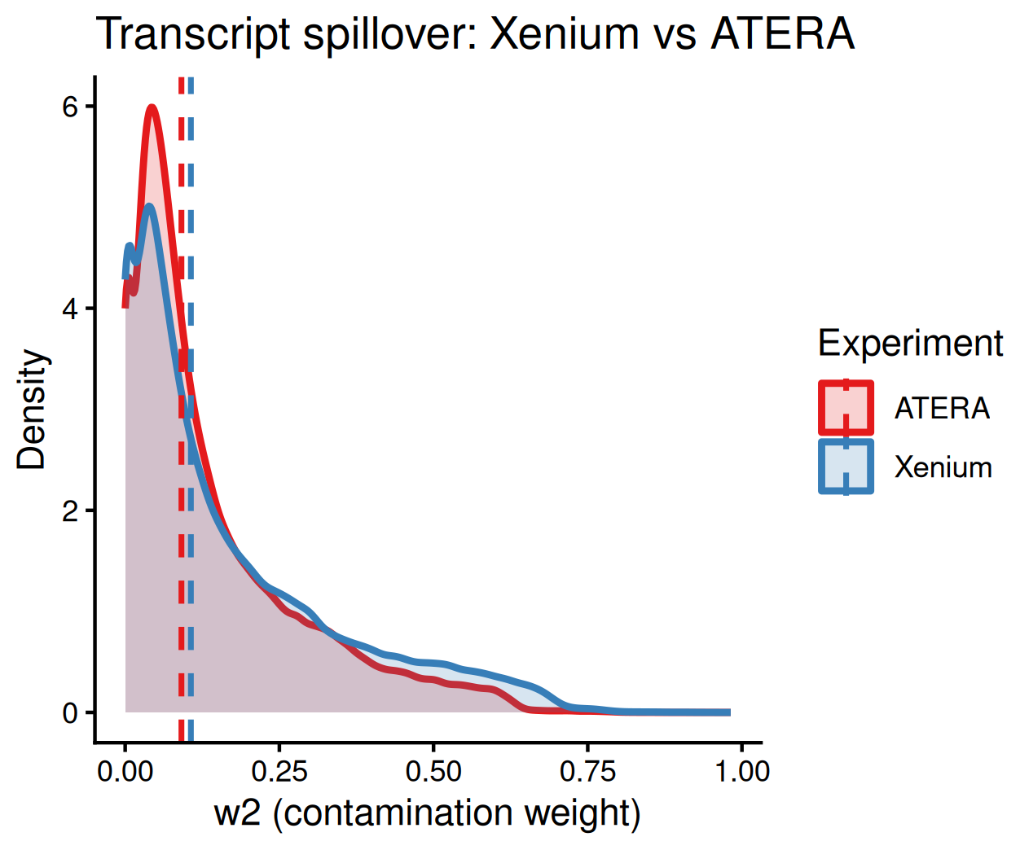
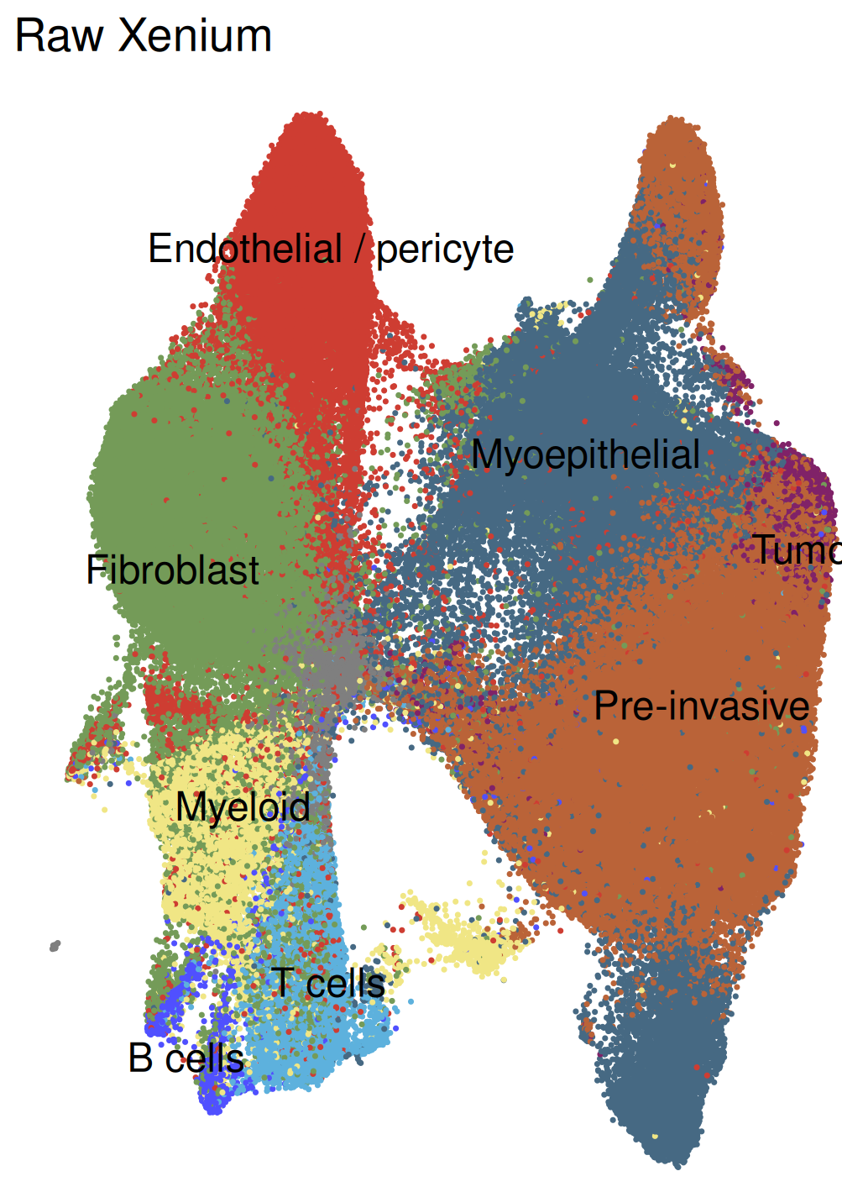
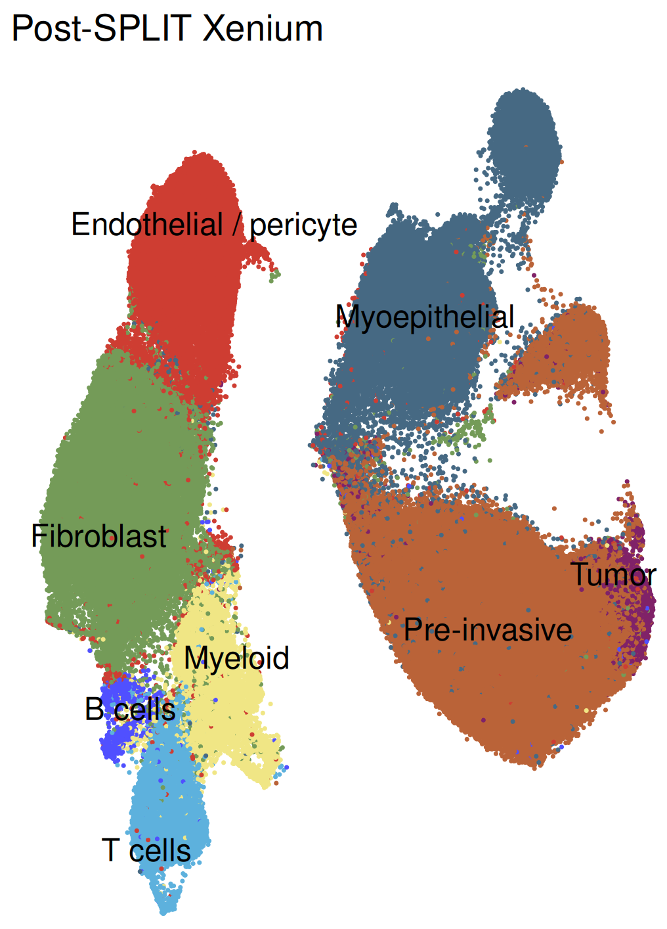
Demo data: annotation and SPLIT decontamination
DATA
1 Reference
Janesick et al. 2023 Chromium Flex breast cancer snRNA-seq; hybrid clusters (“T Cell & Tumor”, “Stromal & T Cell”) removed
2 Annotation
rctd-py (Python RCTD) → first_type, second_type and per-cell weights; we use the fine-grained Level 3 labels
3 Purification
SPLIT::purify() subtracts transcripts from the neighbouring cell type; low-count cells and rare genes filtered
Secondary-type weight (w2): spillover proxy
Xenium UMAP before vs. after SPLIT
• Median w2 ≈ 0.1: a typical cell carries ~10% transcripts from a neighbour type
• After SPLIT, Xenium lineages separate cleanly (fibroblast / endothelial / myeloid / T / B / epithelial)
• Demo object = SPLIT-purified Xenium with RCTD Level 3 labels in first_type
Why decontamination matters here
Segmentation spillover is worst exactly at interfaces between unlike cells, i.e. at tumor boundaries. Without it, a macrophage touching a tumor nest “expresses” tumor genes and boundary gradients can be artifacts.
stGradient | spatial analysis of tumor boundaries
9
Notes:
SPLIT (bdsc-tds) uses RCTD deconvolution weights and the reference profiles to subtract the expected contribution of the secondary cell type from each cell's counts. As of v0.2.0 it is annotation-tool agnostic. For boundary analyses this is important: our gene-distance module would otherwise pick up tumor transcripts in immediately adjacent stromal cells purely from segmentation bleed.

Slide 10
Demo data: what is in the object
DATA
17 cell types in first_type (RCTD, Janesick Level 3)
library(stGradient)
seurat_obj <- load_xenium_seurat(
rds_path = "purified_xenium.rds",
celltype_col = "first_type",
cancer_labels = c("DCIS 1", "DCIS 2",
"Invasive_Tumor", "Prolif_Invasive_Tumor")
)
Tumor epithelium (cancer_labels)
DCIS 1, DCIS 2, Invasive_Tumor, Prolif_Invasive_Tumor
Myoepithelial
Myoepi_ACTA2+, Myoepi_KRT15+
Stroma / vascular
Stromal, Endothelial, Perivascular-Like
• Reads the Seurat .rds, builds a stable cell ↔ barcode map
• Adds is_cancer from the labels you choose: the definition of “tumor” is an explicit, reviewable decision
• DCIS and invasive labels are both treated as tumor here; they can be split to compare pre-invasive vs. invasive boundaries
Myeloid
Macrophages_1, Macrophages_2, LAMP3+_DCs, IRF7+_DCs, Mast_Cells
Lymphoid
B_Cells, CD4+_T_Cells, CD8+_T_Cells
stGradient | spatial analysis of tumor boundaries
10
Notes:
The cancer_labels argument is the single most consequential choice: it defines which cells seed the tumor polygons. For immunology questions about invasive fronts specifically, one could rerun with only Invasive_Tumor and Prolif_Invasive_Tumor.

Slide 11
PART 2
Defining tumor regions
Every downstream metric is measured relative to these polygons, so they must be reproducible and auditable

Slide 12
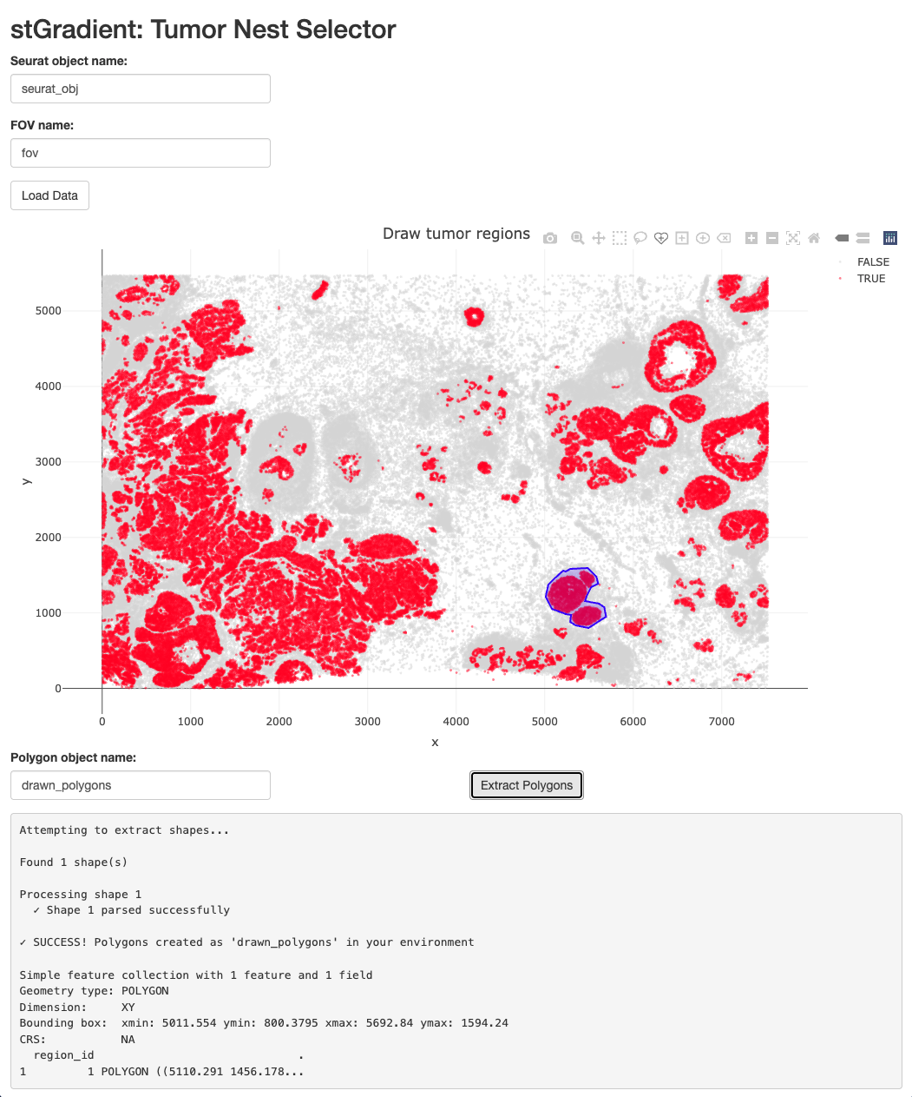
Route 1: drawing tumor regions interactively
REGIONS
When to use it
When a pathologist or collaborator wants specific regions, e.g. a single invasive front, one DCIS duct, or areas that match an H&E annotation.
• launch_stGradient() opens a Shiny app with cells plotted by is_cancer
• Enter the Seurat object and FOV name, then Load Data
• Draw freehand polygons with the plotly toolbar, then Extract Polygons
• Polygons are returned to the R session as an sf object
launch_stGradient()
seurat_obj <- add_polygon_membership(seurat_obj, drawn_polygons)
stGradient | spatial analysis of tumor boundaries
12
Notes:
The drawn polygons feed every downstream function exactly like automated ones. The trade-off is reproducibility: hand-drawn regions are hard to repeat across many samples, which motivates the automated route on the next slide.

Slide 13
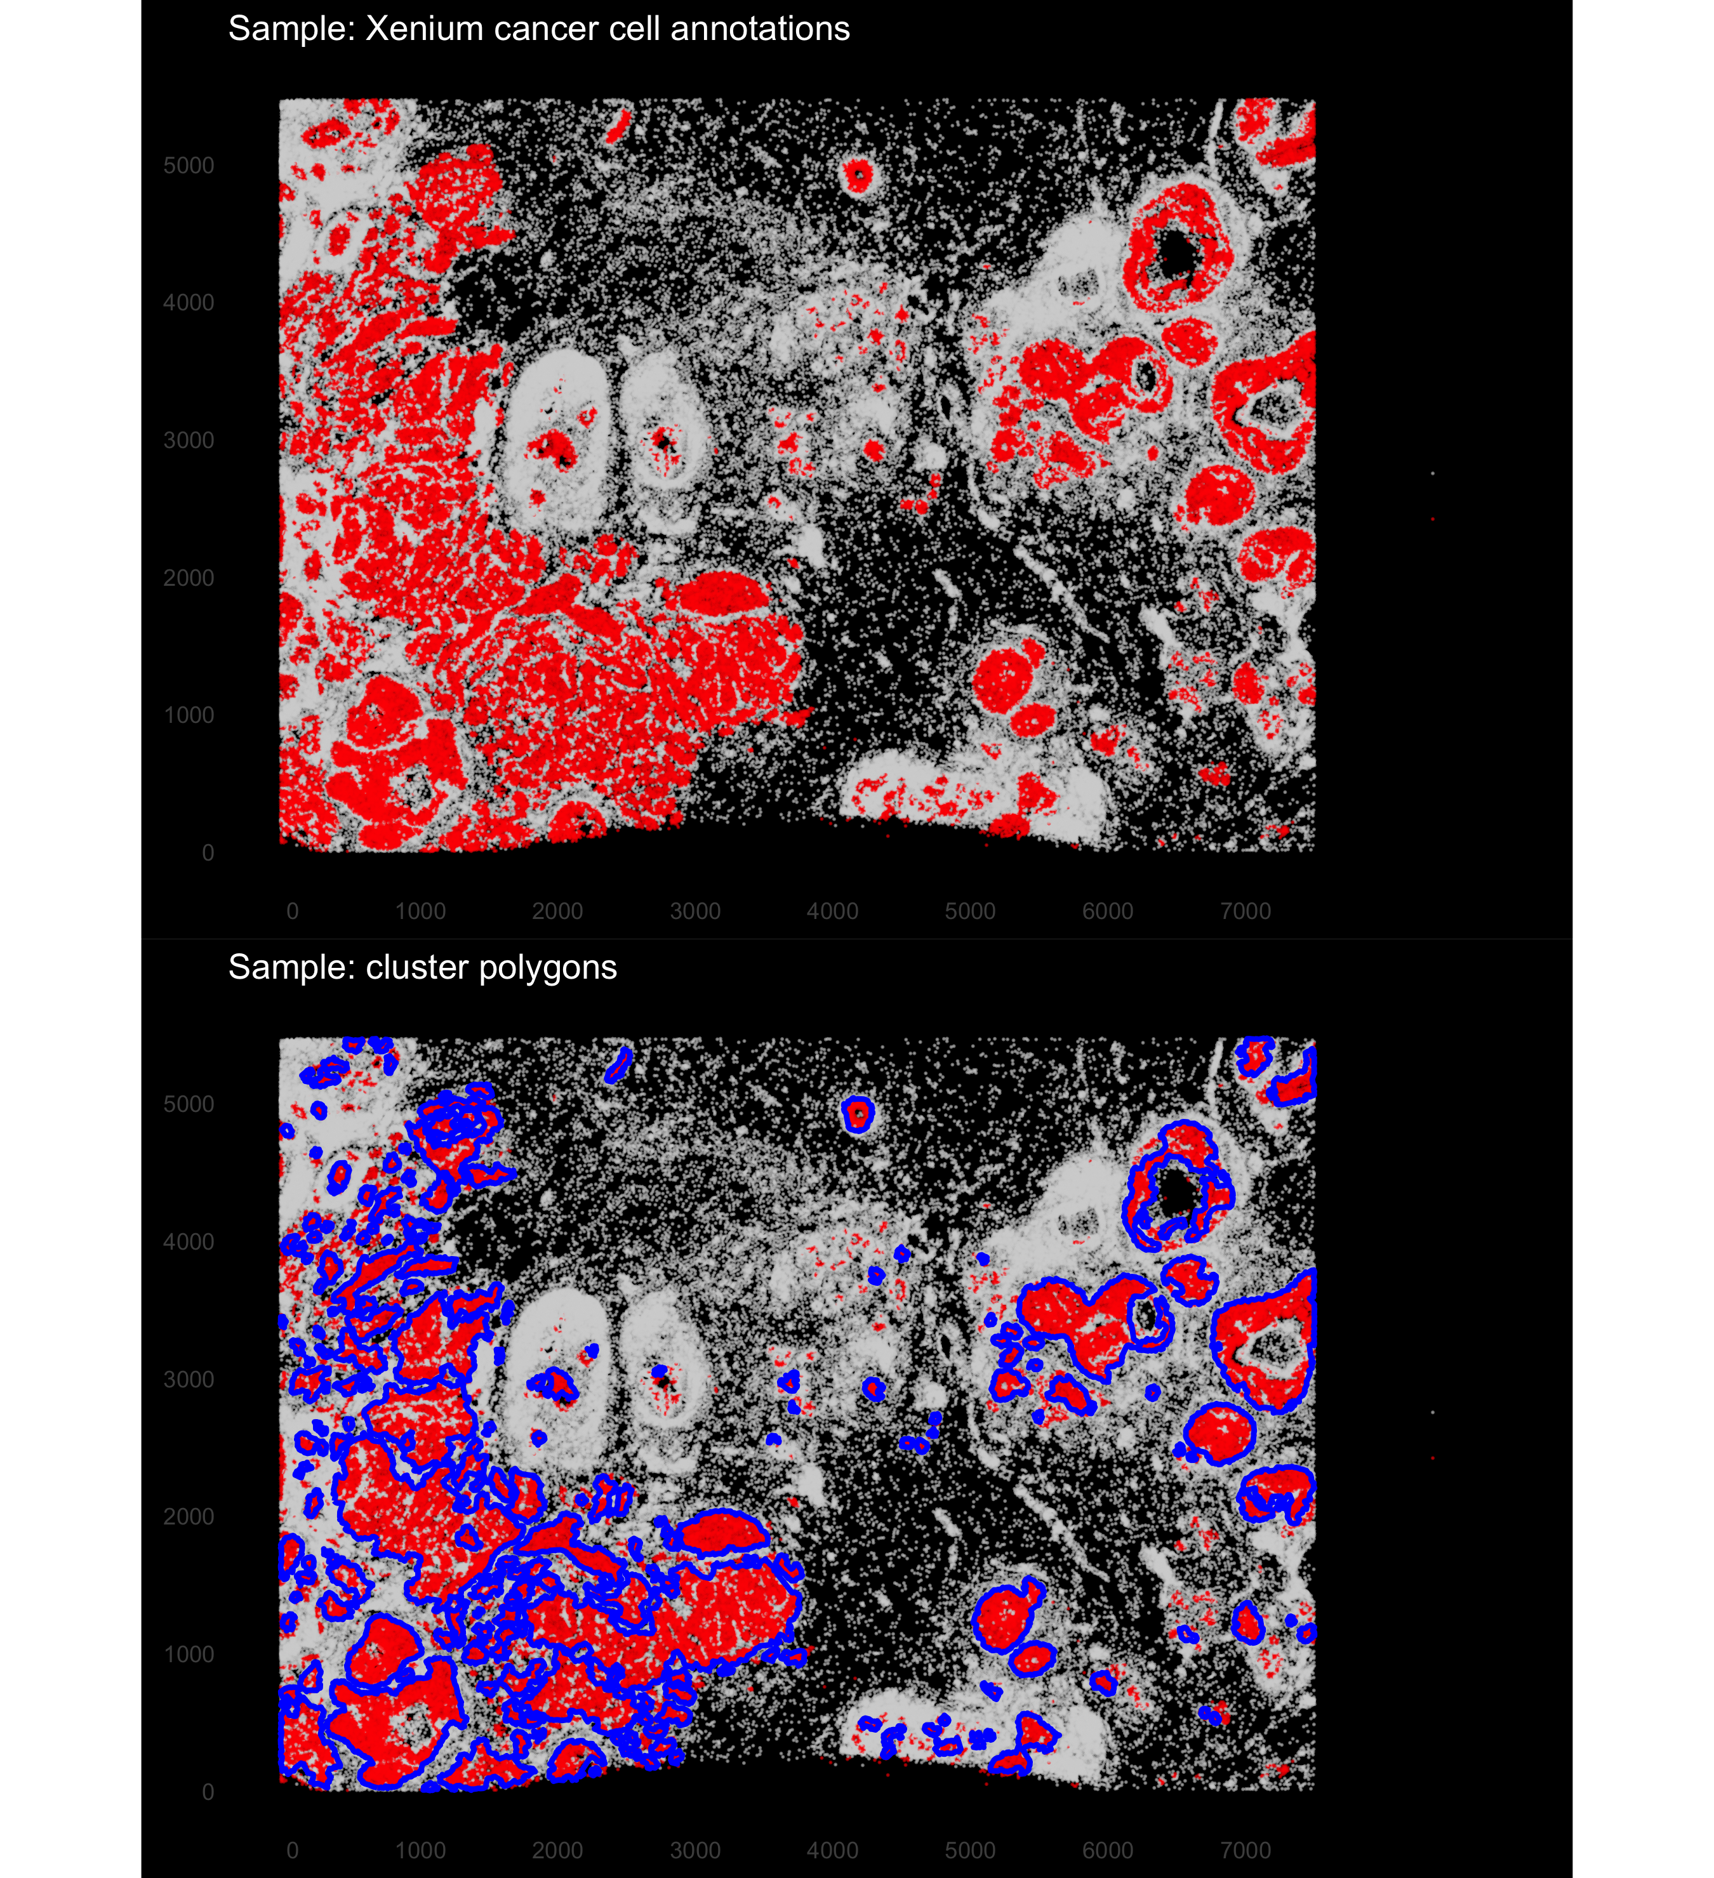
Route 2: automated detection with DBSCAN
REGIONS
Why automate
Manual annotation is slow and hard to reproduce across samples; automated calls scale and can be re-run with identical parameters.
• DBSCAN on cancer-labelled cells only: eps = neighborhood radius (µm), minPts = minimum neighbors for a dense core
• Isolated cancer cells become noise and are left outside polygons
• Each cluster is wrapped in a concave hull (concaveman; lower concavity = tighter fit)
• Returns sf polygons; add_polygon_membership() flags each cell inside/outside
seurat_obj <- add_dbscan_polygons(seurat_obj,
eps = 35, minPts = 20)
auto_polygons <- get_cancer_regions(seurat_obj)
add_dbscan_polygons(): cancer cells (red), polygons (blue)
stGradient | spatial analysis of tumor boundaries
13
Notes:
DBSCAN groups cancer cells into dense clusters; a concave hull then follows the shape of each nest rather than a convex envelope that would swallow stroma. Figure shows eps = 35 um, minPts = 20. The next slide shows how to choose these parameters from the data.

Slide 14
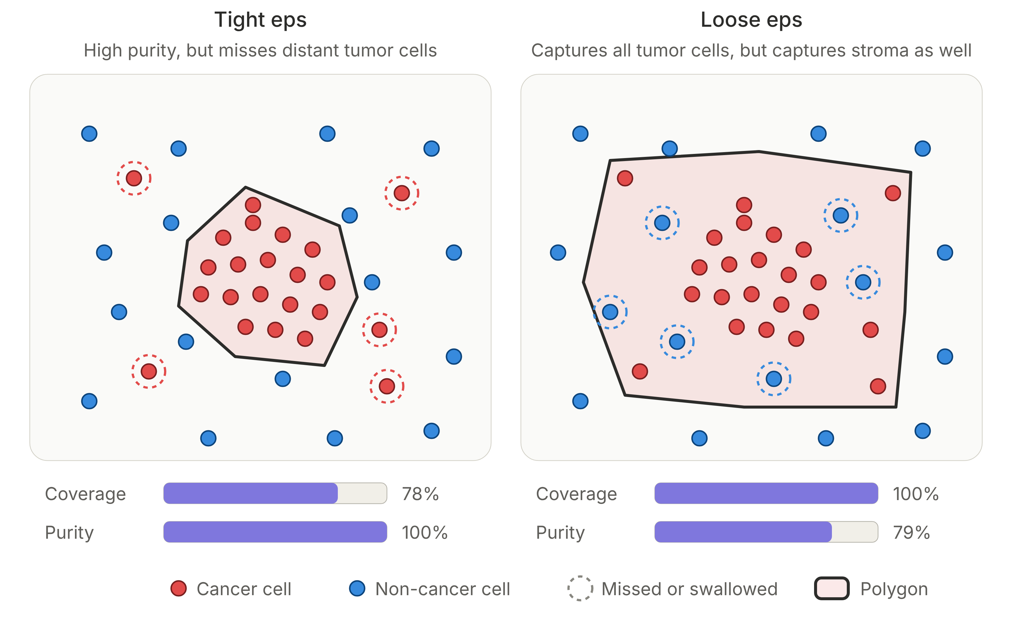
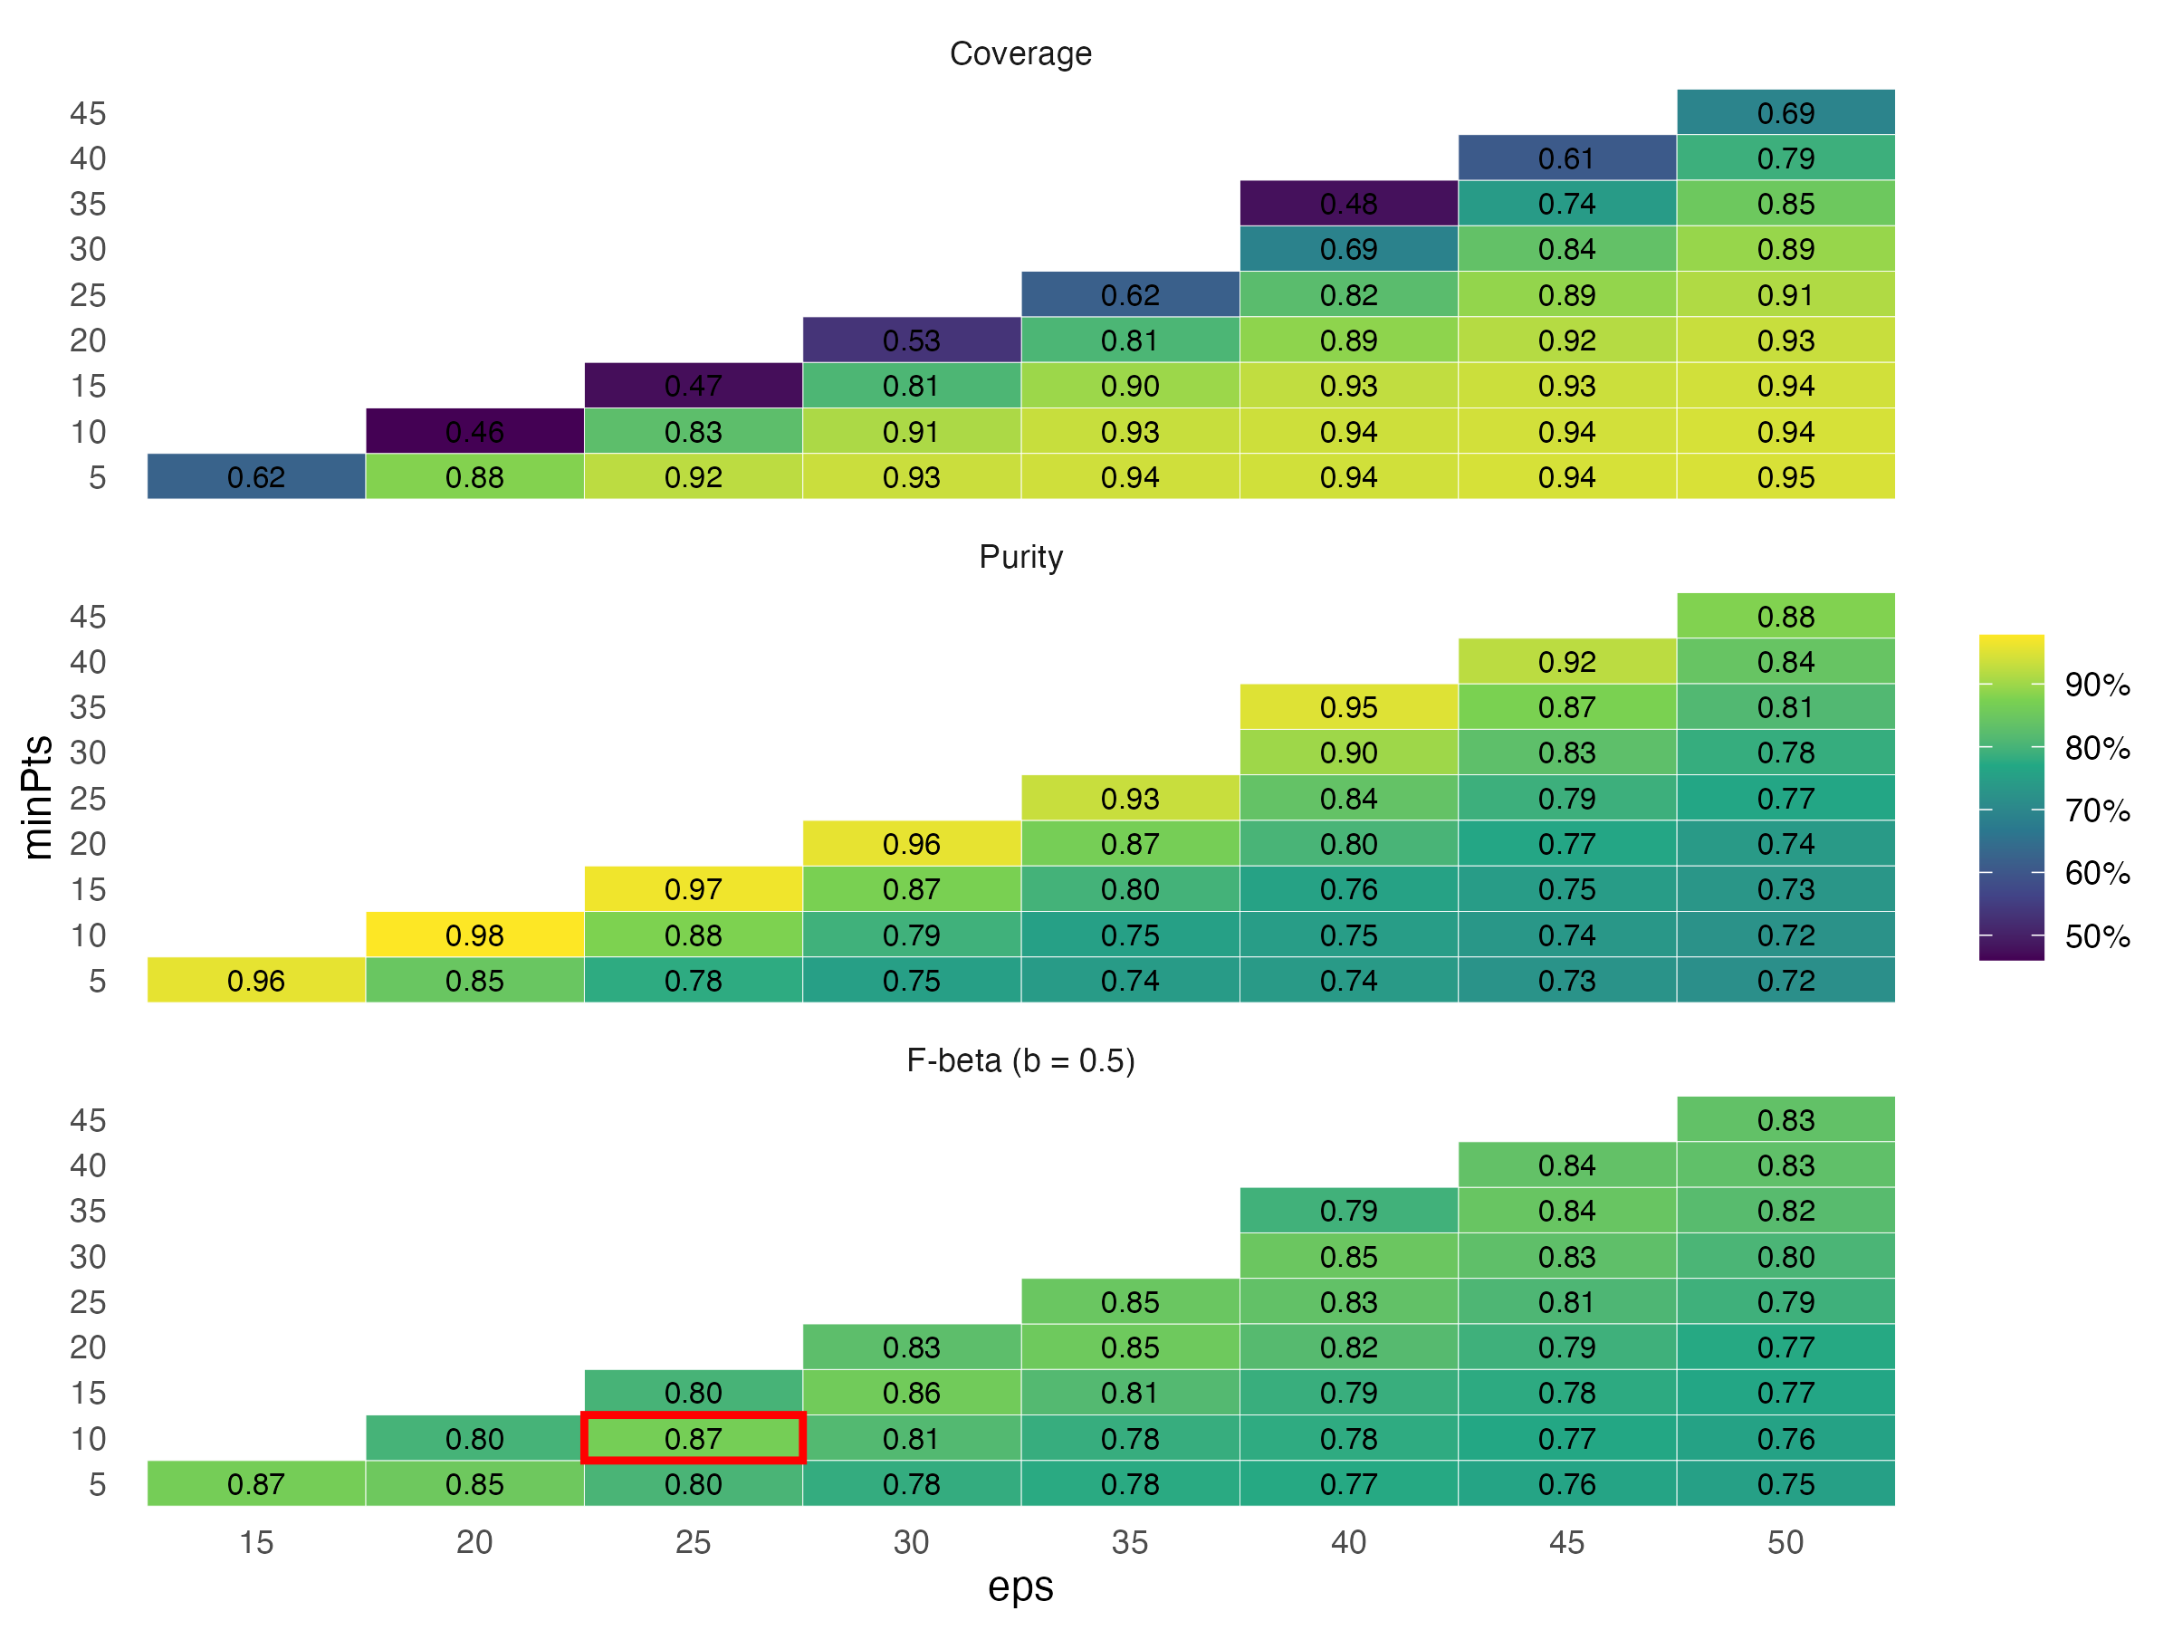
Choosing DBSCAN parameters: coverage vs. purity
REGIONS
• Coverage = fraction of cancer cells inside a polygon; Purity = fraction of cells in polygons that are cancer
• Fβ = (1+β²)·P·C / (β²P + C); β = 0.5 weights purity more
• Grid over eps × minPts; settings with >15% cancer cells as noise are discarded; ties broken by silhouette
• Demo optimum: eps = 25 µm, minPts = 10 (C = 0.83, P = 0.88, F0.5 = 0.87)
stGradient | spatial analysis of tumor boundaries
14
Notes:
optimize_dbscan_params() makes the trade-off explicit. Loose eps swallows stroma into the tumor (lower purity), which would bias every inside/outside comparison toward zero. We favor purity (beta = 0.5) because contaminating the 'inside' group is worse than missing scattered tumor cells. The figures later in this deck used eps = 35, minPts = 20 (F0.5 = 0.85, close to optimal).

Slide 15
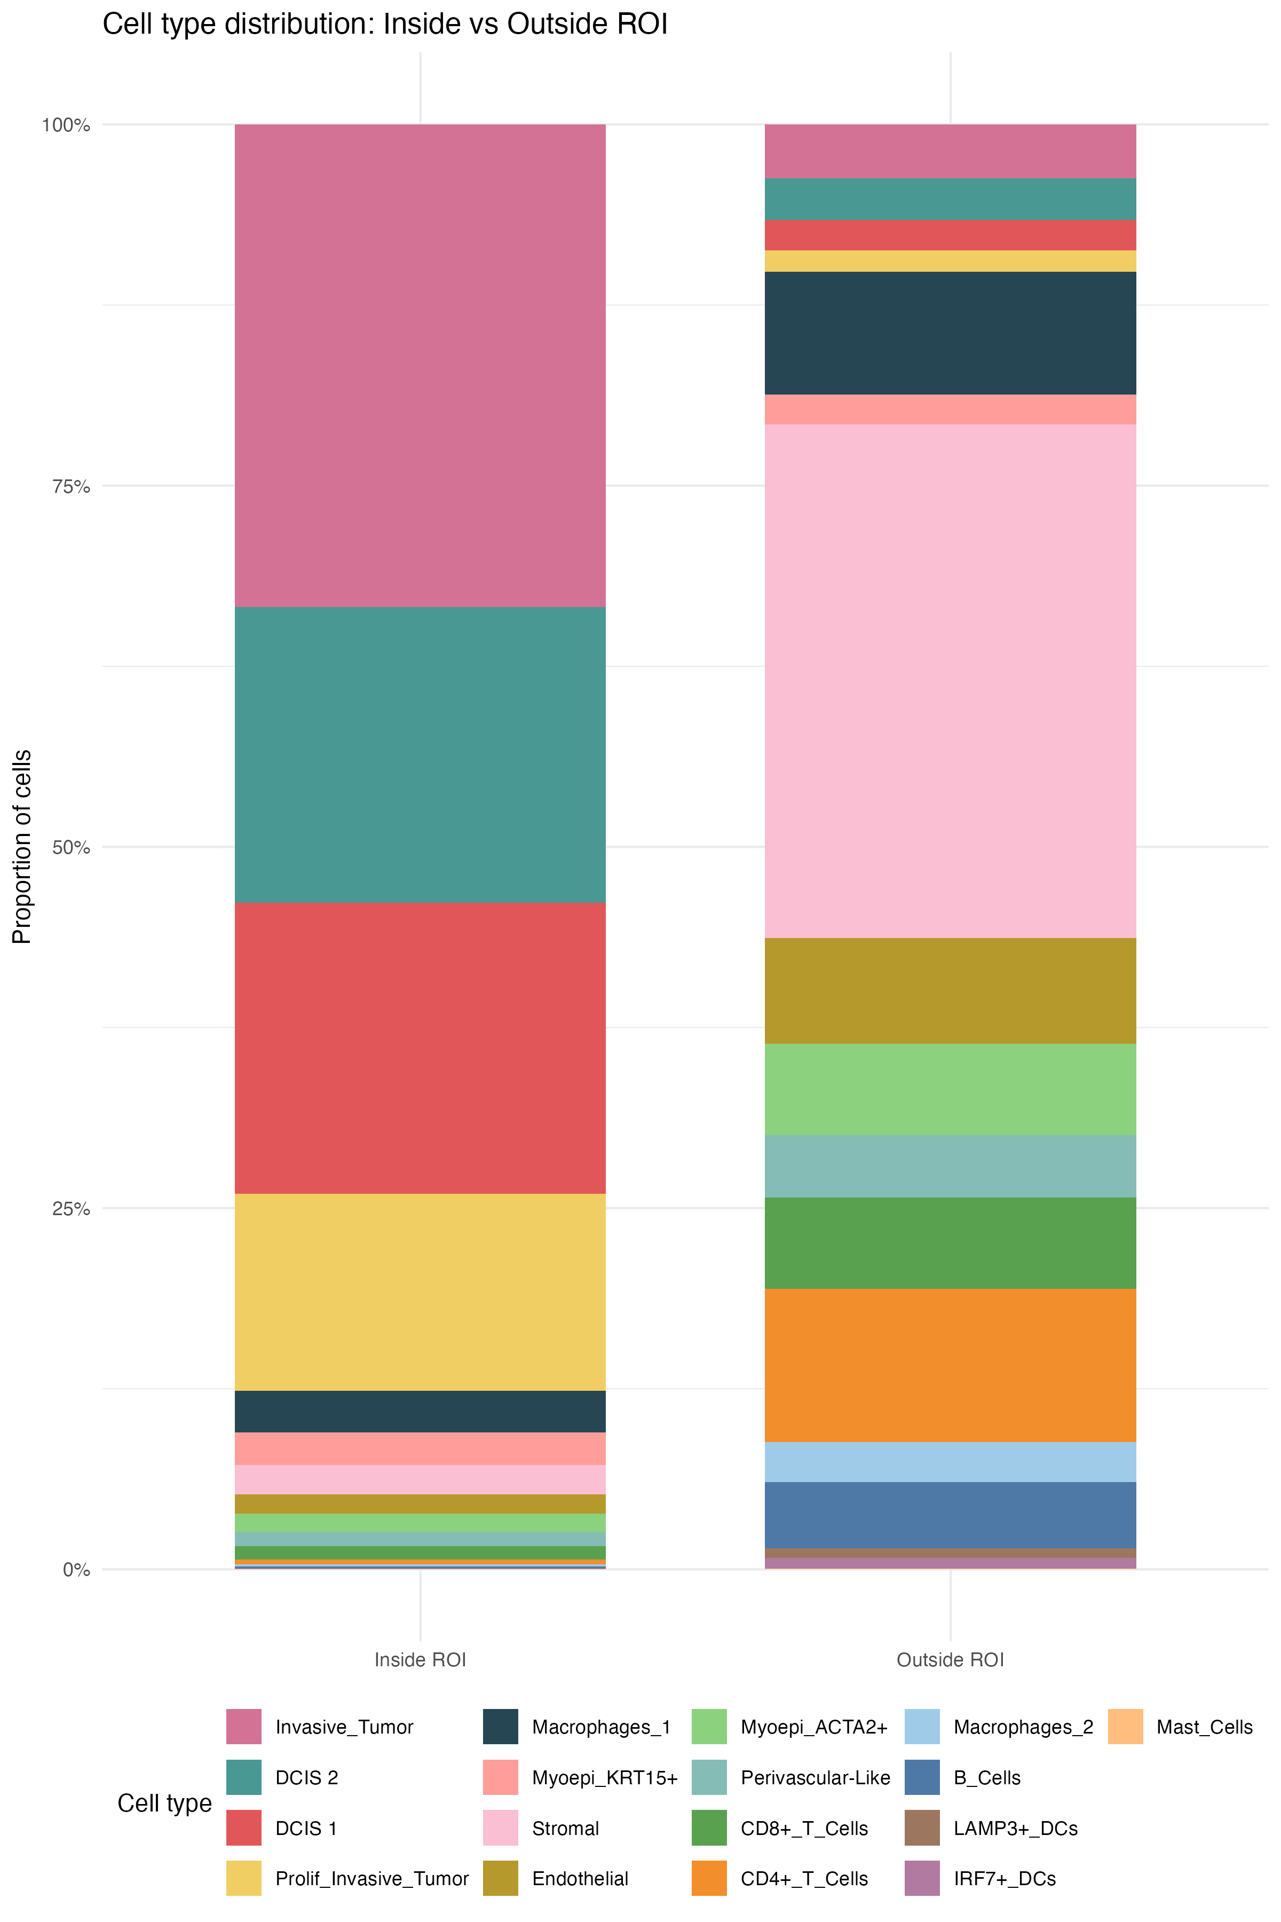
ROI QC: composition inside vs. outside the polygons
REGIONS
Motivation
Before measuring gradients, confirm that polygons capture tumor and exclude the microenvironment. This is the sanity check collaborators should look at first.
• Inside: ≈ 85–90% tumor (Invasive, DCIS 1/2, Prolif_Invasive); small residual macrophages and myoepithelium
• Outside: Stromal is the largest population, followed by CD4+ T, Macrophages_1, Endothelial, CD8+ T, Myoepi_ACTA2+ and B cells
• Lymphocytes are almost absent inside polygons (CD8+ ≈ 1%), a first hint of a non-inflamed / excluded pattern
• Also available: plot_roi_celltype_dist() and plot_roi_inout_celltype_dodge() for counts
stGradient | spatial analysis of tumor boundaries
15
Notes:
qc_plot_xenium() returns the per-cell data frame used for these bar charts. Proportions read from the stacked bar; exact numbers are available from qc_out$df.

Slide 16
PART 3
Distance profiles
How far from the boundary does the microenvironment stop looking like tumor, and which cell types drive that change?

Slide 17
Method: signed distance and separation metrics
DISTANCE
• Signed distance: Euclidean distance from each cell centroid to the nearest polygon boundary (sf), negative inside
• Inside group: “all inside” (whole tumor) or “boundary inside” (tumor cells within d of the edge)
200 µm
100 µm
Transcriptomic distance
d
1 − Pearson r between mean log-normalized expression profiles of inside vs. outside (0 = identical, 2 = anti-correlated)
tumor
d < 0
Composition difference
Σ (p_in − p_out)² summed over cell types; per-type terms kept to show which types drive separation
DE strength
Mean |log2FC| of top 100 genes, Seurat FindMarkers (Wilcoxon, min.pct 0.1) inside vs. outside
Critical distance
Outside group at threshold d = all cells with 0 < distance ≤ d (cumulative shells, d = 10…200 µm)
find_critical_distance(): distance of maximum separation, and plateau = first d reaching 90% of max
stGradient | spatial analysis of tumor boundaries
17
Notes:
Three complementary views of 'how different is the outside from the tumor': whole-transcriptome similarity (pseudobulk correlation), cell-type composition, and the magnitude of the strongest DE genes. Because the outside group is cumulative (0, d], each value summarizes everything within d; the slope of the curve tells you where change is happening. Composition difference is independent of sample size; DE strength depends on Seurat's test and filters.

Slide 18
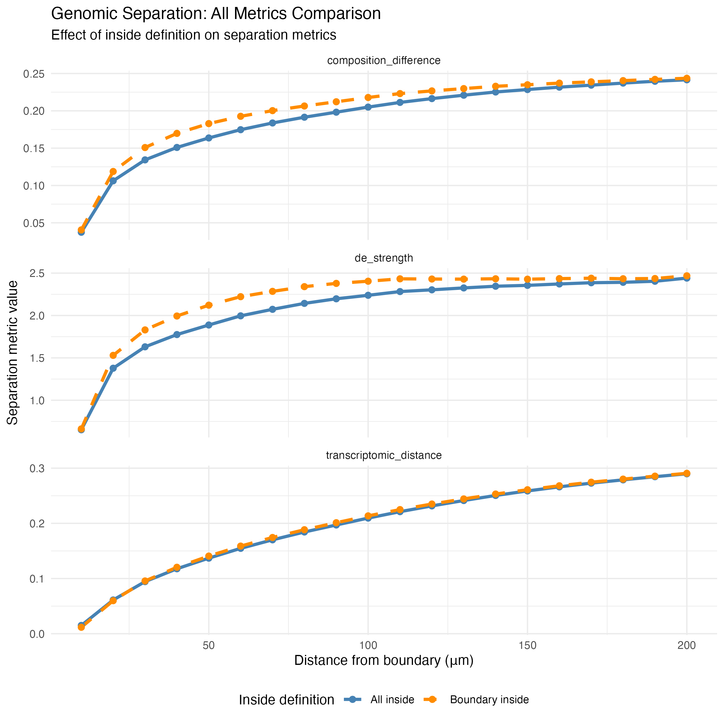
Result: separation rises within ~40 µm, then plateaus
DISTANCE
Why it matters
Gives a data-driven definition of the “margin”: how wide the peritumoral zone should be for downstream comparisons, instead of an arbitrary 100 µm.
• All three metrics climb steeply over the first 20–40 µm (~2–4 cell diameters): the immediate rim still contains tumor-like cells and myoepithelium
• Composition and DE strength approach a plateau around ~100–150 µm; transcriptomic distance keeps rising slowly to 200 µm, suggesting gradual stromal programme changes extend further than cell-type shifts
• “Boundary inside” gives slightly stronger composition/DE separation at 30–100 µm; pseudobulk transcriptomic distance is nearly identical for both definitions
stGradient | spatial analysis of tumor boundaries
18
Notes:
Plateau values are approximate readings from the curves; find_critical_distance() returns them exactly. With cumulative shells the curves are monotone-ish by construction, so focus on where they bend. Comparing these curves across patients (e.g. responders vs non-responders) is the natural cohort-level use.

Slide 19
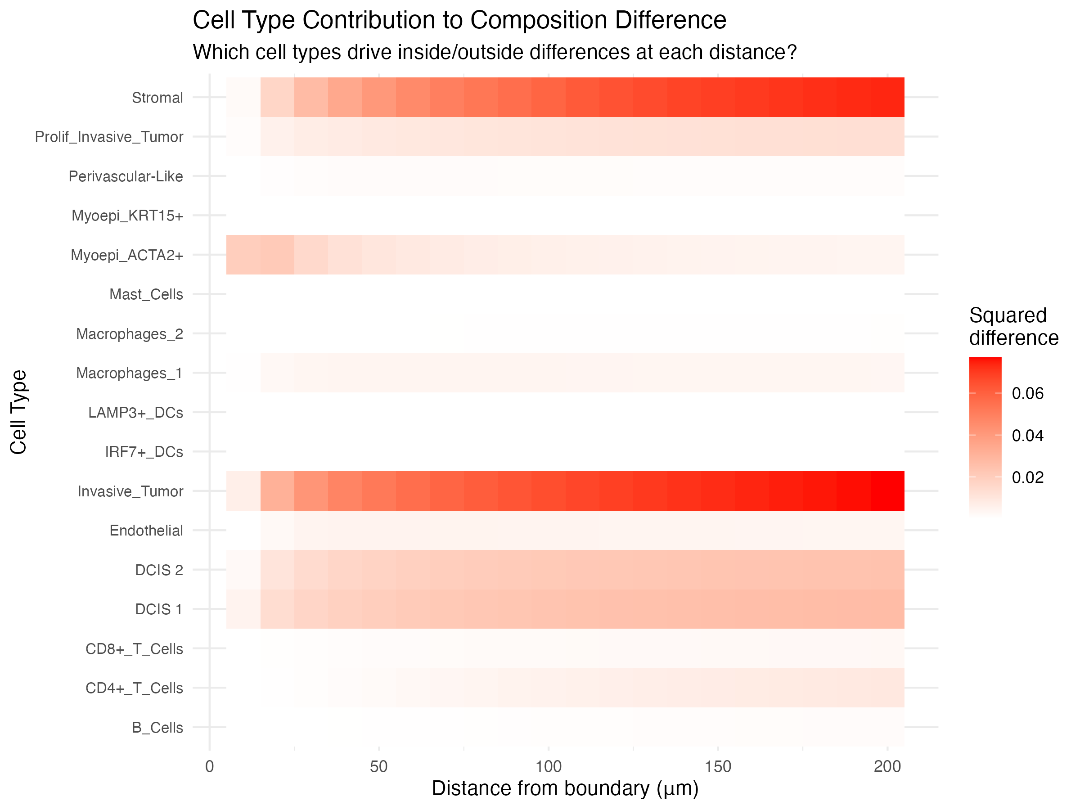
Which cell types drive the composition difference?
DISTANCE
Why it matters
Decomposes one summary number into cell types, so we can see which populations actually define the tumor–stroma boundary.
• Each tile = (p_in − p_out)² for one cell type at distance d; a column sums to the composition difference
• Invasive_Tumor loss and Stromal gain dominate and grow steadily with distance
• DCIS 1/2 contribute a constant share beyond ~30 µm
• Myoepi_ACTA2+ contributes only within ~30 µm: the myoepithelial layer wrapping DCIS ducts
• Immune types barely move the total because they are rare, so look at their proportions directly (next slide)
stGradient | spatial analysis of tumor boundaries
19
Notes:
plot_celltype_heatmap() uses results$celltype_contributions from calculate_distance_profile(). Because the metric is a sum of squared proportion differences, abundant populations dominate. Rare but biologically important populations such as T cells need the proportion view on the next slide.

Slide 20
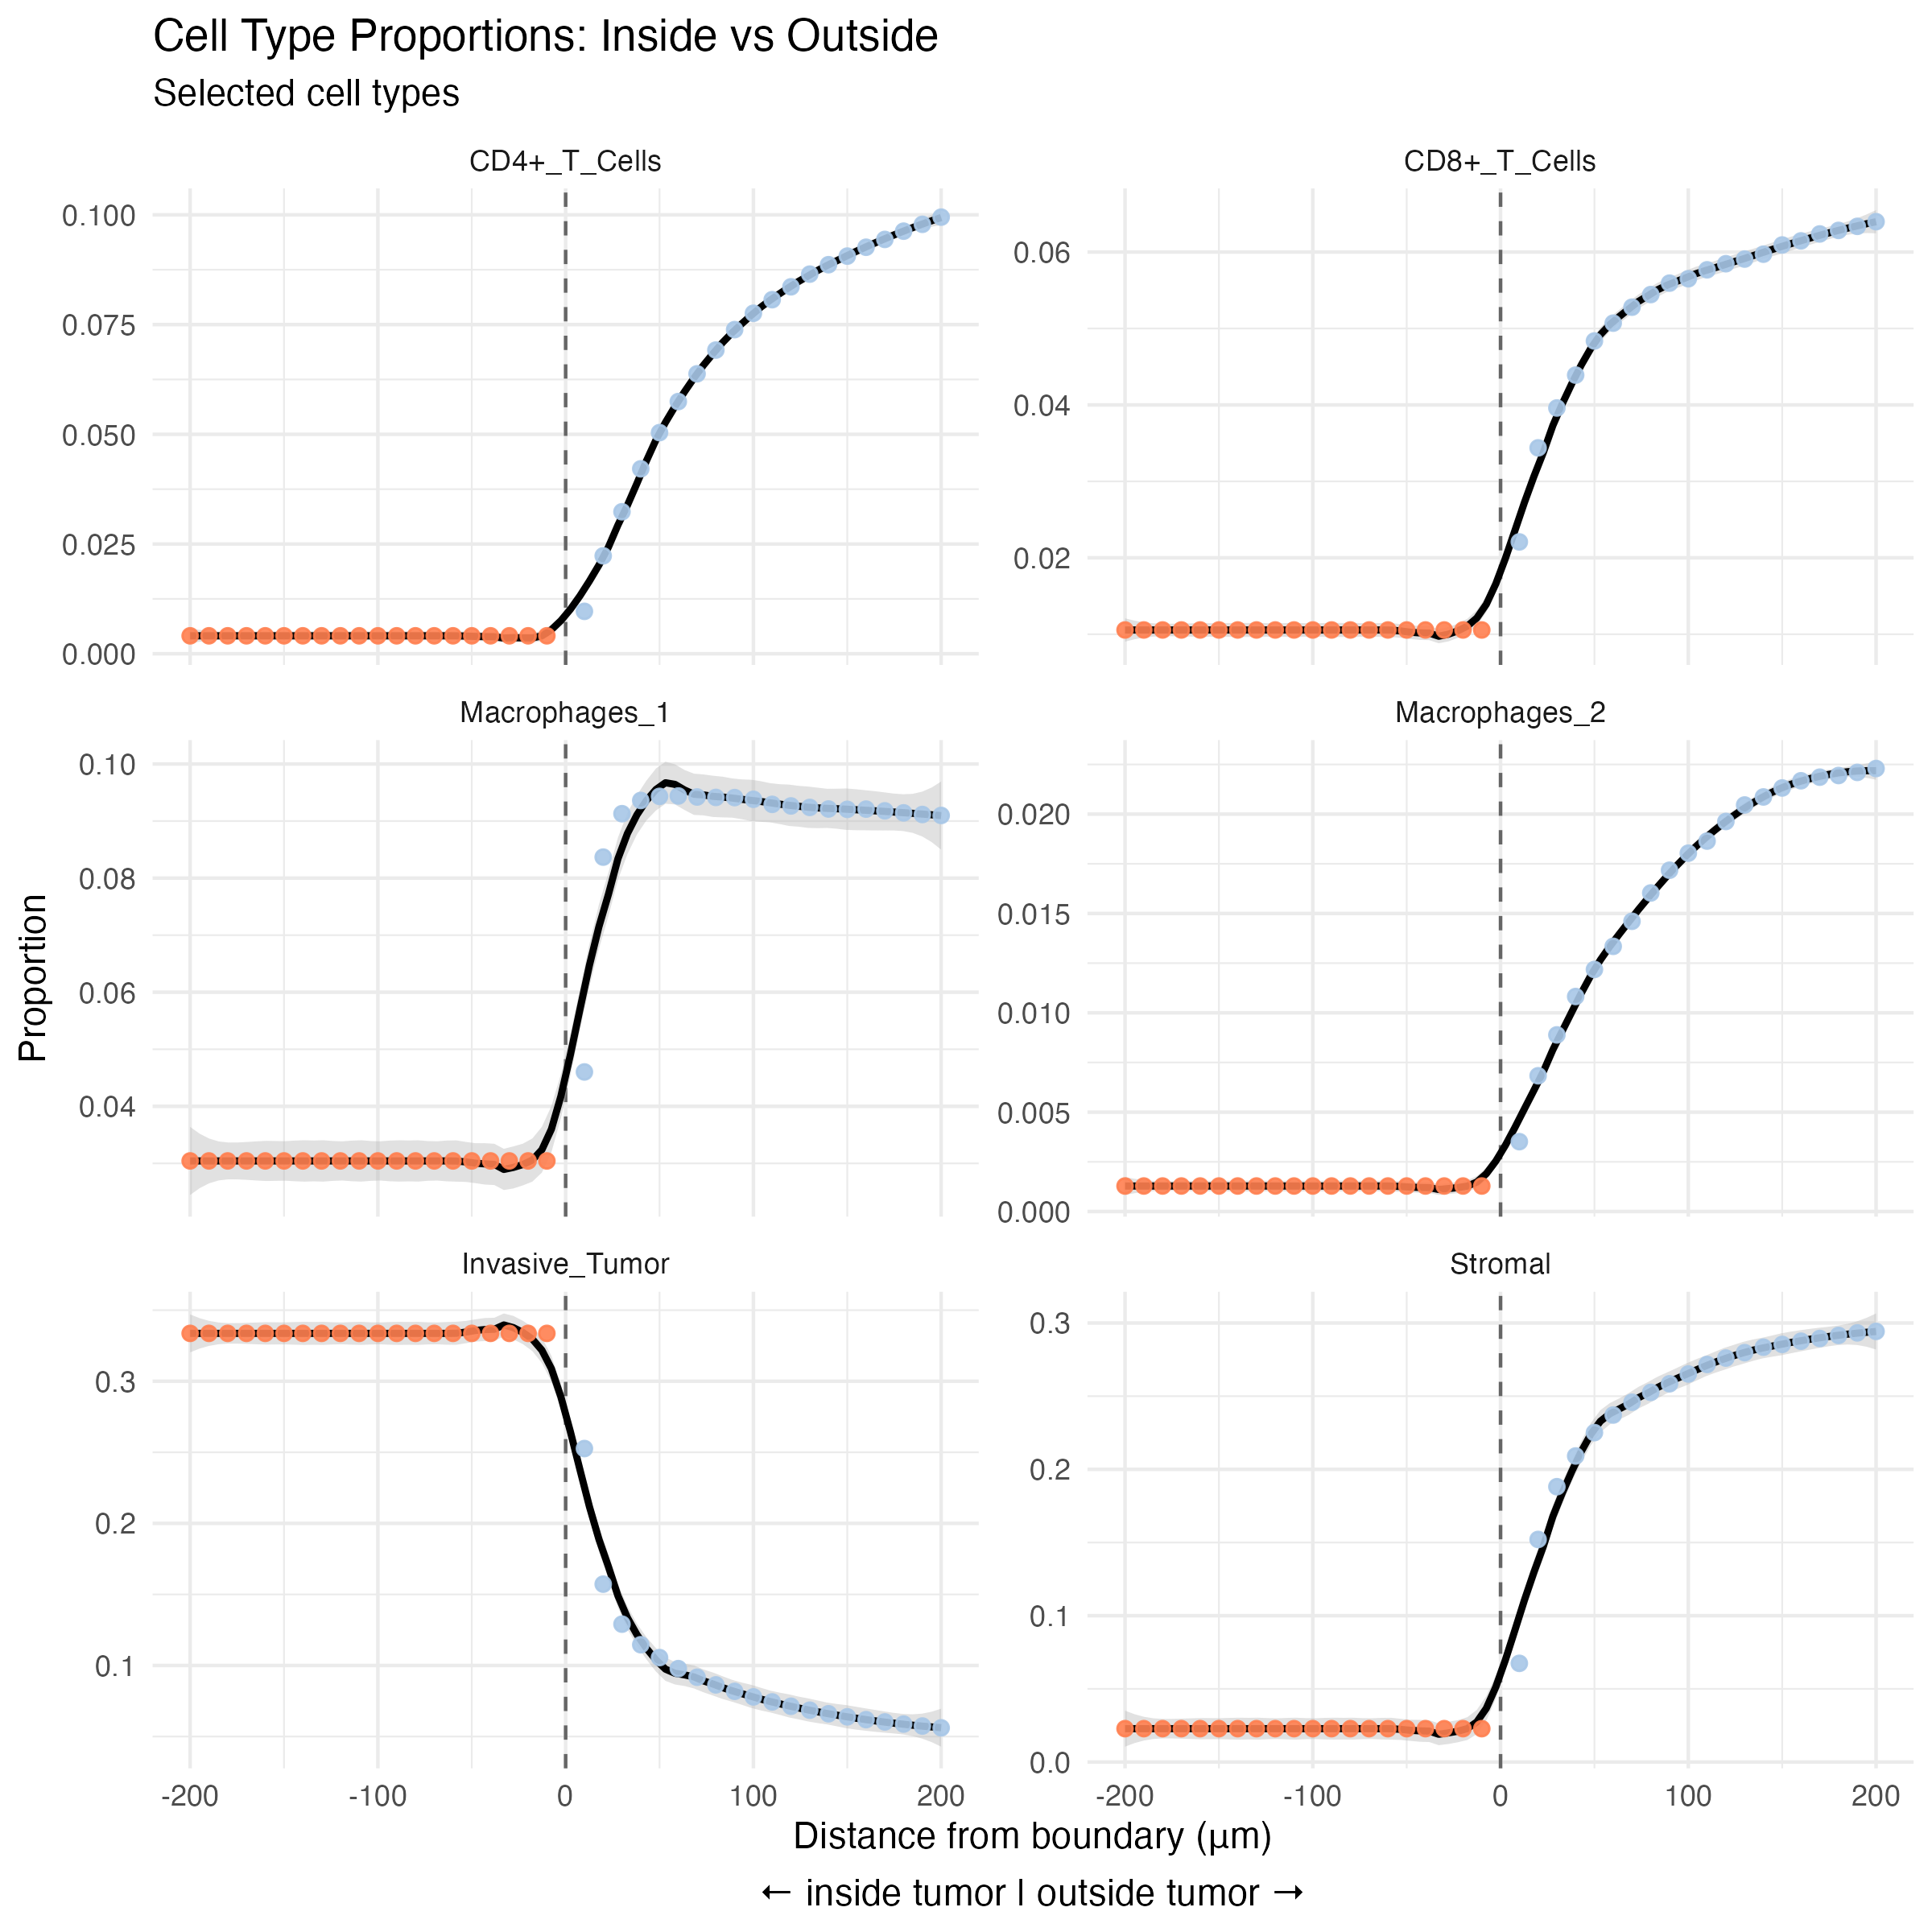
Cell-type gradients: macrophage rim, T cells further out
DISTANCE
• How to read: orange = proportion inside the tumor; blue = cumulative proportion of outside cells within d
• Macrophages_1 jump to a plateau (~9%) within ~40 µm: a macrophage rim at the tumor edge
• CD4+ and CD8+ T cells and Macrophages_2 rise gradually and are still increasing at 200 µm
• Inside the tumor, CD8+ T cells are ≈ 1% and CD4+ T cells < 0.5%
• Pick populations with plot_celltype_proportions(..., celltypes = c("B_Cells", "CD8+_T_Cells"))
Immunology read-out
Lymphocytes are depleted at the immediate margin and accumulate further into the stroma, behind a rim of macrophages: consistent with an immune-excluded-like margin. Worth testing across a cohort.
stGradient | spatial analysis of tumor boundaries
20
Notes:
plot_celltype_proportions() shows inside proportion (constant in inside_mode = 'all') and cumulative outside proportion. A macrophage rim with T cells held further out is the pattern described in e.g. Peranzoni et al. 2018 (PNAS). This is one section; the hypothesis needs cohort-level confirmation.

Slide 21
PART 4
Spatial co-occurrence (PCF)
Beyond “how many”: which cell types are organized together in the peritumoral microenvironment?

Slide 22
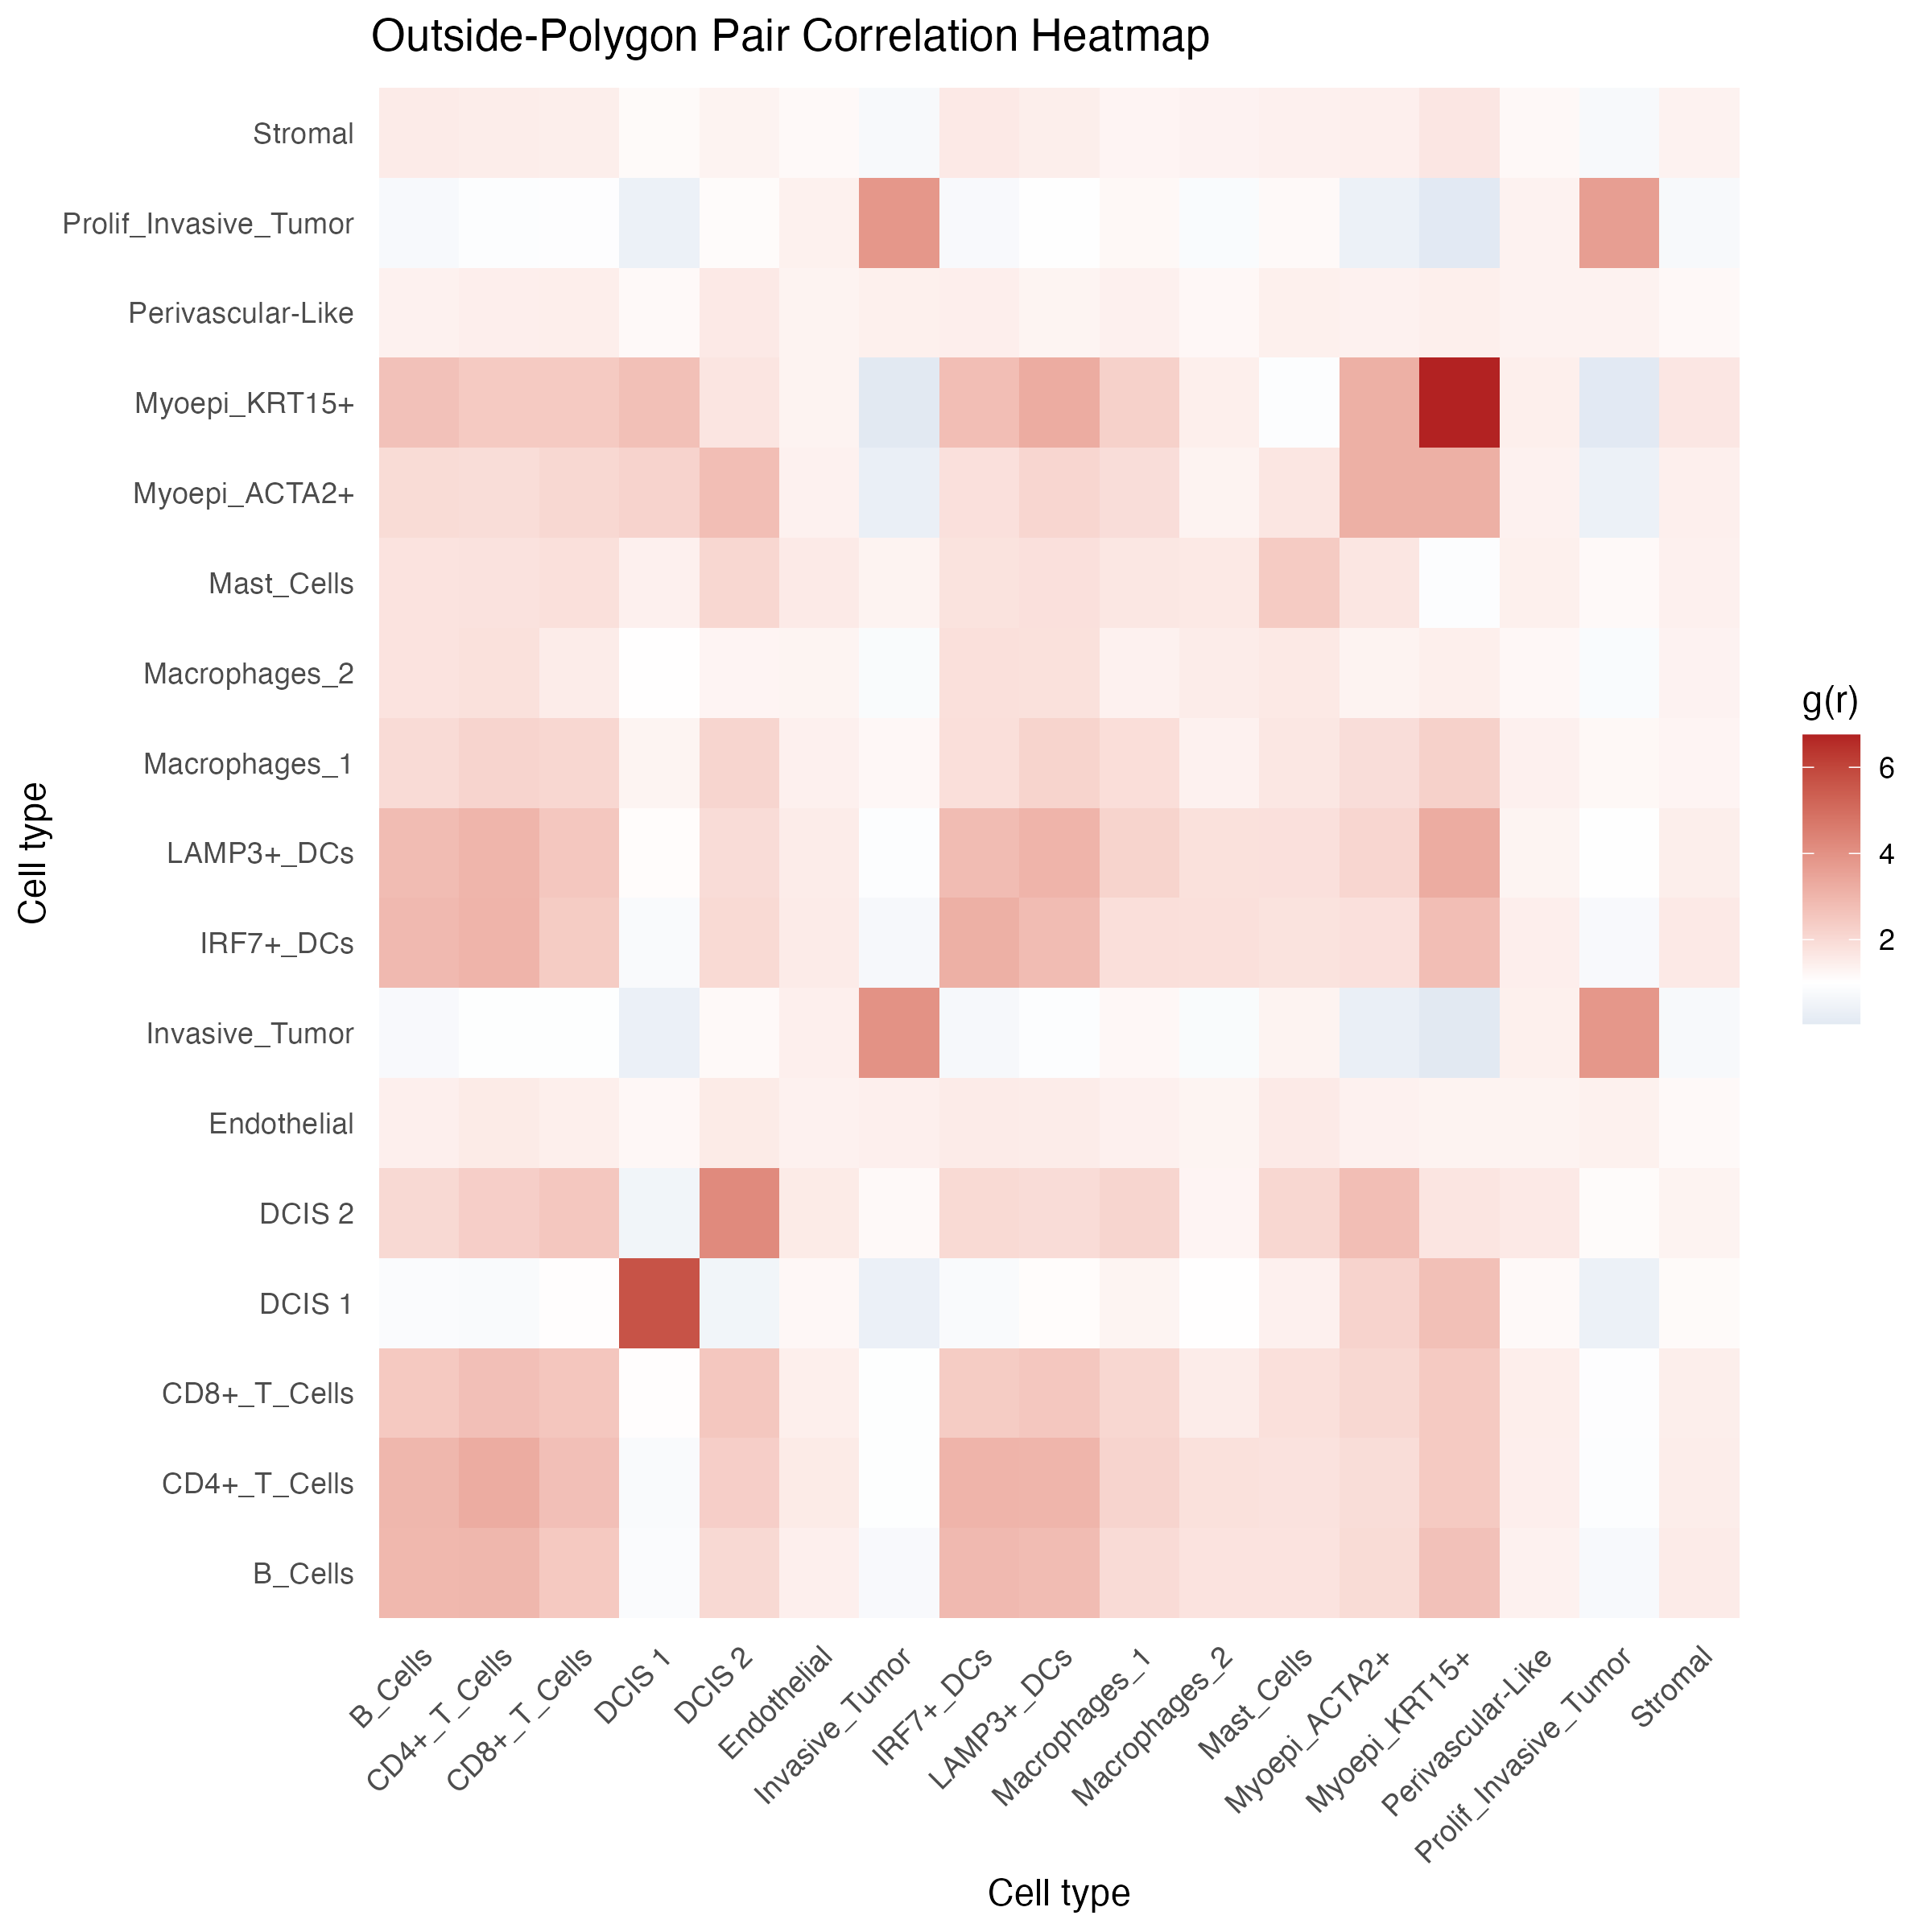
Pair correlation functions outside the tumor
PCF
Motivation
Counts can't tell whether CD8 T cells sit next to macrophages, DCs or B cells. Cell-cell proximity is a prerequisite for interaction (antigen presentation, suppression, TLS formation).
• Points = cells outside tumor polygons, marked by cell type (types with < min_cells dropped)
• Cross-type PCF g_ij(r) (spatstat::pcfcross, isotropic edge correction): density of type-j cells at distance r from type-i cells, relative to complete spatial randomness
• g = 1 random, g > 1 co-localization, g < 1 avoidance; heatmap shows g at r = 200 µm
• Demo: a lymphoid/DC block (B, CD4+, CD8+, LAMP3+ and IRF7+ DCs) is mutually enriched (g ≈ 2–3); tumor types co-cluster only with themselves; Myoepi_KRT15+ self-clustering is strongest (ductal layers)
stGradient | spatial analysis of tumor boundaries
22
Notes:
calculate_pcf_outside_summary() evaluates every unordered pair once (ordered_pairs = FALSE) at the requested radius. Tumor-labelled cells outside polygons are DBSCAN noise or small buds; their strong self-clustering is expected. The lymphoid-DC block is consistent with immune aggregates / TLS, which we test directly in the TLS module.

Slide 23
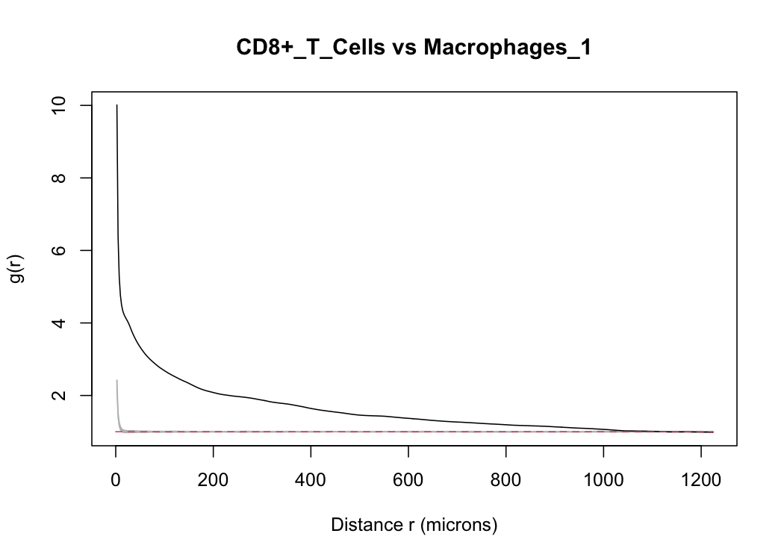
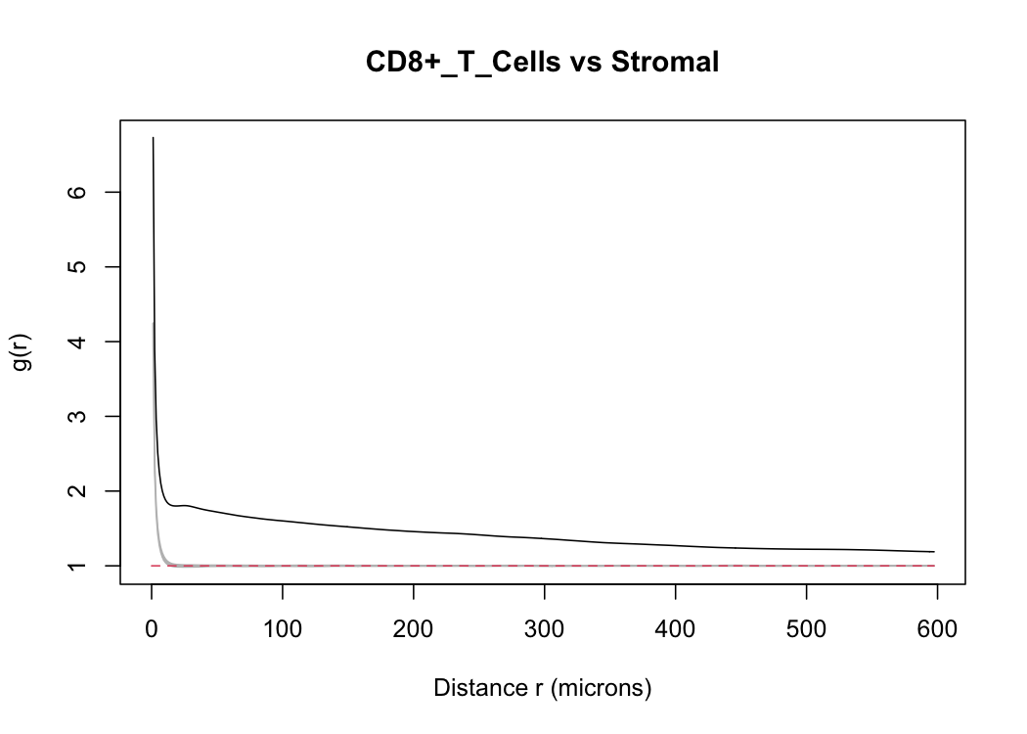
Significance via Monte Carlo envelopes
PCF
Black = observed g(r); grey band = envelope of 39 simulations; red dashed = g = 1
• CD8+ T vs Macrophages_1: g ≈ 4 at short range, ≈ 2 at 200 µm, far above envelope: strong stromal CD8–macrophage co-localization
Caveat for interpretation
CSR null over the bounding box (incl. tumor holes) lifts most pairs above 1 (CD8–Stromal ≈ 1.5). Compare pairs relatively or set window_obj.
stGradient | spatial analysis of tumor boundaries
23
Notes:
plot_pcf_outside_pair_envelopes() calls spatstat envelope() with pcfcross, nsim = 39 (pointwise ~5% level), bandwidth 10 um, saving one PNG per pair. Because outside cells cannot occupy tumor polygons, the CSR null over the full bounding box inflates g for every pair. The informative signal is relative: CD8-macrophage (~2 at 200 um) vs CD8-stromal (~1.5). A random-labelling null or a window excluding polygons (window_obj argument) would give cell-type-specific attraction directly.

Slide 24
PART 5
Gene–distance analysis
Which transcriptional programmes change continuously along the tumor → stroma axis?

Slide 25
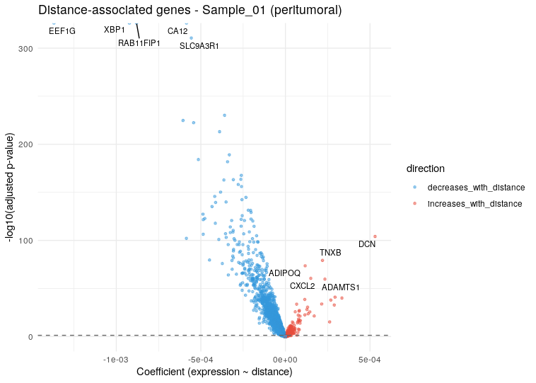
Modeling expression as a function of boundary distance
GENES
Motivation
Cell-type composition misses within-type state changes (e.g. fibroblast activation, chemokine gradients). A continuous model finds genes that track distance without pre-defined bins.
• compute_distance_from_boundary(): per-cell signed distance to nearest polygon
• focus = “peritumoral” (0 < d), “intratumoral” or “both”; distances capped at min(max_distance, 95th pct)
• For each gene expressed in ≥ 10 cells: OLS expr ~ distance on log-normalized data + Spearman ρ; BH-adjusted p-values
• Quantile distance bins (10) summarize mean expression for trend plots
• Decrease with distance (blue): EEF1G, XBP1, CA12, RAB11FIP1, SLC9A3R1
• Increase with distance (red): DCN, TNXB, ADAMTS1, ADIPOQ, CXCL2
stGradient | spatial analysis of tumor boundaries
25
Notes:
The volcano x-axis is the linear slope (expression units per micron), y-axis is -log10 BH-adjusted p. Many more genes decrease than increase: the strongest signal is the luminal tumor programme fading out with distance.

Slide 26
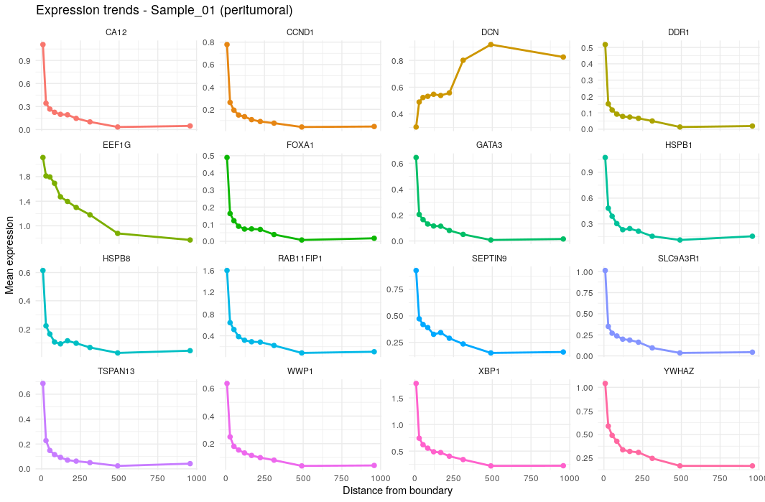
Result: luminal genes decay, stromal genes rise
GENES
• Falling: FOXA1, GATA3, XBP1, CA12, CCND1 → the ER+/luminal breast tumor programme, steepest in the first bin
• Rising: DCN (fibroblast ECM), TNXB, ADIPOQ (adipose / normal stroma), CXCL2 (inflammatory chemokine)
• Most of the change happens within the first ~50 µm, matching the distance-profile plateau
Caveats & good practice
• Tumor genes near the edge partly reflect tumor cells just outside polygons and residual spillover
• For state changes, subset to one cell type (e.g. fibroblasts, macrophages) before modeling
• Neighbouring cells aren't independent: rank by effect size / ρ, not p alone
Mean expression per quantile distance bin (peritumoral cells)
stGradient | spatial analysis of tumor boundaries
26
Notes:
This figure was generated with an earlier, larger distance cap (x-axis to ~1000 um); the current default caps at 200 um. Running the model within a single cell type (subset the Seurat object first) is the best way to isolate microenvironmental state gradients, e.g. macrophage polarization or T-cell exhaustion markers versus distance.

Slide 27
PART 6
Tertiary lymphoid structures
Find organized B/T-cell aggregates from cell labels and validate them with an independent expression signature

Slide 28
Calling TLS from cell-type labels: method
TLS
Motivation
seurat_obj <- call_tls(
seurat_obj,
celltype_col = "first_type",
b_types = "B_Cells",
t_types = c("CD4+_T_Cells", "CD8+_T_Cells"),
dc_types = c("LAMP3+_DCs", "IRF7+_DCs"),
eps = 50, minPts = 20,
min_B = 20, min_T = 20, min_frac_B = 0.05)
get_tls_summary(seurat_obj) # per-TLS composition
TLS presence and maturity associate with checkpoint-blockade response and survival in several cancers. Reproducible calling lets us count, size and stage them per sample.
• 1. Seed: DBSCAN on B + T cells only (eps = 50 µm, minPts = 20)
• 2. Expand: any cell within eps of a clustered lymphoid cell joins that aggregate (captures DCs, stroma, vessels)
• 3. Call: ≥ 20 B, ≥ 20 T and B fraction ≥ 5%, which excludes pure T-cell infiltrates
• 4. Stage: aggregates containing LAMP3+ (DC-LAMP+) DCs are flagged “mature-like”
Caveat on “maturity”
LAMP3+ DCs are a panel-limited proxy. Formal staging needs germinal-centre features (CD21+ follicular DCs, BCL6+ B cells). All thresholds are exposed so they can be tuned with pathology input.
stGradient | spatial analysis of tumor boundaries
28
Notes:
References for importance: Cabrita et al. 2020, Helmink et al. 2020, Petitprez et al. 2020 (all Nature). call_tls() adds TLS_id (NA outside called TLS) and in_TLS metadata; get_tls_summary(called_only = FALSE) also lists candidate aggregates that failed the criteria.

Slide 29
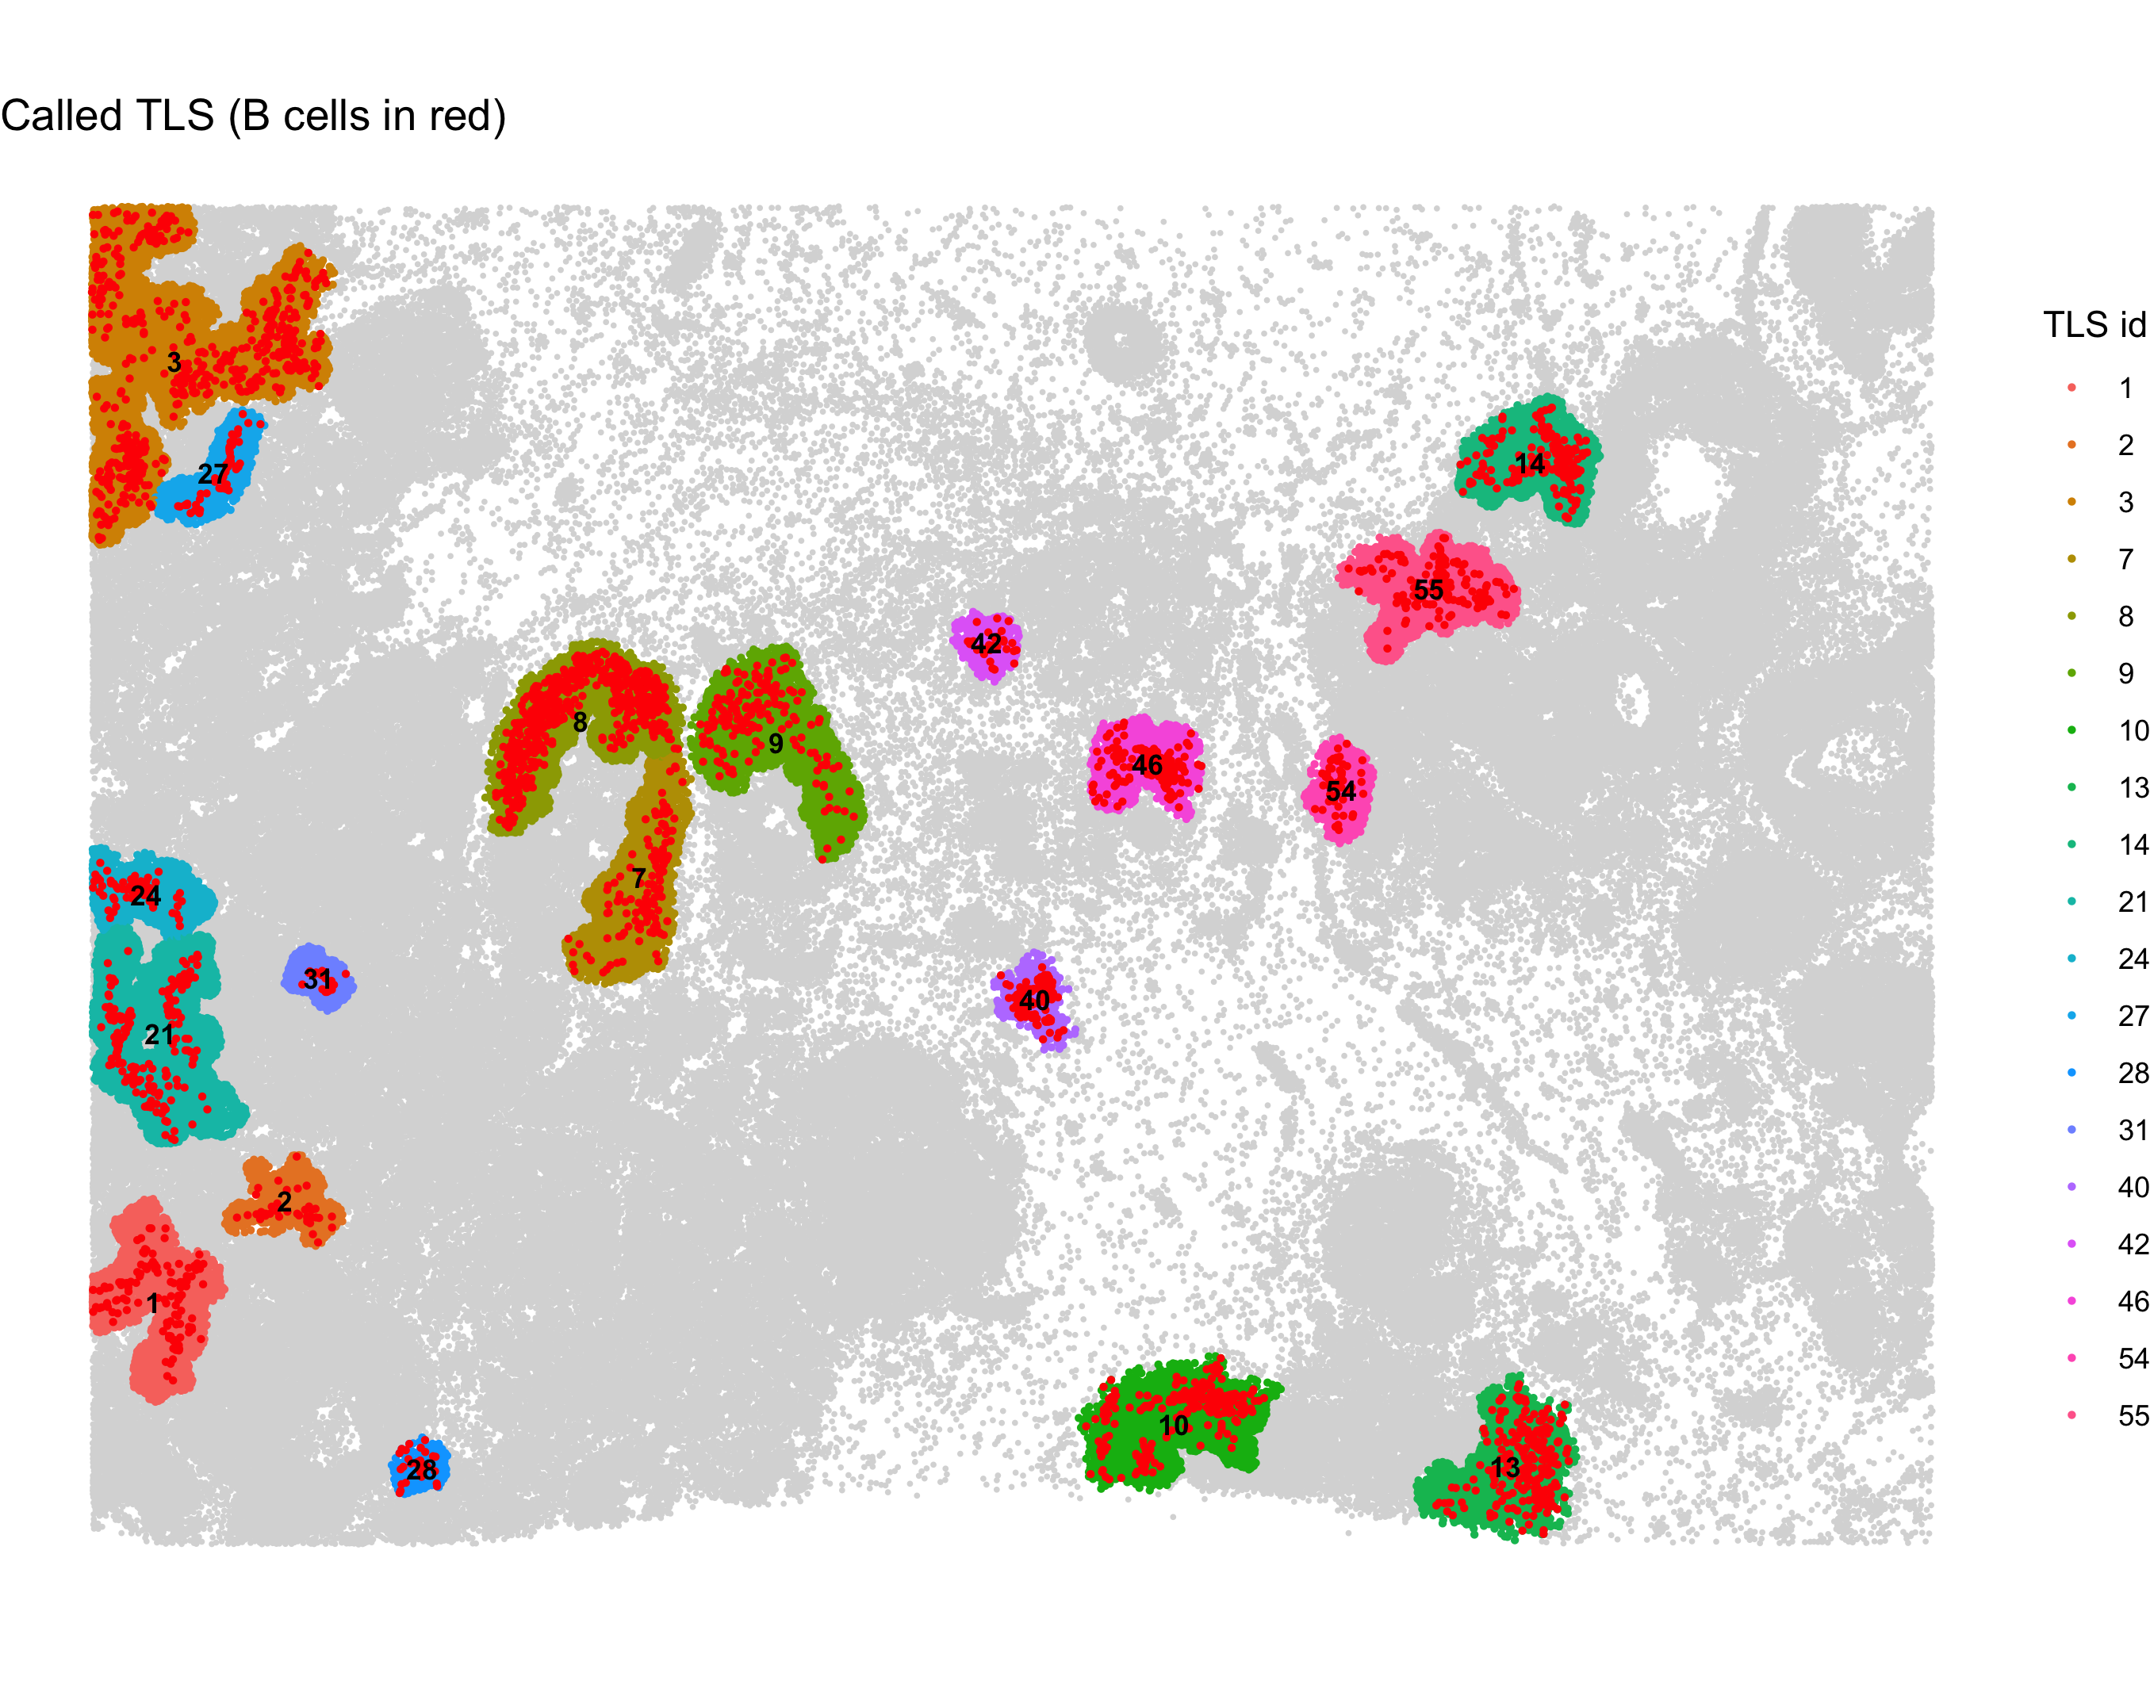
TLS calls in the demo section
TLS
• 19 TLS called across the section
• Sizes range from compact aggregates (28, 31, 40, 42) to large, elongated ones (3, 7–9)
• TLS 7, 8 and 9 wrap around two duct-like structures in the center of the section
• Several sit on the left edge of the field (1–3, 21, 24, 27), so they may be truncated by the section boundary
Next question
Do these calls reflect real lymphoid organization? We check them against an independent expression signature on the next slide.
plot_tls_map(): each called TLS colored by ID, B cells in red
stGradient | spatial analysis of tumor boundaries
29
Notes:
Counts and IDs come from the plot_tls_map legend. IDs are DBSCAN cluster numbers, so gaps (e.g. no TLS 4-6) are aggregates that failed the TLS criteria.

Slide 30
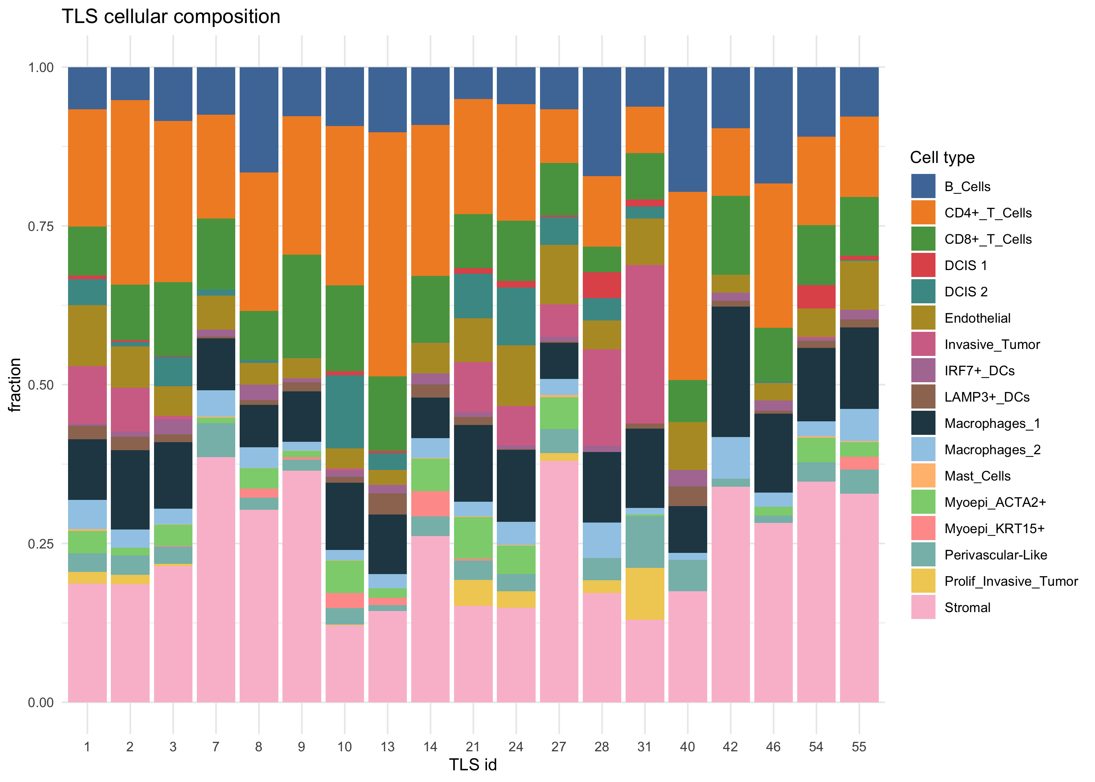
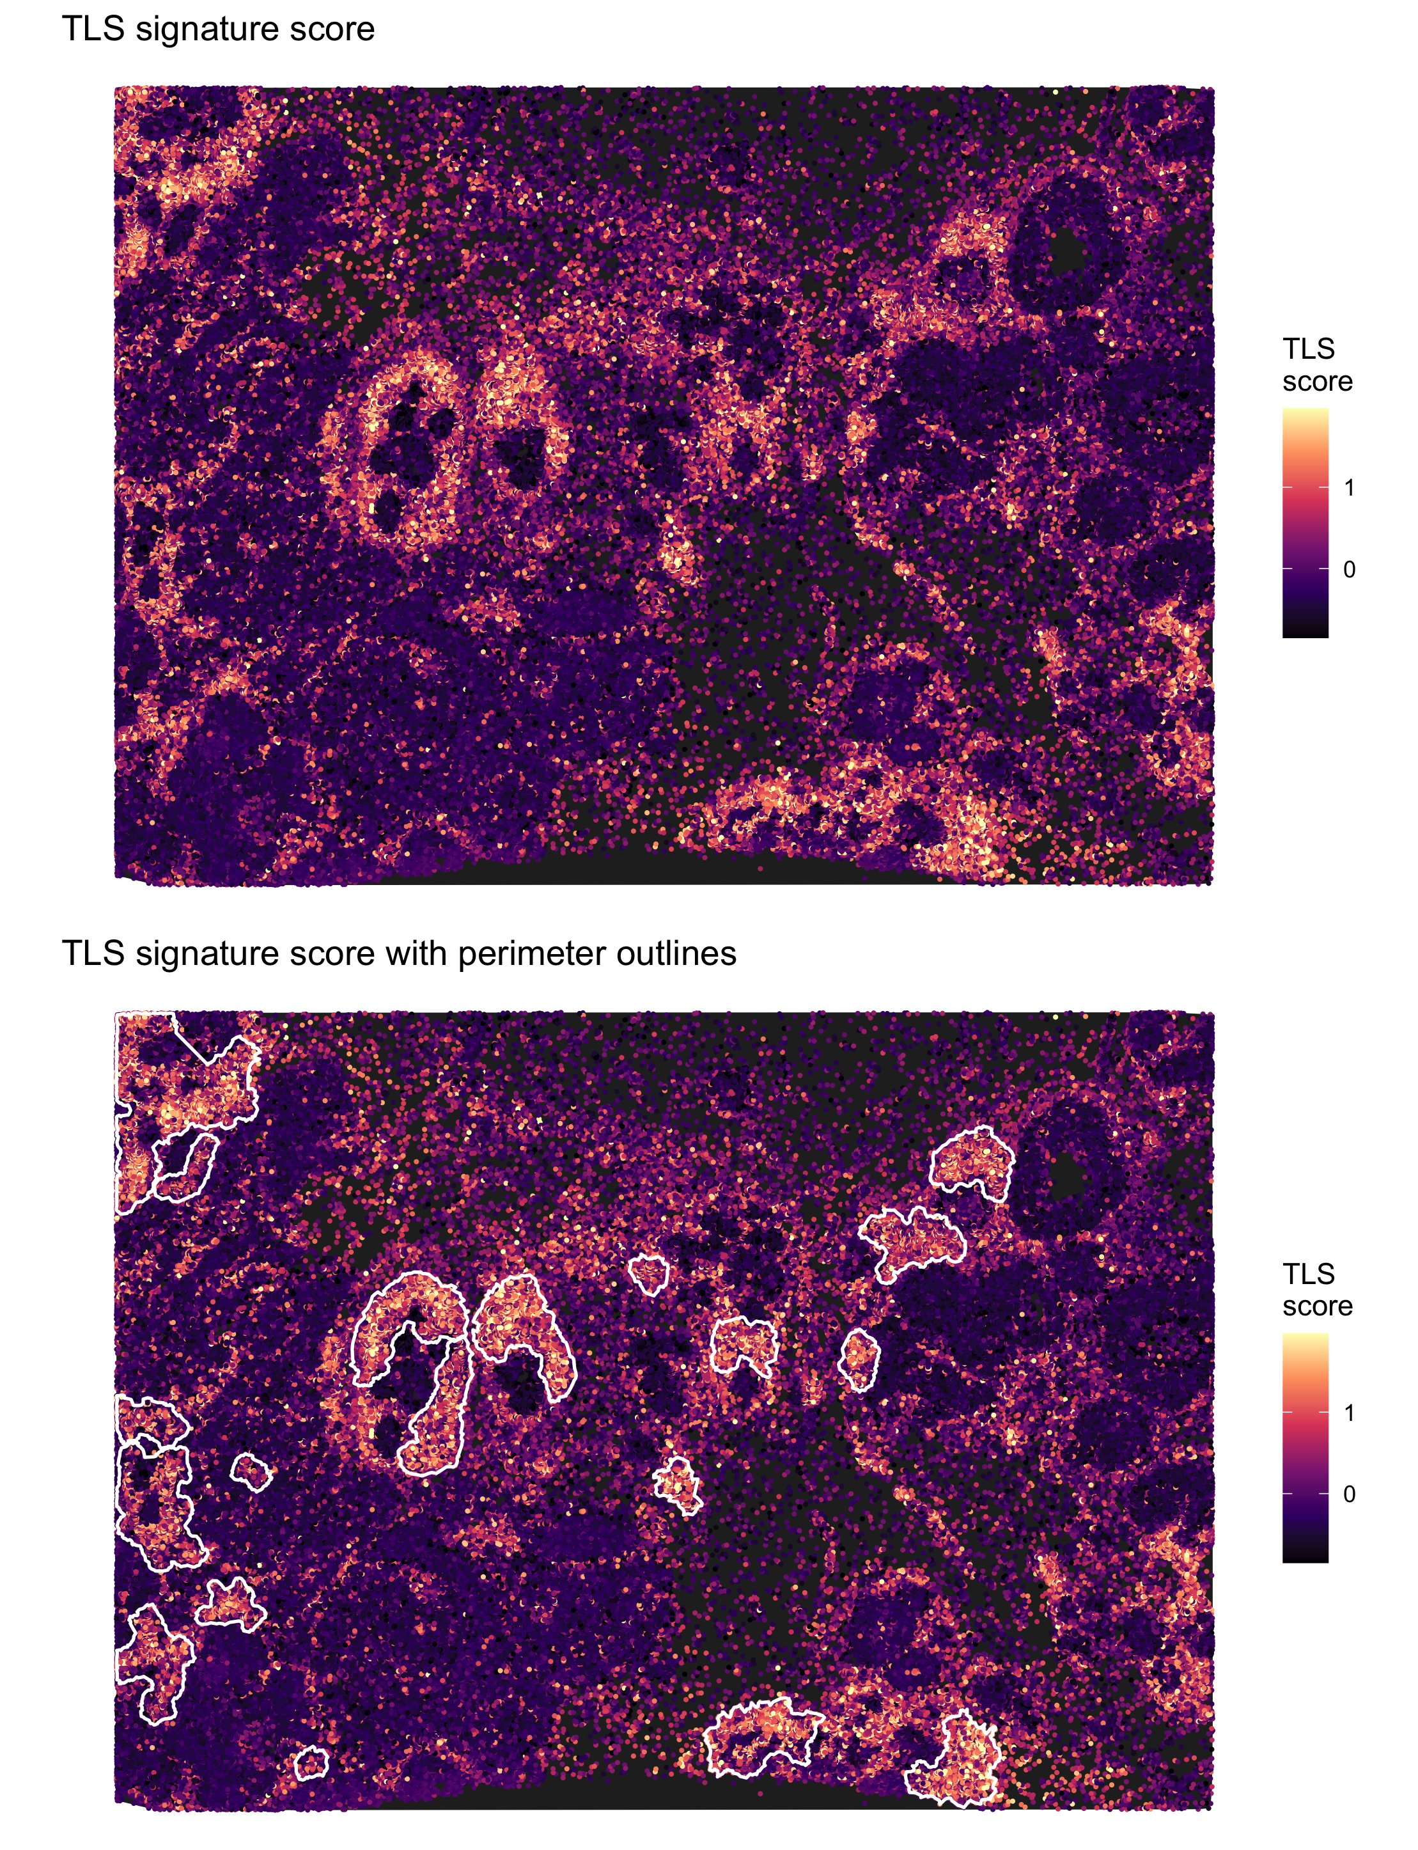
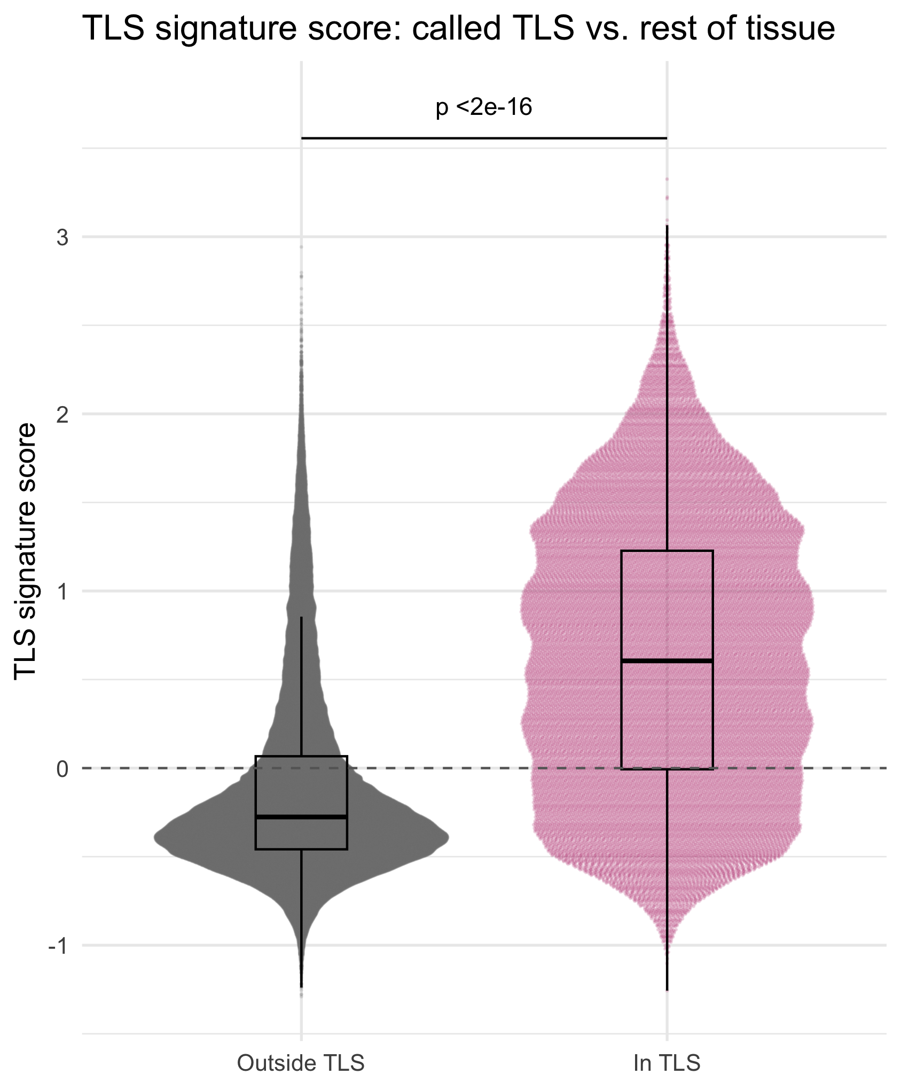
Validating TLS calls with a gene signature
TLS
Per-TLS composition
• CD4+ T dominant, B cells 5–20%, LAMP3+ DCs in most aggregates
• TLS 28 and 31 contain substantial invasive tumor: tumor-associated aggregates
Signature score, TLS outlined
In TLS vs. rest: Wilcoxon p < 2e−16
Orthogonal check
Calls use labels + geometry; the 22-gene score (AddModuleScore: MS4A1, CD79A, CR2, CXCL13, CD3E…) uses expression only.
stGradient | spatial analysis of tumor boundaries
30
Notes:
add_tls_score() drops signature genes missing from the panel. summarize_tls_score()$by_tls ranks each TLS by mean score; low-scoring aggregates are candidates for false positives and worth reviewing on H&E. In the score map, high-scoring regions without a call indicate looser lymphoid infiltrates that don't meet the B-cell criteria.

Slide 31
What the demo section tells us
TAKEAWAYS
Margin width
Tumor–stroma separation emerges within 20–40 µm and plateaus by ~100–150 µm
Immune architecture
Macrophage rim at the edge; CD4+/CD8+ T cells enriched further out, sparse inside: excluded-like
Peritumoral organization
Lymphoid + DC cells co-localize; CD8+ T cells strongly co-localize with Macrophages_1
Transcriptional gradient
Luminal tumor programme decays; ECM, adipose and chemokine genes rise with distance
Lymphoid structures
19 TLS called, most with LAMP3+ DCs, independently supported by signature score
stGradient | spatial analysis of tumor boundaries
31
Notes:
These are single-section observations meant to show what the package produces, not biological conclusions. The value comes from running the same pipeline across a cohort and comparing curves, co-occurrence and TLS metrics between groups.

Slide 32
Getting started
CODE
devtools::install_github("ndsimons/stGradient")
library(stGradient)
# Regions
best <- optimize_dbscan_params(seurat_obj, noise_pct = 0.15,
b = 0.5, plot = TRUE)[1, ]
seurat_obj <- add_dbscan_polygons(seurat_obj,
eps = best$eps, minPts = best$minPts)
polys <- get_cancer_regions(seurat_obj)
# Distance profiles
seurat_obj$boundary_distance <-
calculate_boundary_distances(seurat_obj, polys)
res <- calculate_distance_profile(seurat_obj,
group_by = "first_type", metric = "all")
plot_all_metrics(res$profile)
# PCF
pcf <- calculate_pcf_outside_summary(seurat_obj, polys,
distance = 200, celltype_col = "first_type")
plot_pcf_outside_heatmap(pcf, midpoint = 1)
# Gene-distance
seurat_obj <- compute_distance_from_boundary(seurat_obj)
gd <- find_distance_associated_genes(seurat_obj,
assay = "Xenium", focus = "peritumoral")
# TLS
seurat_obj <- call_tls(seurat_obj, celltype_col = "first_type",
b_types = "B_Cells",
t_types = c("CD4+_T_Cells", "CD8+_T_Cells"))
seurat_obj <- add_tls_score(seurat_obj, assay = "Xenium")
Documentation
pkgdown site with 7 topic vignettes: loading, region selection, distance metrics, PCF, gene-distance, TLS, visualization. github.com/ndsimons/stGradient
stGradient | spatial analysis of tumor boundaries
32
Notes:
Everything shown today runs from these calls. vignette_figures.Rmd in the repo regenerates every figure from a Seurat .rds via rmarkdown::render(params = list(rds_path = ...)).

Slide 33
Current limitations and where collaborators can help
DISCUSSION
Limitations to keep in mind
Discussion questions
• Single-sample, descriptive metrics: cohort comparisons (e.g. responders vs. non-responders) currently done downstream, e.g. mixed models on per-sample curves
• Cumulative shells smooth local changes; ring-wise bins would isolate specific distance bands
• Label- and segmentation-dependent: annotation quality and spillover (hence SPLIT) propagate into every metric
• PCF null is CSR over the bounding box; random labelling or custom windows are better for cell-type-specific attraction
• 2D sections: distances to a 3D tumor surface are approximated
• Which cohorts / contrasts matter most (treatment response, tumor subtype, pre- vs. post-therapy)?
• Which tumor definition: all epithelial vs. invasive-only fronts?
• Which immune states to model vs. distance (exhaustion, IFN-γ, antigen presentation, macrophage polarization)?
• What TLS criteria / maturity markers fit your panel and tissue?
• Can we validate key patterns with IF/IHC or H&E pathology review?
stGradient | spatial analysis of tumor boundaries
33
Notes:
Use this slide to steer the conversation toward concrete next analyses and datasets.

Slide 34
Thank you — questions?
Code: github.com/ndsimons/stGradient
Contact: Noah D. Simons • noah.simons@providence.org
Acknowledgements: Anton Kravchenko, Alexa Dowdell (contributors)
Demo data: 10x Genomics Xenium FFPE Human Breast dataset; annotation & SPLIT purification following the SPLIT vignette (bdsc-tds/SPLIT); reference: Janesick et al., Nat Commun 2023
Built on Seurat, sf, dbscan, concaveman and spatstat

