Slide 1

stGradient
Distance-based analysis of tumor boundaries
in single-cell spatial transcriptomics
R package demo • Xenium breast cancer example
Contributors: Noah Simons, Anton Kravchenko, Alexa Dowdell, Sasha Stanton, David Page
github.com/ndsimons/stGradient
Notes:
Welcome. Today I'll walk through stGradient, an R package for quantifying how cells, cell-cell organization and gene expression change as a function of distance from tumor boundaries. Everything shown was run on a public 10x Xenium breast cancer section that was annotated and decontaminated with the SPLIT workflow.

Slide 2
Motivation: Develop an R package for interactive distance-based tumor analysis
Single-cell spatial platforms like Xenium measure where every cell is and what it expresses, but translating to tumor biology in complex - stGradient makes those analyses reproducible.
Integrates into common workflows
Use cases:
• R and Seurat: works directly on Xenium Seurat objects; results come back as metadata columns, sf polygons and data frames
• Interactive: draw tumor regions in a Shiny app and pull them straight into your session
• Reproducible: data-driven region calls and parameters you can re-run on every sample
• Publication-ready output: every plot is a ggplot you can restyle or combine
How far does the tumor’s influence extend into the stroma?
Are T cells infiltrating tumor nests, or held back in the stroma?
Which immune and stromal cells sit together around the tumor?
Which genes and programs change across the tumor margin?
Are there tertiary lymphoid structures, and how mature are they?
Xenium output
Seurat object
stGradient
Figures & tables
stGradient | spatial analysis of tumor boundaries
2
Notes:
The pitch in one slide. Viewers such as Xenium Explorer are great for looking at the tissue, but quantitative questions about tumor boundaries (how far, which cells, which genes) usually need bespoke scripts. stGradient packages those analyses as R functions that work on a standard Seurat object, so anyone comfortable with Seurat can go from a Xenium run to these answers interactively in their own R session. Each question on the right maps to one module we'll walk through.

Slide 3
Why tumor boundaries matter
WHY
• The invasive margin is a distinct ecosystem. Tumor, stroma, myeloid and lymphoid cells meet; gradients of chemokines, hypoxia and ECM remodeling shape who gets in.
• Immune spatial phenotypes predict outcome. Inflamed vs. immune-excluded vs. desert tumors respond differently to checkpoint blockade; T-cell density at the core and margin (e.g. Immunoscore) is prognostic.
• Excluded T cells are often trapped in stroma, e.g. by macrophages or fibroblast barriers, which is invisible if we only count cell types per sample.
• Tertiary lymphoid structures (TLS) near tumors associate with checkpoint response and survival.
• Single-cell spatial platforms (Xenium, CosMx, ATERA) give per-cell coordinates and transcriptomes, so we can measure these gradients directly instead of inferring them.
The analytical gap
• Most spatial tools summarize clusters / niches, not continuous change relative to a structure
• “Margin” widths are usually chosen arbitrarily (e.g. 100 µm)
• Boundary calls are often manual and irreproducible
What stGradient adds
• Reproducible tumor-region polygons from cell labels
• Signed per-cell distance to boundary as a common coordinate
• Separation, co-occurrence, gene-trend and TLS analyses on that coordinate
stGradient | spatial analysis of tumor boundaries
4
Notes:
Key idea: distance to the tumor boundary is a biologically meaningful axis. Immune exclusion, stromal barriers, and TLS formation are all spatial phenomena defined relative to tumor nests. Context references: Chen & Mellman 2017 (immune phenotypes), Galon et al. (Immunoscore), Peranzoni et al. 2018 PNAS (macrophages retain CD8 T cells in stroma), Cabrita/Helmink/Petitprez 2020 Nature (TLS and checkpoint response).

Slide 4
Questions stGradient answers
OVERVIEW
Biological question | Module | Key functions
Where exactly are the tumor nests? | Region selection | launch_stGradient(), optimize_dbscan_params(), add_dbscan_polygons()
How far does the tumor's influence extend, and which cells change? | Distance profiles | calculate_boundary_distances(), calculate_distance_profile(), find_critical_distance()
Which cell types co-localize in the peritumoral stroma? | Pair correlation (PCF) | calculate_pcf_outside_summary(), plot_pcf_outside_pair_envelopes()
Which genes change along the tumor→stroma axis? | Gene–distance | compute_distance_from_boundary(), find_distance_associated_genes()
Are there organized lymphoid aggregates (TLS)? | TLS analysis | call_tls(), add_tls_score(), summarize_tls_score()
stGradient | spatial analysis of tumor boundaries
5
Notes:
Each module maps to a concrete biological question. All functions take a Seurat object with a spatial FOV and a cell-type column, so the package drops into existing Seurat workflows.

Slide 5
Workflow at a glance
OVERVIEW
1
Load
2
Define regions
3
Measure distance
load_xenium_seurat()
→
add_dbscan_polygons()
→
calculate_boundary_distances()
Stable cell IDs and an is_cancer flag
Shiny drawing or DBSCAN + concave hulls
Signed distance of every cell to the nearest boundary
Analysis modules • all built on the per-cell signed distance (negative inside, positive outside)
Distance profiles
Pair correlation (PCF)
Gene–distance
TLS
How far does the tumor’s influence reach?
Which cells co-localize outside the tumor?
Which genes change across the margin?
Are lymphoid structures present?
• Transcriptomic distance
• Composition difference
• DE strength, critical distance
• Cross-type g(r) per pair
• Monte Carlo envelopes
• Per-gene linear model
• Spearman correlation, BH-adjusted
• DBSCAN on B + T cells
• Maturity flag, signature score
Every module returns ggplot objects and data frames. TLS calling uses only cell labels and coordinates, not tumor polygons.
stGradient | spatial analysis of tumor boundaries
6
Notes:
The organizing principle is a single per-cell coordinate: signed distance to the nearest tumor boundary, negative inside, positive outside. Downstream modules all consume that coordinate or the polygons. TLS calling is independent of the tumor polygons.

Slide 6
PART 1
Demo data
Public 10x Xenium FFPE breast cancer section, annotated with RCTD and decontaminated with SPLIT

Slide 7
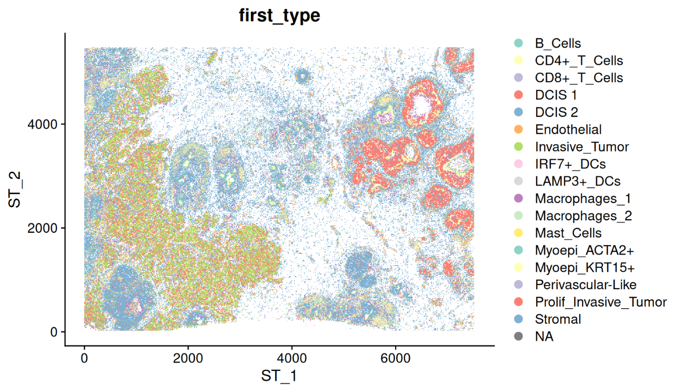
Demo data: Xenium FFPE human breast cancer
DATA
• Sample: 10x Genomics public dataset “Xenium FFPE Human Breast with biomarkers” (sample S1, bottom section)
• Platform: Xenium in situ, targeted panel (269 genes in the object)
• Field: ≈ 7.5 × 5.5 mm, >100k segmented cells
• Histology: DCIS and invasive carcinoma nests in a stroma rich in T, B and myeloid cells
Why this dataset for a demo
Public and well annotated, with pre-invasive and invasive tumor nests, an immune-rich stroma and lymphoid aggregates, so every stGradient module has signal to find.
Cells colored by first_type: SPLIT-purified Xenium with RCTD Level 3 labels (coordinates in µm)
stGradient | spatial analysis of tumor boundaries
8
Notes:
Data source: https://www.10xgenomics.com/datasets/xenium-ffpe-human-breast-biomarkers (S1 bottom). Annotation and purification follow the SPLIT vignette; the reference is the Chromium Flex dataset from Janesick et al. 2023. Cell counts / field size are approximate from the coordinate range.

Slide 8
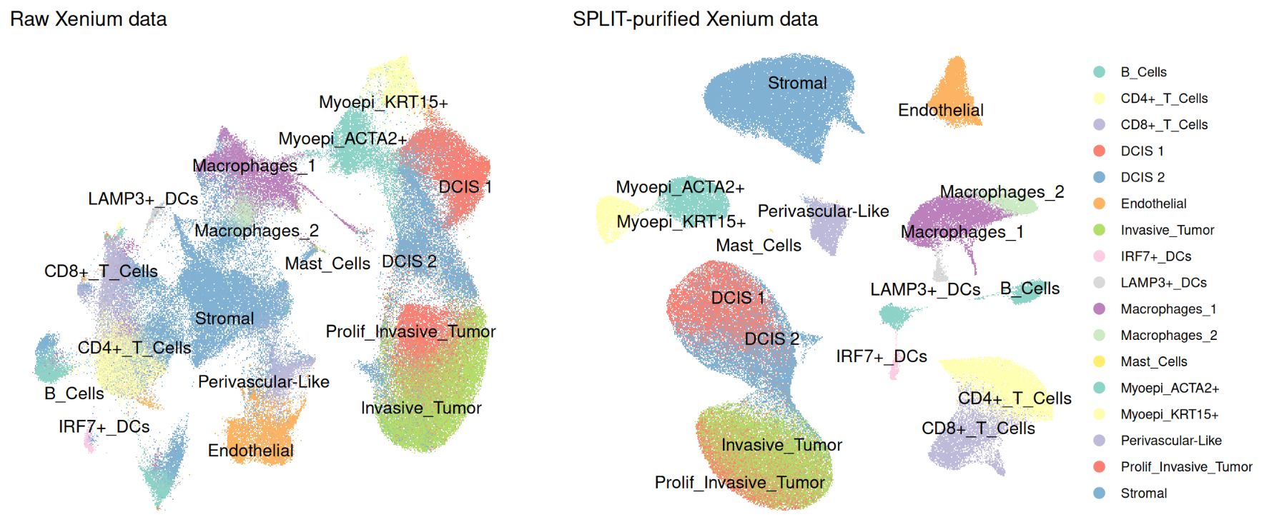
Demo data: annotation and SPLIT decontamination
DATA
Why decontamination matters
Segmentation spillover is worst at interfaces between unlike cells, i.e. at tumor boundaries. Without it, a macrophage touching a tumor nest “expresses” tumor genes.
• Raw: T cells, macrophages and stroma blur into one continuum
• After SPLIT: discrete clusters, including rare DCs, mast and B cells
• Demo object = SPLIT-purified Xenium, labels in first_type
Xenium UMAP colored by first_type, before (left) and after (right) SPLIT purification
1 Reference
2 Annotation
3 Purification
Janesick et al. 2023 Chromium Flex breast cancer snRNA-seq; hybrid clusters removed
rctd-py (Python RCTD) → first_type and per-cell weights; fine-grained Level 3 labels
SPLIT::purify() subtracts transcripts from the neighbouring cell type
stGradient | spatial analysis of tumor boundaries
9
Notes:
SPLIT (bdsc-tds) uses RCTD deconvolution weights and the reference profiles to subtract the expected contribution of the secondary cell type from each cell's counts. As of v0.2.0 it is annotation-tool agnostic. For boundary analyses this is important: our gene-distance module would otherwise pick up tumor transcripts in immediately adjacent stromal cells purely from segmentation bleed.

Slide 9
Demo data: what is in the object
DATA
17 cell types in first_type (RCTD, Janesick Level 3)
library(stGradient)
seurat_obj <- load_xenium_seurat(
rds_path = "purified_xenium.rds",
celltype_col = "first_type",
cancer_labels = c("DCIS 1", "DCIS 2",
"Invasive_Tumor", "Prolif_Invasive_Tumor")
)
Tumor epithelium (cancer_labels)
DCIS 1, DCIS 2, Invasive_Tumor, Prolif_Invasive_Tumor
Myoepithelial
Myoepi_ACTA2+, Myoepi_KRT15+
Stroma / vascular
Stromal, Endothelial, Perivascular-Like
• Reads the Seurat .rds, builds a stable cell ↔ barcode map
• Adds is_cancer from the labels you choose: the definition of “tumor” is an explicit, reviewable decision
• DCIS and invasive labels are both treated as tumor here; they can be split to compare pre-invasive vs. invasive boundaries
Myeloid
Macrophages_1, Macrophages_2, LAMP3+_DCs, IRF7+_DCs, Mast_Cells
Lymphoid
B_Cells, CD4+_T_Cells, CD8+_T_Cells
stGradient | spatial analysis of tumor boundaries
10
Notes:
The cancer_labels argument is the single most consequential choice: it defines which cells seed the tumor polygons. For immunology questions about invasive fronts specifically, one could rerun with only Invasive_Tumor and Prolif_Invasive_Tumor.

Slide 10
PART 2
Defining tumor regions
Every downstream metric is measured relative to these polygons, so they must be reproducible and auditable

Slide 11
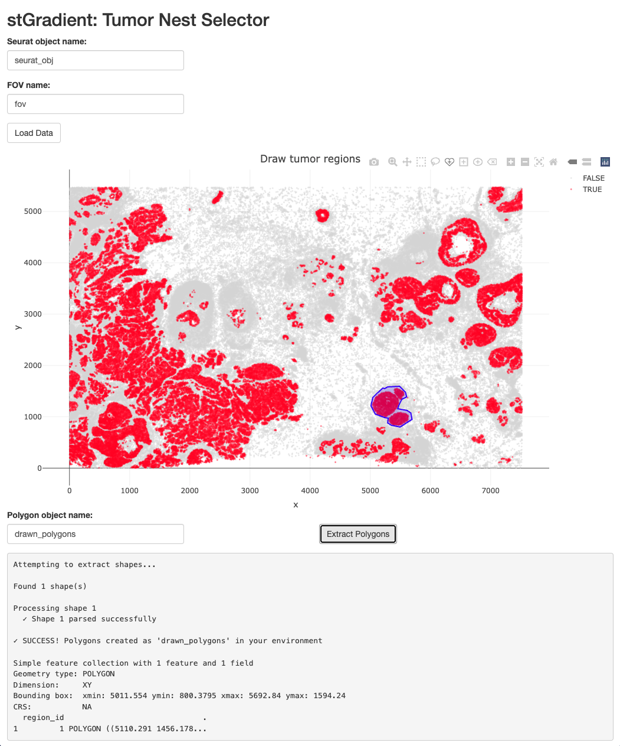
Route 1: drawing tumor regions interactively
REGIONS
When to use it
When a pathologist or collaborator wants specific regions, e.g. a single invasive front, one DCIS duct, or areas that match an H&E annotation.
• launch_stGradient() opens a Shiny app with cells plotted by is_cancer
• Enter the Seurat object and FOV name, then Load Data
• Draw freehand polygons with the plotly toolbar, then Extract Polygons
• Polygons are returned to the R session as an sf object
launch_stGradient()
seurat_obj <- add_polygon_membership(seurat_obj, drawn_polygons)
stGradient | spatial analysis of tumor boundaries
12
Notes:
The drawn polygons feed every downstream function exactly like automated ones. The trade-off is reproducibility: hand-drawn regions are hard to repeat across many samples, which motivates the automated route on the next slide.

Slide 12
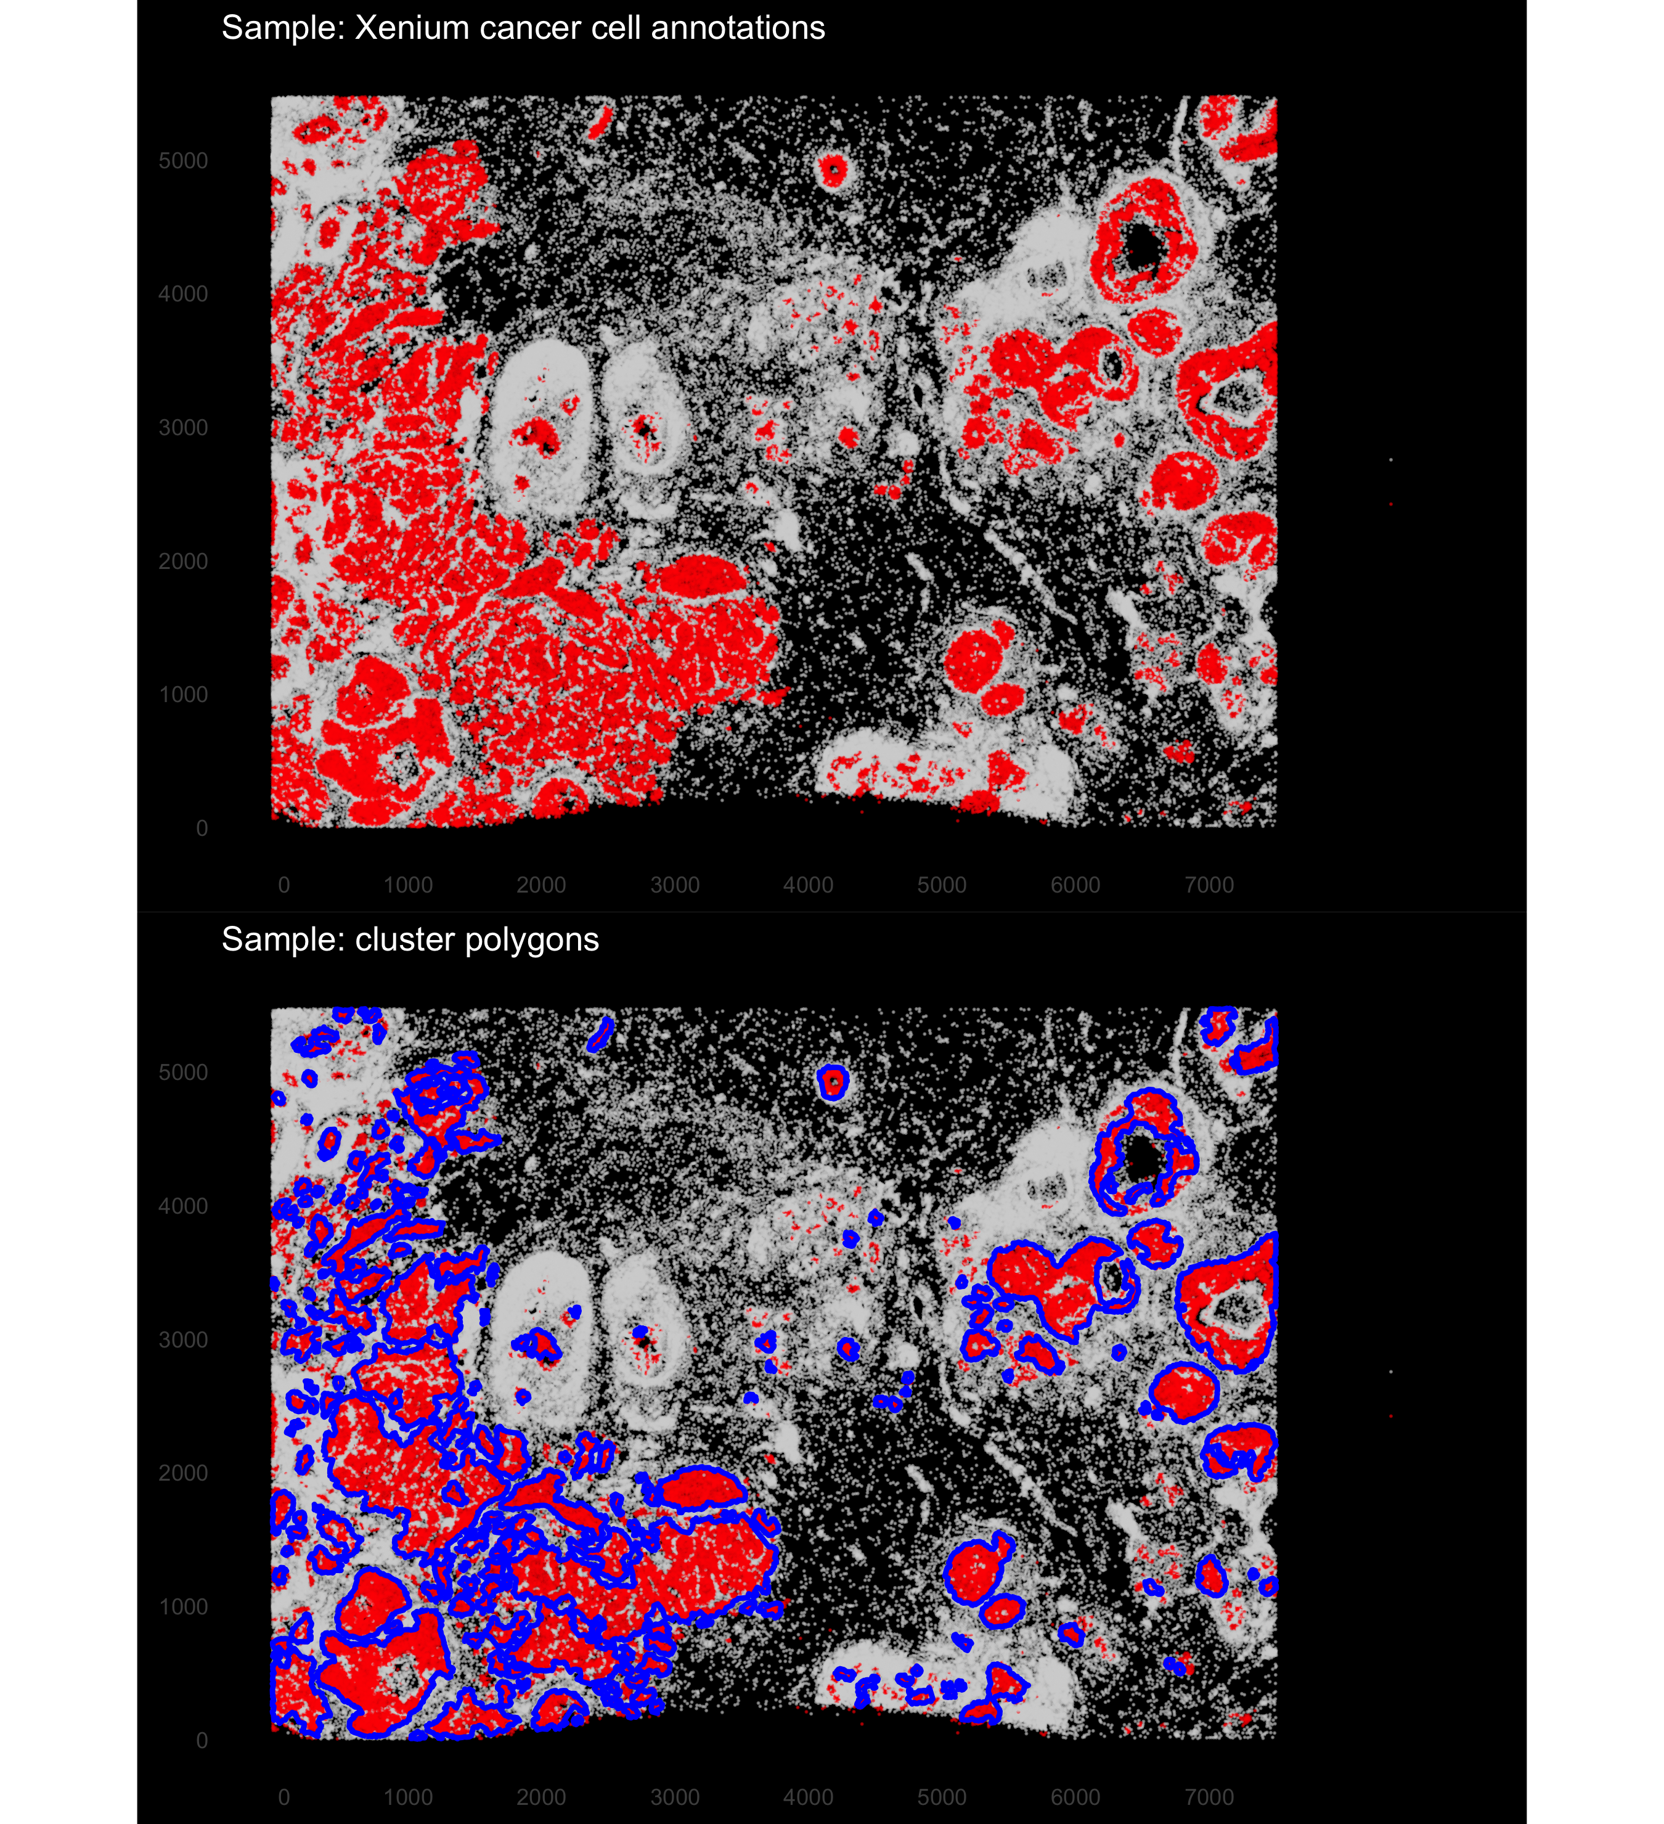
Route 2: automated detection with DBSCAN
REGIONS
Why automate
Manual annotation is slow and hard to reproduce across samples; automated calls scale and can be re-run with identical parameters.
• DBSCAN on cancer-labelled cells only: eps = neighborhood radius (µm), minPts = minimum neighbors for a dense core
• Isolated cancer cells become noise and are left outside polygons
• Each cluster is wrapped in a concave hull (concaveman; lower concavity = tighter fit)
• Returns sf polygons; add_polygon_membership() flags each cell inside/outside
seurat_obj <- add_dbscan_polygons(seurat_obj,
eps = 35, minPts = 20)
auto_polygons <- get_cancer_regions(seurat_obj)
add_dbscan_polygons(): cancer cells (red), polygons (blue)
stGradient | spatial analysis of tumor boundaries
13
Notes:
DBSCAN groups cancer cells into dense clusters; a concave hull then follows the shape of each nest rather than a convex envelope that would swallow stroma. Figure shows eps = 35 um, minPts = 20. The next slide shows how to choose these parameters from the data.

Slide 13
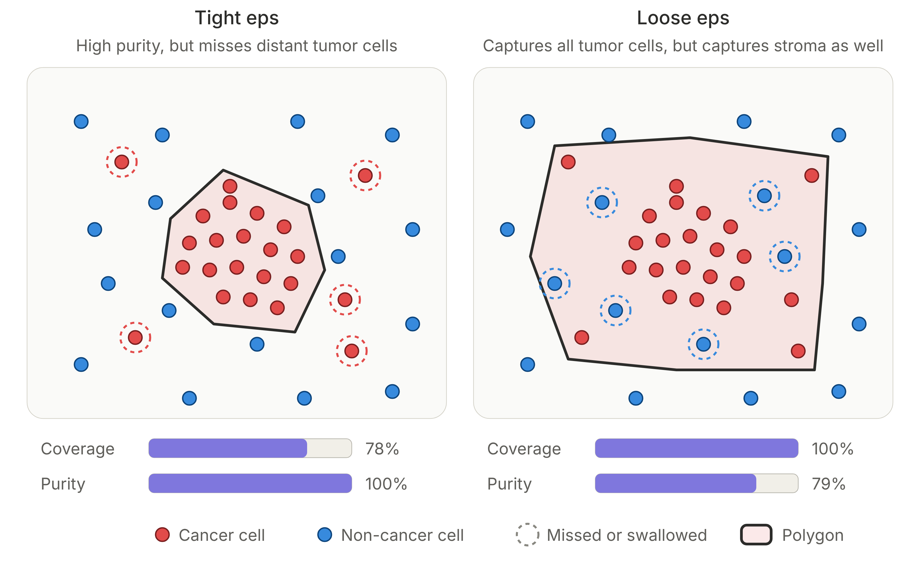
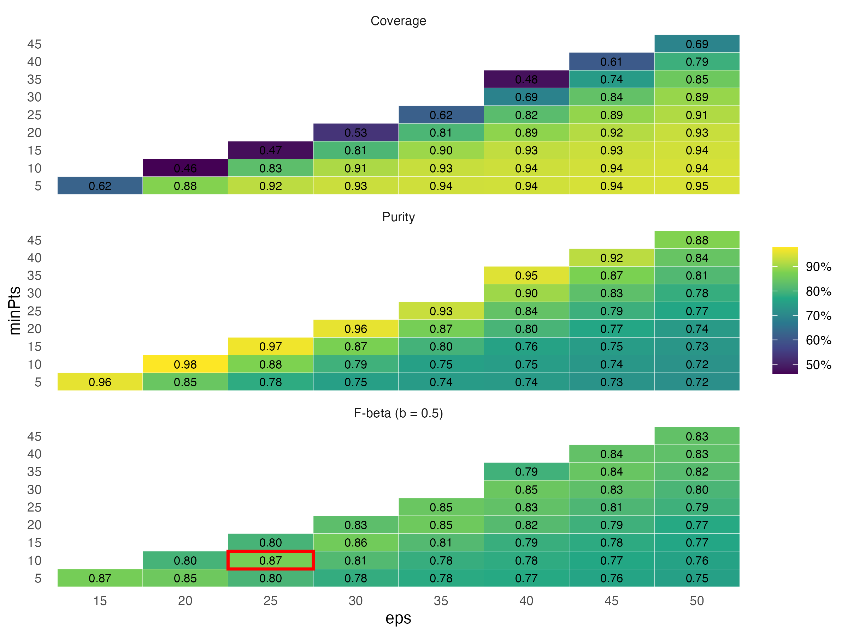
Choosing DBSCAN parameters: coverage vs. purity
REGIONS
• Coverage = fraction of cancer cells inside a polygon; Purity = fraction of cells in polygons that are cancer
• Fβ = (1+β²)·P·C / (β²P + C); β = 0.5 weights purity more
• Grid over eps × minPts; settings with >15% cancer cells as noise are discarded; ties broken by silhouette
• Demo optimum: eps = 25 µm, minPts = 10 (C = 0.83, P = 0.88, F0.5 = 0.87)
stGradient | spatial analysis of tumor boundaries
14
Notes:
optimize_dbscan_params() makes the trade-off explicit. Loose eps swallows stroma into the tumor (lower purity), which would bias every inside/outside comparison toward zero. We favor purity (beta = 0.5) because contaminating the 'inside' group is worse than missing scattered tumor cells. The figures later in this deck used eps = 35, minPts = 20 (F0.5 = 0.85, close to optimal).

Slide 14
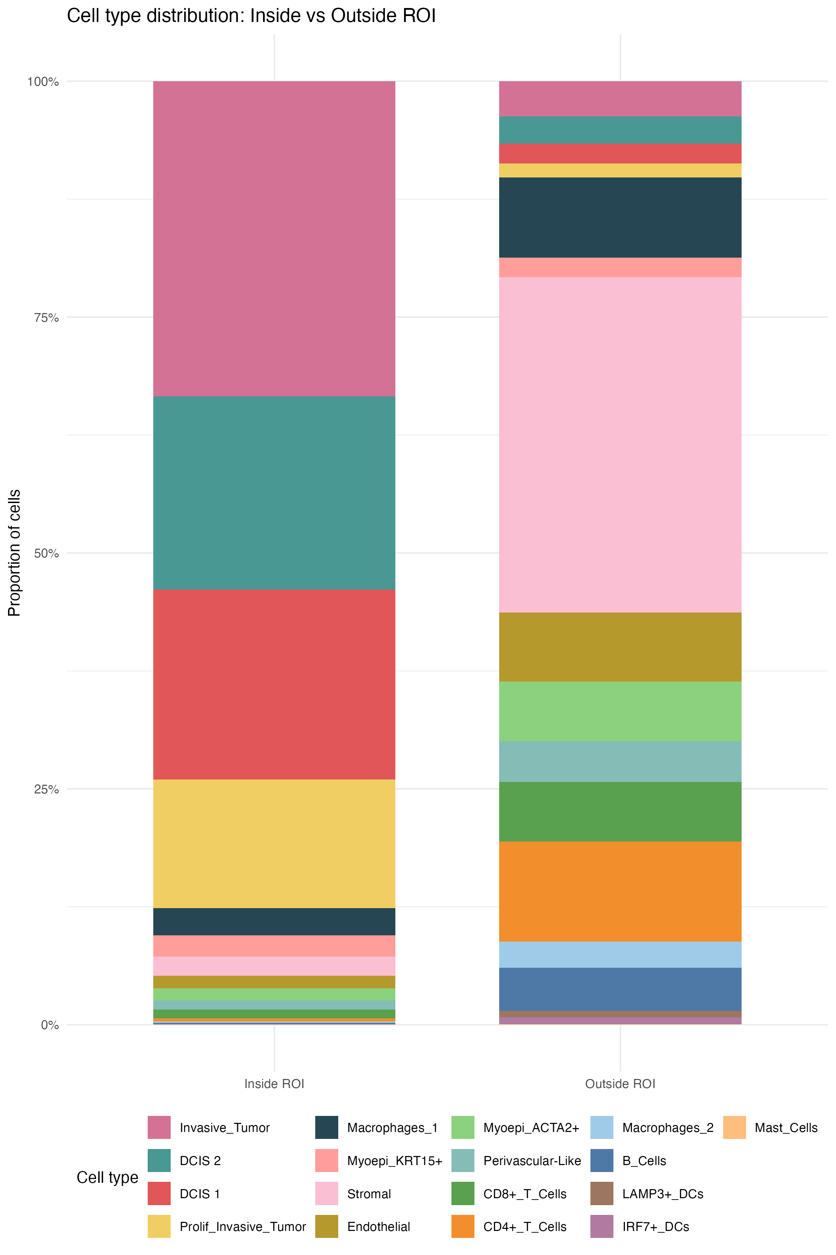
ROI QC: composition inside vs. outside the polygons
REGIONS
Motivation
Before measuring gradients, confirm that polygons capture tumor and exclude the microenvironment. This is the sanity check collaborators should look at first.
• Inside: ≈ 85–90% tumor (Invasive, DCIS 1/2, Prolif_Invasive); small residual macrophages and myoepithelium
• Outside: Stromal is the largest population, followed by CD4+ T, Macrophages_1, Endothelial, CD8+ T, Myoepi_ACTA2+ and B cells
• Lymphocytes are almost absent inside polygons (CD8+ ≈ 1%), a first hint of a non-inflamed / excluded pattern
stGradient | spatial analysis of tumor boundaries
15
Notes:
qc_plot_xenium() returns the per-cell data frame used for these bar charts. Proportions read from the stacked bar; exact numbers are available from qc_out$df.

Slide 15
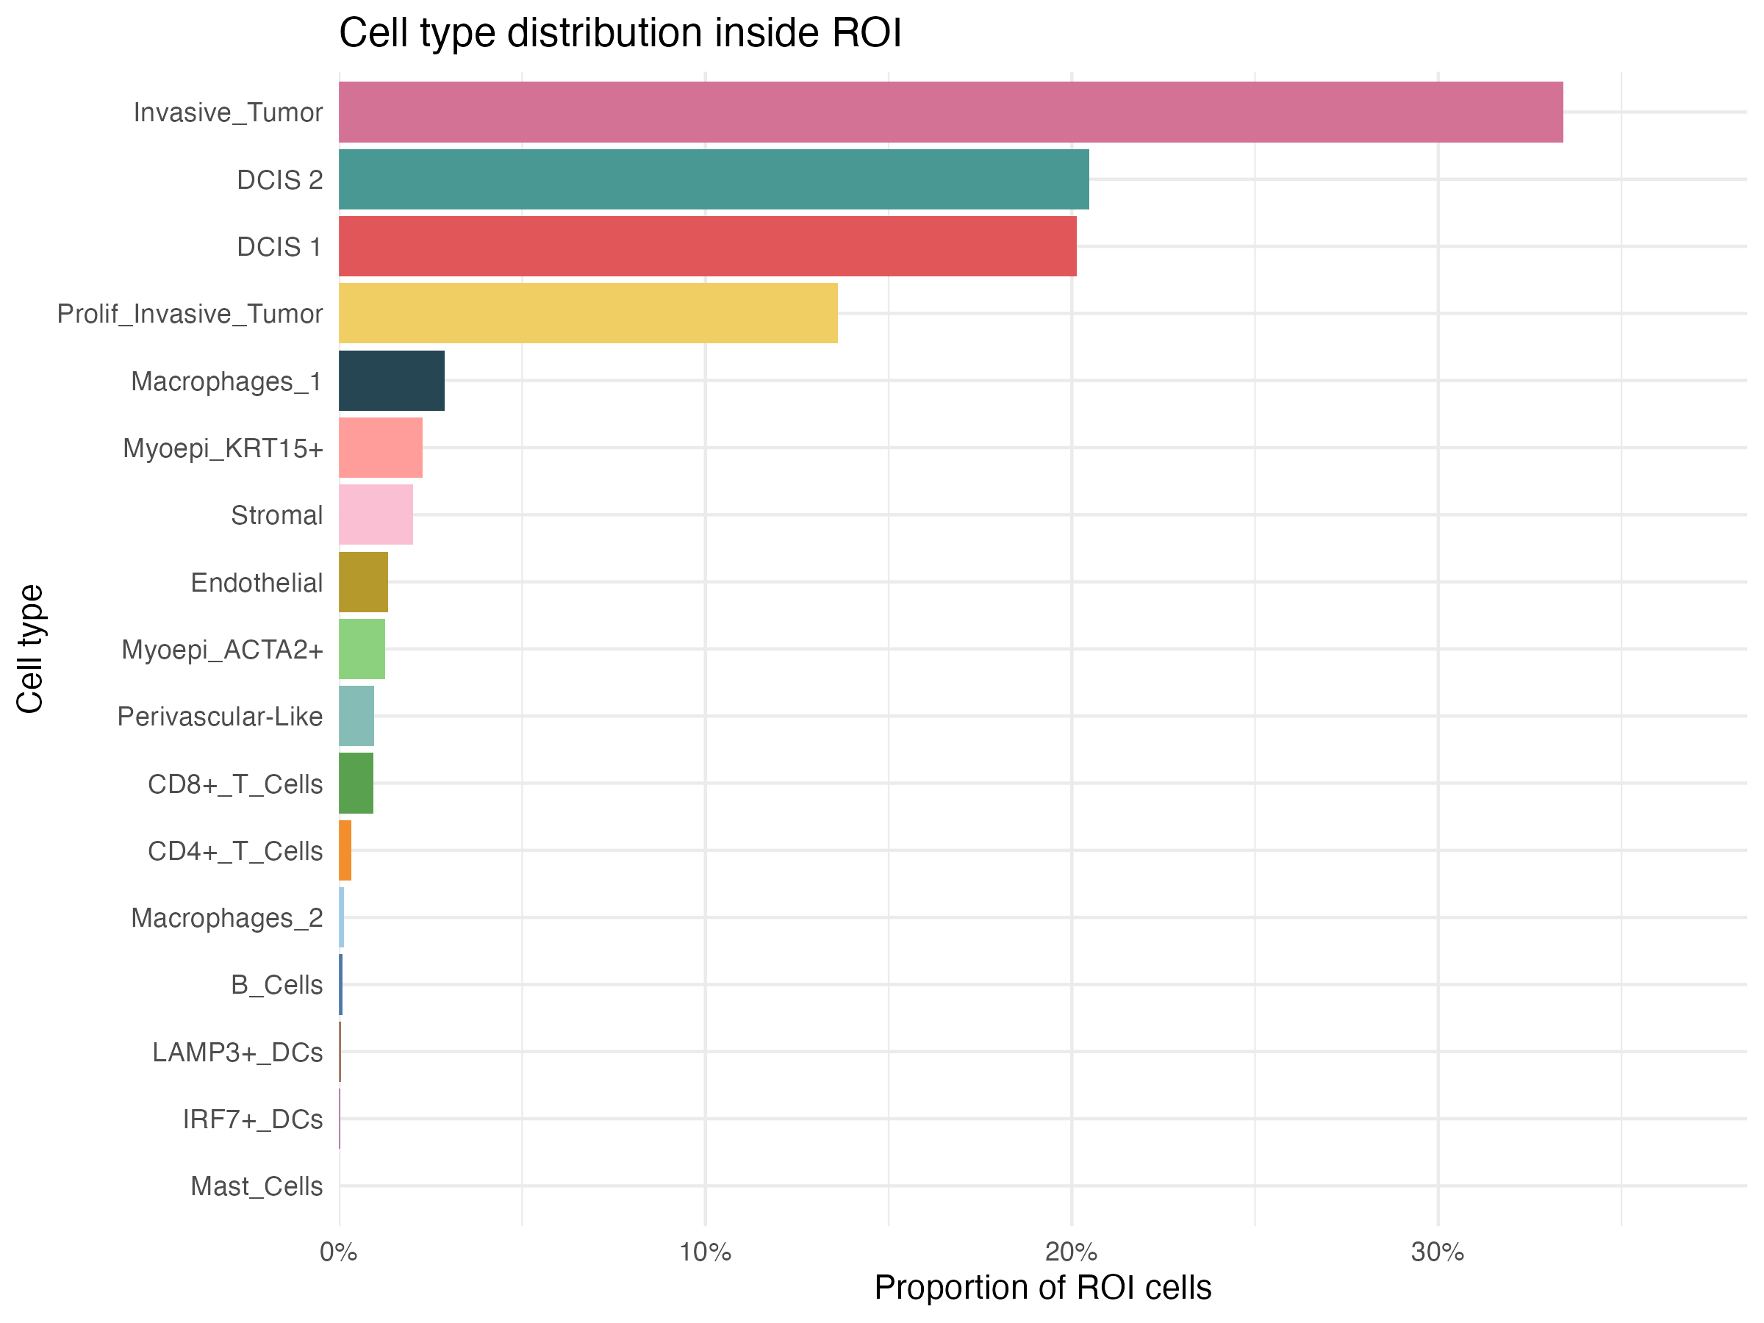
ROI QC: what is inside the tumor polygons?
REGIONS
Why look at this
Purity check on the polygons: anything non-tumor inside the ROI is either infiltrate or stroma the hull swallowed.
• ≈ 88% tumor: Invasive (≈ 33%), DCIS 2 and DCIS 1 (≈ 20% each), Prolif_Invasive (≈ 14%)
• Largest non-tumor populations: Macrophages_1 (≈ 3%), Myoepi_KRT15+, Stromal, Endothelial (≤ 2% each)
• CD8+ T ≈ 1%, CD4+ T < 0.5%, B cells ≈ 0% inside tumor nests
• labels = "both" adds counts and percentages to each bar
plot_roi_celltype_dist(metric = "proportion")
stGradient | spatial analysis of tumor boundaries
16
Notes:
This reads the qc_out$df data frame from qc_plot_xenium(). Myoepithelial cells inside polygons are expected: they line DCIS ducts, so the hull around a duct includes them. Macrophages are the main immune population that actually penetrates tumor nests here.

Slide 16
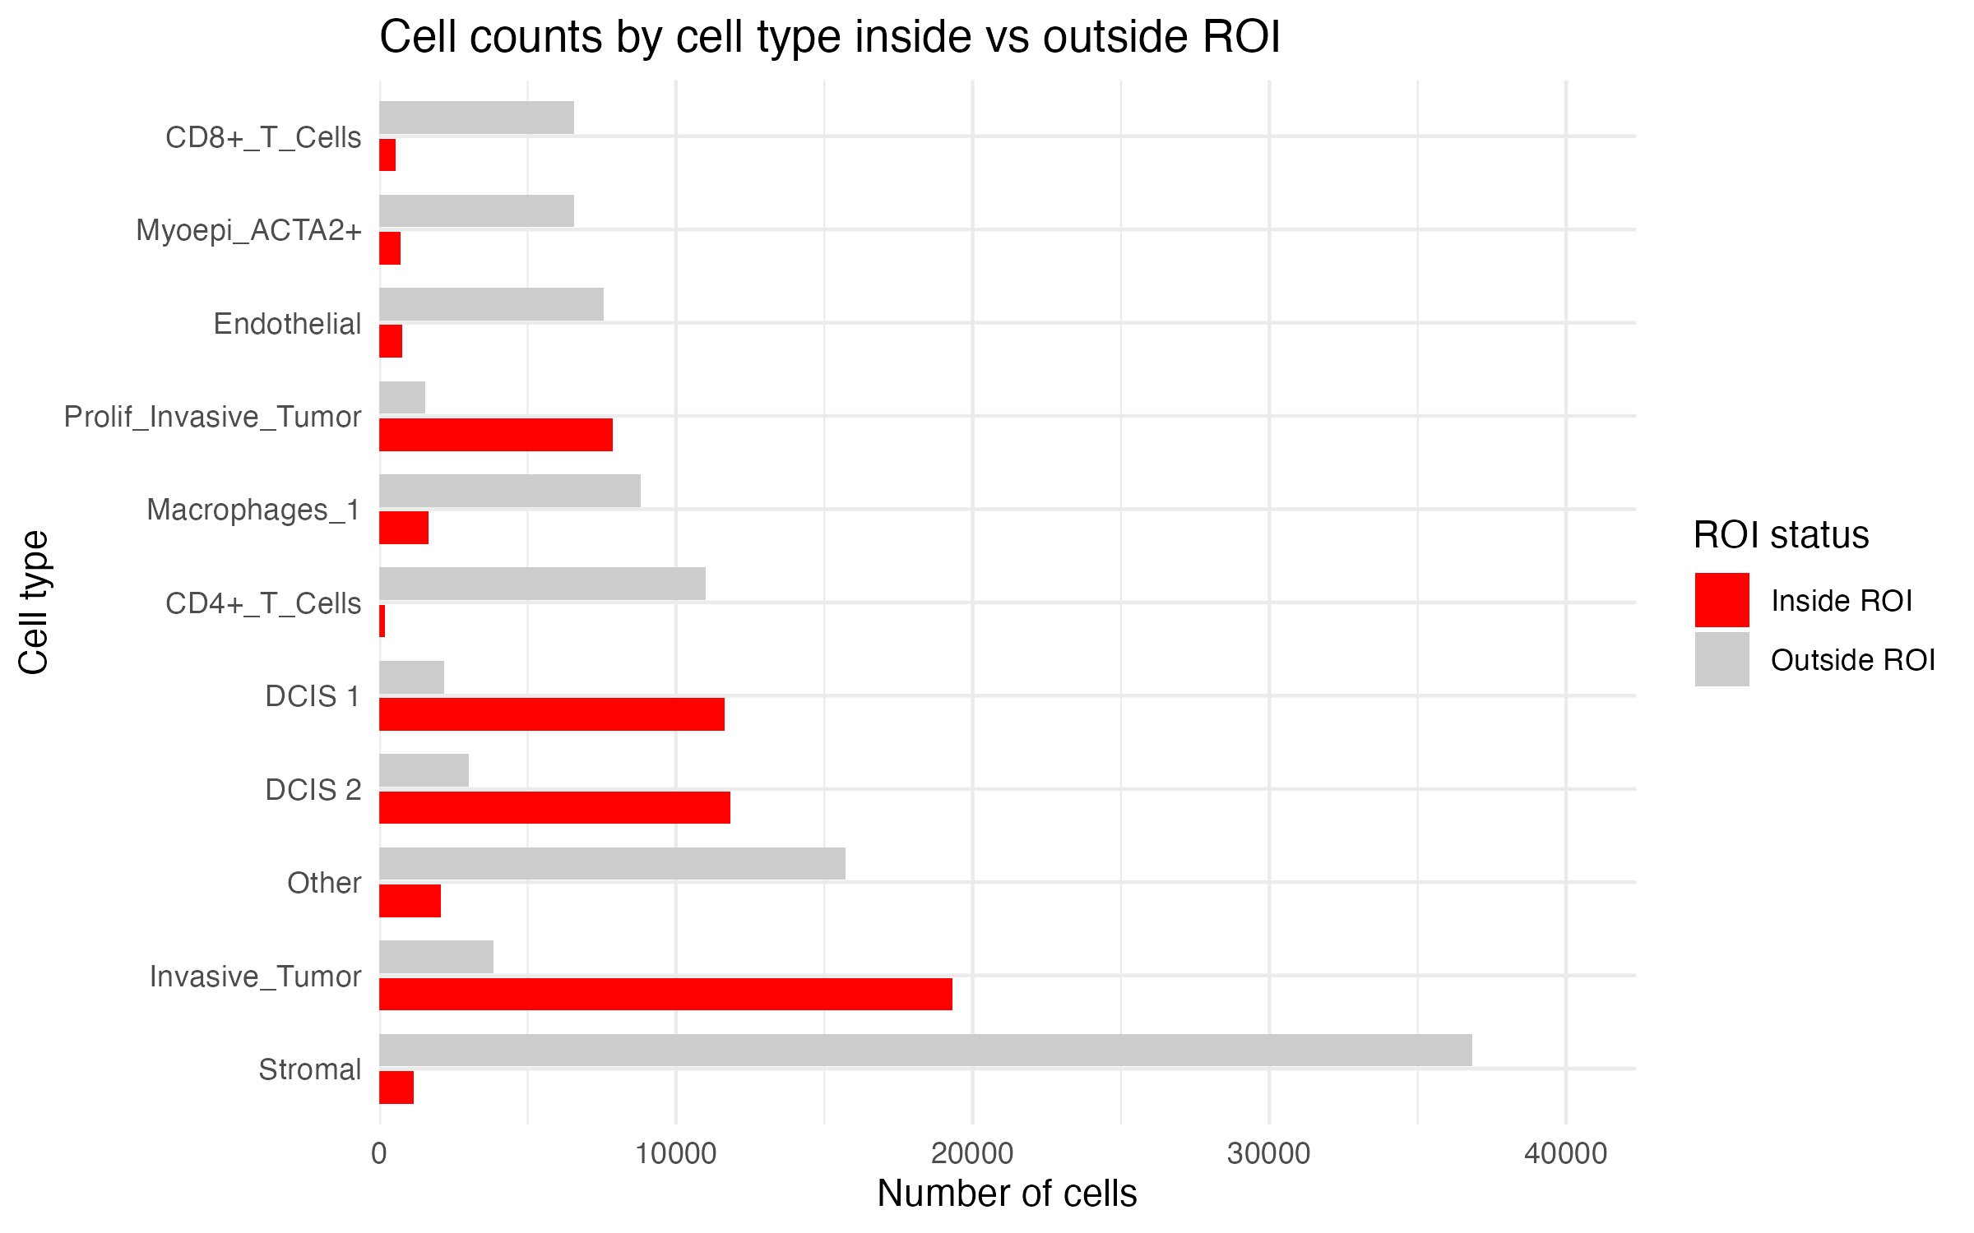
ROI QC: cell counts inside vs. outside
REGIONS
Why look at this
Absolute counts show both how well the polygons capture tumor and how many cells each downstream comparison rests on.
• Coverage: ≈ 51k tumor-labelled cells inside vs ≈ 11k outside (≈ 83%), matching the DBSCAN coverage estimate
• Outside tumor cells are scattered or budding cells that DBSCAN calls noise
• Stromal ≈ 37k outside vs ≈ 1k inside
• CD4+ T ≈ 11k outside vs ~200 inside; CD8+ T ≈ 6.5k vs ~600
plot_roi_inout_celltype_dodge(metric = "count", top_n = 10); remaining types pooled as “Other”
stGradient | spatial analysis of tumor boundaries
17
Notes:
Counts read from the bar chart. Tumor types: Invasive, DCIS 1, DCIS 2, Prolif_Invasive. The ~17% of tumor cells outside polygons is consistent with the coverage heatmap for eps = 35, minPts = 20 (0.81). Use top_n_by = "inside" to rank by the ROI population instead of the total.

Slide 17
PART 3
Distance profiles
How far from the boundary does the microenvironment stop looking like tumor, and which cell types drive that change?

Slide 18
Method: signed distance and separation metrics
DISTANCE
• Signed distance: Euclidean distance from each cell centroid to the nearest polygon boundary (sf), negative inside
• Inside group: “all inside” (whole tumor) or “boundary inside” (tumor cells within d of the edge)
200 µm
100 µm
Transcriptomic distance
d
1 − Pearson r between mean log-normalized expression profiles of inside vs. outside (0 = identical, 2 = anti-correlated)
tumor
d < 0
Composition difference
Σ (p_in − p_out)² summed over cell types; per-type terms kept to show which types drive separation
DE strength
Mean |log2FC| of top 100 genes, Seurat FindMarkers (Wilcoxon, min.pct 0.1) inside vs. outside
Critical distance
Outside group at threshold d = all cells with 0 < distance ≤ d (cumulative shells, d = 10…200 µm)
find_critical_distance(): distance of maximum separation, and plateau = first d reaching 90% of max
stGradient | spatial analysis of tumor boundaries
19
Notes:
Three complementary views of 'how different is the outside from the tumor': whole-transcriptome similarity (pseudobulk correlation), cell-type composition, and the magnitude of the strongest DE genes. Because the outside group is cumulative (0, d], each value summarizes everything within d; the slope of the curve tells you where change is happening. Composition difference is independent of sample size; DE strength depends on Seurat's test and filters.

Slide 19
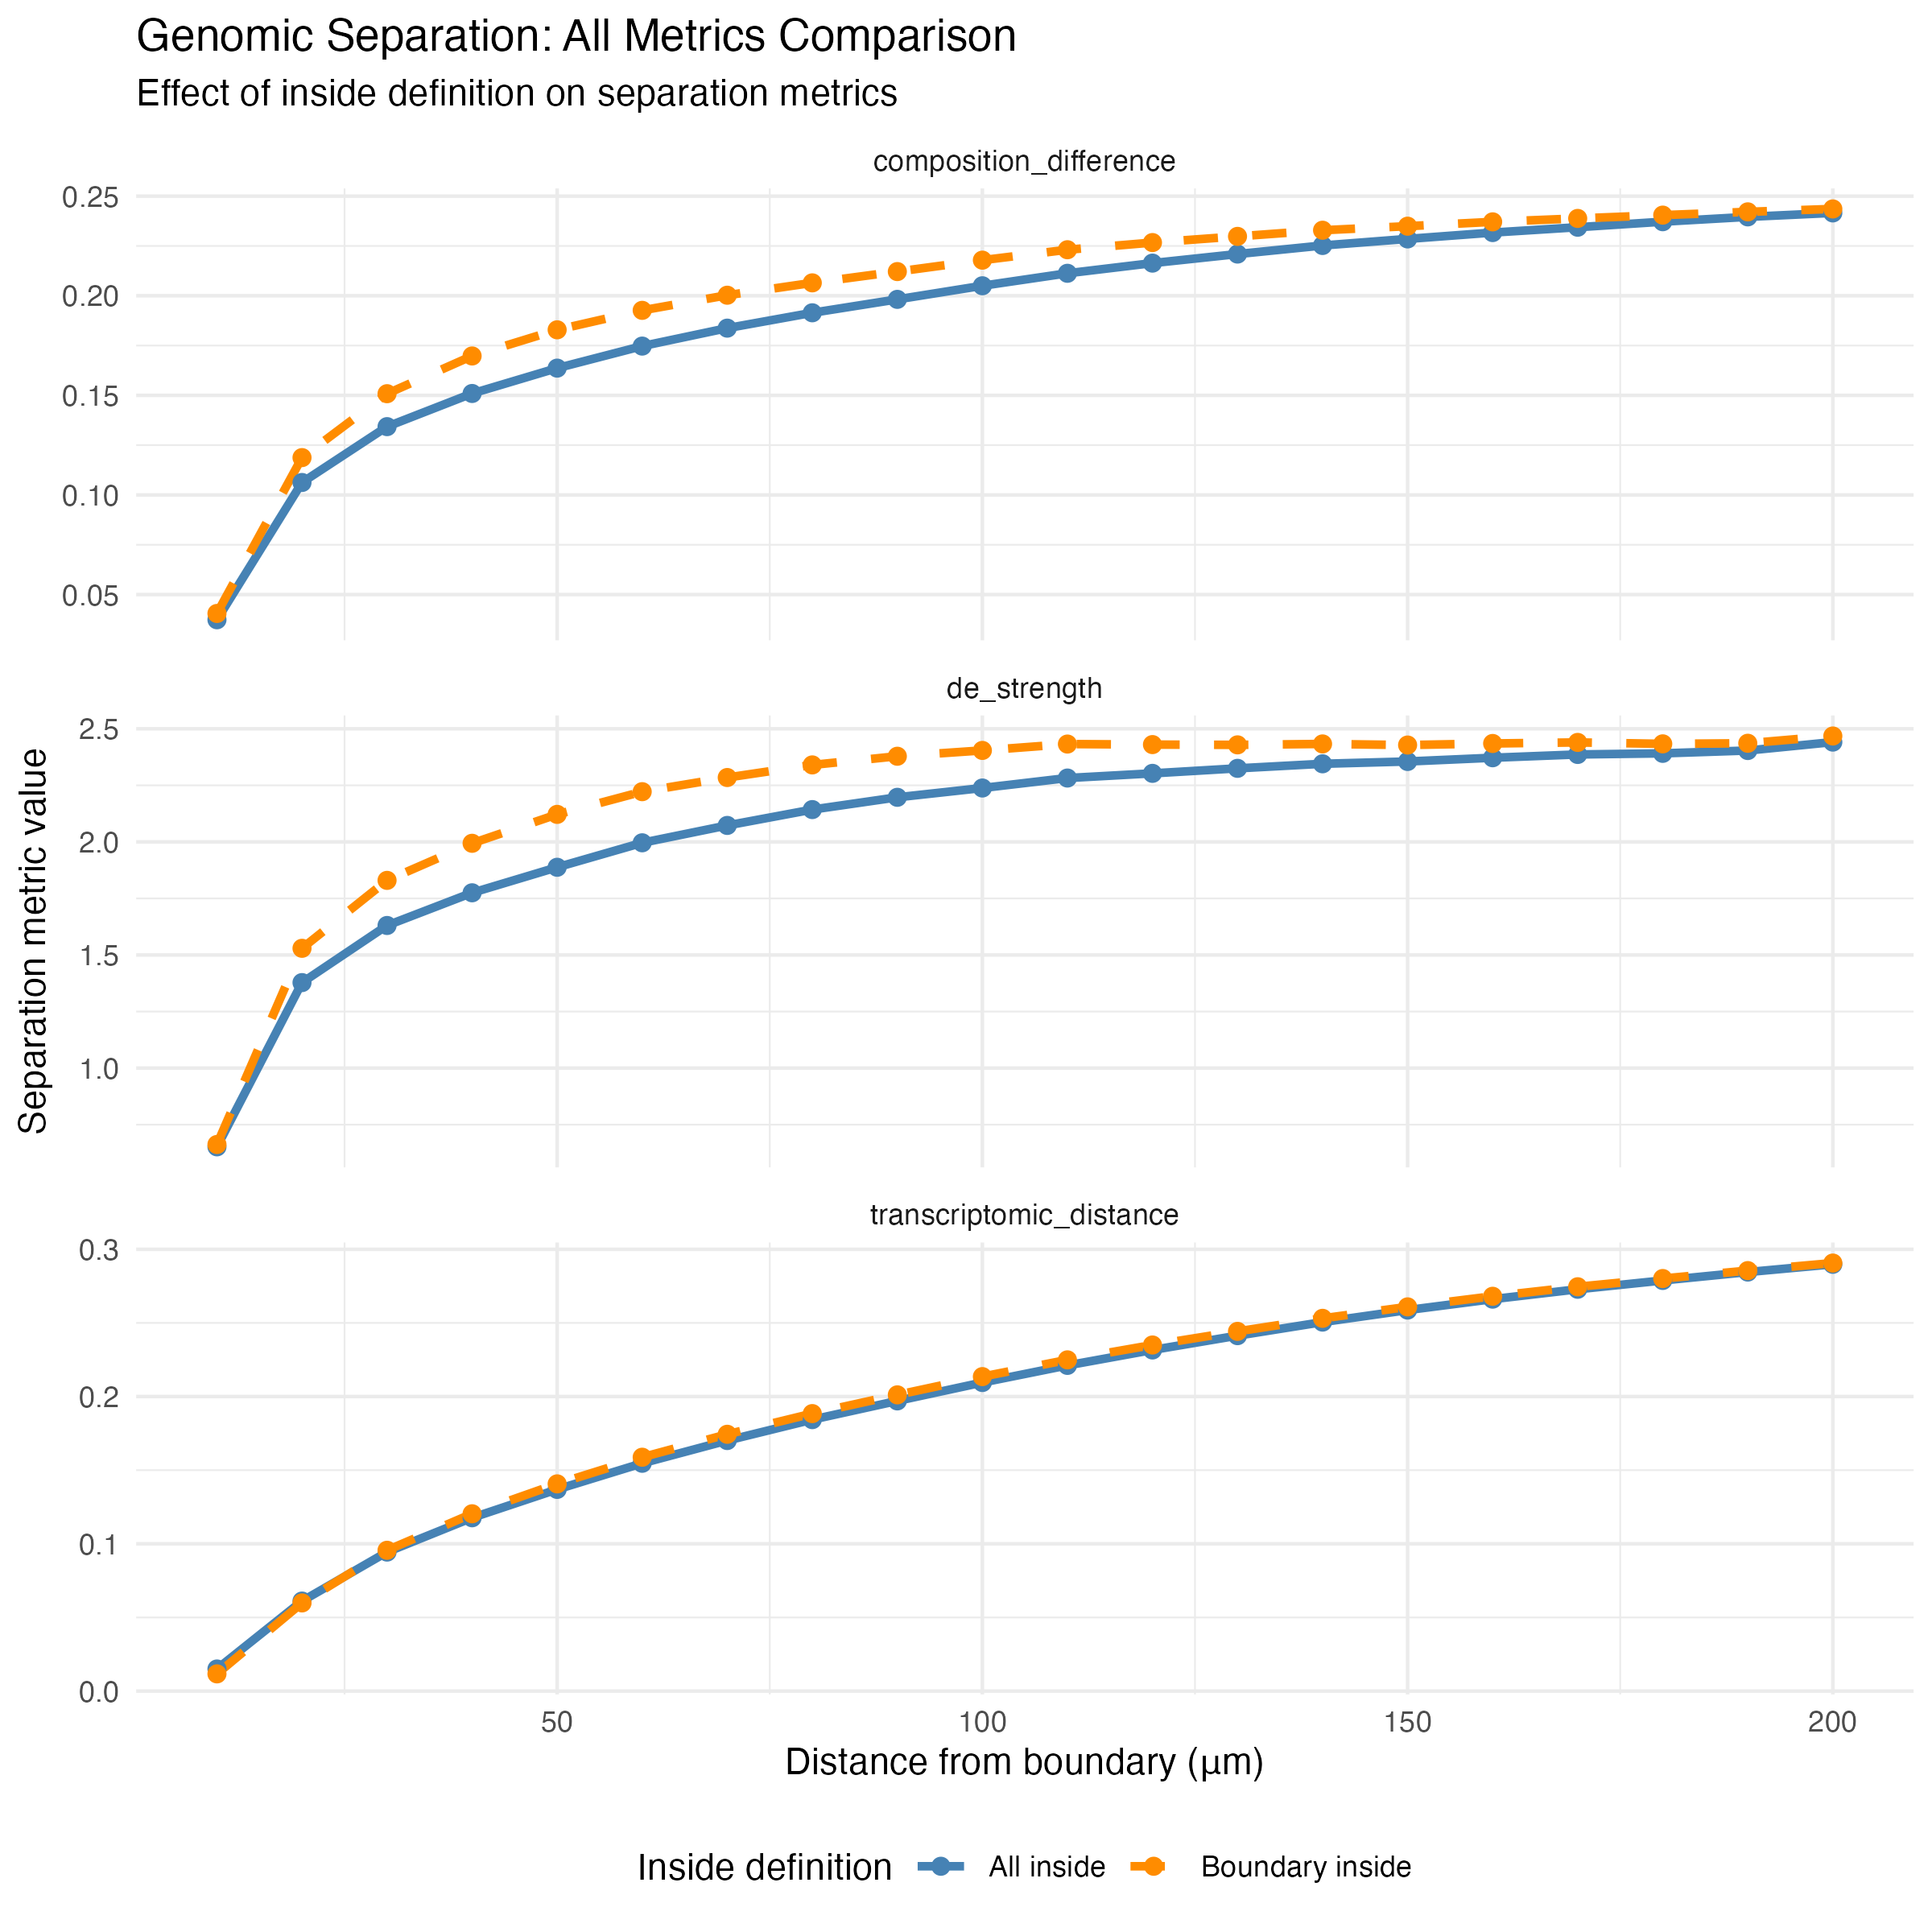
Result: separation rises within ~40 µm, then plateaus
DISTANCE
Why it matters
Gives a data-driven definition of the “margin”: how wide the peritumoral zone should be for downstream comparisons, instead of an arbitrary 100 µm.
• All three metrics climb steeply over the first 20–40 µm (~2–4 cell diameters): the immediate rim still contains tumor-like cells and myoepithelium
• Composition and DE strength approach a plateau around ~100–150 µm; transcriptomic distance keeps rising slowly to 200 µm, suggesting gradual stromal programme changes extend further than cell-type shifts
• “Boundary inside” gives slightly stronger composition/DE separation at 30–100 µm; pseudobulk transcriptomic distance is nearly identical for both definitions
stGradient | spatial analysis of tumor boundaries
20
Notes:
Plateau values are approximate readings from the curves; find_critical_distance() returns them exactly. With cumulative shells the curves are monotone-ish by construction, so focus on where they bend. Comparing these curves across patients (e.g. responders vs non-responders) is the natural cohort-level use.

Slide 20
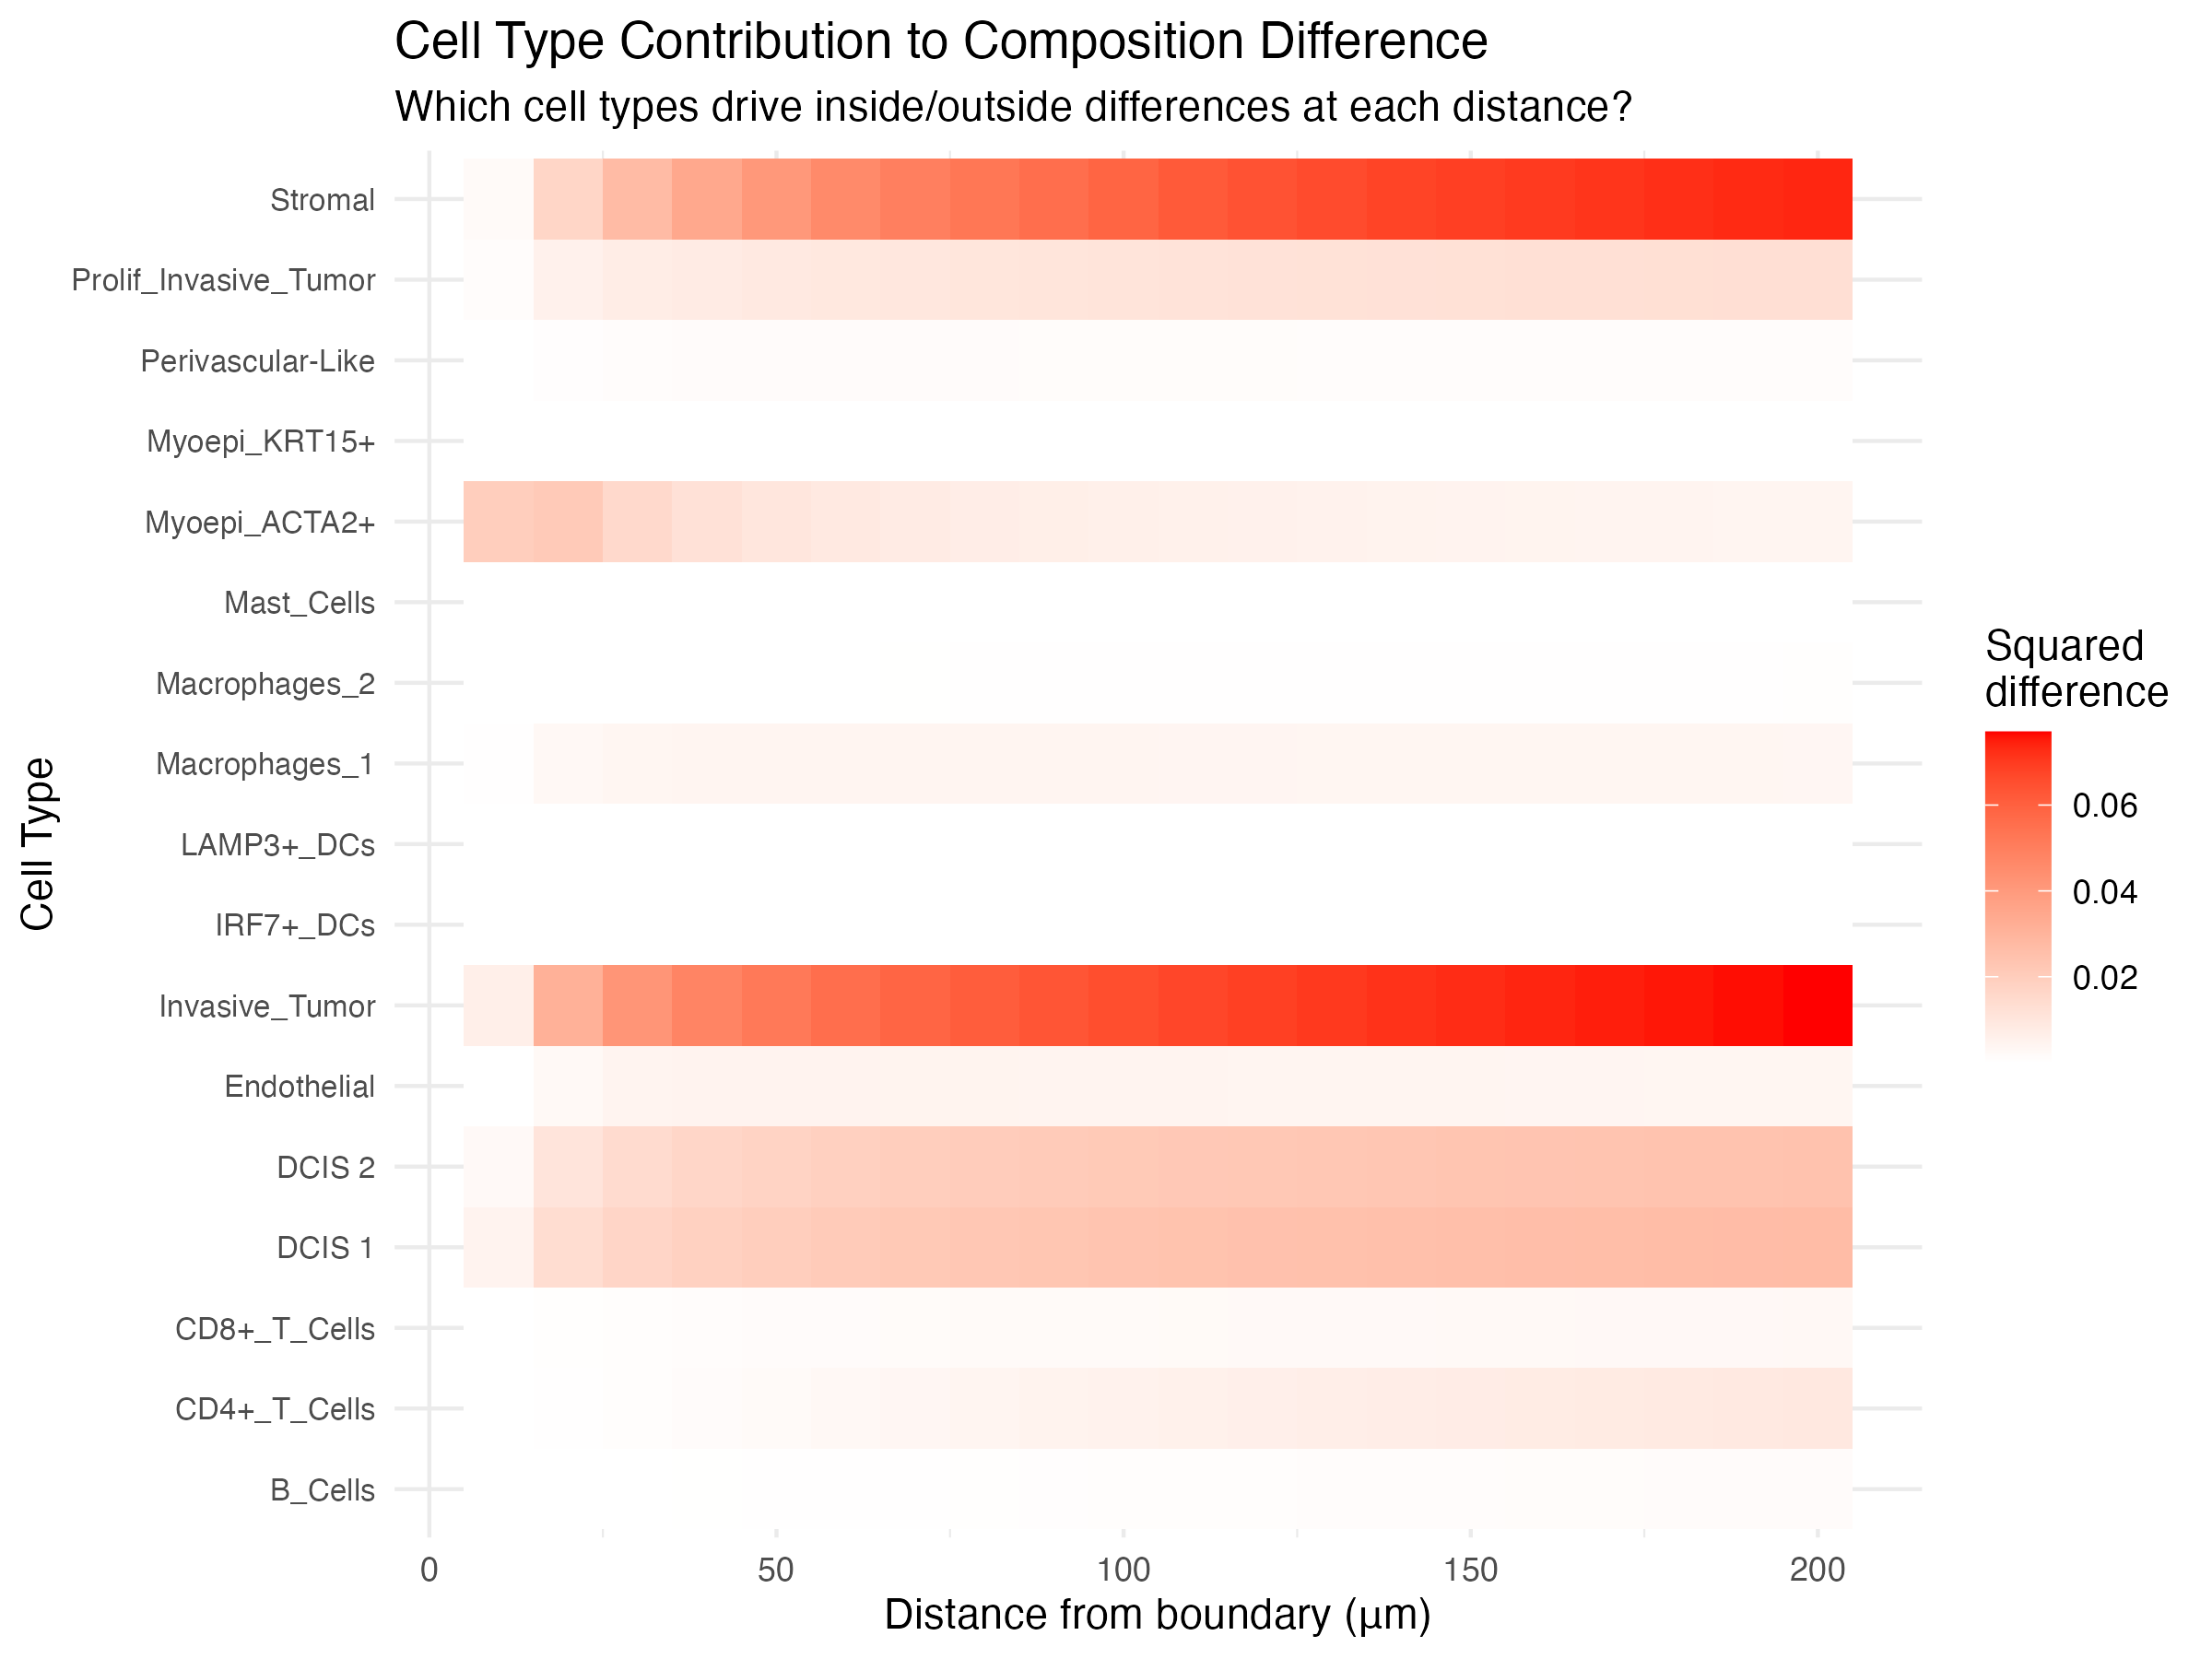
Which cell types drive the composition difference?
DISTANCE
Why it matters
Decomposes one summary number into cell types, so we can see which populations actually define the tumor–stroma boundary.
• Each tile = (p_in − p_out)² for one cell type at distance d; a column sums to the composition difference
• Invasive_Tumor loss and Stromal gain dominate and grow steadily with distance
• DCIS 1/2 contribute a constant share beyond ~30 µm
• Myoepi_ACTA2+ contributes only within ~30 µm: the myoepithelial layer wrapping DCIS ducts
• Immune types barely move the total because they are rare, so look at their proportions directly (next slide)
stGradient | spatial analysis of tumor boundaries
21
Notes:
plot_celltype_heatmap() uses results$celltype_contributions from calculate_distance_profile(). Because the metric is a sum of squared proportion differences, abundant populations dominate. Rare but biologically important populations such as T cells need the proportion view on the next slide.

Slide 21
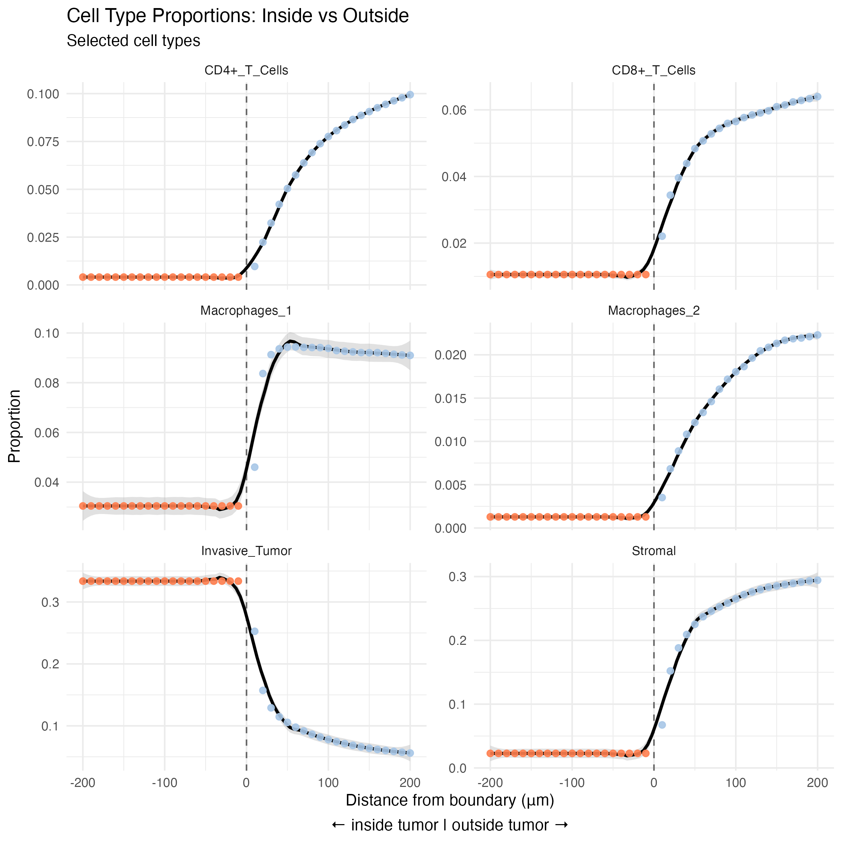
Cell-type gradients: macrophage rim, T cells further out
DISTANCE
• How to read: orange = proportion inside the tumor; blue = cumulative proportion of outside cells within d
• Macrophages_1 jump to a plateau (~9%) within ~40 µm: a macrophage rim at the tumor edge
• CD4+ and CD8+ T cells and Macrophages_2 rise gradually and are still increasing at 200 µm
• Inside the tumor, CD8+ T cells are ≈ 1% and CD4+ T cells < 0.5%
• Pick populations with plot_celltype_proportions(..., celltypes = c("B_Cells", "CD8+_T_Cells"))
Immunology read-out
Lymphocytes are depleted at the immediate margin and accumulate further into the stroma, behind a rim of macrophages: consistent with an immune-excluded-like margin. Worth testing across a cohort.
stGradient | spatial analysis of tumor boundaries
22
Notes:
plot_celltype_proportions() shows inside proportion (constant in inside_mode = 'all') and cumulative outside proportion. A macrophage rim with T cells held further out is the pattern described in e.g. Peranzoni et al. 2018 (PNAS). This is one section; the hypothesis needs cohort-level confirmation.

Slide 22
PART 4
Spatial co-occurrence (PCF)
Beyond “how many”: which cell types are organized together in the peritumoral microenvironment?

Slide 23
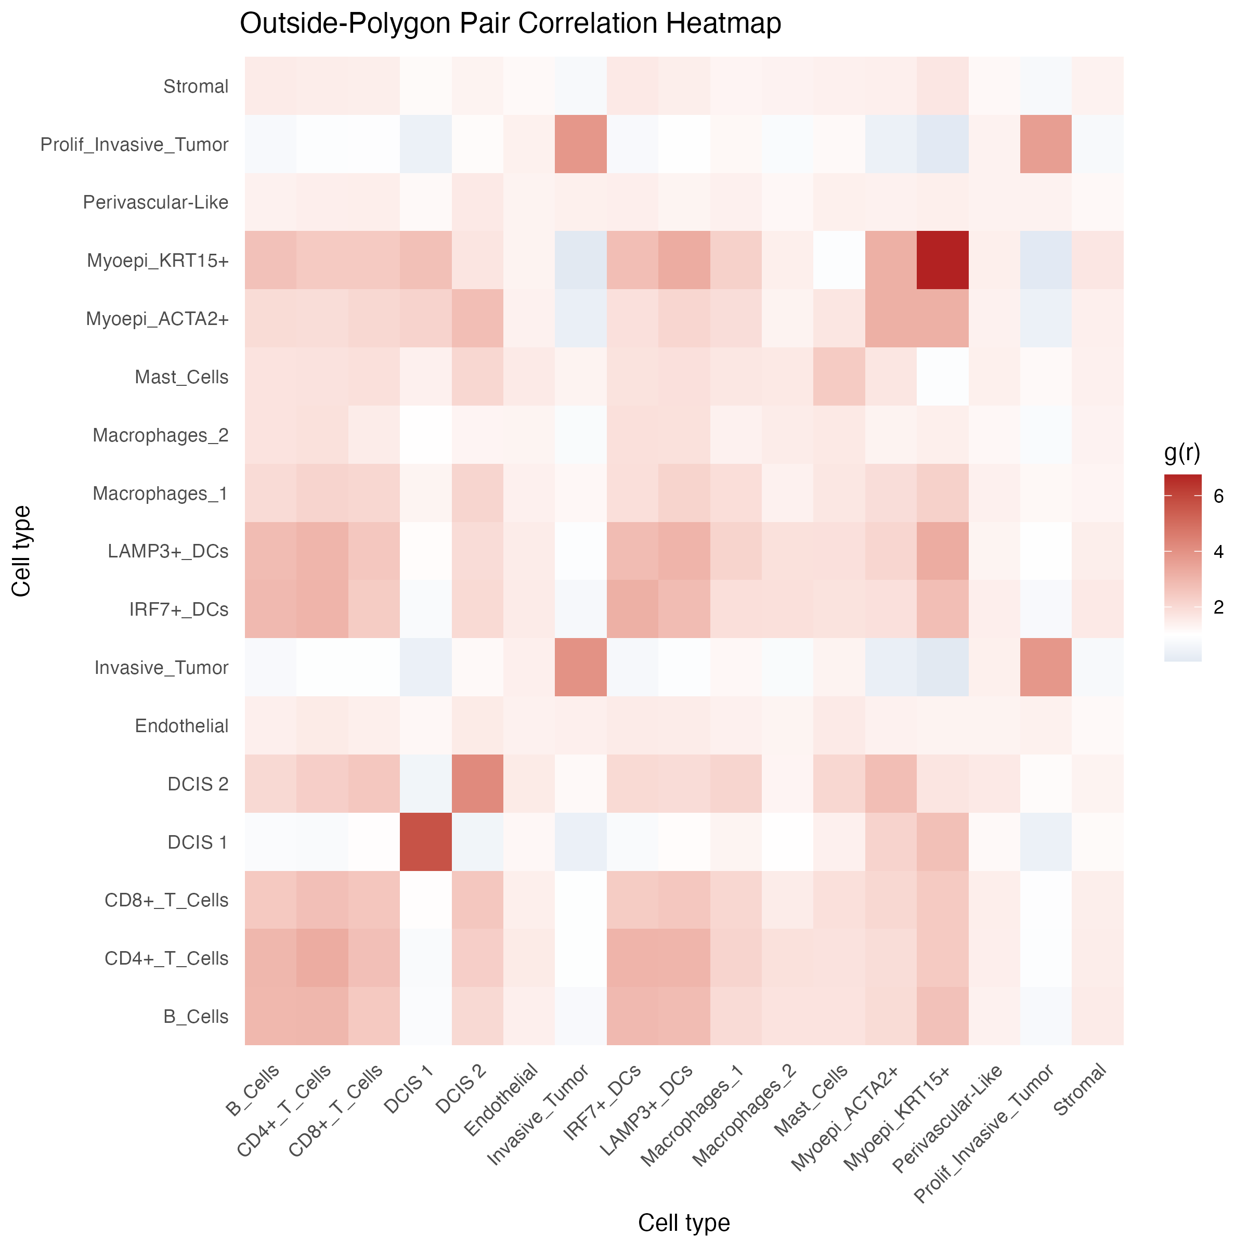
Pair correlation functions outside the tumor
PCF
Motivation
Counts can't tell whether CD8 T cells sit next to macrophages, DCs or B cells. Cell-cell proximity is a prerequisite for interaction (antigen presentation, suppression, TLS formation).
• Points = cells outside tumor polygons, marked by cell type (types with < min_cells dropped)
• Cross-type PCF g_ij(r) (spatstat::pcfcross, isotropic edge correction): density of type-j cells at distance r from type-i cells, relative to complete spatial randomness
• g = 1 random, g > 1 co-localization, g < 1 avoidance; heatmap shows g at r = 200 µm
• Demo: a lymphoid/DC block (B, CD4+, CD8+, LAMP3+ and IRF7+ DCs) is mutually enriched (g ≈ 2–3); tumor types co-cluster only with themselves; Myoepi_KRT15+ self-clustering is strongest (ductal layers)
stGradient | spatial analysis of tumor boundaries
24
Notes:
calculate_pcf_outside_summary() evaluates every unordered pair once (ordered_pairs = FALSE) at the requested radius. Tumor-labelled cells outside polygons are DBSCAN noise or small buds; their strong self-clustering is expected. The lymphoid-DC block is consistent with immune aggregates / TLS, which we test directly in the TLS module.

Slide 24
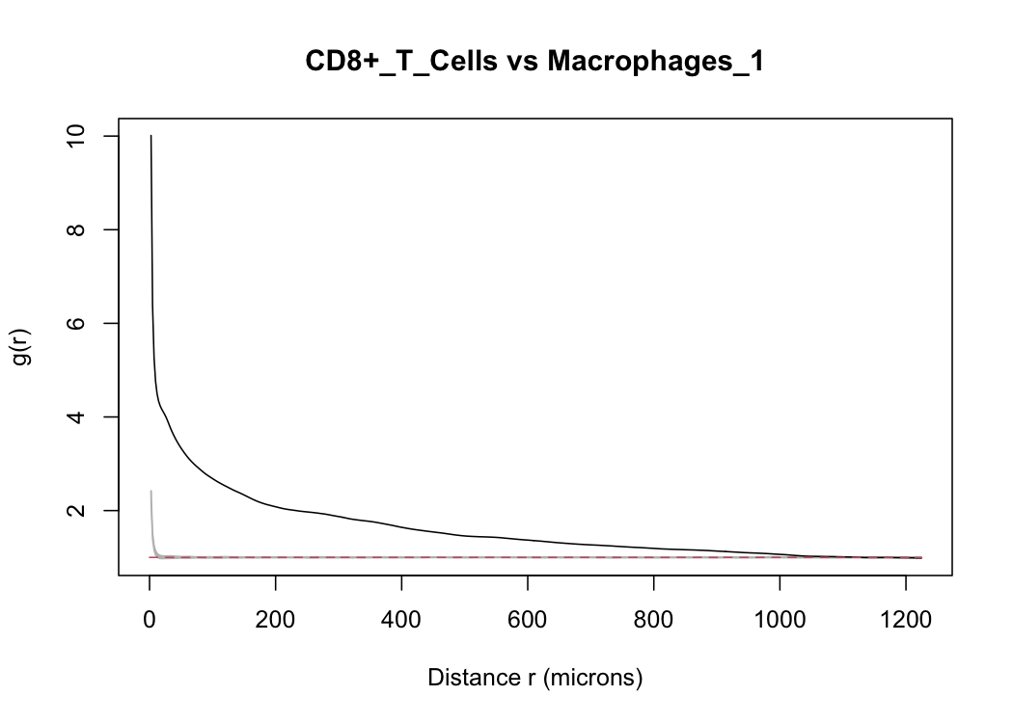
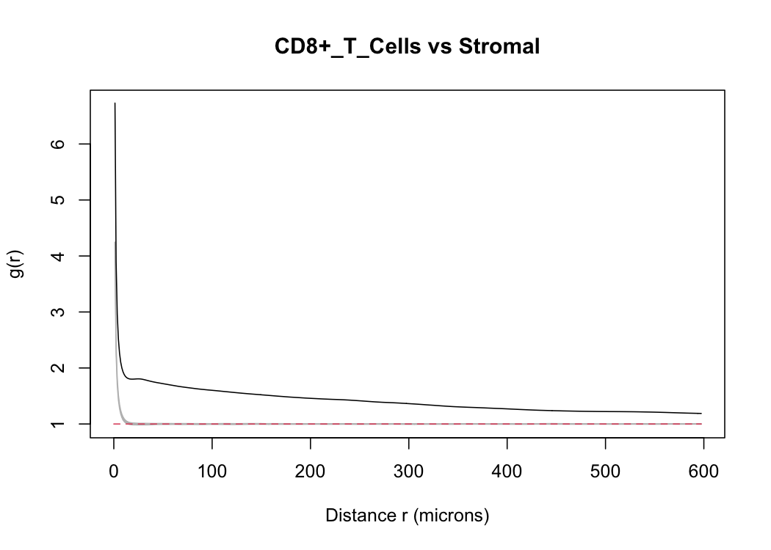
Significance via Monte Carlo envelopes
PCF
Black = observed g(r); grey band = envelope of 100 simulations; red dashed = g = 1
• CD8+ T vs Macrophages_1: g ≈ 4 at short range, ≈ 2 at 200 µm, far above envelope: strong stromal CD8–macrophage co-localization
stGradient | spatial analysis of tumor boundaries
25
Notes:
plot_pcf_outside_pair_envelopes() calls spatstat envelope() with pcfcross, nsim = 39 (pointwise ~5% level), bandwidth 10 um, saving one PNG per pair. Because outside cells cannot occupy tumor polygons, the CSR null over the full bounding box inflates g for every pair. The informative signal is relative: CD8-macrophage (~2 at 200 um) vs CD8-stromal (~1.5). A random-labelling null or a window excluding polygons (window_obj argument) would give cell-type-specific attraction directly.

Slide 25
PART 5
Gene–distance analysis
Which transcriptional programs change continuously along the tumor → stroma axis?

Slide 26
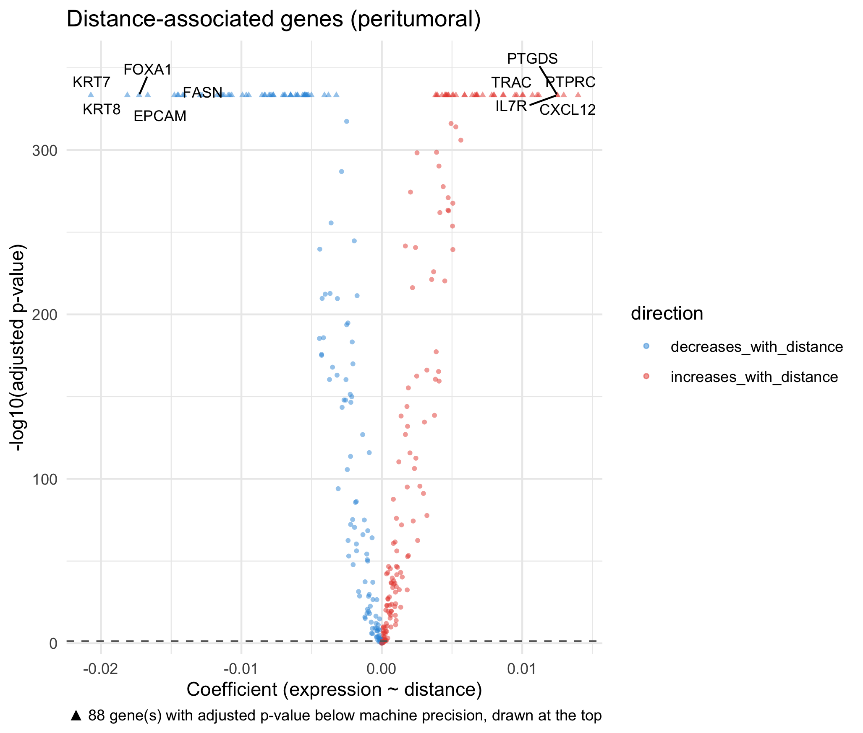
Modeling expression as a function of boundary distance
GENES
Motivation
Cell-type composition misses within-type state changes (e.g. fibroblast activation, chemokine gradients). A continuous model finds genes that track distance without pre-defined bins.
• compute_distance_from_boundary(): per-cell signed distance to nearest polygon
• focus = “peritumoral” (0 < d), “intratumoral” or “both”; distances capped at min(max_distance, 95th pct)
• For each gene expressed in ≥ 10 cells: OLS expr ~ distance on log-normalized data; BH-adjusted p-values
• Quantile distance bins (10) summarize mean expression for trend plots
• Decrease with distance (blue): epithelial / luminal genes KRT7, KRT8, EPCAM, FOXA1, FASN
• Increase with distance (red): immune and stromal genes PTPRC, TRAC, IL7R, CXCL12, PTGDS
stGradient | spatial analysis of tumor boundaries
27
Notes:
The volcano x-axis is the linear slope (expression units per micron), y-axis is -log10 BH-adjusted p. 88 genes have adjusted p-values below machine precision and are drawn as triangles at the top, so rank those by effect size rather than p. Both directions are strongly represented: an epithelial programme fading out and an immune/stromal programme building up with distance.

Slide 27
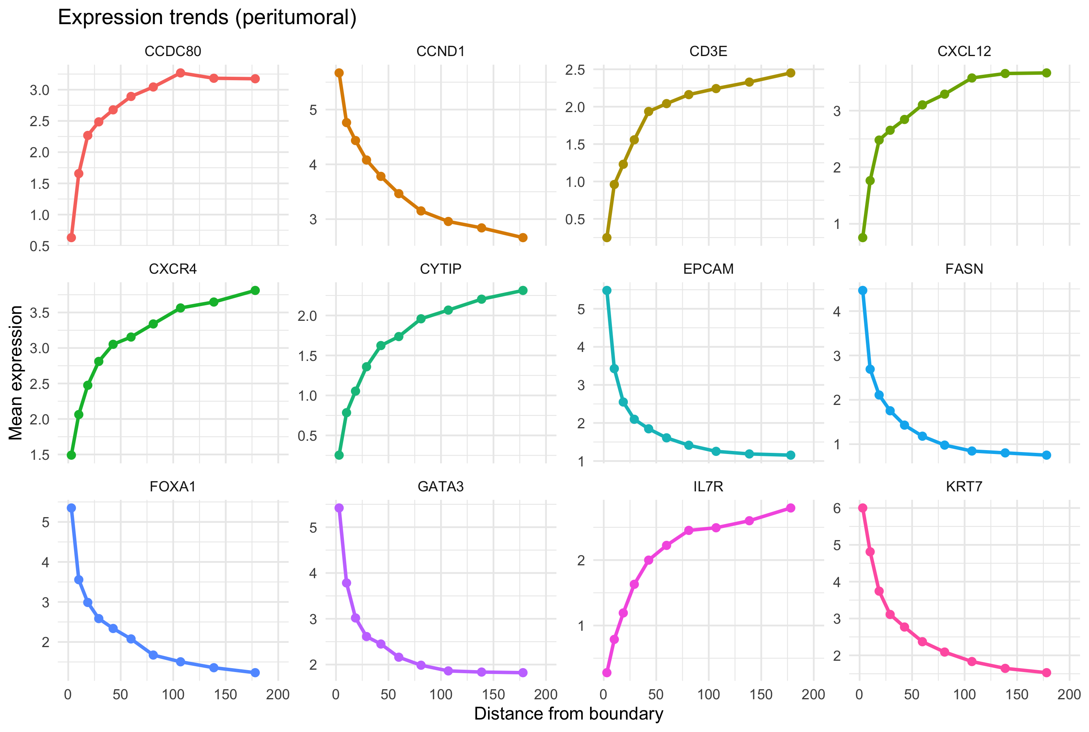
Result: epithelial genes decay, immune genes rise
GENES
• Falling: KRT7, EPCAM, FOXA1, GATA3, FASN, CCND1, the luminal breast epithelial programme; most of the drop is within ~25 µm
• Rising: T-cell genes CD3E, IL7R, CYTIP, CXCR4, still increasing at 180 µm, mirroring the T-cell proportion curves
• Rising then plateauing by ~100 µm: stromal CCDC80 and the chemokine CXCL12
Mean expression per quantile distance bin, peritumoral cells up to 200 µm
stGradient | spatial analysis of tumor boundaries
28
Notes:
x-axis is capped at max_distance = 200 um. Because the model runs on all peritumoral cells, most trends reflect which cell types sit at each distance (tumor cells near the edge, T cells further out). CXCL12 is produced mainly by fibroblasts and has been linked to T-cell exclusion in some tumors (e.g. Feig et al. 2013 PNAS), which makes the CXCL12/CXCR4 pattern a hypothesis rather than a conclusion here. Running the model within a single cell type (e.g. fibroblasts or CD8 T cells) is the way to isolate state gradients.

Slide 28
PART 6
Tertiary lymphoid structures
Find organized B/T-cell aggregates from cell labels and validate them with an independent expression signature

Slide 29
Calling TLS from cell-type labels: method
TLS
Motivation
seurat_obj <- call_tls(
seurat_obj,
celltype_col = "first_type",
b_types = "B_Cells",
t_types = c("CD4+_T_Cells", "CD8+_T_Cells"),
dc_types = c("LAMP3+_DCs", "IRF7+_DCs"),
eps = 50, minPts = 20,
min_B = 20, min_T = 20, min_frac_B = 0.05)
get_tls_summary(seurat_obj) # per-TLS composition
TLS presence and maturity associate with checkpoint-blockade response and survival in several cancers. Reproducible calling lets us count, size and stage them per sample.
• 1. Seed: DBSCAN on B + T cells only (eps = 50 µm, minPts = 20)
• 2. Call: ≥ 20 B, ≥ 20 T and B fraction ≥ 5%, which excludes pure T-cell infiltrates
• 3. Stage: aggregates containing LAMP3+ (DC-LAMP+) DCs are flagged “mature-like”
Caveat on “maturity”
LAMP3+ DCs are a panel-limited proxy. Formal staging needs germinal-centre features (CD21+ follicular DCs, BCL6+ B cells). All thresholds are exposed so they can be tuned with pathology input.
stGradient | spatial analysis of tumor boundaries
30
Notes:
References for importance: Cabrita et al. 2020, Helmink et al. 2020, Petitprez et al. 2020 (all Nature). call_tls() adds TLS_id (NA outside called TLS) and in_TLS metadata; get_tls_summary(called_only = FALSE) also lists candidate aggregates that failed the criteria.

Slide 30
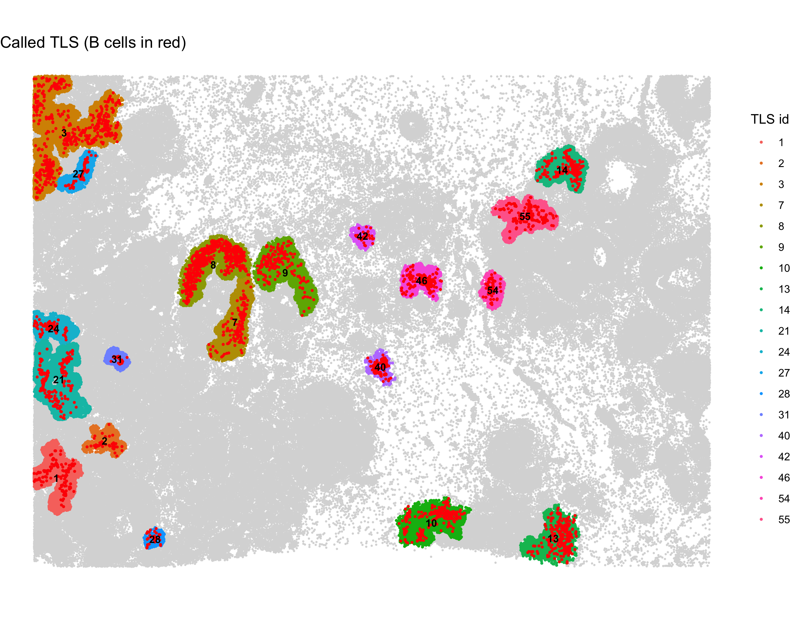
TLS calls in the demo section
TLS
• 19 putative TLS called across the section
• Sizes range from compact aggregates (28, 31, 40, 42) to large, elongated ones (3, 7–9)
• TLS 7, 8 and 9 wrap around two duct-like structures in the center of the section
• Several sit on the left edge of the field (1–3, 21, 24, 27), so they may be truncated by the section boundary
plot_tls_map(): each called TLS colored by ID, B cells in red
stGradient | spatial analysis of tumor boundaries
31
Notes:
Counts and IDs come from the plot_tls_map legend. IDs are DBSCAN cluster numbers, so gaps (e.g. no TLS 4-6) are aggregates that failed the TLS criteria.

Slide 31
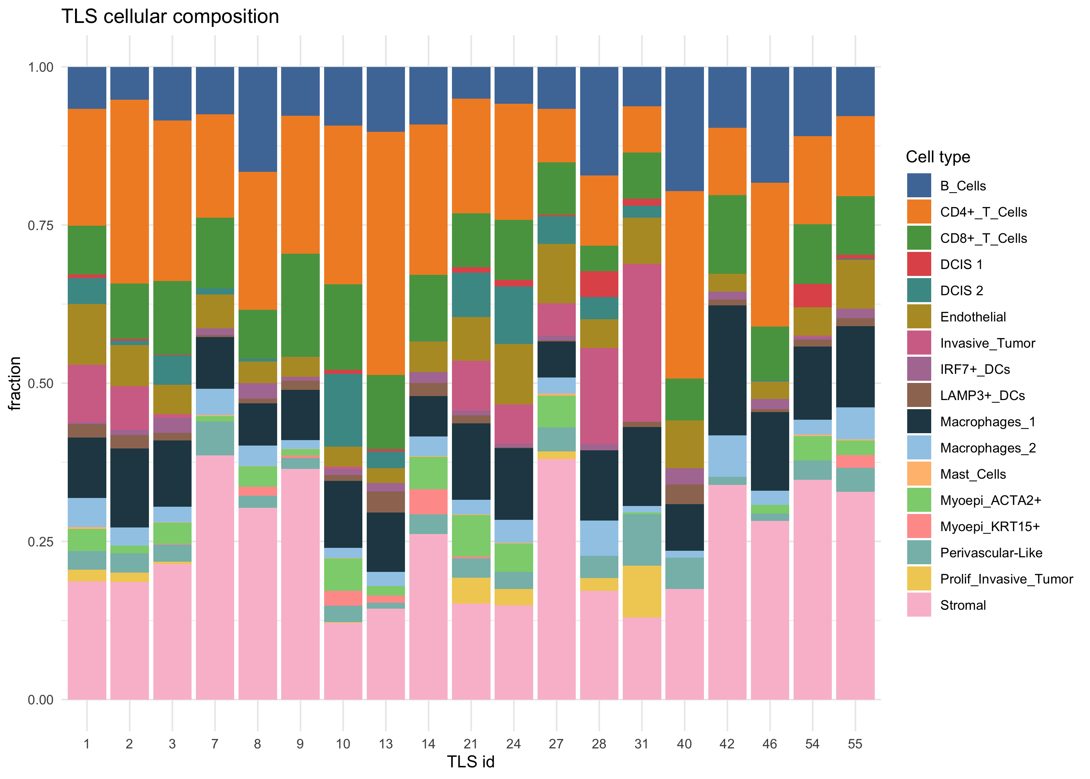
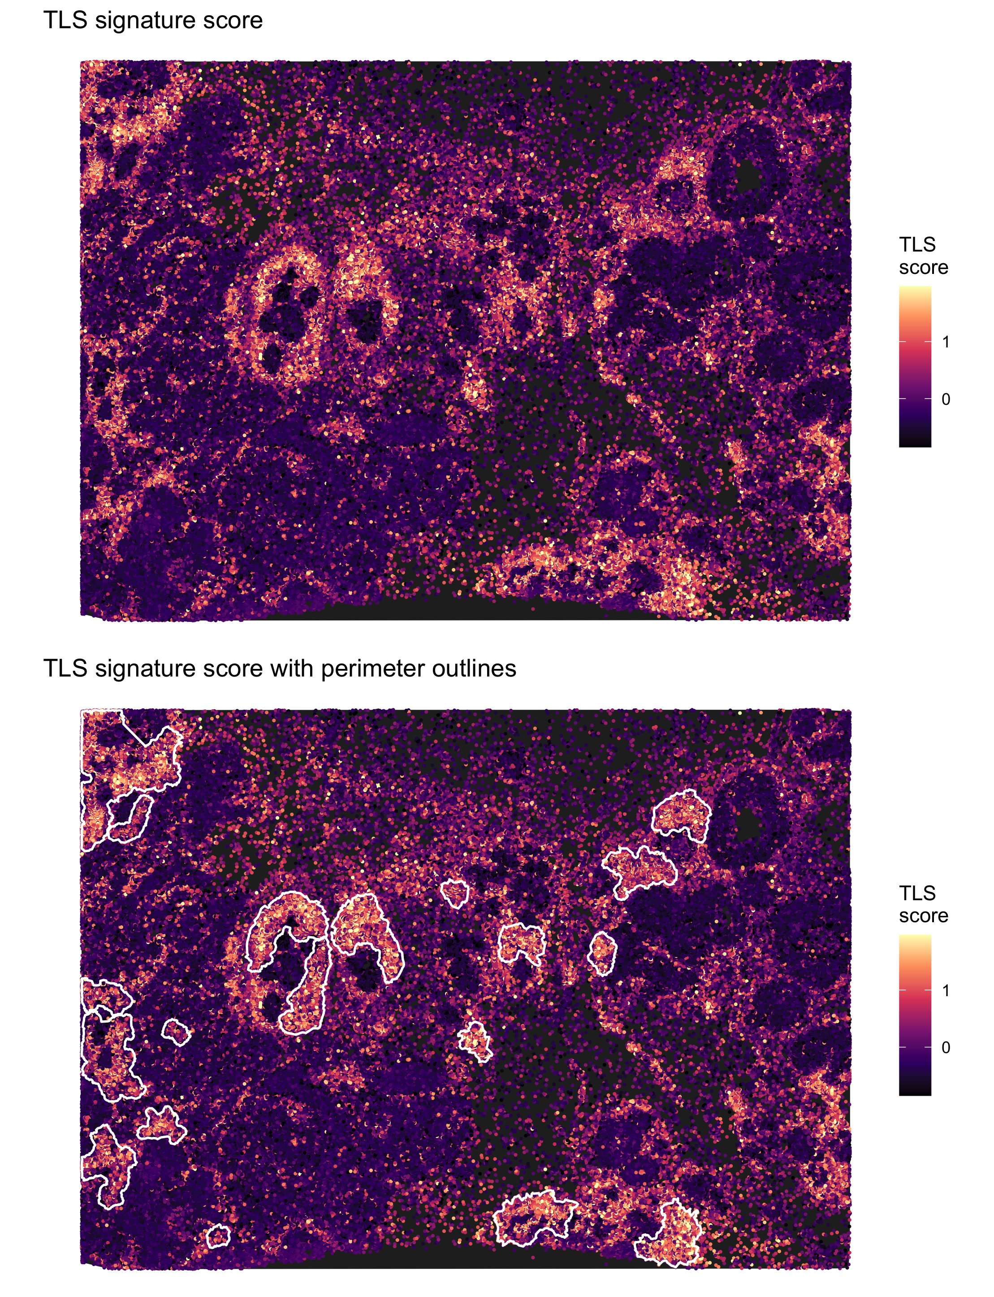
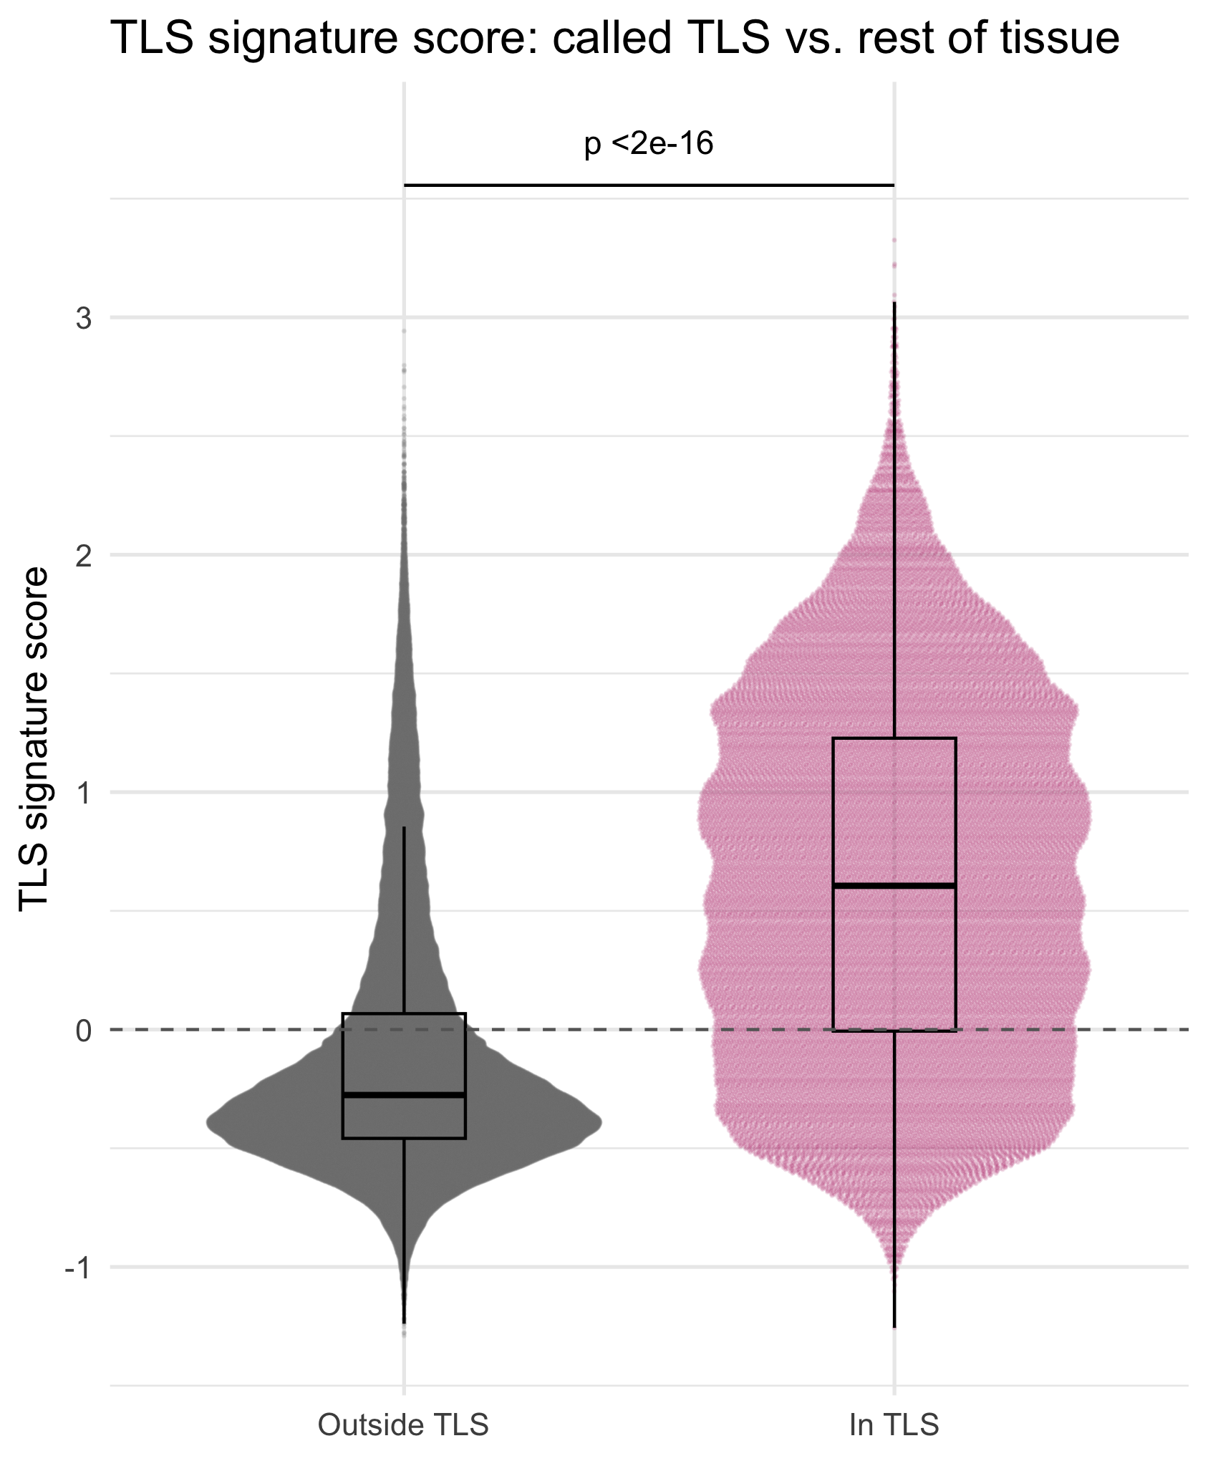
Validating TLS calls with a gene signature
TLS
Per-TLS composition
• CD4+ T dominant, B cells 5–20%, LAMP3+ DCs in most aggregates
• TLS 28 and 31 contain substantial invasive tumor: tumor-associated aggregates
Signature score, TLS outlined
In TLS vs. rest: Wilcoxon p < 2e−16
Orthogonal check
Gene signature enrichment of published 22-gene TLS score
stGradient | spatial analysis of tumor boundaries
32
Notes:
add_tls_score() drops signature genes missing from the panel. summarize_tls_score()$by_tls ranks each TLS by mean score; low-scoring aggregates are candidates for false positives and worth reviewing on H&E. In the score map, high-scoring regions without a call indicate looser lymphoid infiltrates that don't meet the B-cell criteria.

Slide 32
What the demo section tells us
TAKEAWAYS
Margin width
Tumor–stroma separation emerges within 20–40 µm and plateaus by ~100–150 µm
Immune architecture
Macrophage rim at the edge; CD4+/CD8+ T cells enriched further out, sparse inside: excluded-like
Peritumoral organization
Lymphoid + DC cells co-localize; CD8+ T cells strongly co-localize with Macrophages_1
Transcriptional gradient
Epithelial genes (KRT7, EPCAM, FOXA1) decay; T-cell genes and CXCL12 rise with distance
Lymphoid structures
19 TLS called, most with LAMP3+ DCs, independently supported by signature score
stGradient | spatial analysis of tumor boundaries
33
Notes:
These are single-section observations meant to show what the package produces, not biological conclusions. The value comes from running the same pipeline across a cohort and comparing curves, co-occurrence and TLS metrics between groups.

Slide 33
Current limitations
Limitations to keep in mind
• Single-sample, descriptive metrics: cohort comparisons (e.g. responders vs. non-responders) currently done downstream, e.g. mixed models on per-sample curves
• Label- and segmentation-dependent: annotation quality and spillover (hence SPLIT) propagate into every metric
• PCF null is CSR over the bounding box; random labelling or custom windows are better for cell-type-specific attraction
• 2D sections: distances to a 3D tumor surface are approximated
stGradient | spatial analysis of tumor boundaries
35
Notes:
Use this slide to steer the conversation toward concrete next analyses and datasets.

