Slide 1
Earned Value Management Dashboard
Construction Economics and Finance · CE725 · Topic 7
Team 40 Sajjad Nakhwa · Dependar Arya · Neel Shah · Akshat Karkar · Pearsh Gumasta
₹14.00 Cr
19
50 / 50
project budget at completion
work packages tracked individually
independent benchmark comparisons agree
Notes:
0:00-0:30. We built a tool that tells a project manager whether a project is in trouble, where the trouble is, and what it will cost. The part we want to spend most of the time on is how we know the numbers are right - and what that checking still cannot tell us.

Slide 2
The problem, in one number
₹4.02 Cr
₹3.98 Cr
₹3.47 Cr
PLANNED VALUE
what should have been done
ACTUAL COST
what it has cost
EARNED VALUE
what was actually done
Spend is under plan by ₹4 lakh, so the monthly report writes itself as healthy.
The two errors point in opposite directions and cancel.
!
14.7% over budget
!
19 days behind programme
every rupee spent returns 87 paise of budgeted work
measured in time, not as a dimensionless index
Budget against spend is two numbers, and two numbers give one comparison. Separating ‘am I doing the work’ from ‘is the work costing what it should’ needs a third measurement: the budgeted cost of the work actually performed.
Notes:
0:30-2:00. Ask the room: a project has spent 3.98 crore against a plan of 4.02 crore - is it healthy? Pause and let them answer yes. Then reveal the earned value: it has completed only 3.47 crore of work, so it is 14.7 per cent over budget and 19 days behind. Two numbers give you one comparison; you cannot separate doing the work from what the work costs without a third measurement.

Slide 3
Three measurements, and comparisons between them
PV
Budgeted cost of work scheduled
Everything else compares two of the three
What should have been done by now?
EV against AC → cost
CV = EV − AC
CPI = EV ÷ AC
EV
Budgeted cost of work performed
What was actually done?
EV against PV → schedule
SV = EV − PV
SPI = EV ÷ PV
AC
Actual cost of doing it
What did it cost?
“That is the whole method. The rest is bookkeeping on top of it.”
The tool adds Earned Schedule, four forecasting methods and the same calculation at every work package.
Notes:
2:00-3:30. PV, EV and AC are the only three measurements. Cost performance is EV against AC; schedule performance is EV against PV. That is the whole method and the rest is bookkeeping on top of it. Be ready to write any of these on the board - the brief says any member may be asked to explain any formula.

Slide 4
The case study: a G+4 RCC academic block
BAC
₹14.00 crore
Baseline
12 months, Apr 2026 to Mar 2027
Structure
19 leaf work packages, 6 divisions
Data date
end of month 6, Sep 2026
How it went wrong
Hard rock in excavation — 45% over on that package, two months late
Cascaded into footings and foundation RCC
Frame started a month late, running an 18-day slab cycle against 12
Synthetic data. Budgets are order-of-magnitude plausible for an institutional building built to CPWD DSR-style item rates, but they are assumed — not drawn from any tender, estimate or invoice. Slide 12 is about why that choice matters more than it looks.
!
Notes:
3:30-4:30. Say the synthetic-data caveat explicitly and early - do not let it be discovered in questions. Budgets are order-of-magnitude plausible for a building of this size but they are assumed, not from any tender or invoice. We come back to why that choice matters on the last slide.

Slide 5
Four pieces, one repository
1
Python calculation engine
2
Streamlit dashboard
Every EVM measure, computed at work-package level rather than rolled up to a single project curve.
The tool. Verdict and plain-language summary first, then indices, diagnosis and forecast.
3
Live-formula Excel export
4
Independent manual benchmark
Every figure a real formula. Edit a budget or a percent complete and the whole workbook recalculates.
A separate Excel workbook, executed not re-implemented. This is how we know the numbers are right.
→ Switch to the live dashboard — slides 6 to 9 are driven from the running tool
Notes:
4:30-5:00. Keep this slide short - it is a signpost, not content. Then switch to the running dashboard. If the app has not started, present slides 6 to 9 from the screenshots they already carry and do not debug live.

Slide 6
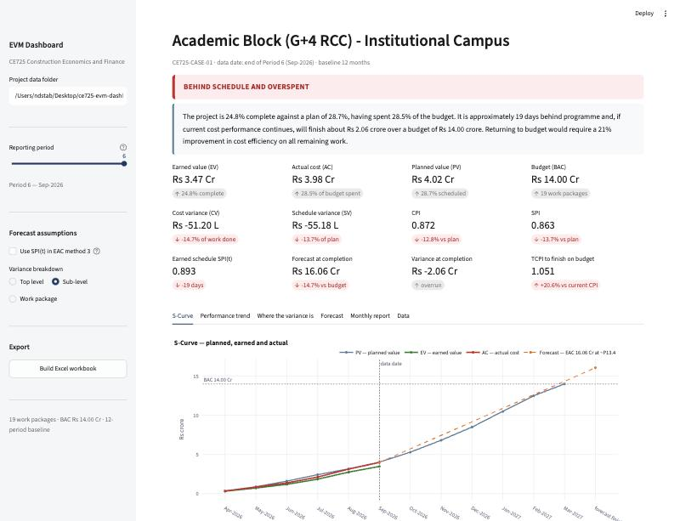
Where the project stands at month six
CPI 0.872
every rupee spent returns 87 paise of budgeted work
TCPI 1.051
efficiency the remaining work must now achieve
We have sustained 0.872 for six months. TCPI asks for a 20.6% improvement on a level of performance never once achieved.
The budget is gone. What remains is deciding who absorbs it.
Notes:
5:00-7:00. Point in order at: the verdict bar reading BEHIND SCHEDULE AND OVERSPENT; the plain-language summary, read aloud, noting it quotes no index without the consequence beside it; CPI 0.872; then TCPI 1.051. If there is time for only one sentence in the whole demonstration it is the TCPI one: the remaining work must run at 1.051 having sustained 0.872 for six months, so the budget is gone and what remains is deciding who absorbs it.

Slide 7
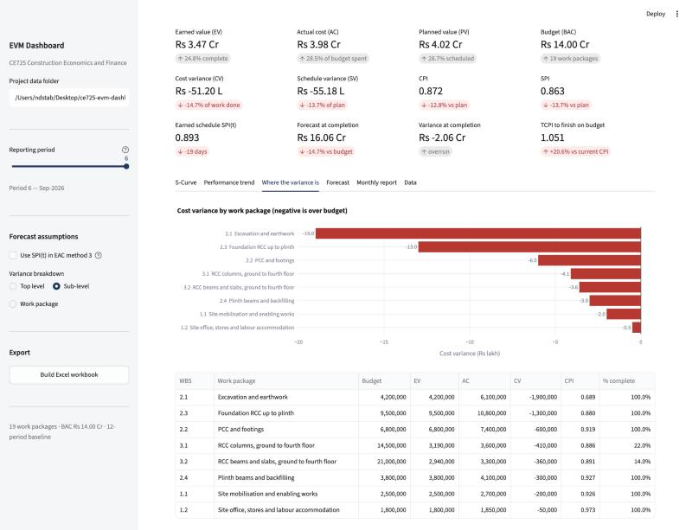
Where the variance actually is
₹38 lakh
in three completed substructure packages — this variance is FINAL
₹7.7 lakh
in the frame, 22% and 14% complete — this can still be managed
Excavation and earthwork: CPI 0.689, 100% complete.
No recovery plan touches it. Stop trying to recover the substructure, protect the frame, and tell the client ₹38 lakh is gone.
This is the slide that justifies carrying the WBS through the whole calculation instead of rolling up to one project curve.
Notes:
7:00-9:00. A project CPI of 0.872 says something is wrong but does not say what to do. Point at Excavation: CPI 0.689 and 100 per cent complete, so that variance is final. Then the frame packages at 22 and 14 per cent, which can still move. 38 lakh of the 51.20 lakh is in completed substructure and only 7.7 lakh is live. The management action is the opposite of what a single project index suggests.

Slide 8
SPI has a structural defect, and Earned Schedule fixes it
SPI = EV ÷ PV
At completion EV must equal BAC and PV must equal BAC.
So SPI returns to 1.00 on every project ever completed, however late.
19 days behind
Earned Schedule, measured in time — SPI(t) 0.893
A site manager can act on nineteen days. Nobody can act on 0.863.
Note CPI flat at 0.86–0.88 across all six periods while SPI swings to 0.743 and back: cost performance stabilises early and rarely recovers.
Notes:
9:00-10:30. SPI reads 0.863 and there is a structural problem with that number. Since EV and PV both converge on BAC, SPI returns to 1.00 on every project however late - the index gets more reassuring as the project gets later. Earned Schedule asks when on the baseline this much value was scheduled to have been earned, which gives 19 days behind. Also point at CPI flat across all six periods: that is the strongest argument against an optimistic recovery plan.

Slide 9
The forecast is a range, and that is the honest answer
₹3.47 Cr
spread between the four standard methods
We deliberately do not pick one.
The four methods differ in a single assumption — what you believe about the remaining work. The spread is the method being honest, not failing.
Narrowing it needs a judgement nobody can make arithmetically: was the rock a closed event, or a symptom of a site that was never properly investigated?
Notes:
10:30-11:30. Four methods, 14.51 crore to 17.98 crore. We deliberately do not pick one: they differ in a single assumption about the remaining work, and the 3.47 crore spread is the method being honest. Narrowing it needs a judgement nobody can make arithmetically - was the rock a closed event or a symptom of a site that was never properly investigated. Then go back to the slides.

Slide 10
How we know the numbers are right
Raw inputs
50 / 50
150
comparisons agree — to ₹0.01 on currency, 1×10⁻⁹ on indices
automated tests — expected values hand-derived before the engine existed
Python engine
Excel formulas
evaluated by
LibreOffice headless
The decision that mattered
Not to write a second Python implementation.
A Python re-implementation validates only your own understanding. Misread a formula and both sides misread it identically, the comparison passes, and both are wrong.
So the benchmark lives in a different execution environment, and it is executed — not re-implemented.
Compare
50 measures, two reporting periods
Notes:
11:30-13:00. 50 of 50 comparisons agree to a paisa on currency and 1e-9 on the indices, across both periods, plus 150 automated tests whose expected values were hand-derived before the engine was written. The critical decision was not to write a second Python implementation: that validates only your own understanding, because a misread formula is misread identically on both sides and the check passes. The benchmark is in a different execution environment and it is executed, not re-implemented.

Slide 11
Four discrepancies, all recorded
What we found | How it resolved
EAC3 off by ₹156 | Our hand calculation was wrong, not the engine — we rounded CPI × SPI mid-chain. Rule adopted: rounding is presentation only.
Two validation tests failing | The tests were wrong, not the engine. Fixing the code to make them pass would have deleted a rule that rejects earned value being double counted.
Executive summary invisible under a dark theme | No test caught it. Every number was correct and the tool was unusable. Found only by opening the running app.
Carry-forward routine fragile on reporting gaps | Caught in review before it produced a wrong answer. Clean data hid it; real data would not.
The second one matters most. The fast route to a green test suite was to change the engine until the tests passed — which would have made the project worse while making the output greener. Ask why a test fails before changing anything.
Notes:
13:00-14:00. Four discrepancies, all in the validation report. Two of them were defects in the check rather than in the thing being checked - our hand calculation of EAC3, and two mis-constructed tests. The second matters most: the fast route to a green test suite was to change the engine until the tests passed, and that would have removed a correct rule.

Slide 12
What none of this validation can do
Both implementations read the same inputs.
60% reported
40% actual
1
the engine computes a wrong EV
2
the benchmark computes the same wrong EV
3
all 50 comparisons agree
4
every index is confidently, precisely wrong
Earned value is percent complete × budget. Percent complete is a judgement made at site, often by someone who is paid more if it is higher. No spreadsheet and no test suite detects an error in it — only a measurement at site does.
We validated the arithmetic to nine decimal places. The arithmetic was never the risk.
And every design choice that makes this dashboard more persuasive makes the problem worse: it renders an unverifiable judgement with six-figure precision, a traffic light and a chart.
The quality of an EVM system is the quality of its percent-complete measurement.
Notes:
14:00-15:00. The closing point - do not rush it. Both implementations read the same inputs, so if a package is reported 60 per cent complete when it is really 40, the engine computes a wrong EV, the benchmark computes the same wrong EV, all 50 comparisons agree, and every index is confidently wrong. We validated the arithmetic to nine decimal places and the arithmetic was never the risk. Everything in this project, including all of our work, is arithmetic on top of a judgement made by a person standing on a site.

