Slide 1
Interactive science, Classes 8 and 9
Lumen
Read it. Watch it. Then prove you have it.
3 courses · 13 lessons · 70 questions · a film for every lesson
github.com/ndstab/lumen
Notes:
Lumen is an interactive science app for Classes 8 and 9, built around a complete record of what learners do.

Slide 2
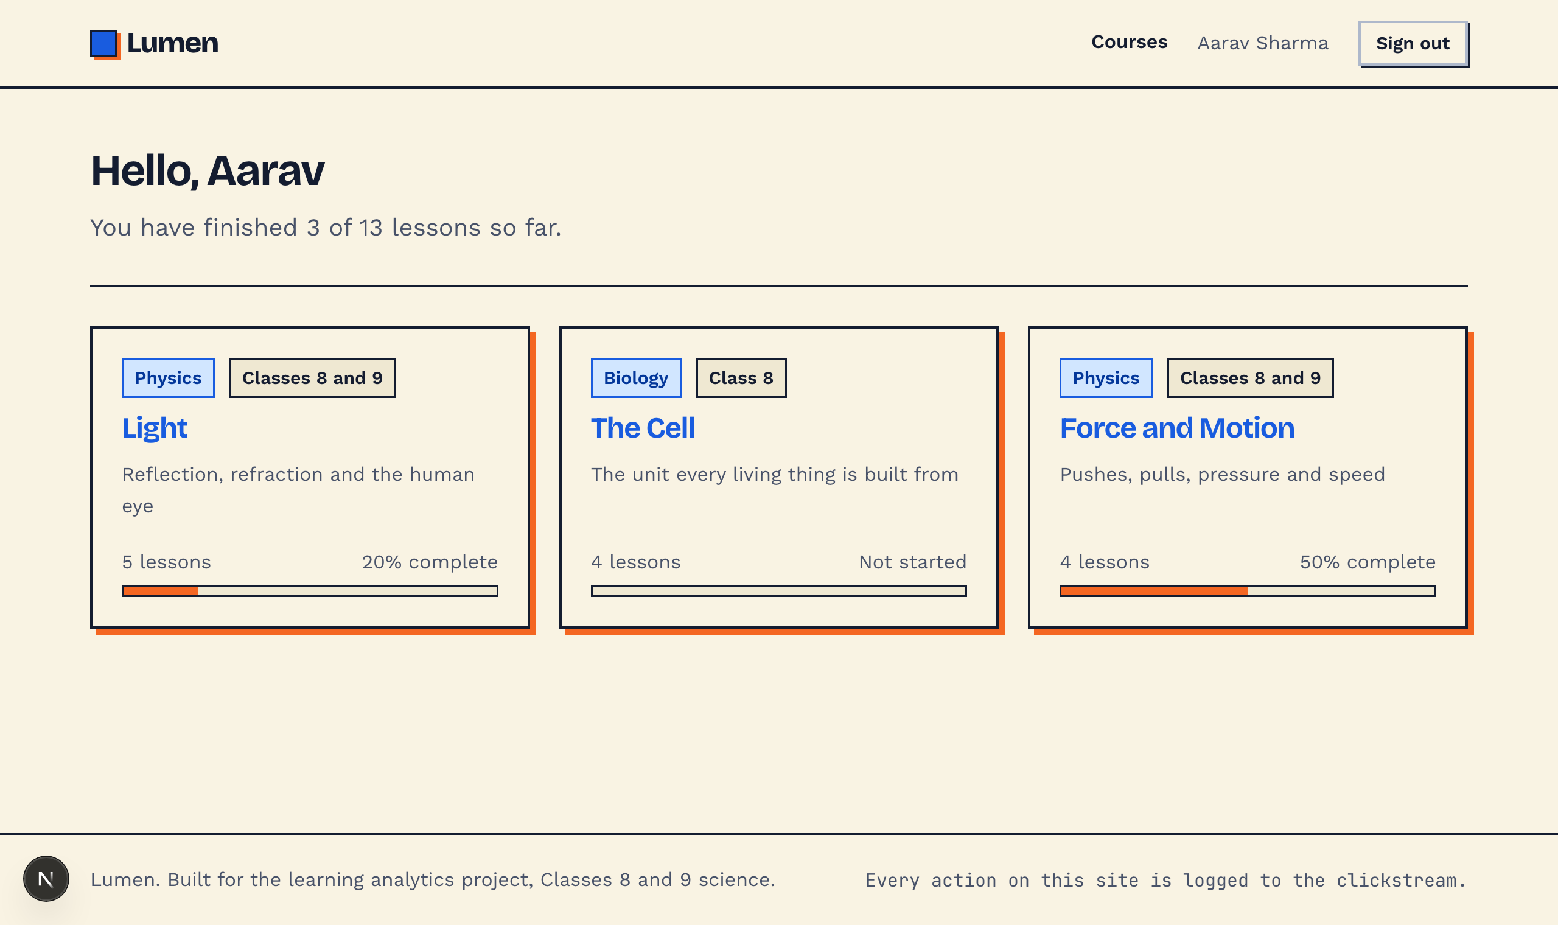
The product
A course, a lesson, and a record of everything
Learners sign in, pick a course, and work through lessons at their own pace.
Every lesson is a reading with drawn figures, a short film, and a quiz.
Progress is tracked per lesson and per course.
Educators get the whole activity record: a live stream, a standard format export, and three analytics views.
3
13
70
12
courses
lessons
questions
drawn figures
Notes:
Two roles. Learners see courses and their own progress. Educators see everything that happened.

Slide 3
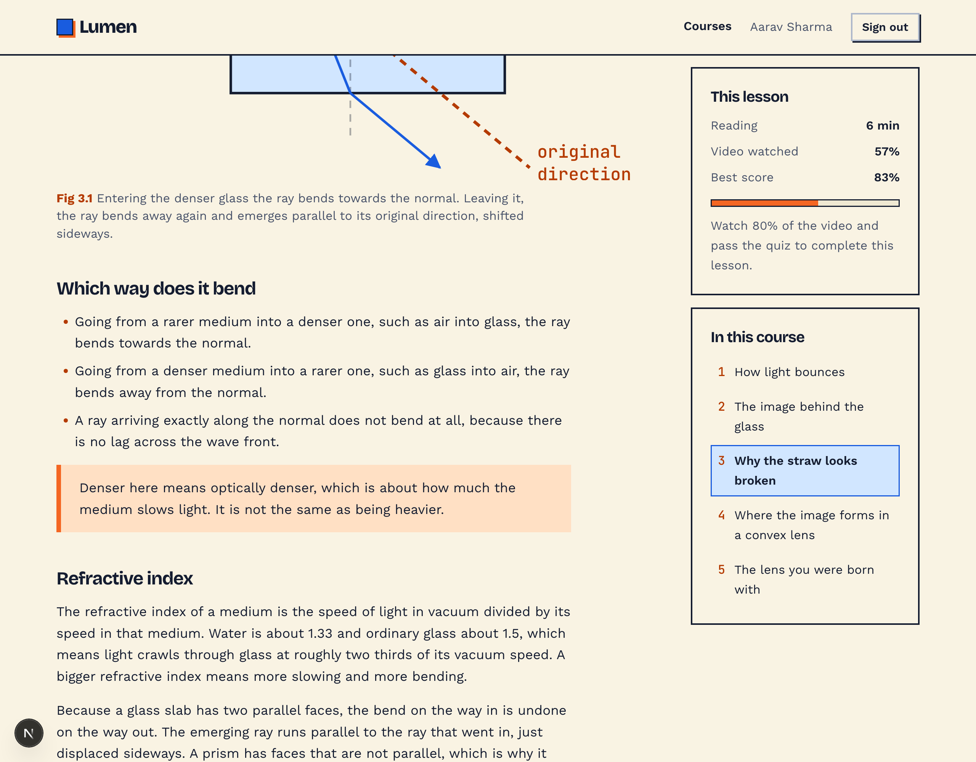
What you can study
Three courses, real syllabus content
5 lessons
4 lessons
4 lessons
Light
The Cell
Force and Motion
Reflection, refraction and the human eye
The unit every living thing is built from
Pushes, pulls, pressure and speed
Aligned to the NCERT syllabus for Classes 8 and 9.
Drawn, not borrowed
Twelve figures across the three courses, each built to correct geometry rather than sketched. This one traces a real ray through a glass slab: bent towards the normal going in, away from it coming out, and emerging parallel to the direction it started in, just displaced sideways.
Notes:
Twelve figures across the three courses, each drawn rather than borrowed.

Slide 4
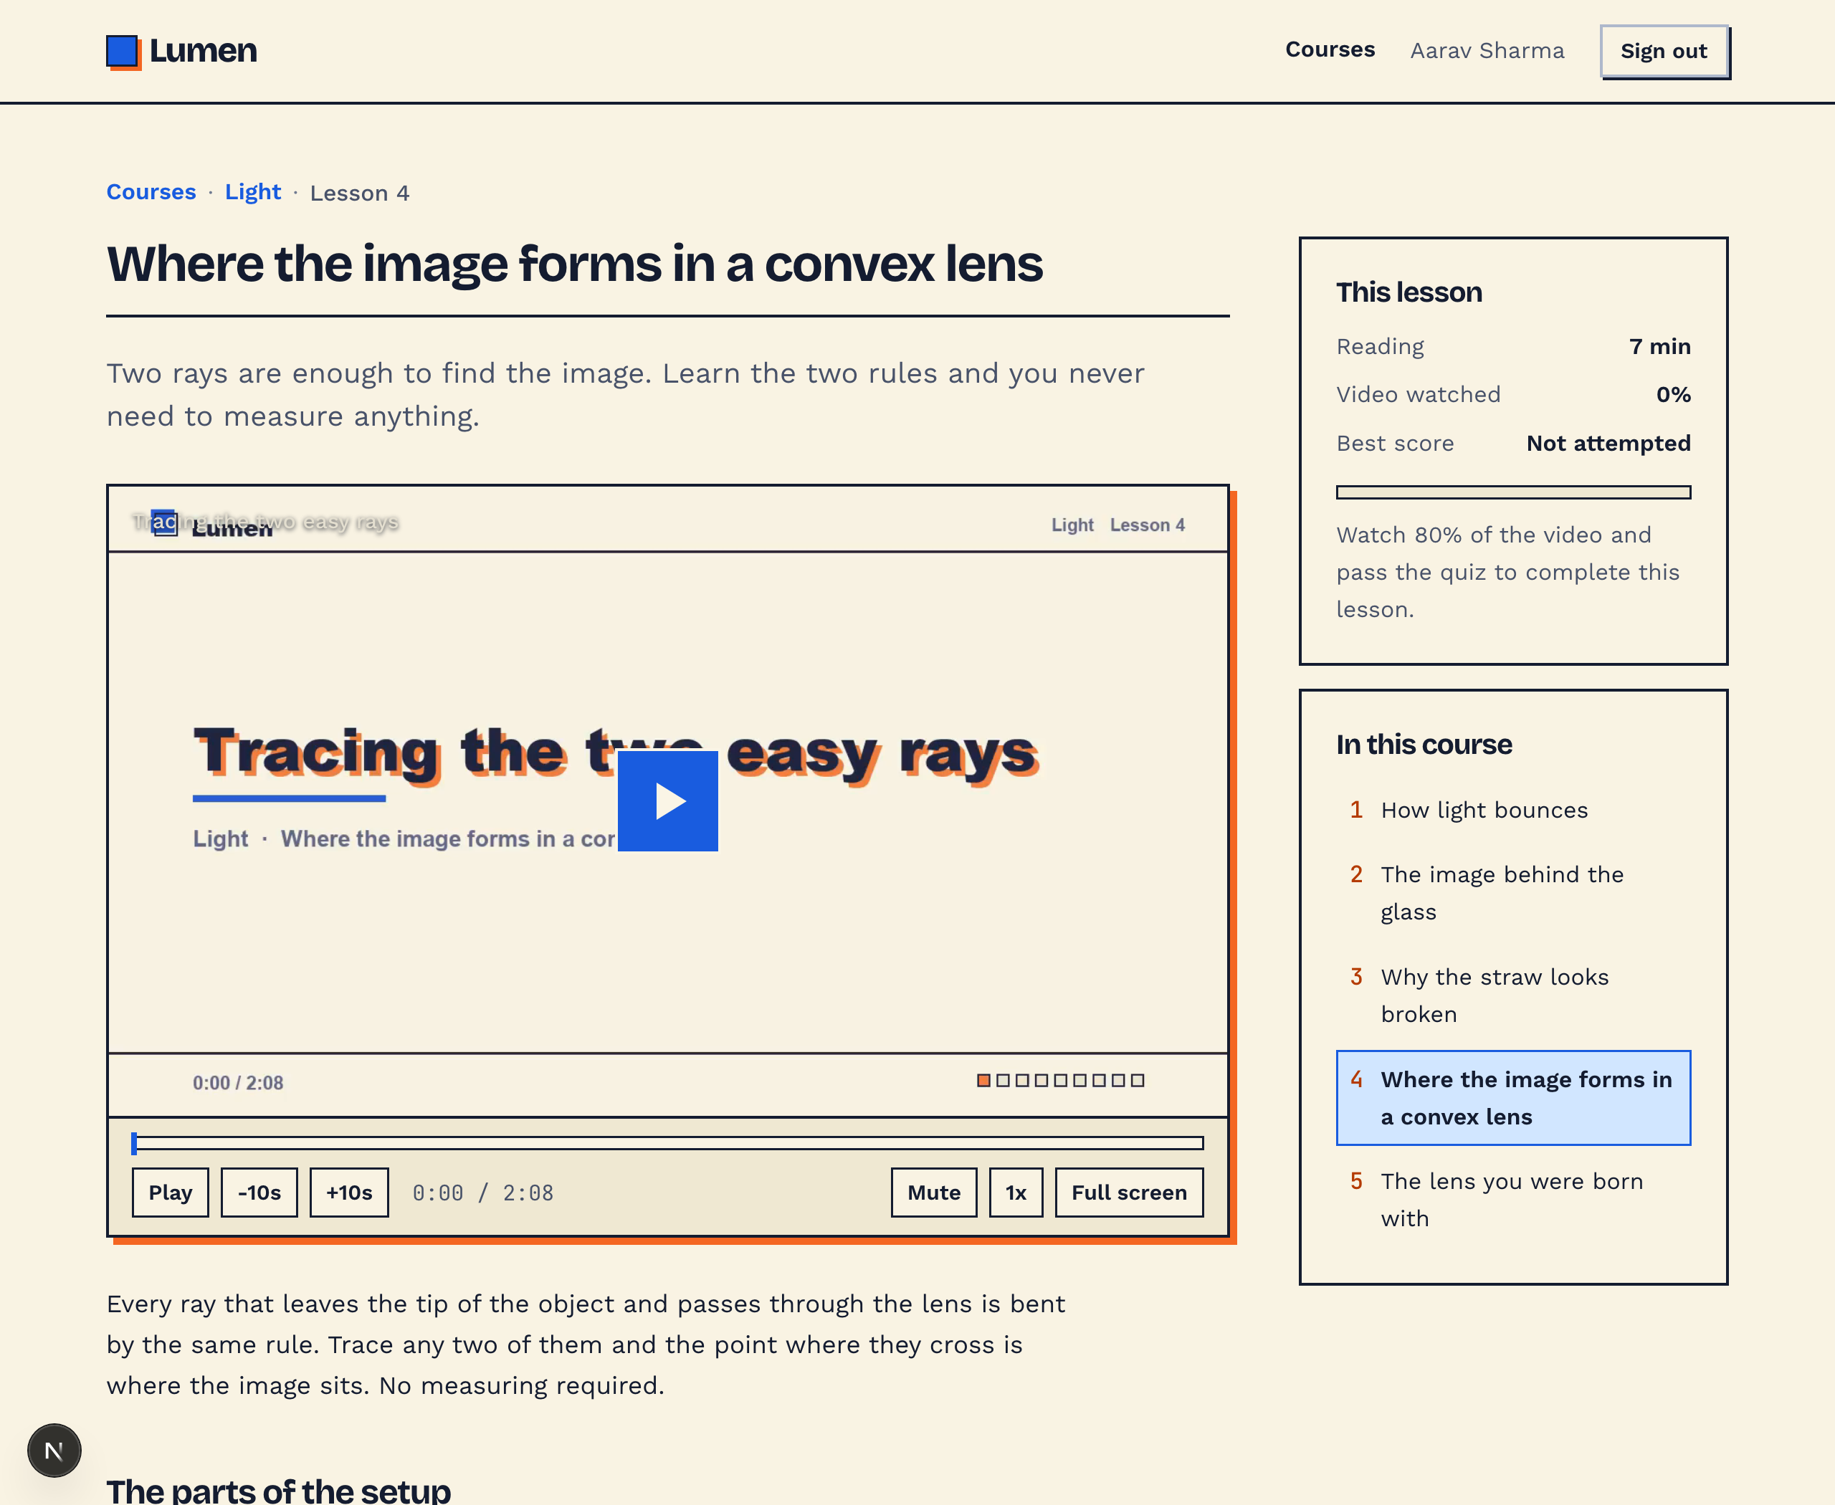
Inside a lesson
Every lesson is three things at once
A reading, with the figures inline where they are needed.
A short film, in a player built for this app.
A quiz, at the bottom of the same page.
A rail showing how much of the film has been watched, the best quiz score, and what still needs doing.
Nothing is locked. Learners move freely, and that freedom is itself visible in the data.
Notes:
Text, video and quiz on one page, in that order.

Slide 5
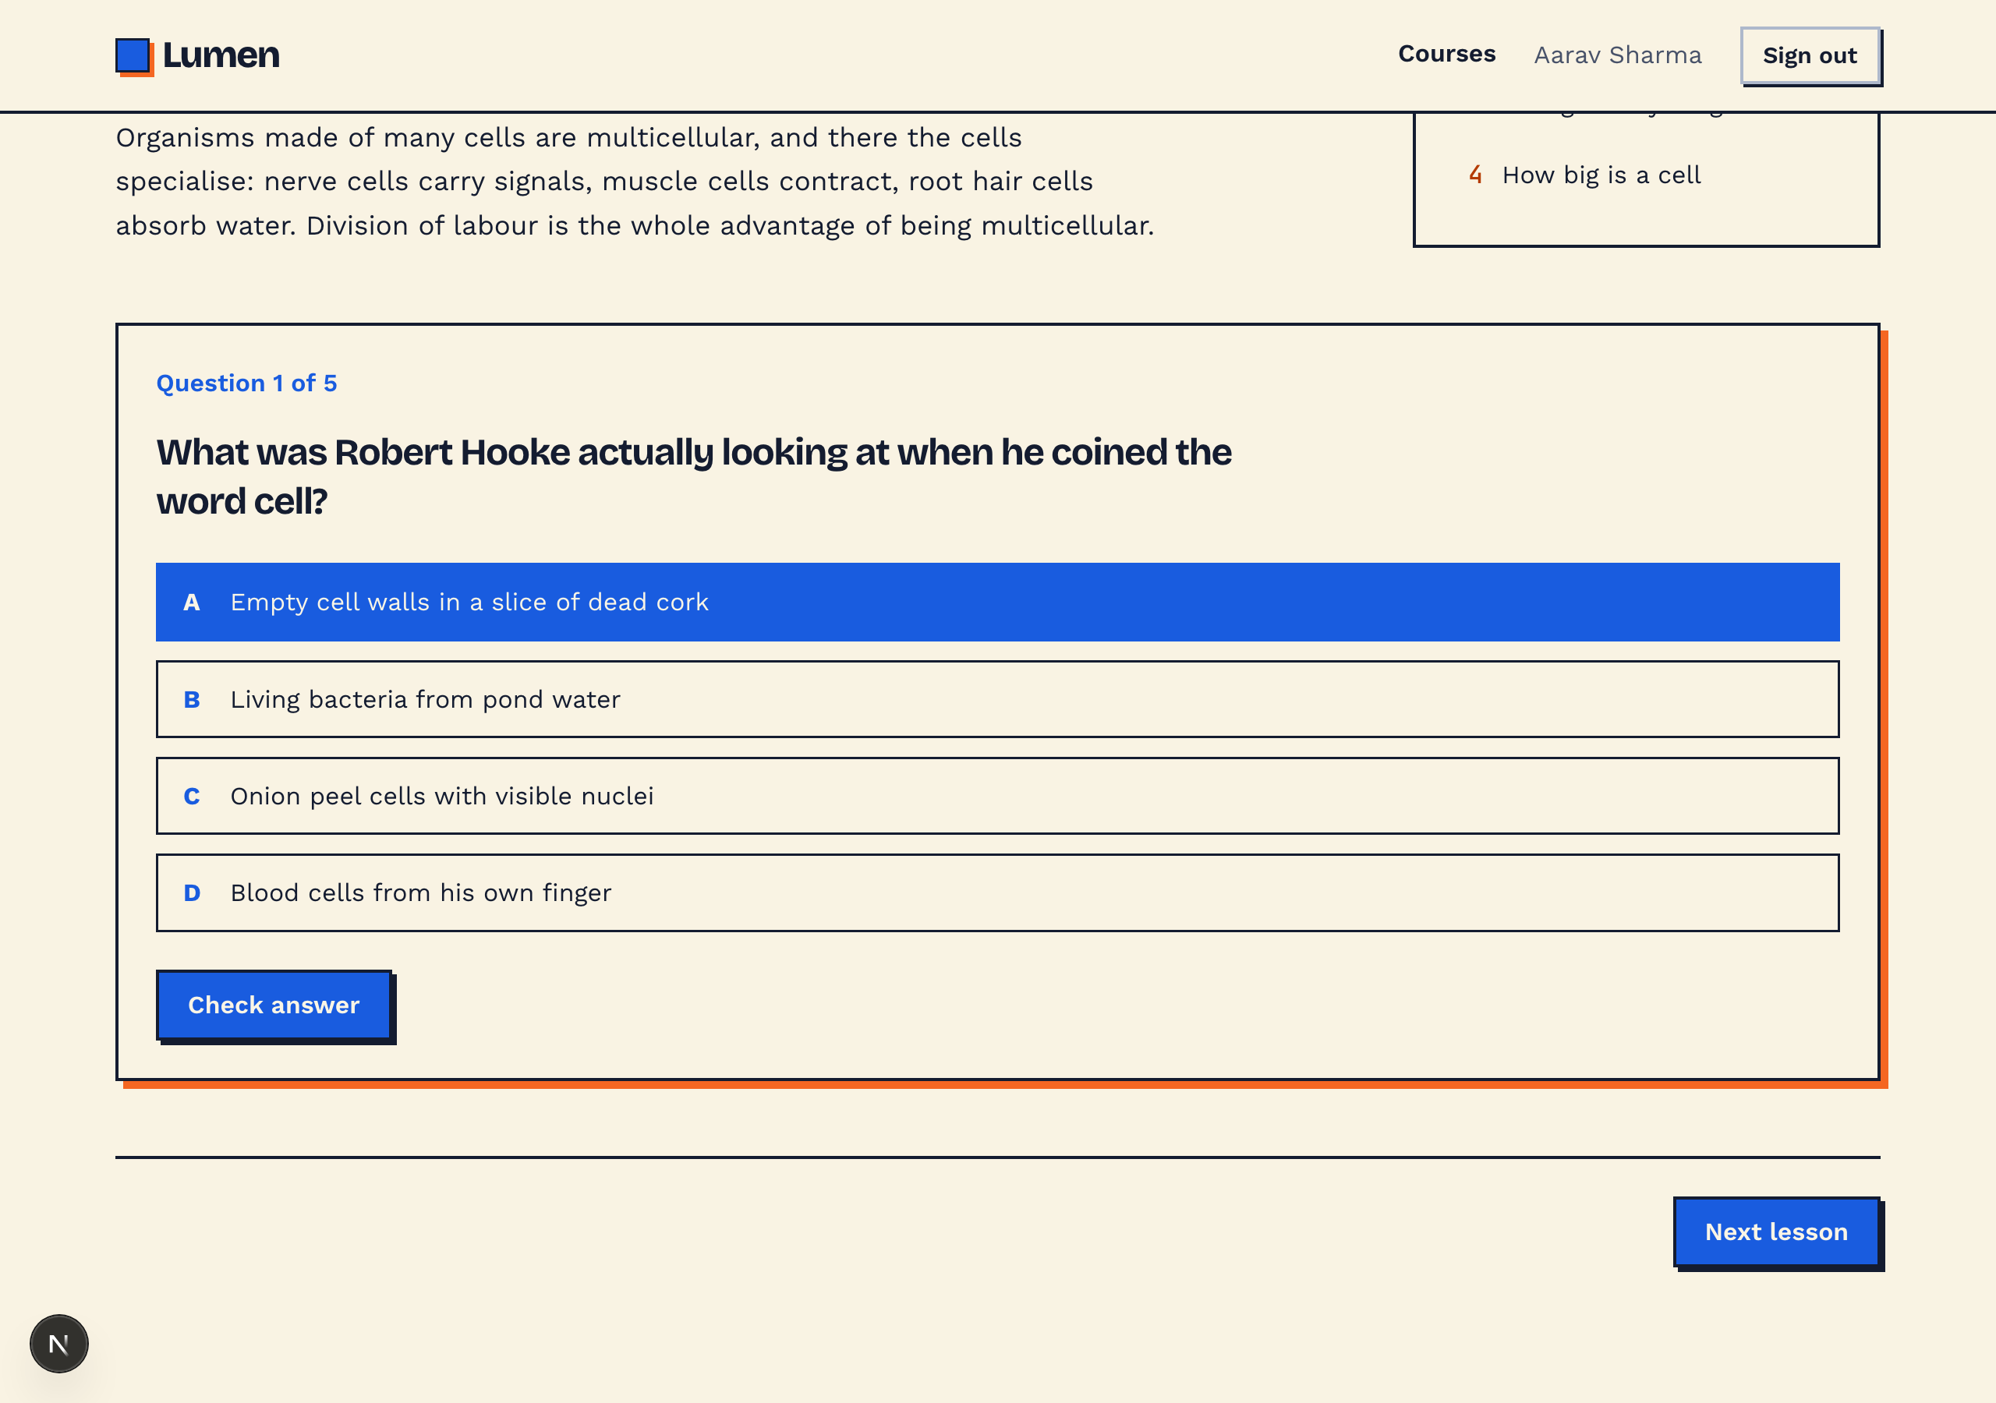
The quiz
Quizzes that explain, not just mark
Three question types: single answer, select all that apply, and numeric entry.
Graded on the server, so the answers are never sitting in the page.
The explanation appears whether the answer was right or wrong.
Unlimited retakes, and every attempt is stored separately.
88
483
attempts recorded
answers graded
Notes:
Storing every attempt separately is what makes the difficulty analysis possible later.

Slide 6
What the system records
Every action, in one vocabulary
22 event types across seven components.
Navigation
Page viewed · Element clicked · Link followed · Page scrolled · Page hidden · Page shown
Video
Started · paused · resumed · seeked · ended · rate changed · volume changed · fullscreen · buffering · milestone · heartbeat
Quiz
Attempt started · option selected · answer cleared · question answered · attempt submitted
Lesson, Course, User, Report
Lesson viewed · Course viewed · Catalogue viewed · Account created · Logged in and out · Reports viewed · Clickstream exported
Clicks are caught by a single listener on the document, so an element nobody thought to instrument is still recorded.
Notes:
Seven components, twenty-plus event types. Small enough to analyse, complete enough to reconstruct a session.

Slide 7
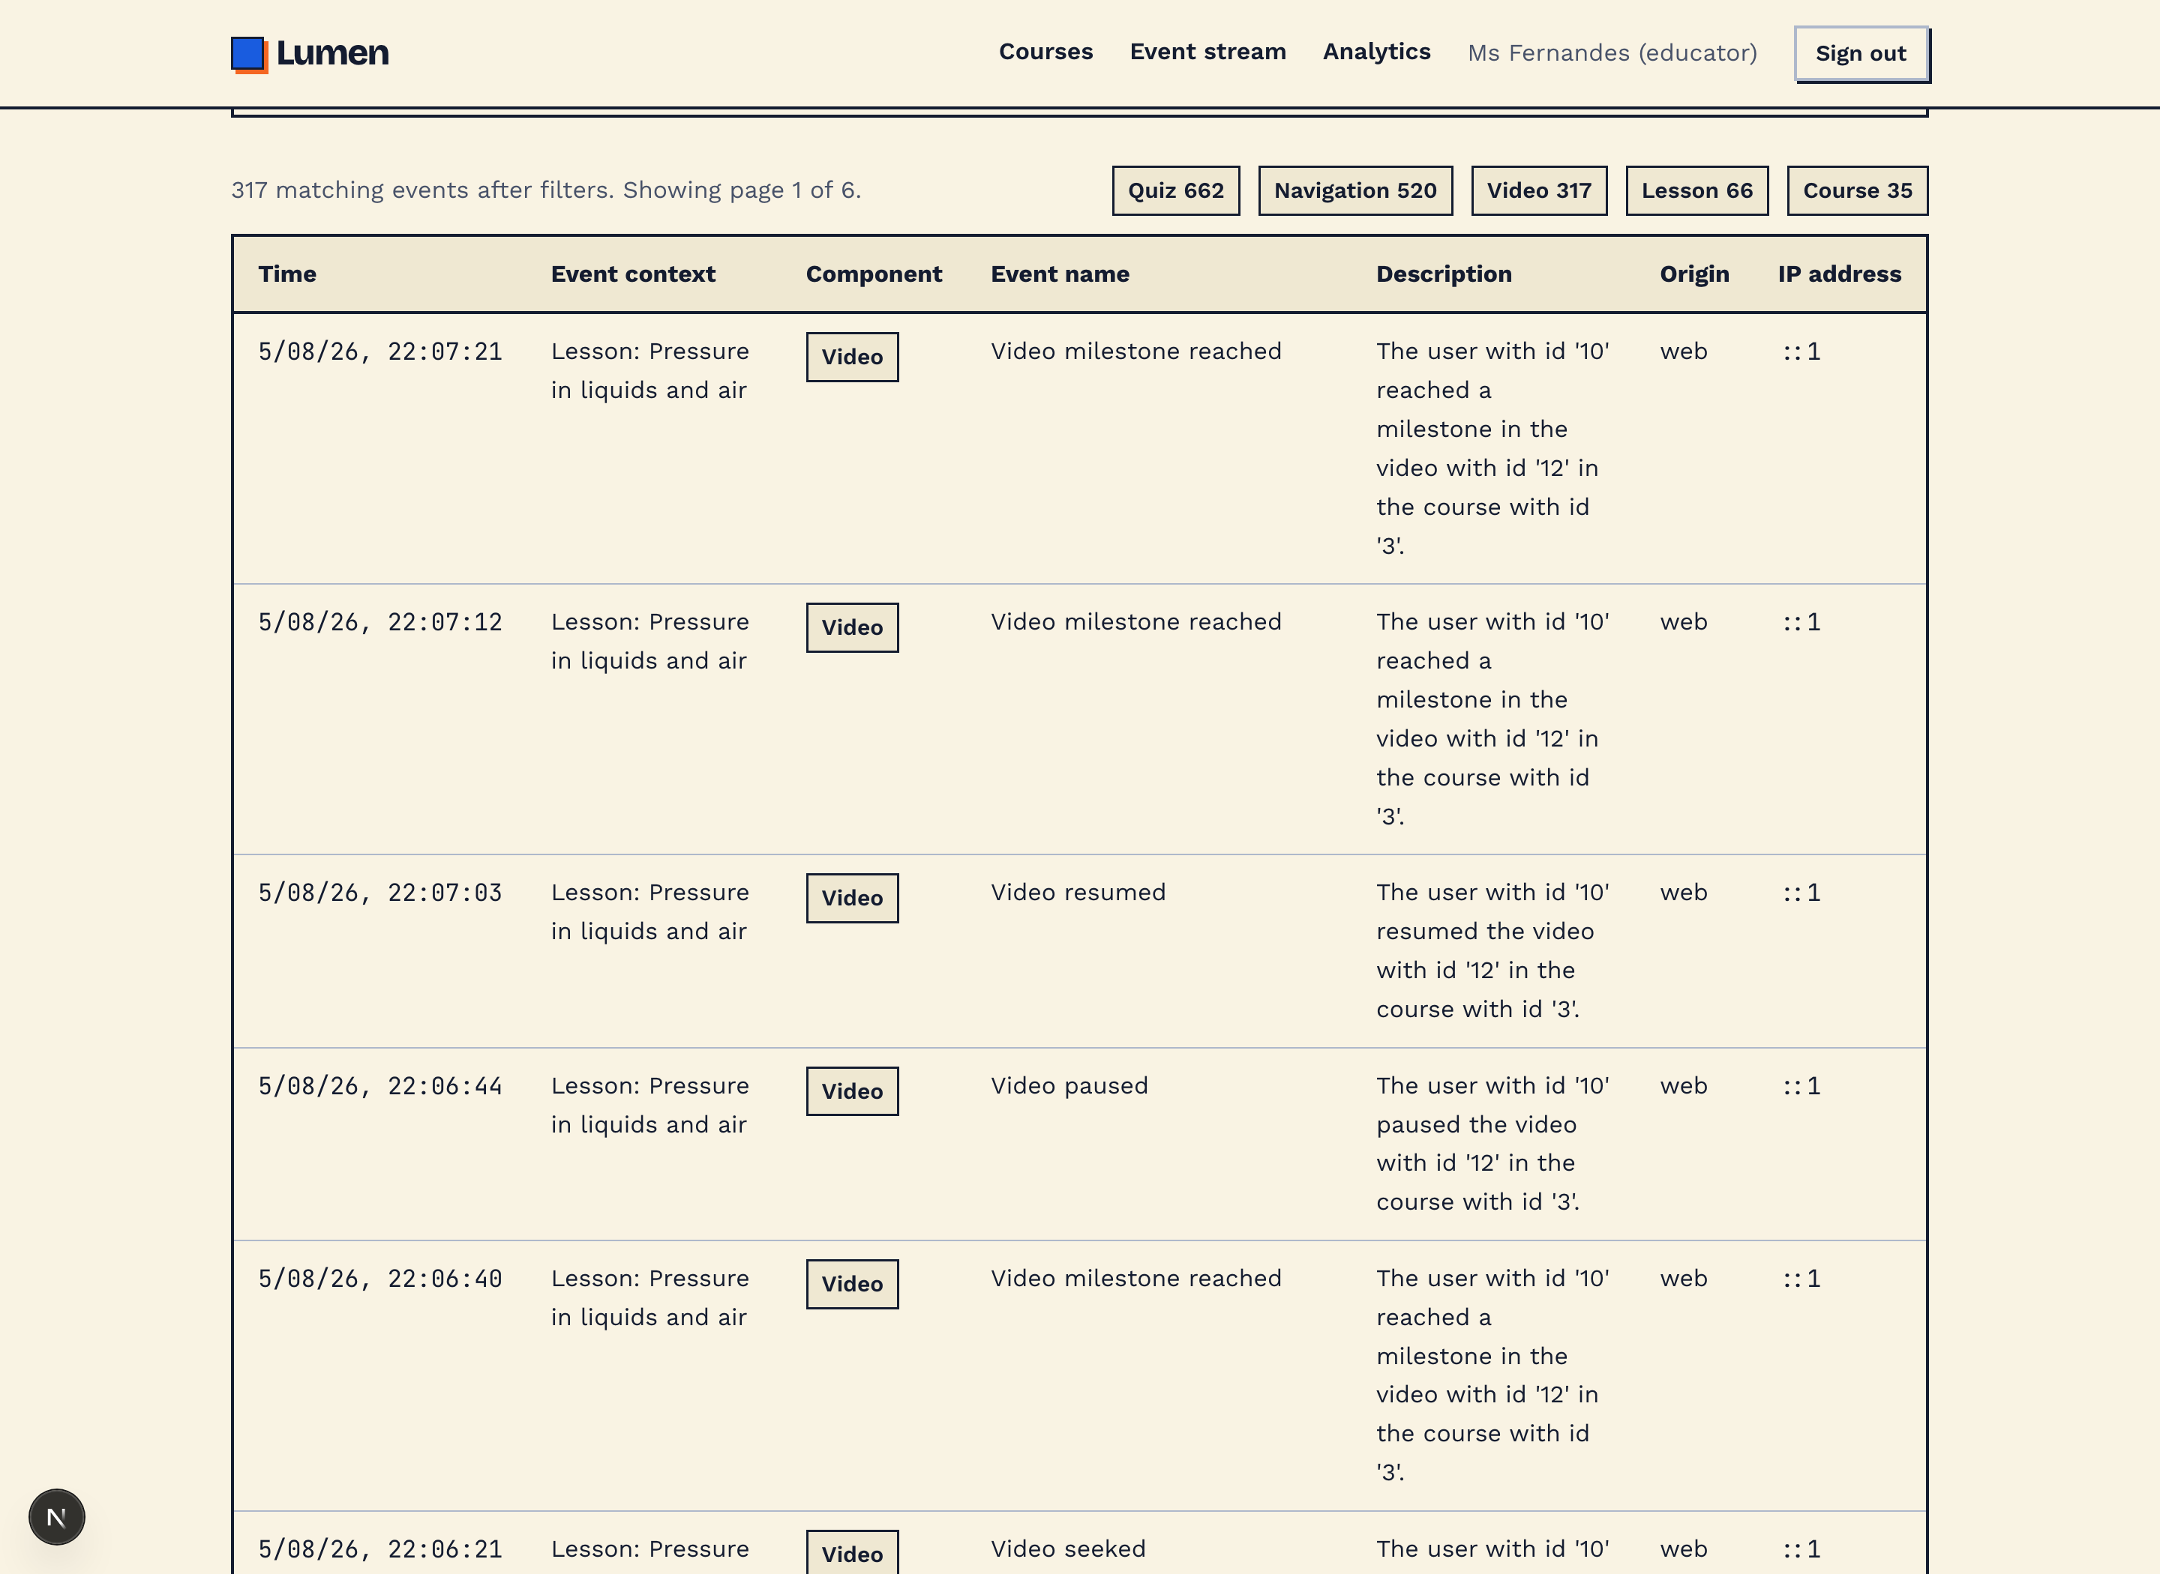
How much detail
A seek is not just a seek
Video is where the record goes deepest. The player is part of the app, so it reports what an embedded player cannot.
{ "from": 84.2,
"to": 61.0,
"direction": "backward",
"jumpSeconds": 23.2 }
One learner rewinding, as stored.
Both ends of every seek, plus direction and distance
Playback rate and volume changes
Buffering stalls, start and end
Milestones at 25, 50, 75 and 100 percent
Watch-time heartbeats while playing
Notes:
317 video events recorded so far, and 59 minutes of watch time.

Slide 8
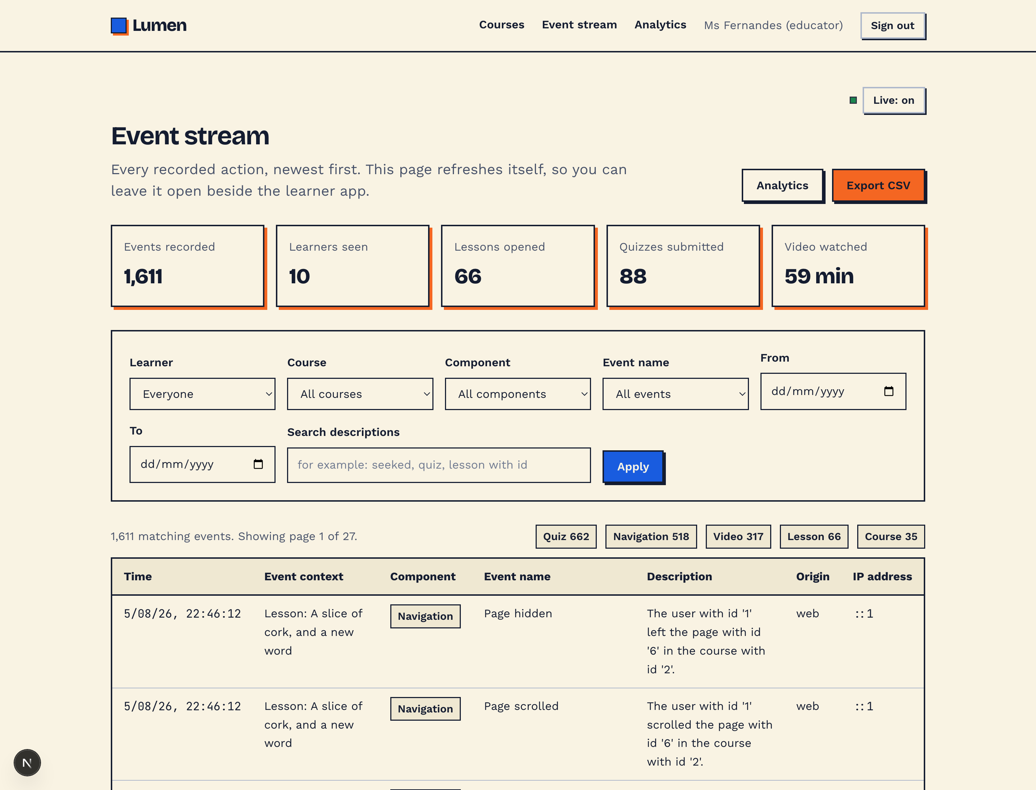
For educators
The whole record, live
Every recorded action, newest first, refreshing on its own.
Filter by learner, course, component, event name, date range or free text.
Descriptions read as sentences naming who did what to which lesson.
Educator activity is recorded too, so the log never goes quiet.
1,632
10
events recorded
learners
Notes:
Open this beside the learner app and rows arrive as you click.

Slide 9
Taking the data out
Exports in the standard log format
One click gives a CSV in the same seven columns as a Moodle standard log report, so the data drops straight into whatever an institution already uses.
The seven columns
Time | occurred_at
Event context | context
Component | component
Event name | event_name
Description | description
Origin | origin
IP address | ip
The on-screen table and the CSV come from the same projection, so they cannot disagree.
Filters apply to the export, so an educator can pull one learner or one course.
Written with a byte order mark, so Excel opens the UTF-8 correctly.
Notes:
The reference sample for this project was a Moodle log export. The output matches it column for column.

Slide 10
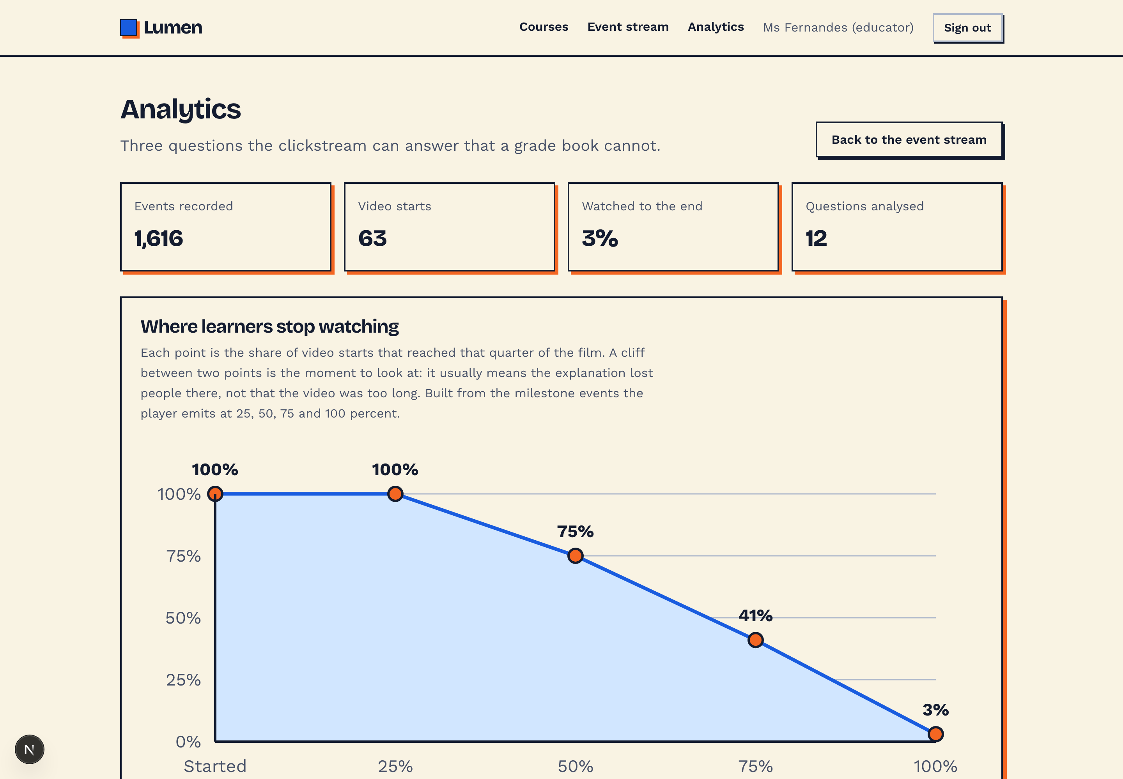
Analytics, one of three
Where learners stop watching
Of 63 video starts, 100% reached a quarter of the way, 75% reached half, 41% reached three quarters, and 3% reached the end.
A cliff between two points is the moment to look at. It usually means the explanation lost people there, not that the film was too long.
None of which is visible from a grade book.
Notes:
Built from the milestone events the player emits at each quarter.

Slide 11
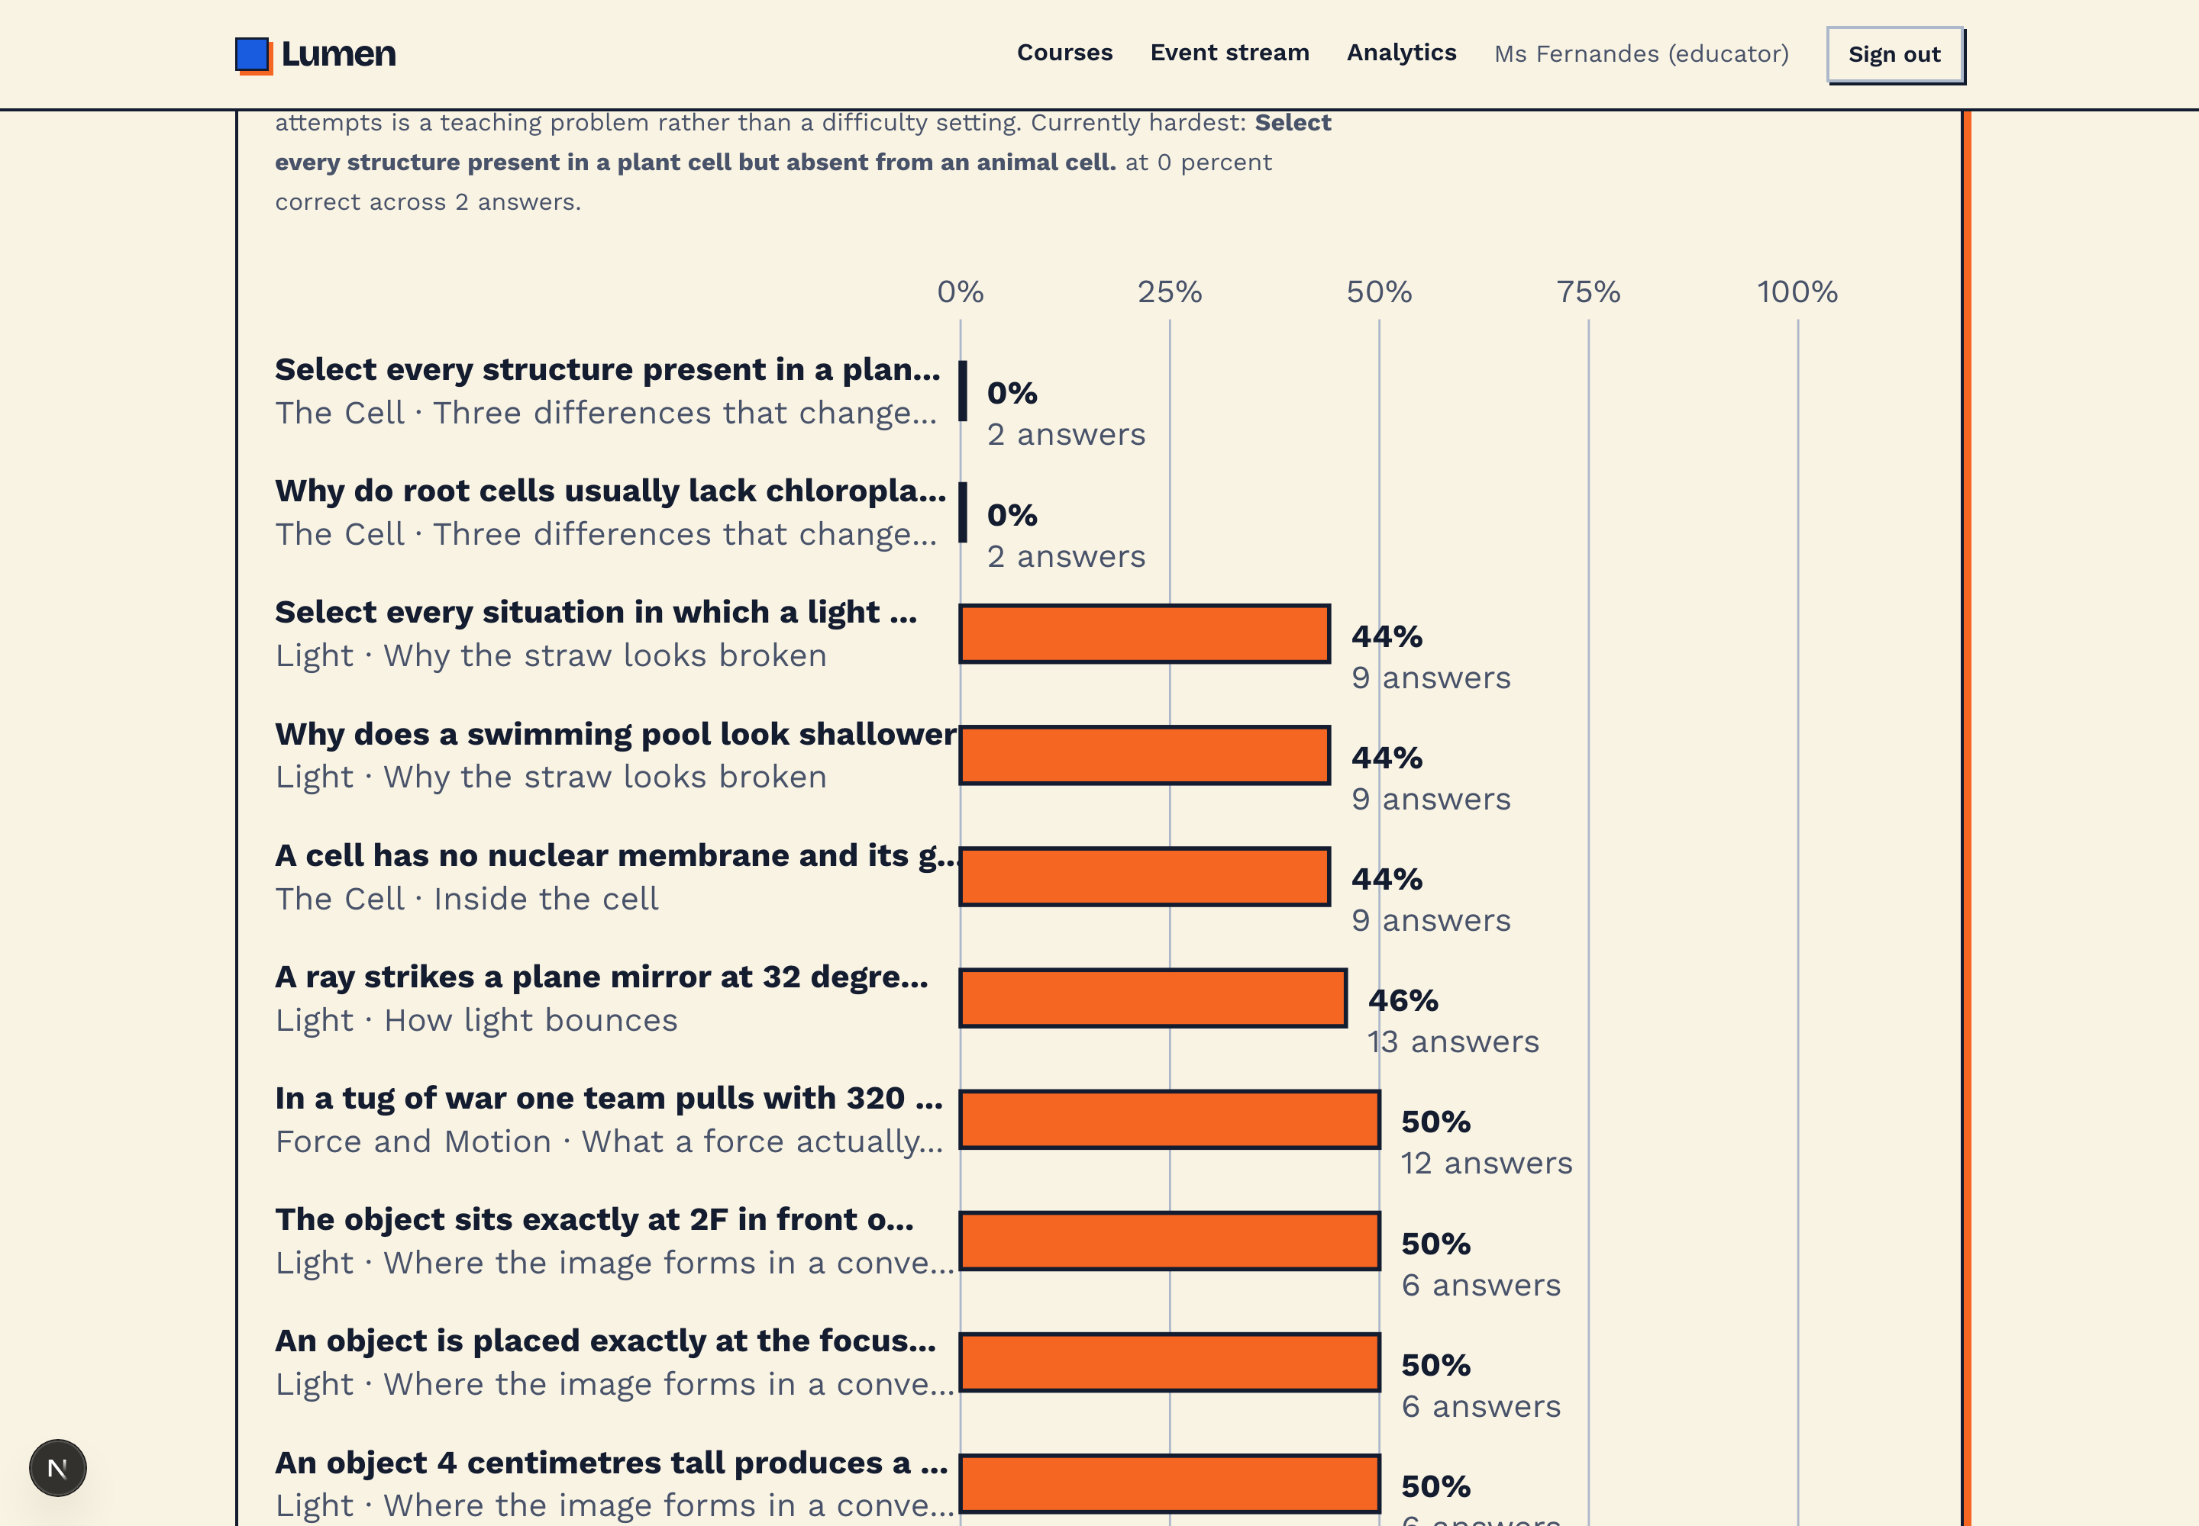
Analytics, two of three
Which questions are actually hard
Percentage correct across all 483 recorded answers, hardest first.
Every attempt counts, including retakes.
A question that stays red after repeated attempts is a teaching problem, not a difficulty setting.
Hardest right now
Select every situation in which a light ray does not change direction.
44% correct across 9 answers
Notes:
Ranked hardest first, so the questions worth rewriting sit at the top.

Slide 12
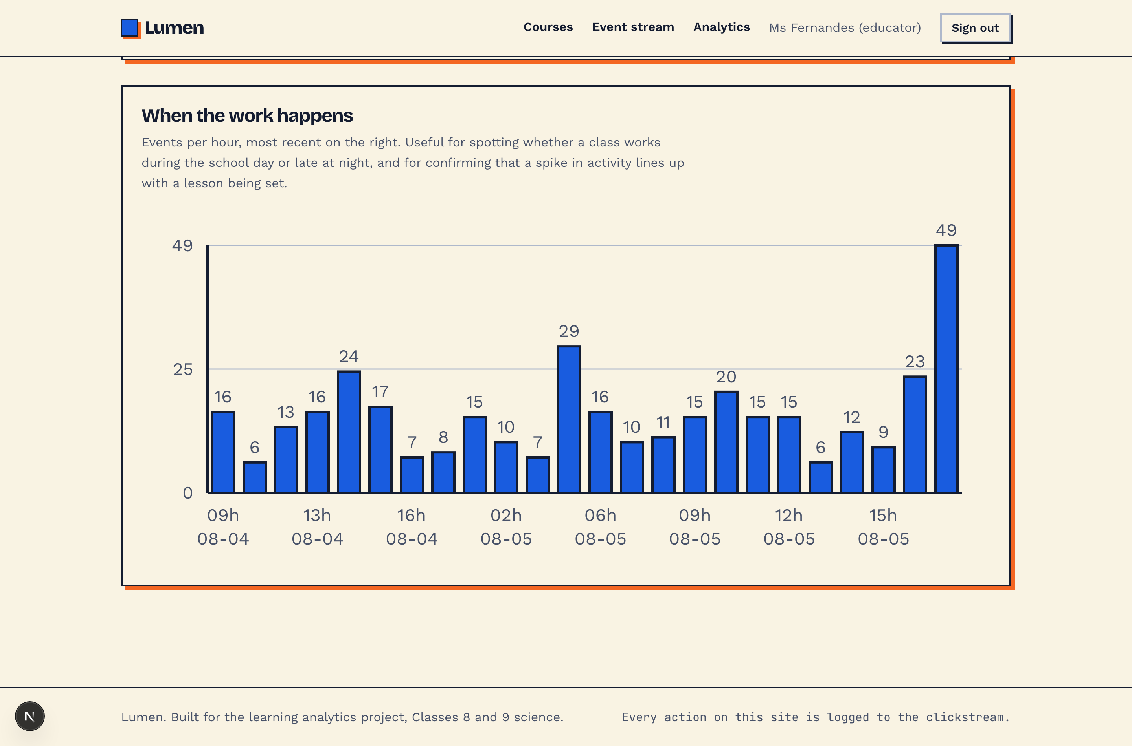
Analytics, three of three
When the work actually happens
Events per hour, most recent on the right.
Shows whether a class works during the school day or late at night.
Confirms that a spike lines up with a lesson being set.
1,632
59
events
minutes watched
Notes:
The three charts together answer questions a grade book cannot.

Slide 13
Built with
Runs from one folder
Next.js 15 and React 19
SQLite
App Router and TypeScript throughout.
The whole system is one file. No service to provision, no deployment needed.
Plain CSS tokens
Charts drawn by hand
Every colour an OKLCH custom property. No component library.
Three SVG charts and twelve figures, in the same palette and line weights.
Clone, install, seed, run. Three commands and a browser, with the lesson films already in the repository.
Notes:
No hosting required to see it working. It runs on a laptop from a clean clone.

Slide 14
Lumen
Read it. Watch it. Then prove you have it.
1,632
22
13
483
events recorded
event types
lessons
answers graded
github.com/ndstab/lumen
Notes:
Repository, README, design specification and demo video are all in the same place.

