Slide 1
IBM Project Update
Justin Anderson
Cesar Ramirez
Jack Nagel
John Rensberger

Slide 2
Our Project
We are teamed up with IBM
We will be continuing on the work from the previous IBM capstone project
We plan to deploy OpenStack for C.S. department faculty
Notes:
Jack

Slide 3
Our Goal
Learn how OpenStack works and how to deploy it
Continue working on the OpenStack deployment from the last year
Document the process of deployment for future use
Deployed more wanted features
Notes:
Jack

Slide 4
What Is OpenStack?
OpenStack is cloud operating system that controls large pools of:
Computing Nodes
Storage Nodes
Network Resources
It allows users to control and deploy these resources through a web portal
Notes:
Justin

Slide 5
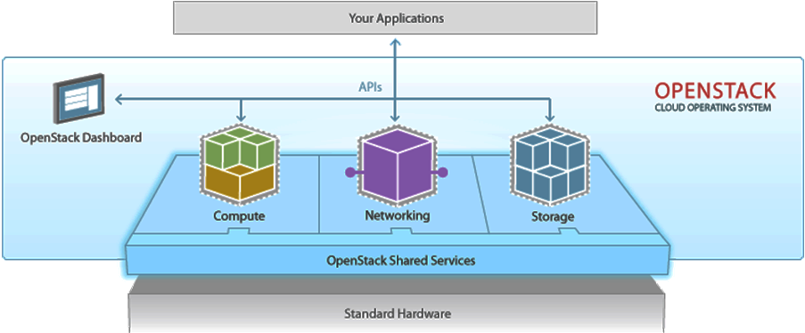
OpenStack Continued
Notes:
Justin

Slide 6
Project Plan
Gather requirements from faculty
Deploy OpenStack for these projects
Document steps needed for future deployments and maintenance
Incorporate OpenStack with Computer Science Department’s LDAP and AD servers
Code scripts for automatic installation
Notes:
Jack

Slide 7
What We’ve Done
We have 3 virtual machines for:
Controller Node
Network Node
Compute Node
We have a finished tentative project plan
We are working setting up a few real machines for more compute nodes

Slide 8
Possible Difficulties
Implement Quantum with OpenStack
Quantum is a component of OpenStack that provides “Networking as a service”
Quantum is currently not installed
Incorporate the C.S. Department’s LDAP and AD server with OpenStack
Testing OpenStack capabilities using a large scale network

Slide 9
Demo

Slide 10
Summary
Our Project
Our Goal
What is OpenStack?
Project Plan
What We Have Done
Possible Difficulties

