Slide 1

CS256 PROJECT
GROUP 6

Slide 2

Student | Troy ID | Contribution
Nguyen Anh Nguyen | 1624733 | Date.h Validate.h Definition.h File_operation.h Function_6.h Organizing data and files User interface and menu.h
Tran Hai Minh | 1624853 | Date.h Validate.h Definition.h File_operation.h Function_4.h Organizing data and files
Nguyen Tuan Anh | 1624834 | Function_1.h Function_5.h Function_4.h
Nguyen Gia Huy | 1624705 | Function_1.h Function_5.h Function_6.h
Vu Duy Hao | 1624802 | Function_1.h Function_5.h Function_6.h
Le Duc Tuyen | 1624790 | Function_2.h Function_3.h
MEMBERS & CONTRIBUTION:

Slide 3

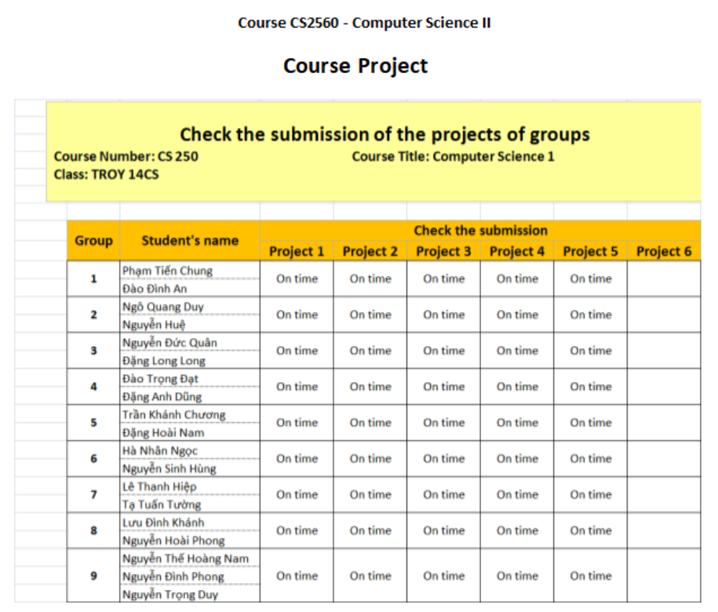
SUMMARY THE TASKS
Create a software program to replace an Excel sheet for managing project submissions in a course.

Slide 4
ROADMAP

Slide 5
BUILD FROM SCRATCH
Diagram to demonstarte the application’s flows
BASE
Initialize structs with appropriate fields
Vector to hold mutiple data
Validate functions
FUNCTION
Write necessary functions for the program
Write the Main function

Slide 6
DIAGRAMS

Slide 7
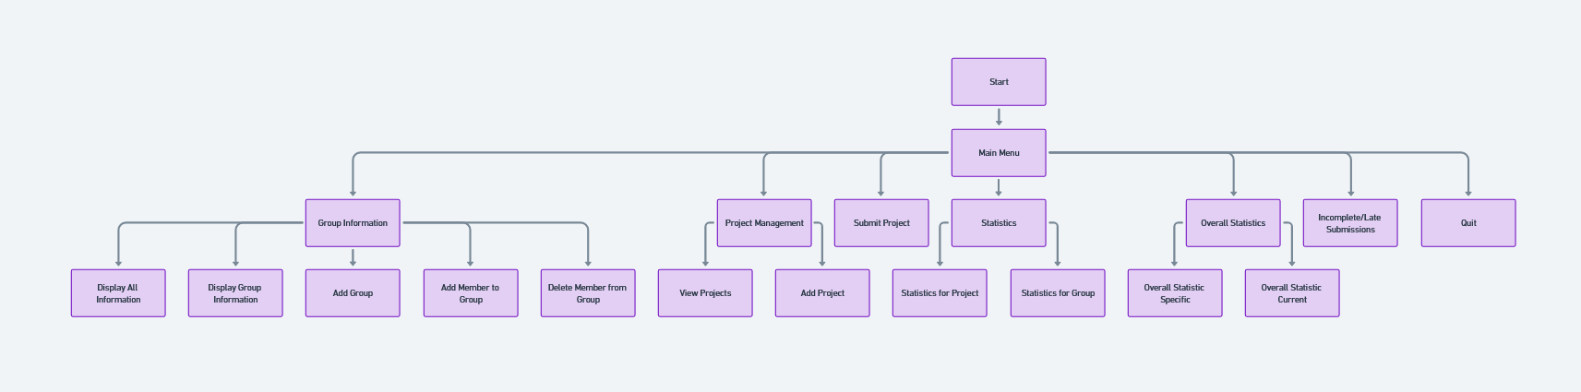

Slide 8
BASE

Slide 9
Data structure:
Use structs to hold datas of STUDENT, PROJECT, GROUP
Use vector to access and manipulate datas
2. Functions
Use for displaying relevant datas, extracting datas, saving information
Use for inputting user inputs and validate if needed

Slide 10
FUNCTION

Slide 11
Display All Information
Display Group Information
Add a new Group
Add a new member to a Group
Delete member from a Group
View Projects
Add a Project
Statistics for Projects
Statistics for Groups
Overall Statistic
Quit

Slide 12
DEMO CODE

