Slide 1

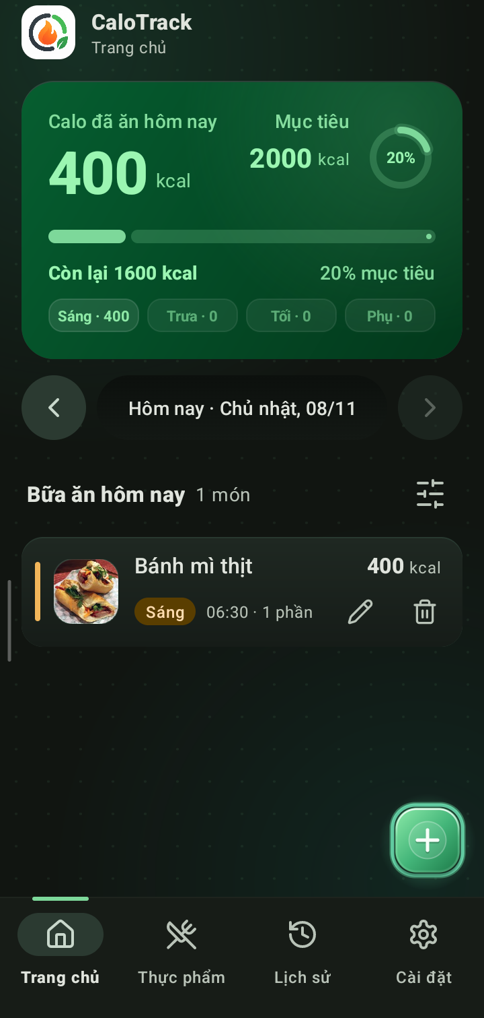
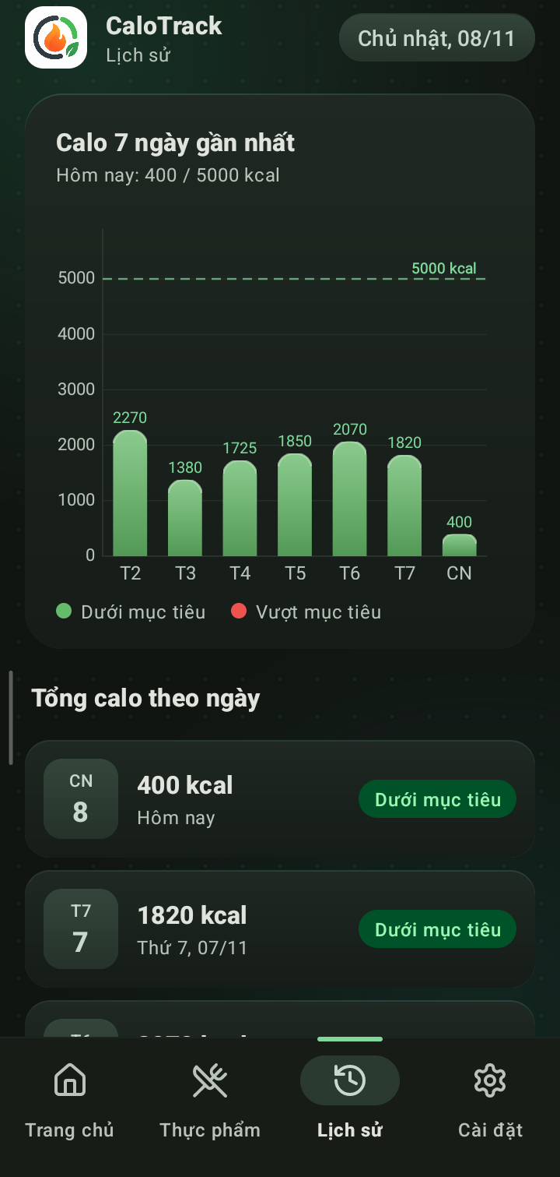
FINAL PROJECT REPORT · TOPIC 10
Calorie Counter App
CaloTrack
An Android application that helps users track daily calorie intake, manage meals, and compare progress against personal goals · built with Kotlin, Room (SQLite), and Material 3.
Group [GROUP NUMBER]
University / Faculty: [UNIVERSITY / FACULTY]
Instructor: [INSTRUCTOR NAME]
Team Members: [TEAM MEMBERS]

Slide 2
01 · INTRODUCTION
Project Overview
CaloTrack is a self-contained offline Android application: users log daily meals by meal type and portion size, the app automatically calculates calories, compares intake against daily calorie goals, and visualizes historical trends via a daily summary list and a 7-day bar chart.
89
4
2
3
Pre-populated Vietnamese foods with bundled photos
Main screens: Home, Foods, History, Settings
SQLite tables managed by Room ORM (foods & meals)
Settings persisted in SharedPreferences (goal, unit, theme)
Platform: Android 7.0 (API 24) and above · targetSdk 34 · 100% offline local storage · no account registration or network connection required.
CaloTrack · Topic 10 · Metrics counted directly from source code: SeedData.kt, AppDatabase.kt, PrefsManager.kt
02 / 25

Slide 3
01 · INTRODUCTION
Motivation & Problem Statement
01
Practical Daily Nutrition Tracking
02
Tailored for Vietnamese Cuisine
Weight loss, muscle gain, and healthy eating habits all start with knowing exactly how many calories are consumed each day.
Global apps often lack local dishes; CaloTrack preloads 89 popular Vietnamese foods (Pho, Bun Cha, Com Tam, Banh Mi) with familiar serving units.
03
Comprehensive Android Engineering
04
Private, Instant & Offline-First
Covers the core Android stack: Activity/Fragment lifecycle, RecyclerView, MVVM with LiveData/Flow, Room SQLite, SharedPreferences, and custom Canvas charts.
All meal records reside securely inside the app sandbox (/data/data/com.ndtien.calotrack), launching instantly without login walls.
CaloTrack · Topic 10
03 / 25

Slide 4
01 · INTRODUCTION
Objectives & Project Scope
Objectives
Project Scope
Build a responsive, stable Android app supporting Android 7.0+ (API 24 to 34)
Fulfill all 9 mandatory functional requirements specified in Topic 10
Apply a clean layered architecture: UI (View) · ViewModel · Room DAO (SQLite)
Persist structured records in SQLite and user preferences in SharedPreferences
Deliver a polished Material 3 Soft-Tech UI with seamless Light & Dark modes
In Scope: Food catalog CRUD, daily meal logging, auto calorie math, status colors, 7-day chart, settings
Extended Features: 89 real food thumbnails, multi-criteria filtering, swipe-to-delete with Undo, past-day navigation
Out of Scope: Cloud synchronization, barcode scanning, wearable integration, macro breakdown (Protein/Carb/Fat)
CaloTrack · Topic 10
04 / 25

Slide 5
01 · INTRODUCTION
Functional Requirements (Topic 10)
01
Pre-seeded Food Database
02
Add Daily Meals
03
Auto Calorie Calculation
89 basic foods initialized in SQLite on first launch; full Add, Edit, Delete support
Breakfast / Lunch / Dinner / Snack; pick from catalog or Quick Entry; selectable date
Total = food calories x portion (0.5 · 1.0 · 1.5…); edit or delete logged meals
04
Chronological Meal List
05
Daily Overview & Status Color
06
Calorie History & Bar Chart
Ordered by meal time; each card displays food photo, name, portion, and calories
Displays Eaten, Goal, and Remaining/Over; turns Green when under goal, Red when exceeded
Daily calorie history list + 7-day rounded gradient bar chart with target limit line
07
Daily Calorie Goal
08
Food Search & Filtering
09
Local Persistence
User-configurable target (500 to 10,000 kcal/day) persisted via SharedPreferences
Real-time accent-insensitive search combined with category and calorie range filters
SQLite (Room) for foods & meals; SharedPreferences for calorie goal, unit, and theme
CaloTrack · Topic 10 · All 9 functional requirements of Topic 10 are fully implemented and verified
05 / 25

Slide 6
01 · INTRODUCTION
Target Users & Core Workflow
01 · LOG MEALS
02 · MONITOR
03 · CUSTOMIZE
Daily Intake
Real-Time Feedback
Personal Preferences
Pick food from 89-item catalog
Use Quick Entry for custom dishes
Adjust portion in 0.5 steps
Edit, swipe-to-delete, or Undo
View Eaten vs. Target calories
4-meal breakdown pills (B/L/D/S)
Green status under target, Red over
Compare 7-day bar chart trends
Set daily goal (500 - 10,000 kcal)
Add, edit, or delete custom foods
Search & filter food catalog
Switch Light / Dark theme smoothly
Target Audience: Individual users (students, fitness enthusiasts, dieters) seeking a fast, single-user nutrition tracker. All data is stored privately inside /data/data/com.ndtien.calotrack/.
CaloTrack · Topic 10 · Seamless single-Activity navigation across 4 BottomNavigationView tabs
06 / 25

Slide 7
02 · SYSTEM DESIGN & UML
UML Use Case Diagram
SYSTEM BOUNDARY · CaloTrack Android Application (Room SQLite + SharedPreferences)
UC01 · Manage Daily Meals
<<include>>
Auto-Calculate Meal Calories
Add, Edit, Delete & Undo Meals
totalCalories = calPerServing x portion
UC02 · Track Daily Calorie Progress
<<include>>
Switch Green / Red Status Theme
View Eaten, Goal, Remaining & Date
Green if eaten <= goal; Red if exceeded
User
UC03 · Manage Food Catalog
<<extend>>
Search & Filter Food Catalog
Primary Actor
(Local Device User)
Browse 89 Foods, Add, Edit, Delete
Accent-insensitive query + category/kcal
UC04 · View History & 7-Day Chart
<<extend>>
Jump to Selected Date Details
Daily Totals List & Weekly Bar Chart
Tap any History row to inspect meals
UC05 · Configure App Settings
<<include>>
Persist to SQLite & SharedPrefs
Set Calorie Goal & Toggle Dark Theme
Room coroutines (IO) & PrefsManager
CaloTrack · Topic 10 · Single-user offline architecture: User interacts directly with all 5 core use cases without login barriers
07 / 25

Slide 8
02 · SYSTEM DESIGN & UML
UML Sequence Diagram: Add Meal & Reactive UI Update
User
AddEditMealDialog
& HomeFragment
HomeViewModel
MealDao / FoodDao
calotrack.db
Actor
UI Layer (View)
Presentation Layer
Room Persistence
SQLite Database
1. Tap (+) FAB -> open AddMealDialog
2. getAllFoods() : Flow<List<Food>> (load 89 foods & photo preview)
3. Pick food & portion -> live kcal
4. Tap Save -> validate & launch(IO)
5. mealDao.insert(mealEntry) / update(mealEntry)
6. INSERT INTO meals & commit tx
7. Notify InvalidationTracker
8. Emit Flow<Meals> & SUM(kcal)
9. Update Hero Card, Ring & List
CaloTrack · Topic 10 · Reactive unidirectional data flow: SQLite writes automatically trigger Flow -> LiveData -> UI updates without manual refresh
08 / 25

Slide 9
02 · SYSTEM DESIGN & UML
Overall Layered MVVM Architecture
UI Layer (View)
Events / Observe
ViewModel Layer
Queries / Flow
Data Layer (Room SQLite)
MainActivity + 4 Fragments, BottomSheets, Uiverse Custom Views, ViewBinding
HomeViewModel & HistoryViewModel · LiveData, switchMap, MediatorLiveData
FoodDao & MealDao returning reactive Kotlin Flow · calotrack.db
SharedPreferences
PrefsManager: target_calories, dark_mode, unit
WRITE PATH (COROUTINES)
READ PATH (REACTIVE FLOW)
User taps Save -> Dialog validates fields -> lifecycleScope.launch(Dispatchers.IO) executes DAO insert / update / delete off the main thread.
DAO returns Flow<T> -> converted via asLiveData() -> Fragment observes changes; any SQLite mutation updates the UI automatically.
CaloTrack · Topic 10 · Single-Activity architecture retains active Fragments via hide/show for instant (<15ms) tab switching
09 / 25

Slide 10
02 · SYSTEM DESIGN & UML
Technology Stack
Layer | Technology | Role in CaloTrack
Language | Kotlin 1.9.22 · JDK 17 | 100% Kotlin codebase; Coroutines & Flow for asynchronous I/O
Build System | Gradle 8.6 · AGP 8.3.2 · KSP | Project compilation and compile-time Room DAO code generation
Android SDK | compileSdk 34 · minSdk 24 | Supports Android 7.0 (Nougat) through Android 14
UI Framework | Material 3 (1.12.0) · ViewBinding | Type-safe view binding, BottomNavigation, Cards, Chips, BottomSheets
Custom Graphics | Android Canvas API · LruCache | UiverseCalorieRingView, UiverseOrbFabView (3D FAB), RoundedGradientBarRenderer
Architecture | AndroidX Lifecycle 2.8.0 (MVVM) | ViewModel, LiveData, switchMap, and MediatorLiveData state management
Database | Room 2.6.1 over SQLite | 2 relational tables (foods, meals), compile-time verified SQL queries
Preferences | SharedPreferences (calotrack_prefs) | Persists daily calorie goal (500-10,000 kcal), energy unit, and Dark Mode
Charting | MPAndroidChart v3.1.0 (JitPack) | 7-day calorie bar chart with custom 3D rounded gradient renderer
CaloTrack · Topic 10 · Versions extracted directly from build.gradle, app/build.gradle, and gradle-wrapper.properties
10 / 25

Slide 11
03 · FRONTEND & FEATURES
Source Code Structure
app/src/main/
├─ assets/foods/ 89 real food photos (.jpg)
├─ java/com/ndtien/calotrack/
│ ├─ MainActivity.kt BottomNav + Fragment host
│ ├─ UiverseCalorieRingView.kt Radial % gauge on Hero card
│ ├─ UiverseOrbFabView.kt 3D Emerald FAB + Sonar halo
│ ├─ data/ Food · MealEntry · DAOs · DB
│ ├─ ui/home/ HomeFragment · HomeViewModel
│ ├─ ui/meal/ AddEditMealDialog
│ ├─ ui/food/ FoodList · Adapter · Filter
│ ├─ ui/history/ HistoryFragment · BarRenderer
│ ├─ ui/settings/ SettingsFragment
│ └─ util/ DateUtils · Prefs · ImageLoader
└─ res/ Layouts · Drawables · Night Theme
data · Room Persistence
Food and MealEntry @Entity classes; FoodDao and MealDao SQL interfaces; SeedData with 89 dishes.
ui · Feature Packages
Modularized by screen: each package contains its Fragment, ListAdapter (DiffUtil), and ViewModel/Dialog.
Custom Canvas Views
UiverseCalorieRingView, UiverseOrbFabView, and RoundedGradientBarRenderer deliver 60fps 3D visuals.
assets & res · Multi-Theme UI
89 optimized 160x160 food thumbnails cached in LruCache; full Light and Dark (values-night) themes.
CaloTrack · Topic 10 · Clean package-by-feature organization in app/src/main
11 / 25

Slide 12
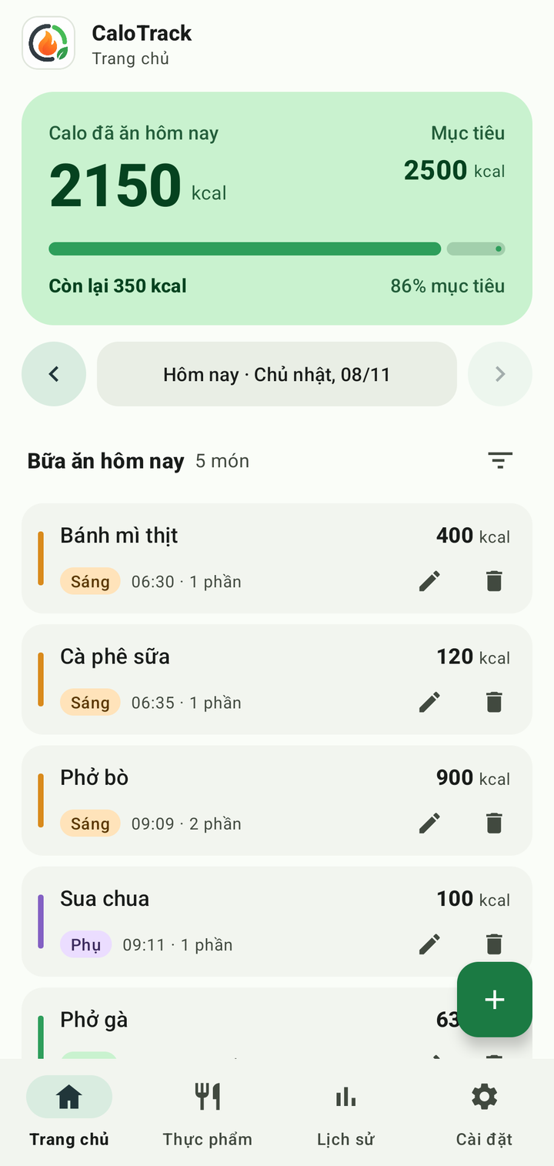
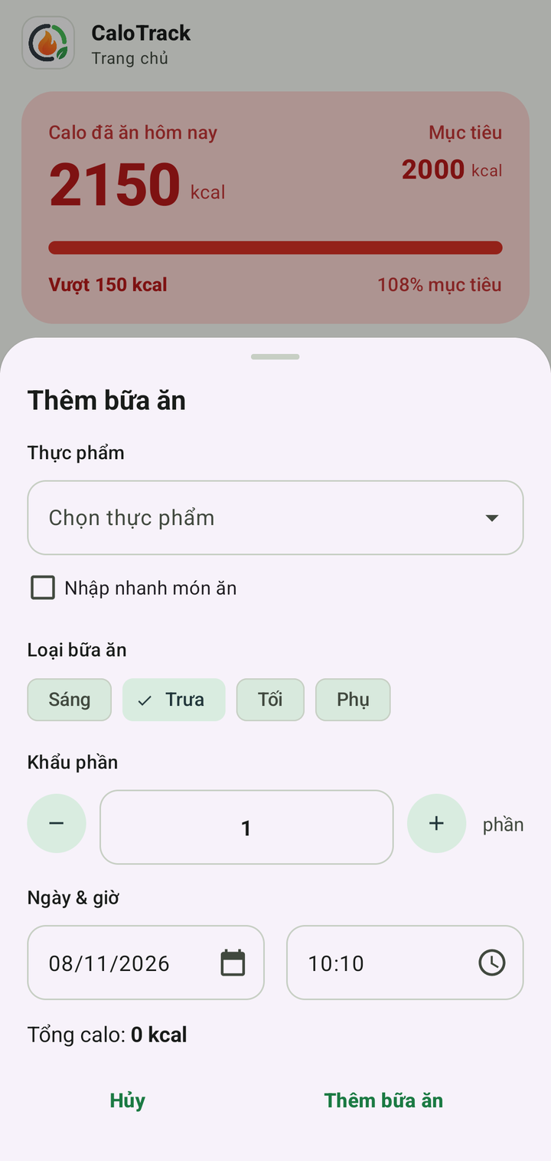
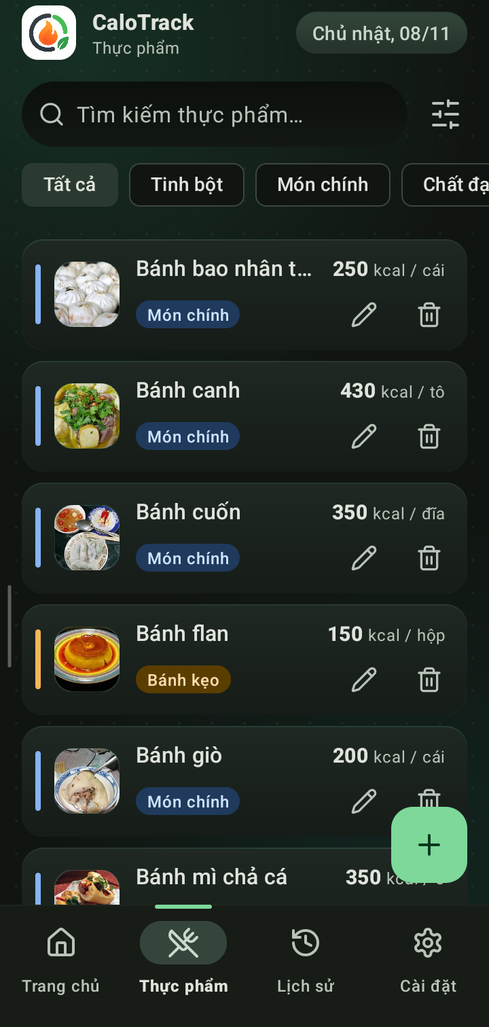
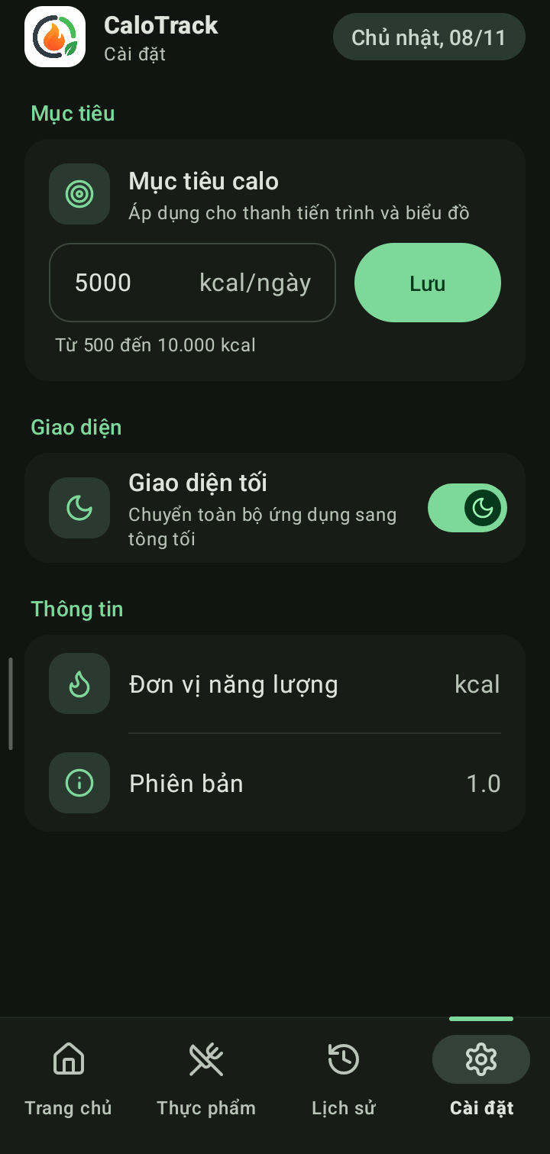
03 · FRONTEND & FEATURES
User Interface Gallery (Light & Dark Modes)
Home (Light)
Add Meal Sheet
Food Catalog (89 Photos)
7-Day History Chart
Settings
Home (Dark 3D UI)
CaloTrack · Topic 10 · Real screenshots captured from physical Xiaomi devices and Android Emulator
12 / 25

Slide 13
03 · FRONTEND & FEATURES
Feature Implementation: Adding & Calculating Meals
1
Auto-select meal type by current hour (Breakfast, Lunch, Dinner, Snack)
ui/meal/AddEditMealDialog.kt · saveMeal()
val quick = binding.cbQuickEntry.isChecked
val name = if (quick) binding.etQuickName.text
?.toString()?.trim().orEmpty()
else selectedFood?.name.orEmpty()
if (name.isEmpty()) { /* show field error */ return }
val portion = parsePortion() // "1,5" -> 1.5
if (portion <= 0) { setPortionInvalid(true); return }
val entry = MealEntry(
id = old?.id ?: 0L,
foodId = if (quick) null else selectedFood?.id,
foodName = name,
caloriesPerServing = calPerServing,
portion = portion,
totalCalories = calPerServing * portion,
mealType = currentMealType(),
date = selectedDate, time = selectedTime, ...)
lifecycleScope.launch(Dispatchers.IO) {
if (old != null) mealDao.update(entry)
else mealDao.insert(entry)
}
2
Pick dish via AutoComplete dropdown (with live photo) or Quick Entry
3
Adjust portion size with - / + stepper (0.5 step; supports comma decimals)
4
Live formula preview: totalCalories = caloriesPerServing x portion
5
Validate fields -> run DAO insert/update on Dispatchers.IO -> show Snackbar
CaloTrack · Topic 10 · Production code from AddEditMealDialog.kt · DatePicker restricts maxDate to today
13 / 25

Slide 14
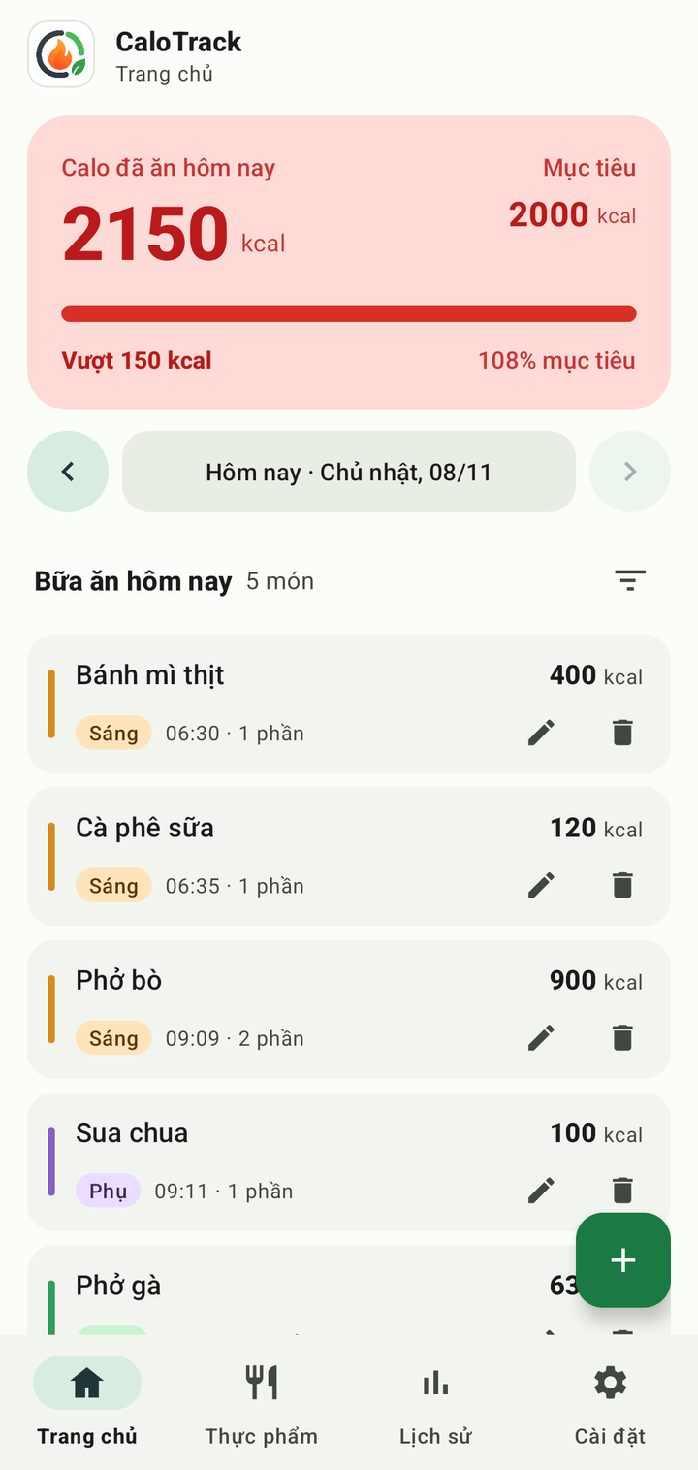
03 · FRONTEND & FEATURES
Daily Calorie Overview & Dynamic Status Color
ui/home/HomeFragment.kt · updateOverview()
val safeTarget = target.coerceAtLeast(1)
val diff = safeTarget - eaten
val isOver = diff < 0
val pct = ((eaten * 100.0) / safeTarget).roundToInt()
tvRemain.text = if (!isOver)
"Con lai ${fmtCal(diff)} kcal" // Remaining
else "Vuot ${fmtCal(-diff)} kcal" // Exceeded
binding.ringCalorieGauge.setProgress(pct, isOver)
// Switch Hero card surface, text & progress bar colors:
// Green (bg_hero_under) when under goal, Red (bg_hero_over) when over
binding.layoutHeroBg.setBackgroundResource(
if (isOver) R.drawable.bg_hero_over
else R.drawable.bg_hero_under
)
progressCal.setIndicatorColor(barColor)
progressCal.setProgressCompat(pct.coerceIn(0, 100), true)
Goal 2,500 kcal -> Green
Goal 2,000 kcal -> Red
CaloTrack · Topic 10 · Total intake is computed reactively via SUM(totalCalories) for the selected date
14 / 25

Slide 15
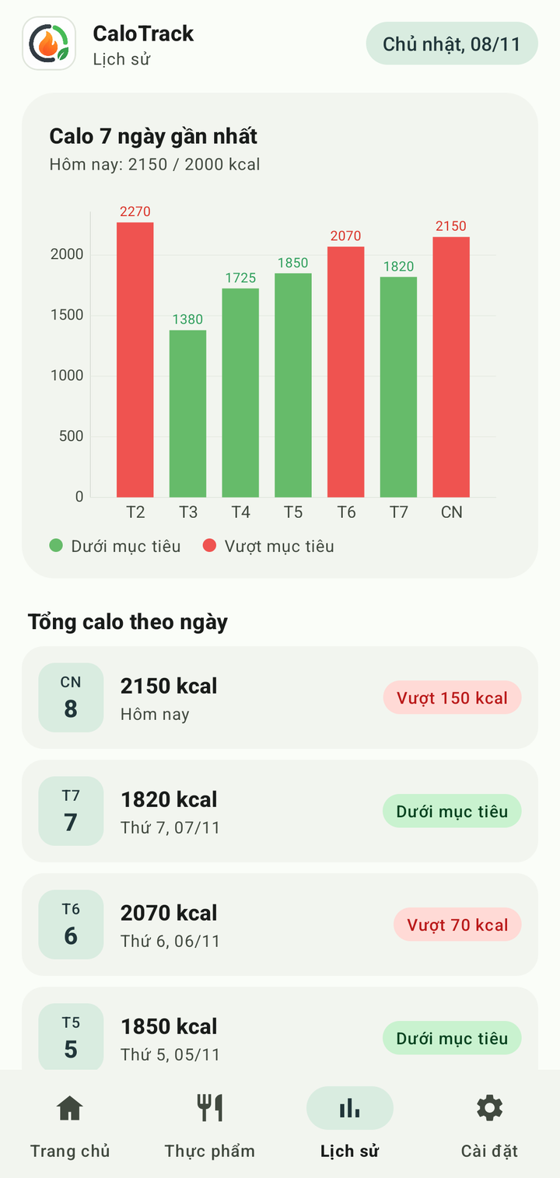
03 · FRONTEND & FEATURES
Calorie History & 7-Day Bar Chart
data/MealDao.kt + ui/history/HistoryViewModel.kt
7-Day SQL Aggregation vs. Chart Output
@Query("SELECT date AS date,
COALESCE(SUM(totalCalories),0) AS total
FROM meals WHERE date BETWEEN :from AND :to
GROUP BY date ORDER BY date ASC")
fun getDailyTotals(from: String, to: String)
: Flow<List<DayTotal>>
val last7 = DateUtils.last7Days()
val weeklyTotals = mealDao.getDailyTotals(
last7.first(), last7.last()).asLiveData()
Date | SUM(totalCalories) | Status
Mon · 02/11 | 2,270 kcal | Over Goal
Tue · 03/11 | 1,380 kcal | Under Goal
Wed · 04/11 | 1,725 kcal | Under Goal
Thu · 05/11 | 1,850 kcal | Under Goal
Fri · 06/11 | 2,070 kcal | Over Goal
Sat · 07/11 | 1,820 kcal | Under Goal
Sun · 08/11 | 2,150 kcal | Over Goal
ui/history/HistoryFragment.kt · updateChart()
val entries = days.mapIndexed { i, date ->
BarEntry(i.toFloat(), (totalByDate[date] ?: 0.0).toFloat()) }
val overFlags = days.map { (totalByDate[it] ?: 0.0) > target }
dataSet.colors = overFlags.map { if (it) colorOver else colorUnder }
Days without logged meals are zero-filled in memory so the chart always renders all 7 columns. Bars and value labels switch between Green and Red against the 2,000 kcal target.
CaloTrack · Topic 10 · Tapping any day row in History jumps directly to HomeFragment for that specific date
15 / 25

Slide 16
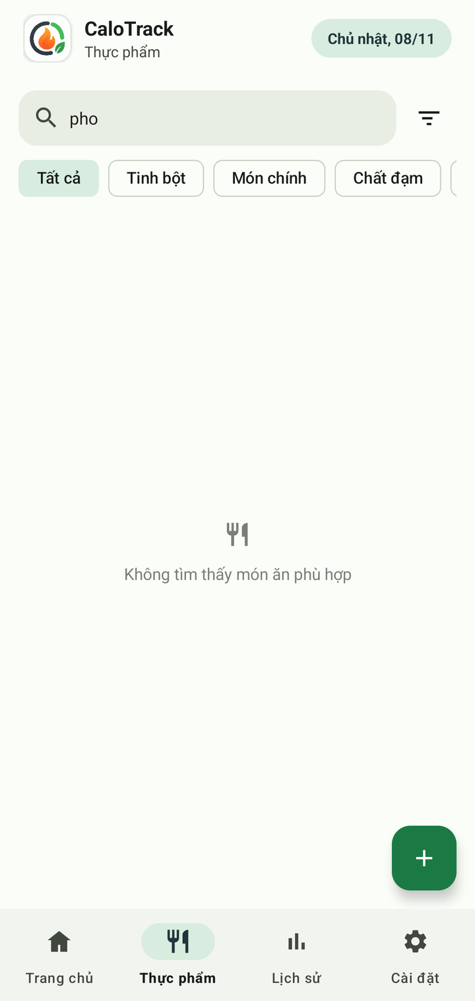
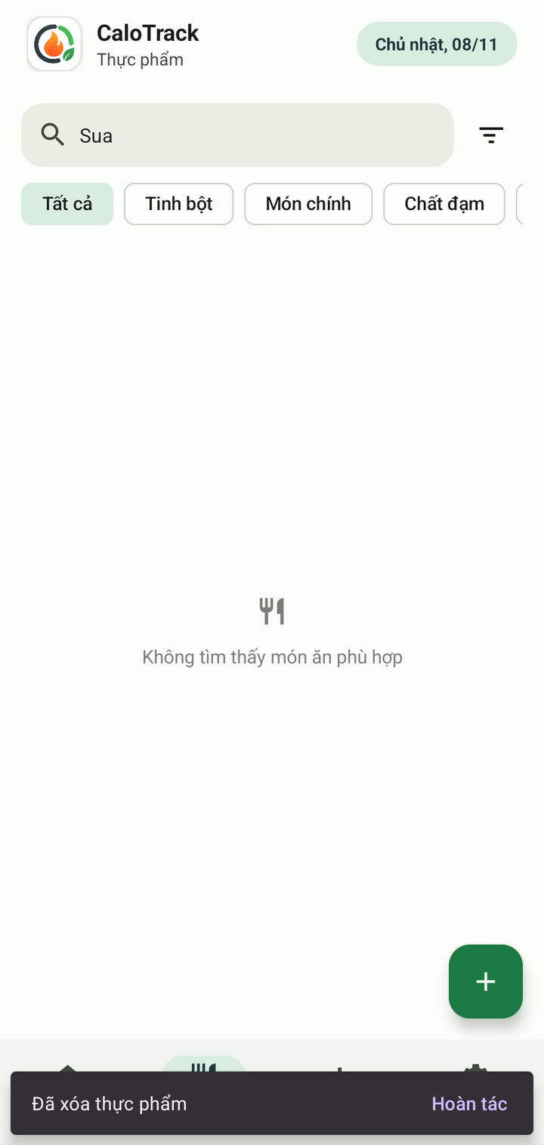
03 · FRONTEND & FEATURES
Accent-Insensitive Search, Filtering & Undo
ui/food/FoodListFragment.kt · Accent-Insensitive Search
private fun normalize(s: String): String {
val nfd = Normalizer.normalize(s.lowercase(), Normalizer.Form.NFD)
return nfd.replace(Regex("\\p{InCombiningDiacriticalMarks}+"), "")
.replace('đ', 'd')
}
// Typing "pho" matches "Phở bò", "Phở gà", "Phở cuốn"
if (q.isNotEmpty()) {
list = list.filter { normalize(it.name).contains(q) }
}
ui/food/FoodListFragment.kt · Delete with Snackbar Undo
private fun deleteFoodWithUndo(food: Food) {
viewLifecycleOwner.lifecycleScope.launch {
withContext(Dispatchers.IO) { foodDao.delete(food) }
Snackbar.make(binding.root, R.string.food_deleted, LENGTH_LONG)
.setAction(R.string.undo) {
lifecycleScope.launch(Dispatchers.IO) { foodDao.insert(food) }
}.show()
}
}
Query 'pho' -> 3 Pho dishes
Delete + One-Tap Undo
CaloTrack · Topic 10 · Combined AND filtering across keyword query, food category chips, serving unit, and calorie range
16 / 25

Slide 17
04 · DATABASE & STORAGE
Local Storage Overview: SQLite & SharedPreferences
Table: foods (SQLite)
Table: meals (SQLite)
calotrack_prefs.xml
id (INTEGER PK AUTOINCREMENT)
name (TEXT NOT NULL)
caloriesPerServing (REAL)
servingUnit · category (TEXT)
id (INTEGER PK AUTOINCREMENT)
foodId (INTEGER NULLABLE)
foodName · caloriesPerServing
portion · totalCalories · mealType
date (yyyy-MM-dd) · time (HH:mm)
target_calories (Int, default 2000)
dark_mode (Boolean, default false)
unit (String, default "kcal")
demo_seeded (Boolean)
89 pre-seeded dishes across 8 categories
Chronological daily meal logs
Lightweight key-value SharedPreferences
Room ORM Schema Generation · Compile-time KSP generates SQLite DDL from @Entity classes with auto-increment primary keys.
Snapshot Columns in meals · meals stores foodName and caloriesPerServing directly so editing/deleting a food never alters past history.
ISO-8601 Date & 24h Time Strings · Storing date as yyyy-MM-dd and time as HH:mm enables direct lexicographical sorting and BETWEEN queries.
Synchronous First-Launch Seeding · 89 Vietnamese foods are inserted inside RoomDatabase.Callback.onCreate within the initial transaction.
CaloTrack · Topic 10 · Source files: data/Food.kt, data/MealEntry.kt, util/PrefsManager.kt
17 / 25

Slide 18
04 · DATABASE & STORAGE
Entity-Relationship Diagram (ERD: 2 SQLite Tables)
foods
meals
@Entity(tableName = "foods") · 89 Pre-seeded Rows
@Entity(tableName = "meals") · Daily Meal Logs
PK id
INTEGER
AUTOINCREMENT, NOT NULL
1 ---- 0..N
PK id
INTEGER
AUTOINCREMENT, NOT NULL
name
TEXT
Dish name (NOT NULL)
FK foodId
INTEGER
NULLABLE (NULL if Quick Entry)
caloriesPerServing
REAL
kcal per 1 serving
foods.id -> meals.foodId
(Logical Reference)
foodName
TEXT
Snapshot of dish name
servingUnit
TEXT
Default: "phần"
caloriesPerServing
REAL
Snapshot of kcal/serving
category
TEXT
8 food groups
portion
REAL
Portion multiplier (0.5, 1.0...)
totalCalories
REAL
caloriesPerServing * portion
mealType
TEXT
BREAKFAST / LUNCH / DINNER / SNACK
Why a Decoupled 2-Table SQLite Design?
date
TEXT
Format: yyyy-MM-dd
time
TEXT
Format: HH:mm
Lightweight Local Storage: CaloTrack runs 100% on-device using SQLite, requiring only 2 core tables (foods and meals).
Historical Integrity: meals copies foodName and caloriesPerServing at log time so editing or deleting a food never corrupts past history.
Flexible Quick Entry: When logging an uncataloged dish via Quick Entry, foodId is stored as NULL.
createdAt
INTEGER
Epoch timestamp (ms)
CaloTrack · Topic 10 · Minimalist 2-table SQLite schema managed by Room ORM (AppDatabase version = 1)
18 / 25

Slide 19
04 · DATABASE & STORAGE
SQL Queries in Room DAOs
SELECT · Daily Meals & Total Sum · MealDao.kt
GROUP BY · Historical Daily Totals · MealDao.kt
SELECT * FROM meals
WHERE date = :date ORDER BY time ASC
SELECT COALESCE(SUM(totalCalories), 0)
FROM meals WHERE date = :date
SELECT date AS date,
COALESCE(SUM(totalCalories), 0) AS total
FROM meals
GROUP BY date ORDER BY date DESC
SELECT · Catalog & Keyword Search · FoodDao.kt
INSERT · UPDATE · DELETE · Generated by Room KSP
SELECT * FROM foods -- getAllFoods()
ORDER BY name COLLATE NOCASE ASC
SELECT * FROM foods WHERE name -- searchFoods(q)
LIKE '%' || :q || '%'
@Insert(onConflict = OnConflictStrategy.REPLACE)
suspend fun insert(food: Food): Long
@Update suspend fun update(meal: MealEntry)
@Delete suspend fun delete(meal: MealEntry)
CaloTrack · Topic 10 · All queries use parameterized bindings (:date, :q) verified at compile time by Room KSP
19 / 25

Slide 20
04 · DATABASE & STORAGE
Database Initialization & SharedPreferences
data/AppDatabase.kt · getInstance()
util/PrefsManager.kt
Room.databaseBuilder(appContext,
AppDatabase::class.java, "calotrack.db")
.addCallback(object : RoomDatabase.Callback() {
// Seed 89 foods synchronously inside creation tx
override fun onCreate(db: SupportSQLiteDatabase) {
super.onCreate(db)
SeedData.getFoods().forEach { food ->
db.insert("foods", CONFLICT_NONE,
ContentValues().apply {
put("name", food.name)
put("caloriesPerServing", ...)
put("servingUnit", food.servingUnit)
put("category", food.category)
})
}
}
})
.build()
private val prefs = context.getSharedPreferences(
"calotrack_prefs", Context.MODE_PRIVATE)
var targetCalories: Int
get() = prefs.getInt(KEY_TARGET_CALORIES, 2000)
set(v) = prefs.edit().putInt(KEY_TARGET_CALORIES, v).apply()
var darkMode: Boolean // default false
val unit: String get() = prefs.getString(KEY_UNIT, "kcal")...
ui/settings/SettingsFragment.kt
val value = etTarget.text?.toString()?.trim()?.toIntOrNull()
if (value != null && value in 500..10000) {
prefs.targetCalories = value
homeViewModel.refreshTarget() // syncs Home & History
} else { /* Toast "Please enter 500 to 10,000 kcal" */ }
CaloTrack · Topic 10 · Dark mode preference is applied in MainActivity.onCreate() with a smooth Circular Reveal transition
20 / 25

Slide 21
05 · TESTING & RESULTS
Testing Methodology & Verification Cases
1 · Build & KSP
2 · Physical Phones
3 · Emulator
4 · DB Inspection
gradlew assembleDebug
Redmi 10C & Note 13 Pro 5G
Clean install & seed test
Verify calotrack.db & prefs via ADB
Test Case | Expected Result | Actual Result
First app launch after clean install | foods table contains 89 dishes | PASS · 89 dishes across 8 categories
Add 'Pho bo' (450 kcal), portion 1.5 | Auto-calculates 675 kcal | PASS · 675 kcal · daily total 520 -> 1,195
Edit 'Pho bo' meal: portion 1.5 -> 2.0 | Updates same row ID to 900 kcal | PASS · id=78 updated to 900 kcal
Quick Entry 'Yogurt' 100 kcal (Snack) | Inserts meal with foodId = NULL | PASS · foodId=NULL · 100 kcal
Tap Save with empty food selection | Shows validation error, blocks insert | PASS · Inline error shown · 0 rows added
Daily total 2,150 kcal > Goal 2,000 kcal | Hero card turns Red, shows Exceeded | PASS · Red theme · 'Exceeded by 150 kcal' (108%)
Set calorie goal to 300, then 2,500 | 300 rejected; 2,500 saved to prefs | PASS · Warning Toast · target_calories = 2500
Search 'pho' without accents in Foods | Matches Vietnamese 'Phở' dishes | PASS · 3 dishes: Pho bo, Pho cuon, Pho ga
Delete food item then tap Undo | Restores exact record and ID | PASS · 89 -> 88 -> 89 rows (id preserved)
Compare 7-day chart bars vs SQL SUM | Matches daily totals for all 7 days | PASS · 7/7 days match SQLite GROUP BY
Enable Dark Mode and restart app | Persists dark_mode = true | PASS · Launches directly in Dark Mode
Change goal in Settings -> switch to Home | Home & History update immediately | PASS · Updates to 2,500 kcal (86%) instantly
CaloTrack · Topic 10 · All 12/12 functional and edge-case tests passed on Android Emulator and physical Xiaomi devices
21 / 25

Slide 22
05 · TESTING & RESULTS
Key Achievements & Deliverables
9 / 9
12 / 12
Mandatory Topic 10 requirements completed (100%)
End-to-end test cases passed on real hardware
89 Photos
7.3 MB
Real food thumbnails bundled with LruCache memory caching
Self-contained debug APK with 3D Soft-Tech custom views
Repository: github.com/ndtien0406-design/app_calo · Tested on Xiaomi Redmi 10C (720x1650) and Xiaomi Redmi Note 13 Pro 5G (1220x2712 @ 480dpi).
CaloTrack · Topic 10 · Right: Dark Mode (values-night) on History and Food Catalog screens
22 / 25

Slide 23
06 · CONCLUSION
Challenges & Engineering Solutions
Empty food catalog race condition on first launch
Seeded all 89 foods synchronously inside RoomDatabase.Callback.onCreate within the initial SQLite creation transaction
Fragment hide/show tab navigation bypassing onResume
Shared HomeViewModel via activityViewModels() and hooked onHiddenChanged() so goal updates reflect instantaneously
Accent-insensitive Vietnamese search & midnight rollover
Normalized strings with Unicode NFD diacritic stripping; added automatic date rollover check when returning to Home
Preserving historical meal accuracy when foods change
Stored snapshot columns (foodName, caloriesPerServing) in meals and made foodId nullable for Quick Entry
FAB overlapping bottom card actions while scrolling
Built UiverseOrbFabView with Scroll-Aware Auto-Dodge, 112dp list padding, Sonar pulse halo, and paired 0-135 deg icon spin
CaloTrack · Topic 10 · All engineering solutions are implemented in AppDatabase.kt, HomeFragment.kt, FoodListFragment.kt, and UiverseOrbFabView.kt
23 / 25

Slide 24
06 · CONCLUSION
Limitations & Future Enhancements
Current Limitations
Future Enhancements
Energy unit is currently fixed to kcal (read-only in Settings) without live kJ conversion
Tracks total energy (calories) only, without splitting macronutrients (Protein, Carbs, Fat)
All data resides locally on the device without JSON/CSV export or cloud backup
Room database is at schema version 1 without automated Migration scripts for future schema changes
Add interactive kcal / kJ unit conversion (1 kcal = 4.184 kJ) leveraging the unit key in PrefsManager
Extend foods and meals schemas to track Protein, Carbs, Fat, and daily water intake
Support local JSON / Excel backup export and optional Google Drive synchronization
Add automated Room in-memory DAO unit tests and Espresso UI instrumentation suites
CaloTrack · Topic 10 · Roadmap for future releases of CaloTrack
24 / 25

Slide 25
06 · CONCLUSION
Conclusion & Q&A
CaloTrack is a complete, production-ready Android application: fulfilling all 9 requirements of Topic 10, powered by a clean 2-table Room SQLite schema, SharedPreferences, and a 3D Material 3 interface.
Engineering
Product
Key Takeaways
Kotlin, Room SQLite, MVVM LiveData/Flow, Coroutines, and custom 60fps Canvas views
89 Vietnamese foods with photos, auto calorie math, 7-day chart, Light/Dark themes
Decoupled historical meal snapshots, reactive UI streams, real-device verification
Thank You · Questions & Answers
Thank you for your time and attention!
Group [GROUP NUMBER] · CaloTrack (Topic 10) · github.com/ndtien0406-design/app_calo
CaloTrack · Topic 10
25 / 25

