Slide 1
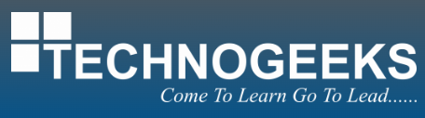
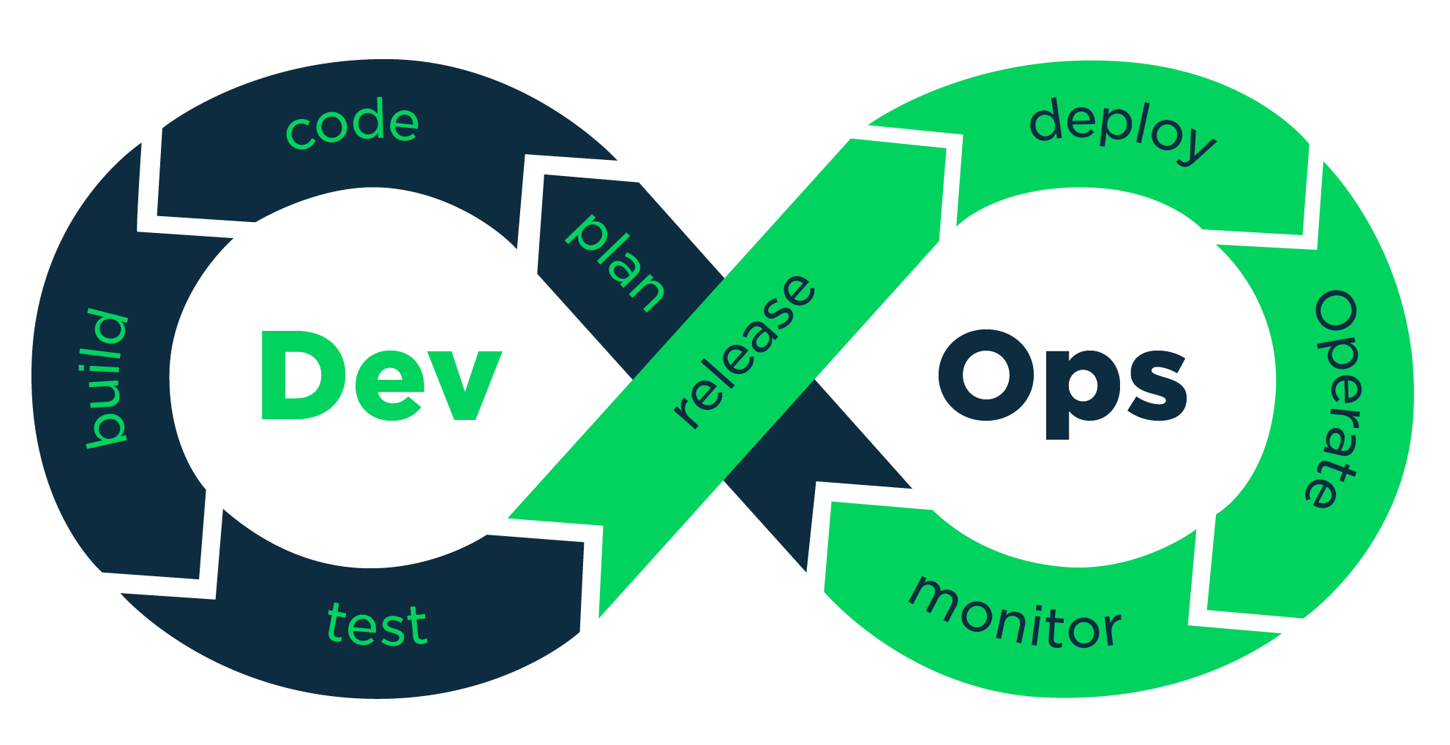
Welcome !

Slide 2
Course : DevOps with cloud computing (AWS)
Cloud computing and AWS
Date – 31st Jan 2024
Trainer – Niranjan Dive

Slide 3
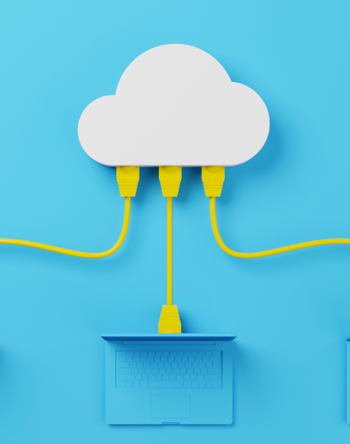
Agenda
What is AWS ?
What is Cloud Computing?
Why Cloud Computing ?
Service Models
Deployment Models

Slide 4
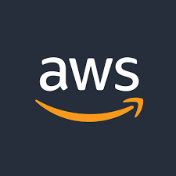
What is AWS ?
Amazon Web Services, Inc. is a subsidiary of Amazon that provides on-demand cloud computing platforms and APIs to individuals, companies, and governments, on a metered, pay-as-you-go basis.

Slide 5
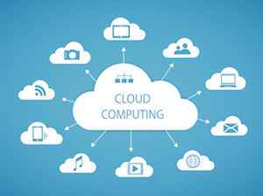
What is Cloud-computing ?
“Cloud computing is the on-demand delivery of IT resources over the Internet with pay-as-you-go pricing”

Slide 6
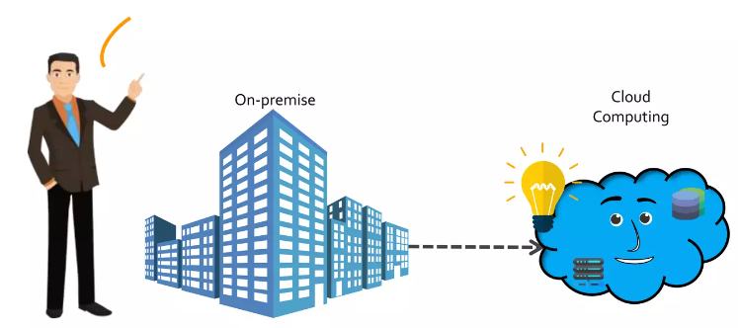
Why Cloud-computing ?
Consider Mr.x wants to start a company.

Slide 7
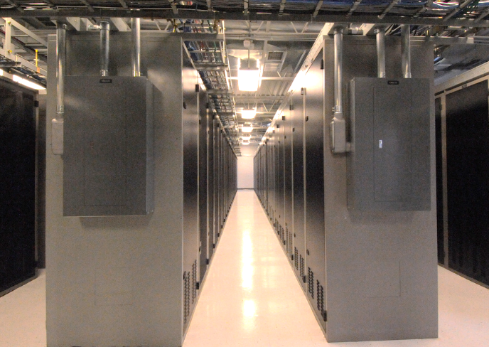
Before Cloud Computing
On-Prem solutions are physical. This means they require:
  Space
  Staff
  Physical security
  Planning
  Capital expenditure
  Is there enough resource capacity?
  Do we have sufficient storage?
  What if your needs change?
  You have to go through the time, effort, and cost required to change all these.
Notes:
Managing hardware takes away time and resources you could be using to improve your architecture and your application. Hardware solutions are physical. This means they require space, staff, physical security, planning and capital expenditure.
You have to guess at theoretical maximum peaks, asking if there is enough resource capacity or if you have sufficient storage. What if your needs change? You have to go through the time, effort, and cost required to change all of these.
For example, if you want to provision a new web site, you would have to go out and buy the hardware, rack and stack it, put it in a data center, and then manage it or have someone else manage it. This approach is very expensive.
Cloud computing addresses some of the issues in the traditional computing model. One of the most prohibitive aspects of traditional computing is the significant up-front investment of acquiring, provisioning, and maintaining on-premises infrastructure. Cloud computing can get businesses up and running with a new solution in place quickly and with very low up-front costs. Then, you can elastically scale up and down in an automated fashion so that you pay only for what you use.
Cloud computing also allows you to select the services that best match your needs, giving you flexibility with a wide range of choices and the ability to change your configuration at will. All of these services are provided on a secured infrastructure.

Slide 8

Cloud Computing
With a cloud services provider like AWS, you don't have to anticipate your hardware needs ahead of time and then order, install, and set it up at your data center. You also don’t need to undergo a long procurement cycle. With a few clicks, you can provision exactly what you need-and it will be available to you in a few minutes.
Notes:
Managing hardware takes away time and resources you could be using to improve your architecture and your application. Hardware solutions are physical. This means they require space, staff, physical security, planning and capital expenditure.
You have to guess at theoretical maximum peaks, asking if there is enough resource capacity or if you have sufficient storage. What if your needs change? You have to go through the time, effort, and cost required to change all of these.
For example, if you want to provision a new web site, you would have to go out and buy the hardware, rack and stack it, put it in a data center, and then manage it or have someone else manage it. This approach is very expensive.
Cloud computing addresses some of the issues in the traditional computing model. One of the most prohibitive aspects of traditional computing is the significant up-front investment of acquiring, provisioning, and maintaining on-premises infrastructure. Cloud computing can get businesses up and running with a new solution in place quickly and with very low up-front costs. Then, you can elastically scale up and down in an automated fashion so that you pay only for what you use.
Cloud computing also allows you to select the services that best match your needs, giving you flexibility with a wide range of choices and the ability to change your configuration at will. All of these services are provided on a secured infrastructure.

Slide 9
Cloud Computing
That means you can provision and terminate resources as necessary on AWS, instead of paying for hardware when you’re not using it. You can treat resources as temporary and disposable resources, free from the inflexibility and constraints of a fixed and finite IT infrastructure.
By harnessing the power of AWS, you can be more agile and efficient with change management, testing, reliability, and capacity planning.
Notes:
Managing hardware takes away time and resources you could be using to improve your architecture and your application. Hardware solutions are physical. This means they require space, staff, physical security, planning and capital expenditure.
You have to guess at theoretical maximum peaks, asking if there is enough resource capacity or if you have sufficient storage. What if your needs change? You have to go through the time, effort, and cost required to change all of these.
For example, if you want to provision a new web site, you would have to go out and buy the hardware, rack and stack it, put it in a data center, and then manage it or have someone else manage it. This approach is very expensive.
Cloud computing addresses some of the issues in the traditional computing model. One of the most prohibitive aspects of traditional computing is the significant up-front investment of acquiring, provisioning, and maintaining on-premises infrastructure. Cloud computing can get businesses up and running with a new solution in place quickly and with very low up-front costs. Then, you can elastically scale up and down in an automated fashion so that you pay only for what you use.
Cloud computing also allows you to select the services that best match your needs, giving you flexibility with a wide range of choices and the ability to change your configuration at will. All of these services are provided on a secured infrastructure.

Slide 10
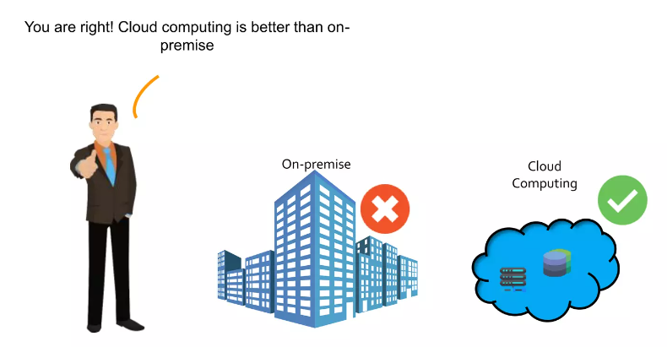
Cloud Computing
Notes:
Managing hardware takes away time and resources you could be using to improve your architecture and your application. Hardware solutions are physical. This means they require space, staff, physical security, planning and capital expenditure.
You have to guess at theoretical maximum peaks, asking if there is enough resource capacity or if you have sufficient storage. What if your needs change? You have to go through the time, effort, and cost required to change all of these.
For example, if you want to provision a new web site, you would have to go out and buy the hardware, rack and stack it, put it in a data center, and then manage it or have someone else manage it. This approach is very expensive.
Cloud computing addresses some of the issues in the traditional computing model. One of the most prohibitive aspects of traditional computing is the significant up-front investment of acquiring, provisioning, and maintaining on-premises infrastructure. Cloud computing can get businesses up and running with a new solution in place quickly and with very low up-front costs. Then, you can elastically scale up and down in an automated fashion so that you pay only for what you use.
Cloud computing also allows you to select the services that best match your needs, giving you flexibility with a wide range of choices and the ability to change your configuration at will. All of these services are provided on a secured infrastructure.

Slide 11
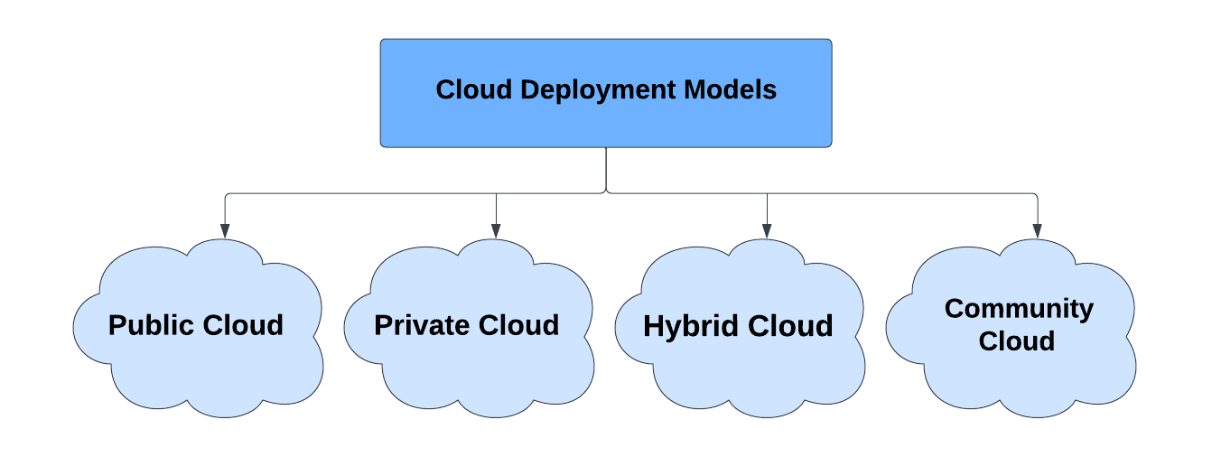
Cloud Deployment Models
Notes:
Managing hardware takes away time and resources you could be using to improve your architecture and your application. Hardware solutions are physical. This means they require space, staff, physical security, planning and capital expenditure.
You have to guess at theoretical maximum peaks, asking if there is enough resource capacity or if you have sufficient storage. What if your needs change? You have to go through the time, effort, and cost required to change all of these.
For example, if you want to provision a new web site, you would have to go out and buy the hardware, rack and stack it, put it in a data center, and then manage it or have someone else manage it. This approach is very expensive.
Cloud computing addresses some of the issues in the traditional computing model. One of the most prohibitive aspects of traditional computing is the significant up-front investment of acquiring, provisioning, and maintaining on-premises infrastructure. Cloud computing can get businesses up and running with a new solution in place quickly and with very low up-front costs. Then, you can elastically scale up and down in an automated fashion so that you pay only for what you use.
Cloud computing also allows you to select the services that best match your needs, giving you flexibility with a wide range of choices and the ability to change your configuration at will. All of these services are provided on a secured infrastructure.

Slide 12
Factors | Public Cloud | Private Cloud | Hybrid Cloud
Resources | Resources are shared among multiple customers | Resources are shared with a single organization | It is a combination of public and private clouds. based on the requirement.
Tenancy | Data of multiple organizations is stored in the public cloud | Data of a single organization is stored in a clouds the public cloud | Data is stored in the public cloud, and provide security in the public cloud.
Pay Model | Pay what you used | Have a variety of pricing models | It can include a mix of public cloud pay-as-you-go pricing, and private cloud fixed pricing. It has other pricing models such as consumption-based, subscription-based, etc.
Operated by | Third-party service provider | Specific organization | Can be a combination of both
Scalability and Flexibility | It has more scalability and flexibility, | It has predictability and consistency | It has scalability and flexibility by allowing organizations to use a combination of public and private cloud services.
Expensive | less expensive | More expensive | Can be more expensive, but it can also be less expensive , depending on the specific needs and requirements of the organization.
Availability | The general public (over the internet) | Restricted to a specific organization | Can be a combination of both.
Notes:
Managing hardware takes away time and resources you could be using to improve your architecture and your application. Hardware solutions are physical. This means they require space, staff, physical security, planning and capital expenditure.
You have to guess at theoretical maximum peaks, asking if there is enough resource capacity or if you have sufficient storage. What if your needs change? You have to go through the time, effort, and cost required to change all of these.
For example, if you want to provision a new web site, you would have to go out and buy the hardware, rack and stack it, put it in a data center, and then manage it or have someone else manage it. This approach is very expensive.
Cloud computing addresses some of the issues in the traditional computing model. One of the most prohibitive aspects of traditional computing is the significant up-front investment of acquiring, provisioning, and maintaining on-premises infrastructure. Cloud computing can get businesses up and running with a new solution in place quickly and with very low up-front costs. Then, you can elastically scale up and down in an automated fashion so that you pay only for what you use.
Cloud computing also allows you to select the services that best match your needs, giving you flexibility with a wide range of choices and the ability to change your configuration at will. All of these services are provided on a secured infrastructure.

Slide 13
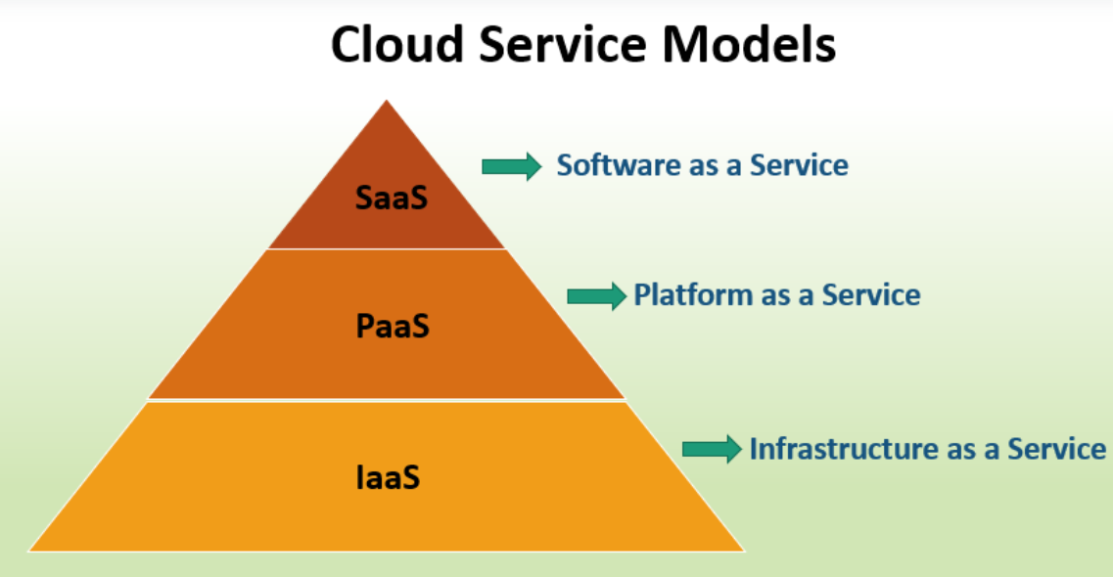
Cloud Service Models
Notes:
Managing hardware takes away time and resources you could be using to improve your architecture and your application. Hardware solutions are physical. This means they require space, staff, physical security, planning and capital expenditure.
You have to guess at theoretical maximum peaks, asking if there is enough resource capacity or if you have sufficient storage. What if your needs change? You have to go through the time, effort, and cost required to change all of these.
For example, if you want to provision a new web site, you would have to go out and buy the hardware, rack and stack it, put it in a data center, and then manage it or have someone else manage it. This approach is very expensive.
Cloud computing addresses some of the issues in the traditional computing model. One of the most prohibitive aspects of traditional computing is the significant up-front investment of acquiring, provisioning, and maintaining on-premises infrastructure. Cloud computing can get businesses up and running with a new solution in place quickly and with very low up-front costs. Then, you can elastically scale up and down in an automated fashion so that you pay only for what you use.
Cloud computing also allows you to select the services that best match your needs, giving you flexibility with a wide range of choices and the ability to change your configuration at will. All of these services are provided on a secured infrastructure.

Slide 14
IaaS - Infrastructure as a Service
IaaS vendors provide the whole infrastructure (virtual machines), which you can configure according to your needs. If you want to work on Linux machines, you can; if you want to work on the Windows machine, that is possible. Also, you will not have to worry about where the machine is located. You can rent as many virtual machines as you want and run your application in parallel.
Example: Amazon EC2. The biggest and most famous IaaS vendor.
Notes:
Managing hardware takes away time and resources you could be using to improve your architecture and your application. Hardware solutions are physical. This means they require space, staff, physical security, planning and capital expenditure.
You have to guess at theoretical maximum peaks, asking if there is enough resource capacity or if you have sufficient storage. What if your needs change? You have to go through the time, effort, and cost required to change all of these.
For example, if you want to provision a new web site, you would have to go out and buy the hardware, rack and stack it, put it in a data center, and then manage it or have someone else manage it. This approach is very expensive.
Cloud computing addresses some of the issues in the traditional computing model. One of the most prohibitive aspects of traditional computing is the significant up-front investment of acquiring, provisioning, and maintaining on-premises infrastructure. Cloud computing can get businesses up and running with a new solution in place quickly and with very low up-front costs. Then, you can elastically scale up and down in an automated fashion so that you pay only for what you use.
Cloud computing also allows you to select the services that best match your needs, giving you flexibility with a wide range of choices and the ability to change your configuration at will. All of these services are provided on a secured infrastructure.

Slide 15
PaaS - Platform as a Service
PaaS stands for Platform as a Service. The vendors provide their clients with a platform to deploy their applications without worrying about the storage and infrastructure.
The application you develop and the data you use are the only things you can own in a PaaS environment. Underlying architecture, including storage infrastructure, runtime, servers, etc., everything is managed by the vendor.
Example: Google App Engine. It allows you to develop and host your web applications in Google’s data centers. The App Engine requires the applications to be written in Java or Python.
Notes:
Managing hardware takes away time and resources you could be using to improve your architecture and your application. Hardware solutions are physical. This means they require space, staff, physical security, planning and capital expenditure.
You have to guess at theoretical maximum peaks, asking if there is enough resource capacity or if you have sufficient storage. What if your needs change? You have to go through the time, effort, and cost required to change all of these.
For example, if you want to provision a new web site, you would have to go out and buy the hardware, rack and stack it, put it in a data center, and then manage it or have someone else manage it. This approach is very expensive.
Cloud computing addresses some of the issues in the traditional computing model. One of the most prohibitive aspects of traditional computing is the significant up-front investment of acquiring, provisioning, and maintaining on-premises infrastructure. Cloud computing can get businesses up and running with a new solution in place quickly and with very low up-front costs. Then, you can elastically scale up and down in an automated fashion so that you pay only for what you use.
Cloud computing also allows you to select the services that best match your needs, giving you flexibility with a wide range of choices and the ability to change your configuration at will. All of these services are provided on a secured infrastructure.

Slide 16
SaaS - Software as a Service
SaaS stands for Software as a Service, in which the vendors let the clients use the application they’ve built. The clients then are charged for using the application. To access the application, all the client needs is an internet connection, a web browser.
In SaaS, everything is managed by the vendor. The platform, data, servers, storage, networking, etc. SaaS does not require any installations or downloads in your existing system. This makes it easier for clients to use the software without having to worry about its maintenance or updates.
Example: Cloud-based Microsoft Office 365, Dropbox etc.
Notes:
Managing hardware takes away time and resources you could be using to improve your architecture and your application. Hardware solutions are physical. This means they require space, staff, physical security, planning and capital expenditure.
You have to guess at theoretical maximum peaks, asking if there is enough resource capacity or if you have sufficient storage. What if your needs change? You have to go through the time, effort, and cost required to change all of these.
For example, if you want to provision a new web site, you would have to go out and buy the hardware, rack and stack it, put it in a data center, and then manage it or have someone else manage it. This approach is very expensive.
Cloud computing addresses some of the issues in the traditional computing model. One of the most prohibitive aspects of traditional computing is the significant up-front investment of acquiring, provisioning, and maintaining on-premises infrastructure. Cloud computing can get businesses up and running with a new solution in place quickly and with very low up-front costs. Then, you can elastically scale up and down in an automated fashion so that you pay only for what you use.
Cloud computing also allows you to select the services that best match your needs, giving you flexibility with a wide range of choices and the ability to change your configuration at will. All of these services are provided on a secured infrastructure.

Slide 17
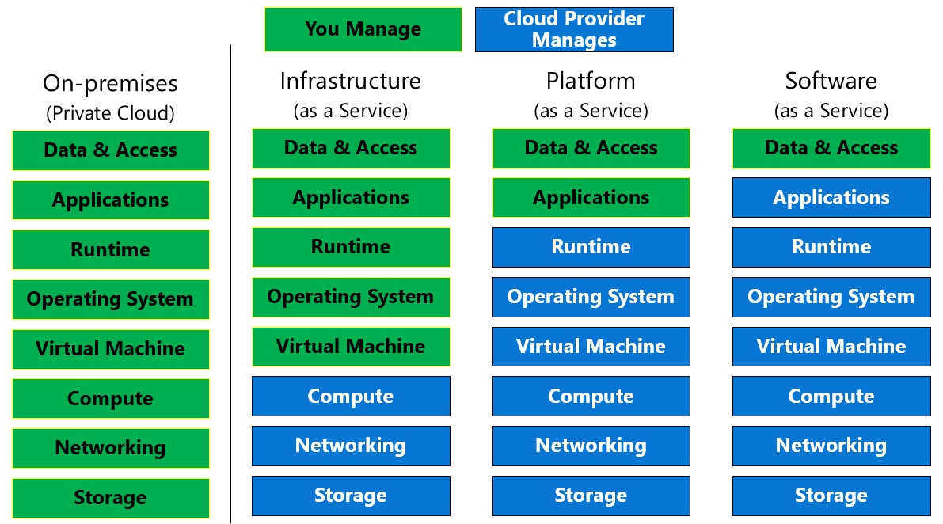

Slide 18
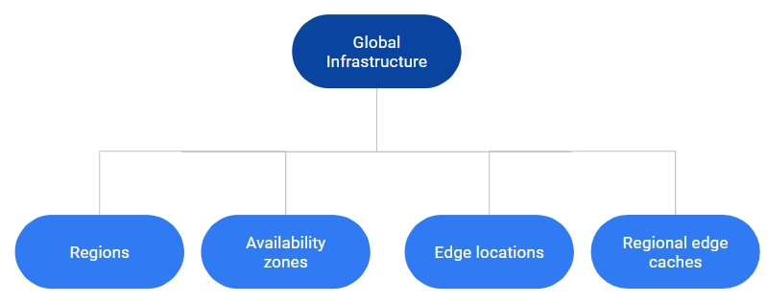
AWS Global Infrastructure
The AWS Global Infrastructure is designed and built to deliver a flexible, reliable, scalable, and secure cloud computing environment with high-quality global network performance.
https://aws.amazon.com/about-aws/global-infrastructure/

Slide 19
Region
AWS Regions are geographical areas where Amazon Web Services (AWS) operates data centers.
They are designed to provide redundancy and high availability.
A Region typically consists of two or more Availability Zones.
Availability Zones
Each Availability Zone is a fully isolated partition of the AWS infrastructure.
Availability Zones consist of discrete data centers.
They are designed for fault isolation.
They are interconnected with other Availability Zones by using high-speed private networking.

Slide 20
AWS Networking – VPC and Subnets
With Amazon Virtual Private Cloud (Amazon VPC), you can launch AWS resources in a logically isolated virtual network that you've defined. This virtual network closely resembles a traditional network that you'd operate in your own data center, with the benefits of using the scalable infrastructure of AWS.
A subnet is a range of IP addresses in your VPC. A subnet must reside in a single Availability Zone. After you add subnets, you can deploy AWS resources in your VPC.

Slide 21
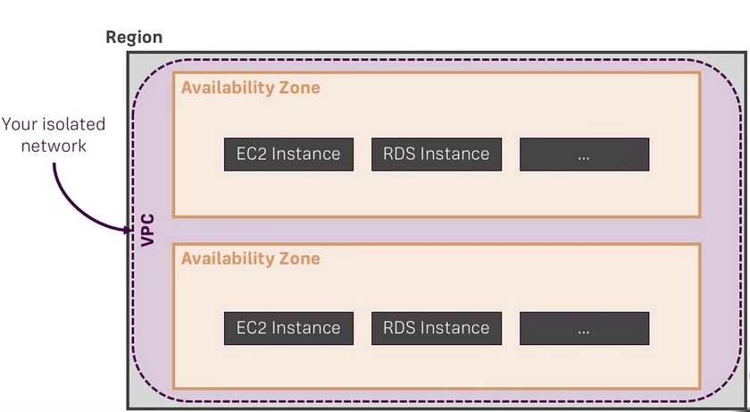

Slide 22
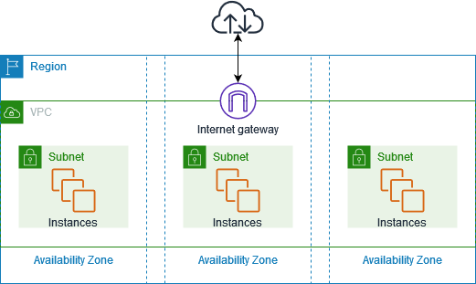

Slide 23


Slide 24

Contact Me:
Mobile: +91 9096092301
Email: trainer.niranjan30@gmail.com

