Slide 1
CS331.L22.KHCL
GVHD: TS. Mai Tiến Dũng
NEURONAL APPROACH FOR OFFLINE HANDWRITING RECOGNITION
Ngô Đức Tuấn (18520186)
Lê Hoàng Long (18521027)

Slide 2
AGENDA
1/ OVERVIEW
2/ DATASET
3/ MODEL ARCHITECTURE
4/ RESULT
5/ DEMO

Slide 3


OVERVIEW - PROBLEM

Slide 4
OVERVIEW – OFFLINE HTR
Handwritten Text Recognition
Online Handwritten Text Recognition
Offline Handwritten Text Recognition

Slide 5





OVERVIEW – INPUT/OUTPUT
Handwriting Recognition: Transcriptions of 400,000 handwritten names – landlord
https://www.kaggle.com/landlord/handwriting-recognition

Slide 6

OVERVIEW – CHALLENGE
+ Variability and ambiguity
+ Characters out of line
+ Noises
+ Writer’s Style: Changeable and inconsistent
For instance:

Slide 7
DATASET - OVERALL
Training
(331,059)
Firstname
(206,799)
Img
(413,823)
Test
(41,382 )
JPG
Surname
(207,024)
Data
Validation
(41,382)
Label
CSV
Transcriptions of 400,000 handwritten names for Optical Character Recognition Dataset

Slide 8
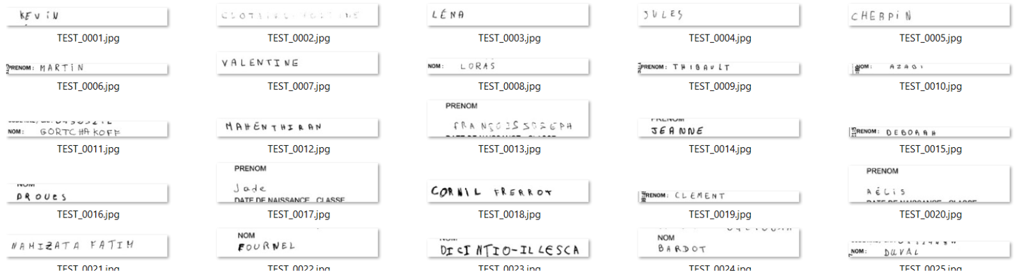
DATASET - OVERALL
Transcriptions of 400,000 handwritten names for Optical Character Recognition Dataset

Slide 9
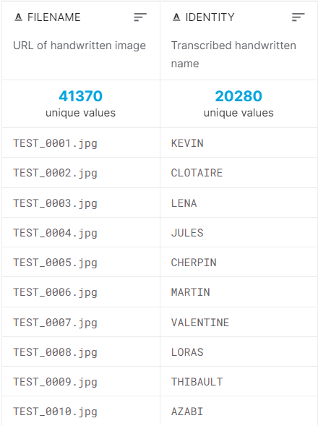
DATASET - OVERALL

Slide 10
DATASET - EDA
EDA
 | Train | Valid | Test
Shape | (330961, 2) | (41370, 2) | (41370, 2)
Missing values | 565 | 78 | 70
Unreadable
Lowercase - Uppercase
Different input size

Slide 11
APPROACHES
APPROACHES
FEATURE EXTRACTION
HOG
LBP
…
SVM

Slide 12
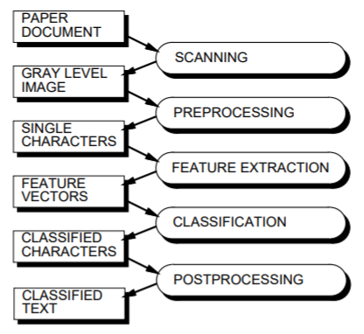
APPROACHES
Oivind Due Trier, Anil K. Jain, Torfinn Taxt - “Feature Extraction Methods for Character Recognition – A Survey”. Posted on July 19, 1995.
https://www.ee.bgu.ac.il/~dinstein/stip2002/FeatureExtractionReviewTrierJainTaxt95.pdf

Slide 13

APPROACHES
?

Slide 14
APPROACHES
APPROACHES
FEATURE EXTRACTION
DEEP METHOD
HOG
LBP
…
CNN
RNN
SVM

Slide 15
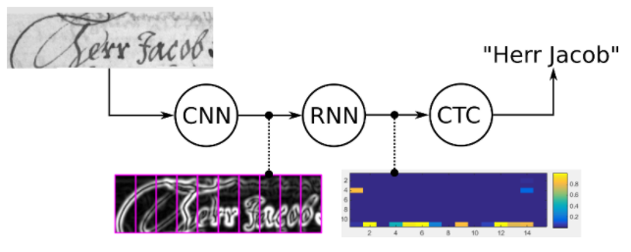
MODEL ARCHITECTURE - IDEA
https://towardsdatascience.com/intuitively-understanding-connectionist-temporal-classification-3797e43a86c'

Slide 16
MODEL ARCHITECTURE – WHY?
+ Have the same characteristics of both CNN and RNN
+ No detailed annotations
+ Good performance
+ Eliminate fully connected layers used in CNN, using fewer params

Slide 17
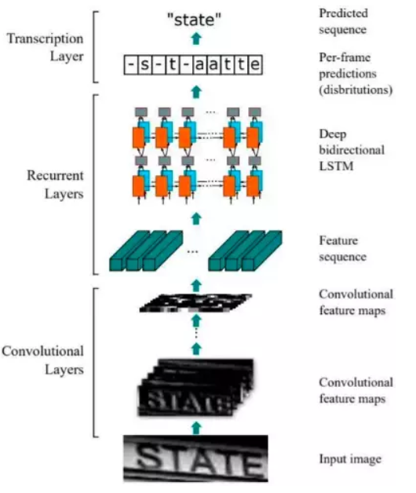
MODEL ARCHITECTURE
An End-to-End Trainable Neural Network for Image-based Sequence Recognition and Its Application to Scene Text Recognition”.
https://arxiv.org/pdf/1507.05717.pdf

Slide 18
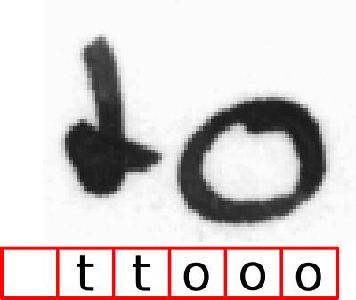
MODEL ARCHITECTURE – CTC LOSS
https://towardsdatascience.com/intuitively-understanding-connectionist-temporal-classification-3797e43a86c

Slide 19
DEMO

Slide 20
RESULT
Loss = CTC, optimizer = Adam, learning rate = 0.0001
Comparison
Epochs | 5 | 60 | 100
Correct characters predicted | 8.61% | 88.67% | 83.19%
Correct words predicted | 0.00 | 74.62% | 69.47%
Time | 288s | 2800s | 4585s

Slide 21


21

