Slide 1

Dodging Master
Team rocket
Cheang wen ding
Ng zuo xian, amadeus
Jerel peck ler hern
Eugene ho shu sheng
Andy tang wei xian

Slide 2
Overall Concept
Time-based, platform type
Getting through traps, advancing to the end point to complete stage

Slide 3
Unique Selling Point
Speed run
Appealing to both casual and competitive players
2D platform trap game

Slide 4
Process Reflection
Character movement
Dash mechanic and jumping
Collision logic
Snapping issues
Affected movements

Slide 5
Process Reflection
Unique ways of coding for each member
Content required for coding, only learnt towards end of trimester
Underestimated amount of time we had

Slide 6
Playtest Reflection

Slide 7
BUG

Slide 8
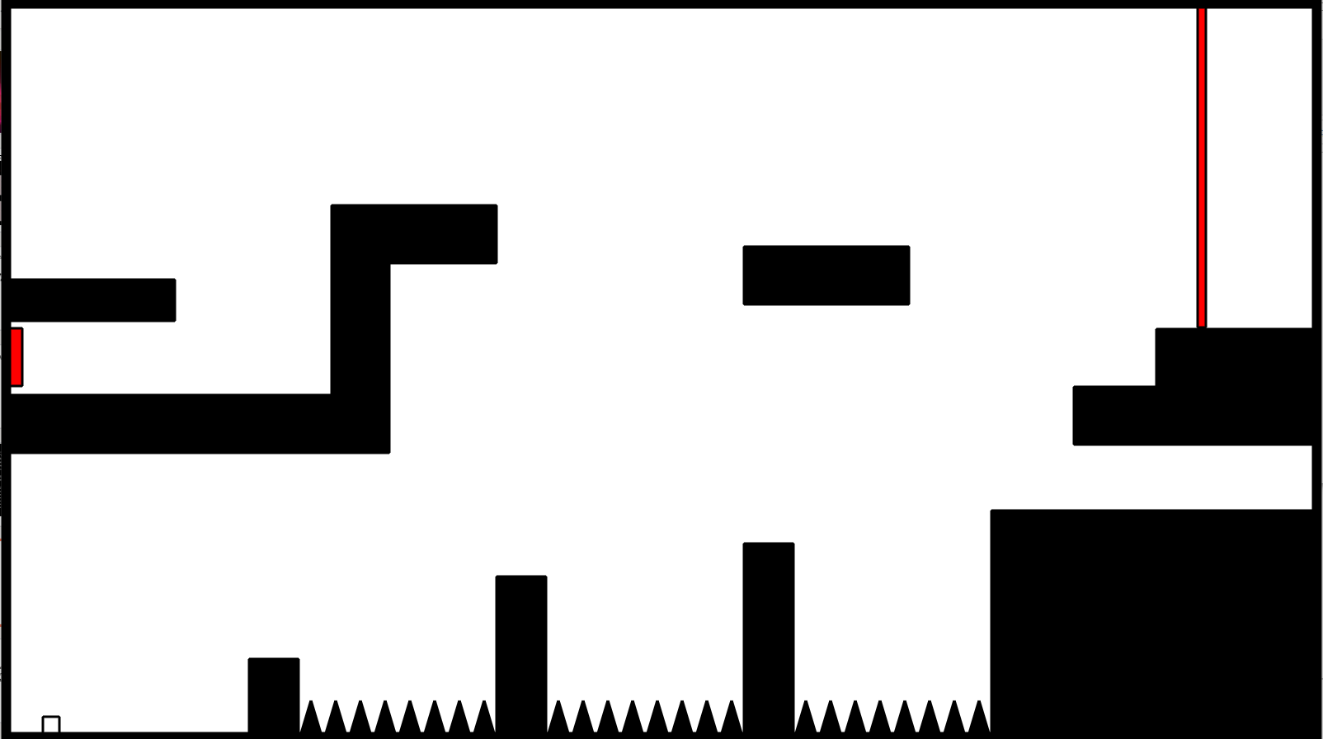
BEFORE

Slide 9
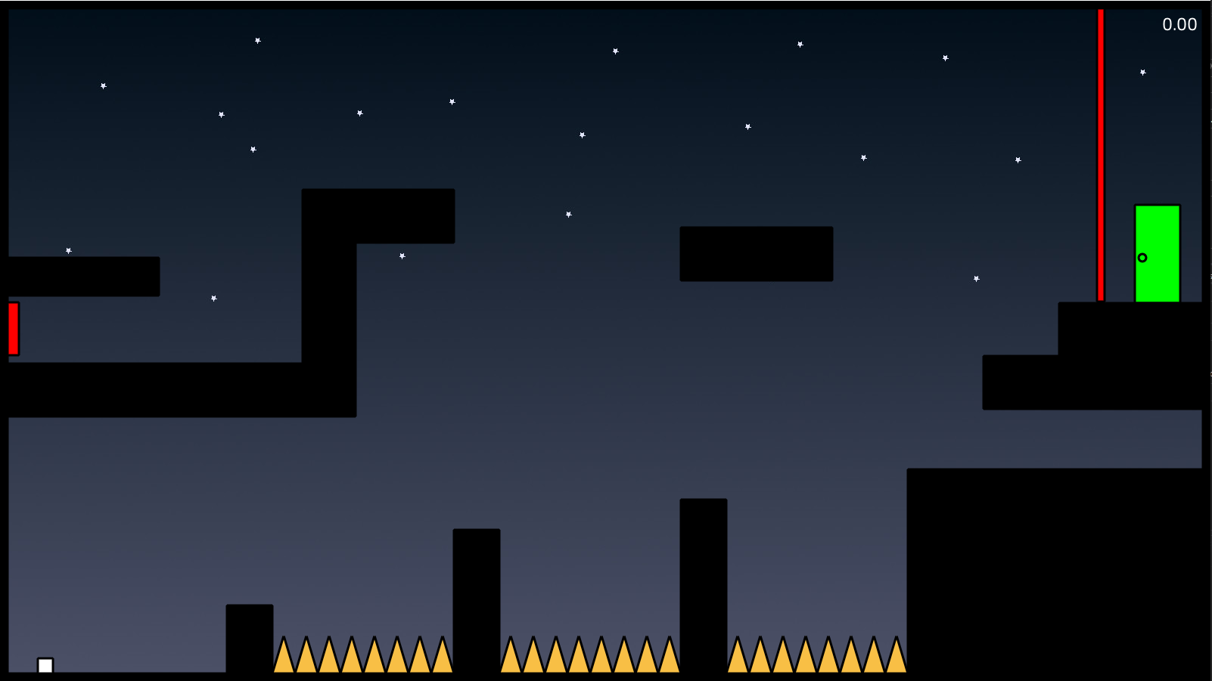
AFTER

Slide 10
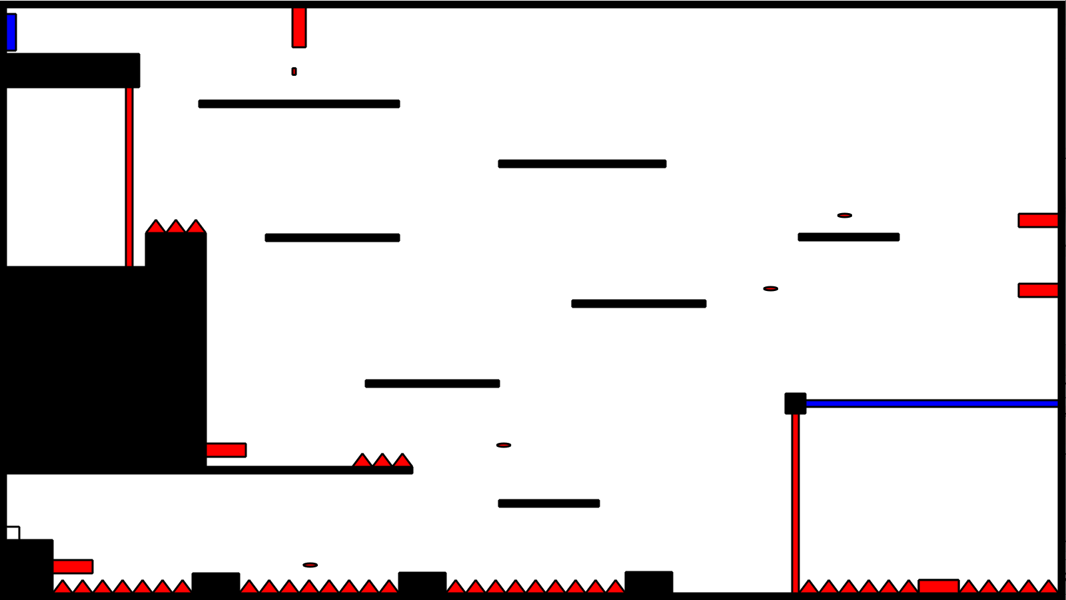
BEFORE

Slide 11
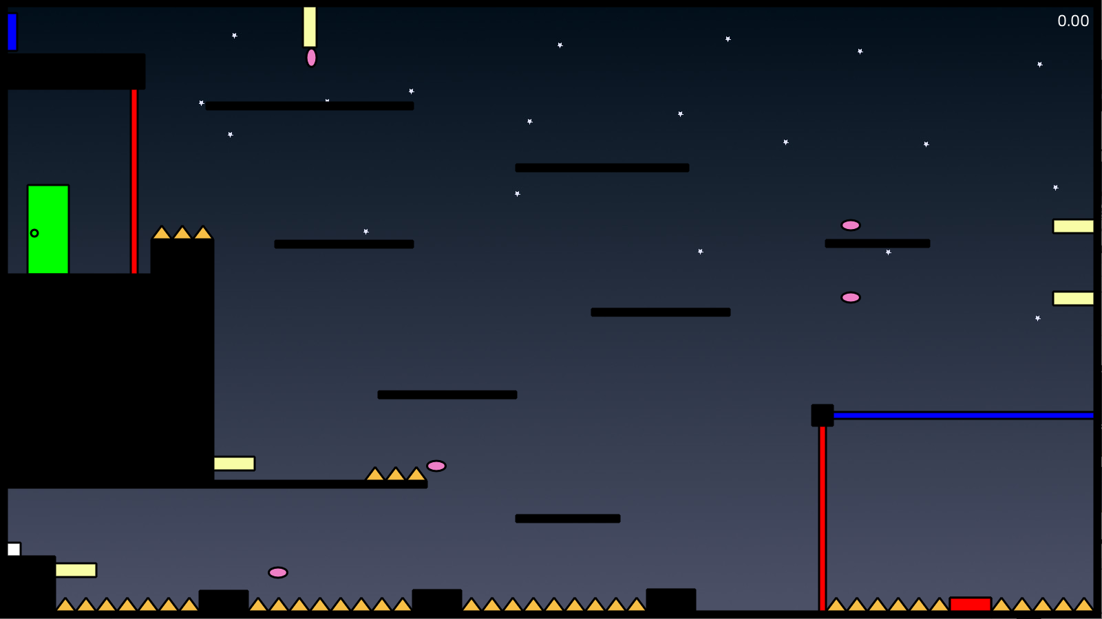
AFTER

Slide 12
Conclusion Reflection
What we've learnt from this project.
The Importance of proper planning.
Importance of portable code.

Slide 13
Conclusion Reflection
What we want to improve on.
Time Management
Detailed Planning

